Slide 1
Discussione in preparazione Workshop
Muon collider Testing Opportunities
24-25 Marzo https://indico.cern.ch/event/1016248
INFN meeting – 12 Marzo 2021

Slide 2
Goal of the Workshop
For the muon collider, the workshop aims to explore ideas and opportunities for:
system testing
exploiting existing facilities and test beams
proposing new test facilities and test beams
This will be input for the definition of an integrated R&D roadmap to demonstrate the feasibility of a muon collider.
The outcome of the workshop shall be an executive summary to be used as a basis for a more extended report.
This will provide input to the Accelerator R&D Roadmap developed by the LDG that will be presented to the CERN SPC and Council.
The workshop should be considered as an open forum to discuss all ideas, we welcome proposals and new ideas.
Future facilities depend yet more strongly on new technology Challenges presented by FCChh and MC in particular

Slide 3
Muon Beam Panel
Daniel Schulte
Mark Palmer
Tabea Arnd
Antoine Chance
Jean-Pierre Delahaye
Angeles Faus-Golfe
Simone Gilardoni
Philippe Lebrun
Ken Long
Nadia Pastrone
Lionel Quettier
Tor Raubenheimer
Chris Rogers
Mike Seidel
Akira Yamamoto
Panel role:
‣ Establish key R&D needs, as dictated by the scientific priorities
‣ Consult widely with the European and international communities, taking into account the capabilities and interests of stakeholders
‣ Take explicitly into account the plans and needs in related scientific fields
‣ Propose ambitious but realistic objectives, work plans, and deliverables
‣ Give options and scenarios for European investment and activity level

Slide 4
March 1, 2021
R. Losito
Workshop to discuss the R&D test programme and facilities
24 & 25 March
1st day
time |  | title | Speaker |  |  | Duration (talk + questions)
13:30 |  | Introduction | Mike Lamont? |  |  | 0:10
13:40 |  | Physics |  |  |  | 0:25
14:05 |  | MICE, EMMA, MuCool, MERIT |  |  |  | 0:25
14:30 |  | Coffee Break |  |  |  | 0:15
14:45 |  | US facilities and test beams |  |  |  | 0:25
15:10 |  | Facilities in ASIA |  |  |  | 0:25
15:35 |  | Nu-Storm as a test Facility |  |  |  | 0:25
16:00 |  | Higgs Factory |  |  |  | 0:25
16:25 |  | Discussion |  |  |  | 0:25
16:50 |  | Coffee Break |  |  |  | 0:15
https://indico.cern.ch/event/1012808/
Hp: discussione 25 mattina

Slide 5
17:05 |  | PSI |  |  |  | 0:20
17:25 |  | PBC |  |  |  | 0:20
17:45 |  | ESS |  |  |  | 0:20
18:05 |  | Proton Facilities at CERN |  |  |  | 0:20
18:25 |  | Other contributions or Discussion |  |  |  | 0:30
18:55 |  | end
2nd day
13:30 |  | Cooling |  |  |  | 0:30
14:00 |  | Targetry |  |  |  | 0:30
14:30 |  | Magnets |  |  |  | 0:30
15:00 |  | RF |  |  |  | 0:30
15:30 |  | Coffee Break |  |  |  | 0:15
15:45 |  | Acceleration & Collider |  |  |  | 0:30
16:15 |  | MDI & Detector |  |  |  | 0:30
16:45 |  | LEMMA |  |  |  | 0:30
17:15 |  | Discussion |  |  |  | 0:30
17:45 |  | Summary & final report |  |  |  | 0:30
18:15 |  | end
M. Calviani
D. Lucchesi
TEST BEAM LEMMA 20min
BERSAGLI 20 min

Slide 6
Discussione
ALTRO
Bersagli
Materiali
Cristalli
MDI/neutrino hazard
Simulazione
Misure di xsec per FLUKA
Test Beam LEMMA
20 min+discussione
Recap LEMMA
Scopo
Misura xsec e emittanza ➔ serve fascio e+ alta intensita’ - cosa e’ stato fatto – cosa si chiede di fare
Apparato
Bisogna capire se parte della strumentazione potrebbe essere riusata
Quando SPSC risponde? 3 week 2022
MAGNETI, RF etc
non oggi => talk dedicati

Slide 7
Discussione
BERSAGLI
LoI SnowMass
Attività in corso finalizzata a LEMMA:
Simulazioni
Laboratorio
Fascio
Manca ad oggi esperienza su protoni:
➔ impegno da discutere e concordare
Presentazione di M. Calviani https://indico.cern.ch/event/978361/
Presentazione di I. Efthymiopoulos
https://conference.ippp.dur.ac.uk/event/967/timetable/#20210211.detailed

Slide 8
extras

Slide 9
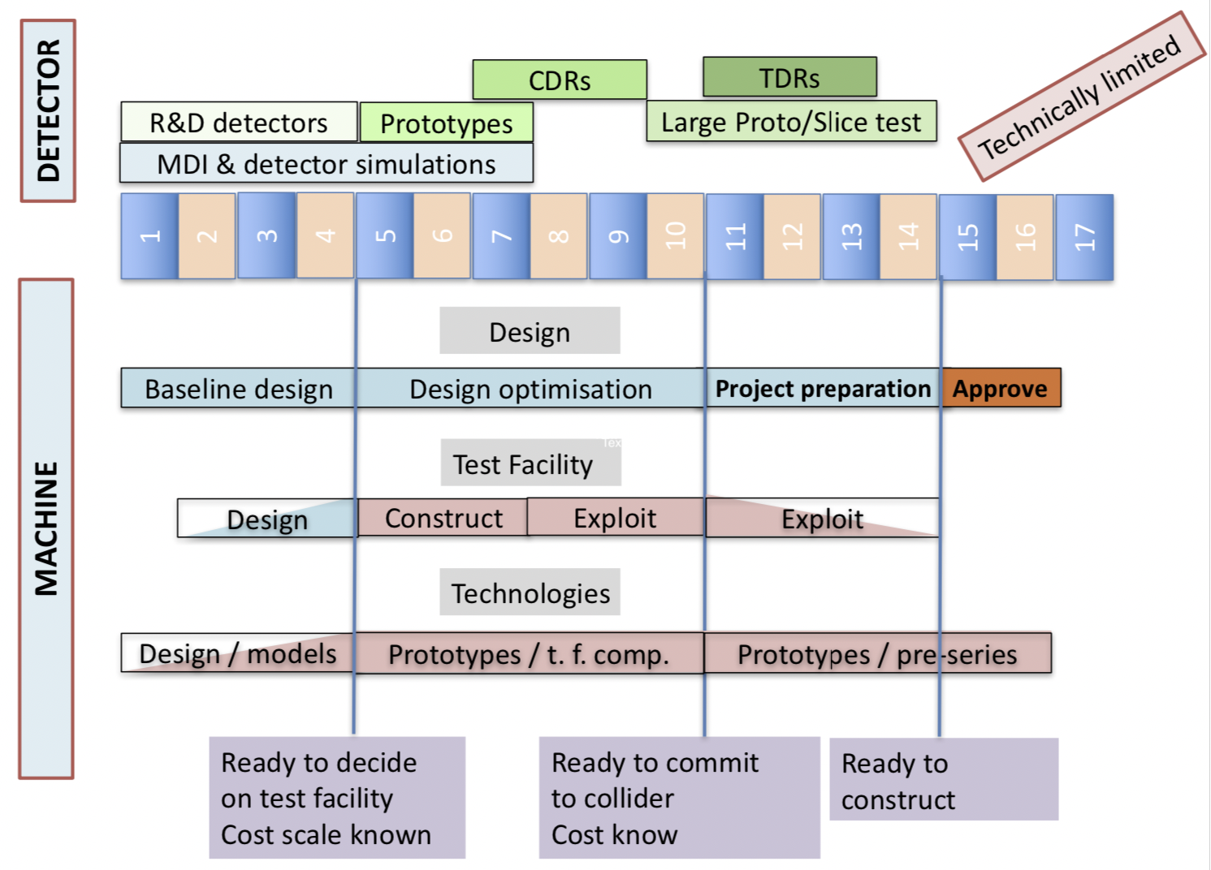
Technically Limited Potential Timeline
Physics Briefing Book arXiv:1910.11775v2 [hep-ex]

Slide 10
Effort for Baseline Design
Put together coherent design requires (mainly human) resources
This goes beyond US effort
Consistent parameters and layouts
Integration of collider systems, trade-offs, choices, …
May highlight additional important issues
Requires (mainly human) resources
Currently MAP is main option, LEMMA is alternative
Key R&D list with priorities
Identify key / feasibility issues
i.e. largest technical risks
Key cost driver, if critical
Key power consumption, if critical
Entry point for collaborators
Proposed MUST
(MUon collider STudy network)
submitted I.FAST EU project

Slide 11
Next steps
Muon Colliders is a unique opportunity at the high-energy frontier
Several teams from different countries already contributed to present knowledge
The on-going work is fostering the preparation of an organized study:
identification of feasibility issues and potential incremental steps
resurrect studies of Muon Colliders taking advantage of the enormous progress already done
identify resources required to address most critical issues
launch international collaboration on Muon Colliders covering Physics, Detector and Accelerator
Synergies with other future accelerators can be easily identified for example on:
high field magnets and fast ramping magnets with efficient energy recovery
efficient RF power production and high field cavities
robust targets
techniques for the large acceptance, rapid acceleration (RLA, LEMMA and other applications)

Slide 12
Some synergies ➔ Key Accelerator Technologies
High-field, robust collider magnets with minimum gap
Dipoles, solenoids, … for collider ring
Efficient fast ramping magnets with efficient energy recovery – magnet powering
For the beam acceleration
Efficient cryogenics, vacuum and shielding systems
Significant beam loss
Robust targets and beam cleaning
High field cavities
In a solenoid for the cooling system
Efficient RF power production
Civil engineering
Other systems (instrumentation)
Beam-dynamics and accelerator design
Start-to-end design and simulations, source design, …

