Slide 1
Possible INFN contributions to the construction of the Electron-Ion Collider
Alessandro Gallo / INFN LNF
INFN-Acceleratori general meeting
16/03/2021

Slide 2
Possible INFN contribution to the EIC construction
A. Gallo, INFN-LNF
SUMMARY
Introduction: the Machine
Organization, Budget, Schedule
Workshop – “Promoting Collaboration on the EIC”
INFN Collaboration: next steps
March 16th 2021, INFN-Acceleratori general meeting

Slide 3
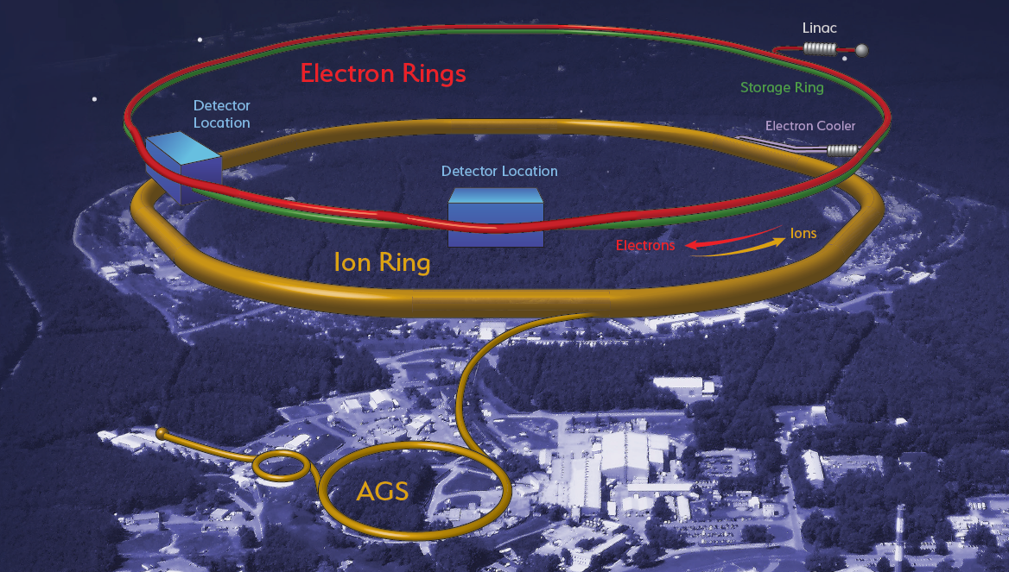
Possible INFN contribution to the EIC construction
A. Gallo, INFN-LNF
References:
CDR-> https://www.bnl.gov/ec/files/EIC_CDR_Final.pdf
EIC Workshop – Promoting Collaboration -> https://indico.cern.ch/event/949203/
March 16th 2021, INFN-Acceleratori general meeting
3

Slide 4
EIC designed to meet NSAC and NAS Requirements
Possible INFN contribution to the EIC construction
A. Gallo, INFN-LNF
The Machine
Center of Mass Energies 20 GeV – 140 GeV
Maximum Luminosity 10³⁴ cm⁻²s⁻¹
Hadron Beam Polarization >70%
Electron Beam Polarization >70%
Ion Species Range p to Uranium
Number of interaction regions up to two
NSAC - Department of Energy Nuclear Science Advisory Committee
NAS - National Academies of Sciences, Engineering, and Medicine
4
March 16th 2021, INFN-Acceleratori general meeting
4

Slide 5
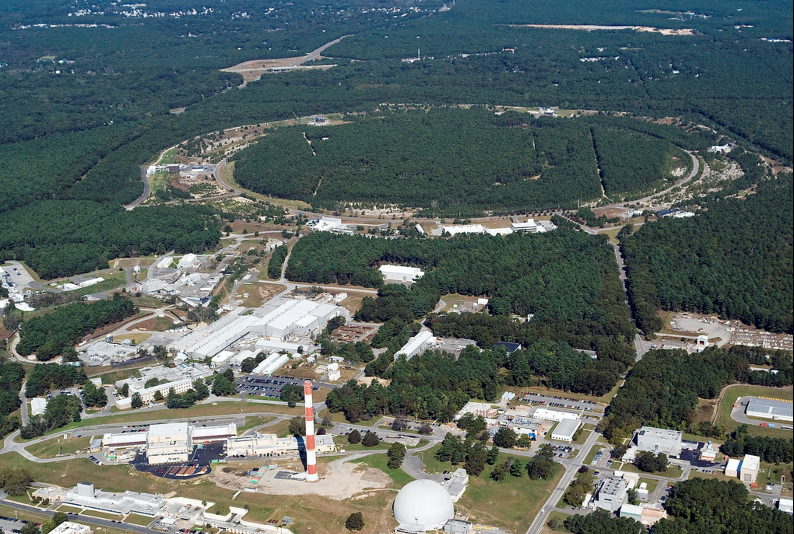
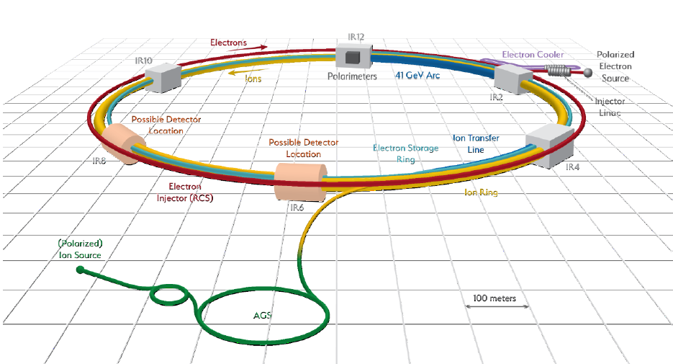
EIC Collider Concept
Possible INFN contribution to the EIC construction
A. Gallo, INFN-LNF
Design based on existing RHIC,
Hadron storage ring 40-275 GeV (existing)
  Many bunches
  Bright beam emittance
  Need strong cooling or frequent injections
Electron storage ring (2.5–18 GeV (new))
  Many bunches,
  Large beam current (2.5 A) ➔ 10 MW S.R. power
Electron rapid cycling synchrotron (new)
  1-2 Hz
  Spin transparent due to high periodicity
High luminosity interaction region(s) (new)
  L = 10³⁴cm⁻²s⁻¹
  Superconducting magnets
  25 mrad Crossing angle with crab cavities
  Spin Rotators (longitudinal spin)
  Forward hadron instrumentation
EIC
5
March 16th 2021, INFN-Acceleratori general meeting
5

Slide 6
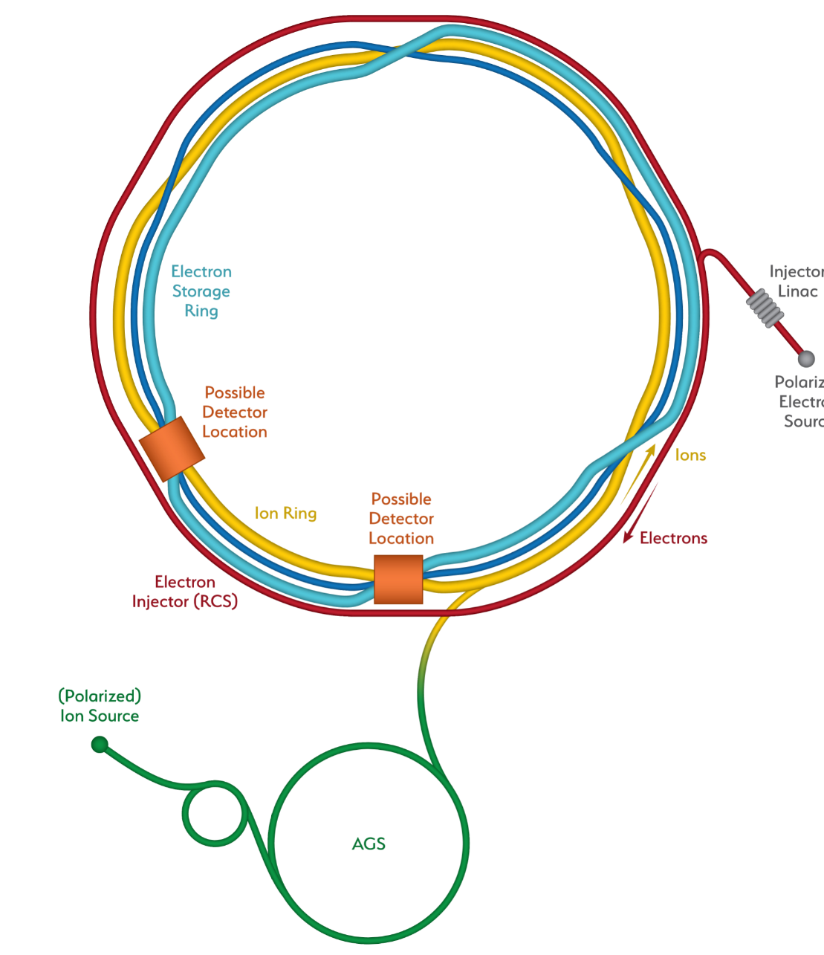
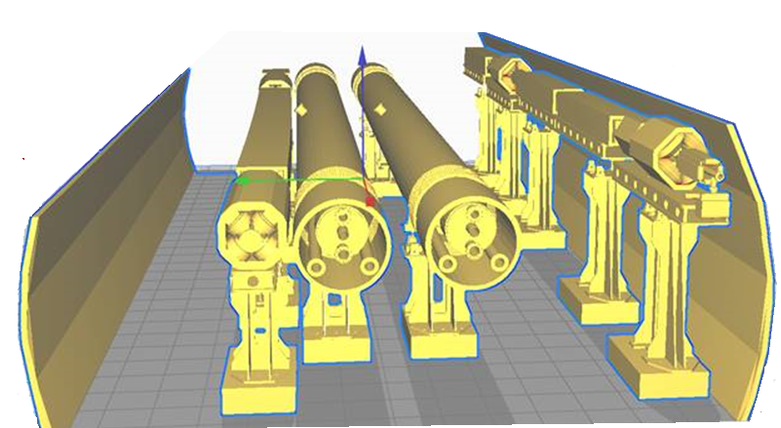
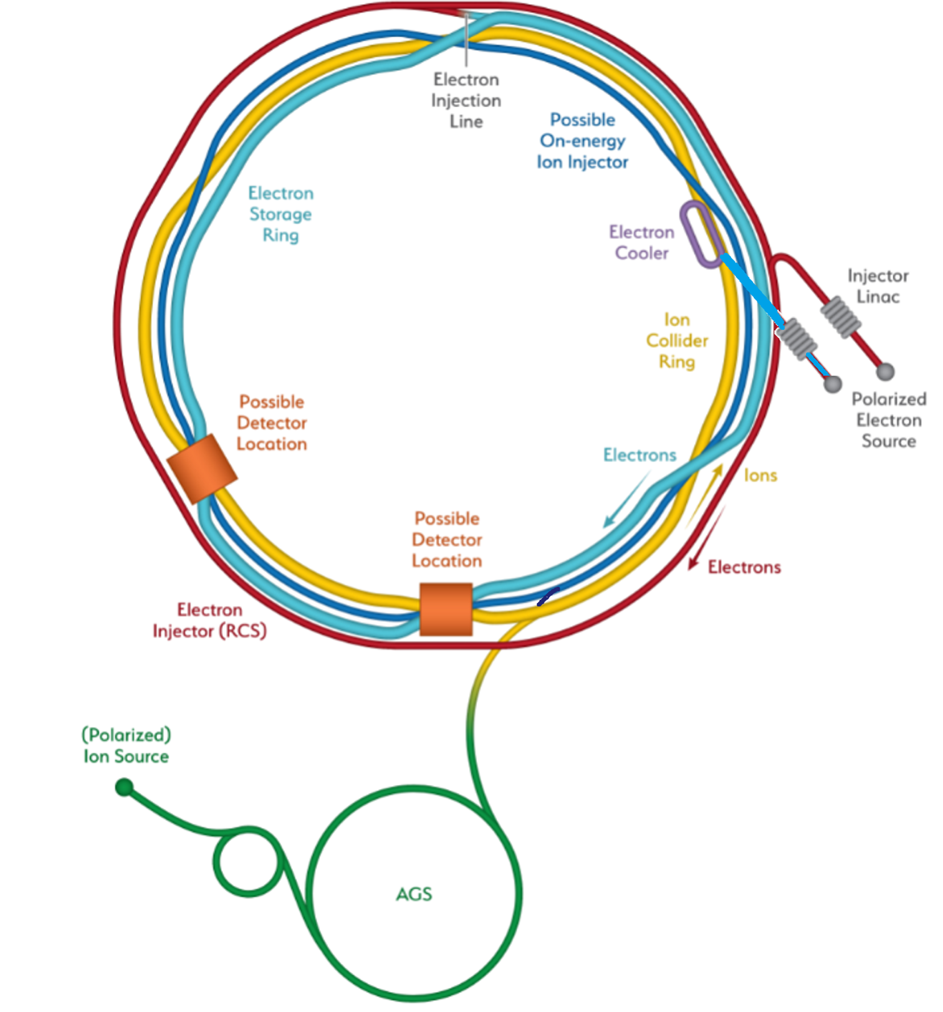
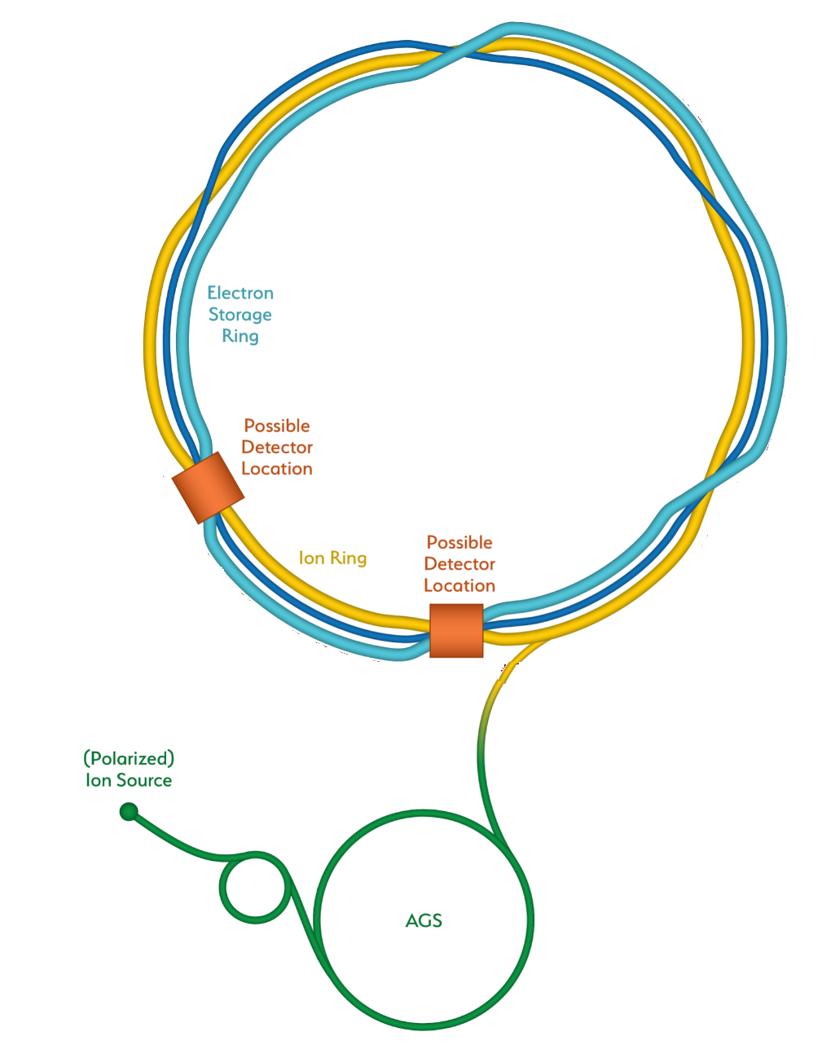
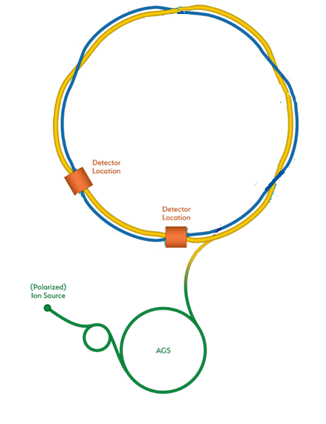
Possible INFN contribution to the EIC construction
A. Gallo, INFN-LNF
EIC
Add electron storage ring
Which holds the electrons which collide with hadrons
We add an electron
Injector complex which delivers full energy electrons to the storage ring
The strong hadron cooling facility completes the facility
Existing RHIC with
Blue and Yellow ring
Hadron Storage Ring
Electron Storage Ring
Electron Injector Synchrotron
Possible on-energy Hadron
injector ring
Hadron injector complex
from RHIC to the EIC
6
March 16th 2021, INFN-Acceleratori general meeting
6

Slide 7
EIC covers full center of mass energy range of 20 – 140 GeV
Possible INFN contribution to the EIC construction
A. Gallo, INFN-LNF
Protons up to 275 GeV:
  Existing RHIC with superconducting magnets allow up to E_{p} = 275 GeV and down to E_{p} = 41 GeV
  RHIC beam parameters are close to what is required for EIC
Electrons up to 18 GeV:
Electron storage ring up to 18 GeV installed in RHIC tunnel, readily achievable with:
    large circumference of 3870 m and
    available superconducting RF technology ➔ U_{rf} = 62 MV
low electron energy of 2.5 GeV is easily obtainable
7
7
March 16th 2021, INFN-Acceleratori general meeting
7

Slide 8
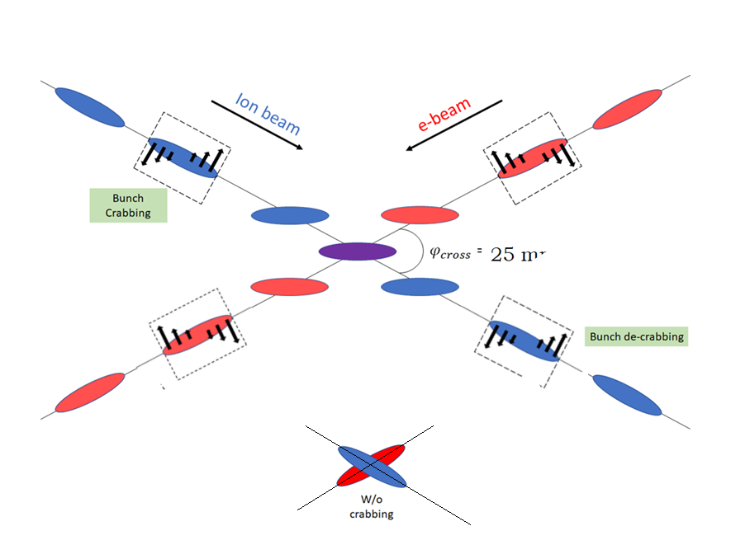
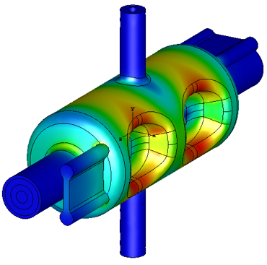
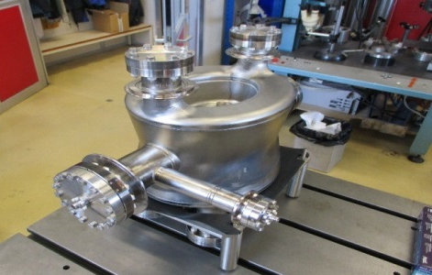
EIC High Luminosity with a Crossing Angle
Possible INFN contribution to the EIC construction
A. Gallo, INFN-LNF
Modest crossing angle of 25 mrad
  Avoid parasitic collisions due to short bunch spacing
  For machine elements, to improve detection
  Reduce detector background
25 mrad
However, crossing angle causes
  Low luminosity
  Beam dynamics issues
avoided by Crab Crossing
  Effective head-on collision restored
  Beam dynamic issues resolved
RF resonator (crab-cavity) prototypes built
and tested with proton beam in the CERN-SPS
8
8
March 16th 2021, INFN-Acceleratori general meeting
8

Slide 9
Possible INFN contribution to the EIC construction
A. Gallo, INFN-LNF
Luminosity versus E_{CM} center of mass energy
10³⁴
10³³
10³²
EIC
Optimization for low E_{cm}
EIC
Optimization for high E_{cm}
Annual Integrated Luminosity [fb⁻¹]
Peak Luminosity [cm⁻²s⁻¹]
100
10
1
Tomography (p/A)
Spin and Flavor Structure of
the Nucleon and Nuclei
Internal
Landscape of the Nucleus
QCD at Extreme Parton Densities-
Saturation
150
Center of Mass Energy E_{cm} [GeV]
9
9
March 16th 2021, INFN-Acceleratori general meeting
9

Slide 10
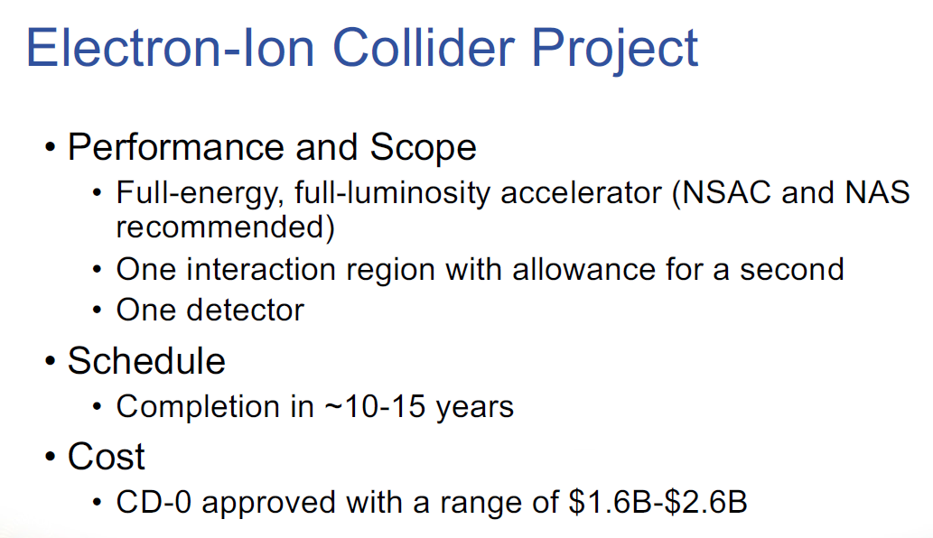
Possible INFN contribution to the EIC construction
A. Gallo, INFN-LNF
10
10
March 16th 2021, INFN-Acceleratori general meeting
10

Slide 11
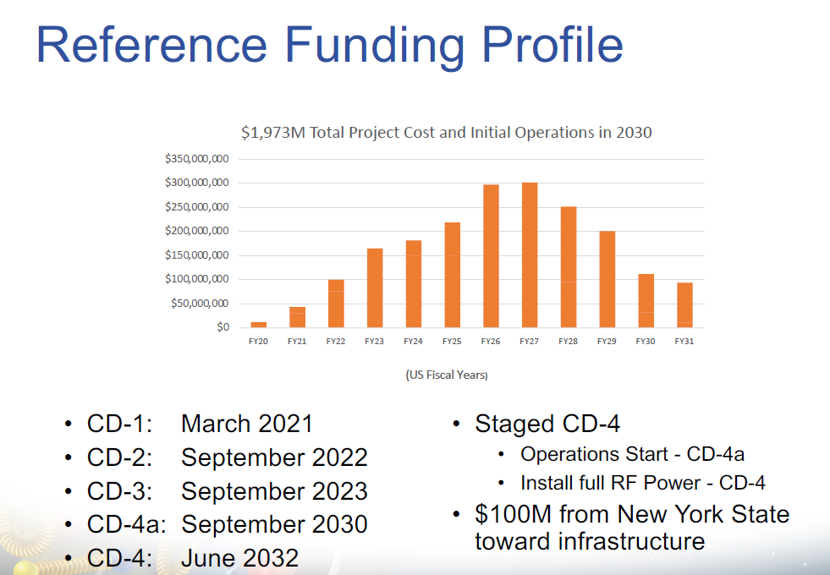
Possible INFN contribution to the EIC construction
A. Gallo, INFN-LNF
11
11
March 16th 2021, INFN-Acceleratori general meeting
11

Slide 12
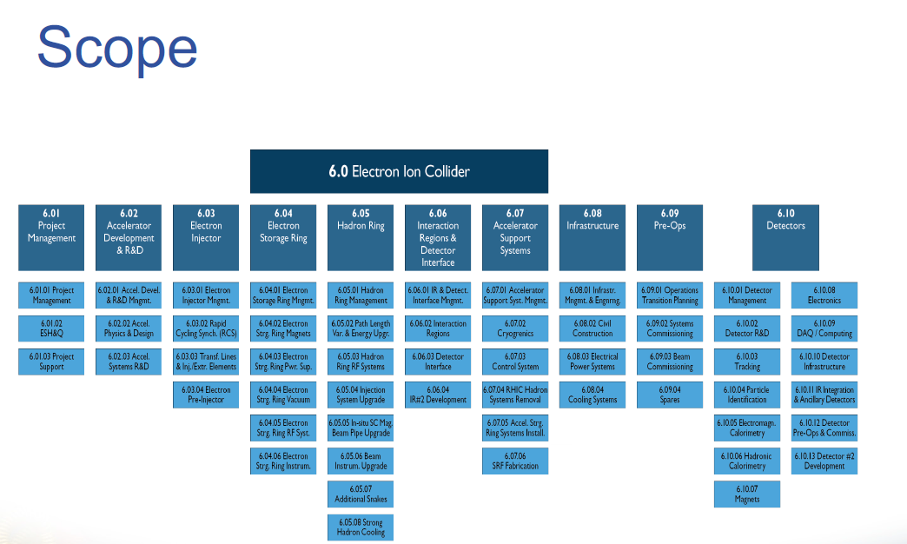
Possible INFN contribution to the EIC construction
A. Gallo, INFN-LNF
12
12
March 16th 2021, INFN-Acceleratori general meeting
12

Slide 13
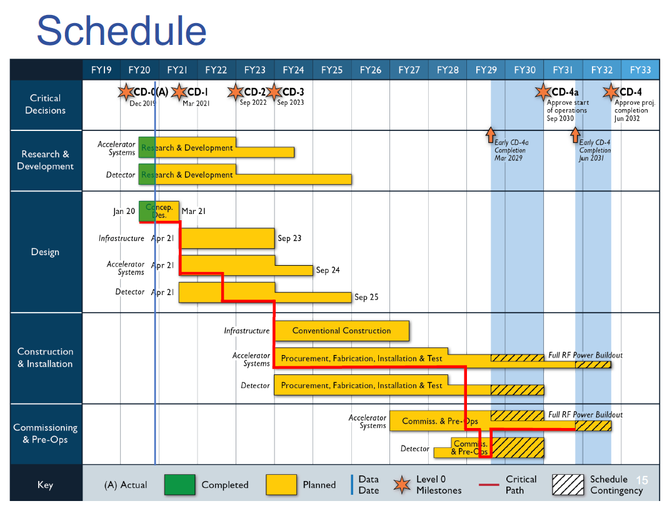
Possible INFN contribution to the EIC construction
A. Gallo, INFN-LNF
13
13
March 16th 2021, INFN-Acceleratori general meeting
13

Slide 14
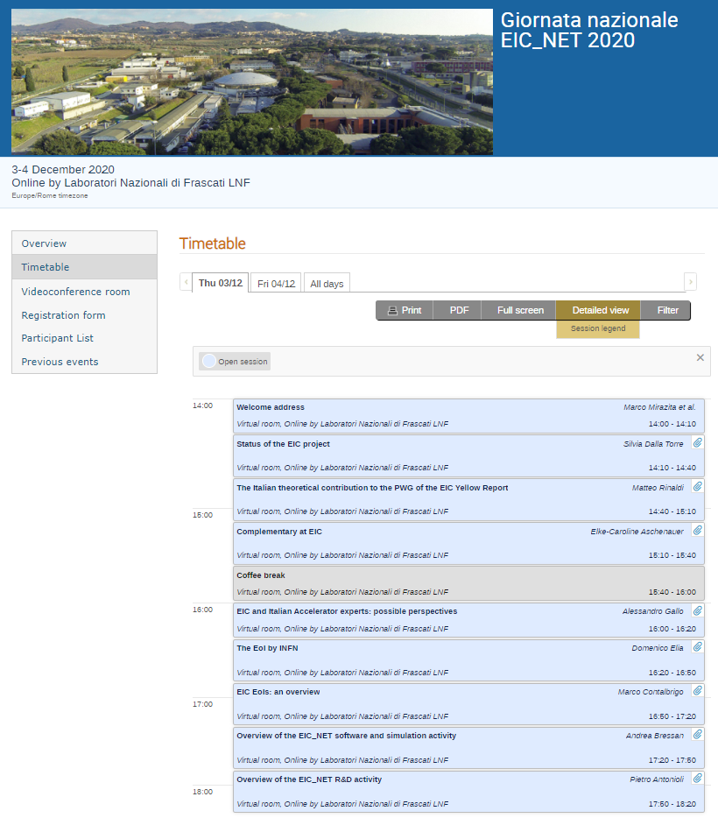
Possible INFN contribution to the EIC construction
A. Gallo, INFN-LNF
INFN involvement in EIC
INFN physicists community interested in the EIC scientific case is gathered in the CSN3 EIC_NET project since 2018;
The involvement of INFN on the EIC accelerator is more recent, and can be considered synergic with the INFN CSN3 community.
Following some previous informal contacts (F. Willeke seminar at LNF, early 2019) INFN accelerator community has been invited to participate to the “EIC Workshop – Promoting Collaboration on the Electron-Ion Collider”, Oct. 7-9 2020
14
14
March 16th 2021, INFN-Acceleratori general meeting
14

Slide 15
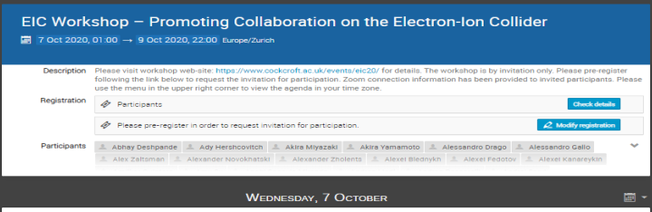
Possible INFN contribution to the EIC construction
A. Gallo, INFN-LNF
Almost all-around-the-clock schedule with regional areas focus sessions
≈ 80 presentations + various open-mic sessions
About 33 hrs of presentations over 50 hrs of total duration!
15
15
March 16th 2021, INFN-Acceleratori general meeting
15

Slide 16
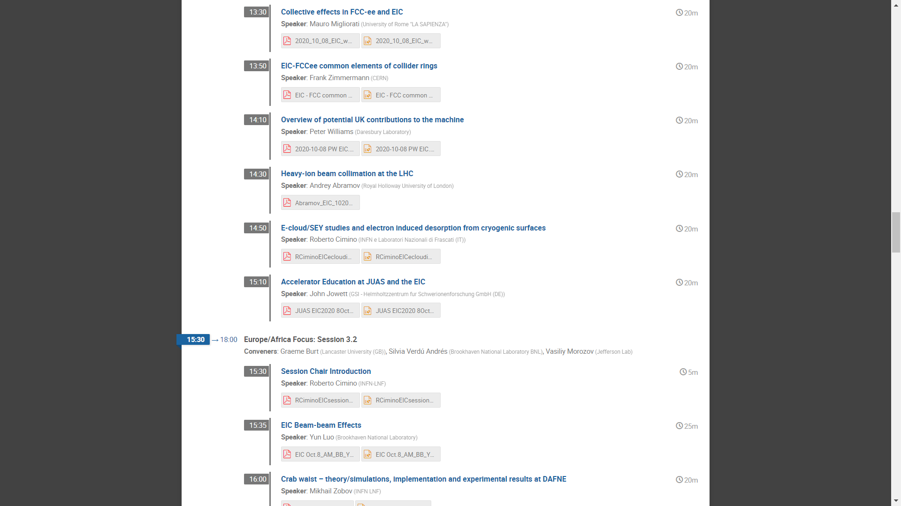
Possible INFN contribution to the EIC construction
A. Gallo, INFN-LNF
INFN contribution to the workshop
INFN Participants
1 | Angelucci Marco | LNF
2 | Biagini Maria Enrica | LNF
3 | Bisoffi Giovanni | LNL
4 | Blanco Garcia Oscar | LNF
5 | Boscolo Manuela | LNF
6 | Carideo Emanuela | RM1
7 | Cimino Roberto | LNF
8 | Drago Alessandro | LNF
9 | Ficcadenti Luca | RM1
10 | Gallo Alessandro | LNF
11 | Guiducci Susanna | LNF
12 | La Cognata Marco | LNS
13 | Liedl Andrea | LNF
14 | Mascali David | LNS
15 | Masullo Maria Rosaria | Na
16 | Migliorati Mauro | RM1
17 | Mikhail Zobov | LNF
18 | Milardi Catia | LNF
19 | Passarelli Andrea | Na
20 | Pastrone Nadia | To
21 | Pira Cristian | LNL
22 | Quartullo Danilo | LNF
23 | Rossi Lucio | Mi
24 | Santopinto Elena | Ge
25 | Tessarotto Fulvio | Ts
26 | Turrisi Rosario | Pd
27 | Vaccaro Vittorio | Na
16
16
March 16th 2021, INFN-Acceleratori general meeting
16

Slide 17
EIC Accelerator Collaboration Opportunities
Possible INFN contribution to the EIC construction
A. Gallo, INFN-LNF
EIC is international from its conception
Collaboration on EIC design and construction –mutually beneficial, providing a gateway to EIC science, advancing accelerator science and technology
Possible contributions to the EIC accelerator could include the full range of accelerator design and hardware
  E.g. IR magnet design and construction, luminosity monitoring, RF R&D and construction, normal conducting magnets, critical vacuum components, feedback systems, polarimetry, contributions to the 2nd IR, beam-dynamics calculations, etc.
17
17
March 16th 2021, INFN-Acceleratori general meeting
17

Slide 18
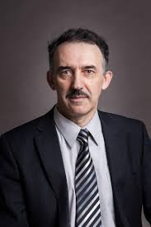
Collaboration – path forward
Possible INFN contribution to the EIC construction
A. Gallo, INFN-LNF
The EIC team making efforts to stay as close as possible to tech driven schedule
With anticipated CD1 in 2021, CD2 in 2022 the time to engage is now
Mechanisms for collaboration developing
  1) Partnership workshops like the one we attend allow to see the broad picture and indicate the areas where project needs and the interests and expertise match
  2) Meetings between the institutional team and EIC project team allow for focused discussion on specific collaboration scope
  many such meetings already happened and
  we expect many more after this workshop
Andrei Seryi,
Associate Director for
Accelerator Systems and International Partnership
18
18
March 16th 2021, INFN-Acceleratori general meeting
18

Slide 19
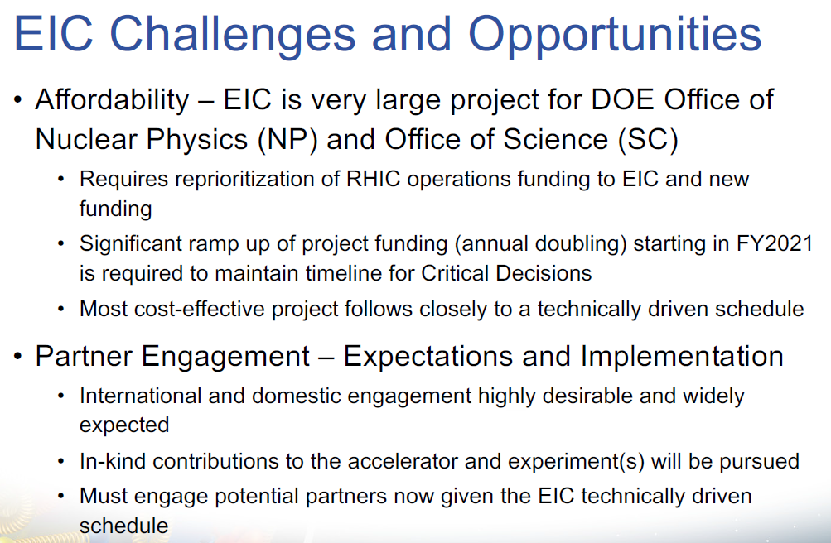
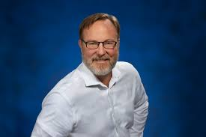
Possible INFN contribution to the EIC construction
A. Gallo, INFN-LNF
Jim Yeck, Project Director
19
19
March 16th 2021, INFN-Acceleratori general meeting
19

Slide 20
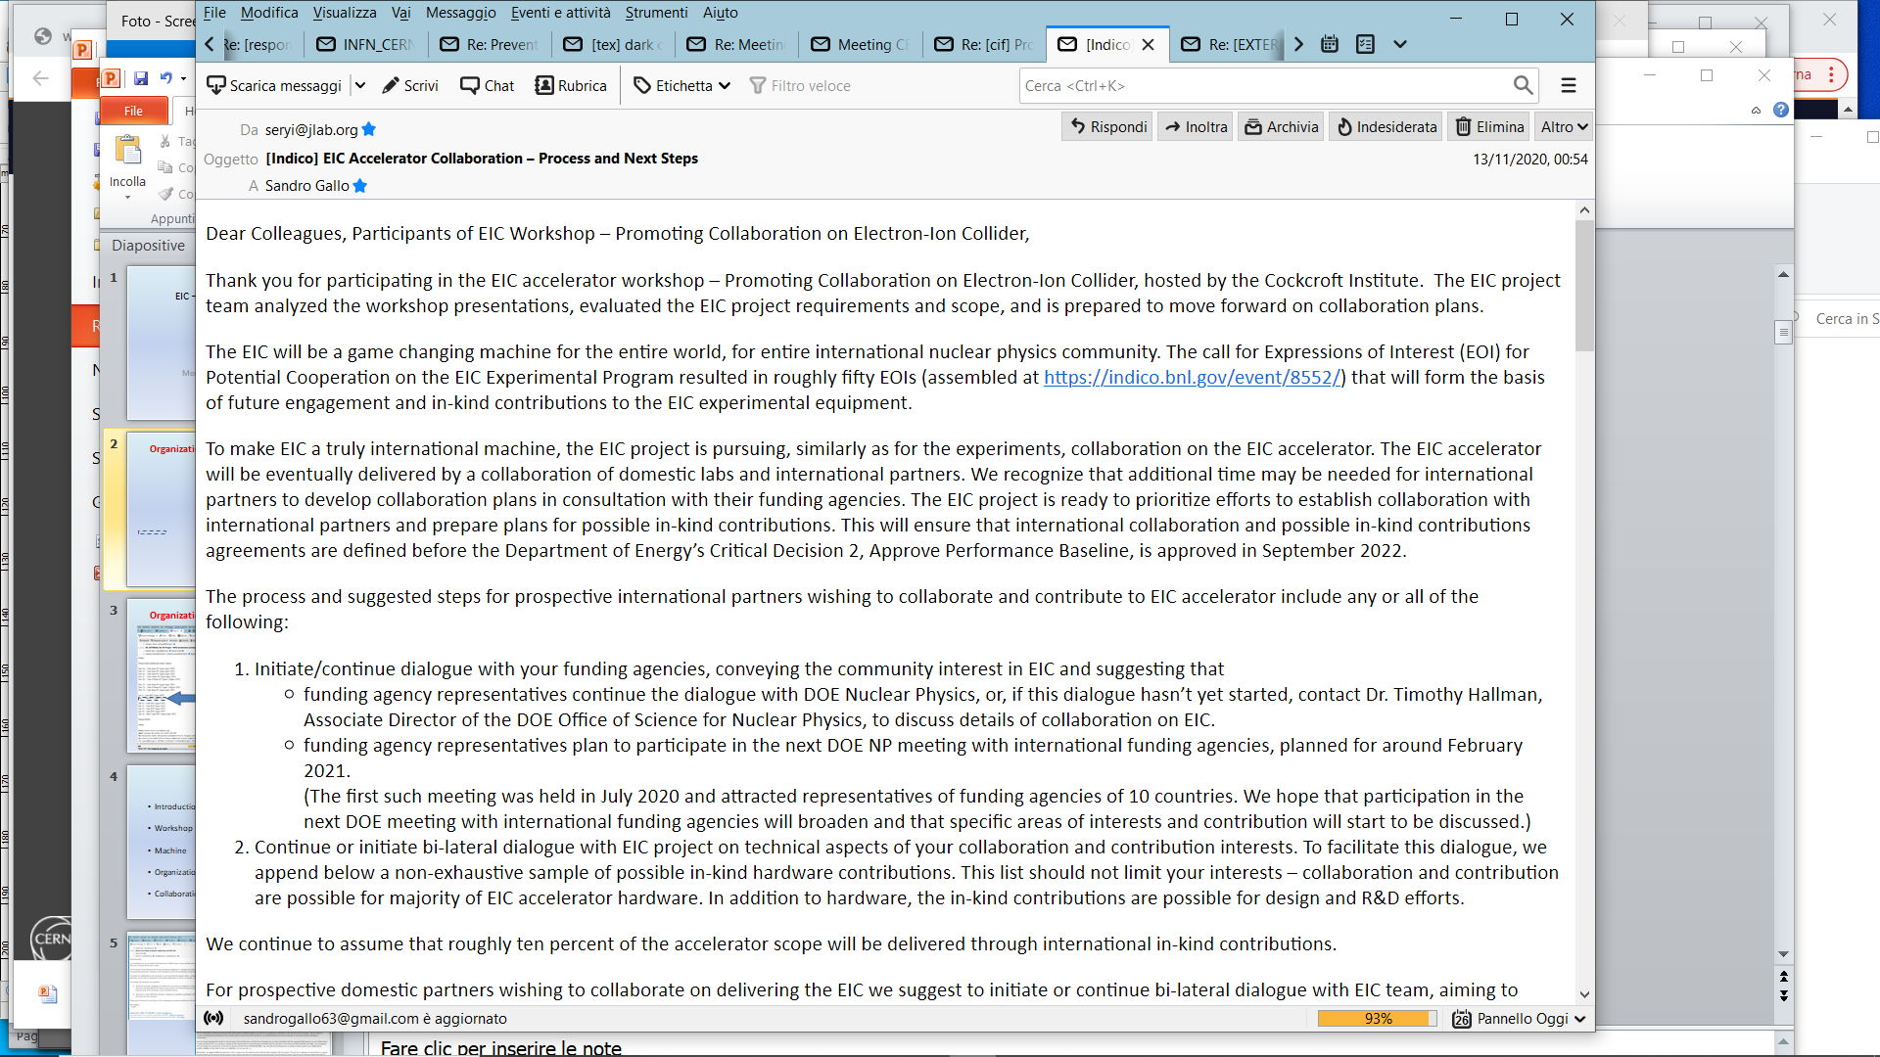
Possible INFN contribution to the EIC construction
A. Gallo, INFN-LNF
Workshop follow-up (Andrei Seryi)
… the EIC project is pursuing, similarly as for the experiments, collaboration on the EIC accelerator.
The EIC project is ready to prioritize efforts to establish collaboration with international partners and prepare plans for possible in-kind contributions.
… international partners wishing to collaborate and contribute to EIC accelerator (should):
1. Initiate/continue dialogue with your funding agencies, conveying the community interest in EIC and suggesting that
….
funding agency representatives plan to participate in the next DOE NP meeting with international funding agencies, planned for around February 2021 (actually Feb. 12)
2. Continue or initiate bi-lateral dialogue with EIC project on technical aspects of your collaboration and contribution interests.
INFN?
… roughly ten percent of the accelerator scope will be delivered through international in-kind contributions
20
20
March 16th 2021, INFN-Acceleratori general meeting
20

Slide 21
Possible INFN contribution to the EIC construction
A. Gallo, INFN-LNF
Workshop follow-up: possible collaboration fields
Beam dynamics and R&D;
Rapid Cycling Synchrotron (magnets, vacuum, instrumentation, power supplies);
Electron Storage Ring (magnets, vacuum, instrumentation, power supplies);
Strong Hadron Cooling system: (instrumentation);
Polarization control systems (spin rotator magnets);
Interaction Region (vacuum, magnet, MDI);
Injection and Extraction systems (kickers);
Collimation Systems (collimators, machine protection;
Pulsed Devices;
RF systems:
  2856 MHz 400 MeV pulsed NCRF linac and RF sources
  Cooler ERL third harmonic cavity system at 1773 MHz
  Cooler injector 197 MHz SRF booster cavity
  1 of 198 and 2 of 295 MHz NCRF bunch merging cavities for the RCS
21
21
21
March 16th 2021, INFN-Acceleratori general meeting
21

Slide 22
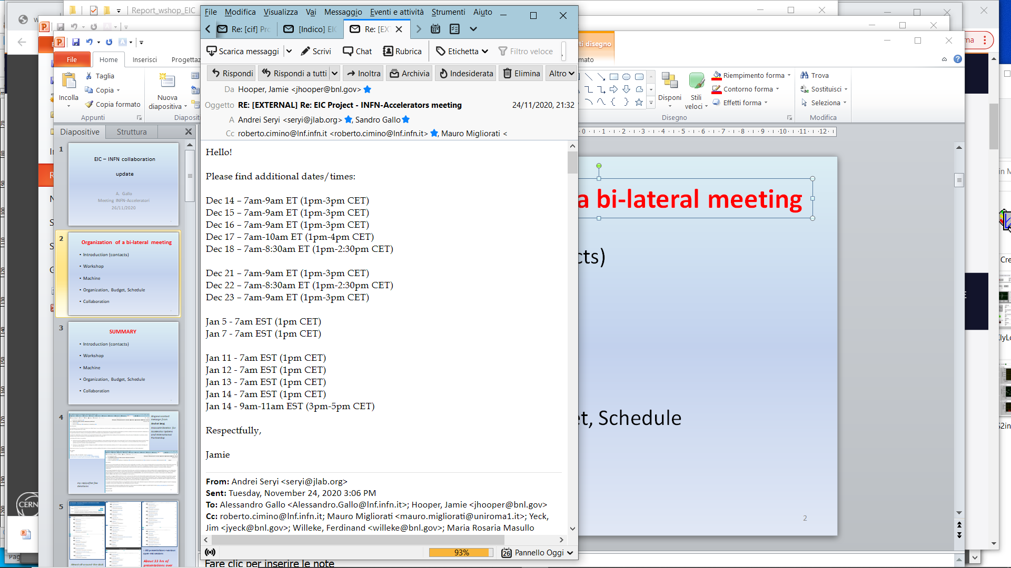
Possible INFN contribution to the EIC construction
A. Gallo, INFN-LNF
INFN-EIC bi-lateral meeting
Goals of the meeting:
Better definition of a collaboration program on the items where INFN groups have already expressed their interest;
Through INFN-Acceleratori reach the whole community to explore other possible fields of collaboration
2021
January 7th
1 pm CET
Pending questions:
What channels could be activated to give resources to the groups willing to collaborate?
Do we need to ask special funds from management?
Can this activity become just an additional work package within the INFN CSN3 general collaboration on the EIC physics? Something similar has happened in the past in CSN1 (PEP-II and SuperKEKB, RD_FA, …)
22
22
22
22
March 16th 2021, INFN-Acceleratori general meeting
22

Slide 23

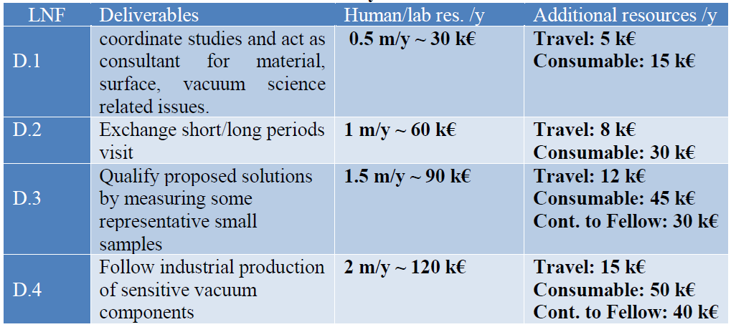
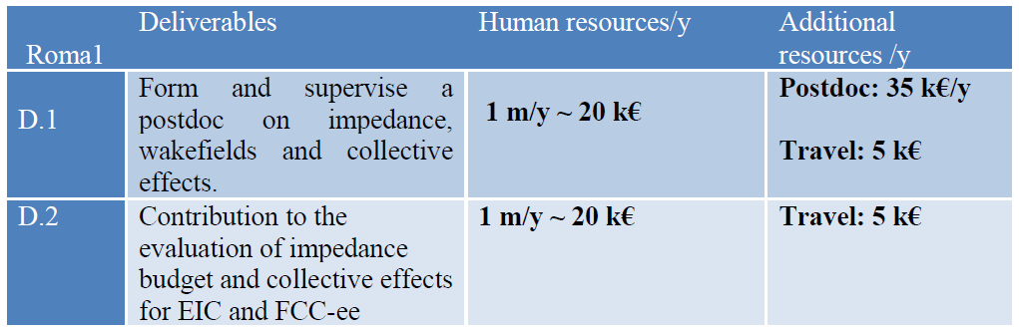
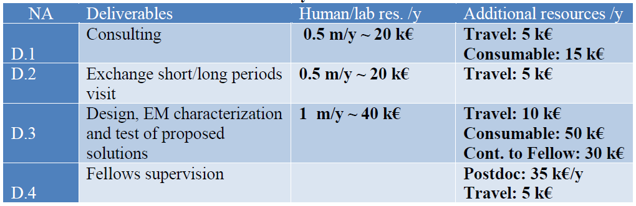
Possible INFN contribution to the EIC construction
A. Gallo, INFN-LNF
INFN-EIC bi-lateral meeting outcome
The meeting was considered positive from all participants;
INFN team illustrated the expressions of interest collected in the national accelerator community, namely:
  Electron cloud studies and mitigation strategies (LNF)
  Ring impedance studies, single bunch dynamics (RM1)
  Experimental characterization of surfaces (NA)
  MDI and IR design (LNF)
Agreement on including items 1÷3 in a unique work package proposal related to beam dynamics theoretical and experimental studies, and mitigation strategies. Item 4 possible subject for a separated WP.
EIC team stressed that an in-kind hardware contribution resulting from the beam dynamics WP activity (such as shields and screens for the ion ring vacuum chamber) would add considerably value to the collaboration.
23
23
23
23
March 16th 2021, INFN-Acceleratori general meeting
23

Slide 24
Possible INFN contribution to the EIC construction
A. Gallo, INFN-LNF
Present status (and conclusions):
A document summarizing the Beam Physics WP activities, including costs and manpower required, has been finalized and delivered to INFN management, CSN3 and EIC team;
March 12 is the date of meeting of DOE NP with international funding agencies (with INFN management) The agenda includes “Highlights from International Institutions on EIC Activities”. The collaboration document following the bilateral meeting is the ground for DOE-INFN discussion;
There is still room for extending the INFN collaboration proposal to other items, so new expressions of interest from our community are still possible and welcome.
As INFN accelerator community we need clear indications from INFN management, as result of discussion with DOE and, more in general, according to the level of priority and strategic interest attributed by INFN to the EIC project.
March 16th 2021, INFN-Acceleratori general meeting
24

Slide 25
Thanks
for the attention …

