Slide 1
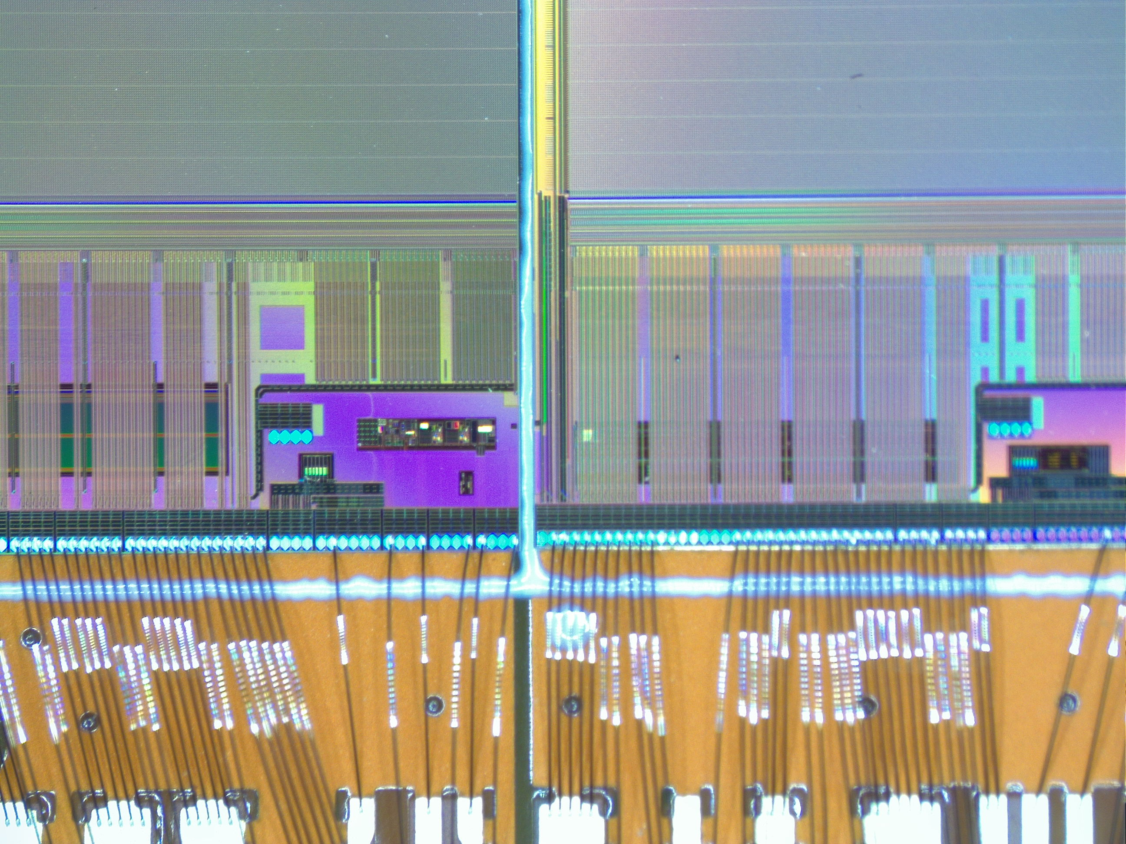
Bonding of a dummy module
Pulltest done: 10g

Slide 2
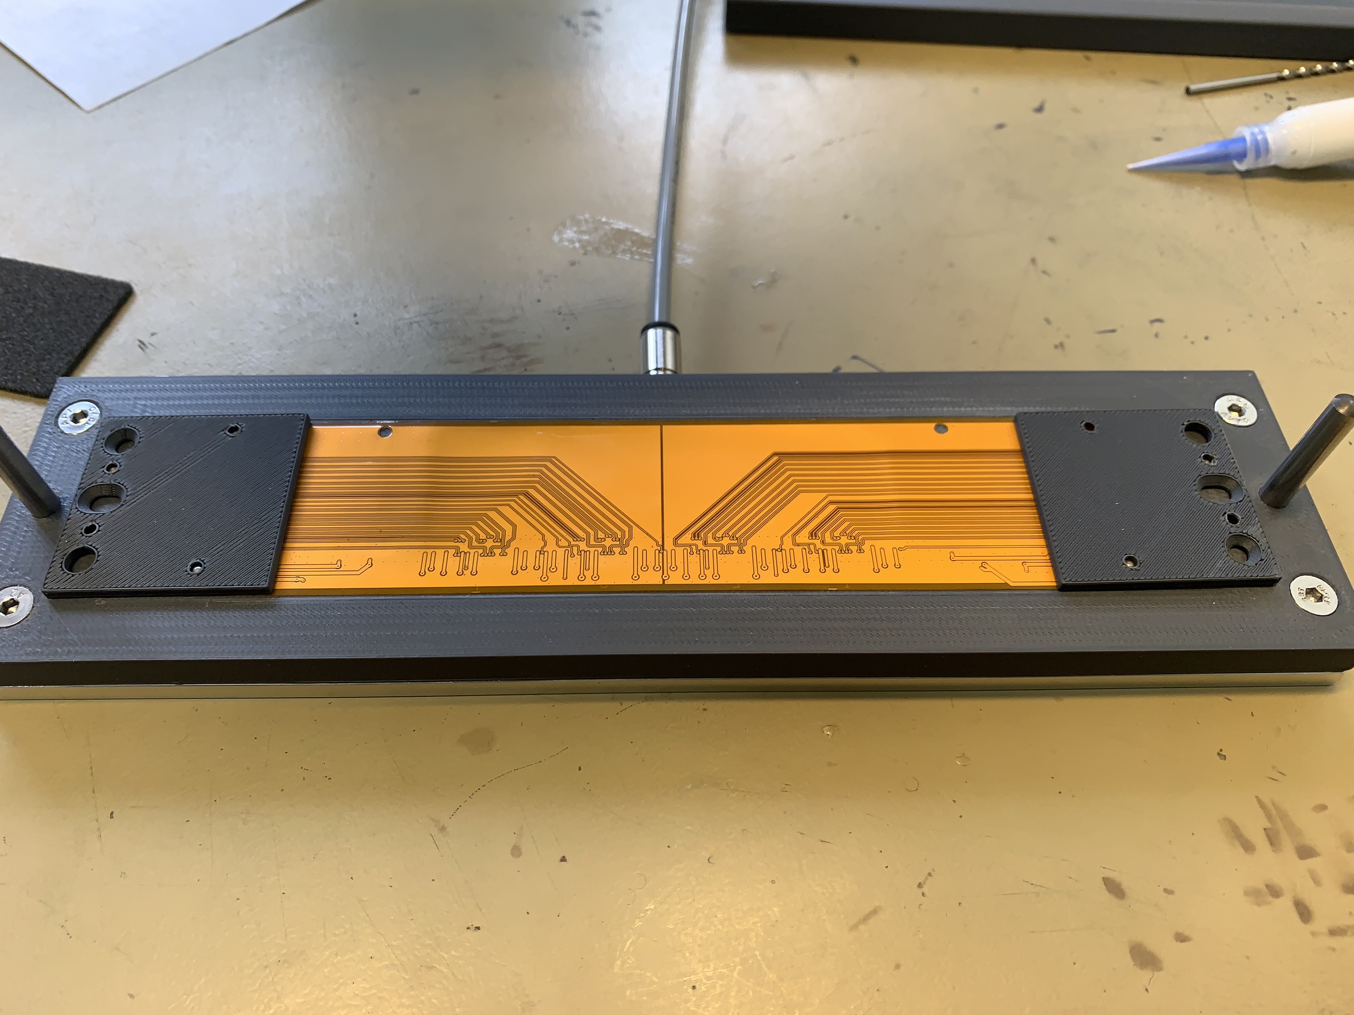
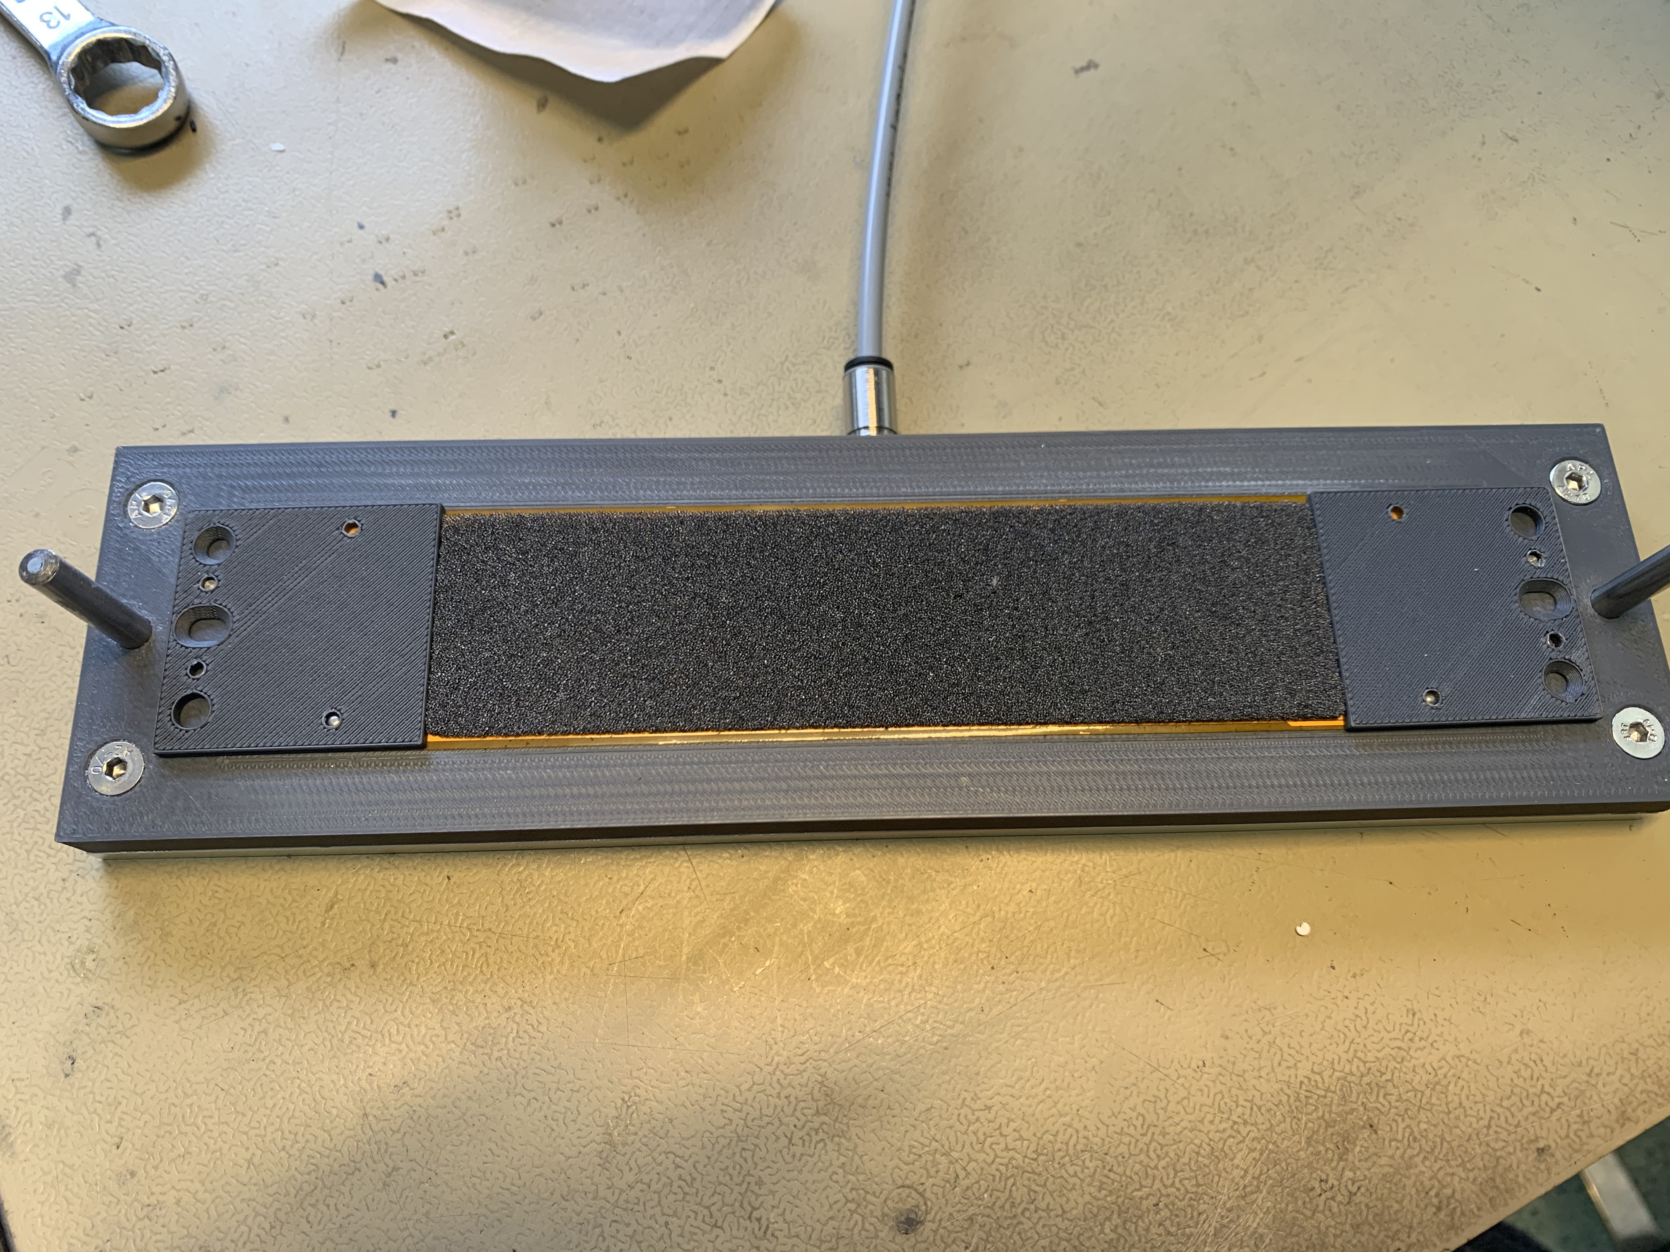
Ladder under gluing

Slide 3
Next steps
Gluing the 2nd module to create the dummy ladder (done on Thursday, waiting the curring of the glue
Request (done) to the mechanics workshop to do a set of jigs in aluminium. Results good but not enough
Assemble a good module to send to Eleuterio for debugging test system
Assemble 2 modules to assemble a ladder
…

