Slide 1
Falaphel
March 10 2021
WP1

Slide 2
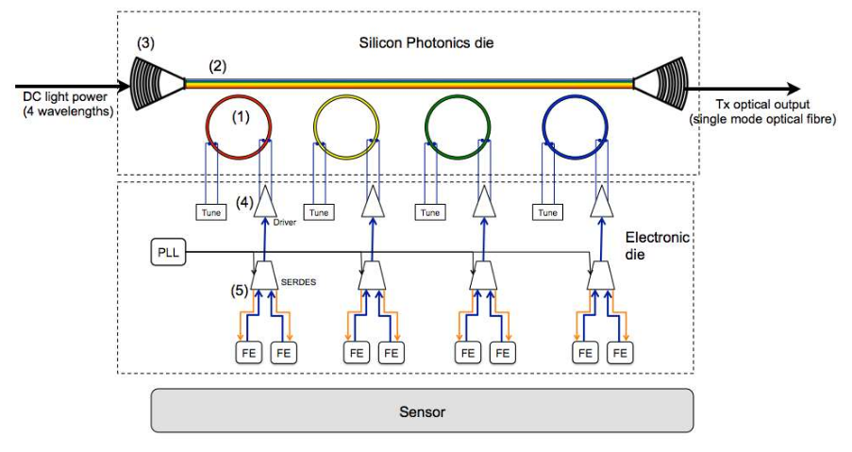
General architecture
Electronic chip
  Front-end matrix
  PRBS generator
  Serdes/Serializer
  PLL
  Drivers
Silicon Photonics chip
  4 Ring Modulator at 25 Gb/s
  4 channels at the Telecom C Band (1530-1565 nm)

Slide 3
General specifications
Operating temperature: -40C to + 85C (performs in this range)
Typical operating temperature: -20C
TID: ≥ 1 Grad (delivered at room T)
Total fluence > 5 x 10¹⁶ n/cm²
Hit rate: 6 GHz/cm²
Data rate: 100 Gb/s (aggregated)
  103.125 Gb/s - 100 Gigabit Ethernet -100 GbE (2nd Generation: 25GbE-based)

Slide 4
Analog Front-end specifications
Pixel capacitance: < 100 fF
Detector leakage: < 20 nA
Input polarity: negative
Power consumption: 0.5 W/cm² (analog+digital)
  6.25 uW/channel (25 x 50 um²)
  RD53: ~10uW/channel (50 x 50 um²)
Minimum MIP charge (at highest irradiation level): 4000 e-
Min stable threshold: 600 e-
Charge above threshold resulting in <25 ns time walk: 300 e-
Min. in-time threshold: 900 e-
Hit loss from in-pixel pileup: <= 1% (analog dead-time)
Recovery from saturation: < 1 us
Noise occupancy: < 10⁻⁶
  ENC << 120 e r.m.s.
  Th dispersion << 120 e r.m.s.
Pixel size: 50 x 25 um²
Isolation of analog circuits: Analog DNW only

Slide 5
Pixel block diagram and Matrix readout

Slide 6
High-speed electronics specifications
Driver and SerDes/Serializer
  Data rate: 25 Gb/s
  Power consumption:
    SerDes < 1.5 W
    Serializer < 1 W (30% smaller wrt SERDES)
    Driver CML < 25 mW
    LpGBT < 0.5 W
  Area:
    SerDes < 0.25 mm² (20 bit)
    Driver CML < 0.30 mm²
PLL
  Power consumption: < 50 mW
  Operating frequency: 25 GHz
  Phase noise < -90 dBc/Hz @ 1 MHz
  Area < 0.10 mm²

Slide 7
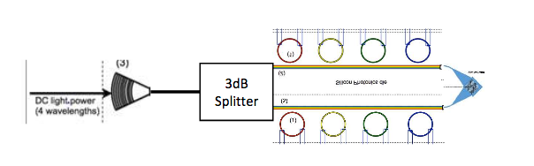
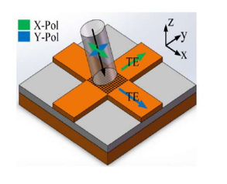
Ring modulator specifications
Ring Radius = 5 um - FSR (@1550 nm)=19-20 nm
Heater efficiency 0.18 nm/mW
Modulation Efficiency 40pm/V
Insertion Loss = 5 dB
Backup scheme
WDM configuration + Polarization Division Multiplexing
8 Ring Modulators at 12.5 Gb/s
The 2D Grating coupler at the output coupled 8 different channels (4 wavelengths x 2 orthogonal polarizations)
The two orthogonal polarization are coupled in two orthogonal WG with the same polarization TE

Slide 8
Electronic chip simulation corners
 | Typ RO | Typ OP | FS OP | SF OP | SS OP | FF OP | SS LT | FF LT | SS HT | FF HT
Model | TT | TT | FS | SF | SS | FF | SS | FF | SS | FF
VDD | 0.9 | 0.9 | 0.8 | 0.8 | 0.8 | 1.0 | 0.8 | 1.0 | 0.8 | 1.0
T | 27 | -20 | -20 | -20 | -20 | -20 | -40 | -40 | 85 | 85
PIC chip?

Slide 9
A candidate for project logo

