Slide 1
Gaseous detectors @ EIC for tracking & PID
15/3/2021
S. Dalla Torre

Slide 2
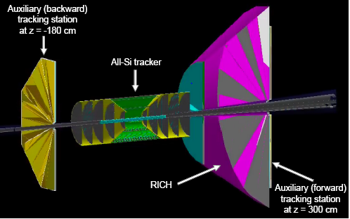
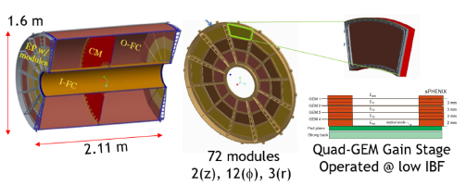
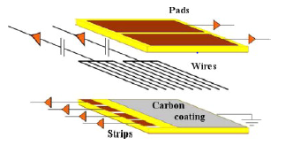
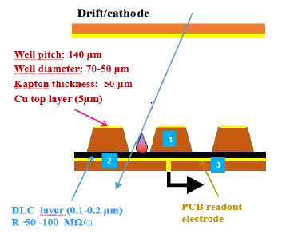
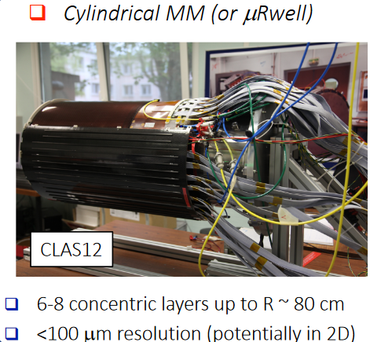
TRACKING (several options considered)
Gaseous detector contributions in a “all-Si option”
A TPC around a Si vertex :
The TPC itself
The TPC sensors
By low-material GEMs
By sTGC
Alternatives to TPC:
Straw trackers
Cylindrical layers of MICROMEGAS or μR-WELL
A μR-WELL cylindrical layer
Around the TPC
For timing
For precise angle information
at DIRC entrance

Slide 3
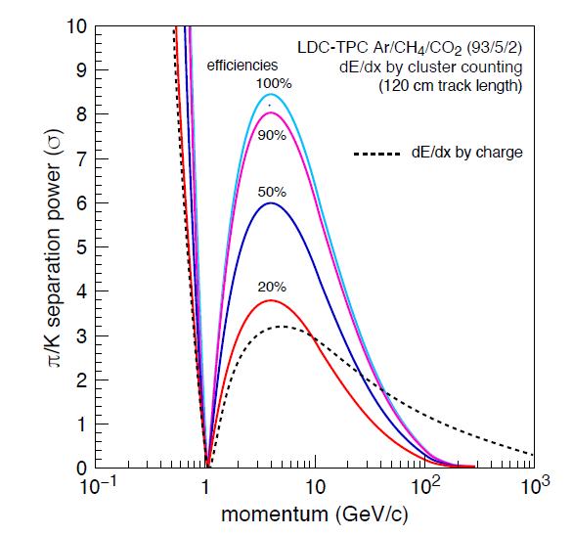
GAS contributions to PID (several options considered)
TPC
classical dE/dx
dE/dx by cluster counting
An example from literature of what dE/dx by cluster counting can be provide
Gaseous photon detectors for RICHes

