Slide 1
HERD SCD weight, very very preliminary
March 5th 2021
G. Ambrosi

Slide 2
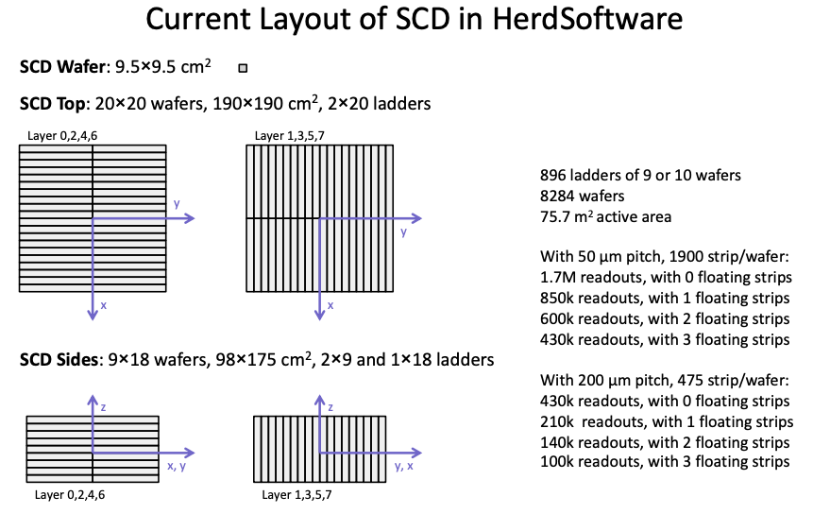
A. Oliva, Feb. 22nd 2021

Slide 3
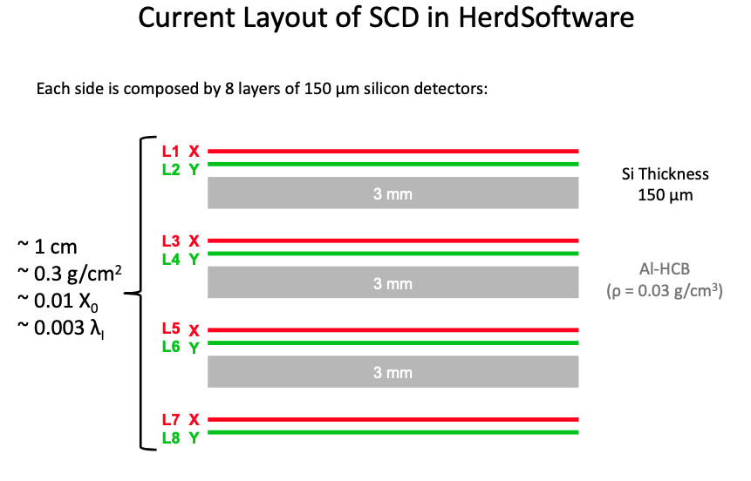
A. Oliva, Feb. 22nd 2021
SUPPORT PLANE
SUPPORT PLANE
SUPPORT PLANE

Slide 4
weight (based on DAMPE design)
ladders: 90 kg
top planes: 150 kg
side planes: 192 kg
mechanical support to the planes: ???
readout electronics: ???
total

