Slide 1


Cryogenic workshop summary
in GWADW 2021
Paola Puppo (INFN-Roma)
Kazuhiro Yamamoto (Toyama)
May 21th 2021

Slide 2
Cryogenic Session: Tuesday May 18th (hour 1)
CE and Voyager
project
Kevin Kuns (MIT)
Realizing Cosmic Explorer 2 with LIGO A+ or Voyager Technology
Sebastien Biscans (MIT LIGO)
Suspension design for Cosmic Explorer
Yehonathan Drori (Department of Physics and Astronomy, Amherst College, Amherst, Massachusetts 01002)
Optical Refrigeration for an Optomechanical Amplifier
Juliedson Reis (Brazil)
Theoretical Effective Emissivity for the LIGO Voyager Test Masses
Summary of Cryogenics workshop, Kazuhiro Yamamoto (Toyama) May 21th 2021

Slide 3
CE and Voyager project
Voyager (A+) is cryogenic (room temperature) upgrade of current LIGO facility.
Cryogenic is a choice of CE2.
CE2 based on A+(room temperature) and Voyager (cryogenic)
(Kuns)
CE2 suspension design based on A+(room temperature) and Voyager (cryogenic) (Biscans)
New type cryocooler (Voyager); Optical Refrigeration for an Optomechanical Amplifier (Drori)
Black body radiation as bulk phenomena (Reis)
Summary of Cryogenics workshop, Kazuhiro Yamamoto (Toyama) May 21th 2021

Slide 4
Kevin Kuns (MIT) Realizing Cosmic Explorer 2 with LIGO A+ or Voyager Technology

Slide 5
Kevin Kuns (MIT) Realizing Cosmic Explorer 2 with LIGO A+ or Voyager Technology

Slide 6
Kevin Kuns (MIT) Realizing Cosmic Explorer 2 with LIGO A+ or Voyager Technology

Slide 7
Sebastien Biscans (MIT LIGO) Suspension design for Cosmic Explorer
Keys of suspension for CE2
(1)If cryogenic is adopted, fibers are made from silicon.
(2)Resonant frequencies are 3Hz at most. Soft (vertical) blade springs are necessary.

Slide 8
Sebastien Biscans (MIT LIGO) Suspension design for Cosmic Explorer
A+(300K)
Voyager(cryogenic)
Acceptable parameter region for blade spring

Slide 9
Yehonathan Drori (Department of Physics and Astronomy, Amherst College, Amherst, Massachusetts 01002) Optical Refrigeration for an Optomechanical Amplifier
Geometrical limit
No geometrical limit

Slide 10
Yehonathan Drori (Department of Physics and Astronomy, Amherst College, Amherst, Massachusetts 01002) Optical Refrigeration for an Optomechanical Amplifier
Phonon
Photon
Photon
Phonon
Phonon is converted to photon and escapes.

Slide 11
Yehonathan Drori (Department of Physics and Astronomy, Amherst College, Amherst, Massachusetts 01002) Optical Refrigeration for an Optomechanical Amplifier
~ gram (~cm)

Slide 12
Juliedson Reis (Brazil) Theoretical Effective Emissivity for the LIGO Voyager Test Masses
Black body radiation is surface phenomena. But actually, body phenomena. Silicon at 123K is somehow transparent for far infrared radiation.

Slide 13
Juliedson Reis (Brazil) Theoretical Effective Emissivity for the LIGO Voyager Test Masses
Black body radiation is surface phenomena. But actually, body phenomena. Silicon at 123K is somehow transparent for far infrared radiation.
~0.4 (because of smallness, about 70mm*30mm*10mm)

Slide 14
Cryogenic Session
Wednesday May 19th-20th (hour 1)
KAGRA
Nobuhiro Kimura (ICRR)
The cooling scenario of the KAGRA test mass without condensation on the surface toward to O4
Tomohiro Yamada (High Energy Accelerator Research Organization)
Reduction of vibration transfer via heat links in KAGRA cryogenic mirror suspension system
Takafumi Ushiba (ICRR)
Recent upgrade of KAGRA cryogenic payload
Summary of Cryogenics workshop, Kazuhiro Yamamoto (University of Toyama) May 21th 2021

Slide 15
Status of KAGRA
“Practical” updates and lessons about cooling at site
How to avoid condensation of mirrors and windows
(Kimura)
Heat links and their vibration isolation (Yamada)
Updates in last 2 years for installed cryogenic payload
(Ushiba)
Summary of Cryogenics workshop, Kazuhiro Yamamoto (University of Toyama) May 21th 2021

Slide 16
Nobuhiro Kimura (ICRR)
The cooling scenario of the KAGRA test mass without condensation on the surface toward to O4
How to avoid ? Kimura and his colleagues proposed as follows.
(1)The cryostat is evacuated well (less residual gas).
(2)At first the radiation shields are cooled down (cryo pump).
(3)At last , the mirror and payload is cooled down.
(4)If necessary, the heater works (de-frost).
In order to confirm this method, the experiment of cryostat at KAGRA site was conducted.

Slide 17
Nobuhiro Kimura (ICRR)
The cooling scenario of the KAGRA test mass without condensation on the surface toward to O4
It works !

Slide 18
Yamada (High Energy Accelerator Research Organization)
Reduction of vibration transfer via heat links in KAGRA cryogenic mirror suspension system
Heat links to cool KAGRA cryogenic payload transfer large vibration. Vibration isolation system is necessary.

Slide 19
Yamada (High Energy Accelerator Research Organization)
Reduction of vibration transfer via heat links in KAGRA cryogenic mirror suspension system
Heat link vibration isolation system in KAGRA cryostat

Slide 20
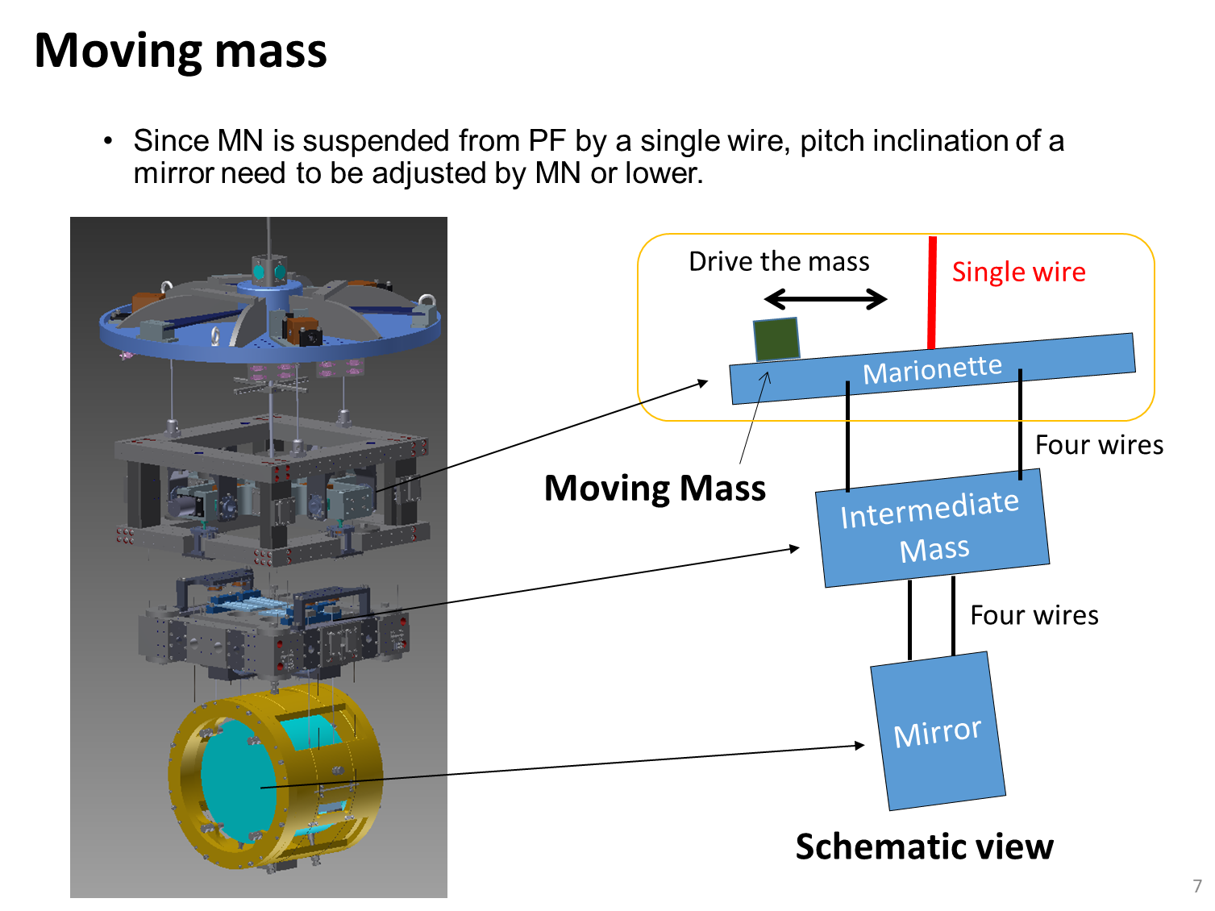
Takafumi Ushiba (ICRR)
Recent upgrade of KAGRA cryogenic payload
Due to complex structure,
old systems are sometimes stuck
after moving several times.
-> New system was developed and installed in KAGRA cryostat.

Slide 21
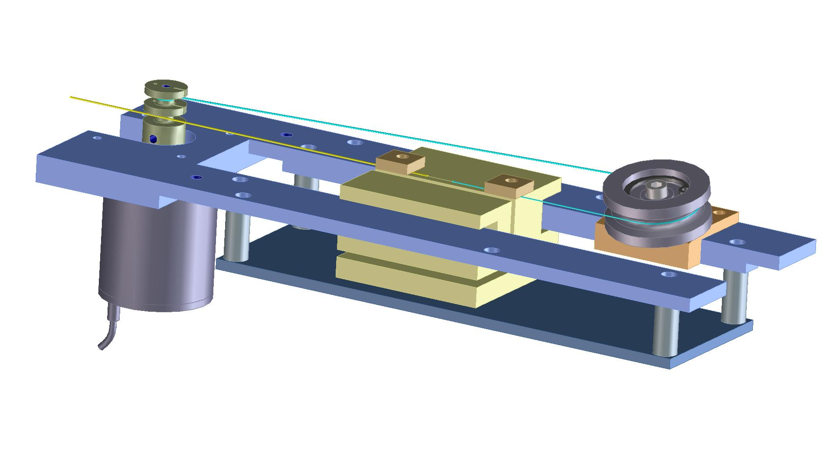
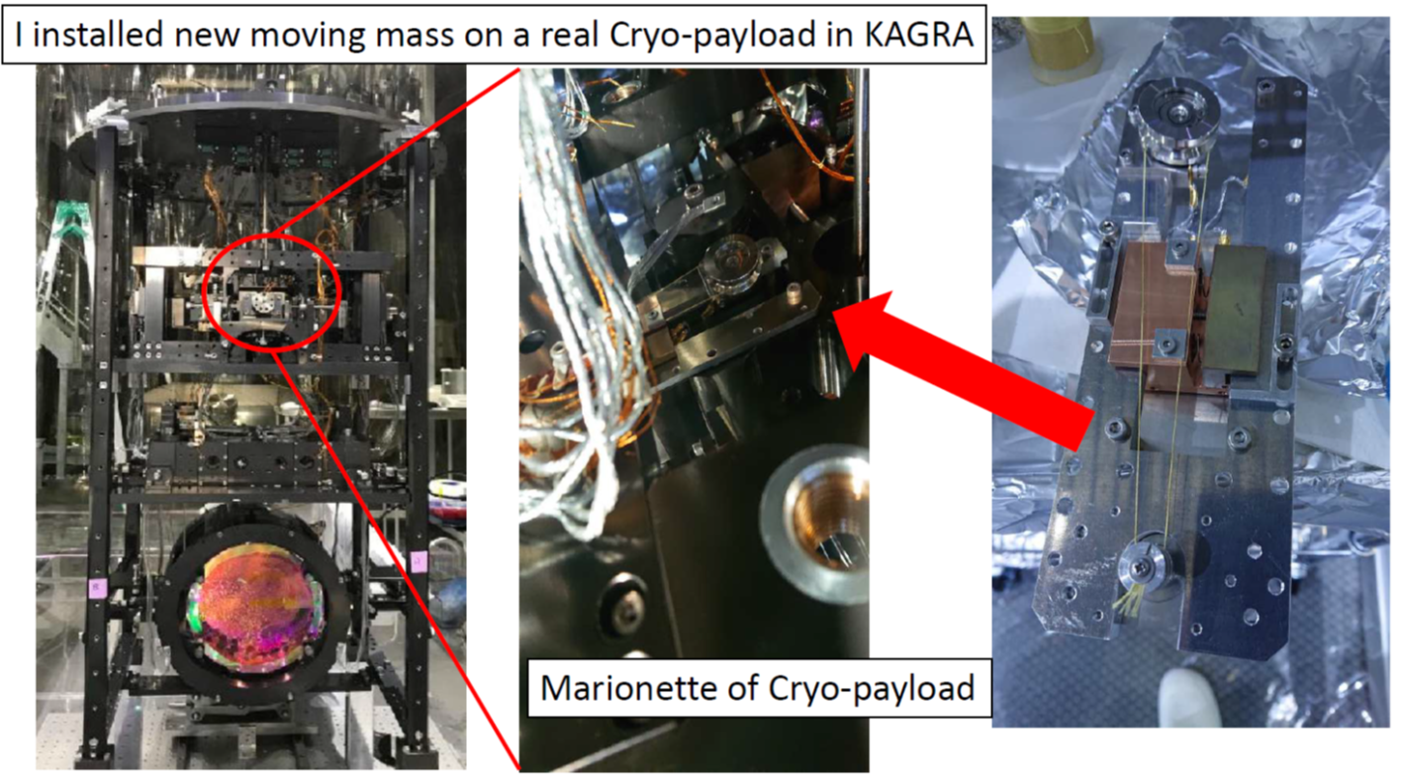
Takafumi Ushiba (ICRR)
Recent upgrade of KAGRA cryogenic payload
Pressure: 2.6×10⁻⁶ Pa
Temperature: 46 K
aligning
New system works in KAGRA cryostat (46K).

Slide 22
Cryogenic Session: Tuesday May 18th (hour 2)
ET project
Fulvio Ricci (Univ. Sapienza, INFN, Rome)
Cryogenics and Vacuum for the Einstein Telescope project
Ettore Majorana (Univ. Sapienza, INFN, Rome)
Outline of cryogenic payload compliance with Einstein Telescope
Henk Bulten (Vrije Universiteit Amsterdam/Nikhef)
Cryogenics and water migration in ET pathfinder
Lennard Busch, Xhesika Koroveshi and Steffen Grohmann (Karlsruhe Institute of Technology (KIT))
Helium-based cooling concept of the ET-LF interferometer
Summary of Cryogenics workshop, Paola Puppo (INFN-Roma) May 21th 2021

Slide 23
Cryogenic Monolithic Suspensions
Vacuum Tubes
Cooling System

Slide 24
Main issues related to cryogenics
• Heat extraction from a heavy mirror and suspension wires for a
cryogenic payload
• Cooling Time
• Safety : a crucial issue when we operate in the underground
environment)
• Mirror pollution due to the temperature gradients
• VIBRATIONS and EXTRA ACOUSTIC NOISE!!!
Open point
Numerical study of the cryotrap configuration
-Numerical evaluation of the geometrical factor for the radiative heat transfer
-Molecular conduction evaluation via montecarlo
Payload cooling time
- We need to reduce it ( up to 1 week per mirror )
- use of the He gas exchange, a complex solution in a real GW interferometer
- Use a telescopic system to transmit the refr. power via solid
Cryogenics: R&D
In addition to the ET design effort, we will discuss and promote R&D for improved detectors, for example for future ET upgrades.
The scope of this division includes work on:
• Simulation of particle sources and shields in the cryostat
• Development of ultra-low noise LF payload cooling systems
• Experimental investigations on LF payload operation, incl. local control
Vacuum & Cryogenics:
Preliminary questions
Before the complete design document, we must address urgent issues following from the current design, for example:
• Diameter and bakeout conditions of the pipe arm tubes
• Desired cool-down and warm-up times
• Heat load on the LF mirrors

Slide 26
Heat Links effect on thermal noise
Thermal Studies
Controls

Slide 31
Cryogenic Session
Wednesday May 19th-20th (hour 2)
R&D’s
Satoshi Tanioka (ICRR, The University of Tokyo.)
Optical loss study of the cryogenic molecular layer using a folded cavity for future gravitational-wave detectors
Luisa Spallino (LNF - INFN)
Impact on Vacuum Requirements by Cryogenically Cooled Mirrors for Gravitational Wave Detection
Marcel ter Brake, Arvi Xhahi, Harry Holland (University of Twente)
Sorption-based vibration-free cryogenic cooling for ET and ETPathFinder
Summary of Cryogenics workshop, Paola Puppo (INFN-Roma) May 21th 2021

Slide 32
Satoshi Tanioka (ICRR, The University of Tokyo.)
Optical loss study of the cryogenic molecular layer using a folded cavity for future gravitational-wave detectors
Folded cavity to characterize this effect

Slide 35
Mitigation strategies…..
Issues on water pressure…

Slide 36
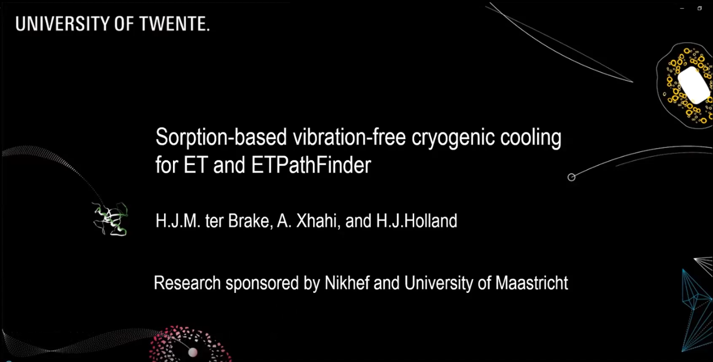
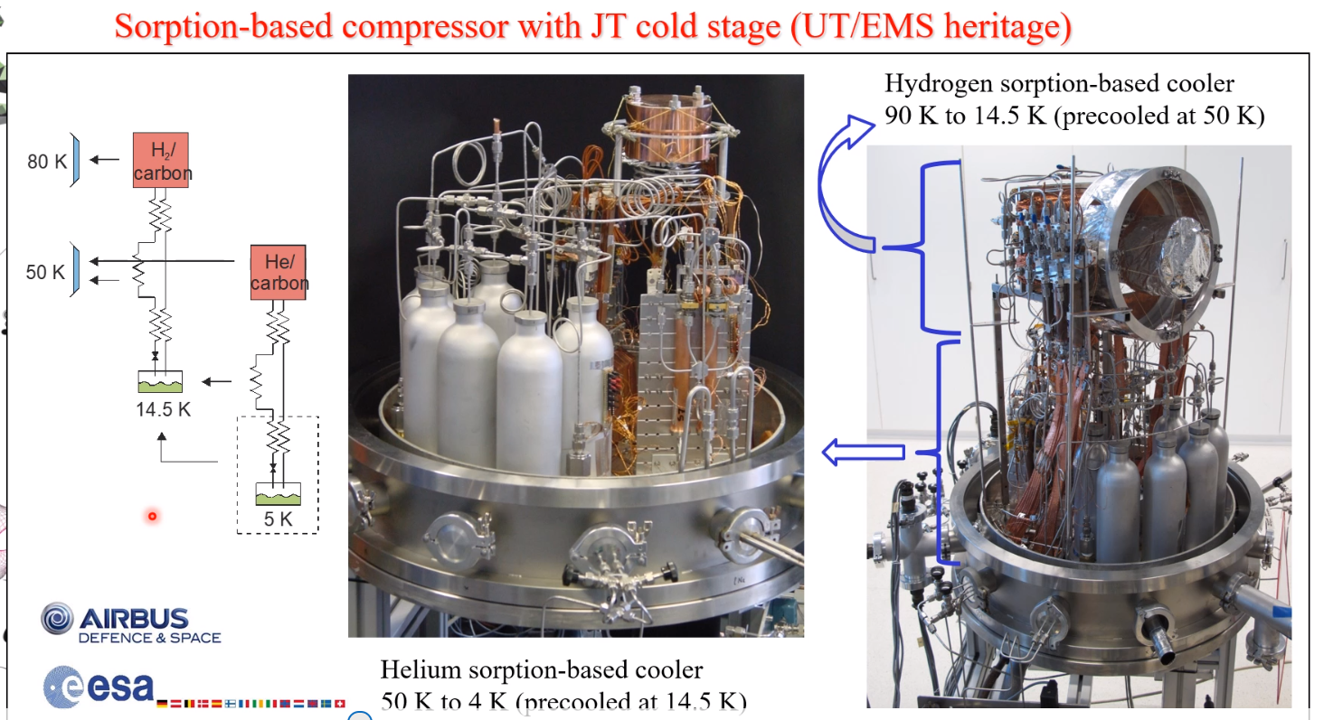

Slide 37
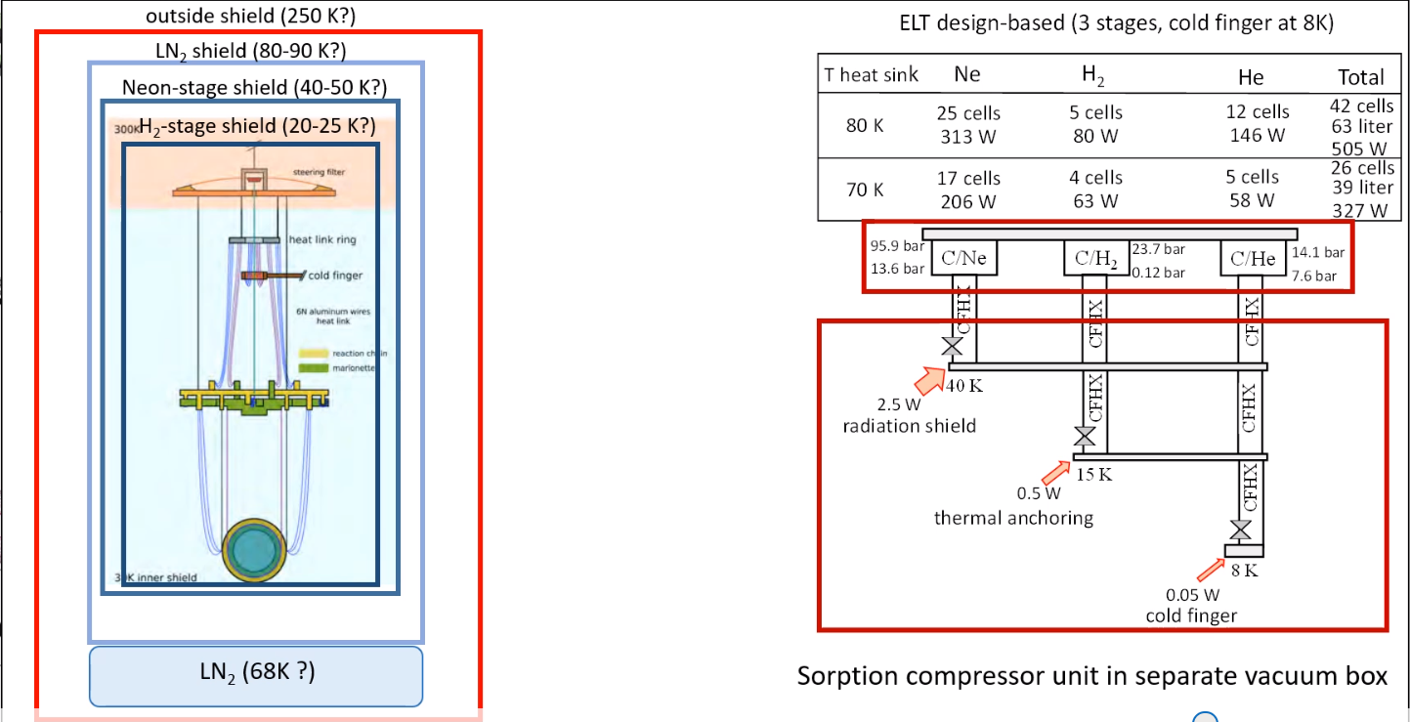
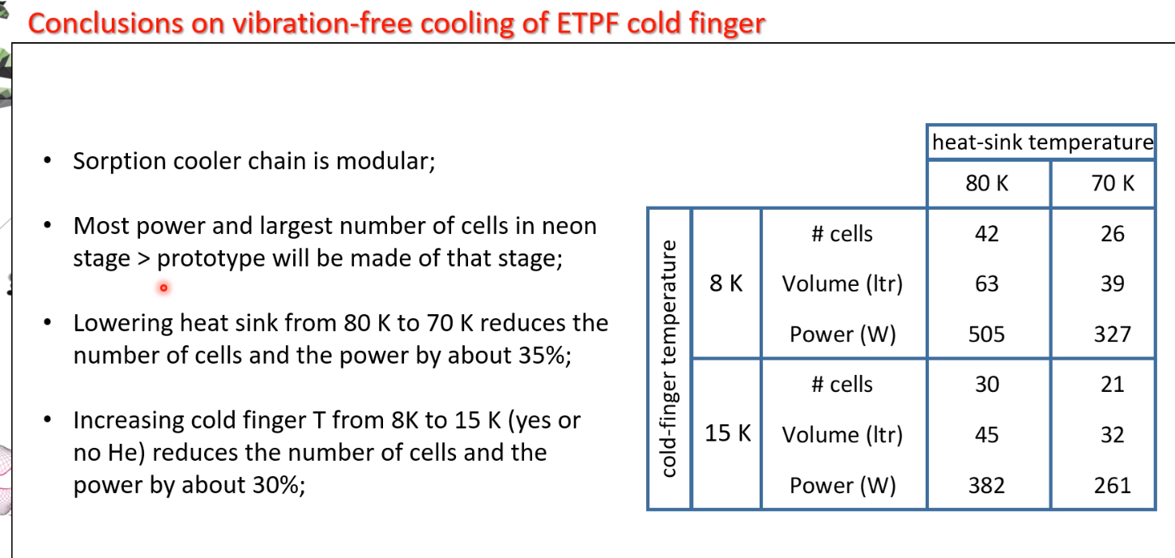

Slide 38
Sorry no time to introduce details but 4 posters !
Mitigation of the electrostatic charge on test mass mirrors in gravitational wave detectors (Marco Angelucci, LNF-INFN)
Towards low suspension thermal noise of cryogenic torsion pendulums with crystalline fibres (Ching Pin Ooi, The University of Tokyo)
Beam suspensions for cryogenic mirrors (Riccardo DeSalvo, Università del Sannio)
Auxiliary Suspension Modelling for Glasgow Cryogenic Interferometer Facility (Victoria Graham, University of Glasgow)

Slide 39
We thank all the speakers!
Summary of Cryogenics workshop, Paola Puppo (INFN-Roma) May 21th 2021

