Slide 1
Radiative mirror thermal compensation system
Adrian Hernandez
Riccardo DeSalvo, Jeremy Blow
Claudio Pineda, Stefano Selleri
LIGO Document G2101030

Slide 2
Cooling principle
A black body at room temperature radiates close to 1 W/cm²
If this radiant heat is not returned from the ambient thermal bath the mirror cools (thermalize)
Fused silica emission coefficient is close to a black body (0.93)
Directing part of the radiated heat to a cold black body the mirror can be cooled
With proper imaging, a cooling spot precisely matching the profile of the stored beam in a GW detector can be projected on a mirror
The heat deposited by the beam can thus be extracted
The cooling power can track the power deposited by the beam

Slide 3
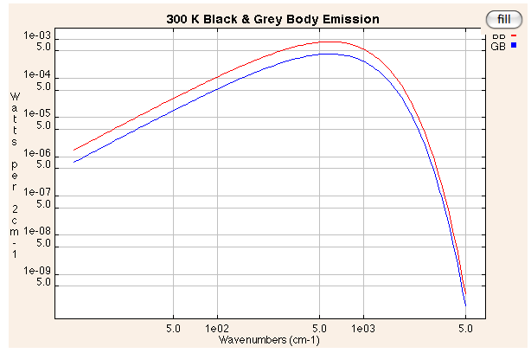
Feasibility
At room temperature a black body
emits 146W/sr-m²
Fused silica emissivity is close to that of a black body 0.93 engineering toolbox http://www.engineeringtoolbox.com/
A 6 cm radius spot emits 1.64W/sr
Black Body Emission Calculator http://infrared.als.lbl.gov/calculators/bb2001.html
Less than 1 sr coverage is sufficient to
extract the ~1 W of deposited power

Slide 4
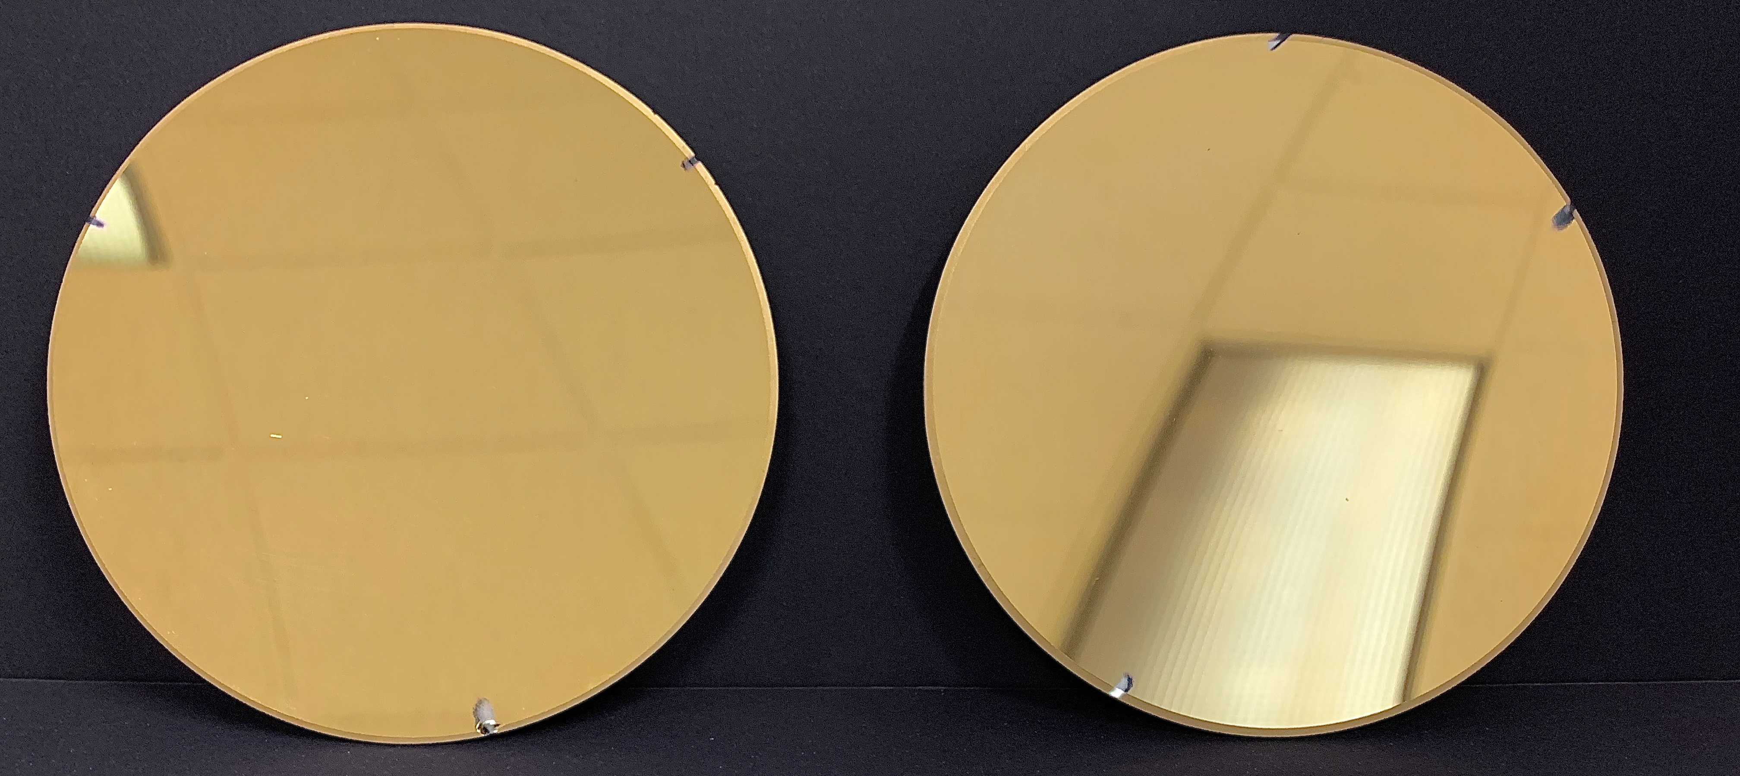
The experiment
A piece of glass disk represent the mirror
Two gold plated mirrors direct the heat power radiated by the glass disk to two shielded black bodies kept at a controlled temperature
The experiment is done in air, due to resource limitations

Slide 5
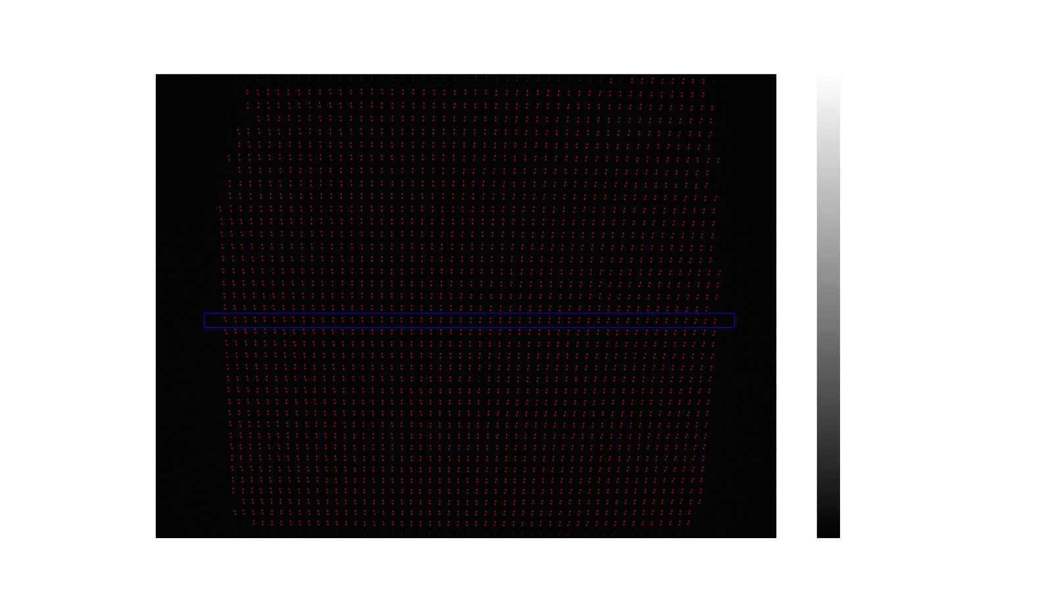
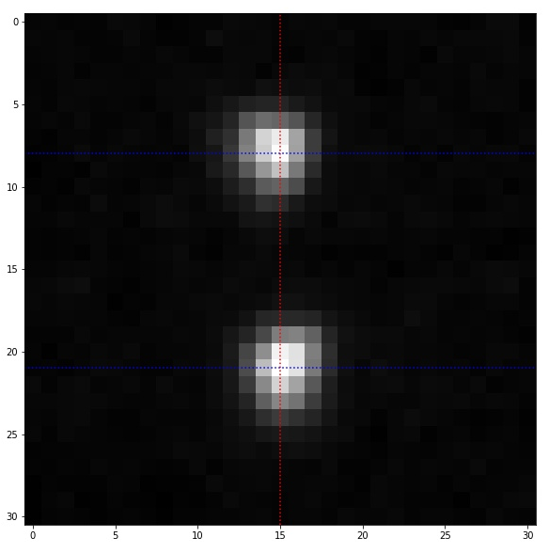
The experiment
A laser with a holographic filter illuminates the glass disk with a matrix of light dots
Reflection on the front and back of the disk make pairs of dots
The reflected dots are monitored by a CCD camera
The relative motion of the dots tracks the induced thermal lensing

Slide 6
Tracking precision achievable
Experiment heating with a sort exposer to a mini heat gun
Observed the cooling phase
Residuals indicate a minimum precision of 0.02 pixel ~ 5 µm/spot
<10 µradian (<1 µradian with optimized optics)
Measured a glass disk thermal relaxation with a time constant of ~46 seconds

Slide 7
Mechanical noise subtraction and differential measurement
The components of the setup may vibrate or drift
Only a small fraction of the image is interested by the thermal lensing
Averaging the position of the frame of dots around the thermal lensing area the movements can be eliminated from the image
A small fraction of µradian sensitivity can be achieved

Slide 8
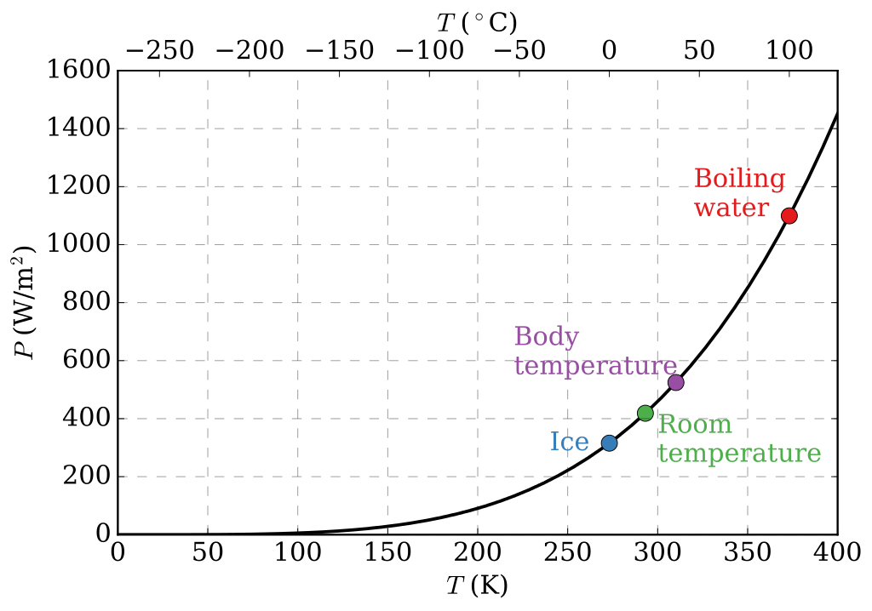
Matching the cooling power level
The mirror, being at ambient temperature, radiates always the same power towards the cold trap, according to the Stefan-Boltzman law
P_{radiated} [W/sr] = σ A T_{mirror}⁴ where σ = black body emissivity
The cold trap returns a power proportional to its temperature
P_{returned} [W/sr] = σ A T_{cold trap}⁴
The cooling power therefore is
P_{cooling} [W/sr] = σ A (T_{mirror}⁴- T_{cold trap}⁴)
Wikipedia

Slide 9
Matching the cooling power level in the experiment and in the interferometer
The cooling power is P_{cooling} [W/sr] = σ A (T_{mirror}⁴- T_{cold trap}⁴)
In the experiment
The cold black body will be dry-ice-cooled at fixed 195K and cooling power
The heating is controlled by an electrically heated black body temperature and matched to the cooling power
In an interferometer the heating will be controlled
by the stored beam power and coating absorption
The cooling black body will be connected
with a thermal resistor to a liquid nitrogen
cold finger and heated to a temperature matching
the cooling power to the deposited power
Cooling can track in feedforward or feedback
the power deposited on the mirror thus
impeding thermal lensing
Wikipedia

Slide 10
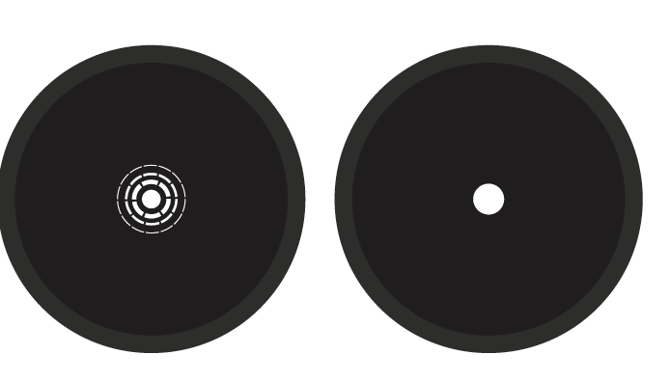
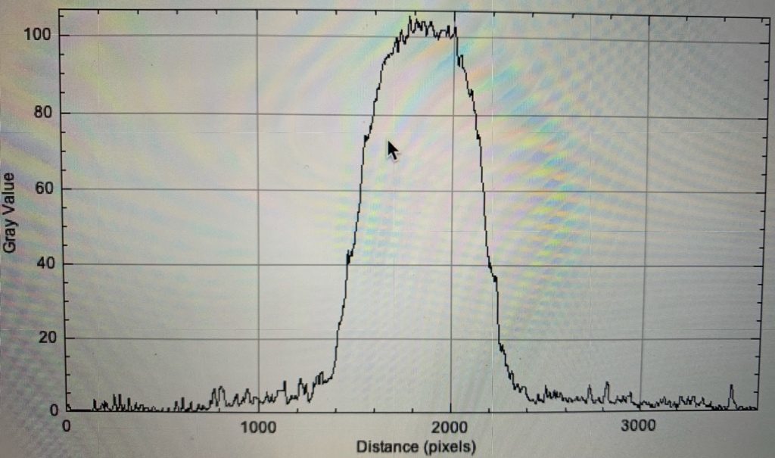
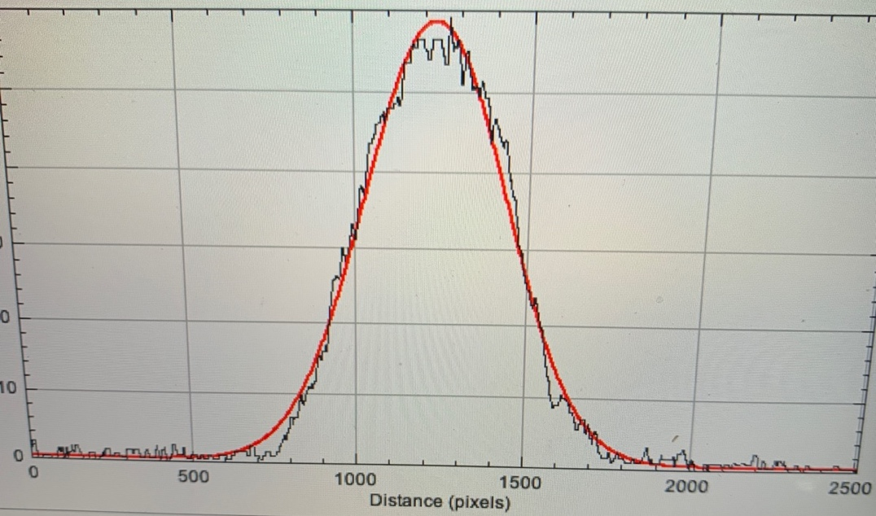
Matching the cooling spot to the interferometer beam shape
A circular black body mouth, imaged on the glass disk, poorly matches the gaussian shape of an interferometer beam
A, slightly defocused, target-shaped metal mask (white body, kept at room temperature) placed in front of the black body nicely matches the gaussian profile
The measurement was done with visible light and the same mirrors

Slide 11
Requirements of the black bodies
To absorb the heat from the mirrors the black bodies need to be kept cold
The cooling power can be tuned by controlling their temperatire
They can be as cold as liquid nitrogen temperature
In the actual implementation it is vital that they are completely shielded in a small cryostat to avoid uncontrolled thermal deformation s to the interferometer mirror
This is also true in the experiment, even if done in air

Slide 12
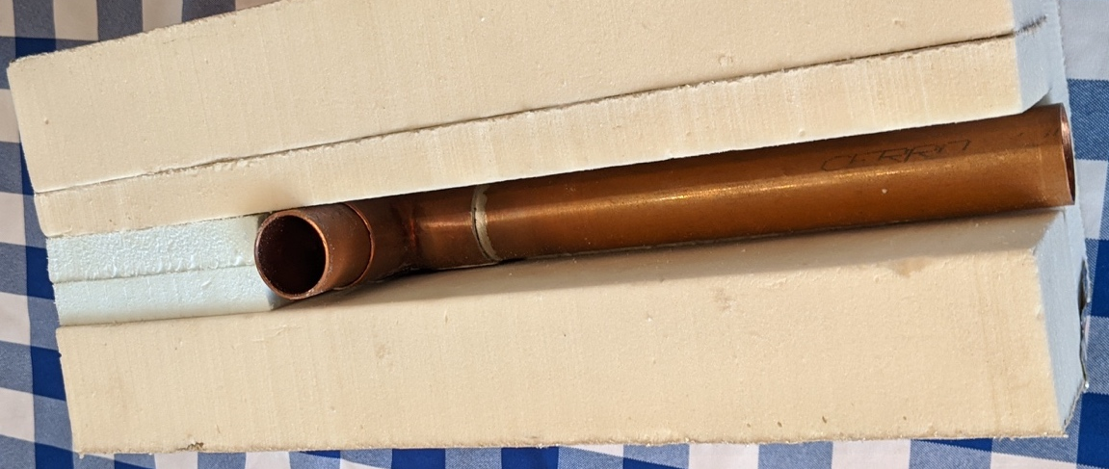
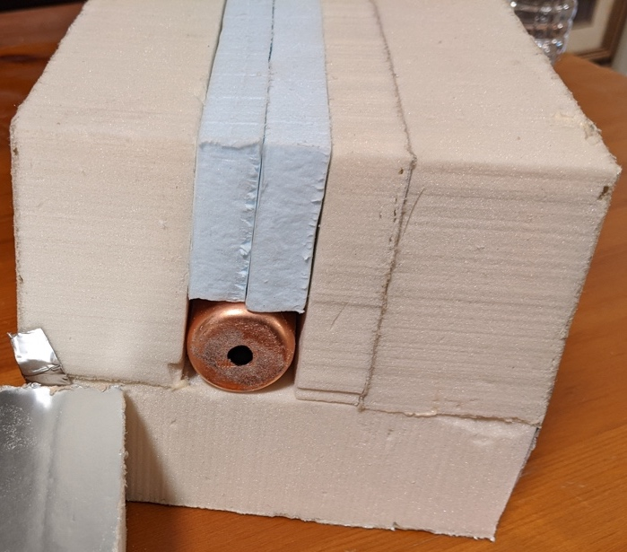
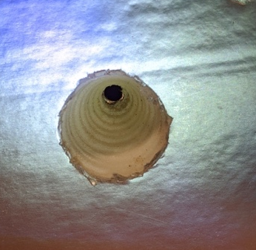
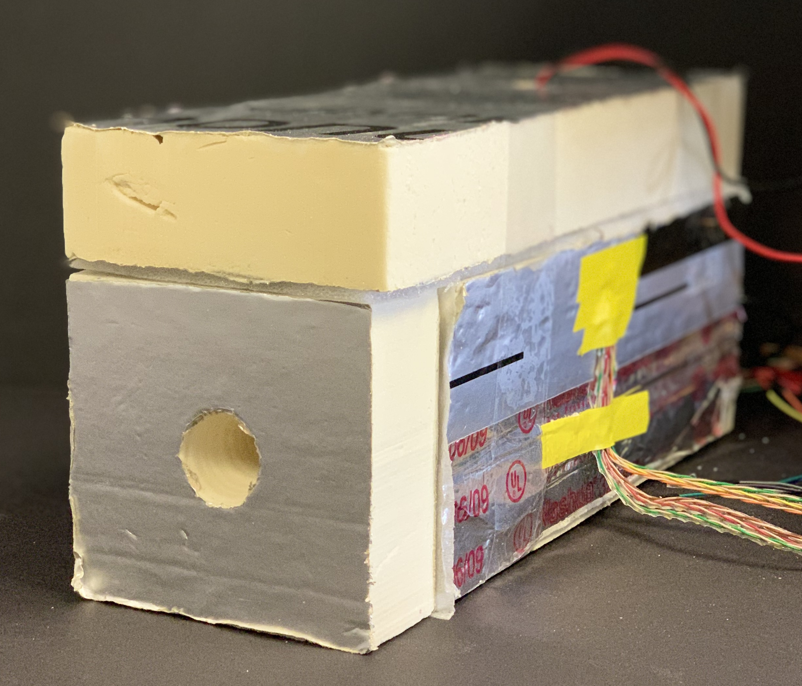
Building the experiment black bodies
The cryostat is built with thick Styrofoam thermal insulation
The black body is a long tube made of BK7 that is close to a black body, multiple internal reflections build up to a close-to-perfect black body.
It is housed in a copper pipe for thermal uniformity.
A conical opening of the thermal insulation ensure that the mouth of the black body is only visible in the solid angle pointing to the gold mirrors
Two thermistors monitor the temperature uniformity along the pipe.
Dry ice (fixed temperature at 195K, heat flow restitution ~50%) is used to chill the black body
A heating resistor is used to heat the black body
The cryostat thermal constant is close to 1 hour

Slide 13
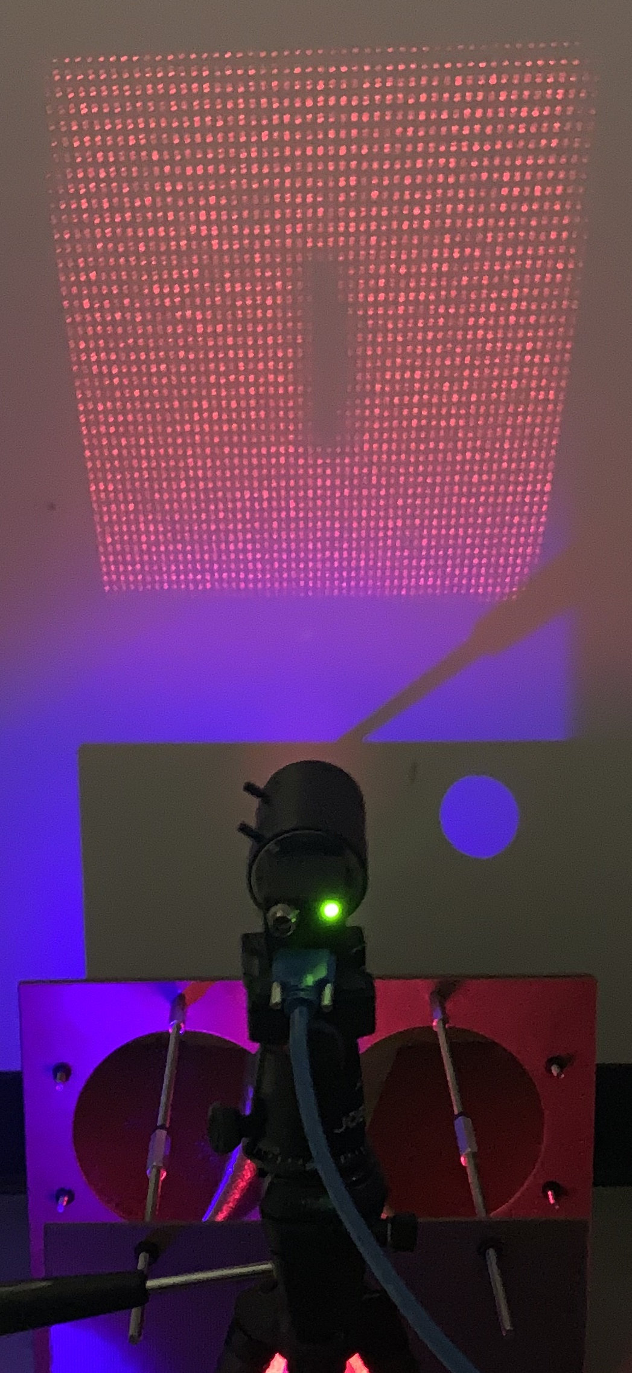
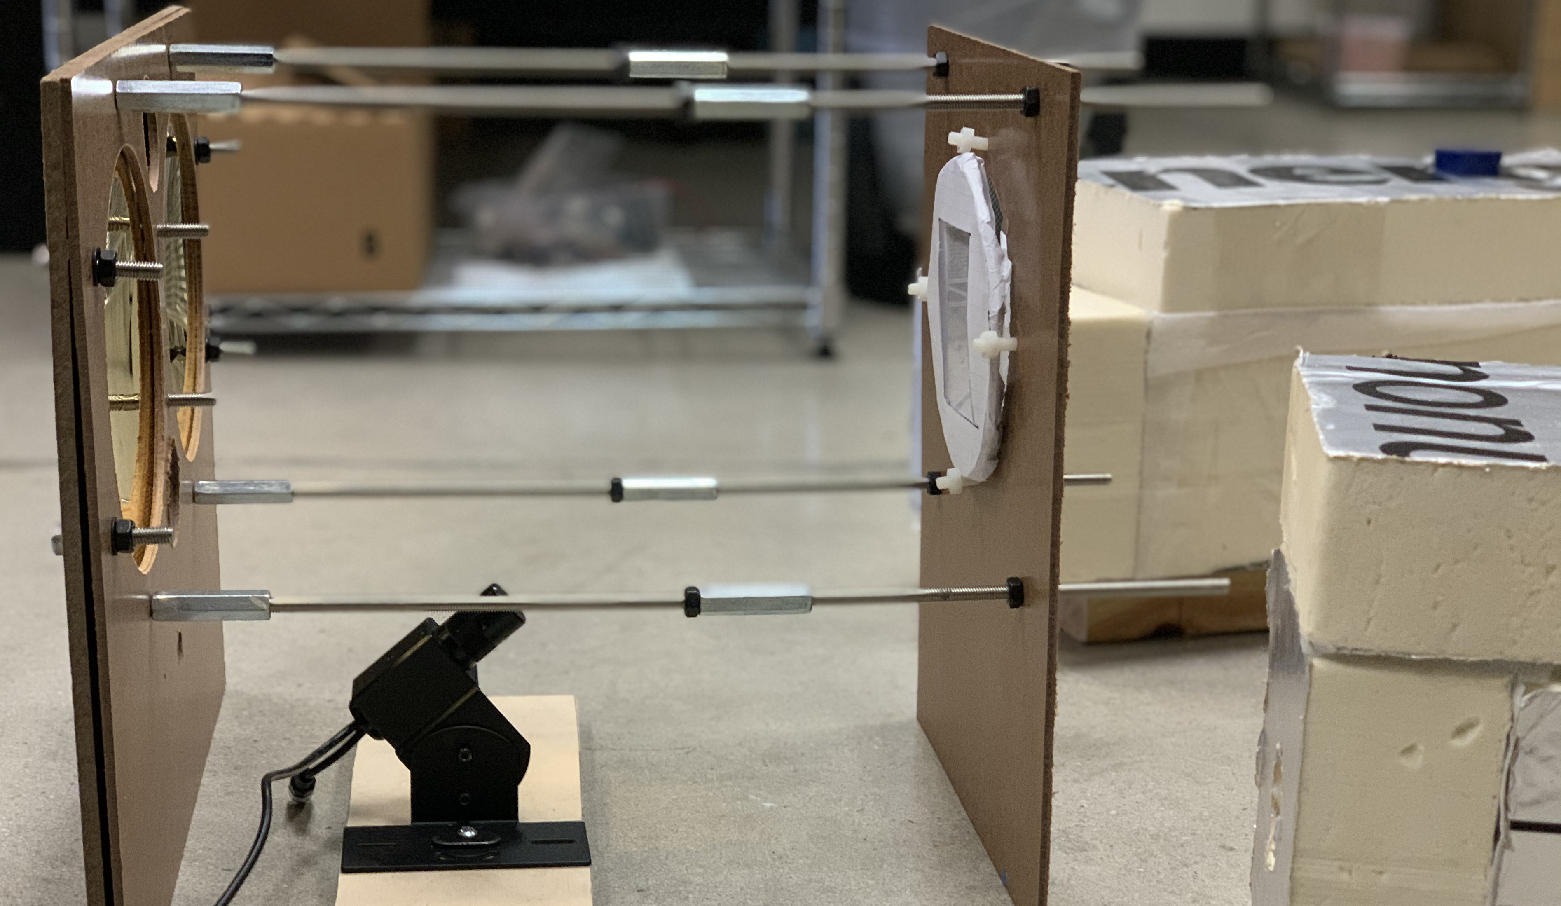
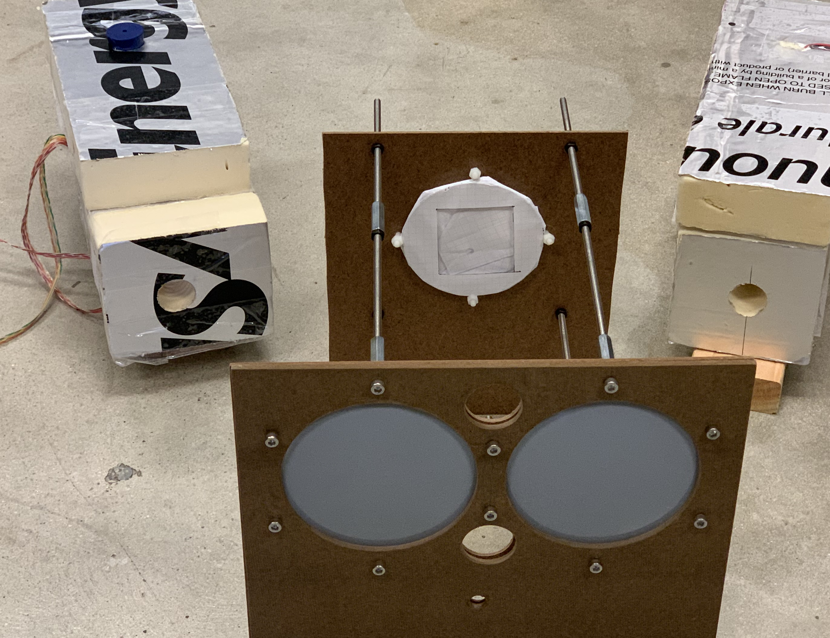
The experiment setup
Light dot matrix on detection screen
Spherical gold-plated mirrors imaging thermal radiation to and from black bodies onto glass plate
Target glass plate
undergoing thermal lensing
CCD camera digitizing light dot positions
Laser with diffractive plate generating light dot matrix reflecting on glass plate
Hot and cold black bodies pointed at gold mirrors

Slide 14
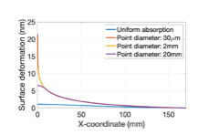
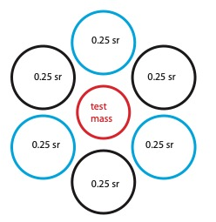
Can directional radiative cooling neutralize point adsorbers
A typical point absorber deposits mW on the mirror surface
It is point-like, but produce a thermal bump typically 1 cm in radius that produce High Order optical Modes
The mirror surface emits ~ 15 mW/cm²-sr
Assuming a 0.5 sr covering mirror and 50% efficiency ~7mW can be absorbed by a cold spot
The cold spot cannot match the point-like deformation but correct the wider area causing most of the HOM feeding
dedicated mirrors are requires
Point absorbers in Advanced LIGO AF Brooks, G Vajente, H Yamamoto,. . . - Applied Optics, 60, (13), pp 4047-4063 (2021)

Slide 15
Ready for actual cooling-heating experiment
The experiment is starting with heating at 85ºC (358K) where larger signal can be produced, data being analyzed
Next dry ice will be used at -78ºK (158K)
Finally, both will be used to produce the thermal bump with one mirror and then cancel with the other

