Slide 1
Test mass cryogenic suspensions with rigid beams
Riccardo DeSalvo RicLab LLC, University of Sannio, University of Utah
Alessandro Bertolini NIKHEF
LIGO Document G2101031

Slide 2
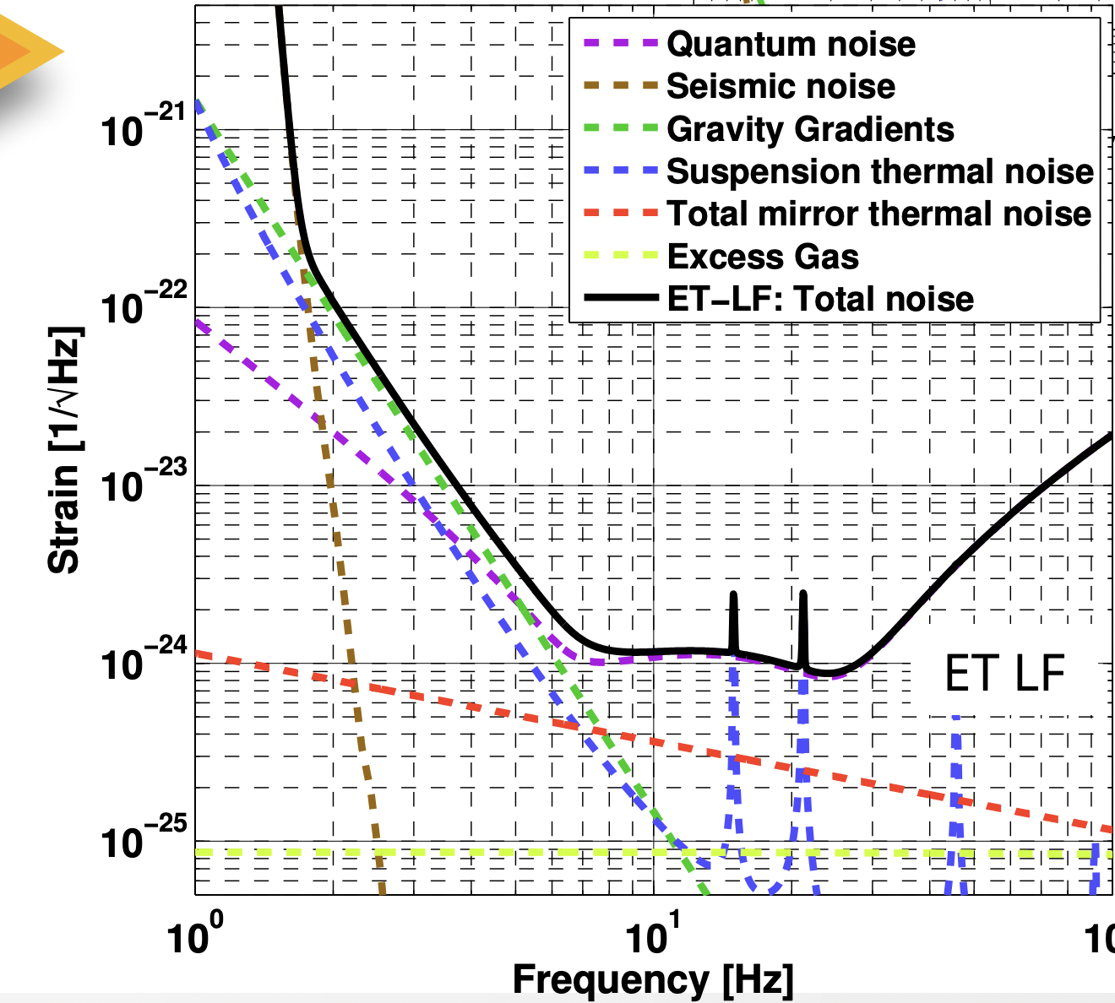
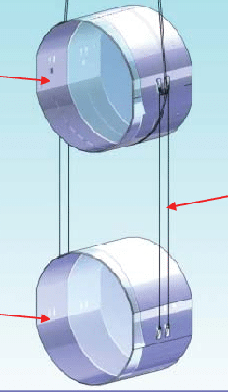
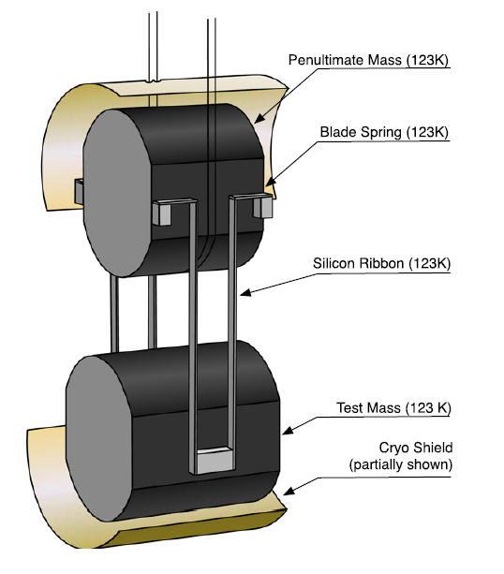
Conflicting requirements
Suspension thermal noise is critical at the lowest frequencies
The suspensions must be
long and thin,
  For vibration attenuation
very flexible
  For thermal noise (minimize pendulum elastic energy)
  Fabricated with metal wires or fused silica fibers
short and fat
  For thermal conductance to extract the heat deposited by the light beam in the mirror,
made of fragile crystals
  for heat conduction (Sapphire or Silicon)

Slide 3
Using beams for cryogenic suspensions
15
Let’s consider a square cross section rod.
  provide large thermal conductivity
  are too rigid to be useful
Short flexures get flexibility with small loss of conductivity
  are extremely fragile, almost impossible to work with
  Tensioning confines the bending making it effectively stiffer
15

Slide 4
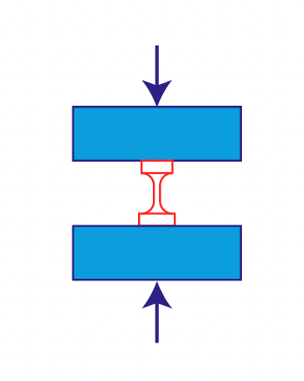
Compressive flexure Solution
flexures working in compressional mode allow :
  To separately machining all components
    Cheaper and more accurate machining)
    Fully engineer the assembly procedure
  Compressional assembly is intrinsically stable
  Bonding and de-bonding with thin metal braze is possible
  Compressional load distributes the bending along the length making the flexure effectively softer

Slide 5
Compressive flexure Brazes
Indium and Gallium are possible braze materials
Braze does not add thermal noise because
  Effectively direct contact between crystalline components
  No elastic oscillation energy is stored in a thin film;
Gallium is a better braze than Indium because
  It melts just above room temperature allowing easier
  assembly and disassembly
  It expands at the transition to solidus thus making better bonds
  It typically better wets crystals
  It has slightly higher Q factor

Slide 6
Implement compression flexure in the beams
Carve a slot with a flat bottom at the end of the fat suspension beam
Insert flexures and a cross bar to be attached to the mirror
Braze in compression
Problem: beams are very massive, transmit vibration via batting center effect

Slide 7
How to realize good attenuation with massive beams
Add percussion point compensation like Inverted pendula Taking advantage of the beam rigidity
The percussion center compensation arm is implemented above the mirror or above, inside the marionette.
Beam resonances are problematic
Passive Eddy current damping, or active damping can be implemented inside the marionette

Slide 8
Example of Beams+flexures internal modes (to be checked with FEM)
Si cylindrical flexures 2-mm diameter,11-mm long;
beam 10-mm diameter, 989-mm long.
Even the beam-flexure resonances are at sufficiently high frequency to be easily damped
yaw mode
~220 Hz
tilt mode ~470 Hz
translational mode ~270 Hz

Slide 9
Use the compensation arm for controls of the test mass
The compensation arms extending inside the marionette can be used as control levers
Actuation for the test mass controls can be applied from above eliminating the need for a recoil mass
Axial and Yaw actuation can be implemented
Pitch actuation is tough, it requires :
  vertical compliance in the beam support points acting
  or act on marionette’s pitch

Slide 10
How to attach the suspension beams to the mirror 2
Grind two vertical trenches and a horizontal slot on the sides of the test mass
  The front surface of the mirror is untouched
The slot forms a shelf to anchor the suspensions in compression
Insert the suspension beams and anchoring bars
All assembly is in compression !!!

Slide 11
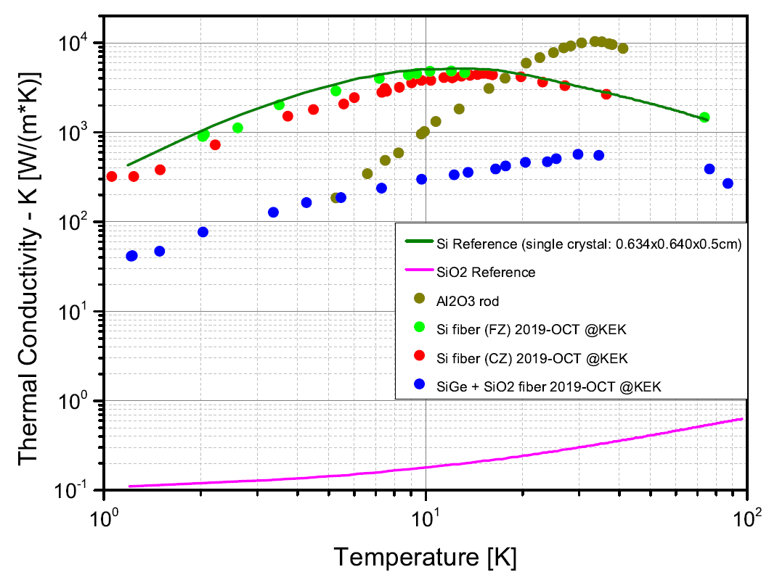
Silicon or Sapphire Suspensions? conductivity
4K
TYPICAL VALUES OF THERMAL CONDUCTIVITY @~ 4K:
sapphire 100W/m*K
silicon 1000W/m*K
recently measured @KEK on 1-mm IMPEX rods.
Phonon peak in Si is shifted towards lower temperatures.
Silicon is preferrable

Slide 12
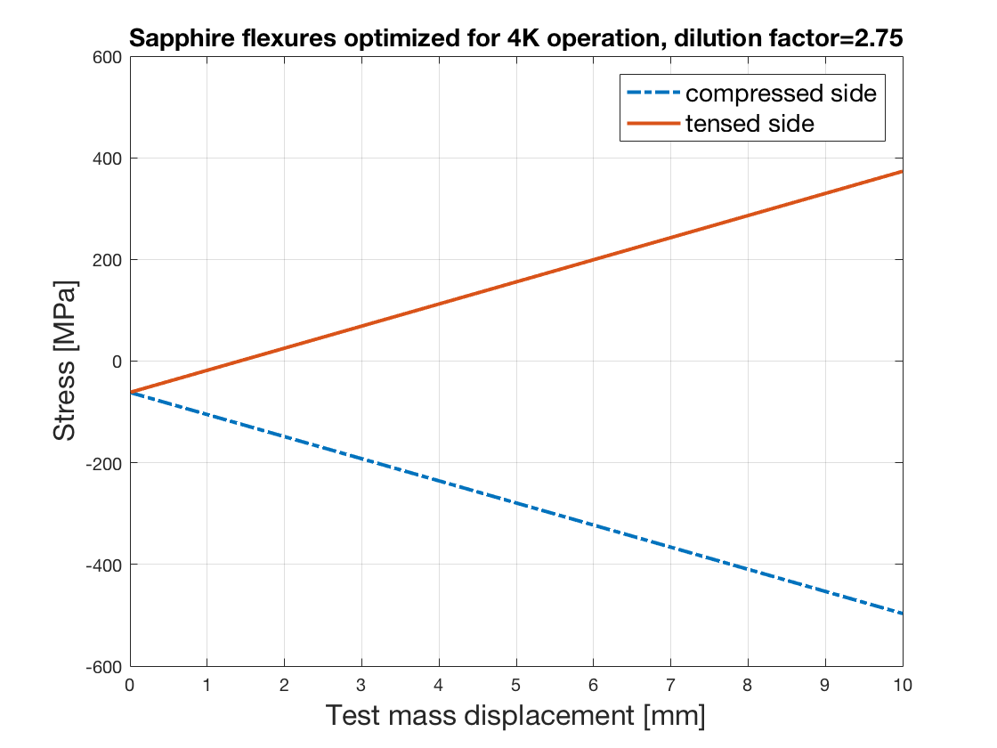
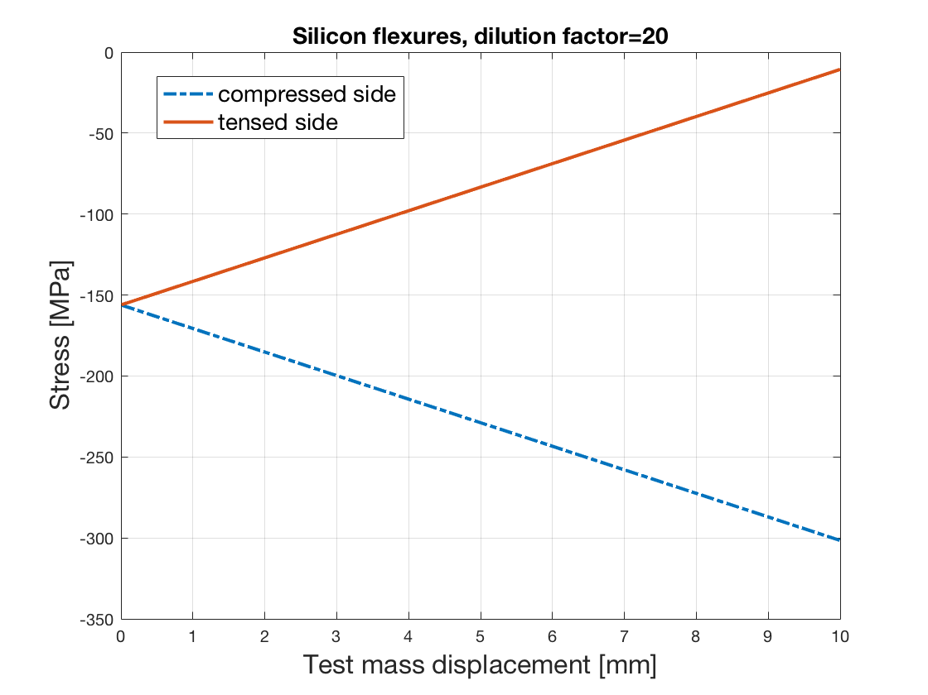
Silicon or Sapphire Suspensions? flexibility
cylindrical flexures
2.5mm diameter X 12.5mm length
cylindrical flexures
2mm diameter X
10mm length
Sapphire has high stiffness
Stress is high and flexures get in tension (may crack) even for minimal swings.
Dilution factor is poor.
Flexures are never in tension and safer than with sapphire.
Dilution factor is good
Silicon is preferrable

Slide 13
Conclusions
KAGRA’s experience has shown that rods under tension are either too rigid or have too little thermal conductivity.
Large diameter rigid rods coupled to the mirror and PUM by means of flexures in compression appear more promising.
Fully compressional configuration allows safe use of much higher stress levels in thinner, softer flexures
Assembly and disassembly are easy

