Slide 1



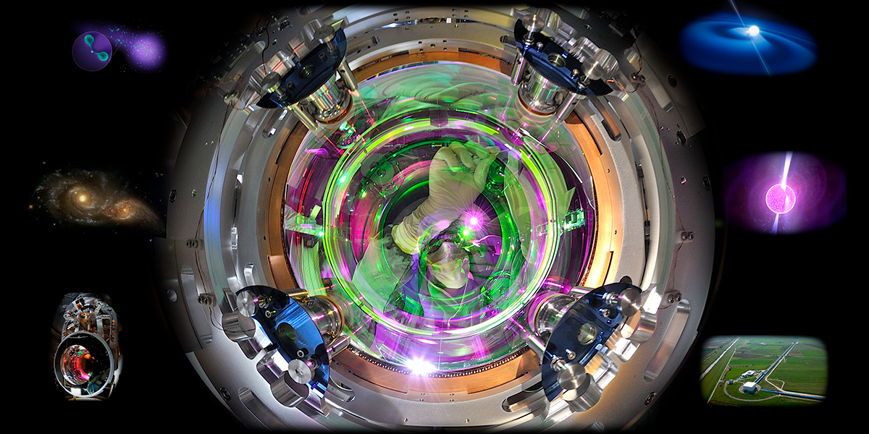
GWADW 2021
Piero Rapagnani
17/05/2021

Slide 2
The Amaldi Research Center (ARC) (https://www.phys.uniroma1.it/fisica/arc_amaldi_research_center) is an interdisciplinary Center for Gravitational Physics and Astrophysics dedicated to Edoardo Amaldi and financed with 10 M€ by MIUR, the Italian Ministry for University and Research, in the framework of the “Dipartimenti di Eccellenza” initiative.
The research activities of the Amaldi Research Center are organized into the following research areas:
Gravitational physics and astrophysics
LIGO-Virgo gravitational-wave data analysis
Multi messenger astronomy
Quantum technologies for gravitational-wave detection
Material science for 3G interferometers
3G gravitational-wave lab
All the experimental activities of the ARC are dedicated to R&D on technologies crucial for 3G Gravitational Wave detectors:
Improvement of optical coatings of mirrors
Development of quantum noise reduction strategies
Cryogenics for cooling down mirrors of 3G gravitational wave detectors

Slide 3
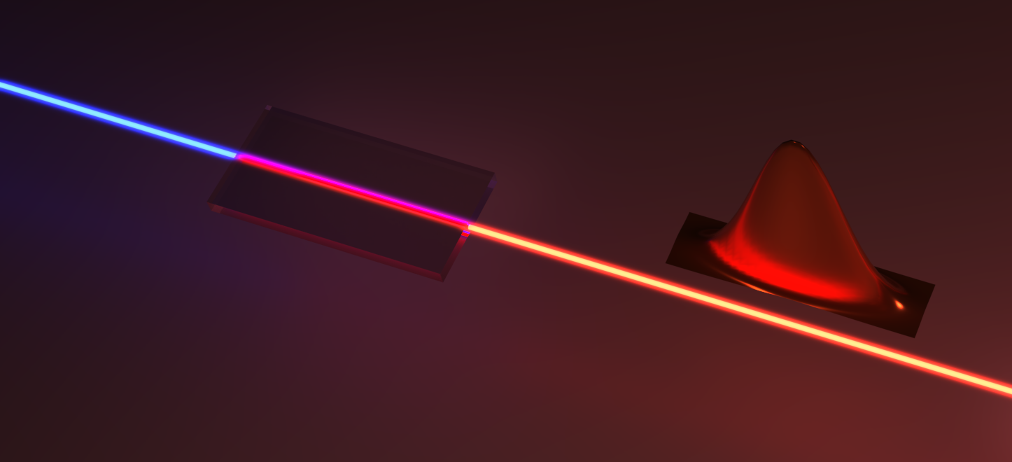
Quantum technologies for gravitational-wave detection
https://www.phys.uniroma1.it/fisica/arc_quantum_technologies_for_gw_detection
Machine learning for quantum sensing
ADAPTIVE PROTOCOLS FOR PHASE ESTIMATION
CALIBRATION OF QUANTUM SENSORS
Ongoing work
Future work:
Machine learning for quantum sensing
Platform for squeezing generation
Development of experimental platform for continous-variable (CV) quantum sensing
Advanced protocols in the multiparameter regime
A. Lumino, et al., Phys. Rev. Applied 10, 044033 (2018);
K. Rambhatla, et al, Phys. Rev. Research 2, 033078 (2020).;
M. Valeri, et al., npj Quantum Information (in press, 2020).
V. Cimini, et al., Phys. Rev. Lett. 123, 230502 (2019)
Bounds and protocols for quantum sensing
V. Cimini, et al., Phys. Rev. Applied 13, 024043 (2018);
E. Polino, et al, AVS Quantum Sci. 2, 024073 (2020).;
A. Z. Goldberg, et al., Phys. Rev. A 102, 022230 (2020).
Machine learning for CV quantum sensing
Faculty Members:
Fabio Sciarrino (Group Leader), Nicolò Spagnolo
Post Docs:
Iris Agresti, Mariana Berros, Gonzalo Carvacho, Valeria Cimini, Taira Giordani, Emanuele Polino
Application of machine learning in the CV regime for quantum sensing

Slide 4
https://www.phys.uniroma1.it/fisica/arc_material_science_for_3g_interferometers
SMART LAB
M. G. Betti, C. Mariani, M. Felici,
E. Placidi, M. Sbroscia,
A. Polimeni, P.Postorino, R. Trotta
5 A. Paolone, et al. Effects of the annealing of amorphous Ta₂O₅ coatings produced by Ion Beam Sputtering concerning the effusion of argon and the chemical composition
Journal of non crystalline solids 557 (2021) 120651

Slide 5
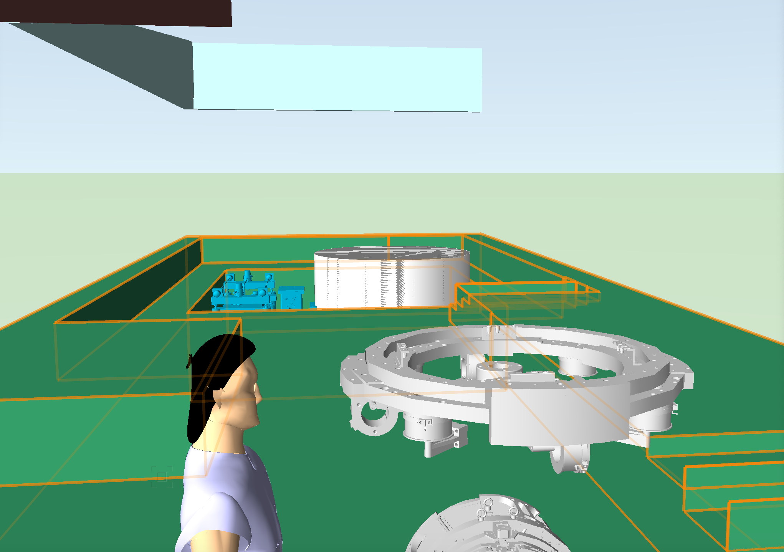
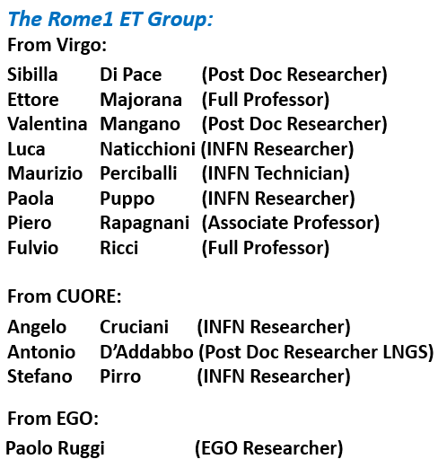
3G Gravitational-Wave Lab
With ARC funds, we are preparing a lab for low temperature tests on a real size prototype of an ET LF-Payload
Cryogenic Tests Area:
Test Cryostat for a full size LF-Payload, cooled by two PT (~Ø 3 m x 3.5 m):
- 2 thermal shields in insulation vacuum
- 1 experimental chamber with separated vacuum
Pulse Tube Cooling Station
Payload Development and Test Area (LF Payload – Real size)

Slide 6
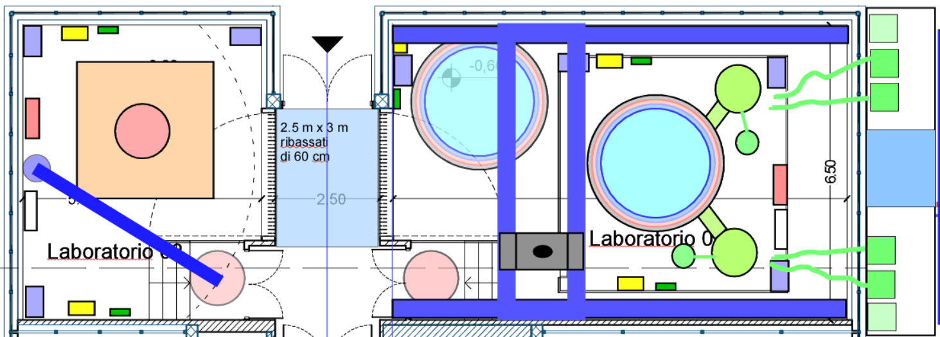
3G Gravitational-Wave Lab
Cryogenic Tests Area:
Test Cryostat for a full size LF-Payload, cooled by two PT (~Ø 3 m x 3.5 m):
- 2 thermal shields in insulation vacuum
- 1 experimental chamber with separated vacuum
Payload Development and Test Area (LF Payload – Real size)
16 tons crane
2 tons crane
Lab ready beginning of 2022
Pulse Tube Cooling Station

Slide 7
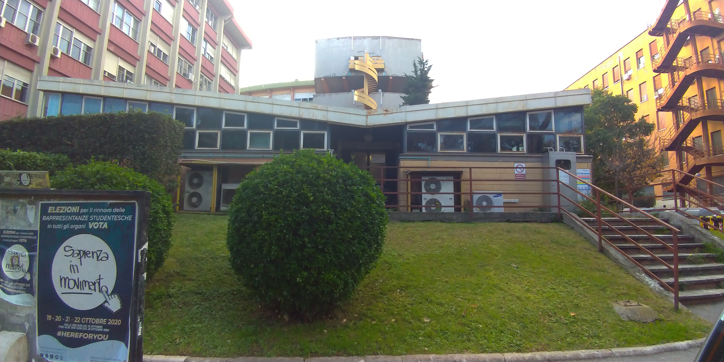
Amaldi Research Center
ET Cryogenics Test Lab

Slide 8
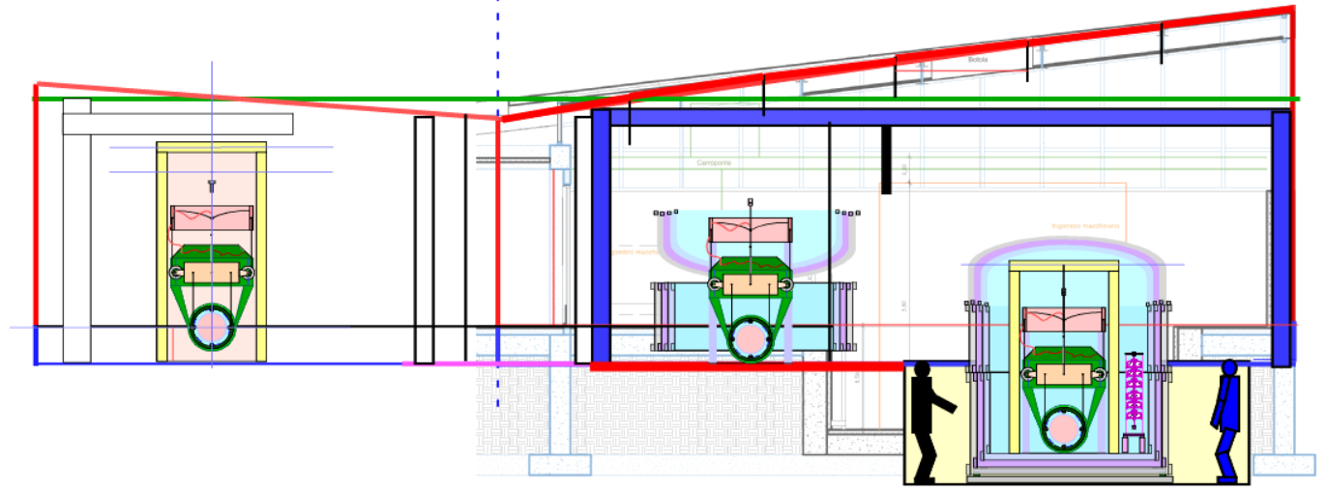
Amaldi Research Center
ET Cryogenics Test Lab

Slide 9
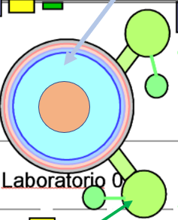
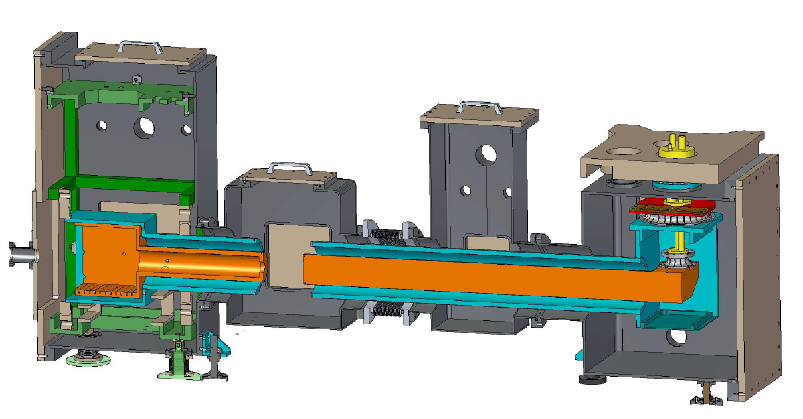
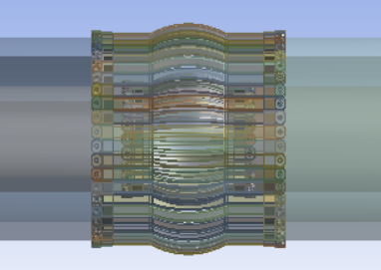
Pulse Tube Cooling Station
First phase:
for ET LF-Payload Test Cryostat
Cryogenic cooling lines suspensions
(VIRGO like)
Cryogenic Test Chamber:
Cooling efficiency,
Residual vibrations,
Sensing and actuators testing
2 PTs in counterphase (CUORE like)
with thermal links in Al5N and Al6N
Soft thermal links
(KAGRA like)
Design by Antonio Marra, Franco Bronzini:
Call for tender started. Construction starting in June 2021.

Slide 10
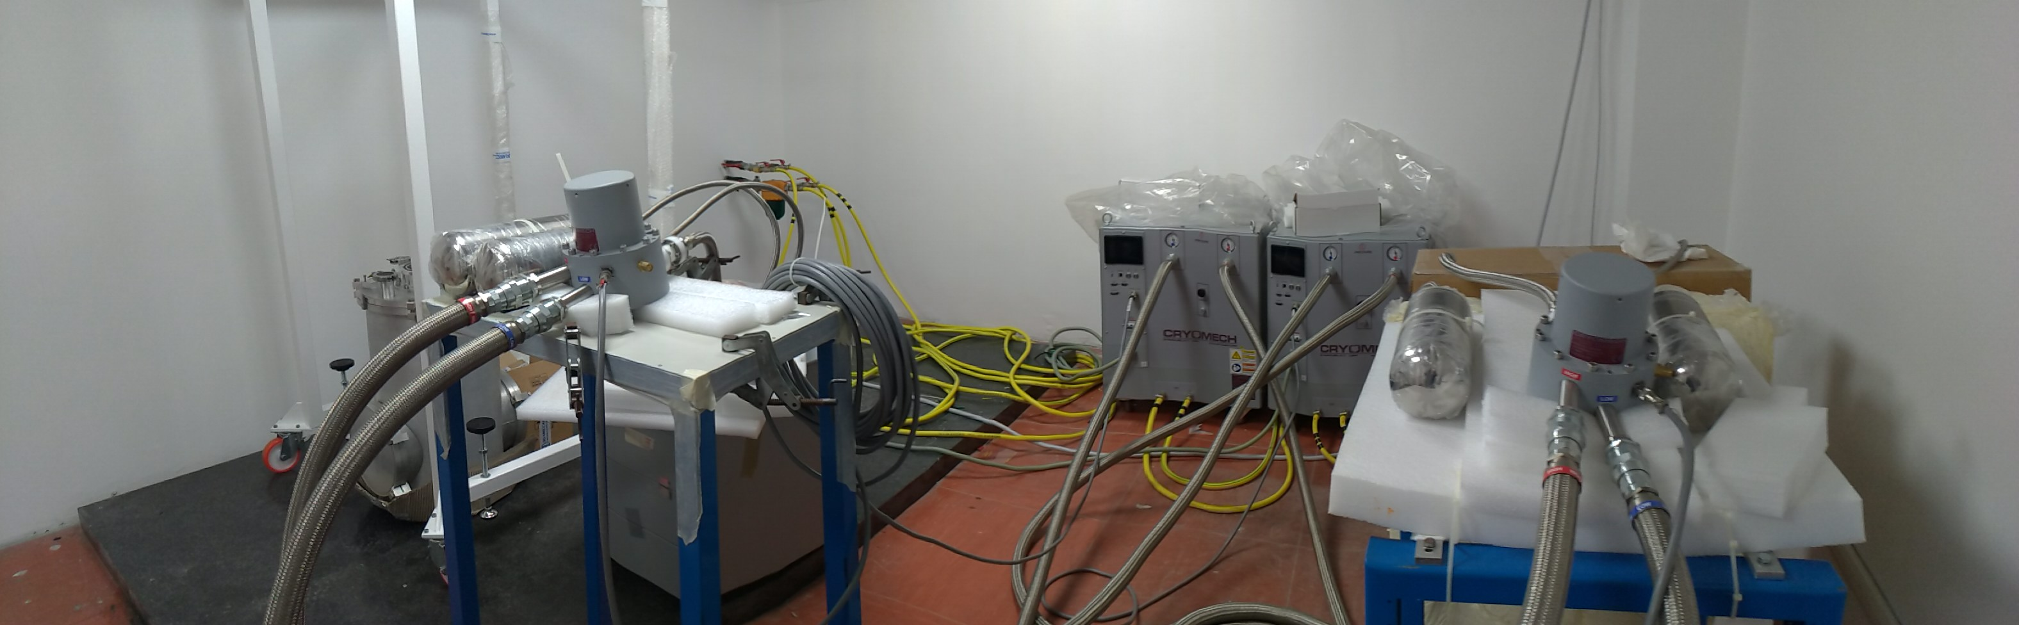
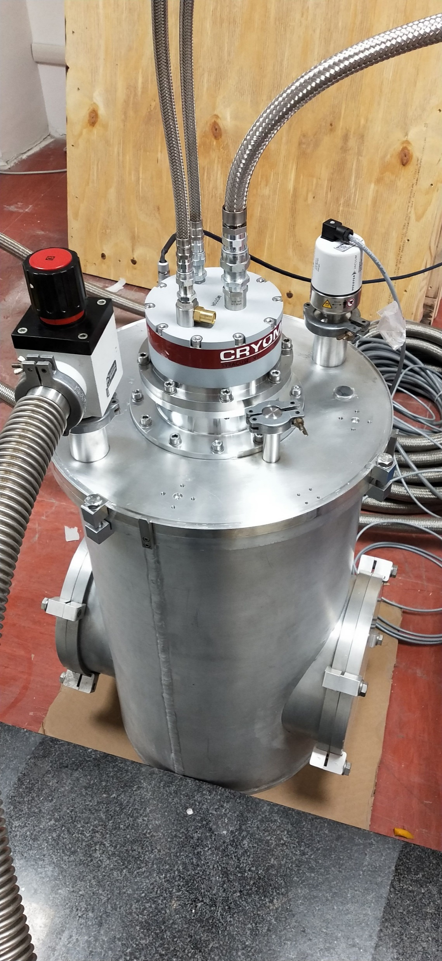
Pulse Tube Station for ET LF-Payload Test Cryostat
With the funds of ARC we have already bought two Pulse Tube Cryomech PT400 (1.8 W @ 4.2 K). They are being used for thermal tests in a temporary test lab in Rome La Sapienza.
Note: development of a good, damped, thermal link technology is essential in any cryogenic system configuration.

Slide 11
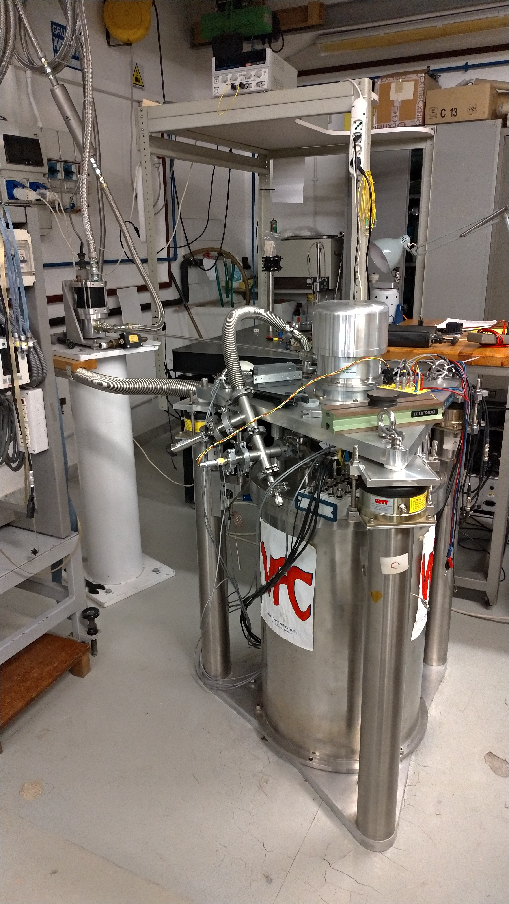
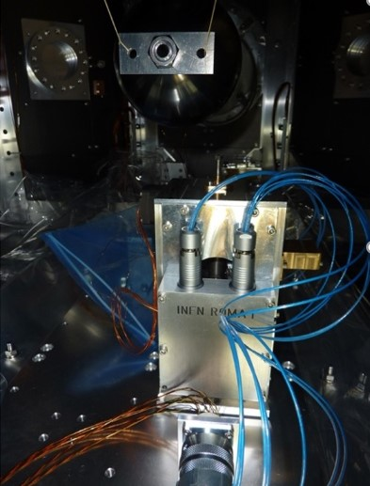
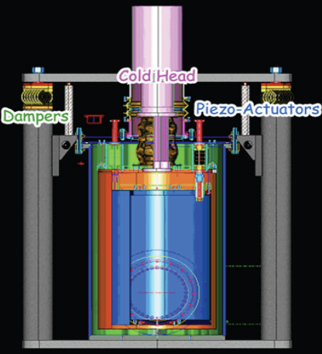
Low vibration PT test facility for sensor and actuators at low temperature: VFC
In our main lab in Rome, we use our low vibration cryogenic setup to develop cryogenic sensing of position/velocity/acceleration, in collaboration with KAGRA, and, since this year, also with CUORE.
For instance:
Design, assembly, calibration of low frequency Vertical Accelerometers for cryogenic operations (feedback control)
Vibration measurements of KAGRA cryostats: vacuum chamber and inner radiation shield @ University of Tokyo (ICRR), at Toshiba Keihin (Yokohama), JP., and at KAGRA site
Active System for Pulse Tube Vibrations Attenuation
Development of cryogenic sensors and actuators is crucial for payload design.
RSI 77(9):095102 - 095102-7 · 2006

Slide 12
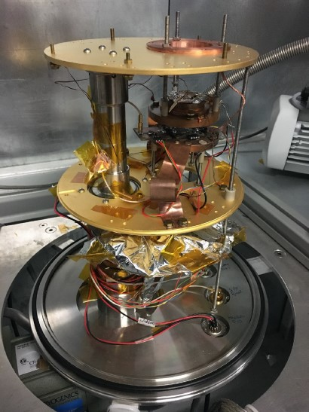
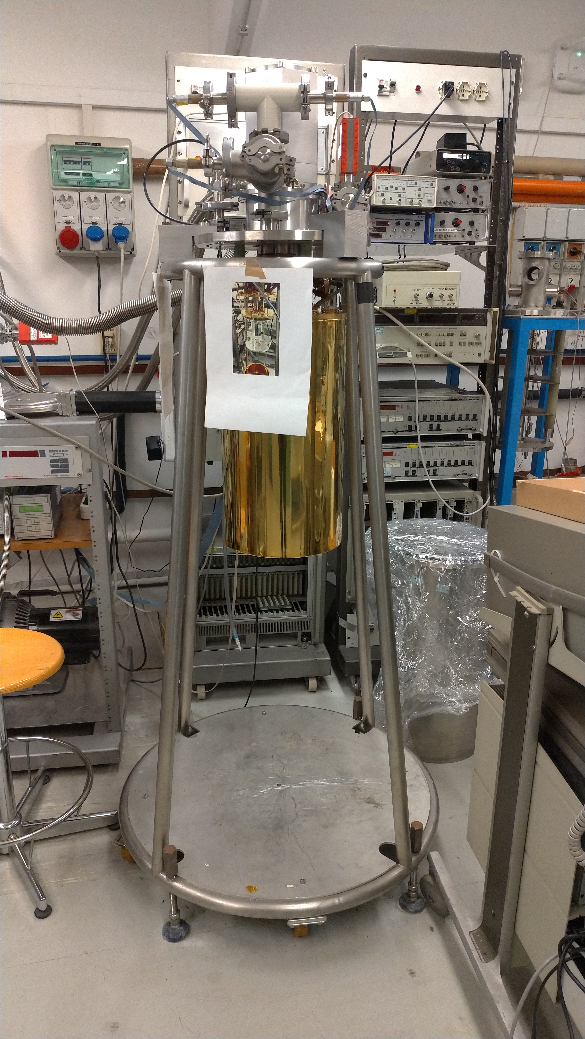
Cryocoolers facilities for thermal conduction measurements
In our Lab in Rome we have also a Cryomech PT dedicated to thermal resistance measurements, both on conductive links, and silicon or sapphire semples bonded with a monolithic bonding technique.
Recently, we gained access also to a facility for thermal conductivity measurements at INFN Laboratori Nazionali del Gran Sasso.
We plan to use it mainly for developing the thermal links for Payload cooling

Slide 13
ET Amaldi Research Center Lab
Program outline
2021:
Tests on high conductivity thermal links (ongoing)
Construction of prototype PT Cooling Station (call for tender started)
Design of test cryostat (starting)
2022:
Construction of test cryostat begins
Tests on dummy ET-LF payload at room temperature:
- frequencies, sensing & actuation, assembly procedure
2023:
- Tests on prototype payload at low temperature in test cryostat

Slide 14
END
Thank you for your attention

