Slide 1
Future constellations for observing Earth’s time variable gravity field
Pieter Visser
Delft University of Technology
Second European Physical Society Conference on Gravitation: measuring gravity (online)
5-7 July 2021 King’s college, London

Slide 2
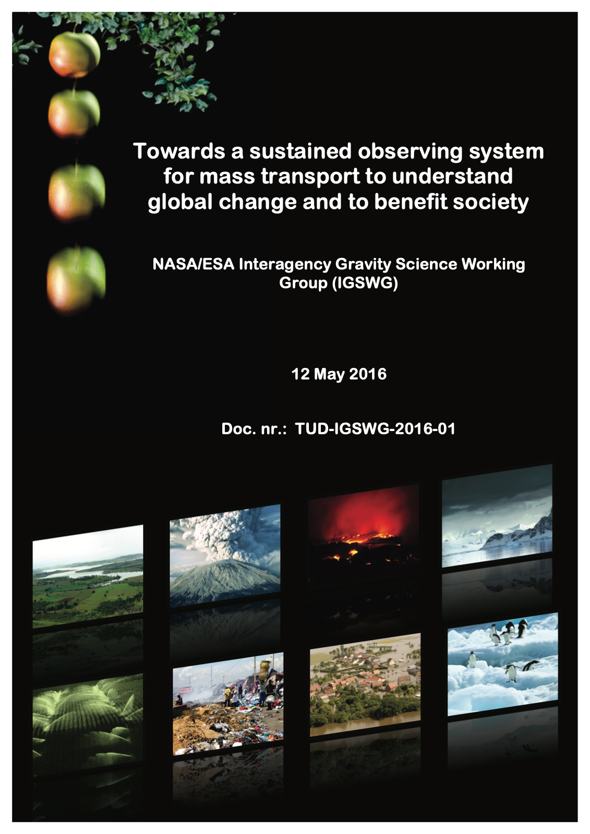

Slide 3
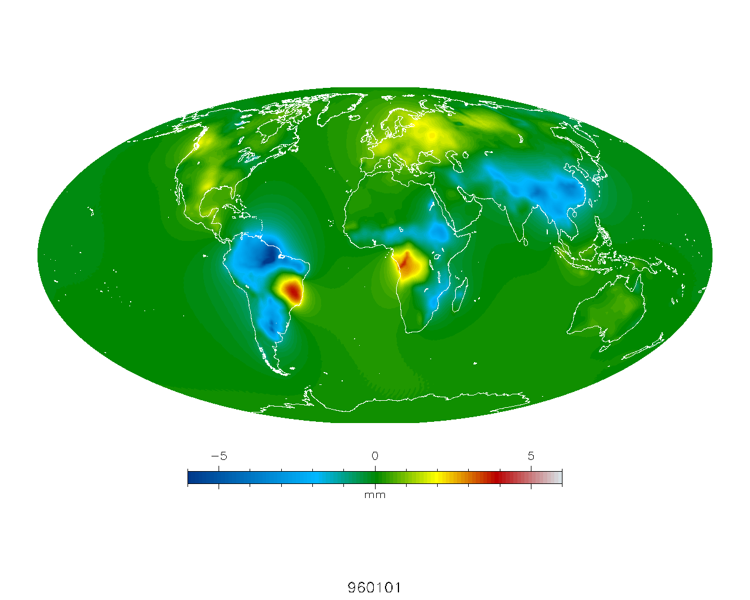
Constellation under study: ESA NGGM and NASA MCDO
NASA and ESA acknowledge the need for continued global observation of mass transport with the highest possible accuracy and spatial resolution
Compatibility between user requirements, constellation concepts, and expected performance
Cooperation and coordination between different space agencies, relevant development is also the Chinese “Tianqin” project
Mass-change And Geosciences International Constellation (MAGIC)
NGGM = Next Generation Gravity Mission
MCDO = Mass Change Designated Observable
Notes:
Both NASA and ESA acknowledge the need for continued global observation of mass transport. Understanding the functioning and evolution of the Earth system (climate, geo-hazards, water cycle). Improved observation of global mass transport in terms of temporal and spatial resolution would benefit a diversity of Earth science domains (e.g. hydrology, oceanography, cryospheric sciences, solid Earth sciences, atmospheric sciences) for both scientific and application focused users, and are necessary to fully characterize diverse global change processes.
This report addresses the compatibility between user requirements, constellation concepts, and expected performance.
A roadmap for implementation in the post-2020 time frame is included. This roadmap defines the path towards sustained observation of mass transport with the required accuracy and spatio-temporal resolution, while addressing the need for cooperation between different space agencies and/or providers, and assessing required activities such as studies and technological developments for both the near and longer terms.
There have been joint studies with Chinese research institutes
Constellation name: MAGIC!

Slide 4
IGSWG report
Introduction
Challenges & user requirements and needs
Concepts
Roadmap → ESA NGGM Phase A started
Conclusions

Slide 5
Introduction: Essential Climate Variables
Notes:
The significance of the expected contribution is indicated in color: red large, blue medium, green smaller.

Slide 6
Challenges & user requirements and needs

Slide 7
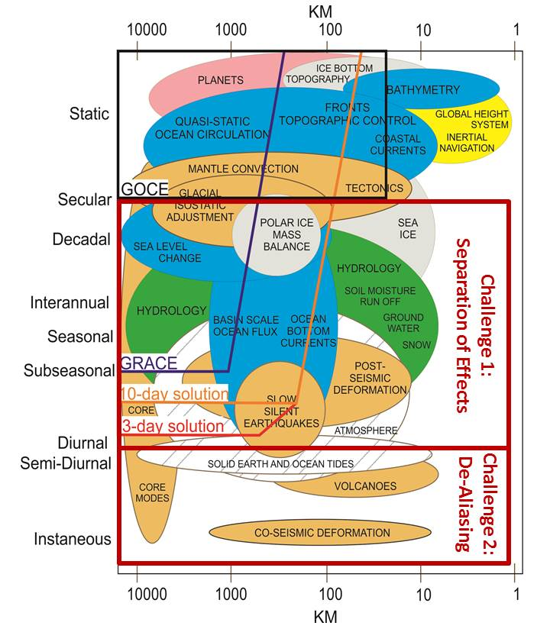
Spatio-temporal observation requirements, challenges and achievable results for future gravity missions
Notes:
De-aliasing and separation of effects: constellation approach required plus enhanced processing methods, e.g. Wiese approach where for example long-wavelength gravity field changes are estimated on a daily basis.

Slide 8
Applications and services

Slide 9
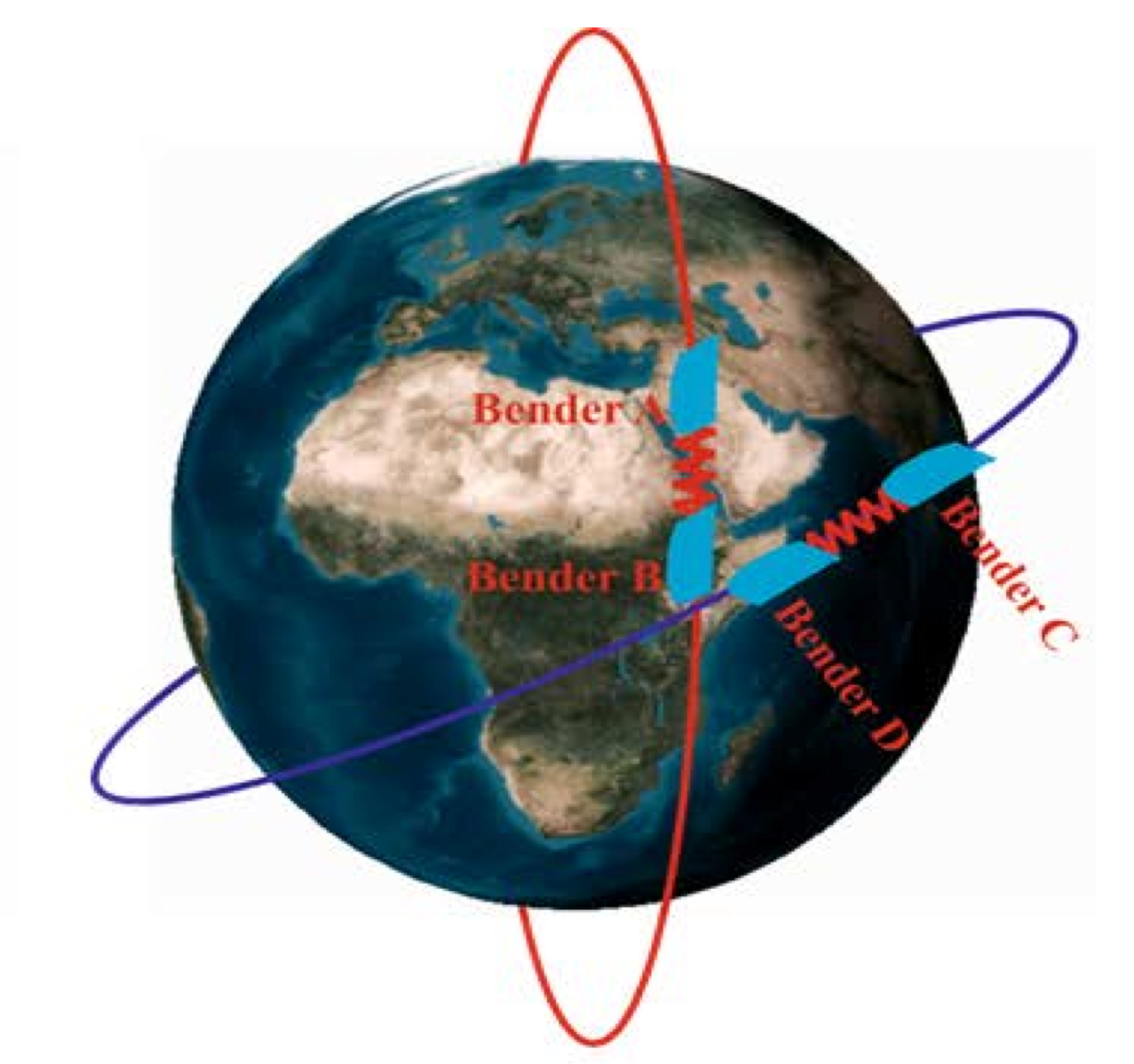
Concepts

Slide 10
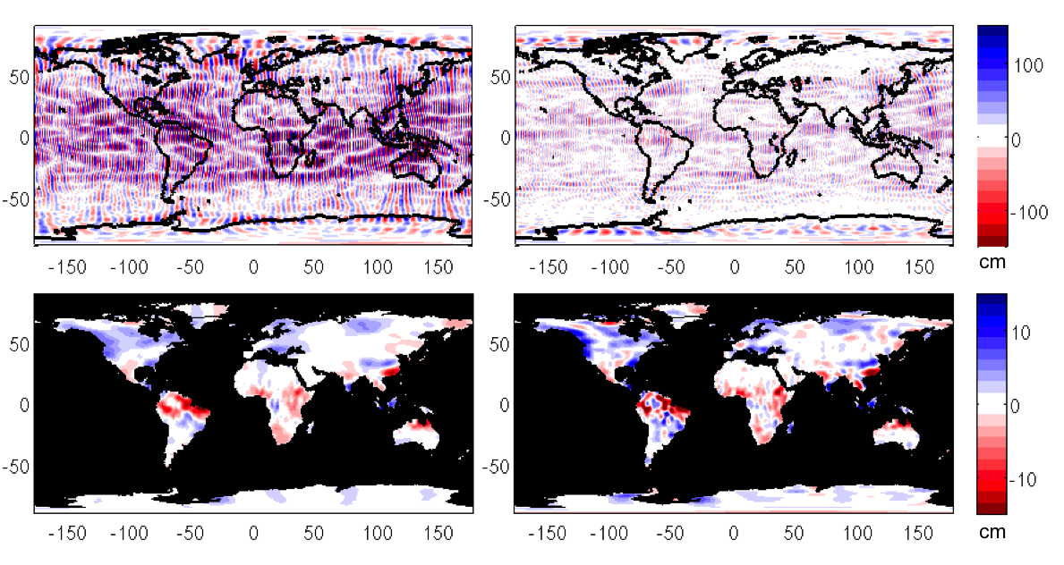
Simulation monthly retrieval
Polar pair
Bender
Before
After
Notes:
Before/After: 200 km post-processing. Note that after post-processing the Bender constellation provides reliable higher spatial resolution products

Slide 11
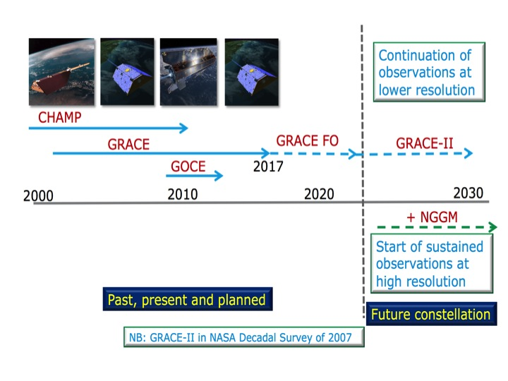
Roadmap - timeline
Notes:
ESA NGGM thus indeed in Phase A!

Slide 12
Roadmap – a model for cooperation
Space agencies, including NASA and ESA, have established models for cooperation → Currently: Joint Mass Change Mission Expert Group (JMCMEG)
Possibilities for sharing knowledge and technology need to be explored and established
Harmonizing ground segments needs to be assessed
Interest by other parties, reflected by e.g. China-ESA meeting in Beijing, 2013
Make use of international forums (e.g. CEOS)
Several gravity workshops have taken place in the past where a global user community was represented
Several IAG and IUGG working groups
Notes:
CEOS: Committee on Earth Observation Satellites (established 1984)

Slide 13
Roadmap – long term (post 2020)
Improved metrology for measuring non-gravitational acceleration, in particular to ensure higher accuracy at low frequencies → Quantum technology (CAI accelerometer)
Improvement of drag-free systems in the appropriate bandwidth
Coordination of ground segments
Improvement of geophysical models and modeling

Slide 14
Conclusions
Observation of mass transport:
Unique contributions to ECVs
Crucial for understanding global change and its impact on society
Full set of user requirements in (accuracy, spatial and temporal) can only be met by constellations
Constellation feasible around the 2025 time frame if NASA, ESA and the user community continue to team up and closely coordinate the realization of the GRACE-II (MCDO) and NGGM missions
Framework has recently been established:
Scientific user community (IUGG, IAG, GGOS, IGSWG)
Interaction with and between space agencies (NASA and ESA)

