Slide 1



³He-rich Solar Energetic Particle Events Observed on Solar Orbiter
George C. Ho¹, Glenn M. Mason¹, Robert C. Allen¹, Robert Wimmer-Schweingruber², Javier Rodríguez-Pacheco³, and the EPD team
¹The Johns Hopkins University Applied Physics Laboratory
²Christian-Albrechts University Kiel, Germany
³University of Alcalá, Spain

Slide 2
Outline
Solar Orbiter (SO) Mission
Energetic Particle Detector (EPD) Suite on SO
Selected topics that have been published by SO/EPD:
  Impulsive ³He-rich SEP
  Quiet time observations
  Helium energy spectra
Summary
EPD data products

Slide 3
Solar Orbiter
A joint ESA-NASA mission launched in February 2020
The spacecraft will take a unique combination of measurements: in situ measurements will be used alongside remote sensing close to the Sun to relate these measurements back to their source regions and structures on the Sun's surface.
Solar Orbiter will set about answering four top-level science questions:
  What drives the solar wind and where does the coronal magnetic field originate from?
  How do solar transients drive heliospheric variability?
  How do solar eruptions produce energetic particle radiation that fills the heliosphere?
  How does the solar dynamo work and drive connections between the Sun and the heliosphere?

Slide 4
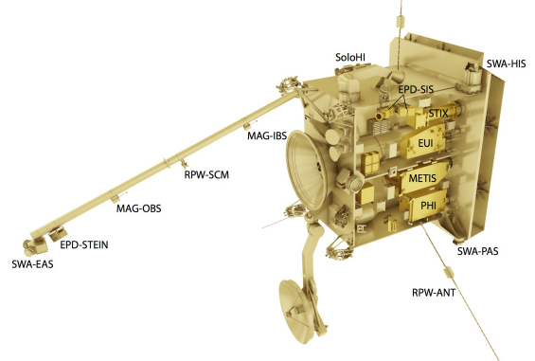
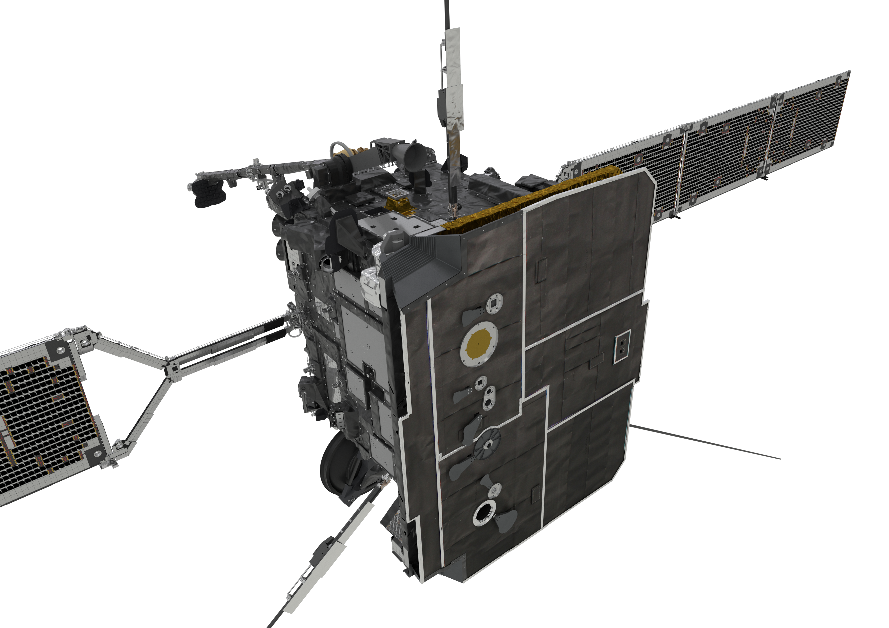
Solar Orbiter Spacecraft
10 instrument suite: 4 in-situ; 6 remote
Müller et al., Solar Phys., 2013

Slide 5
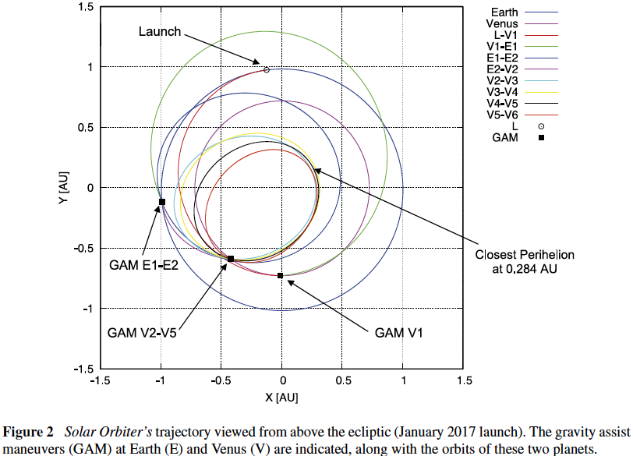
Mission Design
Solar Orbiter is a mission of international cooperation between ESA and NASA, operated by ESA
First perihelion is reached 1.5 years after launch
Operating orbit has a 168 days period
Minimum perihelion at 0.28 au
7 years nominal mission at 25º inclination
Müller et al., Solar Phys., 2013

Slide 6
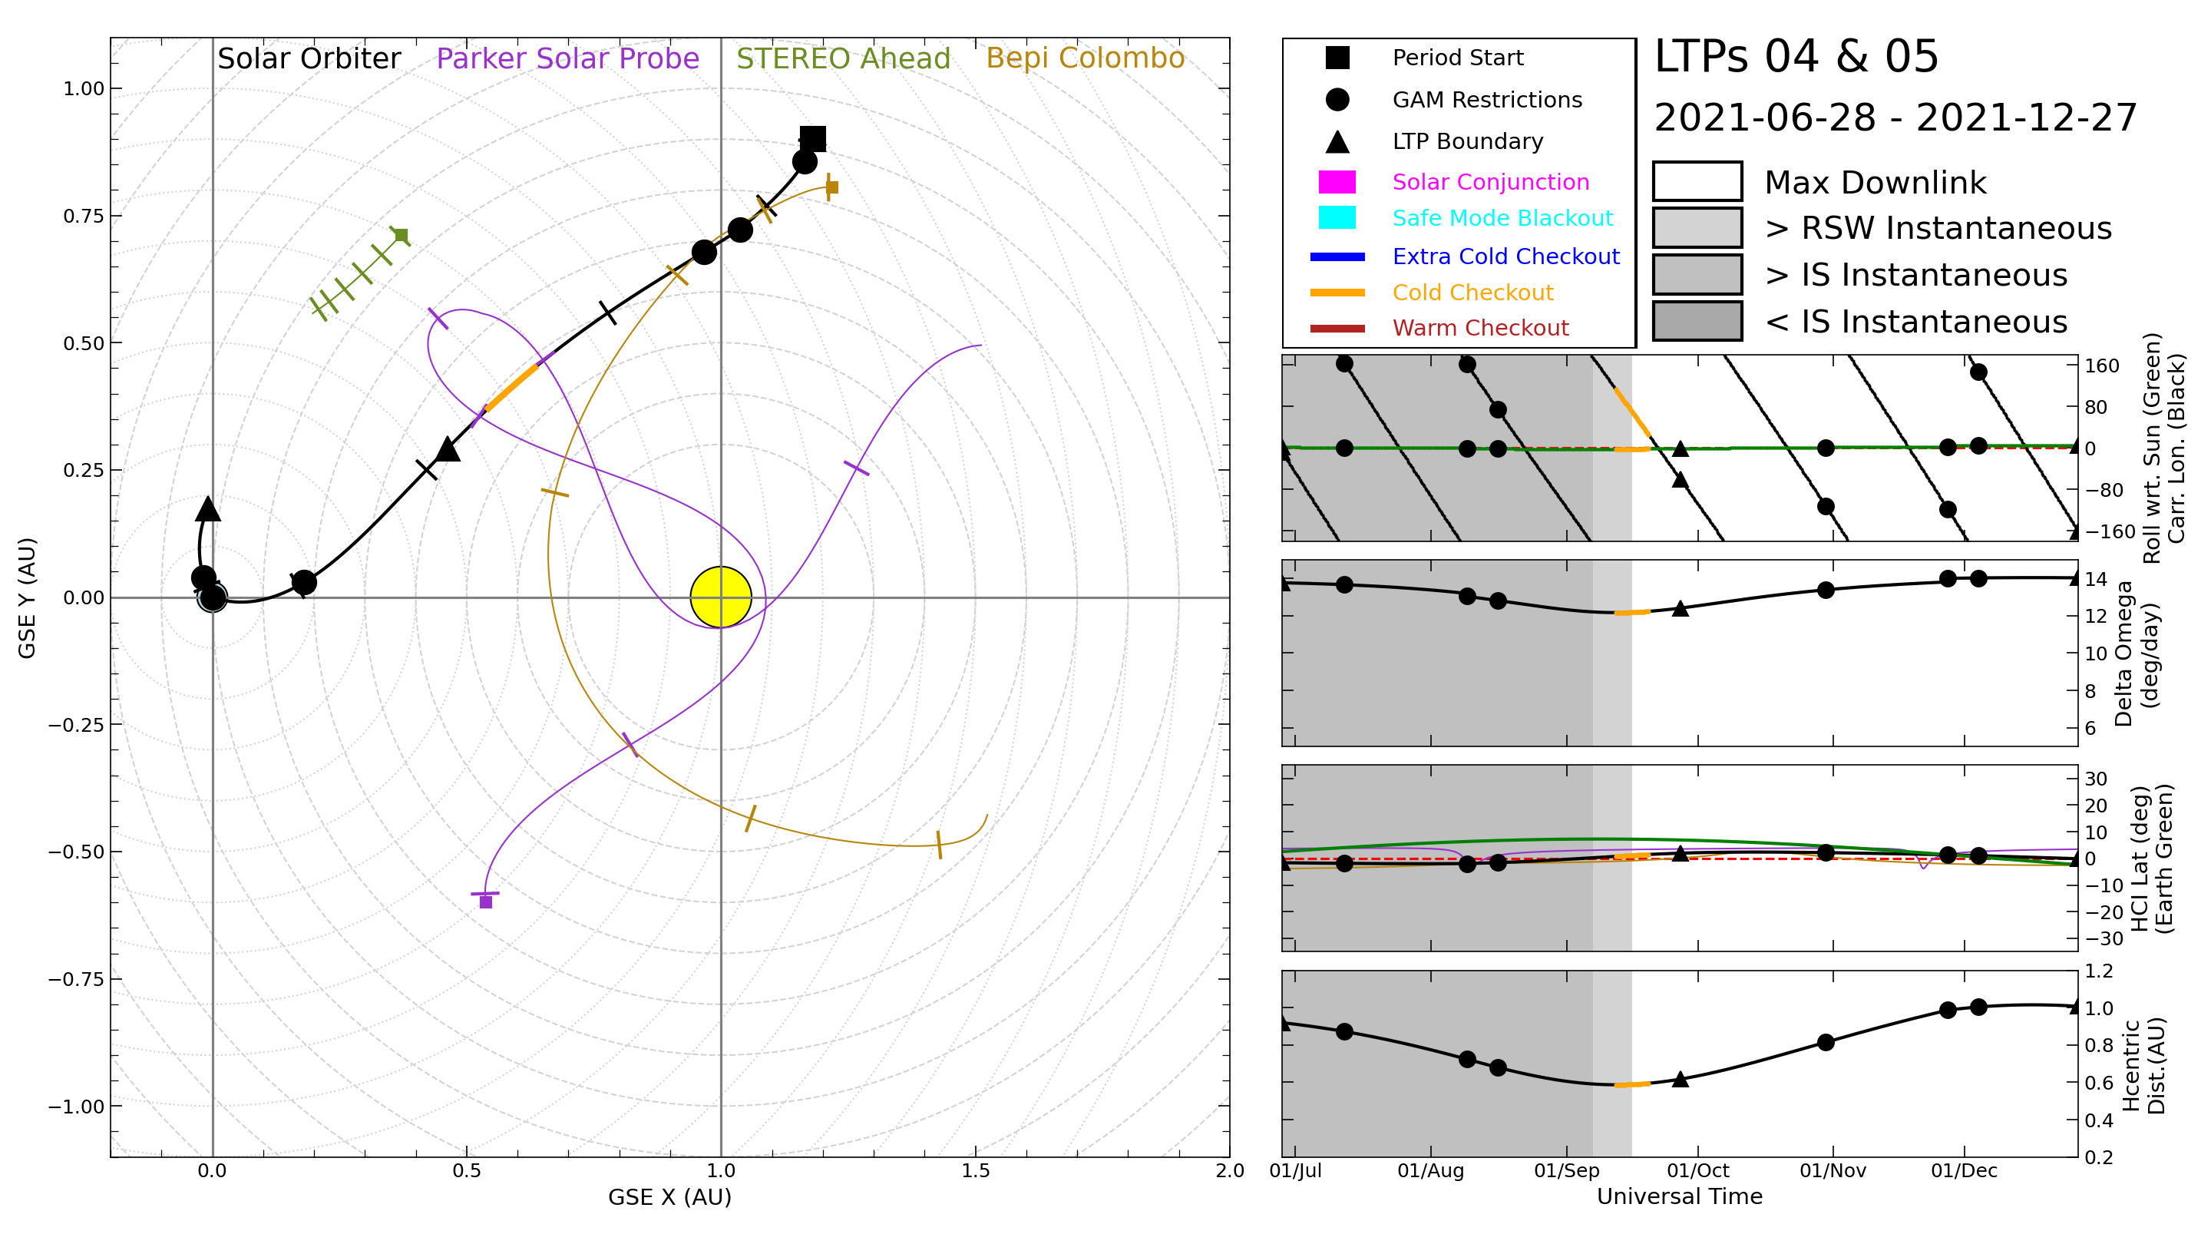
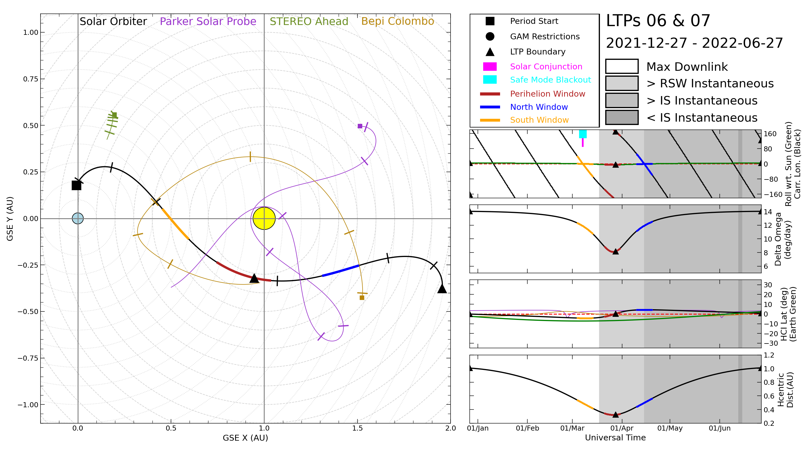
Where is Solar Orbiter

Slide 7
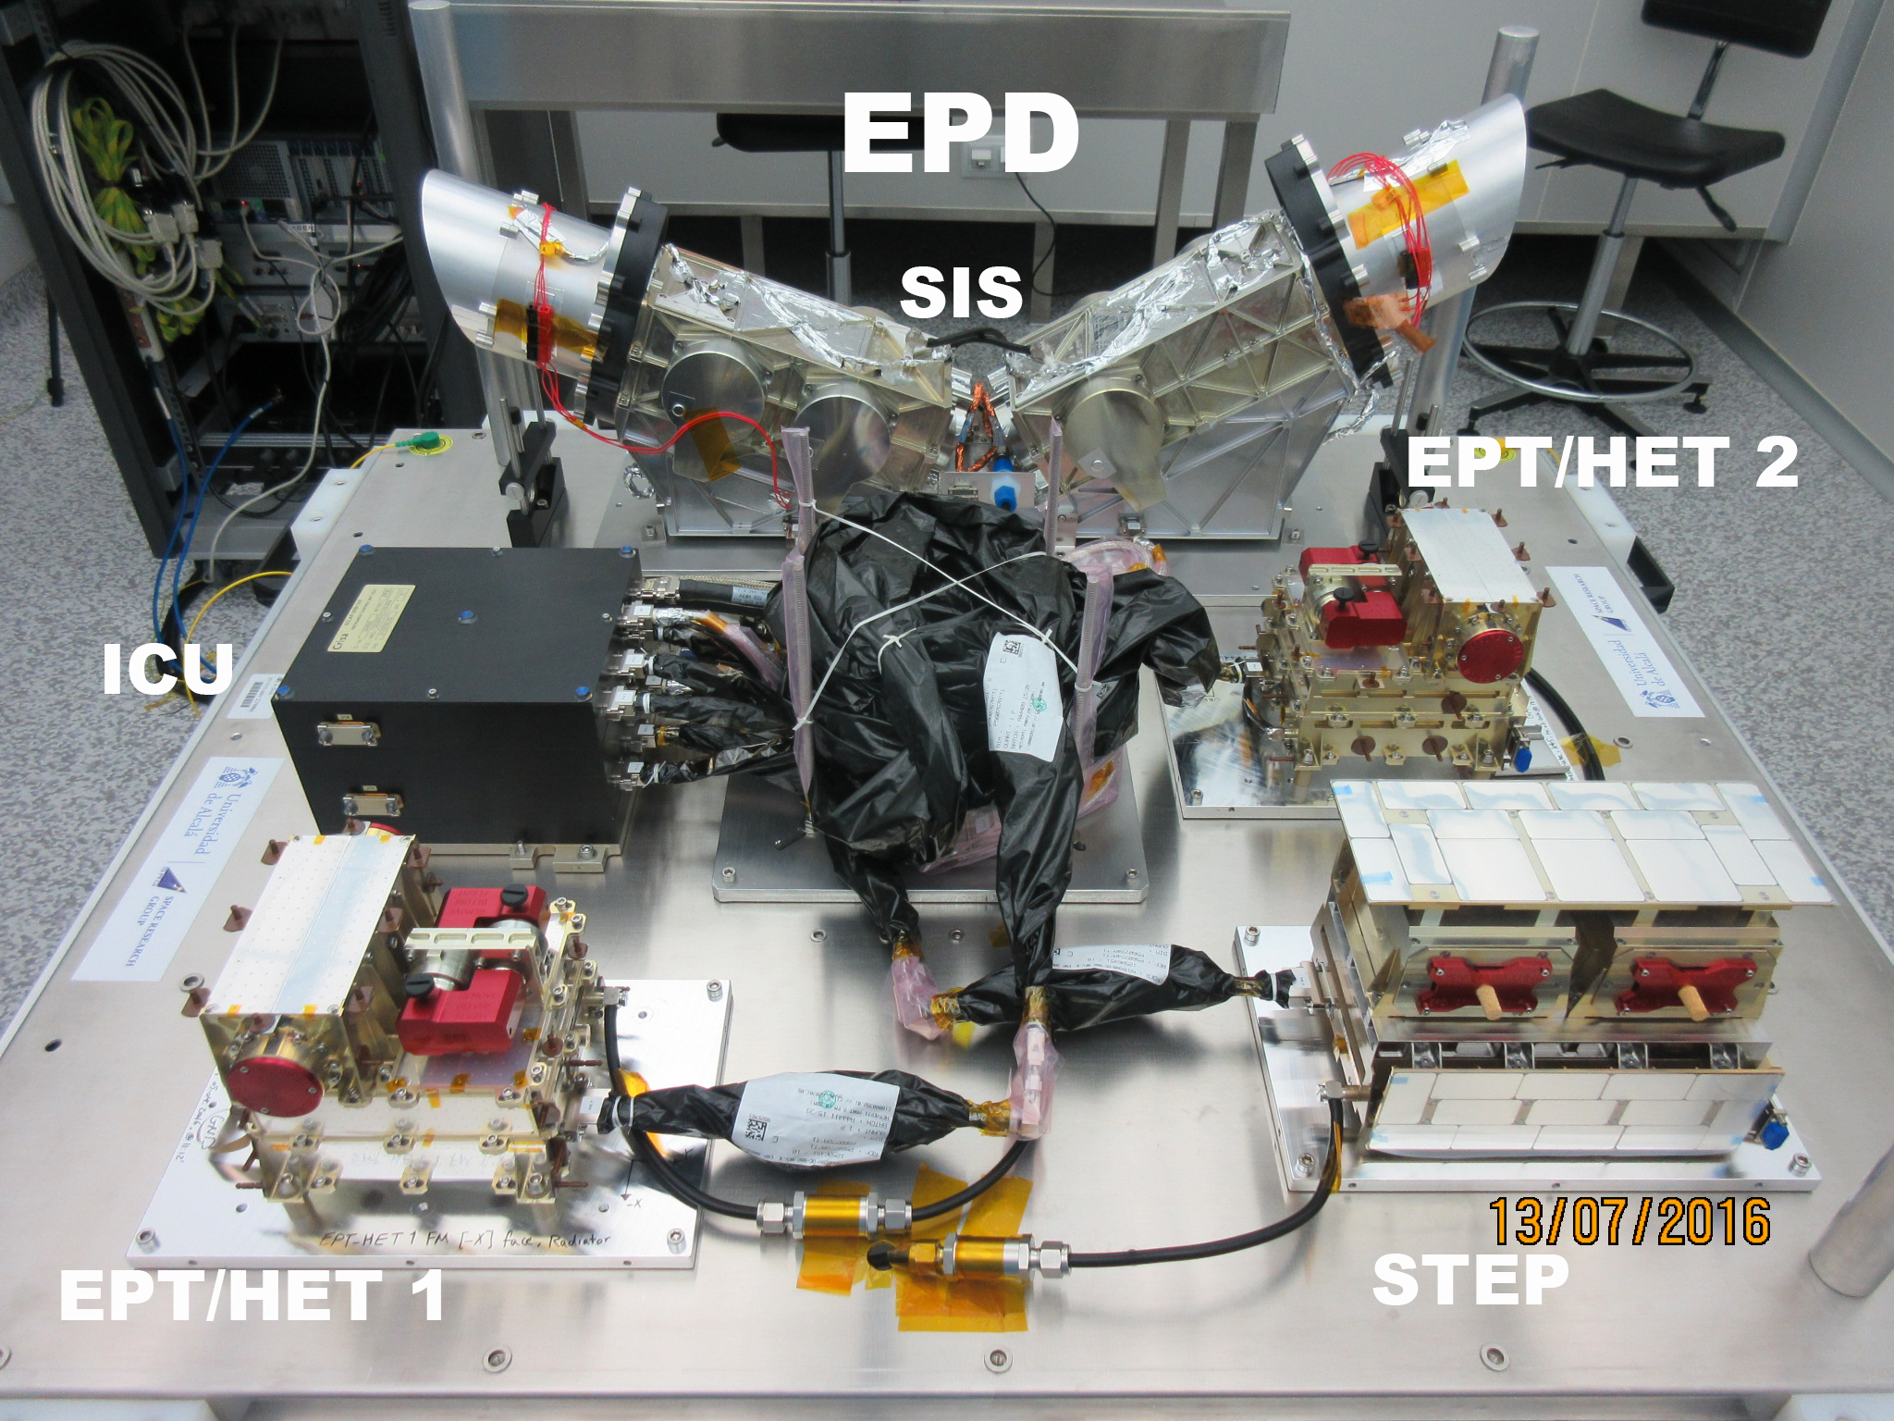
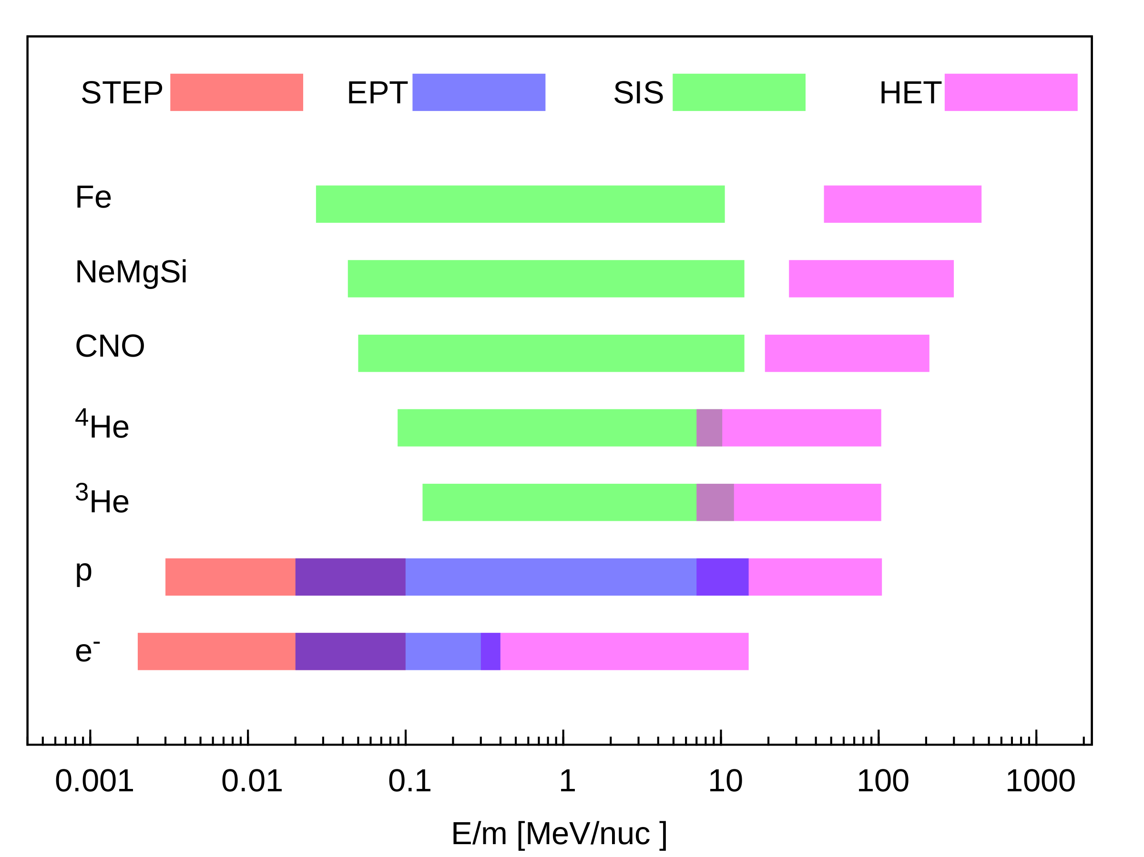
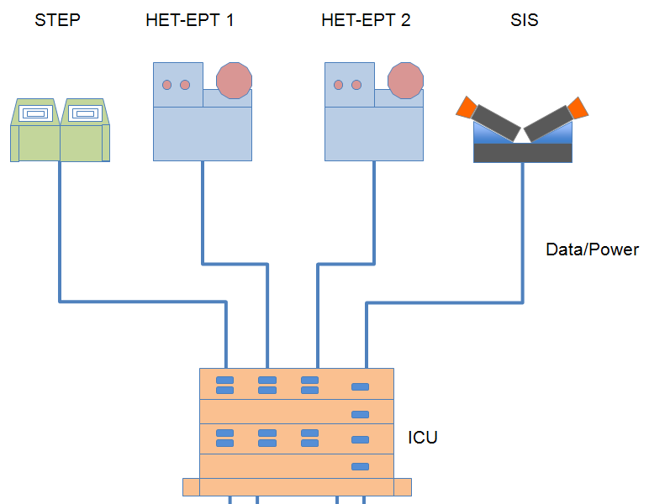
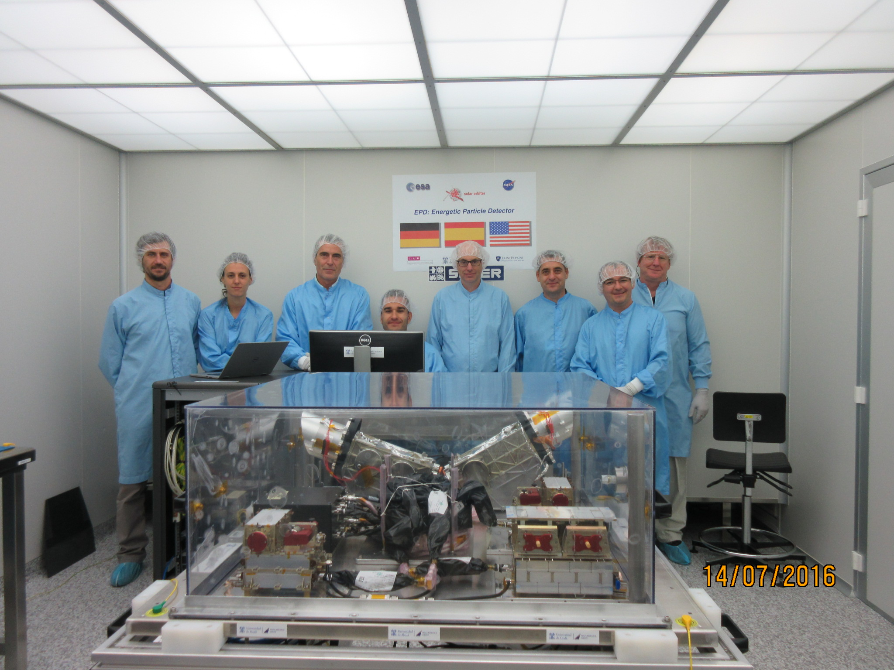
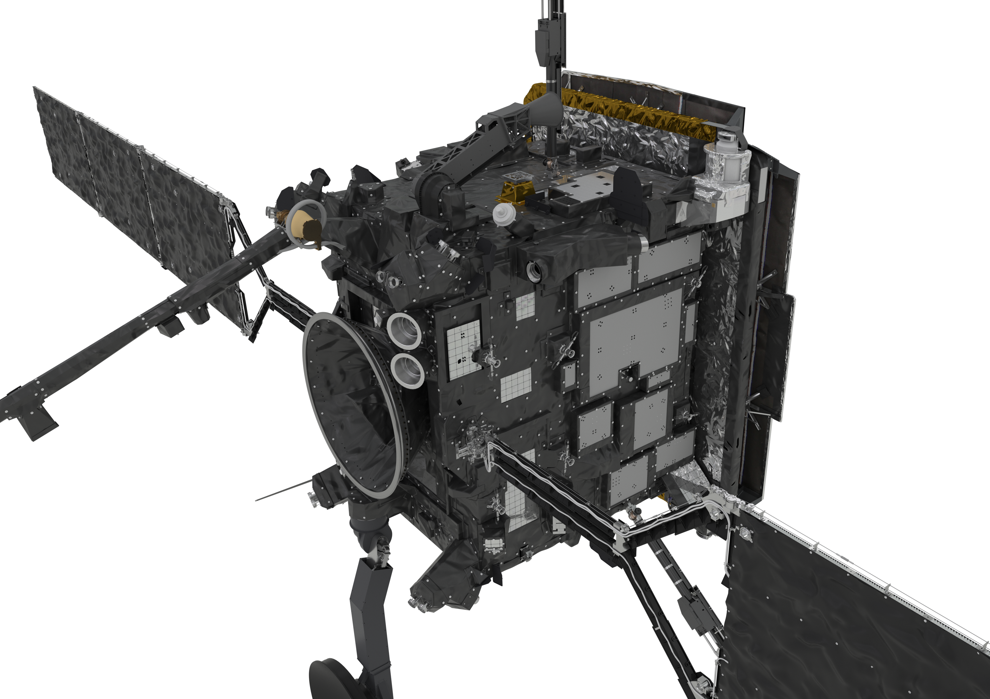
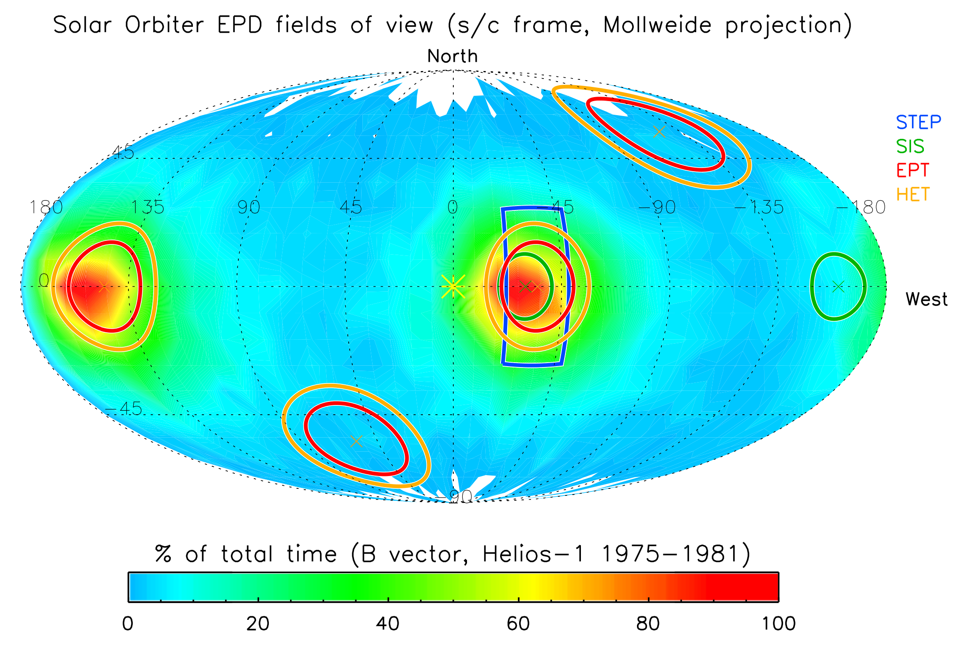
EPD is a suite of four sensors that measures suprathermal to high-energy particles:
STEP (Suprathermal Electrons and Proton)
EPT (Electron-Proton Telescope)
SIS (Suprathermal Ion Spectrograph)
HET (High-Energy Telescope)
SIS
EPT/HET
SIS
STEP
EPT/HET1

Slide 8


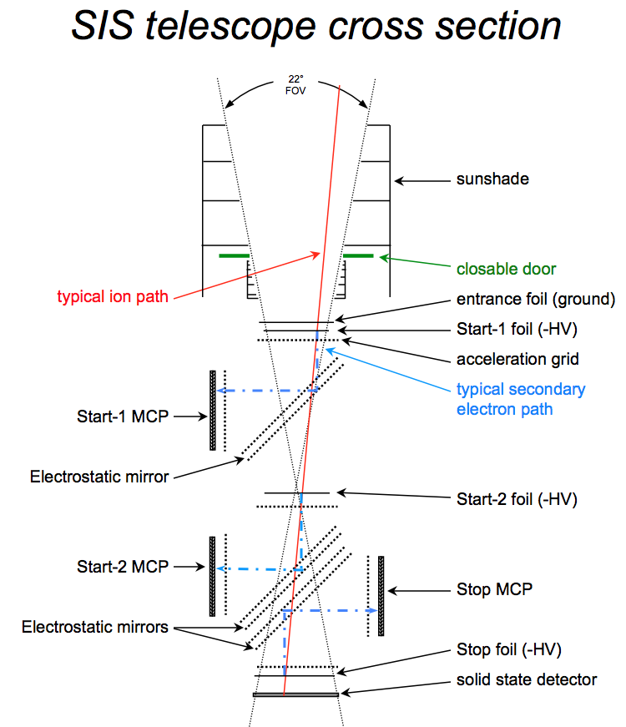
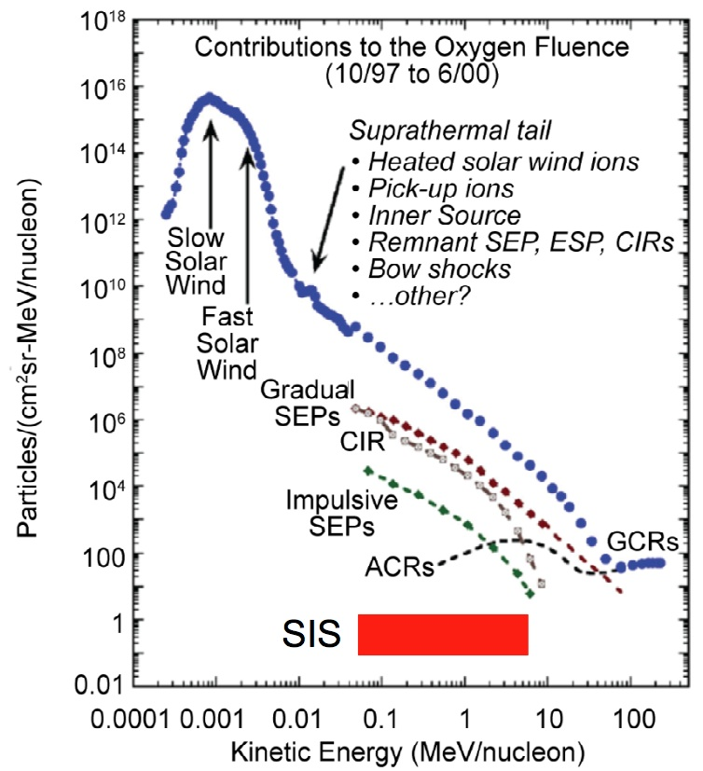
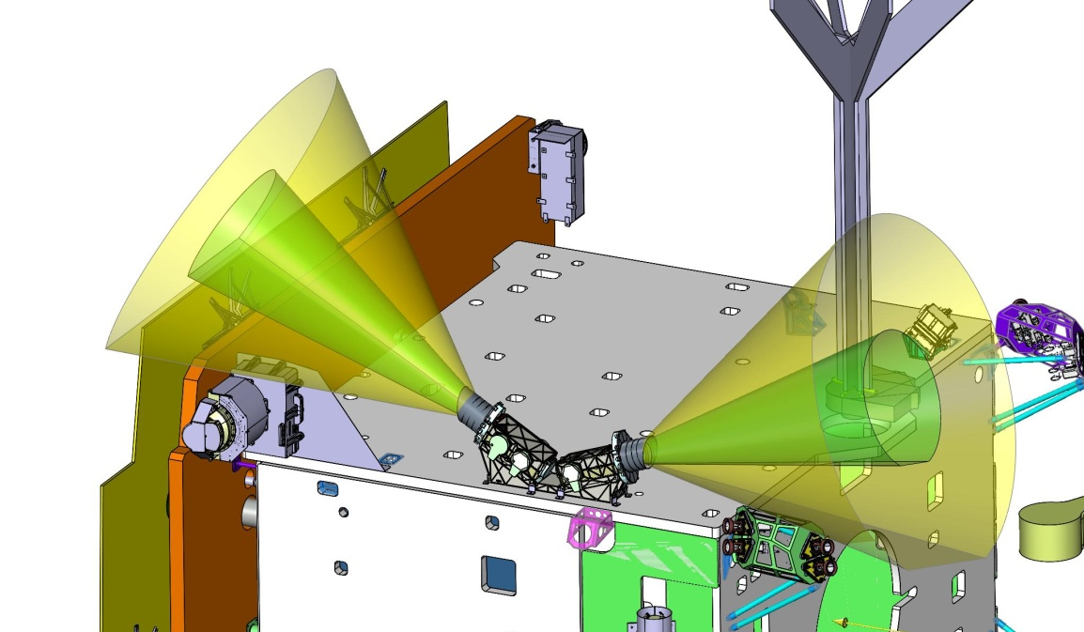
Suprathermal Ion Spectrograph
SIS is a Time-of-Flight by Energy high-resolution ion mass spectrometer
Two identical telescopes measure the ion mass and energy
Same measurement technique as was used on ACE/ULEIS
Rodríguez-Pacheco et al., A&A, 2020
8
8/45
Notes:
8

Slide 9
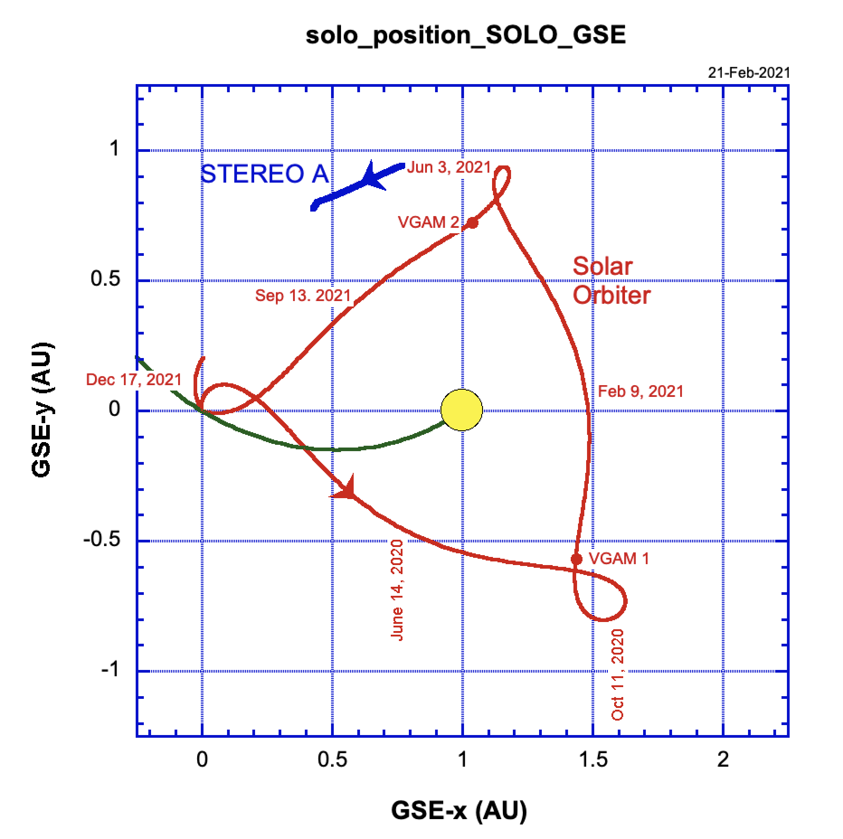
Solar Orbiter/Energetic Particle Activity
Allen et al., 2020

Slide 10
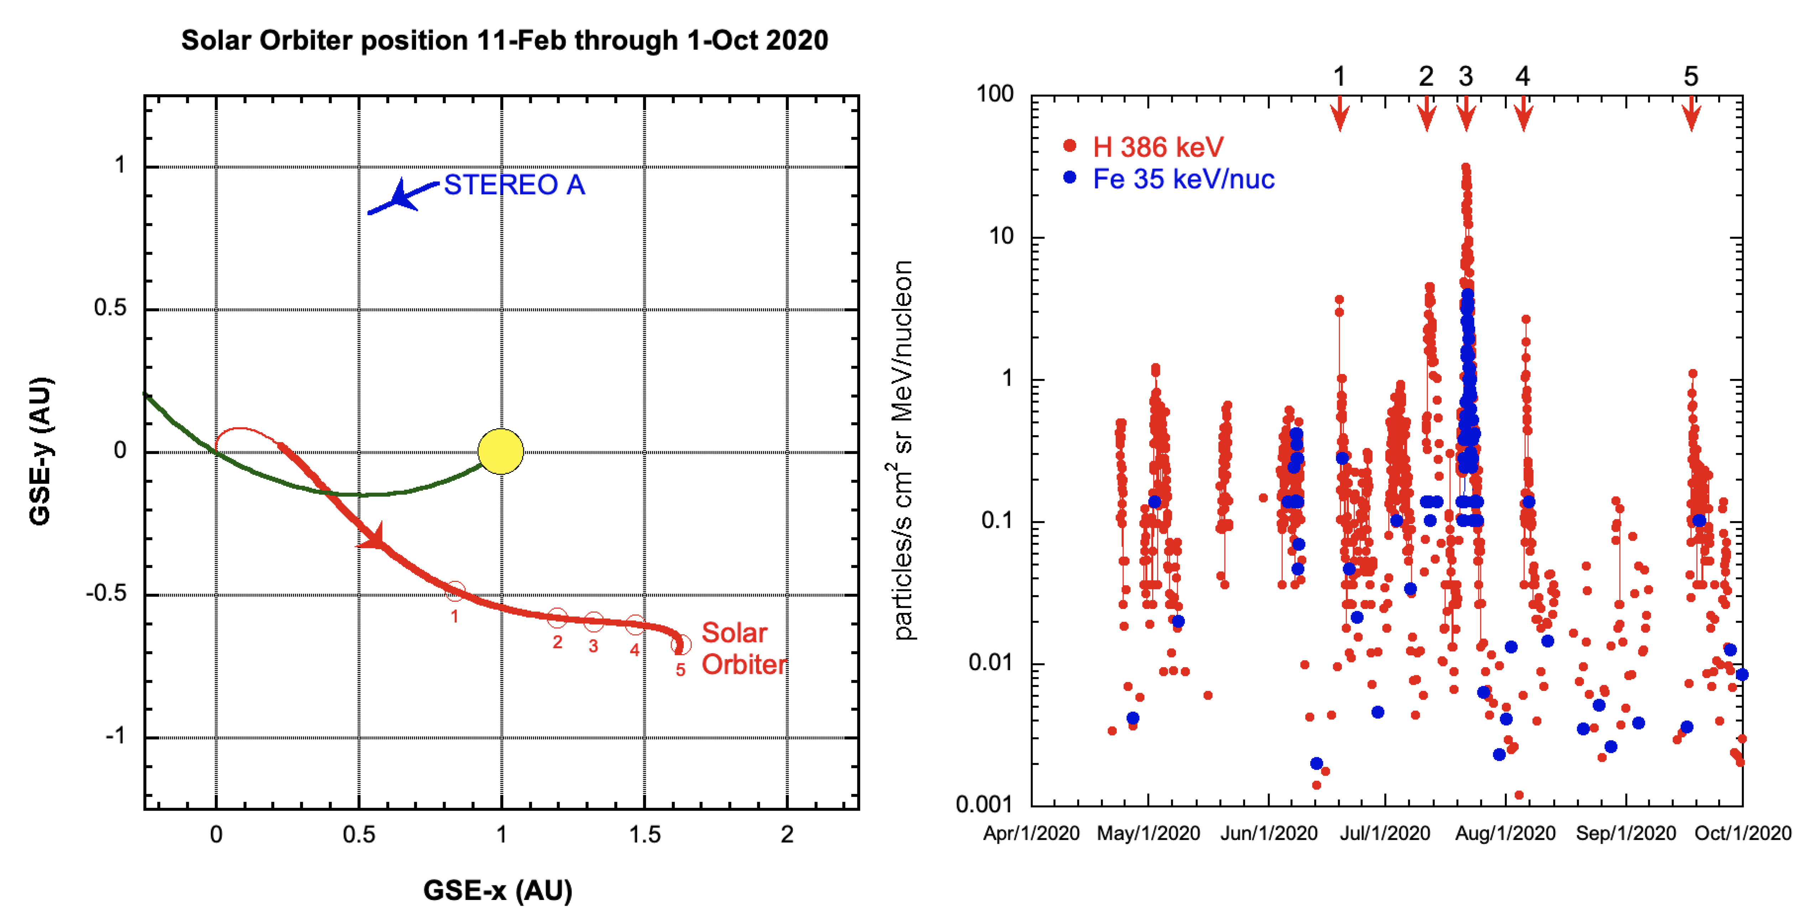
Solar Orbiter EPD/SIS First light Observations
Mason et al., A&A, 2020

Slide 11
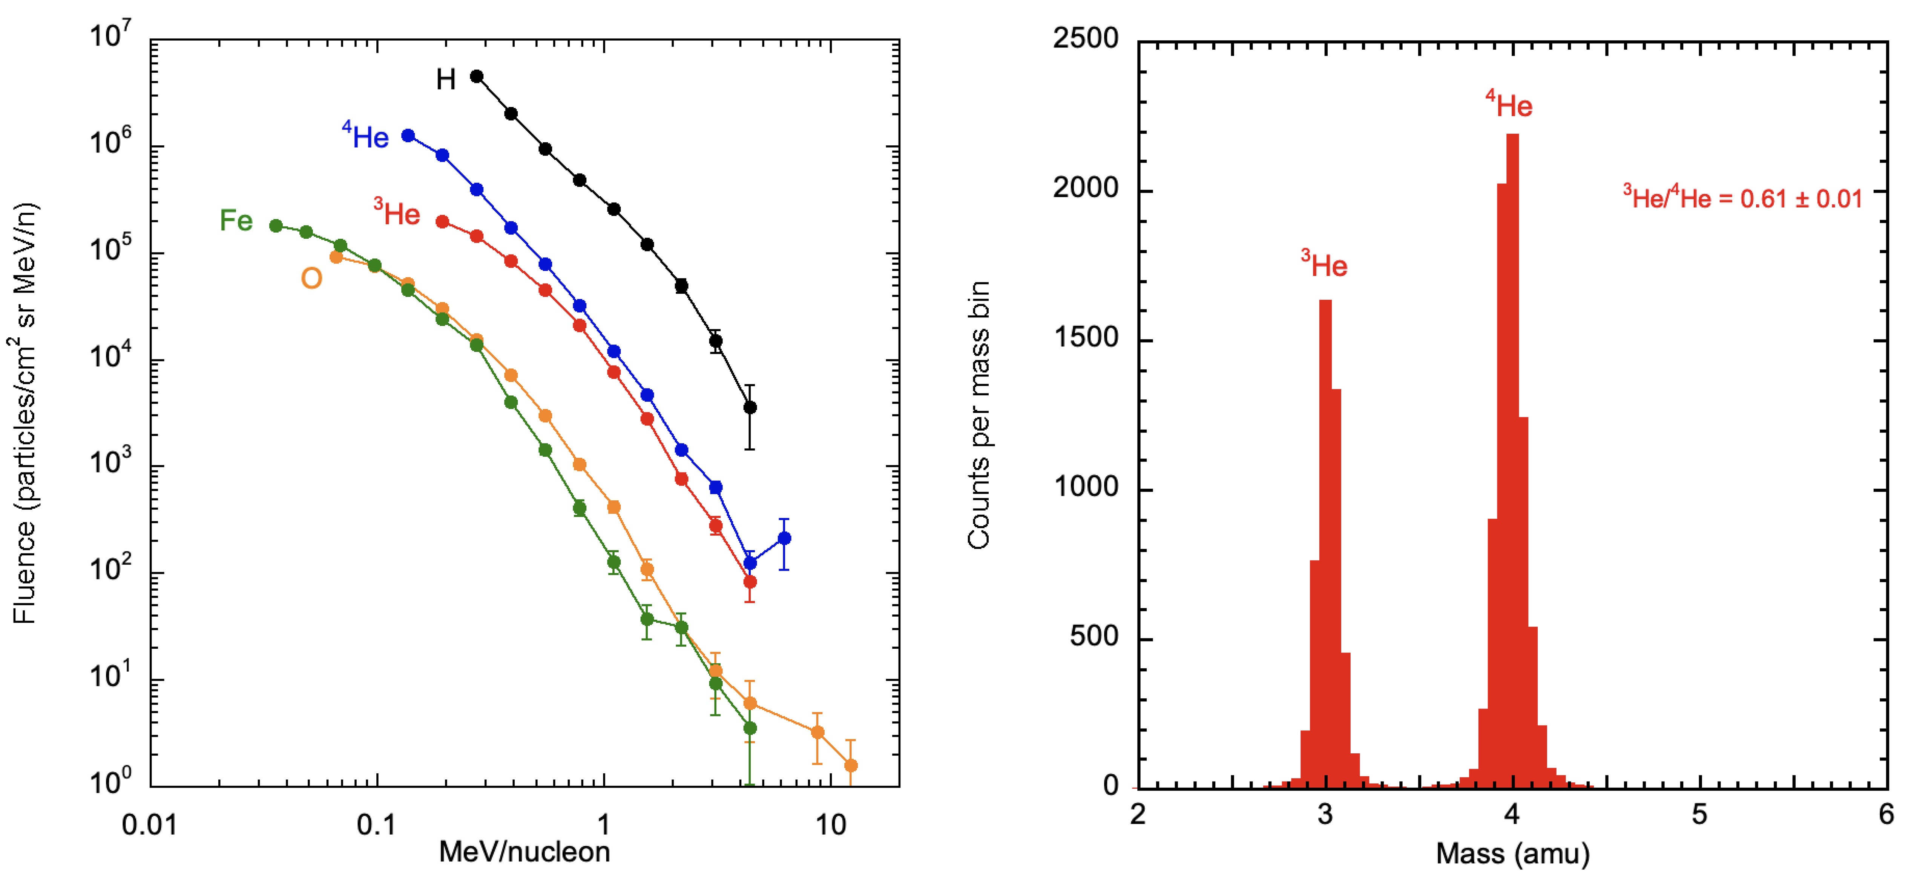
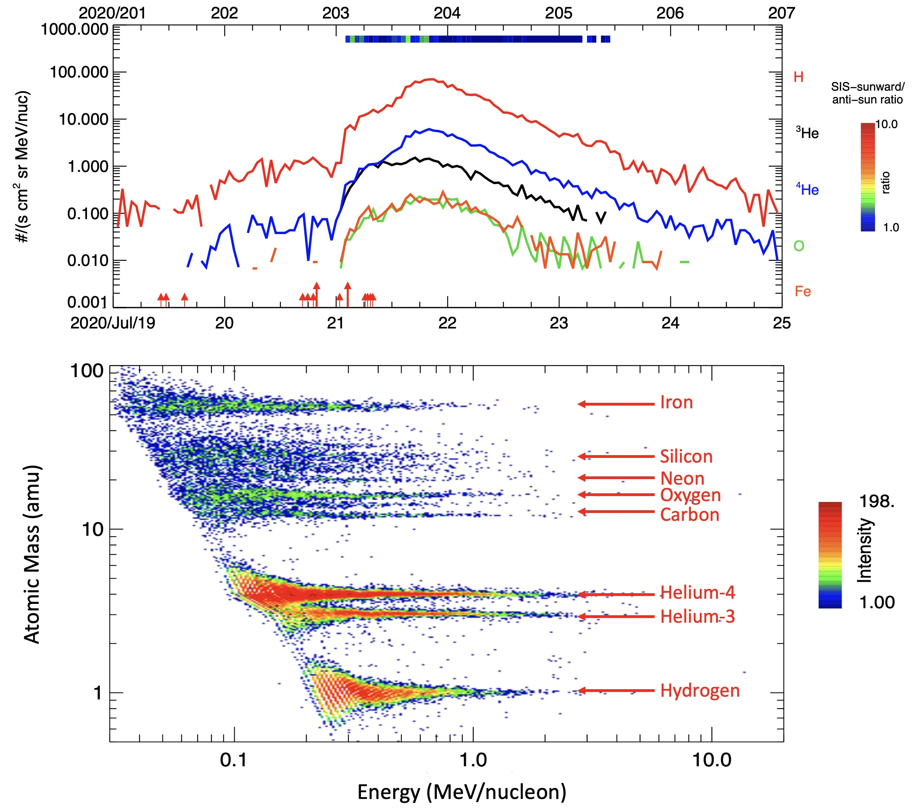
July 21, 2020
Mason et al., A&A, 2020

Slide 12
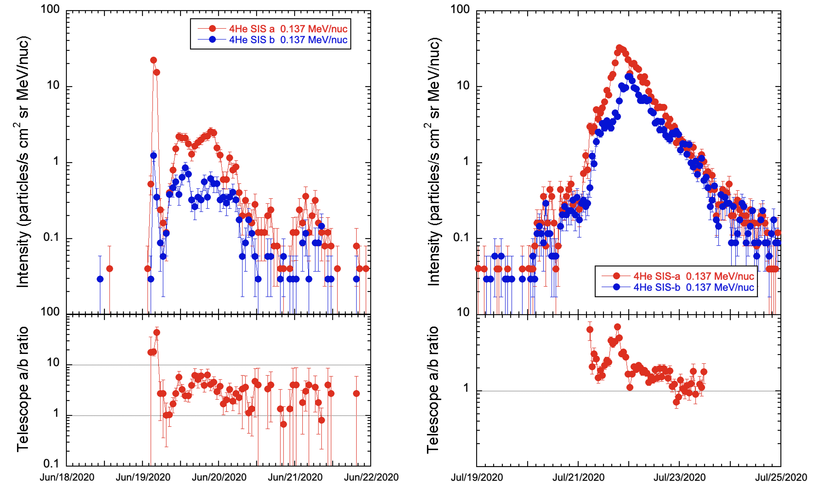
SEP Anisotropy
Mason et al., A&A, 2020

Slide 13
November, 2020
Bucik et al., A&A, 2021

Slide 14
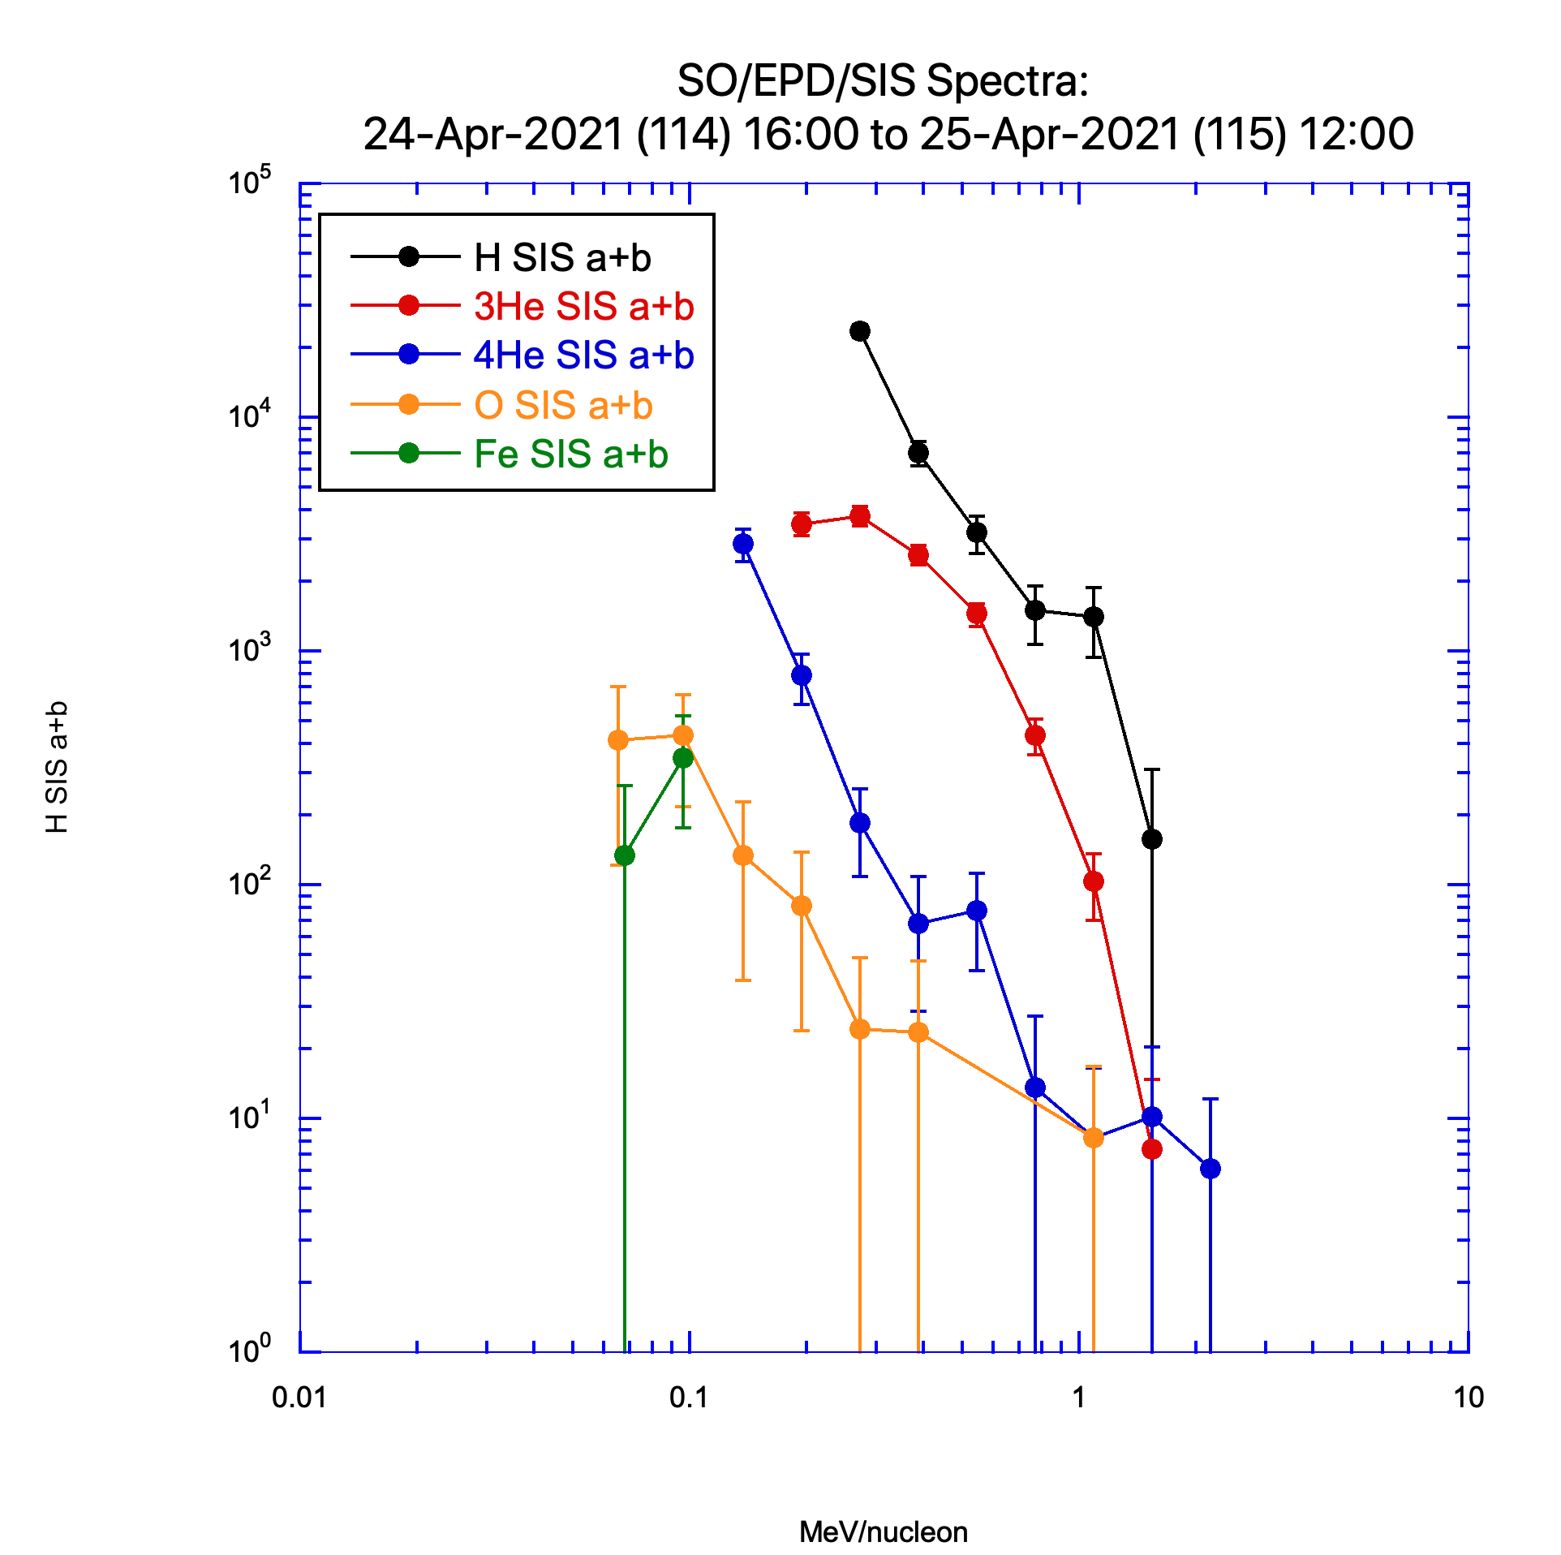
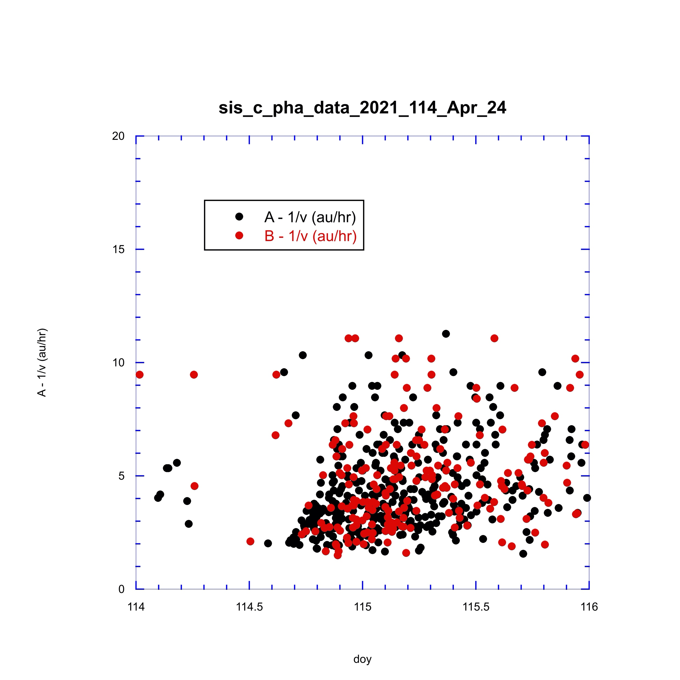
Note impulsive
injection starting
around
Apr 24 13:00

Slide 15
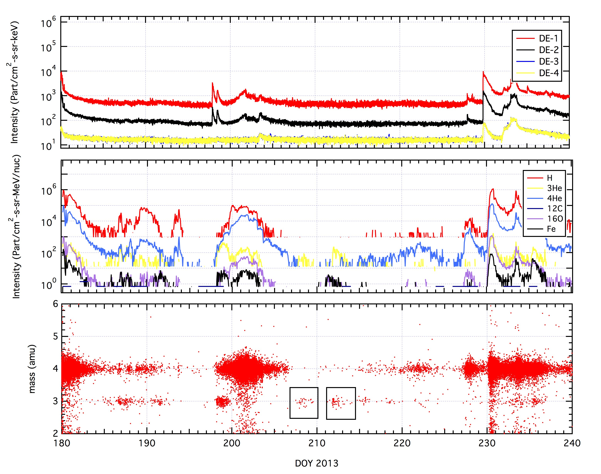
2013 July - August
Ho et al., Solar Phys., 2019

Slide 16
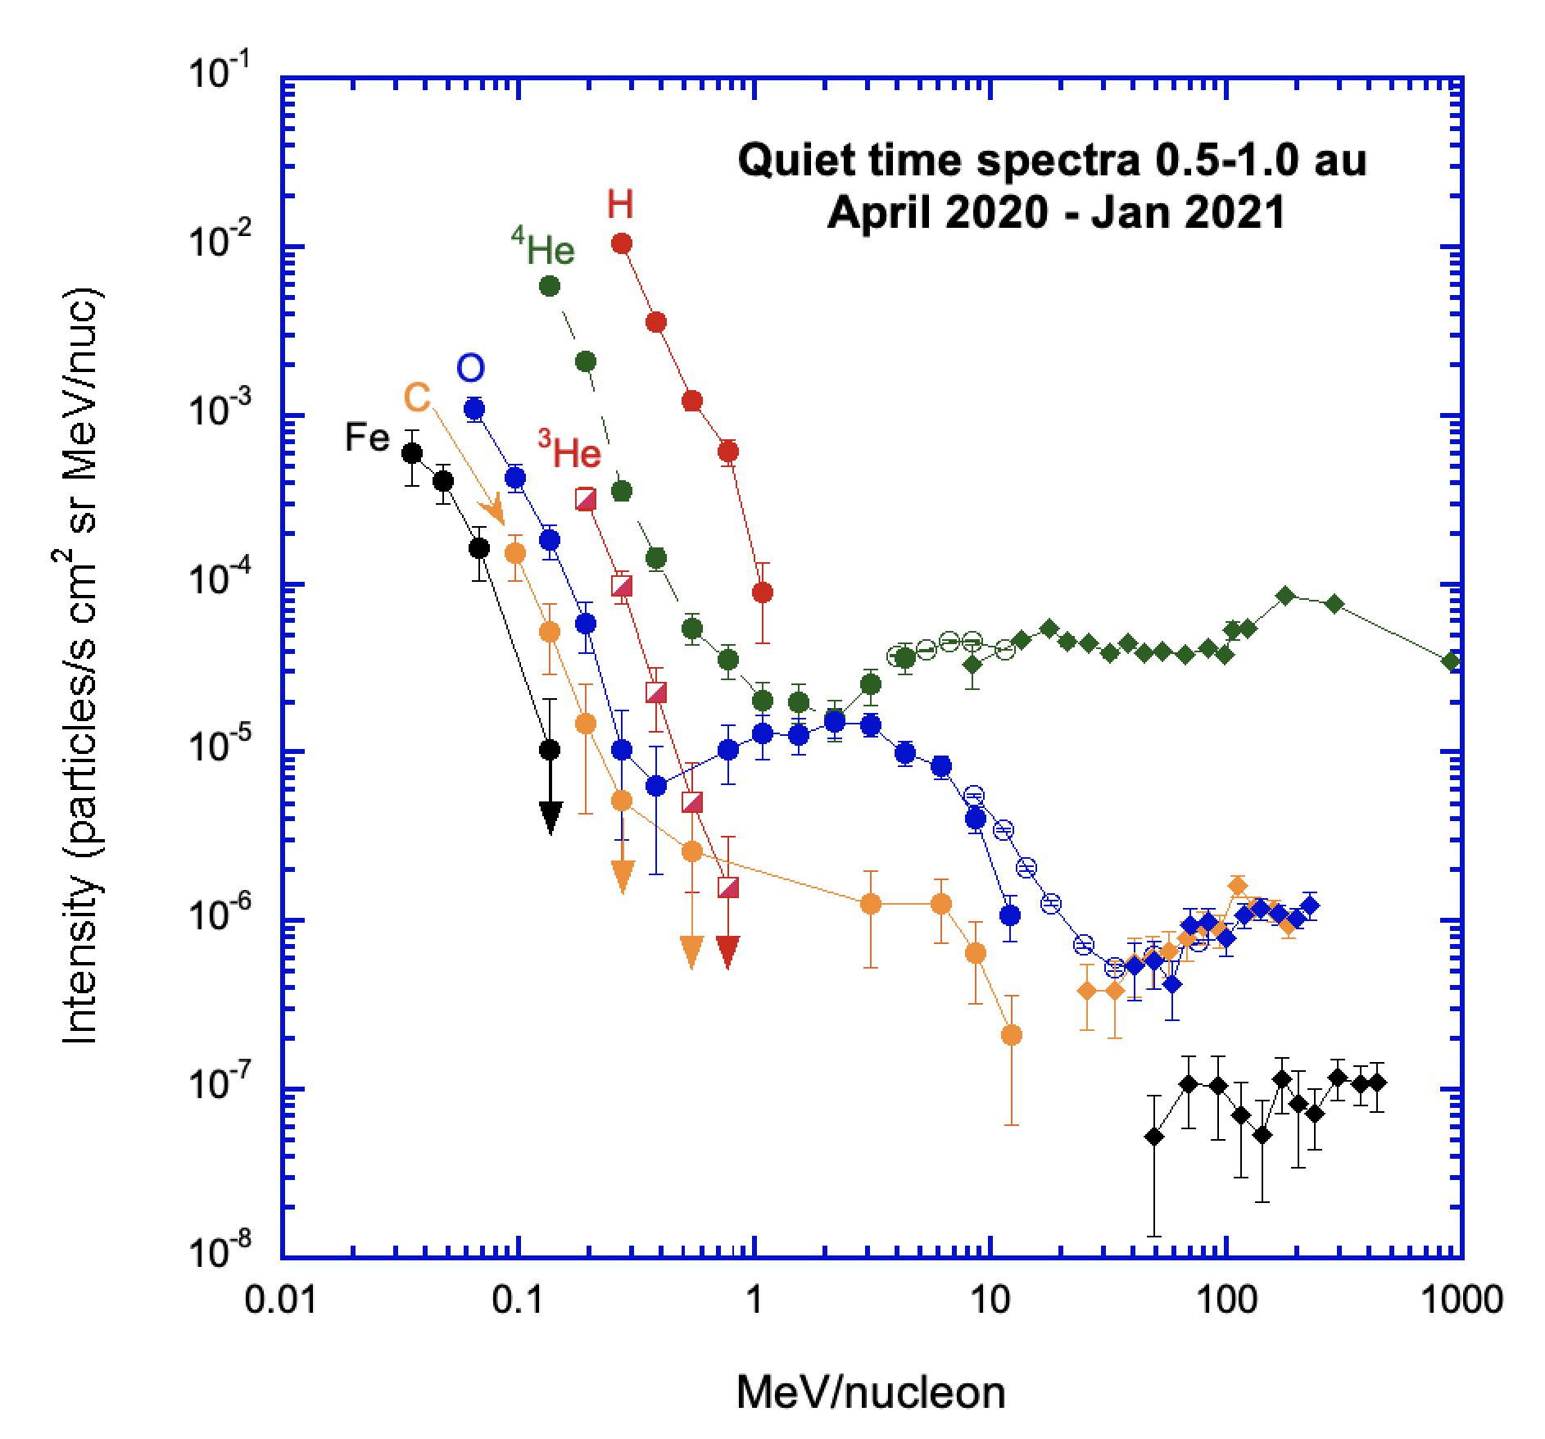
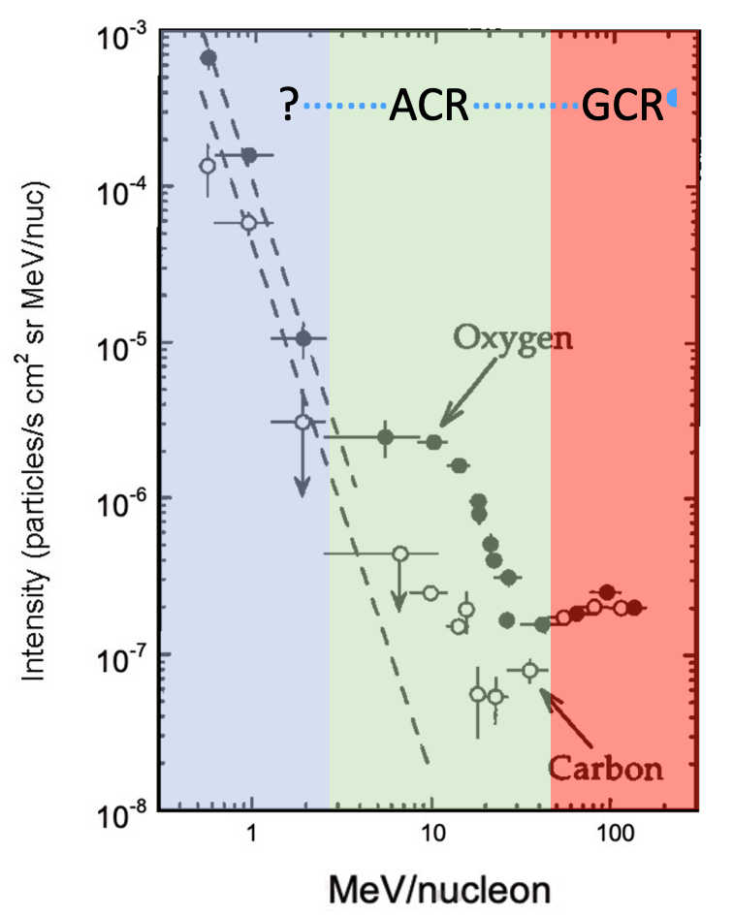
Quiet-time Spectra
GCR O spectrum rises ~30 MeV/nuc
ACR O peak ~ 4 MeV/nuc
  4x more than earlier plot
ACR O transitions to turn-up at 300 keV/nuc
  10x lower E than 92-93
Measurable ³He intensities
Mason et al., A&A, 2021

Slide 17
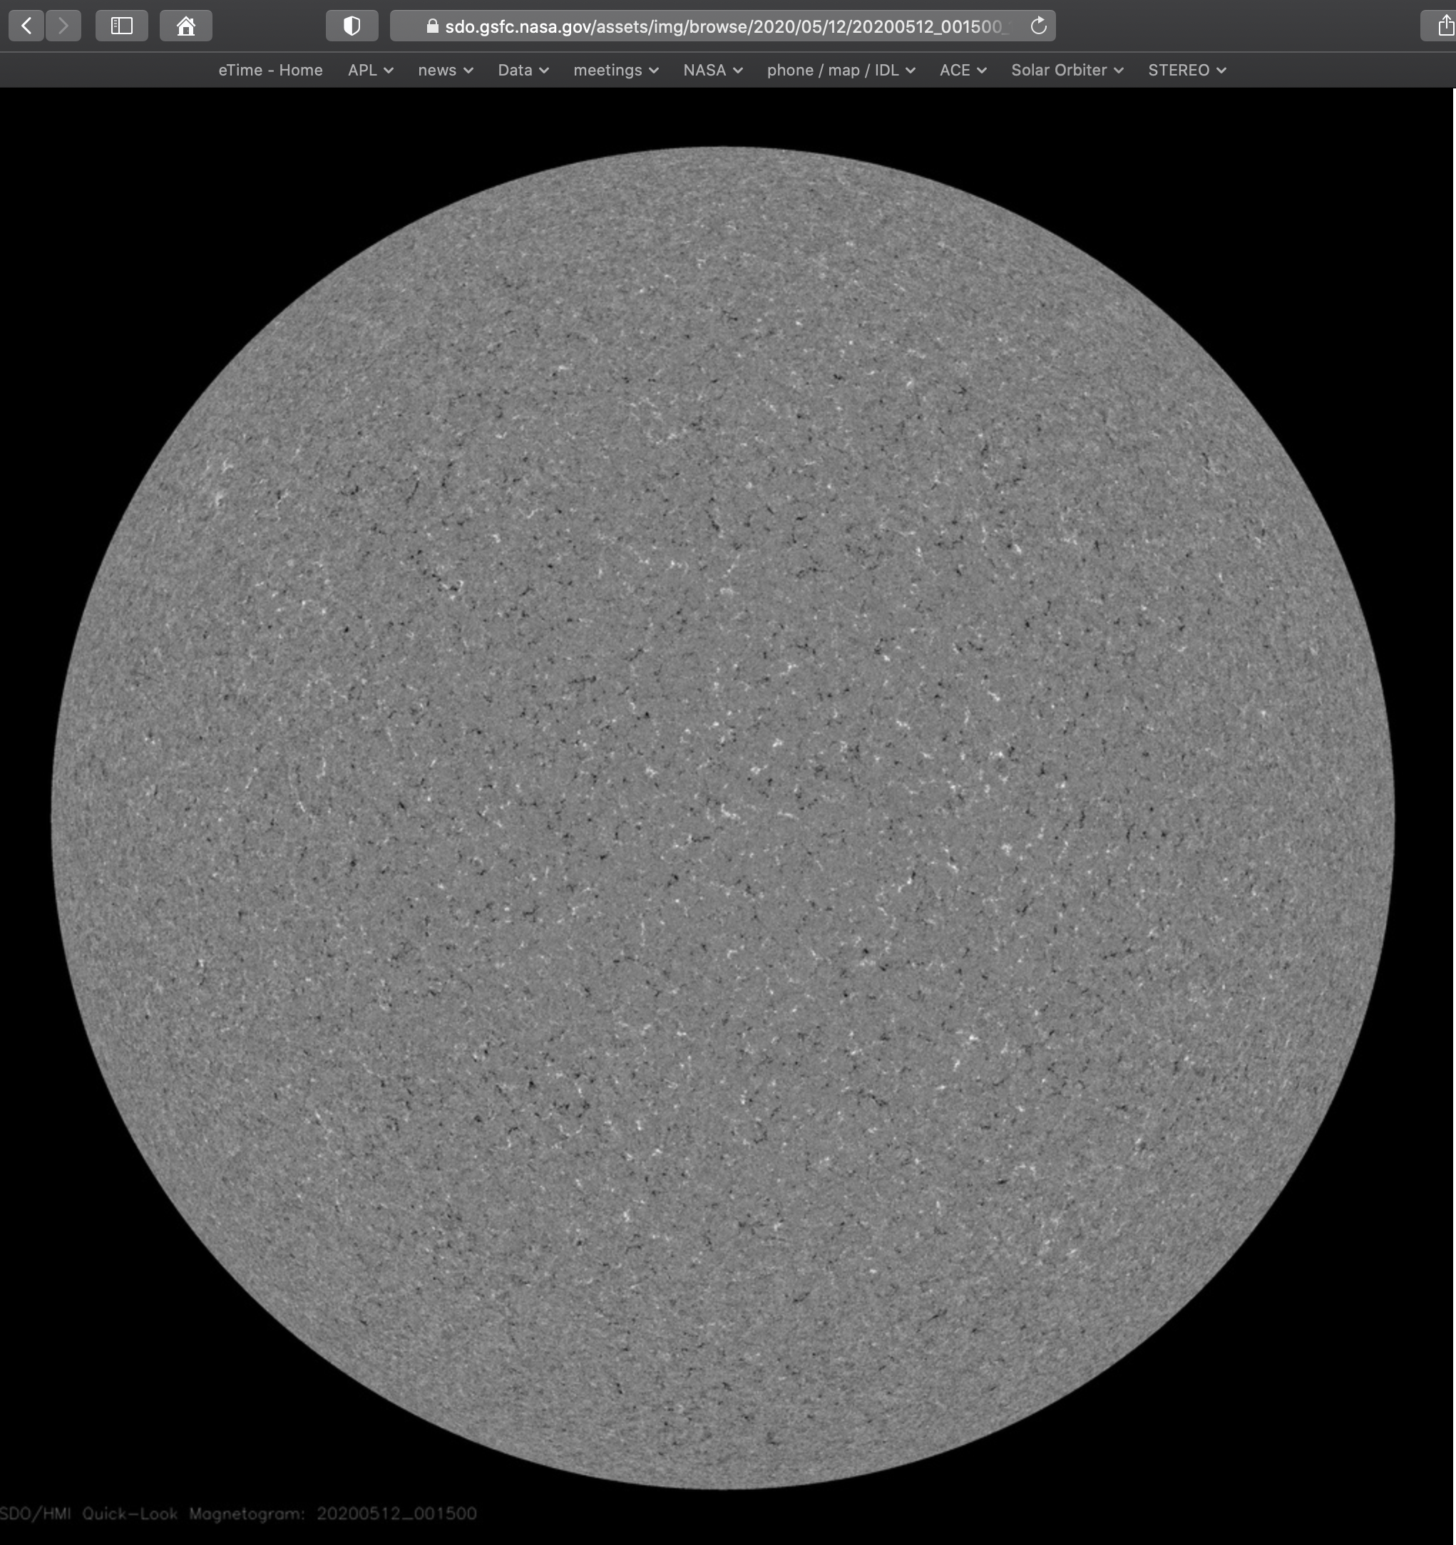
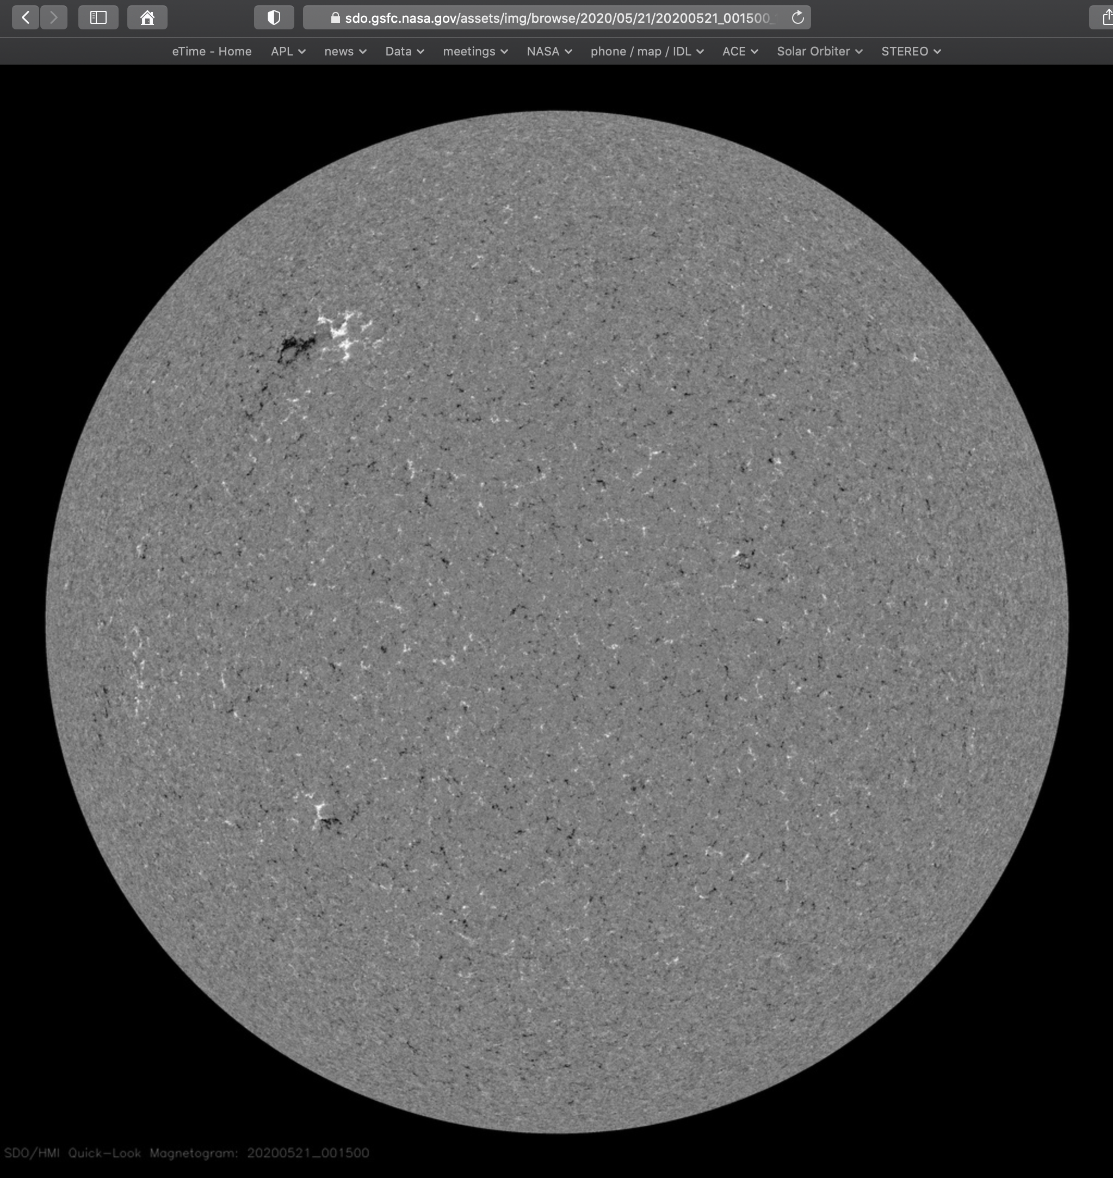
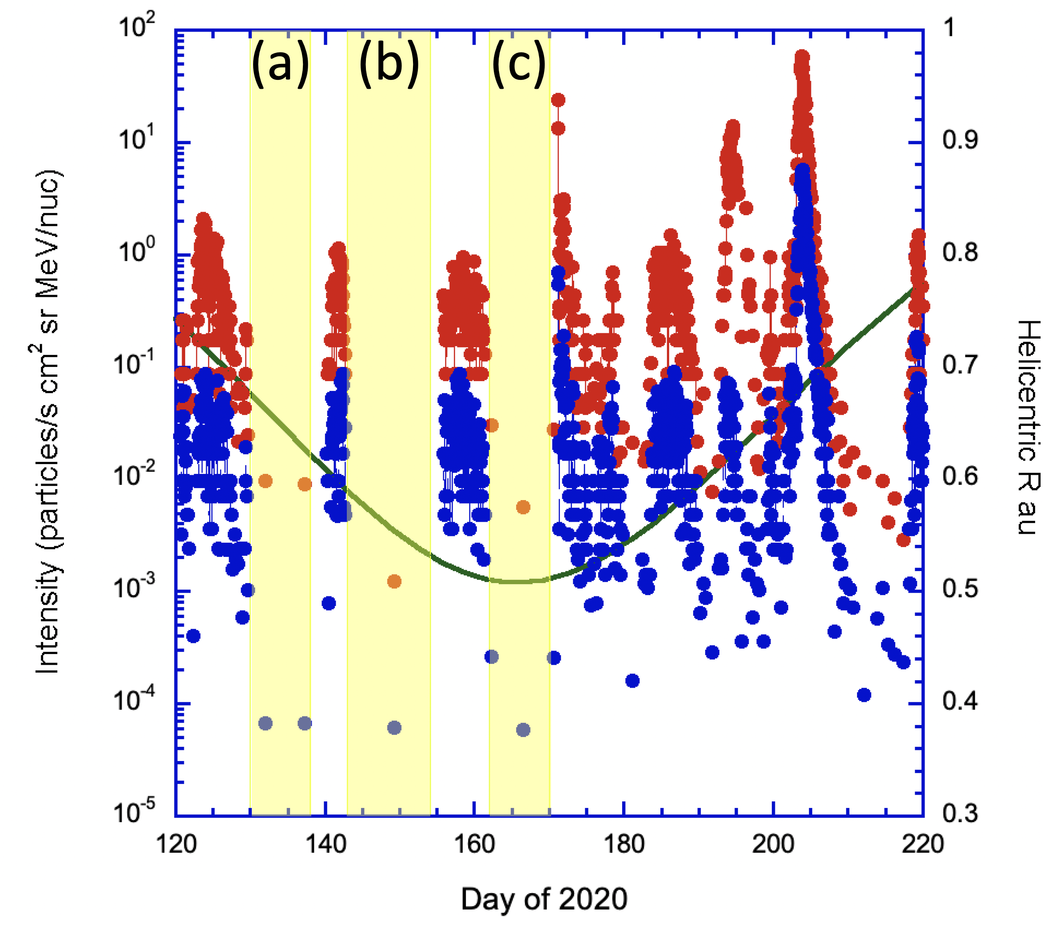
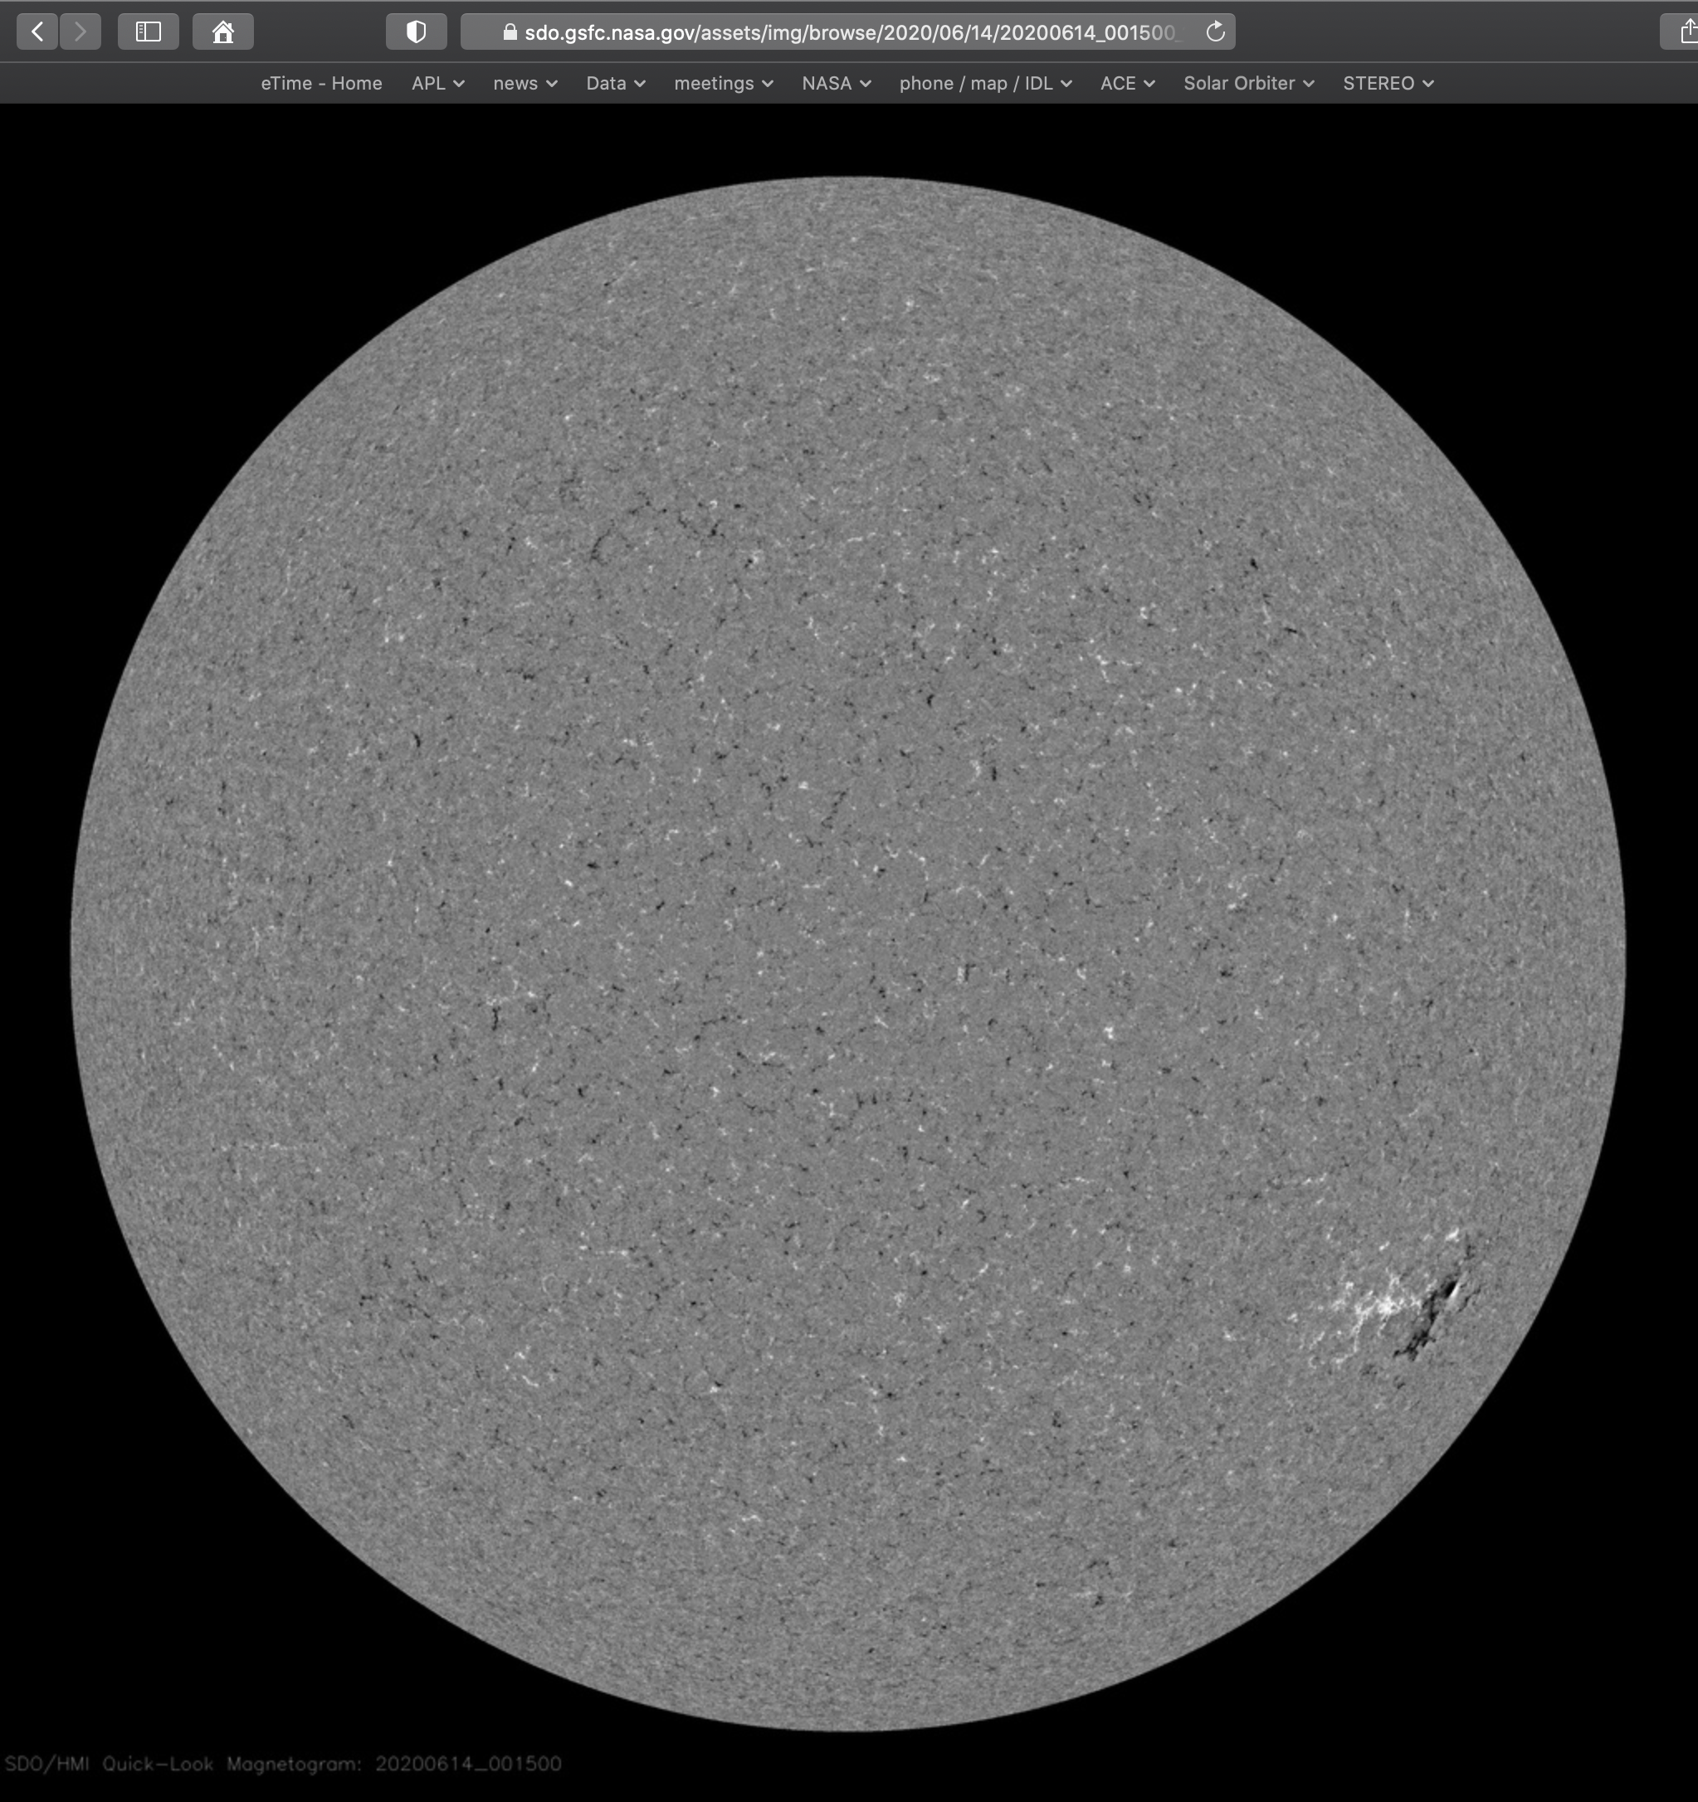
Super Quiet-Time Periods
(a)
(b)
5/12, 5/22, 6/10 would be
approx facing SO at
middle of intervals
noaa reports:
5/12: no ar, no plage
5/22: no ar, no plage
6/13: #2765; no plage
(c)
Mason et al., A&A, 2021

Slide 18
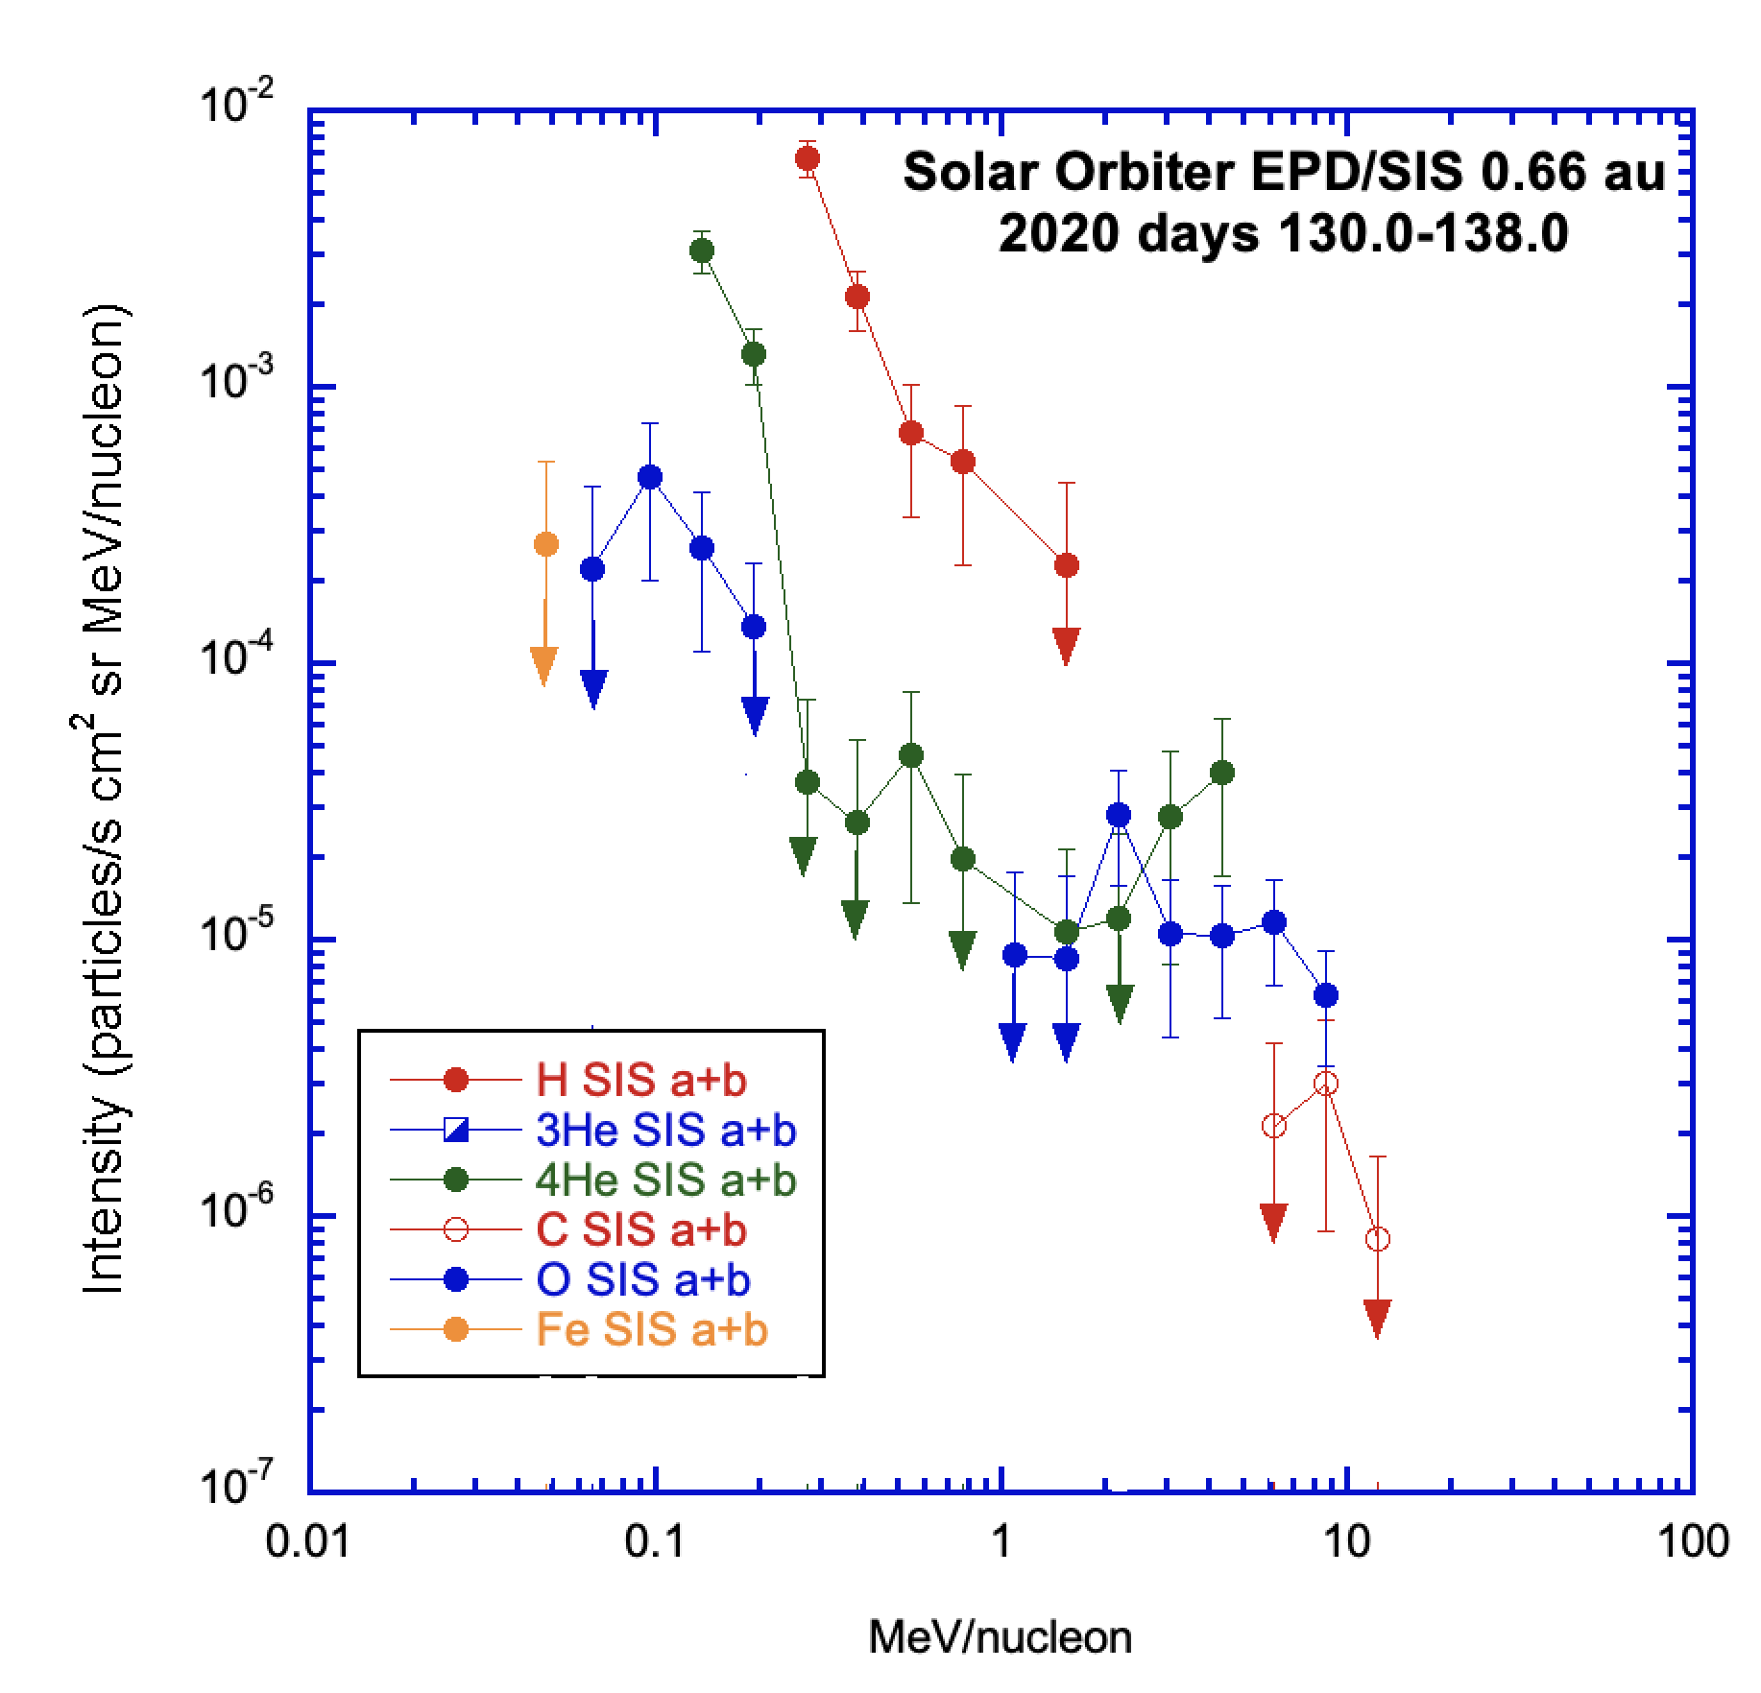
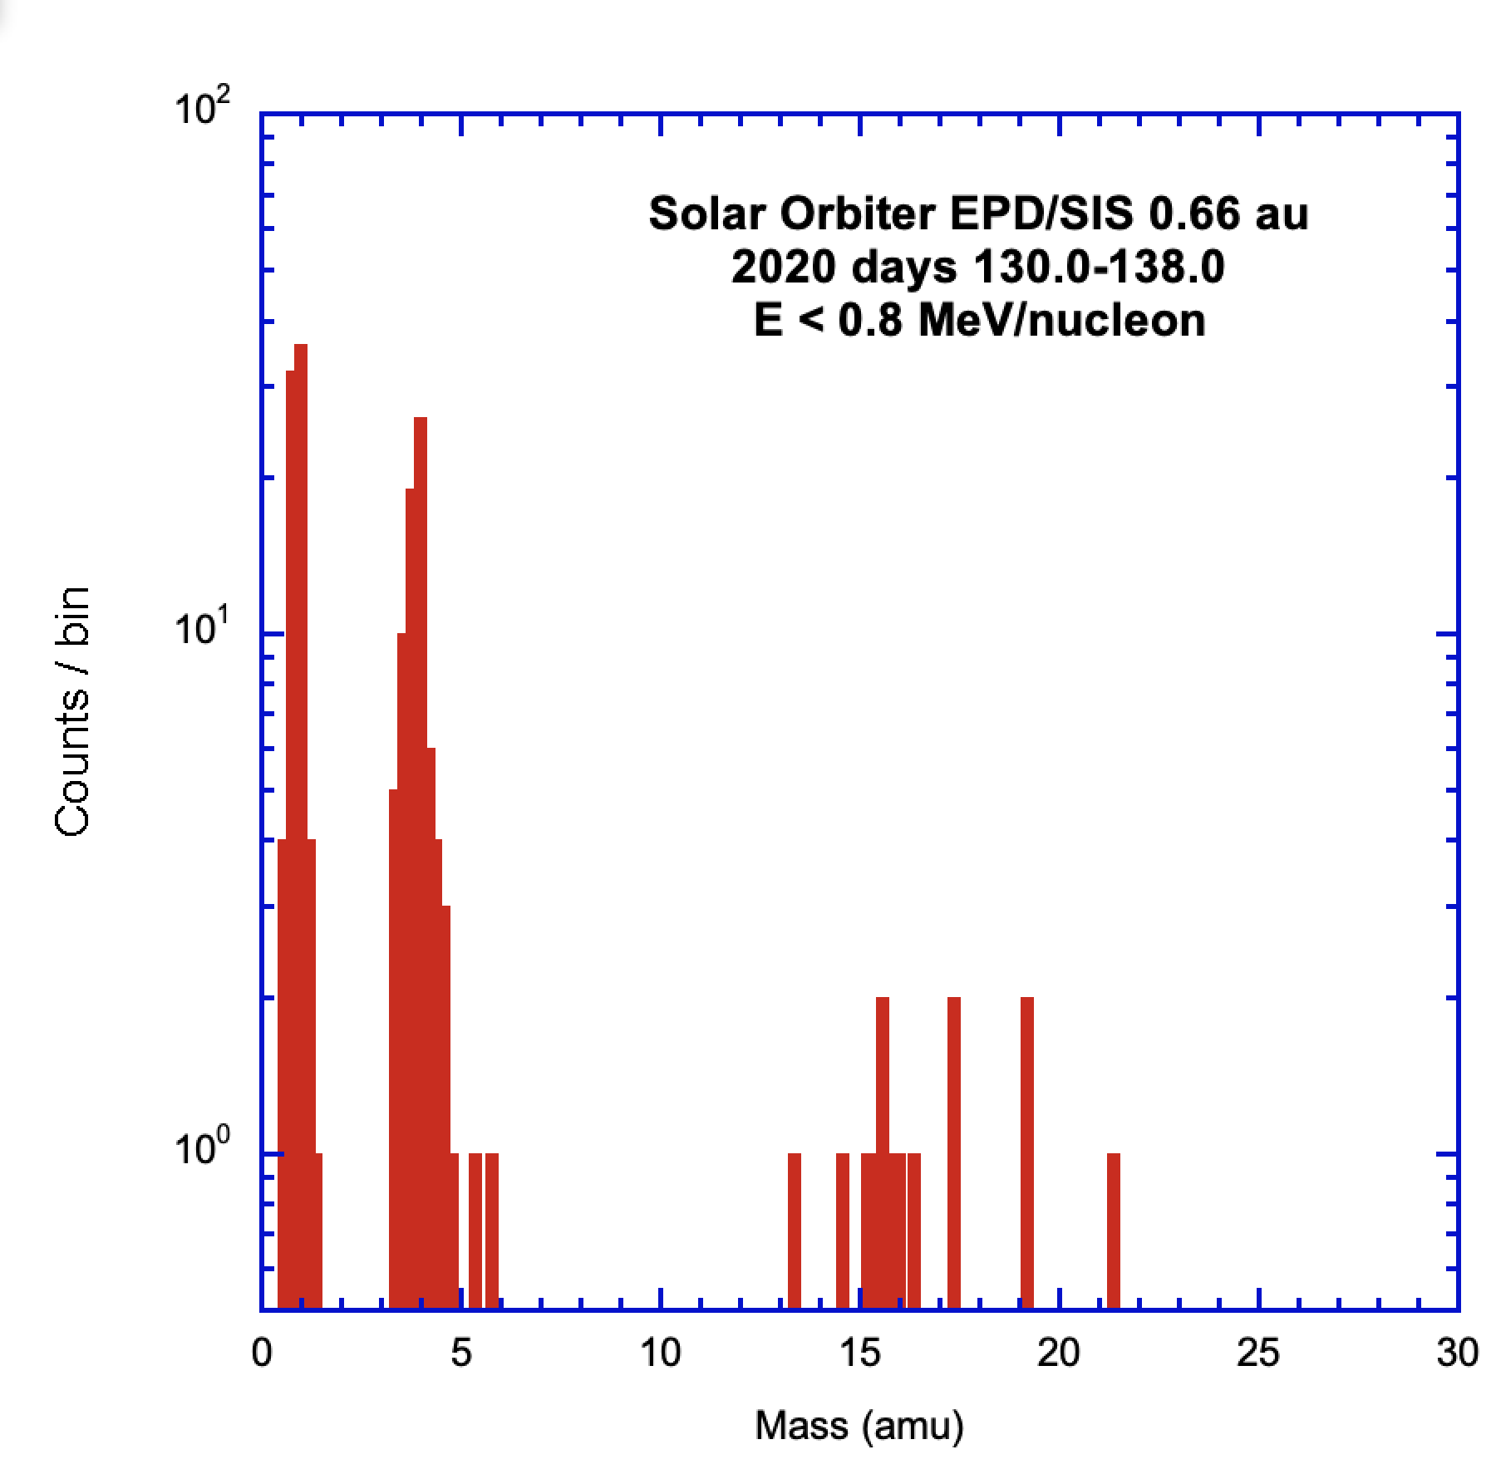
Super Quiet-Time Spectra
No measurable ³He
Only Oxygen and Neon present for heavier element (ACR) in turn up
⁴He spectrum down at 300 keV/nuc
Mason et al., A&A, 2021

Slide 19
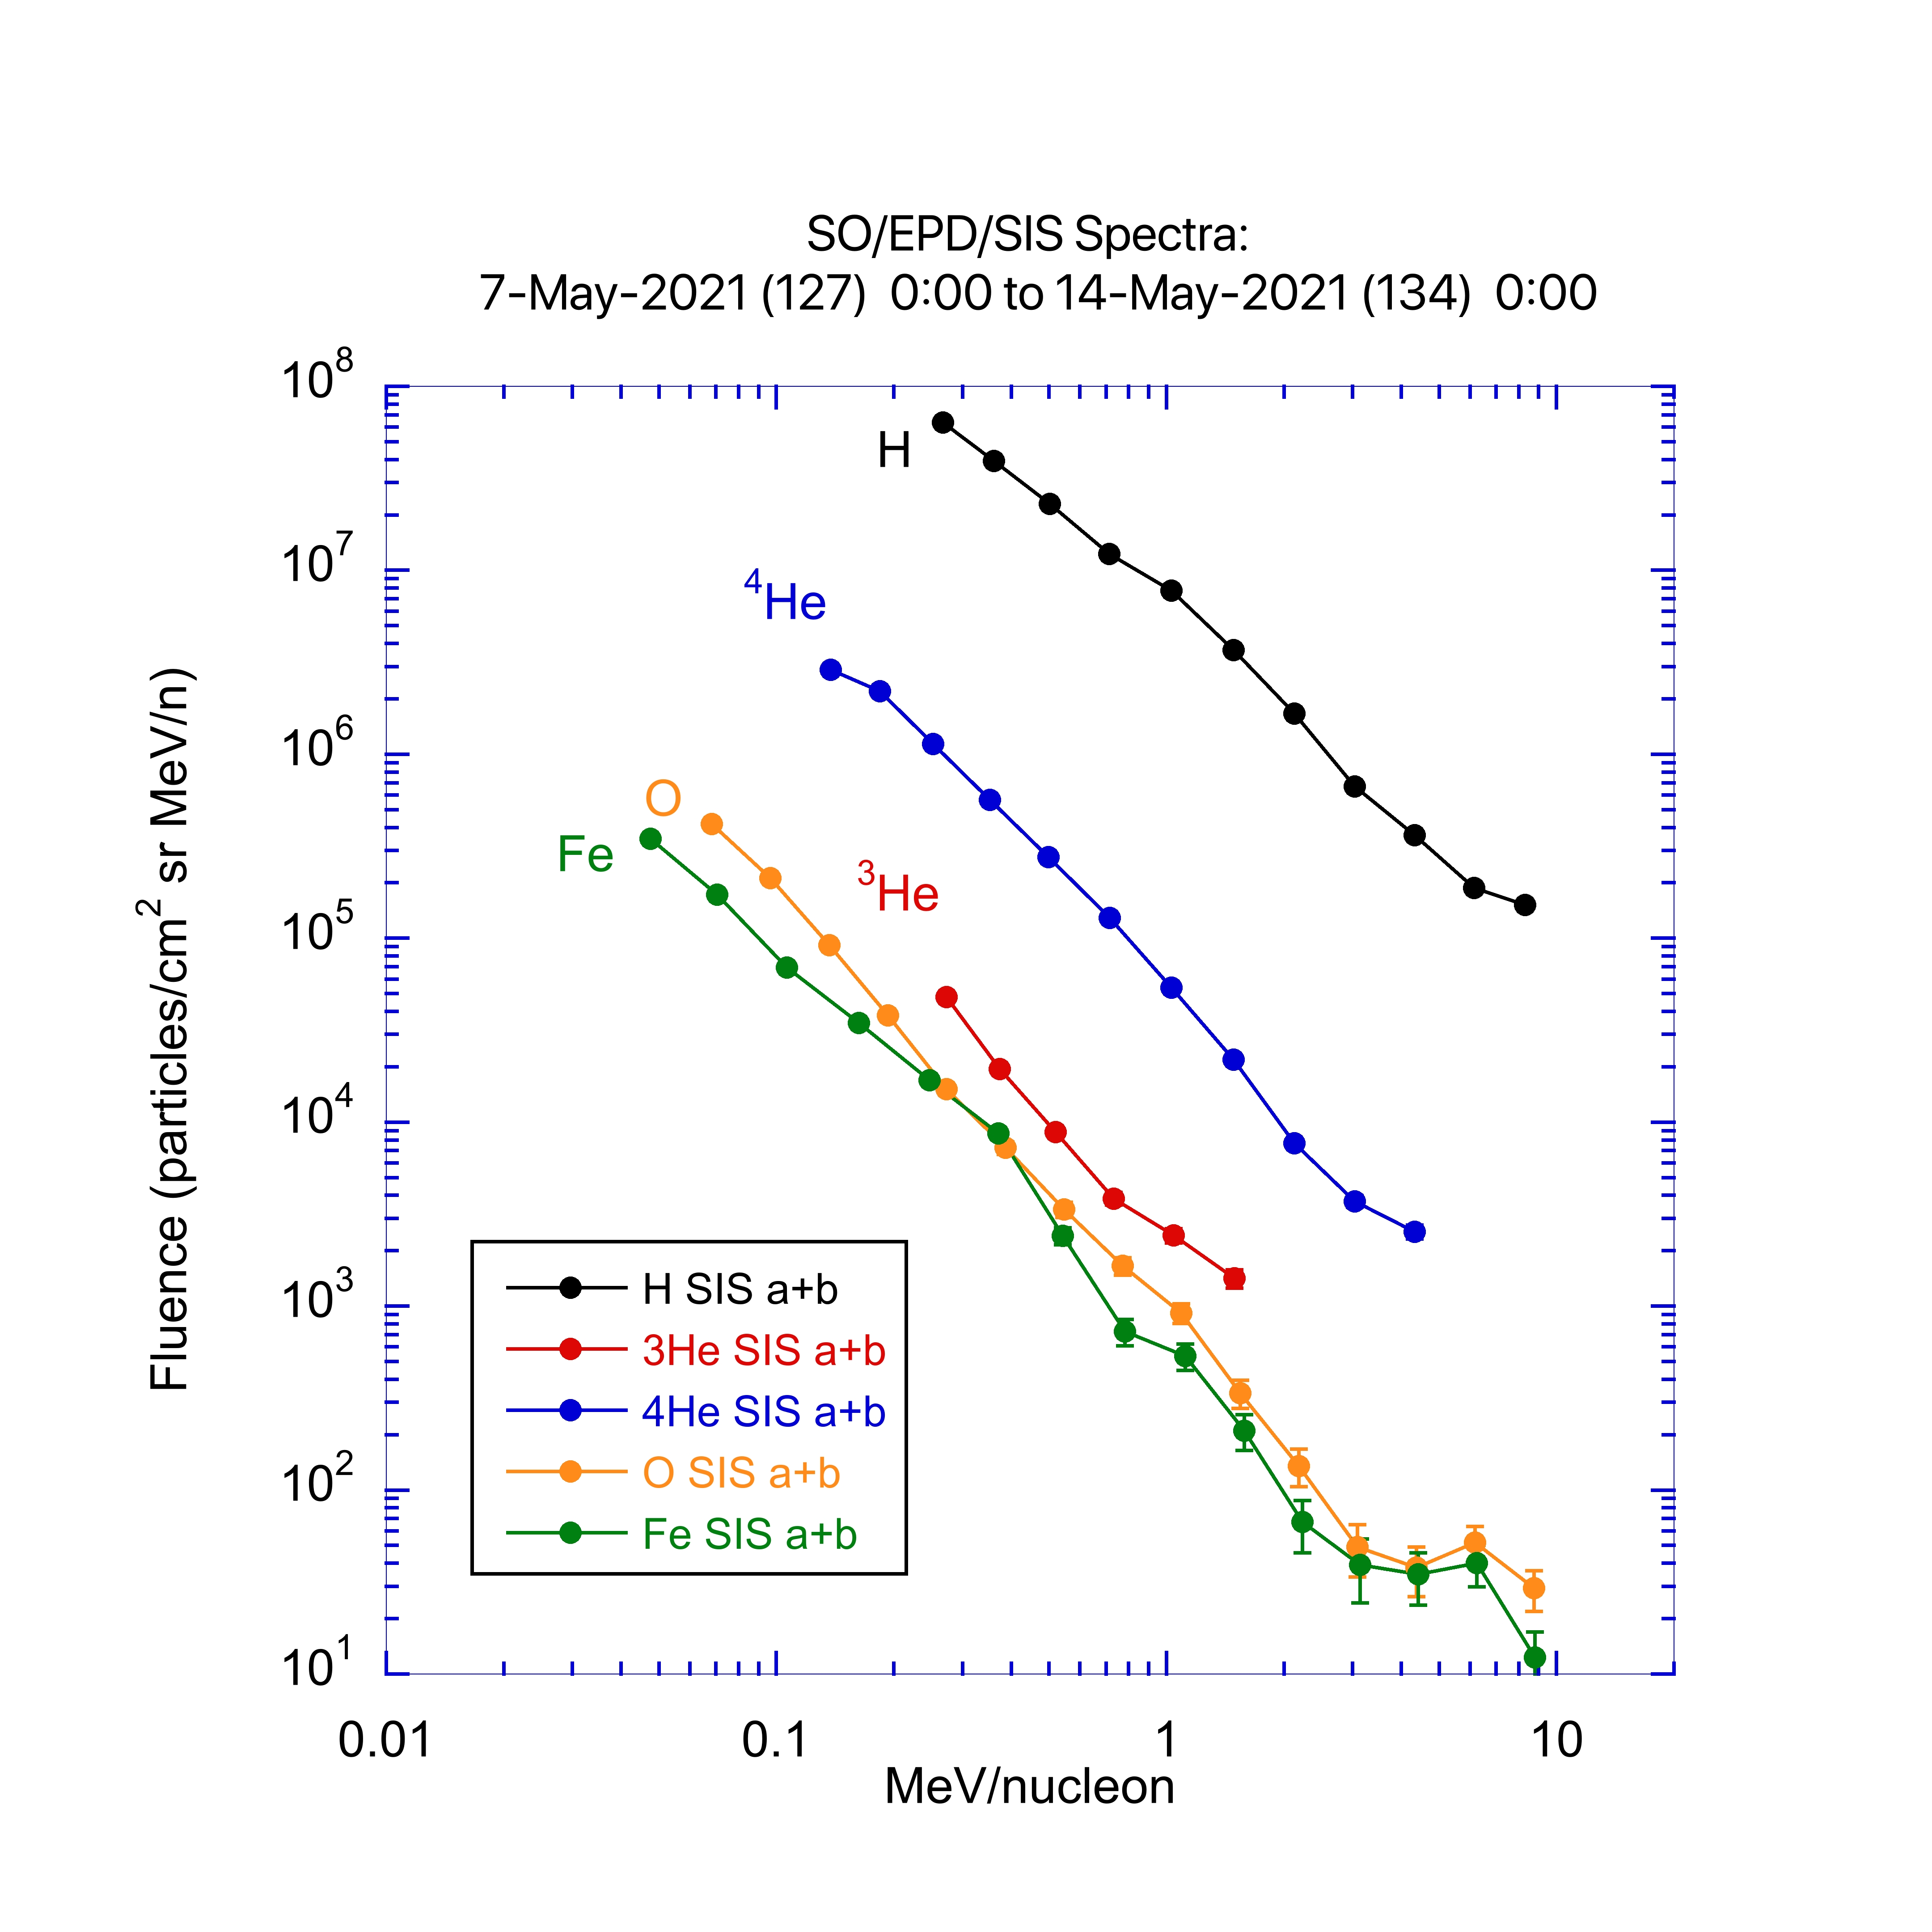
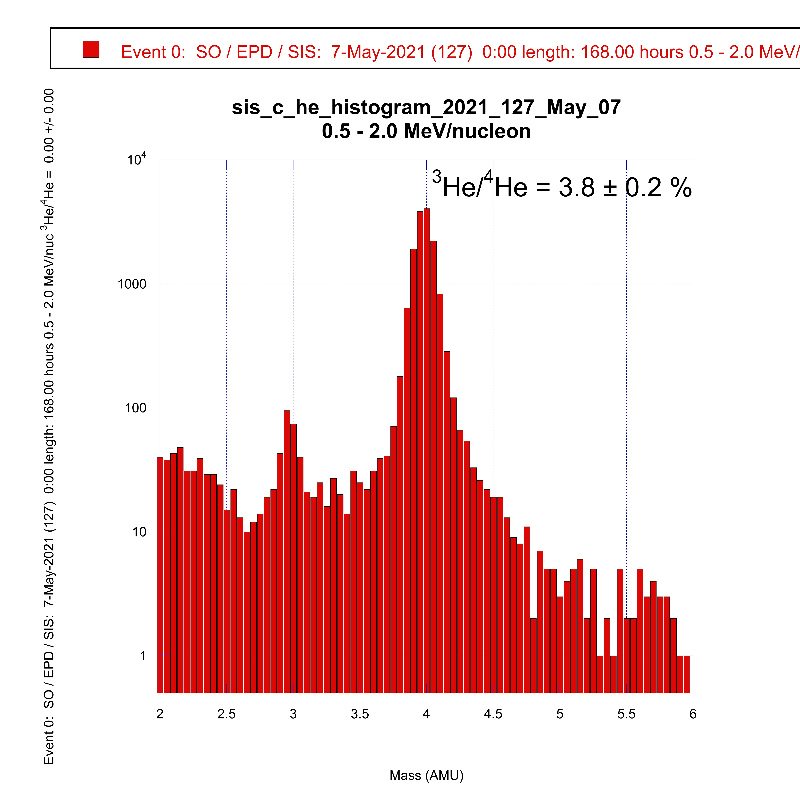
May 7, 2021

Slide 20
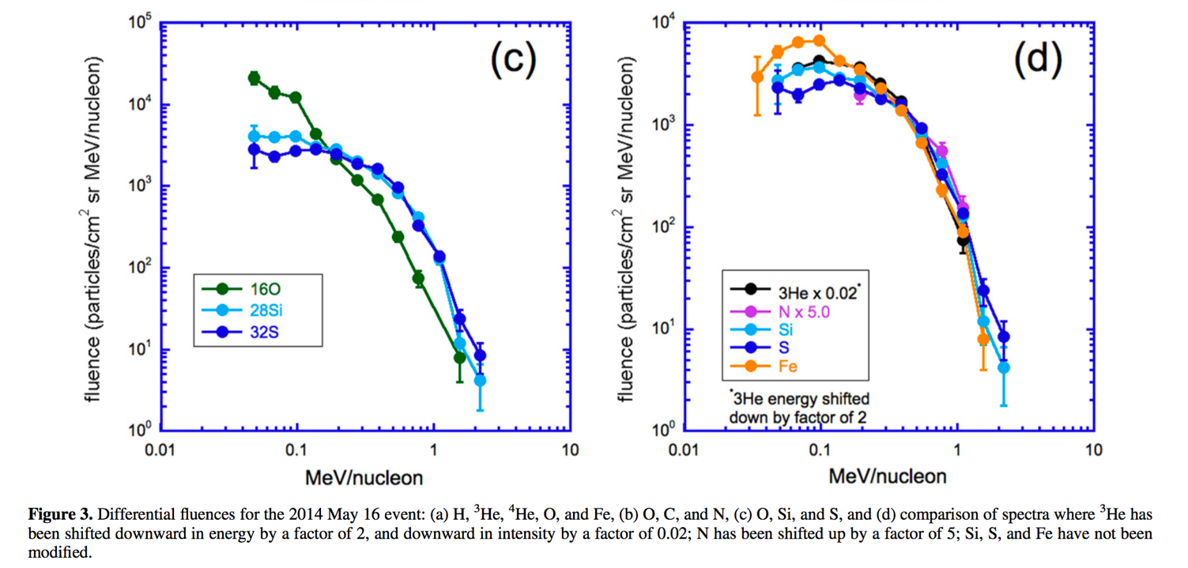
Common shape for ³He, N, Si, and Fe energy spectra
Evidence that the ³He and heavy elements spectra have similar
acceleration/transport history
Mason et al. ApJ, 2016

Slide 21
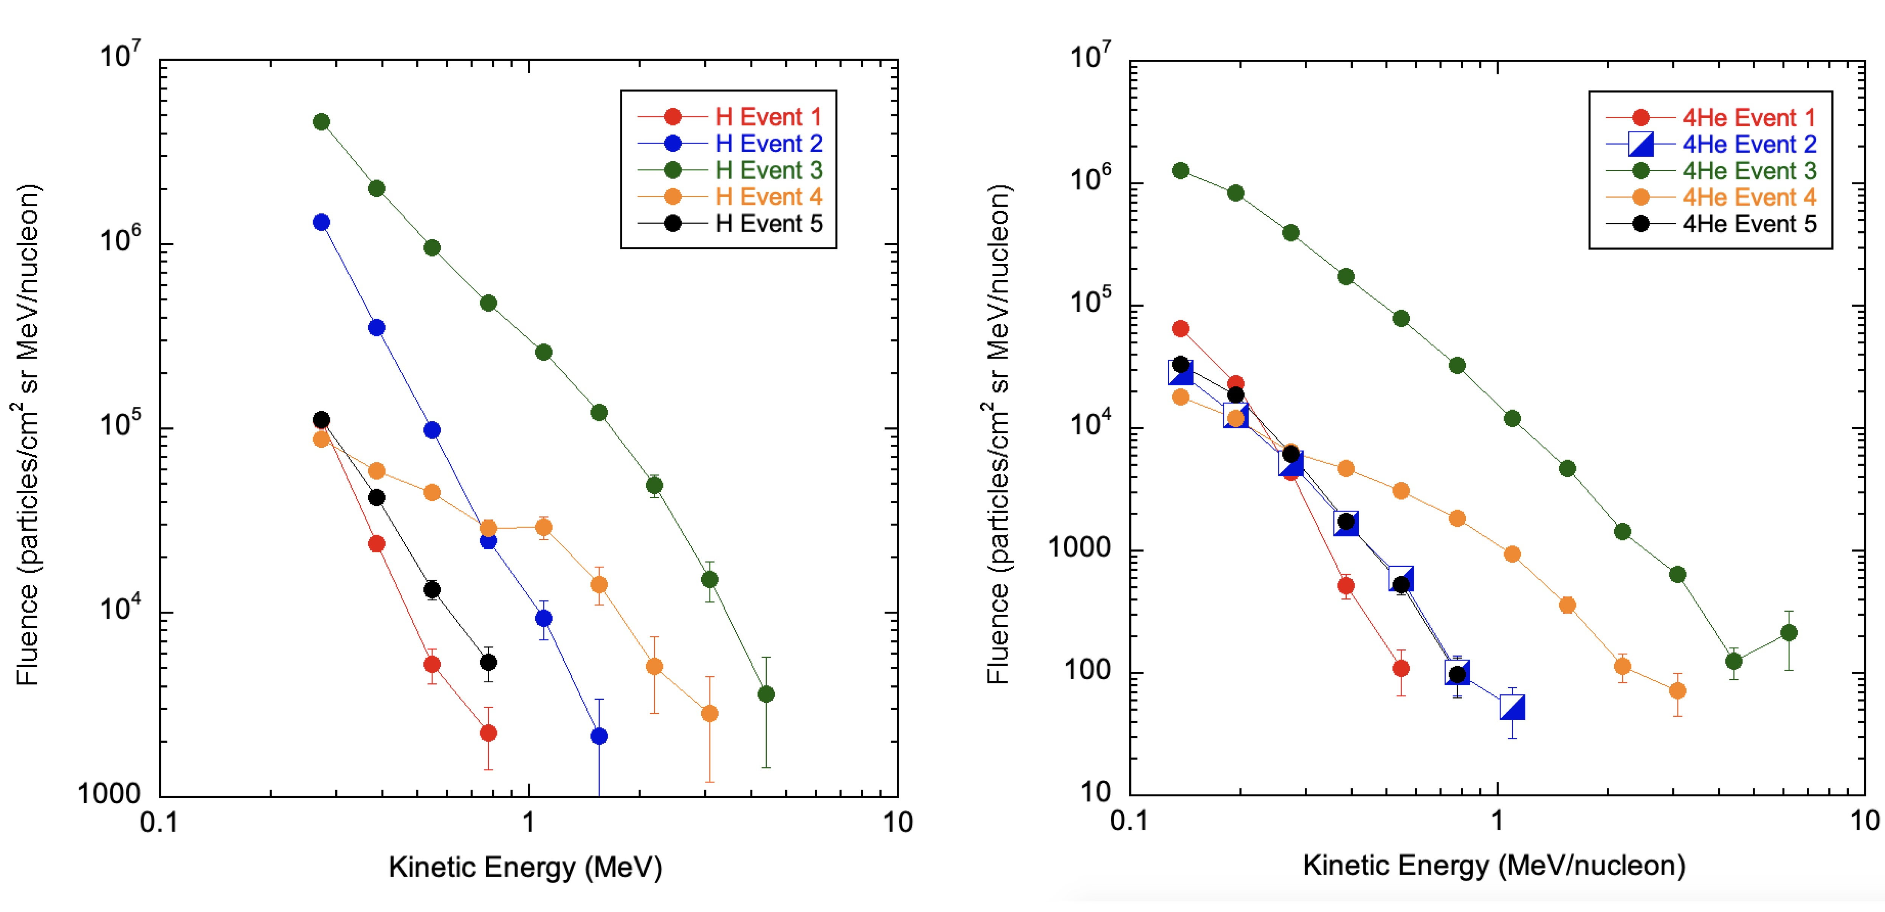
Solar Orbiter EPD/SIS First light Observations
[Mason et al., A&A, 2020]

Slide 22
EPD Inflight Calibration
[Wimmer et al., A&A, submitted, 2021]

Slide 23
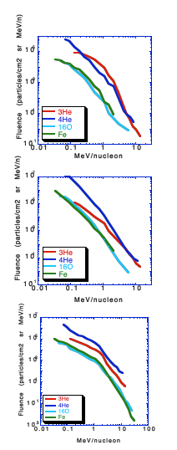
Possible synthesis:
← initial ³He enrichment mechanism (Cascade MHD?)
← further acceleration results in power law spectra
← still further acceleration results in similar spectra for all species
Mason et al., ApJ, 2002

Slide 24
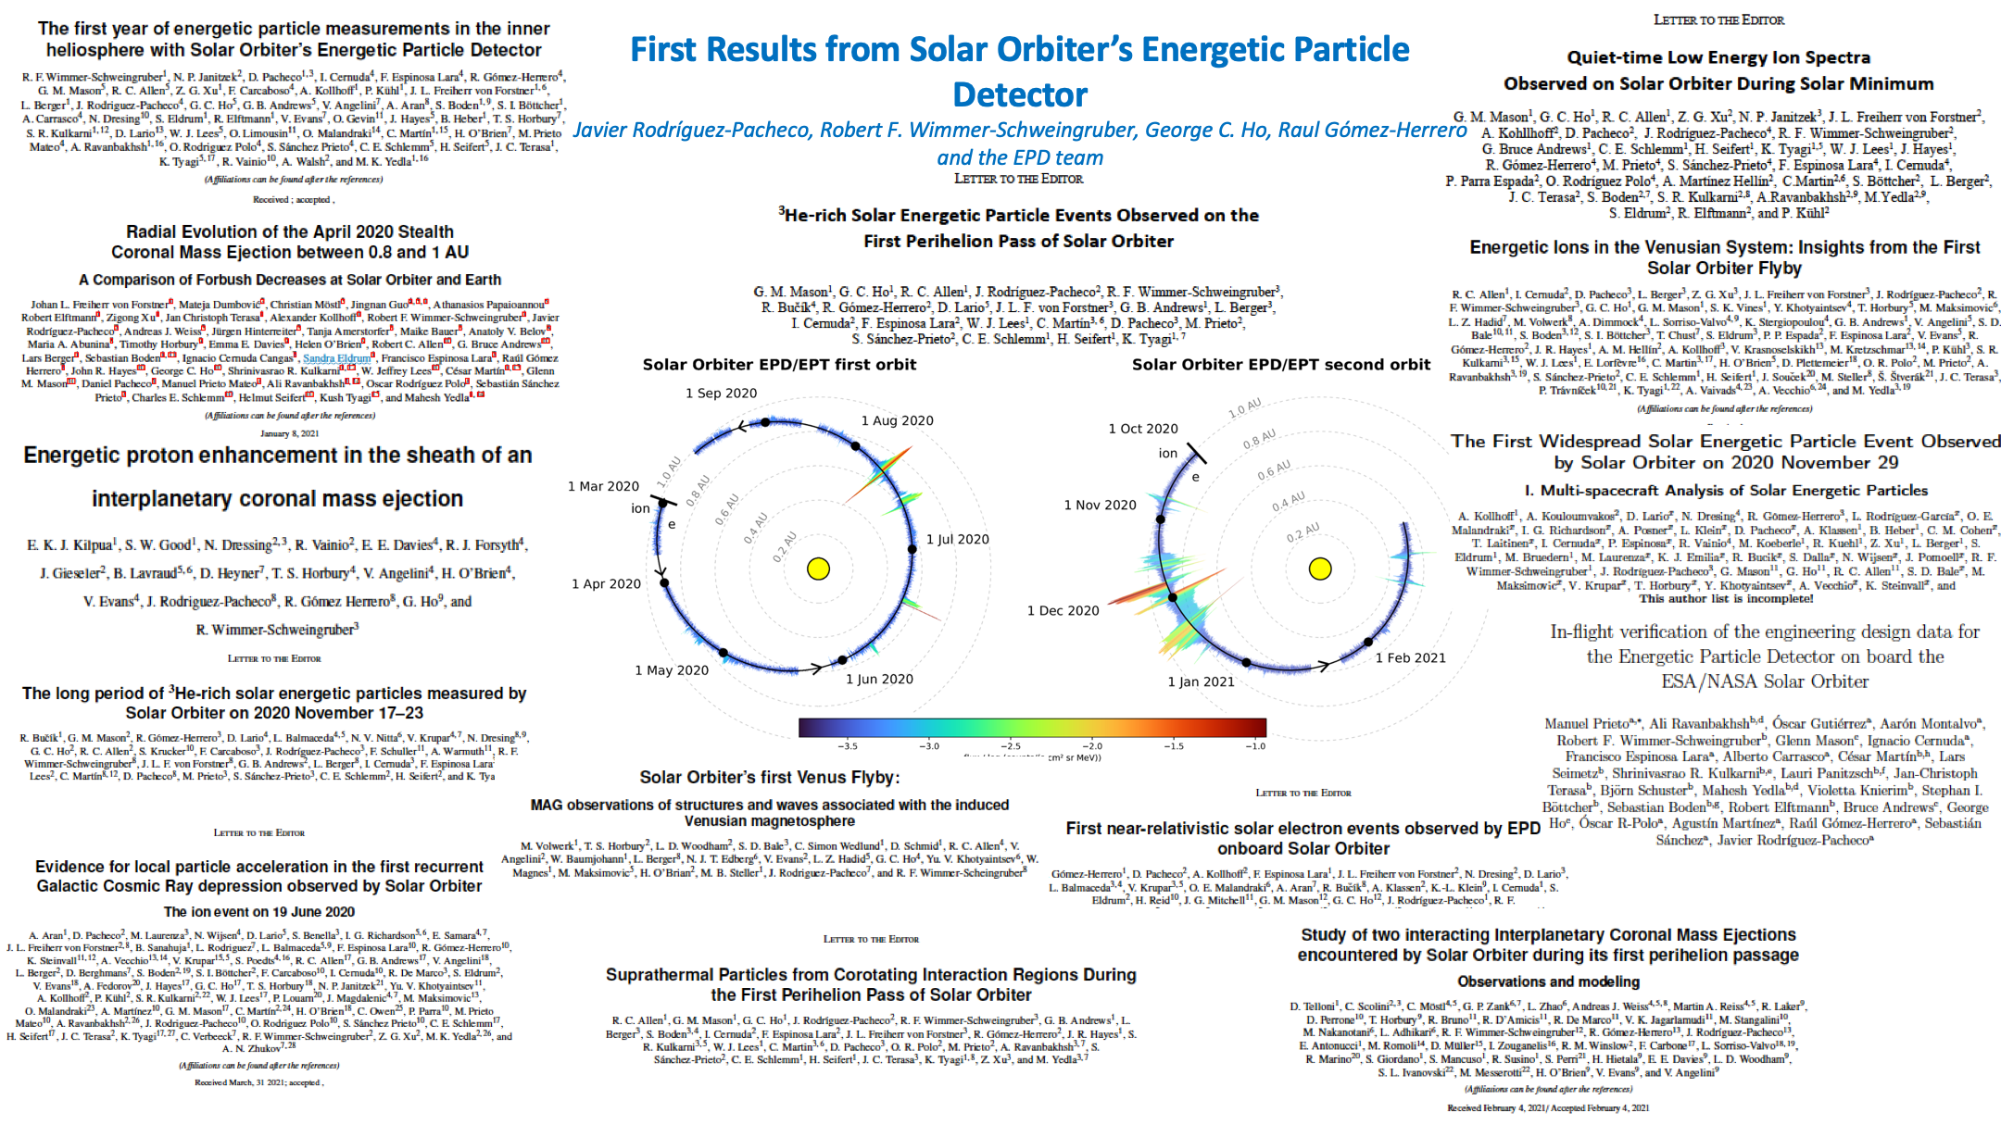

Slide 25
Summary
Solar Orbiter has been measuring particle events since April 2021 continuously in the inner heliosphere
Sufficient numbers of large SEPs, impulsive SEPs, and CIRs have been observed and published in the literatures
EPD data set is excellent and all Solar Orbiter data is available at the ESA SOAR site
Questions?
https://www.aanda.org/component/toc/?task=topic&id=1340

Slide 26

EPD Data Products: SIS
2 FoVs (SIS-A, SIS-B)
SIS-rates:
    12 ion species
    12-17 energy bins (species dependent)
    Cadences: 30m and 30s
    SIS-hehist: Helium mass histogram.
26
Notes:
26

Slide 27
EPD Data Products: EPT
4 FoVs (sun, asun, north, south)
EPT-rates. Ion (64 bins, 5s/30s cadence) and electron (34 bins, 1 min/5 min) intensities.
EPT-HCAD. Ion (12 bins) and electron (17 bins) intensities with high cadence (1s/5s).
SolO SWT #27 07-10-2020
27
Notes:
27

Slide 28
EPD Data Products: STEP
STEP-rates. Pixel (8 bins) and integrated (48 bins) magnet and integral channel intensities with 10s/1min cadence.
STEP-HCAD. High cadence (1s/5s) product with lower energy resolution (4 bins).
STEP-Burst. Pixel (16 bins) and integrated (48 bins) with high cadence (1s). Only during burst periods (15 min/day).
SolO SWT #27 07-10-2020
28
Notes:
28

Slide 29
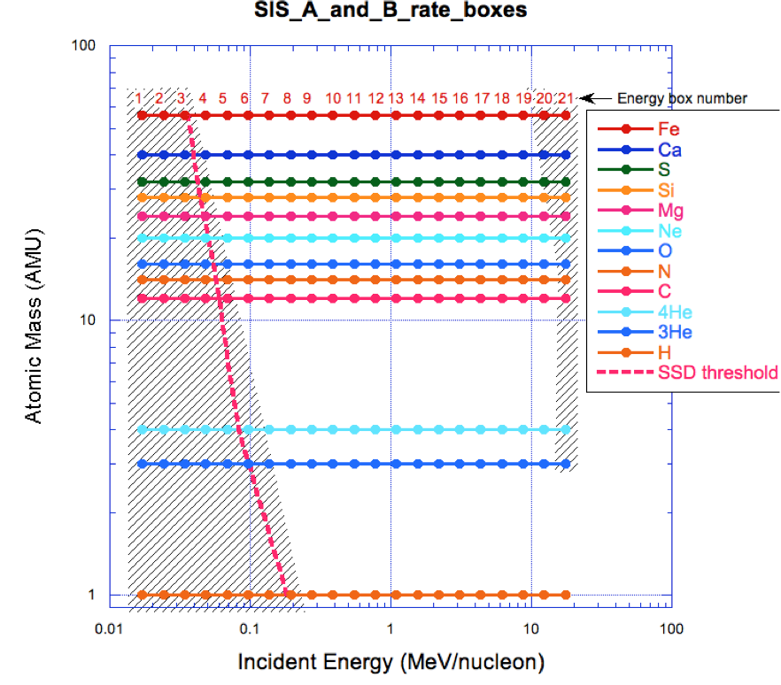
SIS L2 Data Products
Energy Range
  50 keV/nuc – 10 MeV/nuc
Three science data products
  Matrix rates for 12 major elements
  (H, 3He, 4He, C, N, etc)
    Medium & fast cadence
  Helium Histogram *New*
Time Cadences
  Nominal 30 s
  Burst 3 s
  Low Latency 30 minutes
Two look directions *New*
  Sunward 30º off the deck (Telescope A); Anti-sunward 20º off the deck (Telescope B)
  Each has an iris mechanism to control aperture from 100% to 1%
Rodríguez-Pacheco et al., A&A 2020
29/45
Notes:
29

