Slide 1
WELCOME!
MANY THANKS!
DEPT. OF PHYSICS & GEOLOGY
DEPT. OF AGRICULTURAL, FOOD AND ENVIRONMENTAL SCIENCES

Slide 2
The Abbey of San Pietro in Perugia
The abbey of San Pietro in Perugia is today the seat of:
the Department of Agricultural, Food and Environmental Sciences of uniPG
the Foundation for the Agricultural Institution
and it is still a small convent of Benedictine monks ...
San Pietro Abbey is one of the very few monasteries in Italy (and in Europe) that has been constantly inhabited by monks, from its foundation in 966 until today.
More than 1000 years of history are very long and interesting tale and you will learn more about it tomorrow during your visit.
However, today: June 20th, 2022 is an important anniversary.

Slide 3
The Risorgimento, i.e. the unification of Italy, is the 19th century political and social movement that in 1861 resulted in the unification of the Kingdom of Italy from different states of the Italian Peninsula.
Inspired by the rebellions in the 1820s and 1830s against the resolutions of the Congress of Vienna, the unification process was precipitated by the Revolutions of 1848, and completed in 1871 after the conquest of Rome (for someone after the First World War in 1918…)
In this framework the Second Italian War of Independence (Franco-Austrian War, or the Austro-Sardinian War or Italian War) was fought in 1859 by the Second French Empire and the Savoyard Kingdom of Sardinia against the Austrian Empire.

Slide 4
Perugia at that time was part of Papal State
On June 14th, in Perugia an insurrectionary committee ask the pontifical government, through the intermediary of its representative at Perugia Luigi Giordani, to abandon the position of neutrality about the Second War of Independence
Giordani refuted, Perugia people rebelled against the temporal authority of the Pope and established a provisional government, offering the dictatorship to Victor-Emmanuel (king of Sardinia)

Slide 5
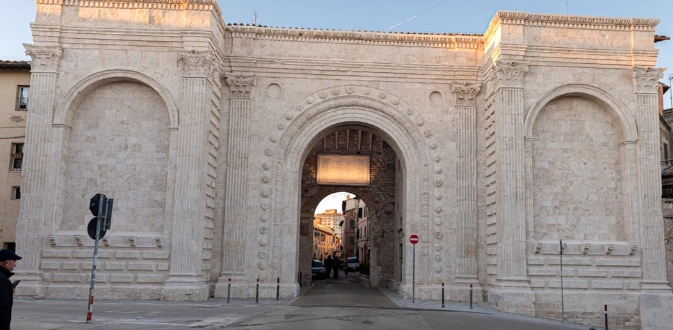
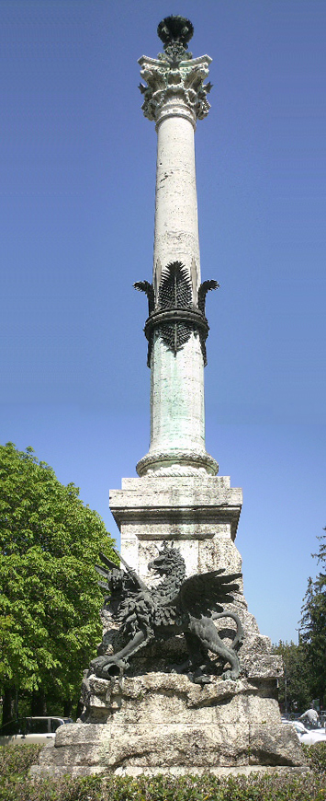
The insurrection was bloodily quashed by Pius IX's troops on June 20th.
The epicenter of the fighting was here at the Port of San Pietro
The
Abbot of the
Monastery of San Pietro,
Placido Acquacotta, hid
numerous civilians and helped
them to escape from the massacre
and the pillage that followed the battle.

Slide 6
On September 14th, 1860 the Savoia troops conquered Perugia, which officially became part of the
Kingdom of Italy on
November 4th.
The monks of San Pietro, because of their help to Perugian insurgents, were allowed to use their possessions as long as at least 3 of the monks who witnessed the ‘Perugia uprising of the 1859’ remained still alive.

Slide 7
Only after the death of the last one, in the 1892, the Foundation for Agricultural Education was established…but the monks are still in the Abbey
At the end Second World War, the liberation of Perugia, already abandoned days ago by the Nazi occupiers, was made to coincide with the anniversary of the Perugia uprising of June 20th

Slide 8
INFO
Torino Workshop
The 13th
PERUGIA
19th-24th
June 2022
ON
AGB
STARS

Slide 9
Wearing FFP2 masks is still mandatory in busses, trains, ships and local public transports and in hospitals….
Wearing masks is no longer mandatory elsewhere BUT we kindly ask you to wear it:
in the conference room
when you can't keep a distance of 1 m from other people
Sanitize often your hands, there are gels at the entrance of the conference hall and close to the refreshment points
Stay at home if you feel unwell or have a fever

Slide 10
Speaker must use the computer of the conference hall.
Please upload your presentation in PPT or PDF in this PC or upload the file in the the conference webpage well in advance.
who follow remotely the workshop can ask questions by virtually raising her/his hand on Teams
Viceversa you in the room can ask question to speakers at home
We are recruiting moderators to help chairmen in handling questions from the room and from home, are there volunteers?

Slide 11
Internet connection:
EDUROAM is available in the conference hall
If you have not Eduroam please let me know
Coffee breaks will be served in the cloister (exit the conference hall and turn left)
Lunches will be served in the medieval garden (exit the conference hall and turn right)

Slide 12
Torino Workshop
The 13th
PERUGIA
19th-24th
June 2022
ON
AGB
STARS

