Slide 1
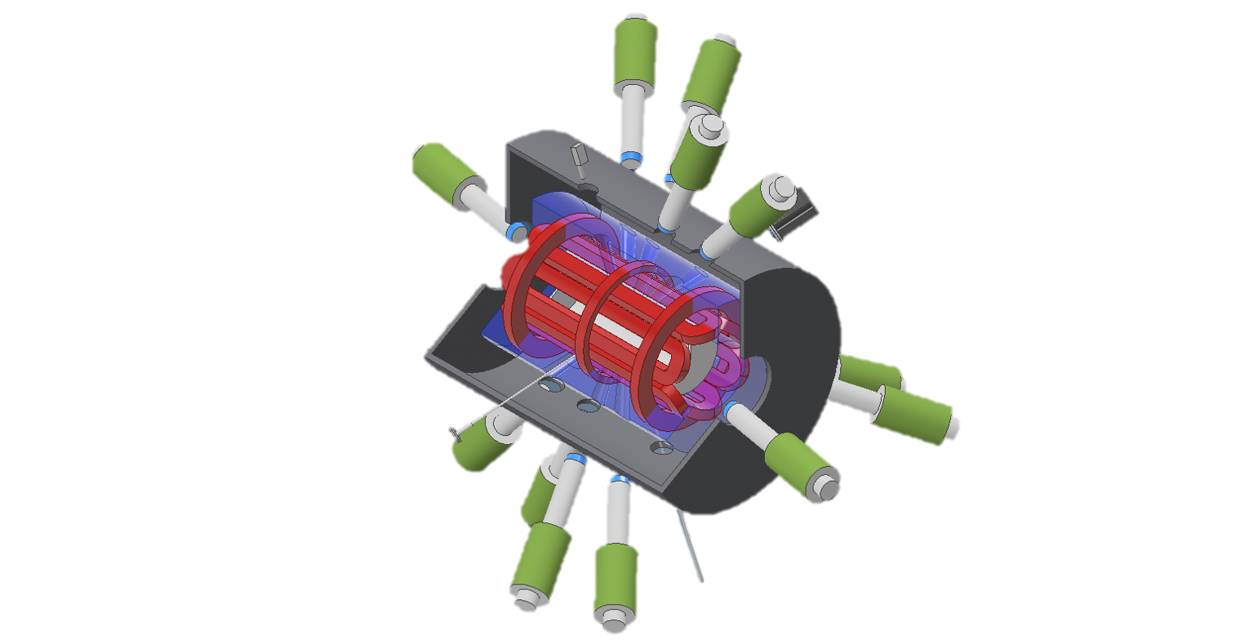
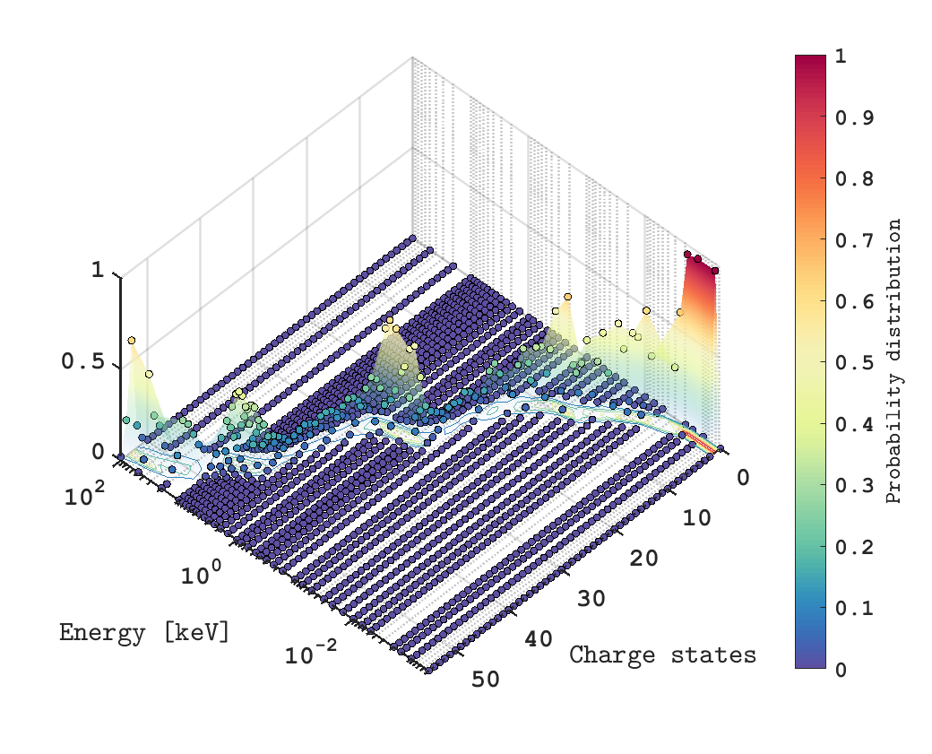
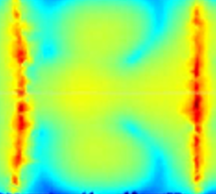




Numerical virtual experiments for in-plasma nuclear
β-decay study in the framework of the PANDORA
project
Angelo Pidatella, INFN - LNS
on behalf of the PANDORA collaboration

Slide 2
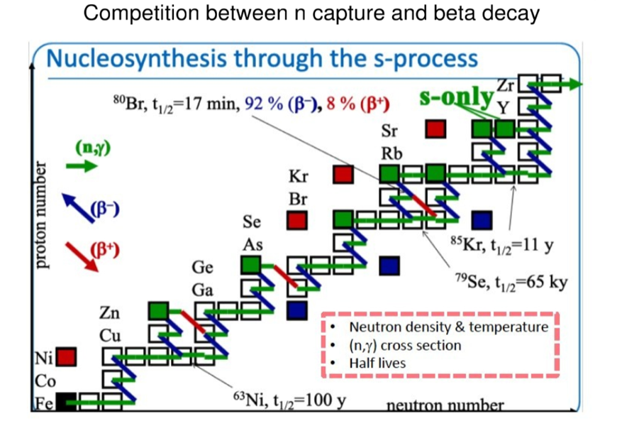
Astrophysical implications of studying β decay in plasma
Important branching points of s-processes in the nucleosynthesis chain depend on the “competitive” rates of neutron capture vs. β-decays
Neutron capture rates in stellar environments
mostly derived from a combination of measurements
and modeling. Direct measurements of stellar rates
never performed so far
The large effects of stellar conditions in β- decays have
been measured in a few cases at storage rings
New perspectives for investigating nuclear β-decays
in highly ionized plasma by the PANDORA experiment
at INFN-LNS
  Bare ¹⁸⁷Re⁷⁵⁺ ions decay, due to the bound-state beta decay, becomes 9 orders
  of magnitude faster than neutral ¹⁸⁷Re atoms with a half-life of 42 Gyr
Busso, M. et al., Ann Rev Astron. Astrophys. 37 (1999) 239
Cristallo, S. et al., APJ Suppl. 197, 17 (2011)
F Bosch, et al., PRL 77 (1996) 5190
Palmerini, S. et al (2021) ApJ 921 7
Mascali,D. et al, Eur. Phys. J. A (2017) 53: 145
Mascali D. et al, Universe 8 (2), 80 (2022)

Slide 3
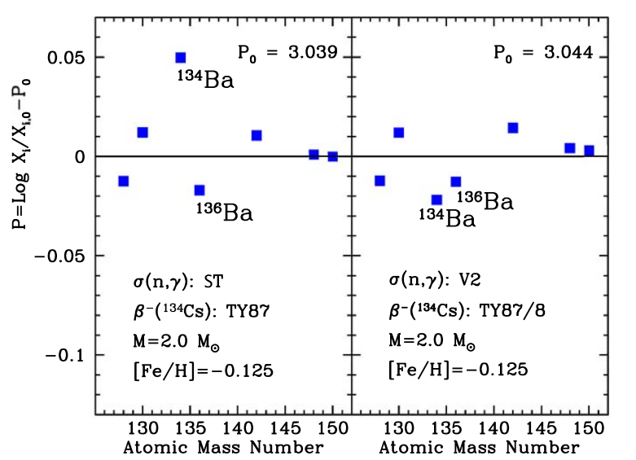
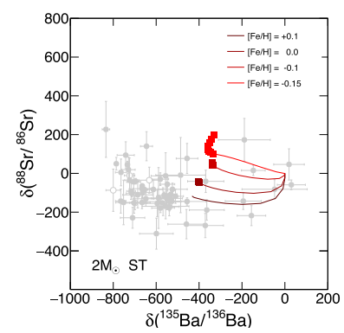
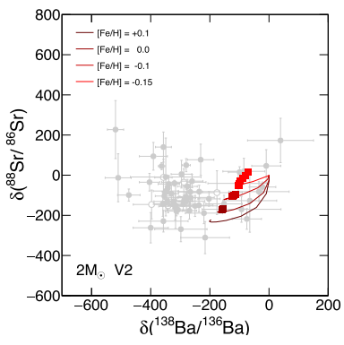
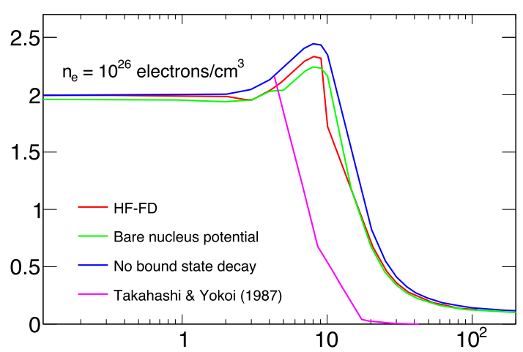





State-of-the-art of atomic input on nuclear decays
Theory of perturbed decay rates in stellar environments (Takahashi, Yokoi – TY)
$$λ^{∗}=p_{0}λ_{0}+ p_{1}λ_{1}+ …$$
$$t_{1/2}= \frac{\ln{2}}{λ}$$
→ $λ_{i}$ can differ by orders of magnitude
→ additional transitions (different forbiddeness) can appear in $λ_{0}$
Nuclear beta-decays of highly ionized heavy atoms in stellar interiors, K Takahashi and K Yokoi, Nuclear Physics A404, 578 (1983)
Beta-decay rates of highly ionized heavy atoms in stellar interiors, K Takahashi and K Yokoi, Atomic Data and Nuclear Data Tables 36, 375 (1987)
The β-decay model described in this theory requires detailed inputs on the level population and charge state distribution of the plasma ions, as well as on the electron energy distribution function (EEDF).
Example: AGB model (Palmerini et al. 2021), ¹³⁴Cs decay, affecting the isotopic admixture of Ba and the effectiveness of the branching point at ¹³⁵Cs → ¹³⁴Ba and ¹³⁶Ba, status as purely s-process nuclei is not reproduced very well by galactic neutron capture nucleosynthesis, when the decay rate is taken from TY
Half-life [years]
TY
TY/8
Palmerini, S. et al (2021) ApJ 921 7
Taioli S et al. arXiv:2109.14230
Thermal Energy [keV]

Slide 4

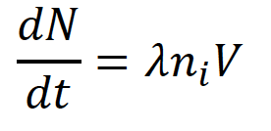
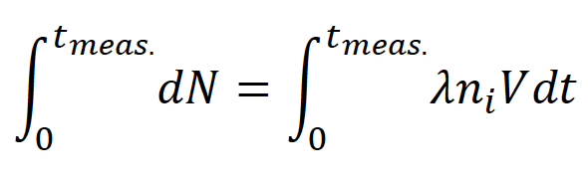
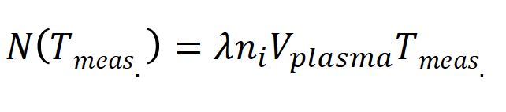
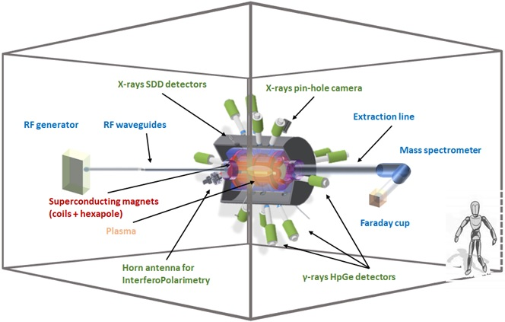
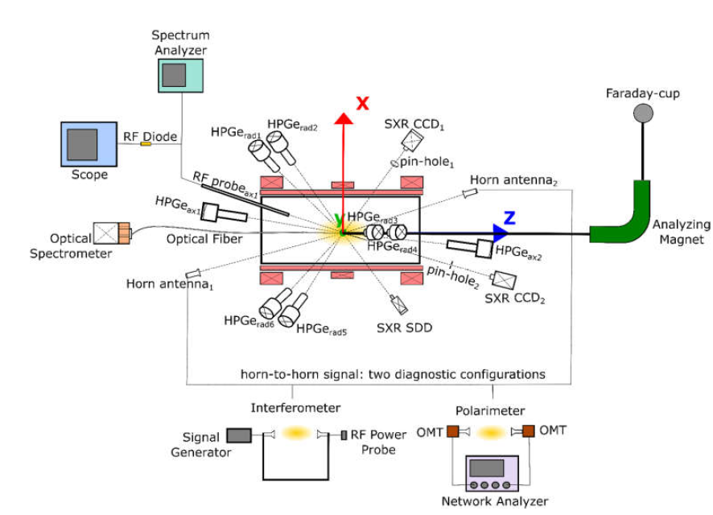
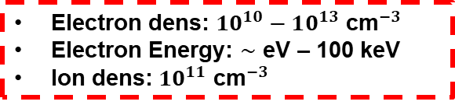
PANDORA concept
PANDORA concept: compact plasma trap to magnetically confine ions of radioisotopes in a microwave-sustained Electron Cyclotron Resonance (ECR) plasma
Main Goal: nuclear decay measurements in a plasma resembling astrophysical conditions (temperature, ion charge state distribution)
Multi-diagnostic setup: monitoring diagnostics + HpGe detectors array for γ-spectroscopy of daughter nuclei after beta-decay
Plasma volume (const.)
ECR magneto-plasma can be maintained in MHD Equilibrium for days or even weeks
Isotope activity
Density of the isotope in the plasma (const.)
Electron dens: $10^{10}−10^{13}$ ${\text{cm}}^{−3}$
Electron Energy: $∼$ eV – 100 keV
Ion dens: $10^{11}$ ${\text{cm}}^{−3}$
Mascali,D. et al, Eur. Phys. J. A (2017) 53: 145
Mascali D. et al, Universe 8 (2), 80 (2022)

Slide 5
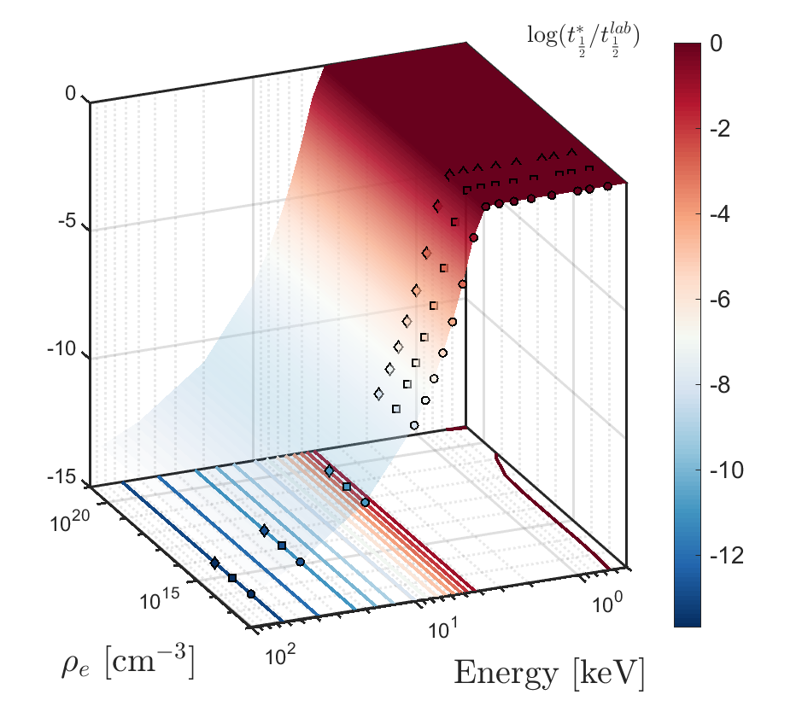



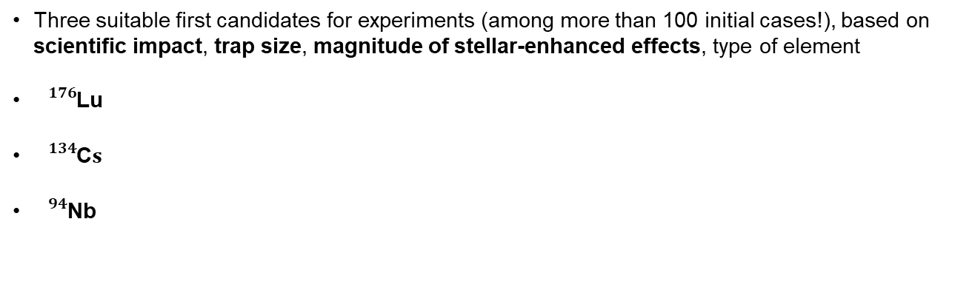

PANDORA concept – physics cases
Three suitable first candidates for experiments (among more than 100 initial cases!), based on scientific impact, trap size, magnitude of stellar-enhanced effects, type of element
${}_{}^{176}{\text{Lu}}$
${}_{}^{134}{\text{C}s}$
${}_{}^{94}{\text{Nb}}$
Cosmo-chronometer/thermometer – Expected theor. reduced lifetime $∼6$ orders of magnitude
s-process branching in AGB stars – Expected theor. reduced lifetime $∼3$ orders of magnitude
s-process branching in AGB stars – Expected theor. reduced lifetime $∼4$ orders of magnitude
OF INTEREST FOR AGB MODELS
$${}_{}^{176}{\text{Lu}}$$
EXPECTED FIRST PANDORA RUNS: 2024
In perspective, for the PANDORA purpose, it will be mandatory
to locally characterize the plasma parameters;
to measure the plasma volume;
to master the plasma stability for days, weeks or even months →to investigate plasma turbulent regimes for preventing MHD instability

Slide 6
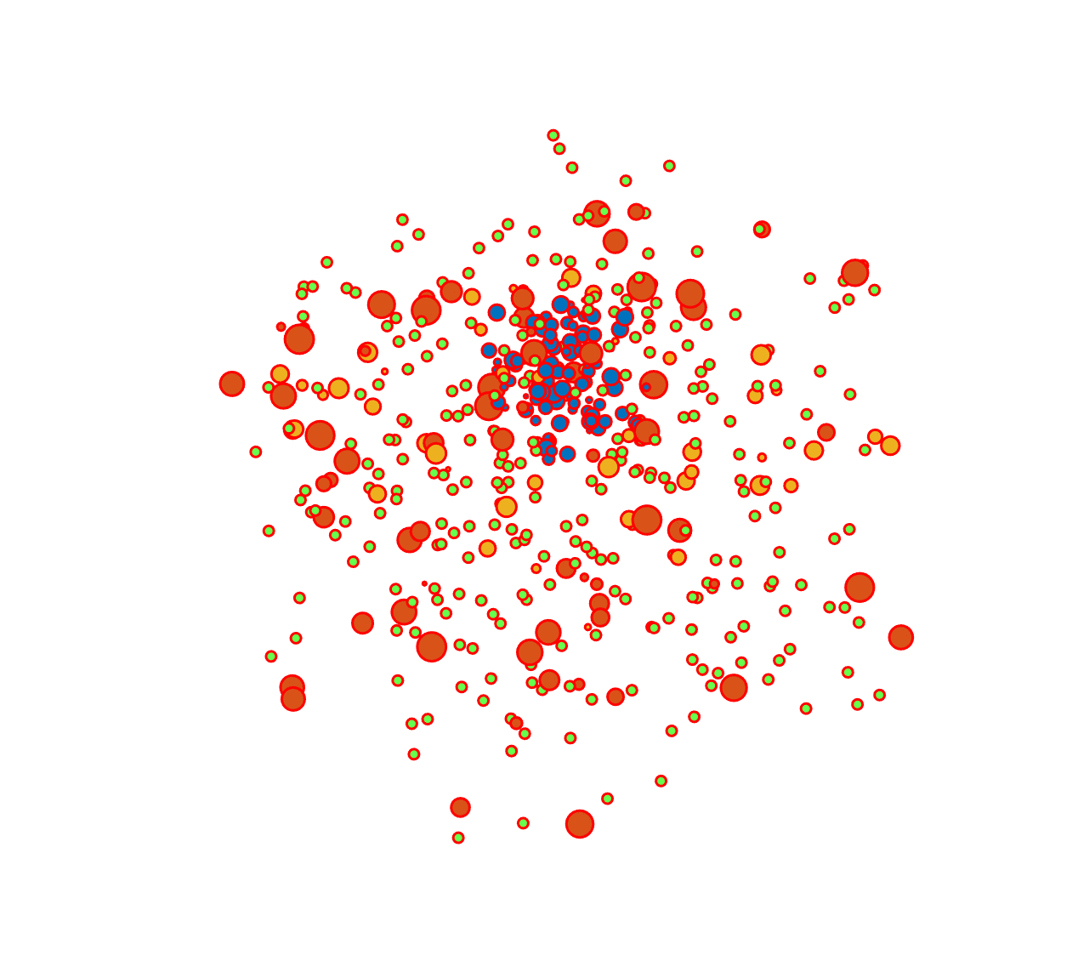


A multi-diagnostic setup & detection system
Plasma
Emitted Radiations
Source Information
Background Noise
for Plasma Enviroment characterization: to correlate the isotope lifetime with Plasma Parameters: density, temperature, CSD
for Isotopes decay tagging: in order to detect and distinguish the γ-ray emitted by the Isotopes
Multi-diagnostics Setup
of non invasive tools
working synergically
Detection system:
γ-rays detectors array
for plasma turbulent regimes investigation
RF Probe + Spectrum Analyzer
Plasma emitted RF radiation measurements : studying on instability damping
Pin-hole Camera
High resolution X-ray Space-resolved Spectroscopy
Impact of instabilities on plasma structure
and confinement
GEANT4 Simulations
Design of a array of γ-rays detectors and total efficiency evaluation
Evaluation of isotopes’s lifetimes
Measurability by a Virtual Experiment

Slide 7
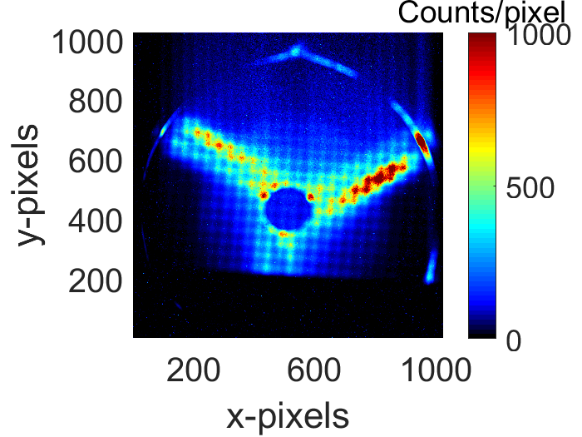
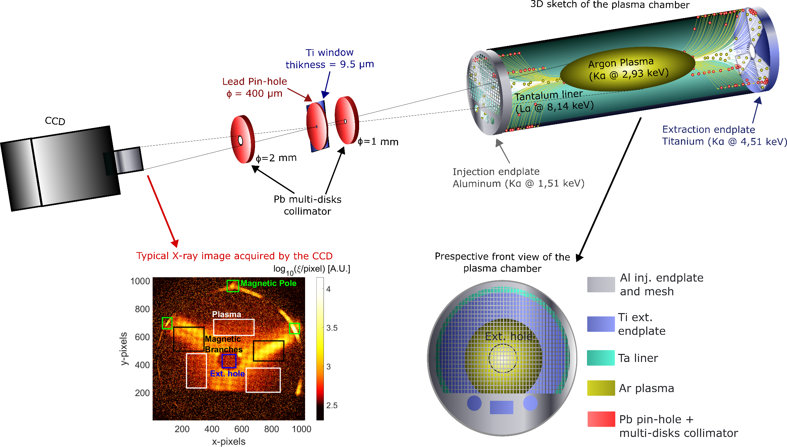
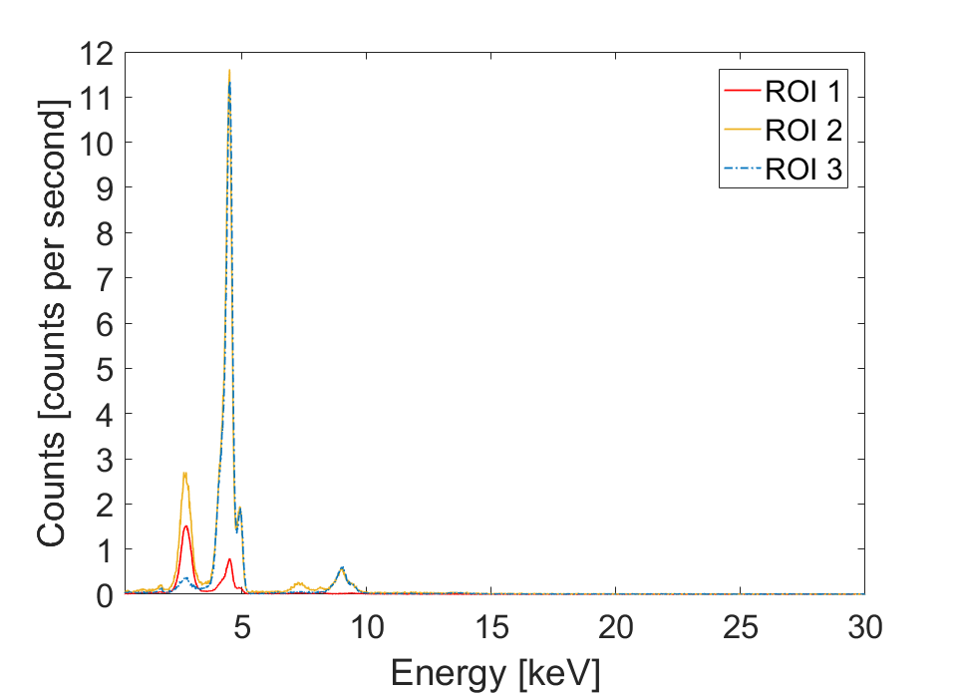
Typical plasma characterization: X-ray diagnostic
Integrated X-ray imaging: volumetric detail, plasma volume
Single-Photon Counting X-ray imaging: space- and spectral-resolved detail
3
2
1
Spatially-Resolved Spectroscopy and Spectrally-Resolved Imaging
Ti
Ar
Ta
D Mascali et al., Plasma Physics and Controlled Fusion 64(3):035020
Jan. 2022, DOI: 10.1088/1361-6587/ac4349
E. Naselli et al 2022 JINST 17 C01009

Slide 8
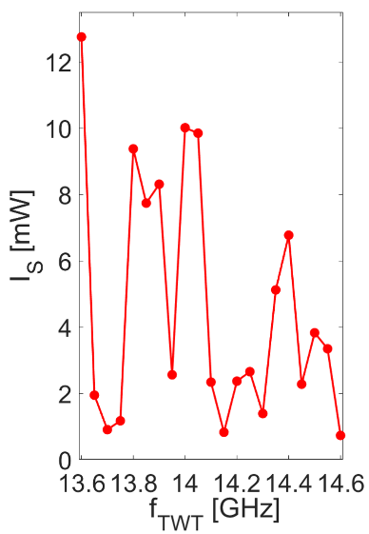
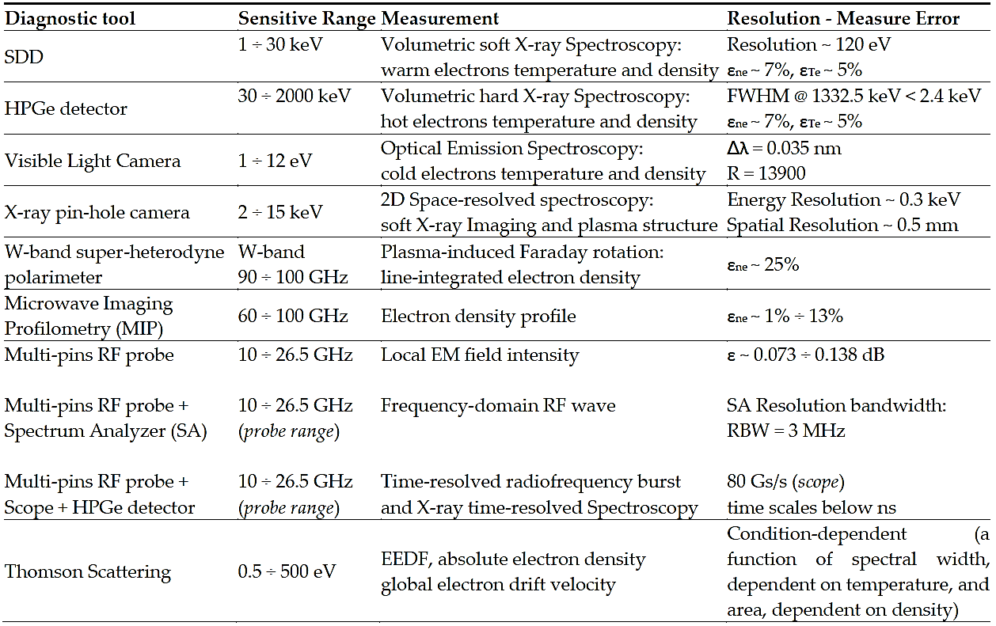
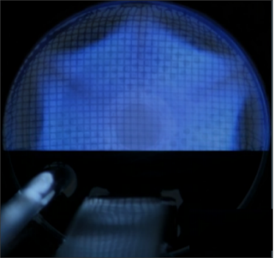
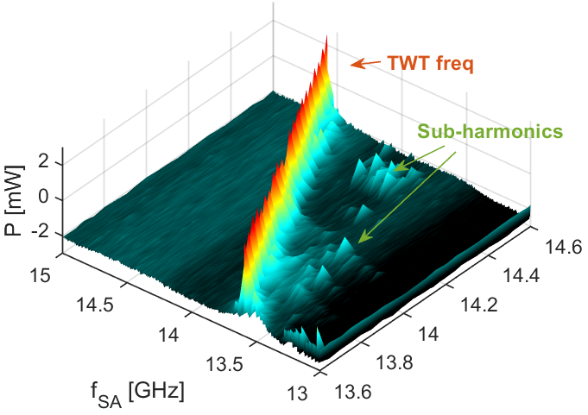



Typical plasma characterization: other diagnostics
Hydrogen spectrum
Optical imaging and spectroscopy by Optical Emission spectroscopy
Plasma emitted RF radiation measurements
  $$H_{α}$$
Semi-empirical quantitative characterization of plasma instability strength in different configurations
Studying TCFH as instability damper
Plasma parameters from cold electrons, plasma core volume, confinement dynamics
  $$H_{γ}$$
  $$H_{β}$$
S. Biri et al., JINST 16 (2021) 02006
Pidatella, A.,et al. Frontiers in Astronomy and Space Sciences Nuclear Physics​ (submitted)
E. Naselli et al., JINST 14, 2019, C1008
E. Naselli et al 2022 JINST 17 C01009

Slide 9
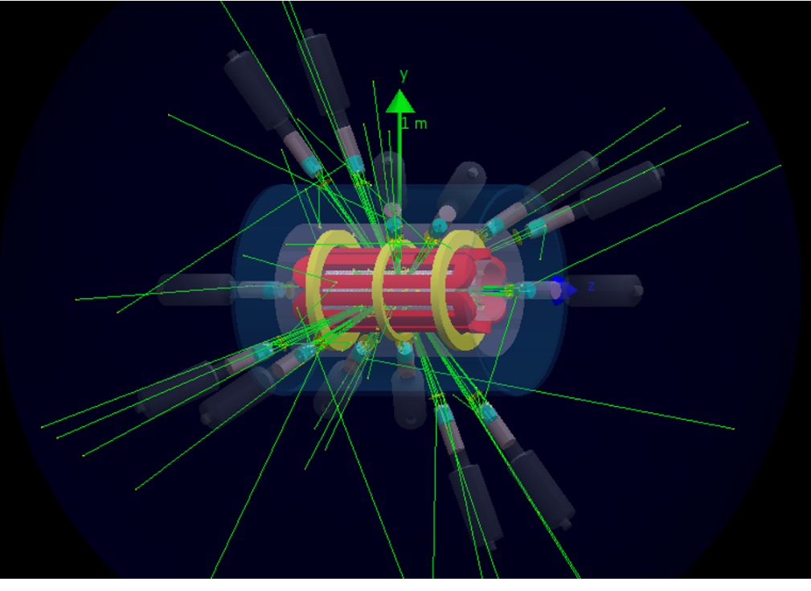
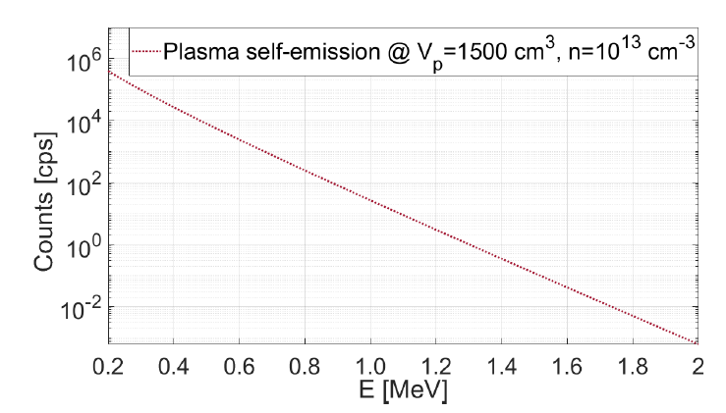
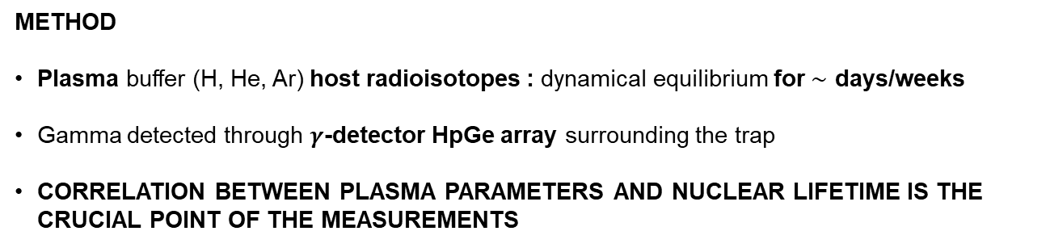

PANDORA concept – design of γ-tagging
The decay-products can be tagged by γ -rays coming out from the ‘‘radio-product’’ with typical energies between 200 keV and 1800 keV
Numerical simulation by GEANT4 according to a certain plasma model to design the array of detector and to estimate the total efficiency of the system
METHOD
Plasma buffer (H, He, Ar) host radioisotopes : dynamical equilibrium for $∼$ days/weeks
Gamma detected through $γ$-detector HpGe array surrounding the trap
CORRELATION BETWEEN PLASMA PARAMETERS AND NUCLEAR LIFETIME IS THE CRUCIAL POINT OF THE MEASUREMENTS
E. Naselli et al., EPJ web of conferences 227, 2020, 02006
Isotope | t_{1/2} [ yr ] | E_{γ} [ keV ]
¹⁷⁶Lu | 3.78 · 10¹⁰ | 202.88 & 306.78
¹³⁴Cs | 2.06 | 795.86
⁹⁴Nb | 2.03 · 10⁴ | 871.09
The noise (consisting, especially, in the plasma self emission) affects the detection of the γ signal
STUDY THE DETECTOR EFFICIENCY
STUDY THE MEASURABILITY OF RADIOISOTOPE DECAY
${}_{}^{176}{\text{Lu}}$ - 306 keV γ

Slide 10
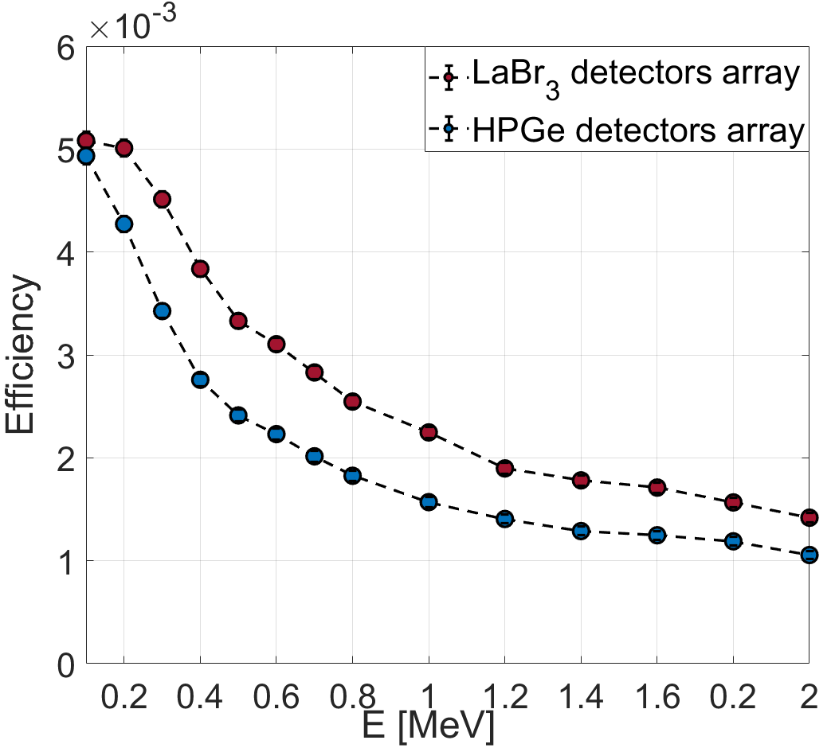
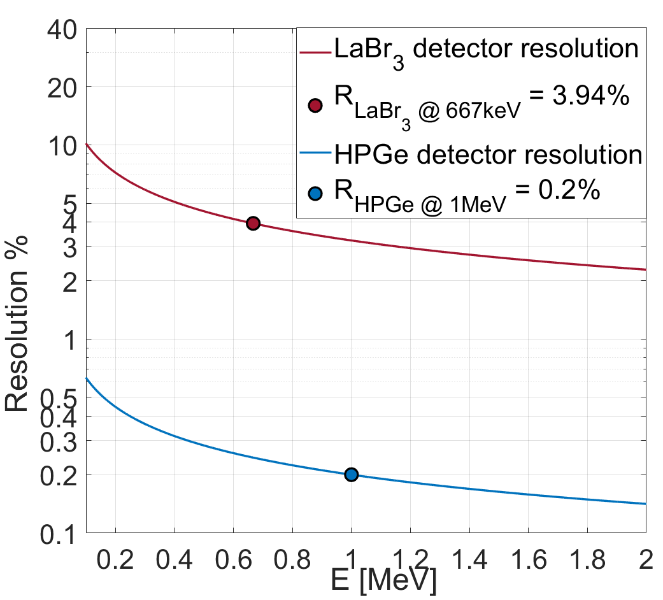
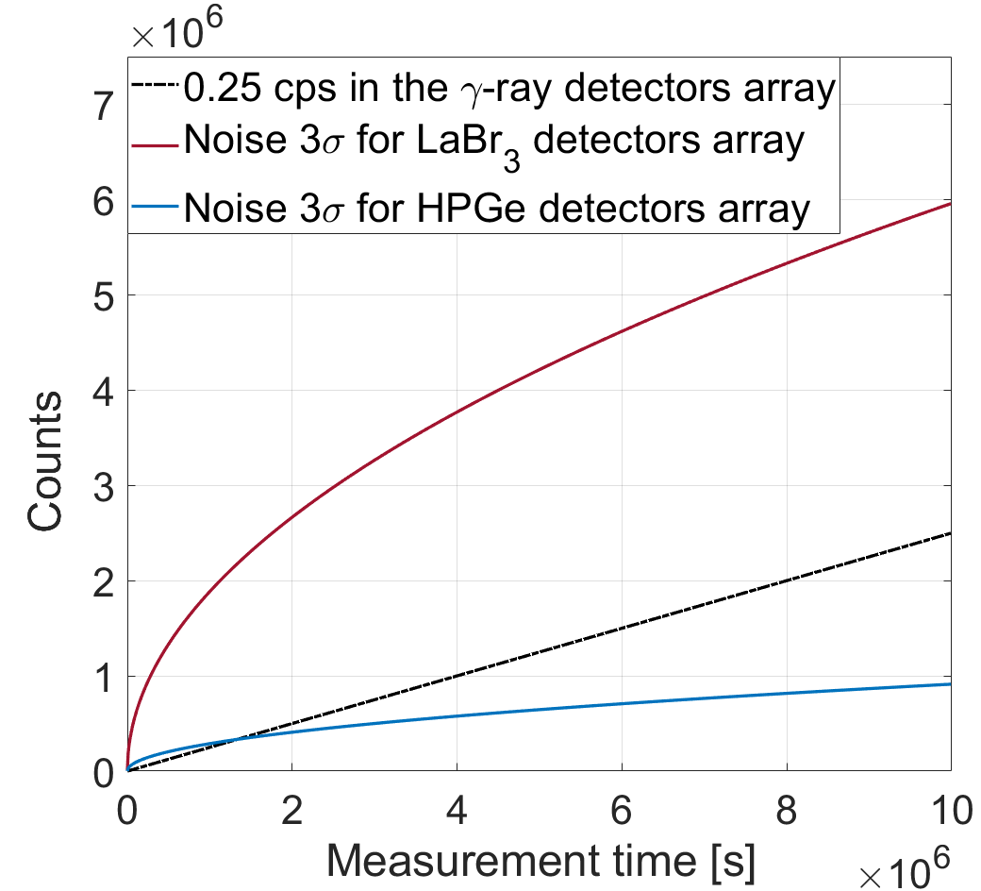

PANDORA concept – design of γ-tagging
The noise (consisting, especially, in the plasma self emission) affects the detection of the γ signal
STUDY THE DETECTOR EFFICIENCY
STUDY THE MEASURABILITY OF RADIOISOTOPE DECAY
${}_{}^{176}{\text{Lu}}$ - 306 keV γ
HPGe vs LaBr3
E. Naselli et al., EPJ web of conferences 227, 2020, 02006
Isotope | t_{1/2} [ yr ] | E_{γ} [ keV ]
¹⁷⁶Lu | 3.78 · 10¹⁰ | 202.88 & 306.78
¹³⁴Cs | 2.06 | 795.86
⁹⁴Nb | 2.03 · 10⁴ | 871.09
σ_{Res} = 7.57 keV
σ_{Res} = 0.24 keV

Slide 11
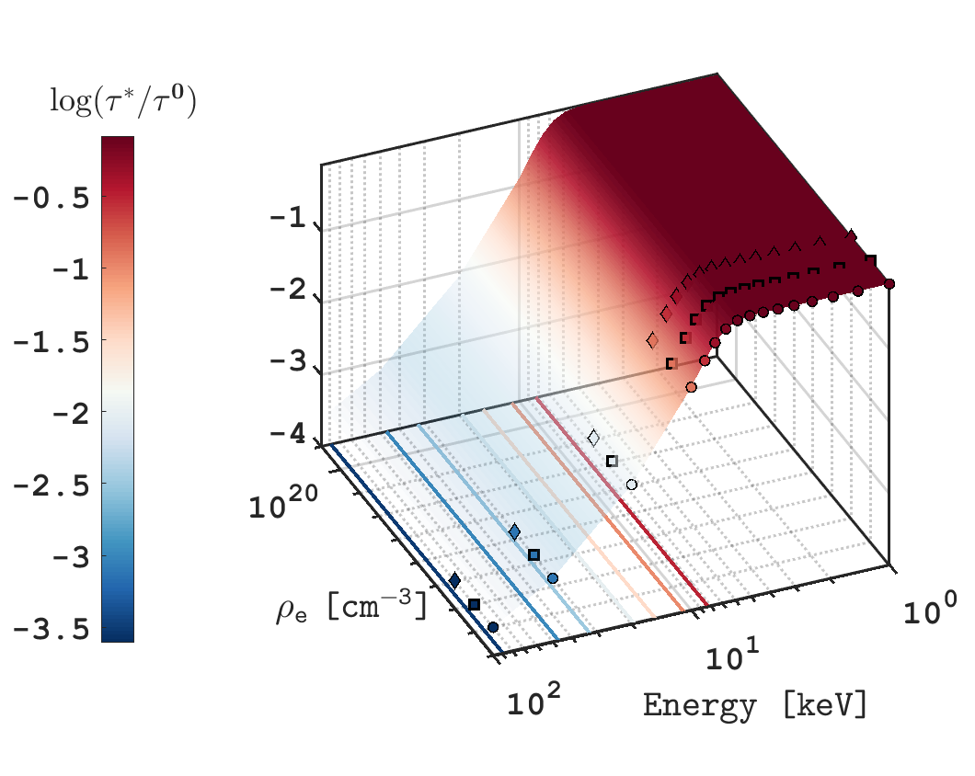
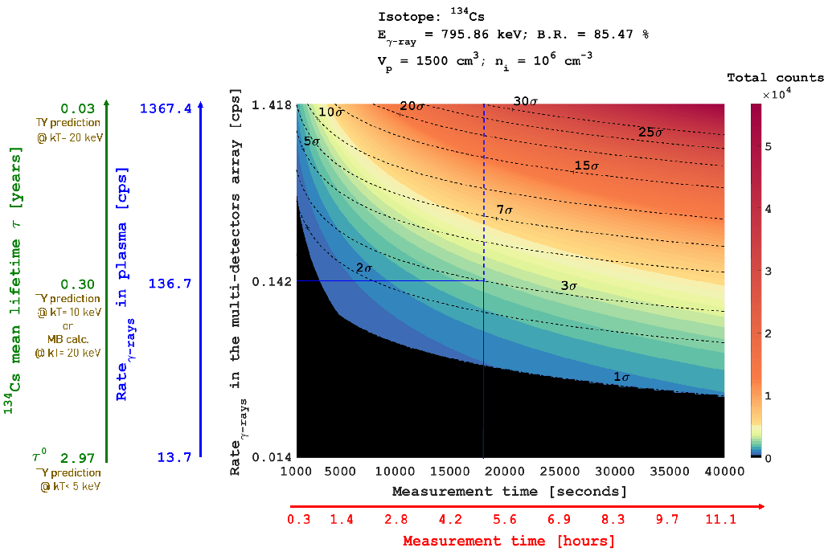

On s-process for AGB stars: virtual experiments
STUDY THE DETECTOR EFFICIENCY
STUDY THE MEASURABILITY OF RADIOISOTOPE DECAY
Let’s focus on the ¹³⁴Cs decay process, relevant for s-process nucleosynthesis branching points in AGB stars modelling
Short-living isotope
¹³⁴Cs | 2.06 [y] | 795.86 [keV]
Measurement time required in terms of 3σ-confidence-level for the decay-rates measurement.
Estimates based on calculations of stellar-perturbed half-life of ionized nuclei, considering the CSD led by electron densities and energies typical of the plasma trap.
CSD computed via ion kinetics population FLYCHK code
Half-life computed adopting the methodology developed by K Takahashi and K Yokoi
Expected experimental measurement time considering cps, det. efficiency
$${}_{}^{134}{\text{Cs}} @ 10^{12}cm^{−3}$$
INPUTS: parent nuclei atomic number, mass number, CSD, nuclear energy levels, spin, parity

Slide 12
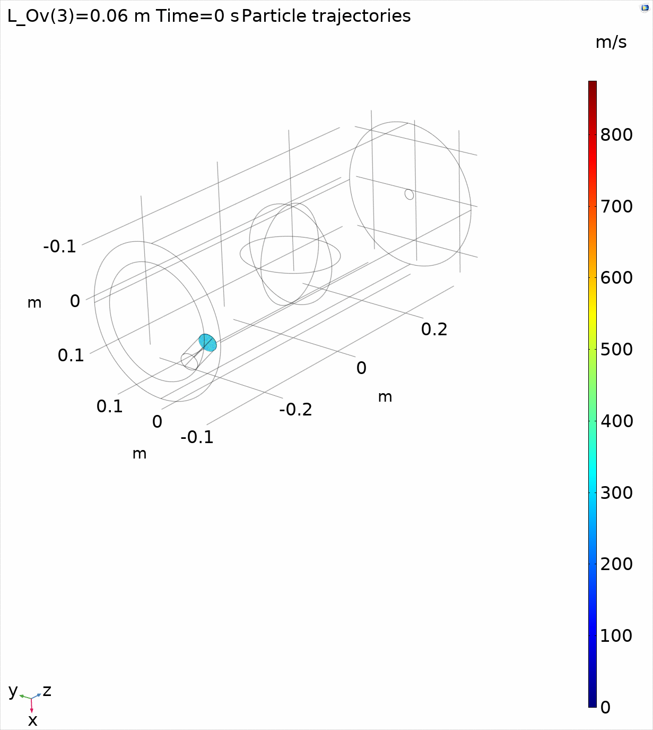
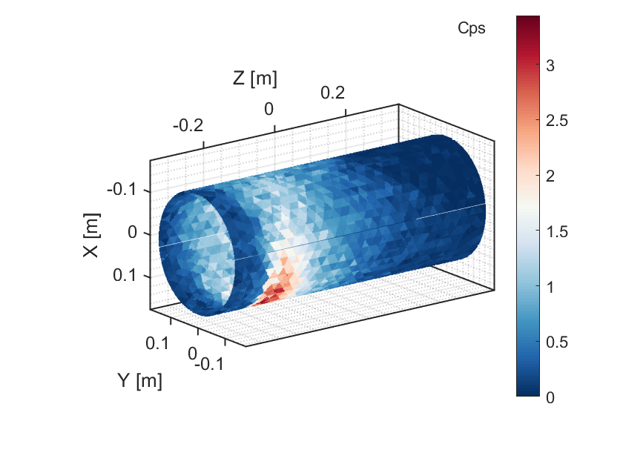
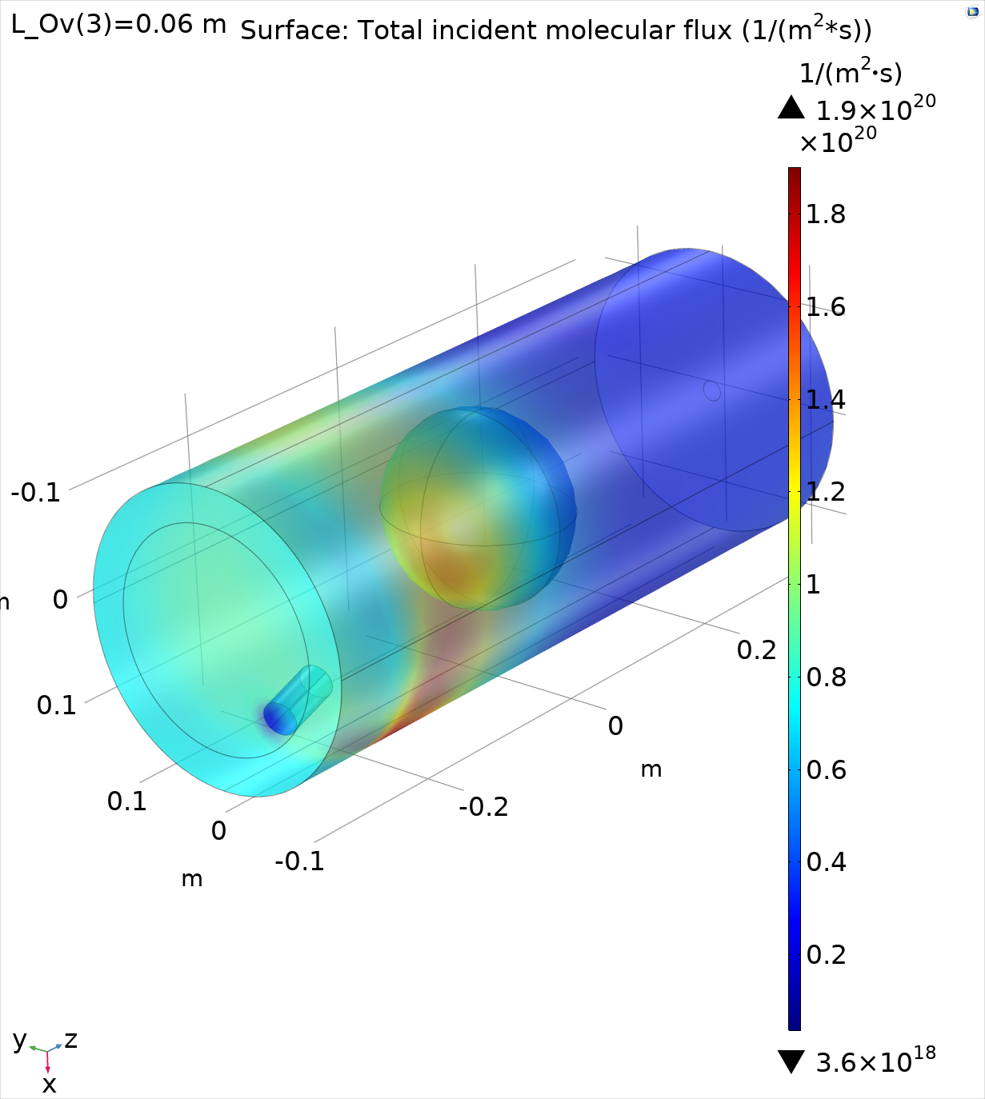
On s-process for AGB stars: virtual experiments
STUDY THE DETECTOR EFFICIENCY
STUDY THE MEASURABILITY OF RADIOISOTOPE DECAY
Let’s focus on the ¹³⁴Cs decay process, relevant for s-process nucleosynthesis branching points in AGB stars modelling
Short-living isotope
¹³⁴Cs | 2.06 [y] | 795.86 [keV]
Simulate the impact of short-lived radioisotopes’ neutral depositions on the plasma chamber walls, being an additional source of background for the HPGe detectors array
Modelling the Cs neutral dynamics in chamber – COMSOL Multiphysics
(1)
(2)
(3)
Particle diffusion tracking
Free Molecular flow regime
Reconstructed density on the surface
Neutrals going into plasma: 21.4 %

Slide 13

On s-process for AGB stars: virtual experiments
STUDY THE DETECTOR EFFICIENCY
STUDY THE MEASURABILITY OF RADIOISOTOPE DECAY
Let’s focus on the ¹³⁴Cs decay process, relevant for s-process nucleosynthesis branching points in AGB stars modelling
Short-living isotope
¹³⁴Cs | 2.06 [y] | 795.86 [keV]
Simulate the impact of short-lived radioisotopes’ neutral depositions on the plasma chamber walls, being an additional source of background for the HPGe detectors array
Modelling the impact on the HPGe efficiency
Work in progress
Increasing the noise with different time-dependent law w.r.t. the background plasma noise
Change of detection efficiency of this signal: different source geometry (chamber wall)
Cumulative events: density of deposited neutrals is not constant in time!
Expected to be more impacting for short-living isotopes!

Slide 14
Summary and perspectives
Important branching points of s-processes in the nucleosynthesis chain depend on the “competitive” rates of neutron capture vs. β-decays
New perspectives for investigating nuclear beta decays in highly ionized plasma via PANDORA: starting from 2024!
Several numerical virtual experiments both on (1) perturbed decay theory – including atomic inputs in the nuclear decay – as it impact on the measurement time required for significant experimental data;
(2) gamma-tagging detector efficiency for each physics case – considering both intrinsic and geometrical aspects, as well as impact of neutral vapor deposition on the plasma chamber wall
Outlook: improvement of simulation on gamma detection, simulation of vapor deposition considering self-consistently obtained plasma parameters
See about Modelling Ion Population Kinetics in ECR Plasmas to Extract Inputs for In-Plasma β-Decay Rates (next talk by B. Mishra)

Slide 15
Thanks for your attention !

Slide 16
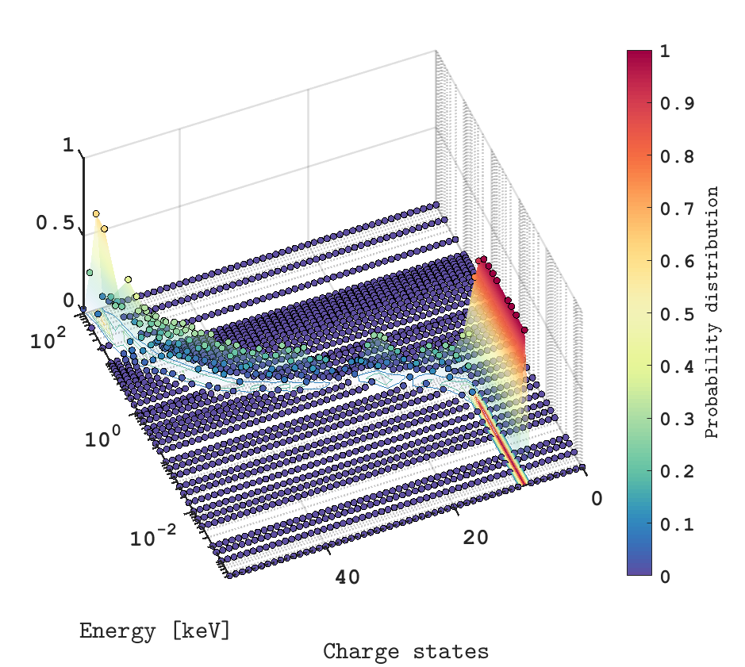
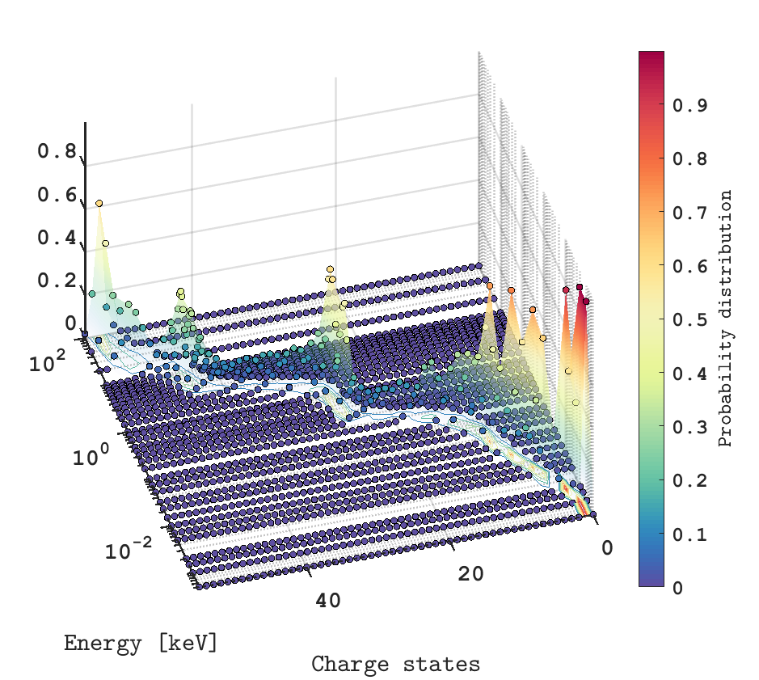
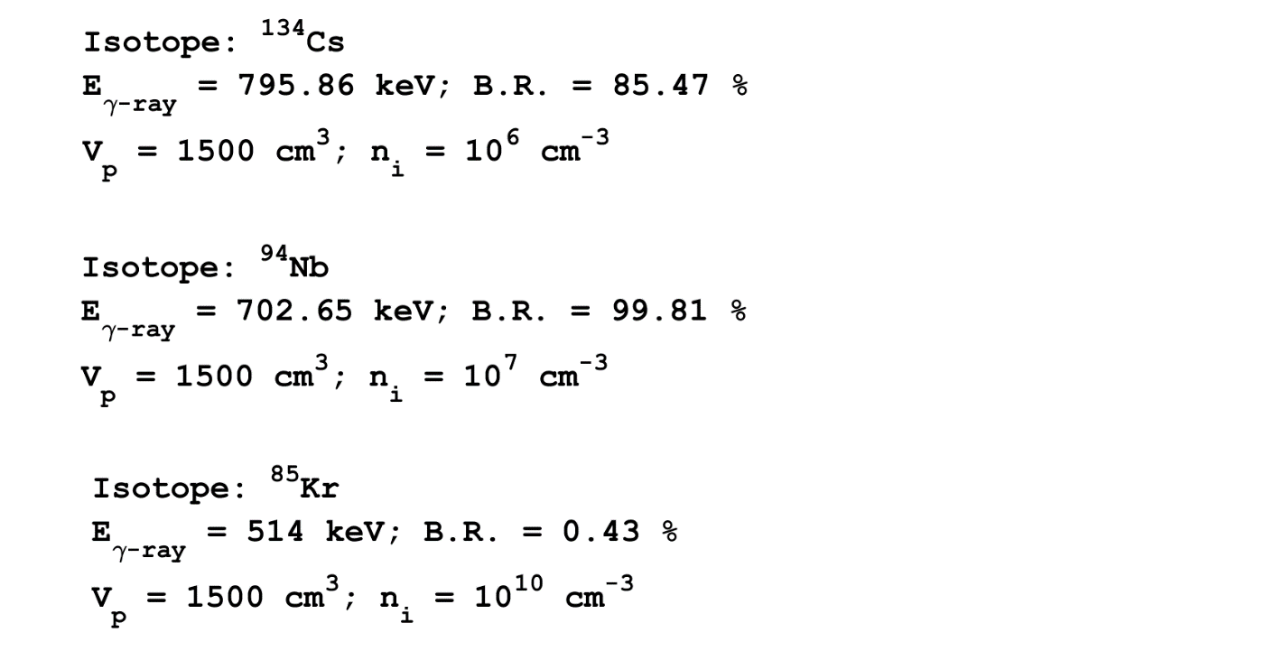
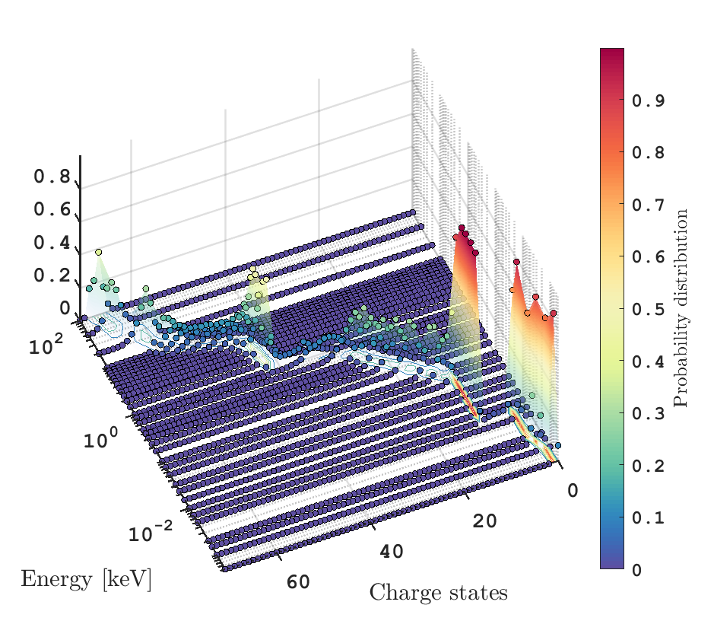
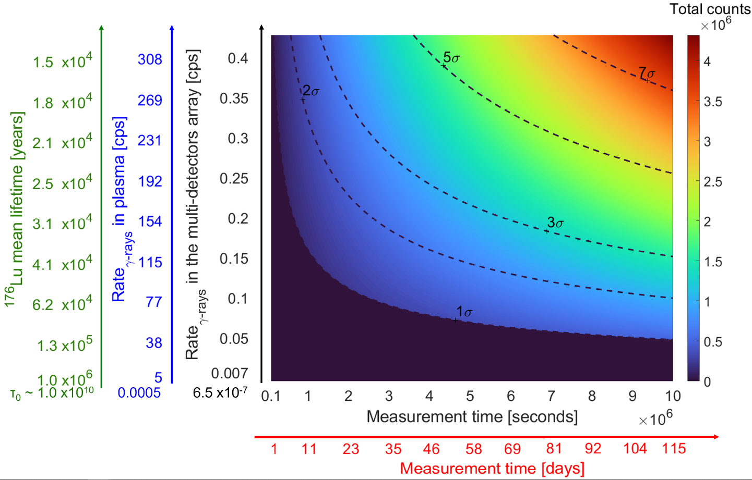
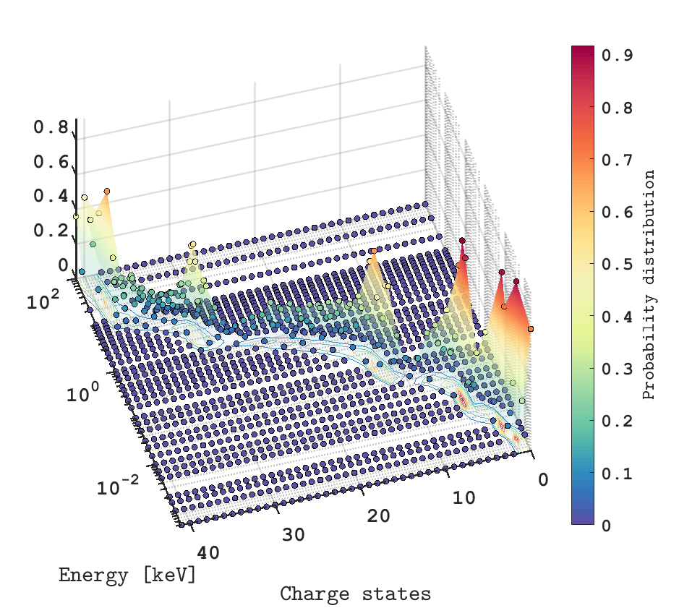
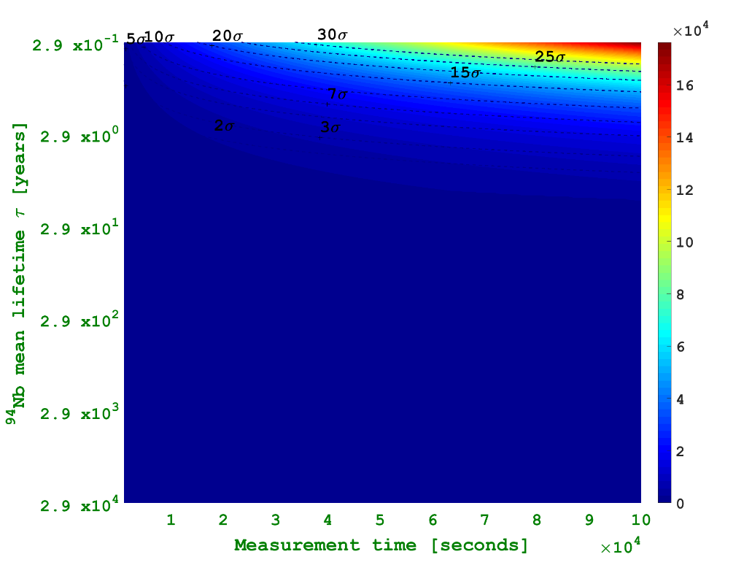
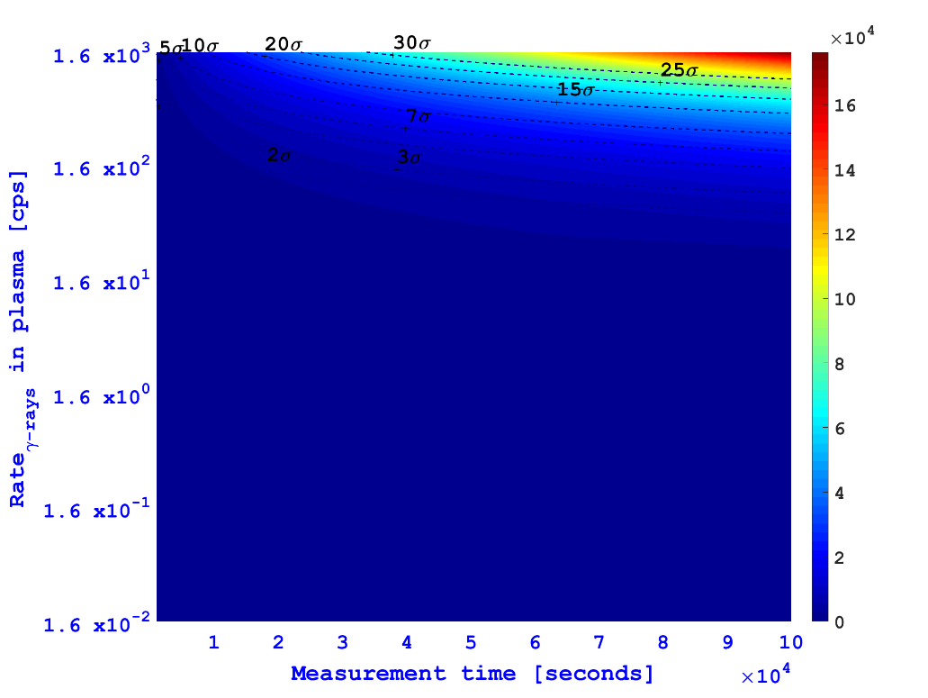
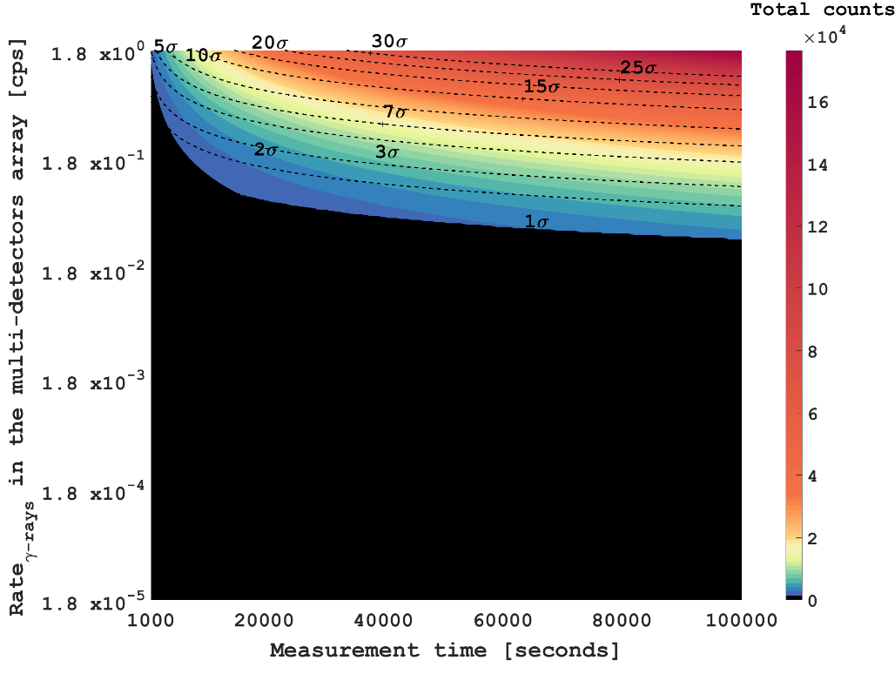
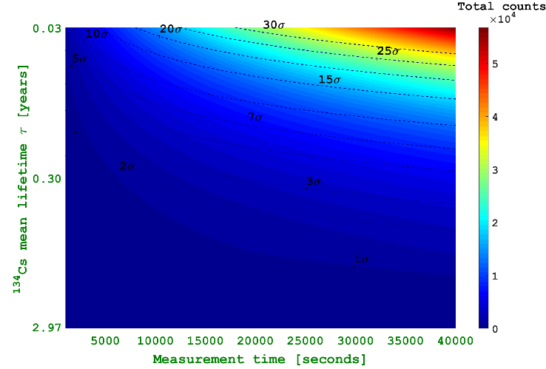

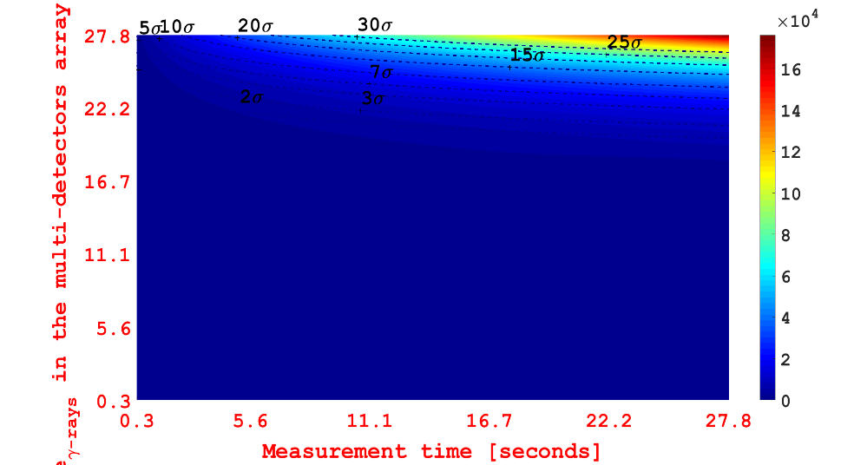
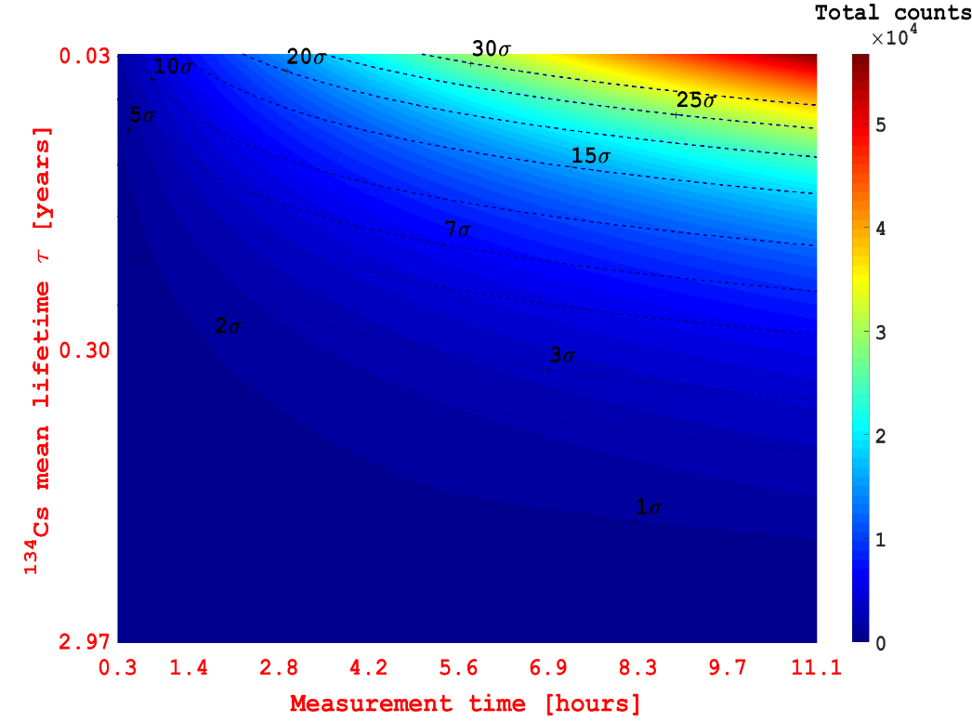








On atomic inputs for perturbed half-life – I
$${}_{}^{134}{\text{C}s→^{134}Ba}$$
$$10^{12}cm^{−3}$$
$$10^{16}cm^{−3}$$
$$10^{24}cm^{−3}$$
$${}_{}^{94}{Nb→^{94}Mo}$$
$$10^{12}cm^{−3}$$
$${}_{}^{176}{Lu→^{176}Hf}$$
$$10^{12}cm^{−3}$$

Slide 17
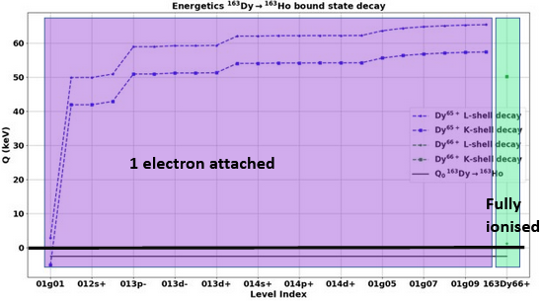



On atomic inputs for perturbed half-life – II
STELLAR
c. d.
c. c.
b. c. / b. d.
Q-value of bound state ¹⁶³Dy→¹⁶³Ho transition as a function of degree of ionization/excitation
CSD and level population of ions
EEDF of electrons
TERRESTRIAL
Nuclear Matrix Element (NME)
Type of transition (allowed, unique first forbidden… - Determines shape factor S_{m}(x)
[1] K. Takahashi and K. Yokoi, Nucl. Phys. A404 (1983) 578

Slide 18
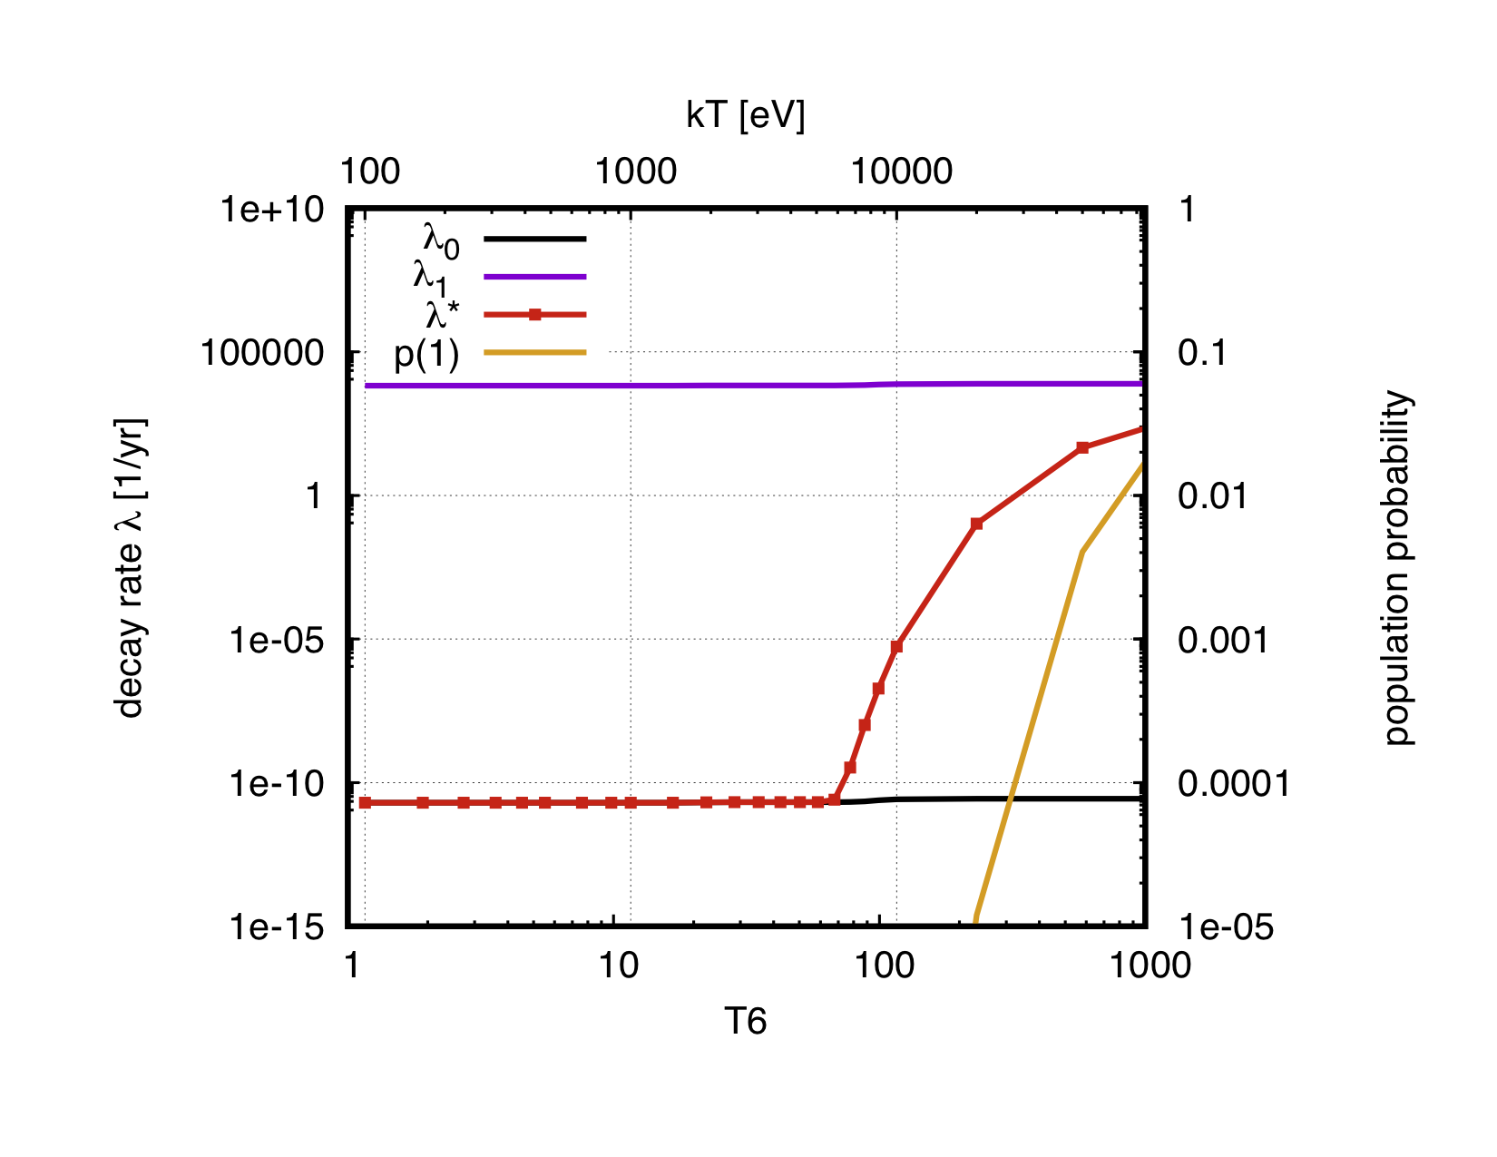
On atomic inputs for perturbed half-life – III
Theory of perturbed decay rates in stellar environments (Takahashi, Yokoi – TY)
$$λ^{∗}=p_{0}λ_{0}+ p_{1}λ_{1}+ …$$
$$t_{1/2}= \frac{\ln{2}}{λ}$$
Decay rate from GS
Decay rate from first nuclear ES
Courtesy of A. Mengoni

Slide 19
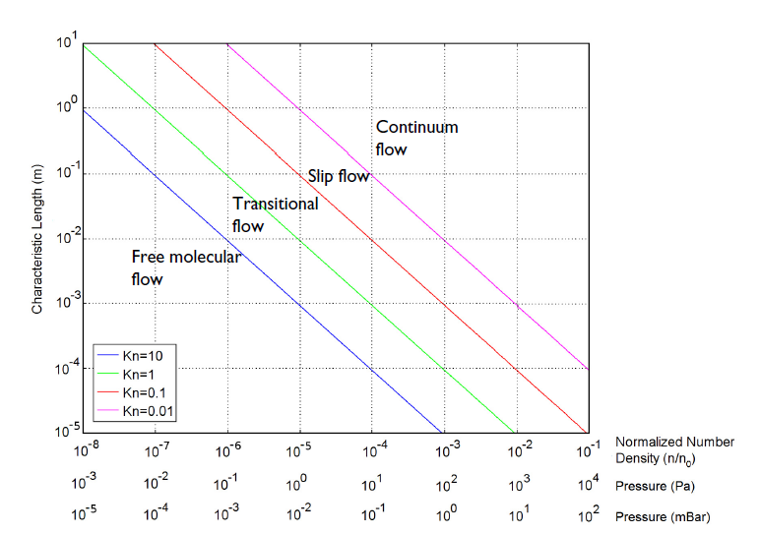


More on neutral depositions: details on simulations
Physics case: cylindrical chamber, neutral diffusion led by the resistive oven, looking at a high-vacuum reservoir.
Q1. Is it possible to study the neutral gas pluming as a fluidodynamic problem? If YES, under which regime?
Considering an ideal gas
$$pV=nRT$$
$$n_{V}=\frac{pN_{A}}{RT}=\frac{p}{k_{B}T}$$
$$Kn=\frac{λ}{L}=\frac{k_{B}T}{πd^{2}p}$$
Considering a chamber pressure of 1E-5 mbar and length 0.7 m, a gas temperature of 417 °K, and a Cs particle diameter of 6E-10 m
Kn = 7
Hydrodynamic simulation of particles flowing under free-molecular flow regime
Particle tracking of MB emitted particles from oven at given temperature

Slide 20

More on neutral depositions: details on simulations
Parameter | Expression | Value | Description
Radius PANDORA |  | 140 mm | Chamber radius
Length PANDORA |  | 700 mm | Chamber length
Radius oven |  | 2.5 mm | Oven radius
MCs |  | 0.134 kg/mol | Mol Weight Cs
M | MCs/N_A | 2.23E-25 kg | Mass
TC |  | 293 K | Cham. Temperature
TO |  | 417 K | Oven Temperature
p_in |  | 1E-2 mbar | Inlet pressure (Vapor Saturation pressure)
p_vacuum |  | 1E-6 mbar | Vacuum
J_in | $$\frac{p_{in}N_{A}}{\sqrt{2R⋅TO⋅MCs⋅π}}$$ | 1.11E22 1/m²s | Emitted molecular flux
Np |  | 10000 | Number of particles
Hydrodynamic simulation of particles flowing under free-molecular flow regime
Particle tracking of MB emitted particles from oven at given temperature

Slide 21



More on neutral depositions: details on simulations
Parameter | Expression | Value | Description
Radius PANDORA |  | 140 mm | Chamber radius
Length PANDORA |  | 700 mm | Chamber length
Radius oven |  | 2.5 mm | Oven radius
MCs |  | 0.134 kg/mol | Mol Weight Cs
M | MCs/N_A | 2.23E-25 kg | Mass
TC |  | 293 K | Cham. Temperature
TO |  | 417 K | Oven Temperature
p_in |  | 1E-2 mbar | Inlet pressure (Vapor Saturation pressure)
p_vacuum |  | 1E-6 mbar | Vacuum
J_in | $$\frac{p_{in}N_{A}}{\sqrt{2R⋅TO⋅MCs⋅π}}$$ | 1.11E22 1/m²s | Emitted molecular flux
Np |  | 10000 | Number of particles
Oven inlet, notaxisymmetric
Total vacuum conditions
Wall conditions = Re-emission
Plasma ellipsoid = sticking probability (go to plasma) or go through
Hydrodynamic simulation of particles flowing under free-molecular flow regime
Particle tracking of MB emitted particles from oven at given temperature

Slide 22






More on neutral depositions: details on simulations

Slide 23





More on neutral depositions: details on simulations
Length oven = 20 mm
Fraction of neutrals going to plasmization = 18.6 %
Length oven = 120 mm
Fraction of neutrals going to plasmization = 28.2 %
Length oven = 10 mm
Fraction of neutrals going to plasmization = 16.8 %
Length oven = 60 mm
Fraction of neutrals going to plasmization = 21.4 %
Length oven = 175 mm
Fraction of neutrals going to plasmization = 40 %

Slide 24


PANDORA concept – design of γ-tagging
Ellipsoidal source + collimation (hole) position of detector (angular distribution)
E. Naselli et al., EPJ web of conferences 227, 2020, 02006

