Slide 1


Numerical methods for AGB stars and modeling in the PARSEC framework
Francesco Addari
Ph.D. student for Astrophysics and Cosmology group
Scuola Internazionale Superiore di Studi Avanzati, Trieste
faddari@sissa.it
Supervisors:
prof. Bressan, Alessandro
prof. Marigo, Paola
Perugia, 21st June 2022

Slide 2
Introduction: Stellar Structure and Evolution dictionary
Complete stellar evolutionary track. The number corresponds to log₁₀ (Age) of the phase.
I am working on the advanced stages of low ( M ≲ 2M⊙ ) and intermediate (2 ≲ M/M⊙ ≲ 7) mass stars: Asymptotic Giant Branch phase (AGB).
PARSEC framework.
Herwig, F. (2005)

Slide 3
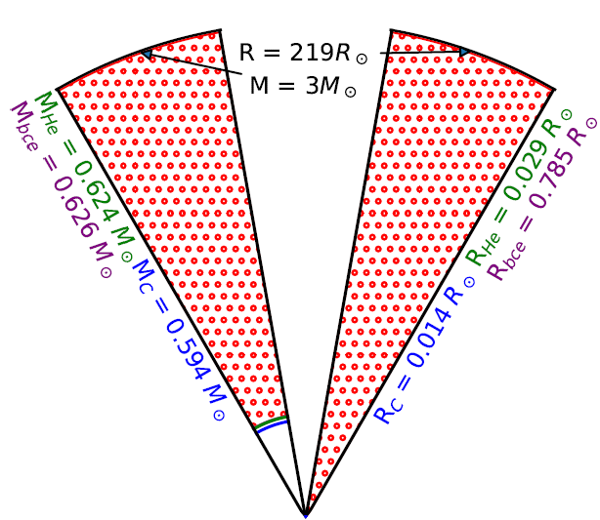
Introduction: Stellar Structure and Evolution dictionary
He-intershell is thin and geometrically unstable!
Herwig, F. (2005)

Slide 4
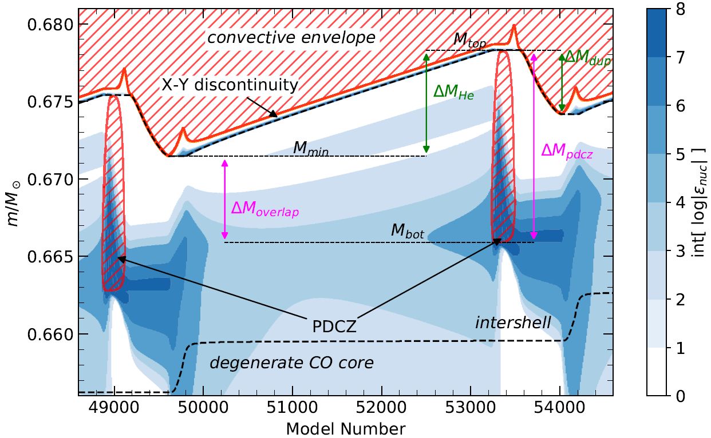

Introduction: Stellar Structure and Evolution dictionary
$$λ= \frac{{ΔM}_{dup}}{{ΔM}_{He}}$$
TDU = Third dredge-up
Recurrent thermal pulses = TPs (He-flashes) every ~10⁴-10⁵ yr
Pulse Driven Convective Zone = PDCZ is the signature of the thermal pulse.
Mixing episodes may take place after TP + Hot Bottom Burning (HBB)

Slide 5
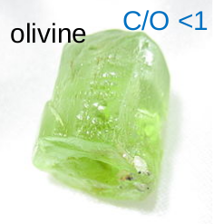
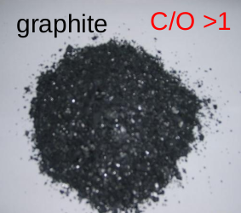
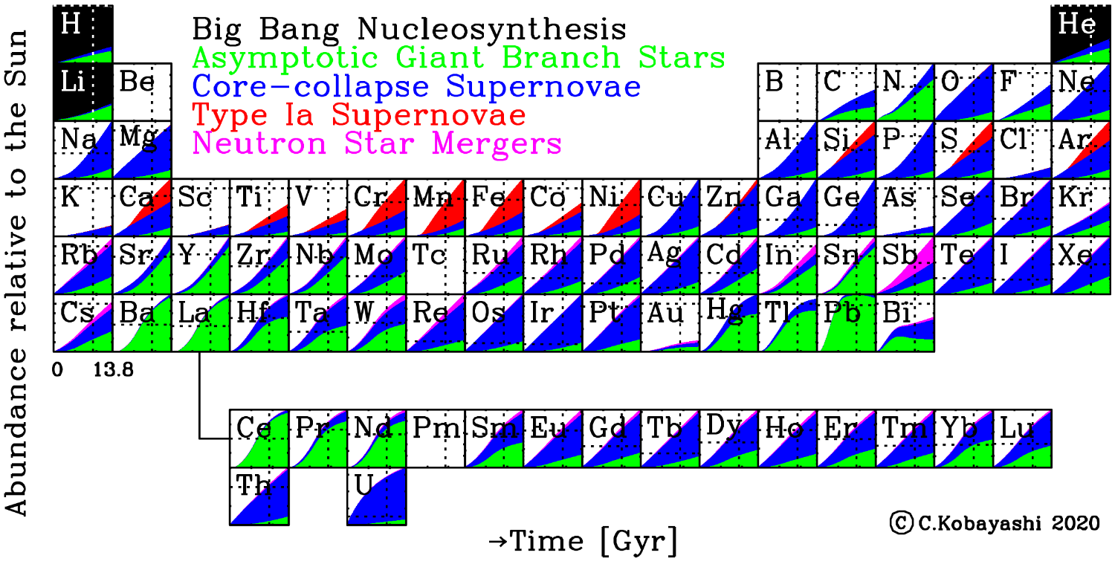
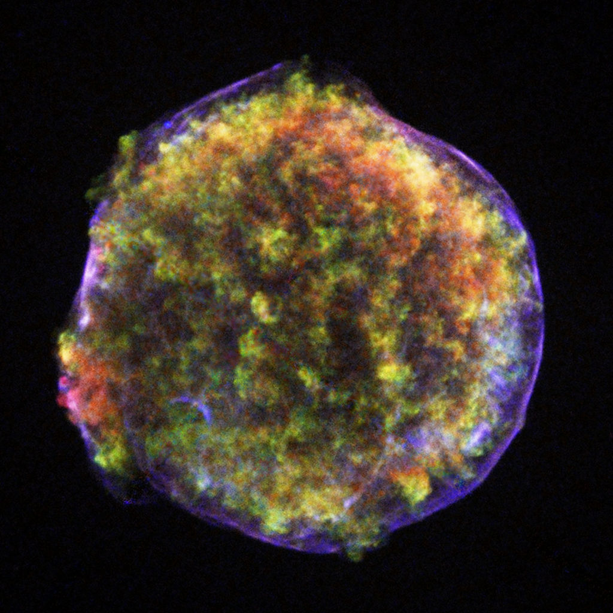
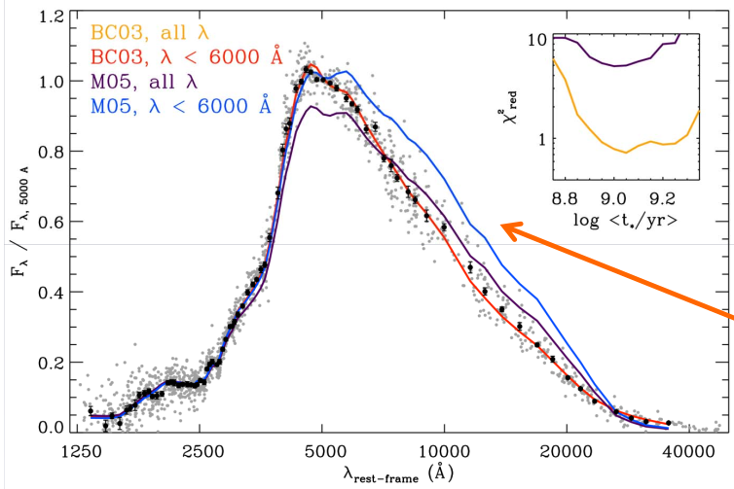
Introduction: why do we still need to study AGB stars?
Rich nucleosynthesis, dust production, final remnants (white dwarfs, electron capture supernovae..).
Complex physics + numerical difficulties involved leads to wide variety of results (convection, mass loss..)
Kriek et al. (2010)

Slide 6
PAdova and TRieste Stellar Evolution Code
PARSEC is extensively described in Bressan et al. 2012, 2013; Chen et al. 2014, 2015; Tang et al. 2014; Fu et al. 2018; Costa et al. 2019. See also new isochrones in the poster by Thanh et al.
My recent additions (ongoing further testing!):
Shell shifting + Δt correction during interpulses in TP-AGB.
Exponential overshooting (Freytag 1996)
ÆSOPUS (Marigo and Aringer 2009) low temperature opacities with C, N, O nodes.
Relevant input physics:
Böhm-Vitense 1958 Mixing Length Theory with α_{MLT} = 1.74
Pre-dust regime Mass loss: Cranmer & Saar 2011. Dust driven regime from RHD simulation of Mattson et al. 2010, Eriksson et al. 2014 and Bladh et al. 2019.
Caffau et al. 2011 chemical composition + OPAL high temperature opacities (Iglesias and Rogers 1996)
No rotation
Notes:
On top of moving the shell during the nuclear reactions, I exploited the physical idea that E1 and EHEL must be equal. The equality gives me back a time. And that is indeed the time that really has elapsed between the two models! That is because the core is inert, burning is only in the shell. The shell is the real clock of the star. If you add that you are choosing timestep based on this “energy conservation criterion” you can speed up the evolution a lot. We tested over a factor of 10 respect to the small timestep with original parsec. You can see now that E1 and Ehel are very similar.
The performance is similar to other codes like mesa, but without parallelization and on a single core.
This is interesting because this idea may be used in other situations. Maybe even in the rgb phase where you still have a hydrogen shell there. Or in the carbon flame for super agb stars. We can exploit the effort made here in other situations.

Slide 7
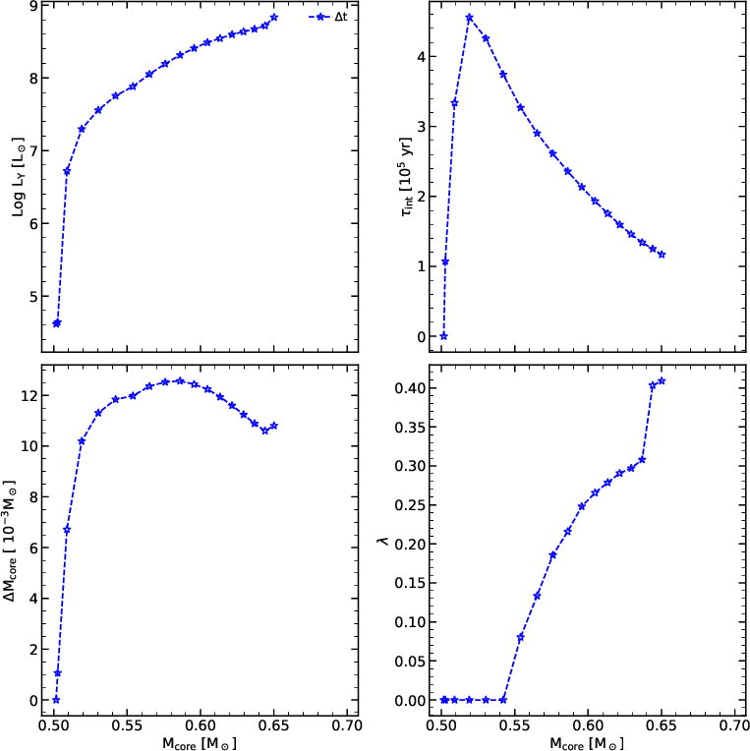
TP-AGB evolution: critical choice of timestep
2.5 M⊙ Z=0.014 Y=0.273 without convective overshooting in any border.
TDU efficiency is high enough to lift C/O > 1, as expected for this mass at solar metallicity (Marigo+2020)

Slide 8
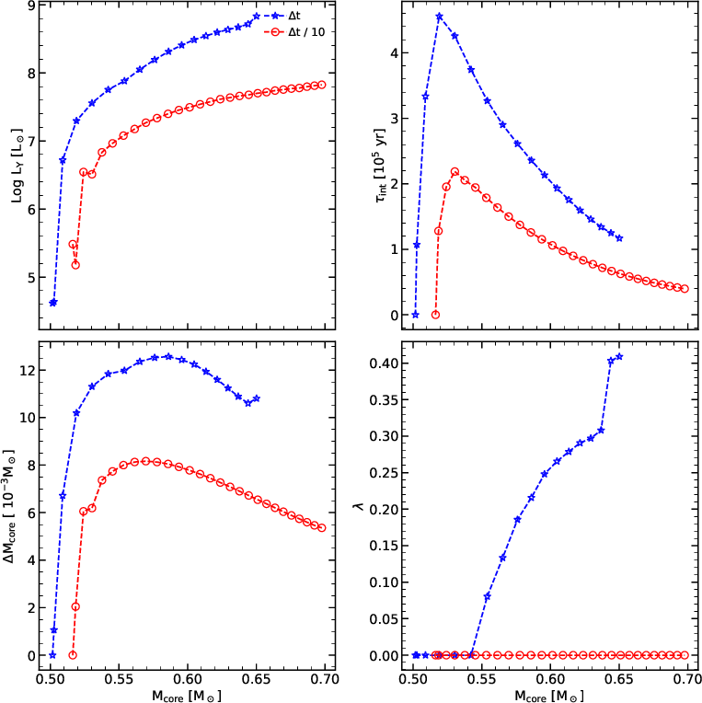
TP-AGB evolution: critical choice of timestep
2.5 M⊙ Z=0.014 Y=0.273 without convective overshooting in any border.
During the interpulse phase the timestep is divided by 10.
Now there is no TDU!

Slide 9
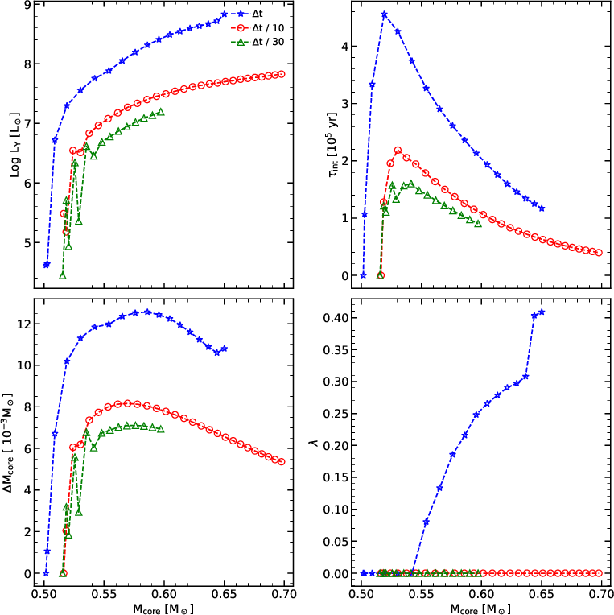
TP-AGB evolution: critical choice of timestep
Dramatically different models.
Only the “large timestep track” is able to do 3rd dredge-up without overshooting.
Where is the problem?
“Energy conservation”
What are the consequences? Different core mass at end of the evolution, different C/O value, mess with initial final mass relation…

Slide 10
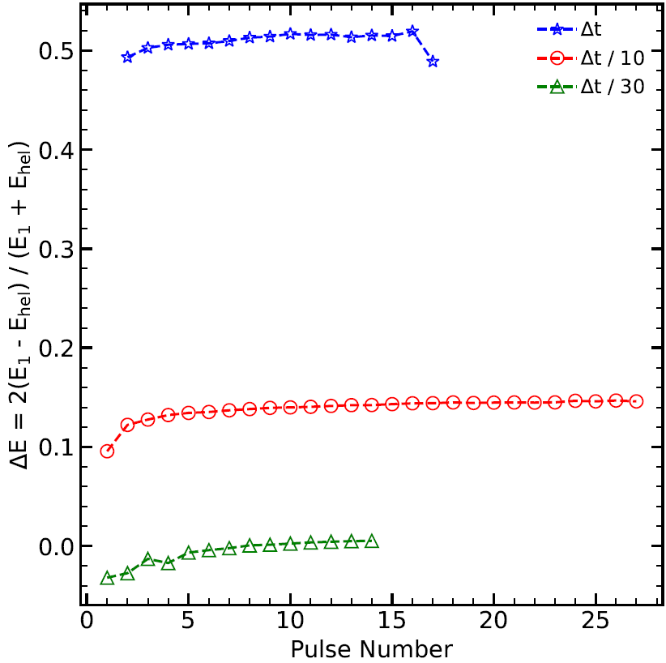
Yes.. But not effectively. Part A: shell shifting
2.5 M⊙ Z=0.014 Y=0.273 no overshooting
Energy is instantaneously conserved, it is one of the stellar structure equation. If not the code would stop.
Two ways to calculate energy produced by hydrogen burning:
E₁ = ∫ L_{H} dt
E_{hel} = ∫ dM (X_{old} – X_{new}) q_{value}
Being ΔE > 0, H-shell is not moving out the right amount for the produced luminosity.
Notes:
But this does not happen! We find out, by comparing the energy from the hydrogen luminosity and the energy calculated from the burnt hydrogen, that they are not the same but of course they should be. Difference are unphysical, because were is going that energy? If you check that the sum of e_nuc + e_grav = e_tot you find agreement. Thus, the shell is not moving accorindly to the luminosity given by the model. That MAY be due to the fact that parsec separates structure equation from chemical routine.
In short (but it was a lot of time this year) I implemented a routine that updates the main structure profile during nuclear reactions network. This alleviates much the problem, but still we are not satisfied because we need more than 200 hours for a 2.5msun track. And the computing time increases as the mass increases.

Slide 11
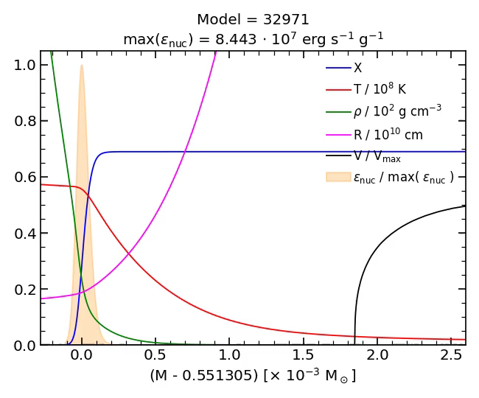
Shell shifting in a nutshell
Everything moves rigidly. You can find a better guess for the next model by writing:
T_{guess}(m) = T(m - ΔM_{x})
where ΔM_{x} is the burnt hydrogen.
The shift is applied only during interpulse, when hydrogen burning is active.
Notes:
So, its energy conserved? It should be since energy conservation is one of the stellar structrure equation. If it wasn’t conserved the model wouldn’t give convergence. If you study tracks at very small timestep you can investigate things being sure that things work. The video shows the energy generation profile (orange) , hydrogen profile (blue) and all the quantities that goes inside the chemical routine. Temperature in red, density in green. You can see everything moves ridigly, and that’s because the h-shell that powers the star is very thin compared to the structure. Its like you burn all the hydrogen in the shell, then temperature and density rises there and you kinda have a “burning front” going outwards. This is done with small timestep, but should be the same at all timestep ideally.

Slide 12
Shell shifting in a nutshell
Alleviates the problem but it is not enough. Still 200+ hours of computing time.
Shell shifting was already suggested by Weigert (1966). Same idea but different implementation.
Notes:
So, its energy conserved? It should be since energy conservation is one of the stellar structrure equation. If it wasn’t conserved the model wouldn’t give convergence. If you study tracks at very small timestep you can investigate things being sure that things work. The video shows the energy generation profile (orange) , hydrogen profile (blue) and all the quantities that goes inside the chemical routine. Temperature in red, density in green. You can see everything moves ridigly, and that’s because the h-shell that powers the star is very thin compared to the structure. Its like you burn all the hydrogen in the shell, then temperature and density rises there and you kinda have a “burning front” going outwards. This is done with small timestep, but should be the same at all timestep ideally.

Slide 13
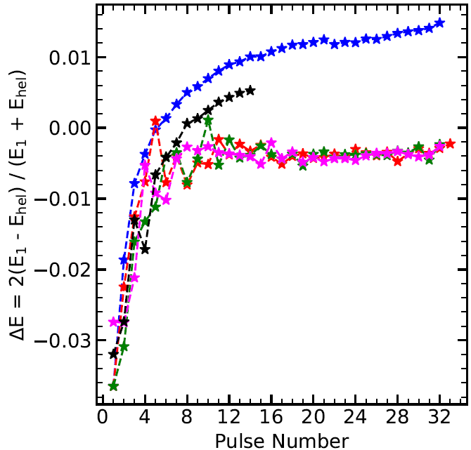
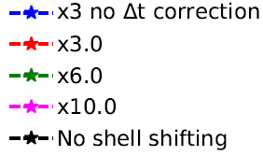

Δt correction: the real clock is the H-shell itself
2.5 M⊙ Z=0.014 Y=0.273 no overshooting
On top of the shell shifting I can choose the timestep imposing the equality between E₁ and (a proxy for) E_{hel}.
From +400 hours (>15000 models between pulses) we can compute the same number of thermal pulses in 50-60 hours (~3000 models per interpulse), with a similar accuracy, for 2.5M⊙ model.
Idea: similar approach may be generalized to other complex situations, i.e. H-shell in RGB phase, inward carbon flame for Super AGB stars... To be continued..
$$∆t^{′}\sim \frac{E_{hel}}{E_{1}}∆t$$
Notes:
On top of moving the shell during the nuclear reactions, I exploited the physical idea that E1 and EHEL must be equal. The equality gives me back a time. And that is indeed the time that really has elapsed between the two models! That is because the core is inert, burning is only in the shell. The shell is the real clock of the star. If you add that you are choosing timestep based on this “energy conservation criterion” you can speed up the evolution a lot. We tested over a factor of 10 respect to the small timestep with original parsec. You can see now that E1 and Ehel are very similar.
The performance is similar to other codes like mesa, but without parallelization and on a single core.
This is interesting because this idea may be used in other situations. Maybe even in the rgb phase where you still have a hydrogen shell there. Or in the carbon flame for super agb stars. We can exploit the effort made here in other situations.

Slide 14
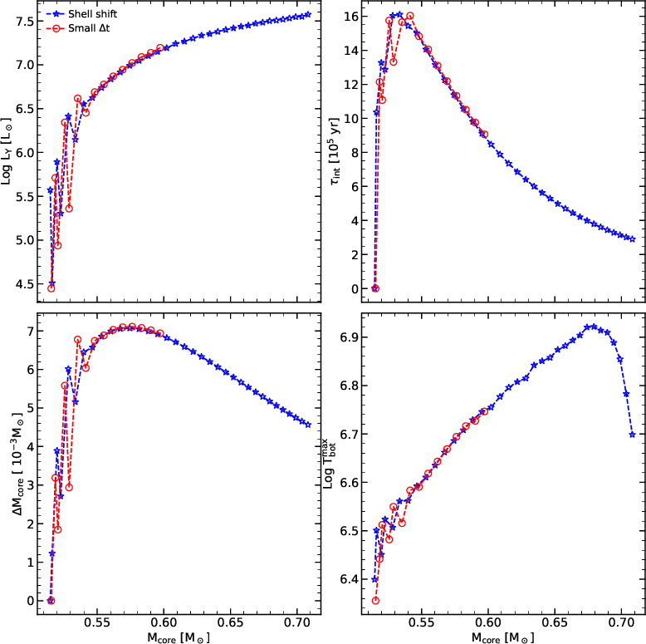
Comparison without shell shifting
2.5 M⊙ Z=0.014 Y=0.273 without convective overshooting in any border.
Red circles: small timestep track.
Blue stars: shell shifting track.
Track is not able to dredge-up material.
Energy is conserved up to the same accuracy.
Notes:
On top of moving the shell during the nuclear reactions, I exploited the physical idea that E1 and EHEL must be equal. The equality gives me back a time. And that is indeed the time that really has elapsed between the two models! That is because the core is inert, burning is only in the shell. The shell is the real clock of the star. If you add that you are choosing timestep based on this “energy conservation criterion” you can speed up the evolution a lot. We tested over a factor of 10 respect to the small timestep with original parsec. You can see now that E1 and Ehel are very similar.
The performance is similar to other codes like mesa, but without parallelization and on a single core.
This is interesting because this idea may be used in other situations. Maybe even in the rgb phase where you still have a hydrogen shell there. Or in the carbon flame for super agb stars. We can exploit the effort made here in other situations.

Slide 15
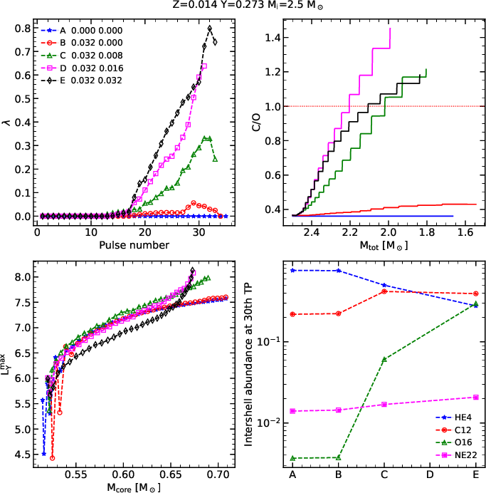

Convective overshooting
$$λ= \frac{{ΔM}_{dup}}{{ΔM}_{He}}$$
Legend columns: f_{ov,env} - f_{ov,pdcz}
Adding the overshooting at the convective envelope is not enough. The efficiency is limited.
Adding the overshooting also to the PDCZ is key to make carbon stars.
Notes:
You can add overshooting in all borders or not. In the legend you have the efficiency of overshooting in the envelope and in the pulse driven convective zone.
Only in the convective envelope is not enough in parsec, red lines. Lambda stays very small. If you add also to the pdcz we have a huge increase, almost to have no core grow. We can see it from efficiency. Red has overshooting only in the envelope, we have some kind of dredge-up but it is very small. If you put a little but of overshooting then it goes up and you can lift c/O>1. Note also that, as expected, the trend of C/O is not monotonic with the efficiency.
Note that (of course) other elements are affected. VARCNO opacities are extremely important!! Also isotopic ratios are affected. You are in principle able to calibrate 3rd dredge-up in many ways.

Slide 16
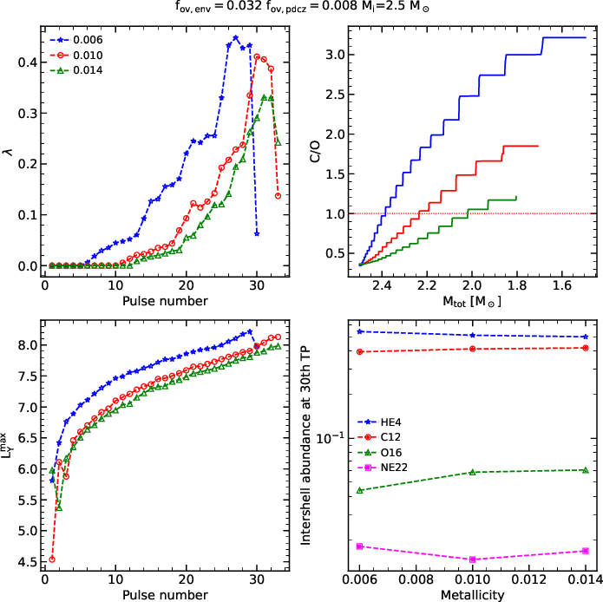
Varying metallicity
At lower metallicity larger efficiency, pulses are more powerful.
Less oxygen in the surface. Easier to get C/O > 1 because intershell composition does not depend on Z.

Slide 17
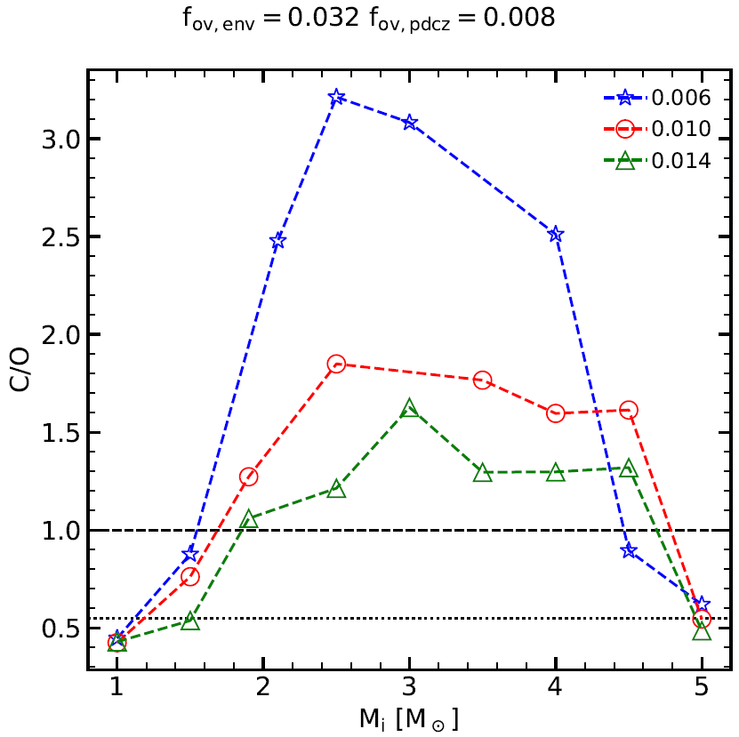
Preliminar results: which stars become C-type?
Carbon enrichment depend on interplay of TDU and HBB. At lower metallicity TDU efficiency is higher and there is less oxygen in the surface.
You expect no carbon stars at the boundaries of the low-intermediate mass range.
As suggested in Marigo et al. 2022 you can calibrate 3rd dredge-up efficiency by looking at the initial-final mass relation. Equivalently, you can get the value for f_{ov,pdcz}. Envelope overshooting can be calibrated using the RGB bump.
Notes:
Finally we can vary also the mass. We can plot the final C/O at the end of the computed track and see which stars become carbon star in the end. This is a way to calibrate the 3rd dredge-up because we can see in the sky which stars are of C-type and infer which is their initial mass. This has been also done in a recent work by Marigo et al 2020 on the non monotonic initial – final mass relation. Indeed there is a kink…?

Slide 18
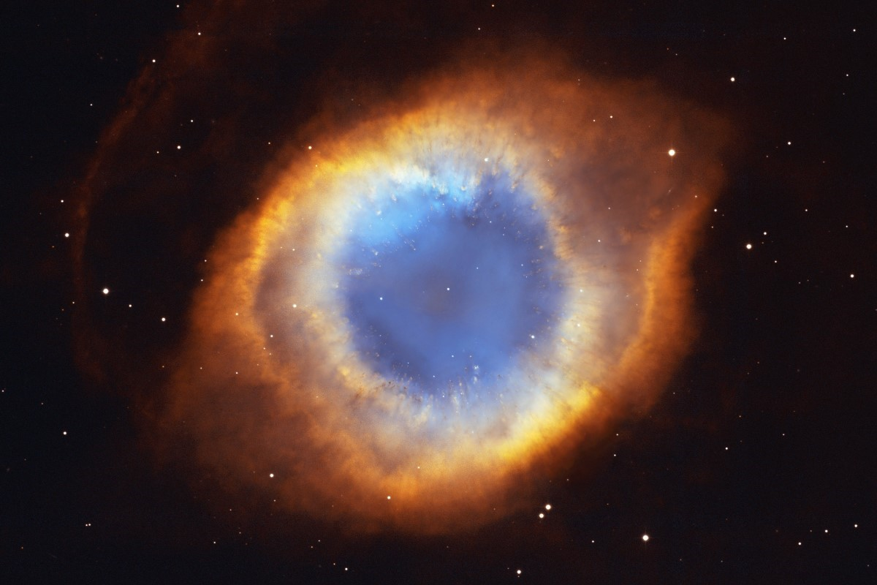
Summary
Timestep choice is critical and it can lead to spurious TDUs.
Computing times can be considerably shortened with shell shifting + Δt correction without losing accuracy.
Hints for considering the overshooting in the PDCZ.

Slide 19
Summary
Timestep choice is critical and it can lead to spurious TDUs.
Computing times can be considerably shortened with shell shifting + Δt correction without losing accuracy.
Hints for considering the overshooting in the PDCZ.
Thanks for your attention!
faddari@sissa.it

Slide 20
Backup slides

Slide 21
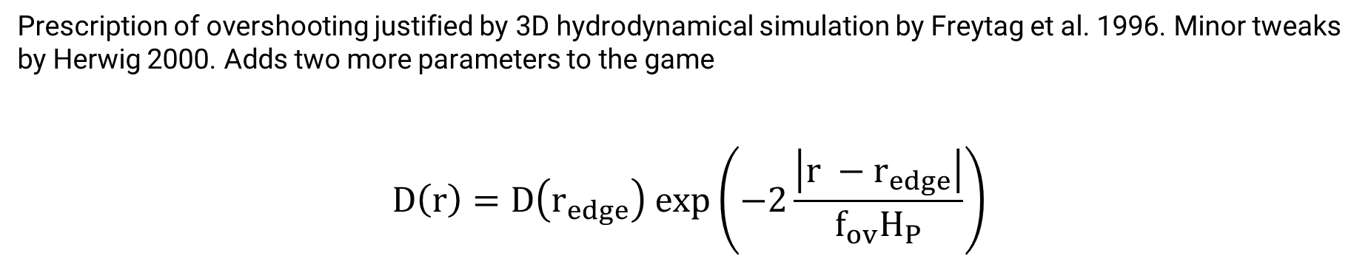
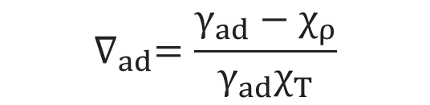
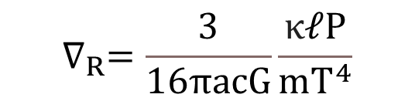


Exponential overshooting
Prescription of overshooting justified by 3D hydrodynamical simulation by Freytag et al. 1996. Minor tweaks by Herwig 2000. Adds two more parameters to the game
$$D\left(r\right)=D\left(r_{edge}\right) exp\left(−2\frac{\left|r −r_{edge}\right|}{f_{ov}H_{P}}\right)$$
$$r_{edge}= r_{schw}±f_{ov,0}H_{P}$$
Convective border is found with the Schwarzchild criterion
$${∇_{R}(r}_{schw})={∇_{ad}(r}_{schw})$$
$$∇_{R}=\frac{3}{16πacG}\frac{κℓP}{mT^{4}}$$
$$∇_{ad}=\frac{γ_{ad}−χ_{ρ}}{γ_{ad}χ_{T}}$$

