Slide 1
13:th Torino Workshop and 3:rd Perugia Workshop
June, 2022
Semi-empirical yields of nuclei from AGB stars and
the origin of carbon in the Galactic disk
Bengt Gustafsson
Uppsala University, Nordita

Slide 2
Nucleosynthesis in the Galaxy, quantitative understanding?
Nuclear reactions in stars
Mixing to the surface
Stellar mass loss
Mixing in the ISM
Star formation
….
“Yields”
Comparison with observations
                -> (p’₁,p’₂, ….p’_{n})
Many ad hoc assumptions and ”free” parameters, often “fixed” by observations

Slide 3
Often one takes
Yields for “given” by stellar models
Galactic evolution parametrized
Here a different approach is tried:
Yields parametrized
Observables combined to minimize effects of uncertainties in Galactic evolution

Slide 4
[C I] 8727 Å
Massive stars!
Low mass stars!
Low masss stars

Slide 5
(1999)
Bensby & Feltzing (2006)

Slide 6
Gustafsson & Mattsson (2017, Olofsson meeting):
Slope in [C/Fe] - [Fe/H] diagrams S for different massive star/low-intermediate mass contributions Γ
Observed value S =
d[C/Fe]/d[Fe/H] ≈ 0.2 -> Γ ≈> 0.45 – 0.50
Γ

Slide 7
Here is a new attempt
Considerably improved observations
Abundances to 5% or better
Ages to 0.5 Gyr
Volume of data!

Slide 8
Botelho et al. (2020)
CH + CN

Slide 9
[C/O] vs [O/H] for solar-like stars

Slide 10
Age dependence of [C/O] for solar-type stars
Nissen et al. (2020)
Botelho et al. (2020)

Slide 11
How to get the (surface) gas density σ_{g}?
≈ 0 for elements from massive stars
dm
X_{e} = abundance fraction by weight
σ_{g}= surface mass density of gas
w = star formation efficiency
k = Kennicutt (Schmidt) exp ≈ 1.4
φ = IMF (Kroupa)
τ(m) = retardation time
y = yield of element e
Z = metallicity
f^{out} = outflow of element e
f_{in} = inflow of element e
dm
X_{e}(t) from observations

Slide 14
Simple evolutionary model
Single zone plus exterior
Initial mass function: ψ ∼ m^{−ν}
Star formation rate: σ_{gas}^{k}
Abundance ~ ∫ y(m,Z(t)) σ_{gas}^{k} m^{−ν} dm ∫e^{- (t-τ(m,Z(t))/T} dt – ∫“astration” dt
From stellar evolution models
For AGB:s y:s are not
taken from stellar models
but parameterized generously

Slide 15
AGB Yield
parametrization

Slide 16
Yield parameters
Values
Peak mass of profile M_{o} 1, 2, 3, 4, 5, 6 M_{sun}
Width of peak W_{o} 1, 2 M_{sun}
Extension to higher mass Q 0 – 1 M_{sun}
Z correction to M_{o} k_{M} 0, 1
Z correction to W_{o} k_{W} 0, 1
Z corrections to SN yield k_{β}, k_{γ} 0, 0.5, 1.0
Solar C contrib. HMS/LIMS Γ 0.05 - 20
Γ
LIMS

Slide 18
Observed slopes
Slopes of [C/O] with [O/H] k_{[O/H]} k_{[O/H]} (age<5 Gyr) k_{[O/H]}(age>5 Gyr)
Nissen et al. (2020). 0.16 ± 0.02 -0.016 ± 0.05 0.19 ± 0.03
Botelho et al. (2020 ) -0.11 ± 0.03 0.001 ± 0.05 -0.12± 0.05

Slide 19
= Carbon contributions at solar age from massive stars relative to low- and intermediate-
mass stars
Allowed by observations (Nissen (2020), …

Slide 20
Also Use [C/O] vs time!
d(C/O)/dt ≈ {yield_{c} – (C/O) yield_{O}}/O , astration terms cancel
≈ Observed abundance x σ_{gas}
Observed
Observed

Slide 22
Observed slopes
Slopes of [C/O] with time
                k_{t} k_{t} (age<5 Gyr) k_{t}(age>5 Gyr)
Nissen et al. (2020) 0.004 ± 0.001 0.004 ± 0.003 0.030 ± 0.003
Botelho et al. (2020 ) 0.004 ± 0.001 0.008 ± 0.002 -0.004± 0.011

Slide 23
Allowed by observations

Slide 24
Varied yield
parameters
Allowed by observations

Slide 25
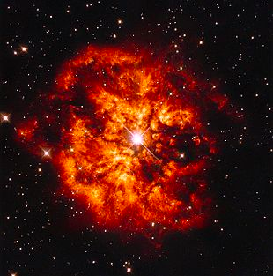
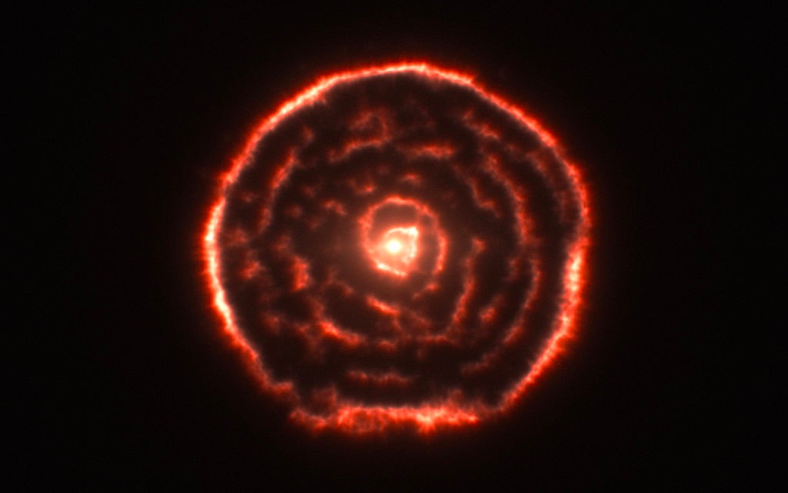
Conclusions
C in Thin Disk to > 70% made by massive stars
About 30% contribution from LIMS C stars is possible
Similar results when Mg is used instead of O
Fe made by stars around 2-5 M_{sun} (in SN Ia)
Most N made by stars with M > 3 M_{sun}
Gas density in thin disk has stayed rather constant
but …

Slide 26

… but
… empirical yields cannot replace physical yields,
… nor understanding of the physics behind,
… and therfore certainty not substitute the work of Mauritzio
and his successors

Slide 32
Future?
For i = 1, … n:
{O_{i} - ε_{i}} = {A_{i}} = F ( ∫dt ∫dm R(t’), IMF(t’,m), σ_{g}(t’), Z(t’), y_{i}(m,t’))
Z(t) ≈. ∑ O_{i}
t’ = t-τ(m,Z(t’)
+ constraints, e.g. from nuclear physics
Determine R, IMF, σ_{g}, Z and y_{i}
Include galactic dynamics
Observations! Abundances, ages, in volume
A good start:
Francini et al. (2020): The Gaia–ESO Survey: Carbon Abundance in the Galactic Thin and Thick Disks,
ApJ 888

Slide 33
Also note
Henry et al. (2018)
35 Galactic well-studied PNe, with progenitor masses
He, C, N abundances

Slide 34
Henry et al. (2918), continued
Unexpectedly low C
and high N
for m > 2 Msun

Slide 35
Can we use different populations?

