Slide 1
Finding the polluter AGB properties of Barium stars with machine learning
Blanka Világos
Konkoly Observatory, Hungary
2022.06.23. XIII. Torino Workshop, Perugia

Slide 2
The problem

Slide 3
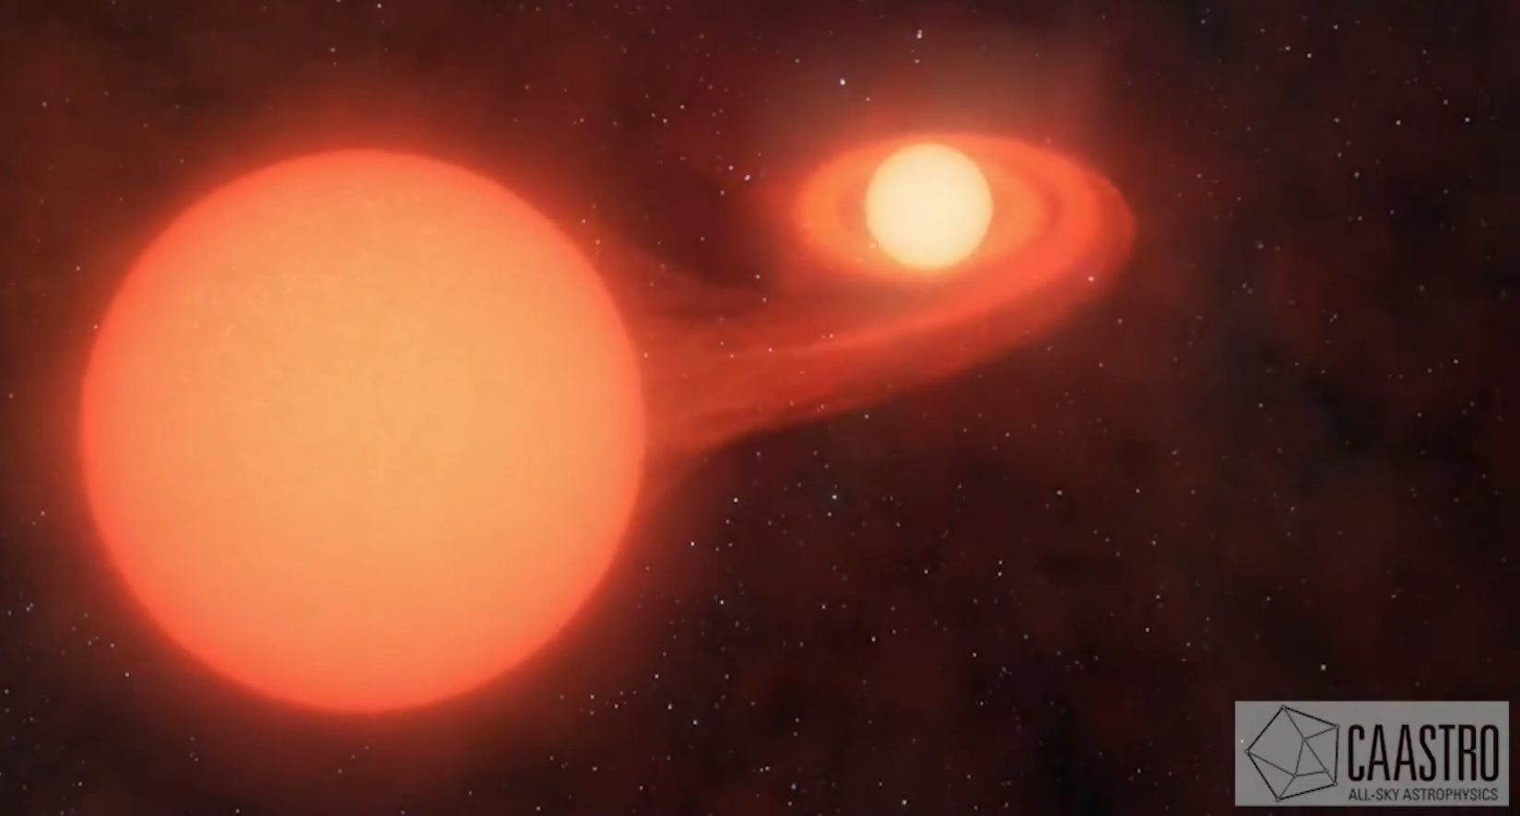
Barium stars
s-process elements, but not yet AGB → binaries, accretion
Now: red giants ~ convective envelope
Abundances: de Castro et al. (2016), Roriz et al. (2021a,b) = 169 stars

Slide 4
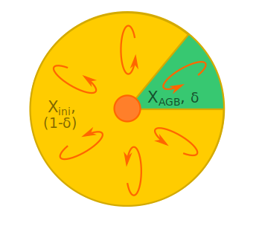
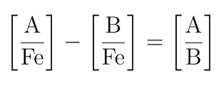
Why having a new classification?
Dilution factor ẟ
Before: ẟ based on Ce
Now: ẟ is a free parameter = Aim: recognise AGB models in spectra regardless of ẟ
Manual parameter of mass
Now using the elemental ratios as well:

Slide 5
The grid for the classificators
Every AGB model transformed by ẟ=[0,0.9] in 0.01 steps → One AGB model diluted in different steps = one class
Train set: 80% Test set: 20% – fine-tuning, 99+% accuracy
= Only models, no observations yet

Slide 6
The classificators

Slide 7
Classificators: Closest method (CM)
Defining goodness of fit (GoF)
Modified 𝛘²-probe
Models reaching the best GoF are chosen, with their best ẟ

Slide 8
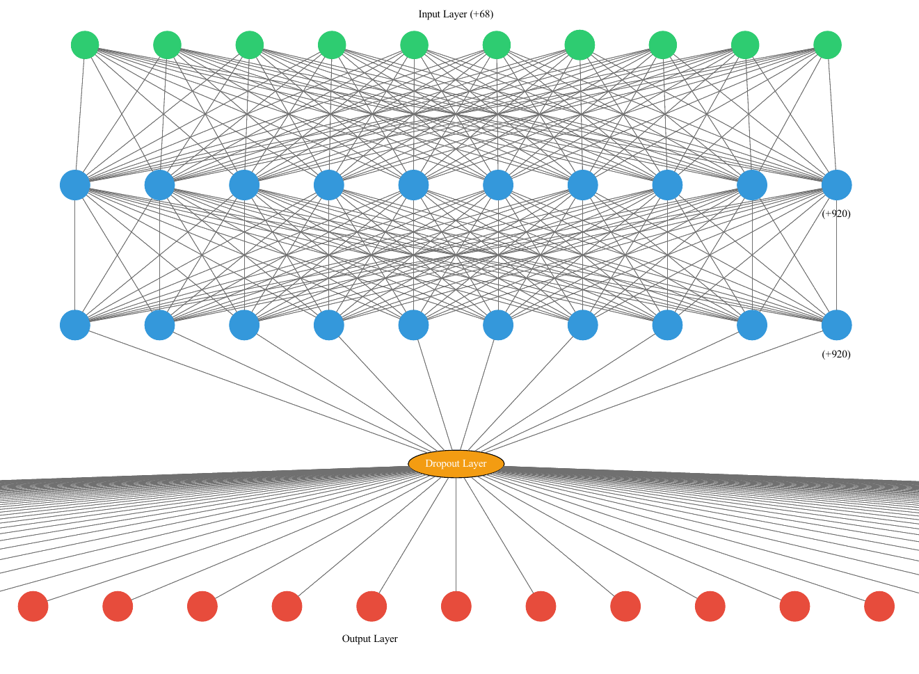
Classificators: Neural network (NN)
Imitating neurons
Fully connected layers
Different weights to neurons when training
Activation function (nonlinear)
> million parameters

Slide 9
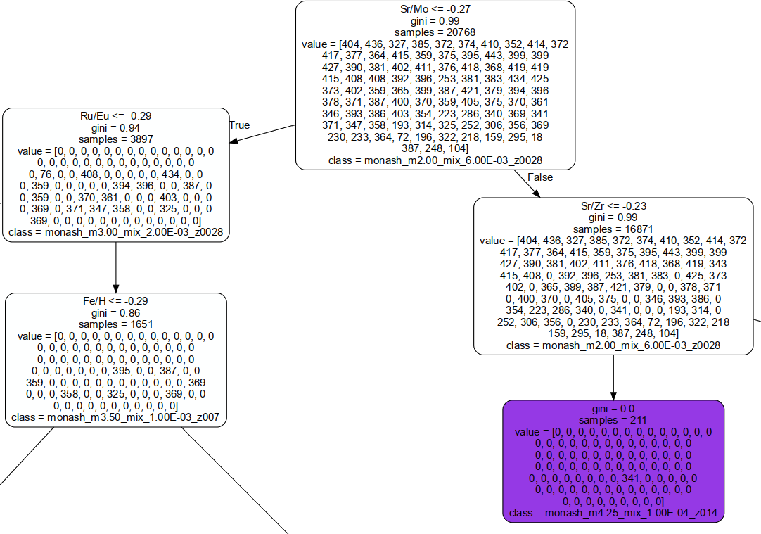
Classificators: Random forest (RF)
Decision trees (15 levels)
Primitive, but 800 does it
Probability: how many trees chose that model

Slide 10
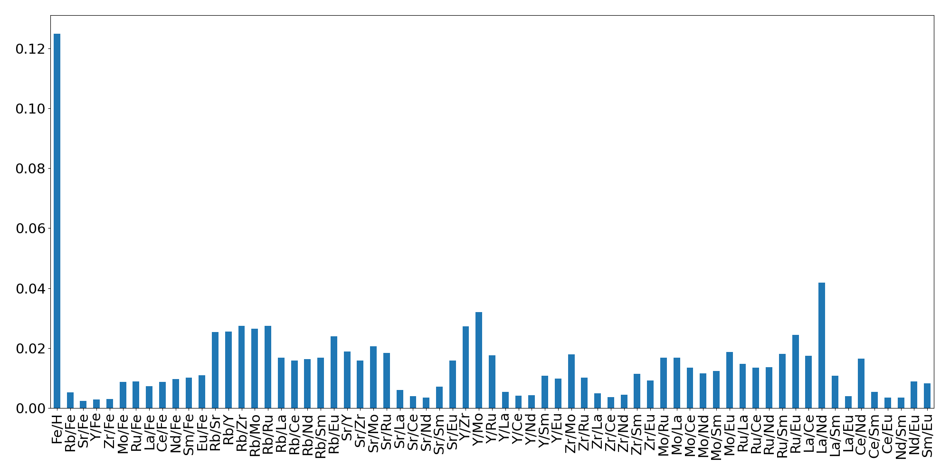
Feature importance (RF)

Slide 11
Results

Slide 12
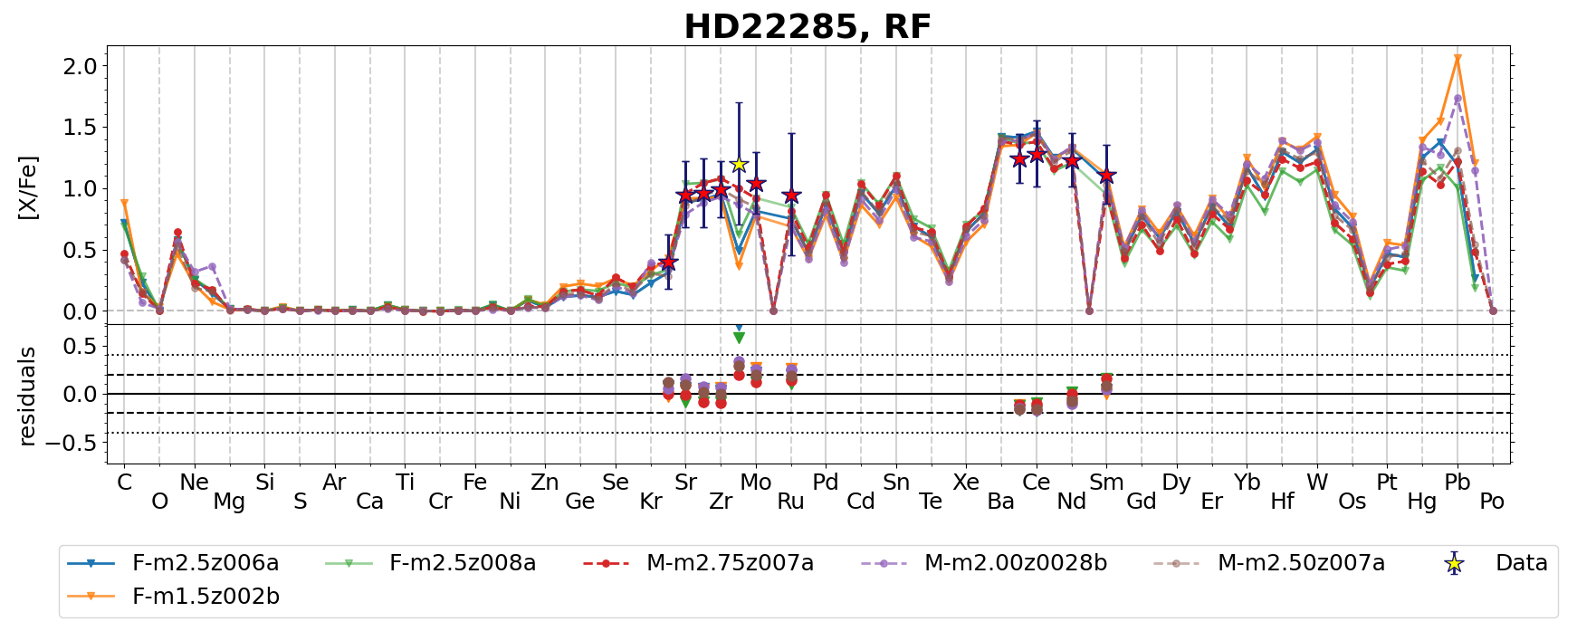
Individual star abundances
Red elements: used in classification (no real impact on stats)

Slide 13
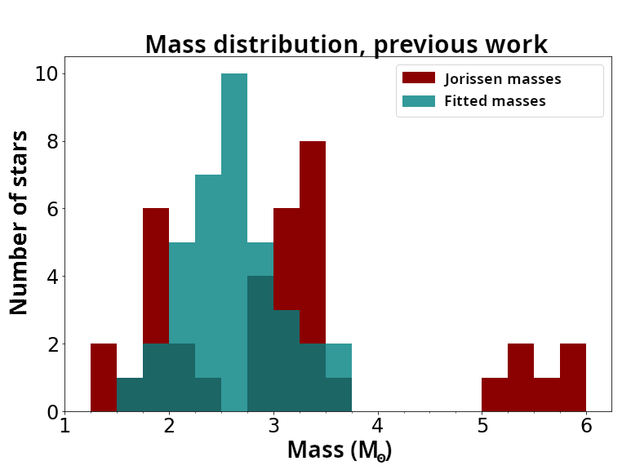
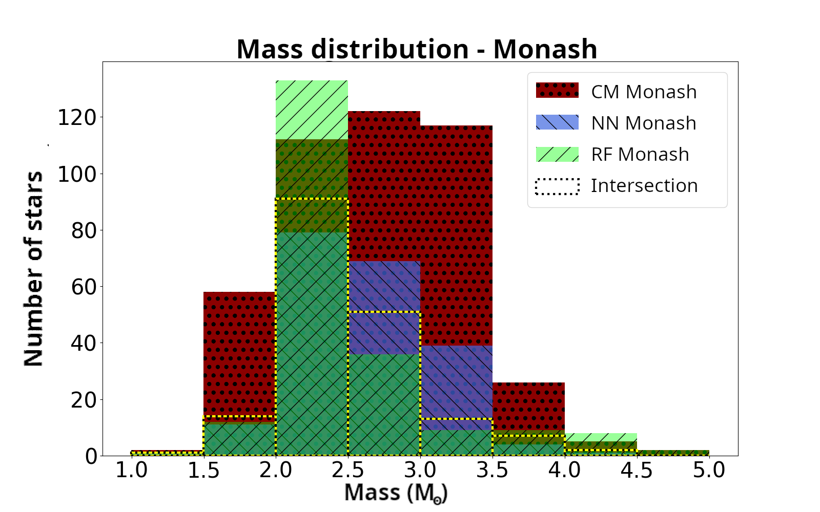
Mass distribution

Slide 14
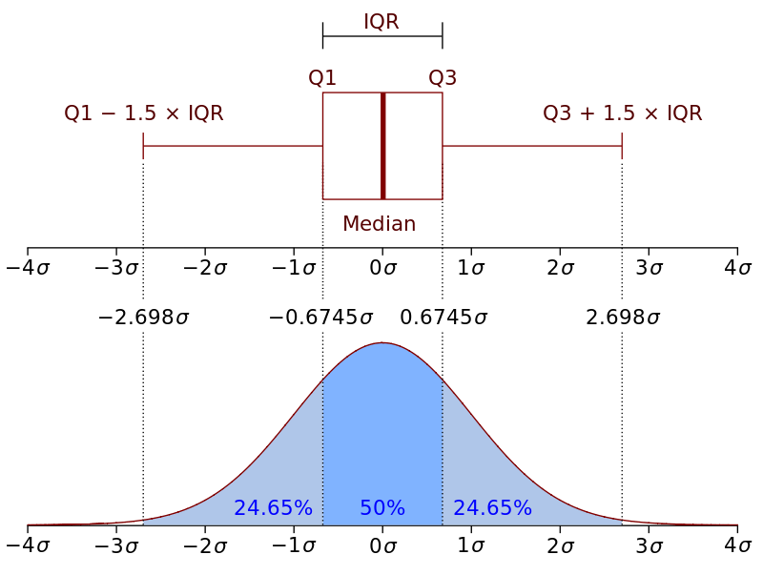
Boxplots
Residuals for each model of each star → distributions for each feature

Slide 15
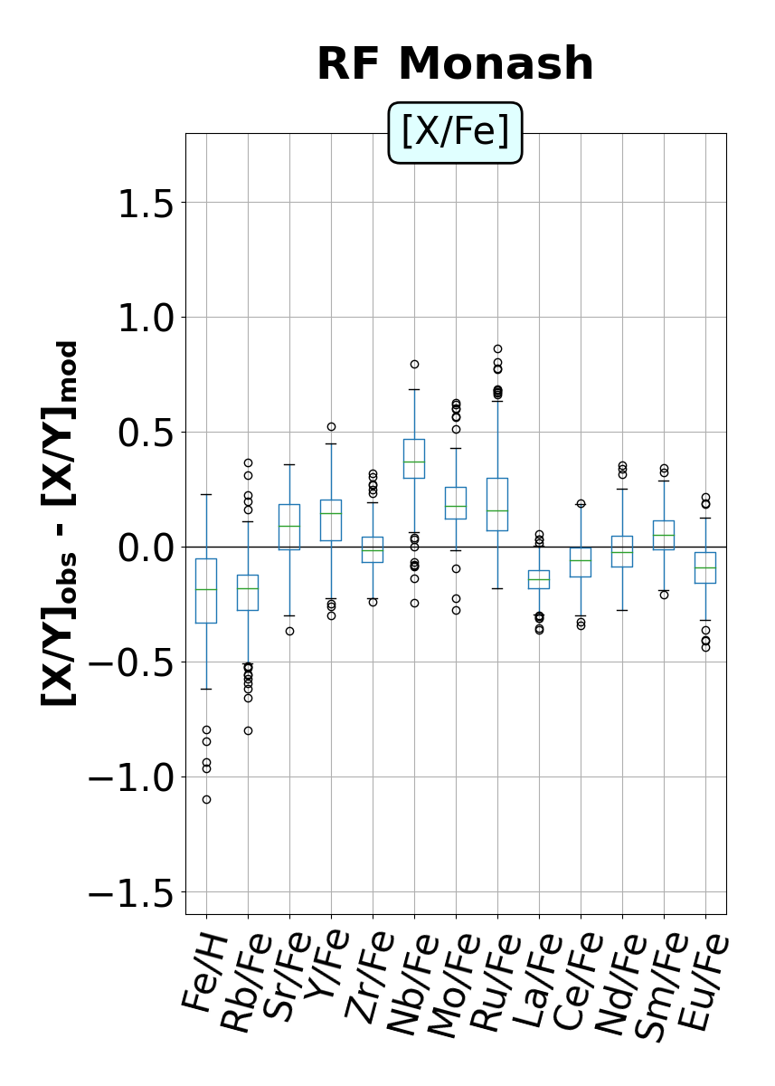
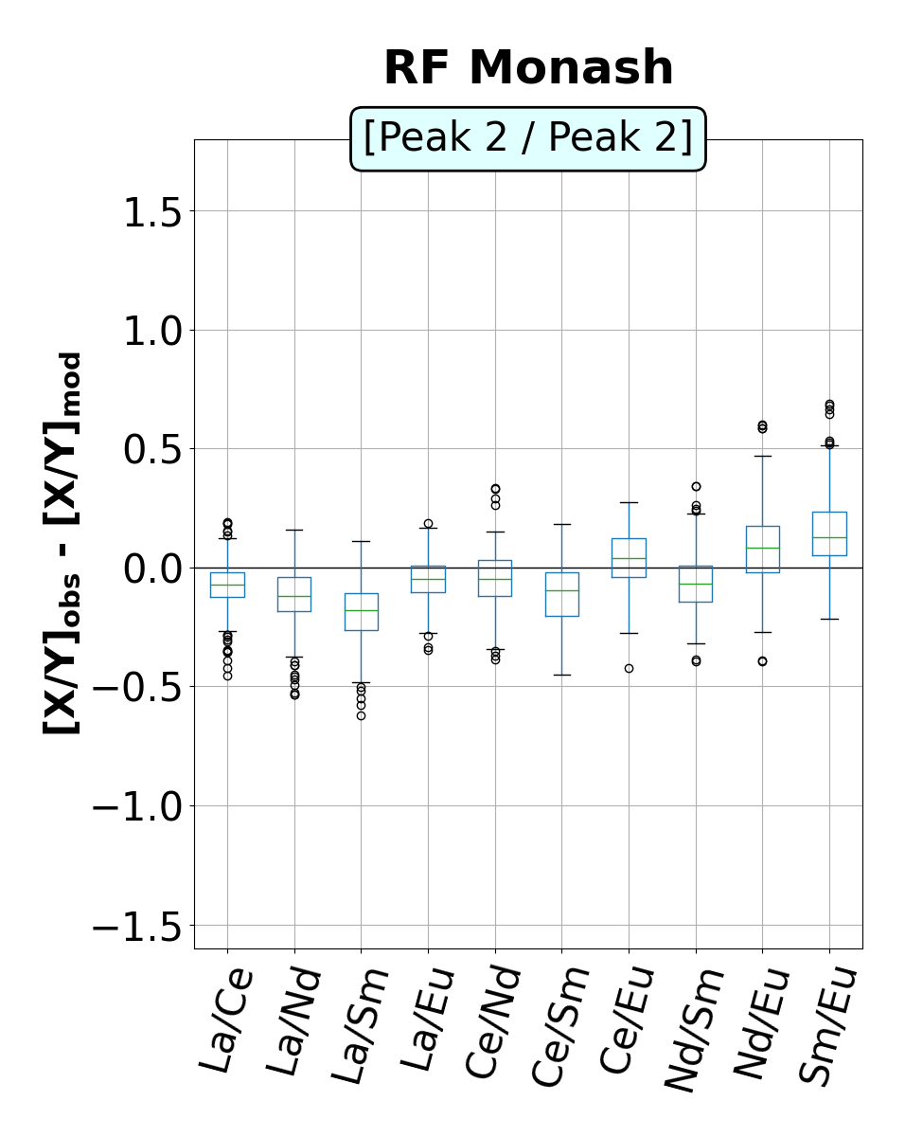
Abundances; Peak 2

Slide 16
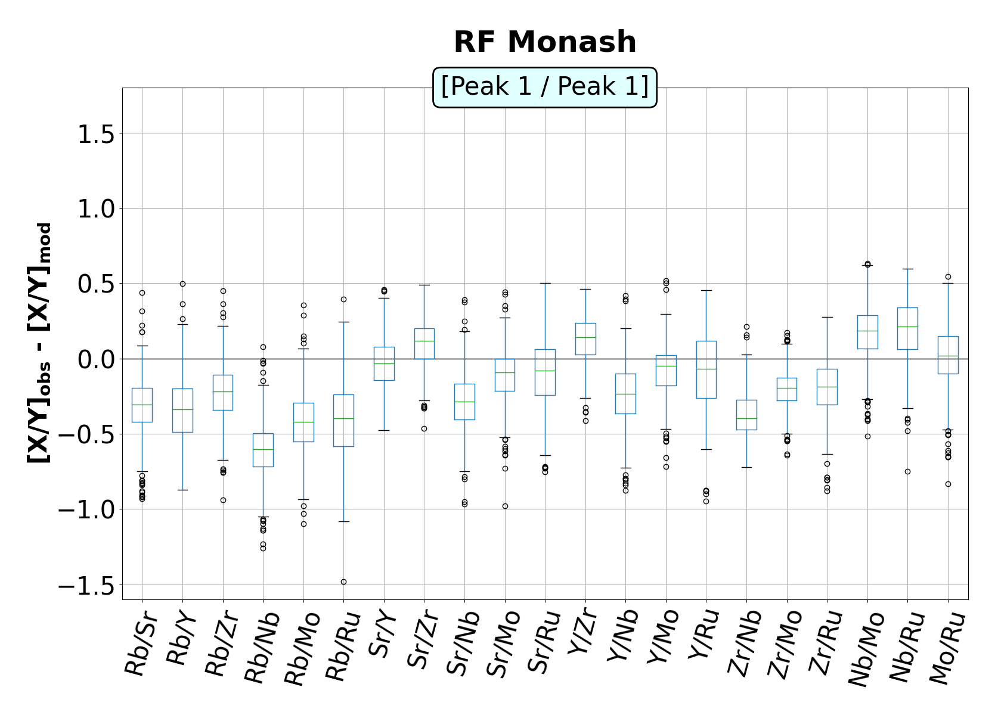
Peak 1

Slide 17
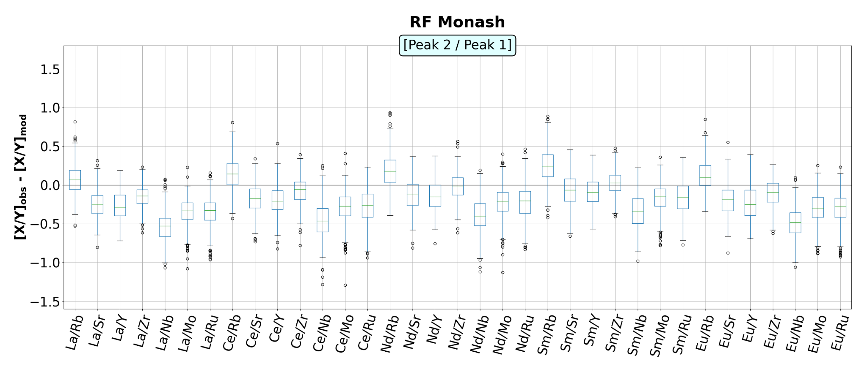
Peak 2 vs Peak 1

Slide 18
Conclusions
Automated classification
Confirmation of Ba star nature
Mass estimation algorithm
Each element for each star ↔ Statistical applications

Slide 19
Grazie per l'attenzione!
Supported by the ÚNKP-21-1 New National Excellence Program of the Ministry for Innovation and Technology from the source of the National Research, Development and Innovation Fund.
Világos et. al.: in prep.

