Slide 1
Core-Collapse Supernovae: the connection between explosion and progenitor structure
arXiv:2110.05544
arXiv:2110.05544
Luca Boccioli
Advisor: Grant J. Mathews
Collaborators: Alessandro Chieffi, Marco Limongi, Lorenzo Roberti
University of Notre Dame
Torino workshop June 21st 2022

Slide 2
Introduction: the Supernova mechanism
Core collapse Supernova (CCSN)
Collapse
Outer
Layers
Iron
Core

Slide 3
Introduction: the Supernova mechanism
Core collapse Supernova (CCSN)
Collapse
Outer
Layers
Core Bounce
Iron
Core
PNS

Slide 4
Introduction: the Supernova mechanism
Core collapse Supernova (CCSN)
Collapse
Shock
Core Bounce
PNS
Shock propagates
Notes:
Lo shock si muove verso l’esterno

Slide 5
Introduction: the Supernova mechanism
Core collapse Supernova (CCSN)
Collapse
Shock stalls
Core Bounce
PNS
Shock propagates
Notes:
Colgate & McKee 1969

Slide 6
Introduction: the Supernova mechanism
Core collapse Supernova (CCSN)
Collapse
Shock stalls
ν
Core Bounce
ν-delayed heating (ν-driven turbulence)
PNS
Shock propagates
Explosion/Fallback
Time ~ 1s

Slide 7
Introduction: our simulation setup
GR1D: spherically symmetric (1D) model with neutrino transport: cannot explode
O’Connor & Ott (2010) CQG 27, 114103
O’Connor (2015) ApJS, 219, 24
GR1D+: spherically symmetric with convection through MLT (1D+): can explode
Boccioli et al (2021) ApJ 912 29

Slide 8
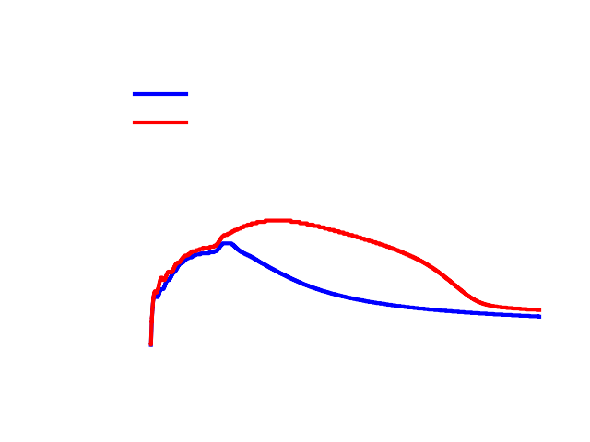
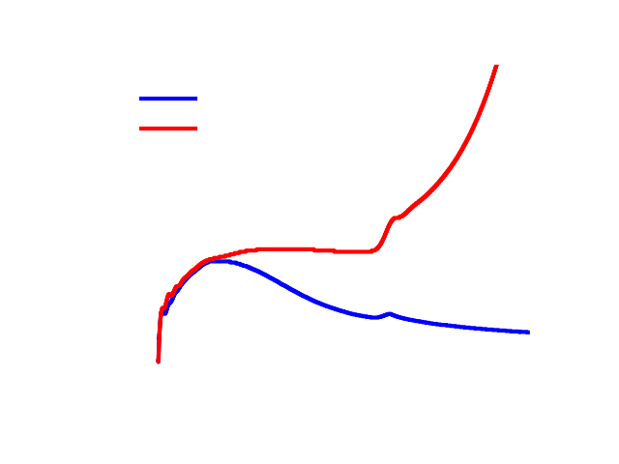
What makes one star explode and another collapse?
Short answer: the accretion of the Si/O interface...
…but it’s more complicated: what property of the Si/O interface makes one star explode and another collapse?

Slide 9
Explodability depends on many variables…
= explosion
= failed SN
Ertl 2016
KEPLER & PHOTB
1D+
KEPLER & GR1D
…the model used to trigger the explosion…
1D+
FRANEC & GR1D
…the code used to evolve the star…
1D+
FRANEC & GR1D
new ¹²C fusion rate^{(*)}
…the reaction rates for key processes…
(*) = Tumino et al. (2018)

Slide 10
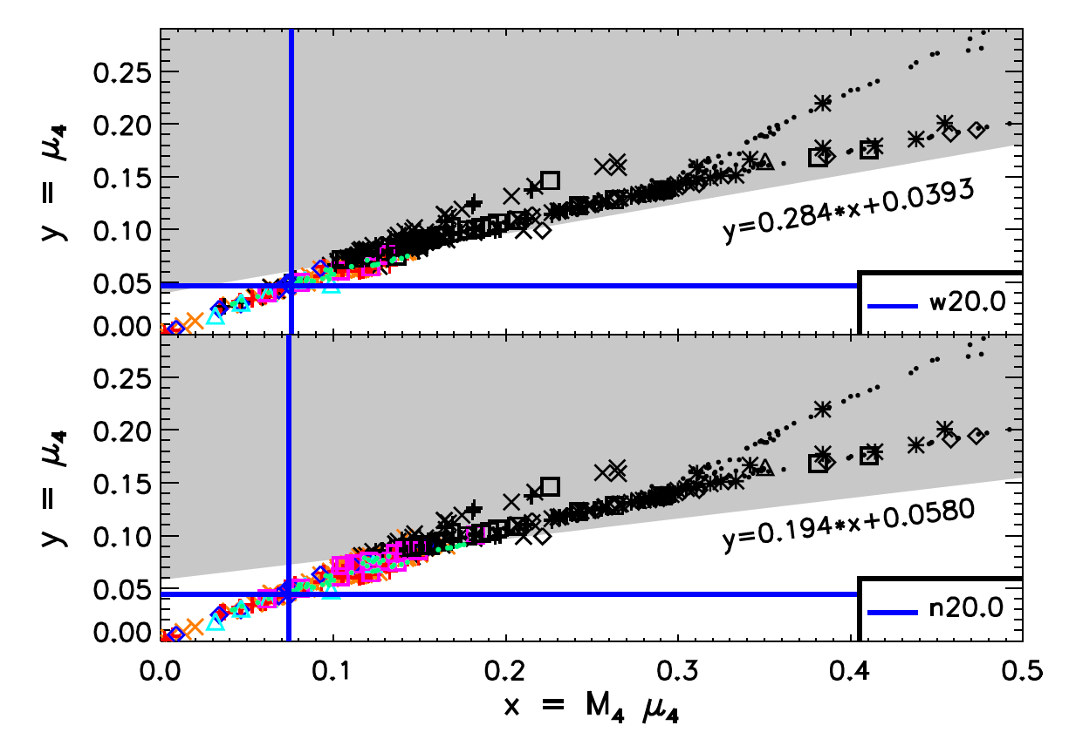
Previous studies
Ertl 2016
PHOTB: Enhanced neutrino luminosity based on observations of SN1987a
Black = failed SN
Colors = successful SN
~5% of progenitors don’t follow the μ₄ - M₄μ₄ criterion

Slide 11
Our approach
Example of a 21 M⨀ without convection
1) We run a standard 1D supernova simulation of each star, without the inclusion of ν-driven convection
R_{accr}
2) We define R_{surge} caused by the accretion of the Si/O interface
R_{surge}
t_{accr}

Slide 12
Our approach
Example of a 21 M⨀ with convection
3) We run the same star using STIR, which implements ν-driven convection in our code using a MLT approach.
Boccioli et al (2021) ApJ 912 29
4) We define the explosion being triggered when the shock reaches 500 km
t_{expl}

Slide 13
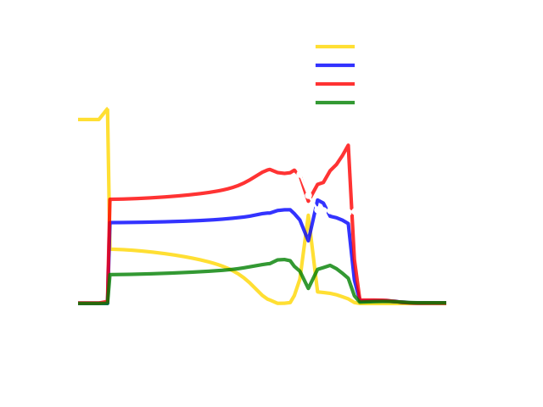
Our approach
Example of a 21 M⨀ before collapse
5) We then locate the Si/O interface in the progenitor. We do it by looking for a discontinuity in entropy.
δρ*
6) We identify the layer at which the discontinuity starts with a *.
Surface
Center
ρ*

Slide 14
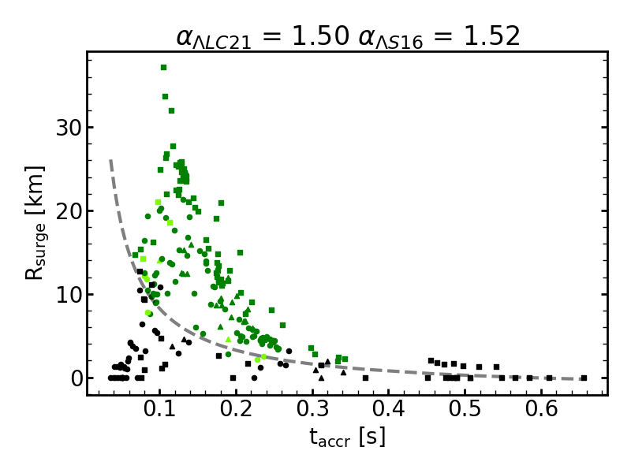
Results: R_{surge} and t_{accr}
Simulations without ν-driven convection with colors based on the outcome of the simulations with ν-driven convection
There is a separation between explosions and failed SN for t_{accr} < 0.4 s
How do we connect R_{surge} and t_{accr} to properties of the progenitor star?

Slide 15
Results: R_{accr} and t_{accr}
Example of a 21 M⨀ without convection
How do we connect R_{surge} and t_{accr} to properties of the progenitor star?
R_{accr}
For t_{accr} < 0.4 one can see that
R_{accr} ∝ 1/t_{accr}
One can then show that:
R_{surge} / R_{accr} ∝ ${δρ}_{∗}^{2}$ / $ρ_{∗}^{2}$
R_{surge}
t_{accr}

Slide 16
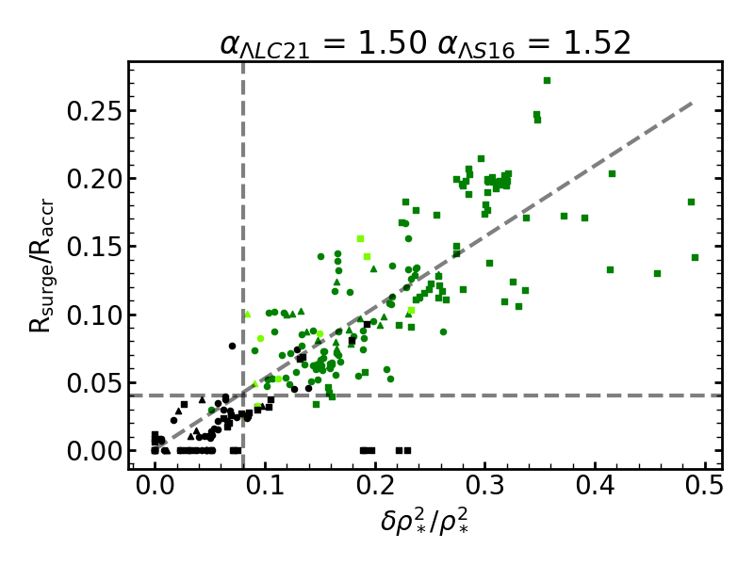
Results: our criterion
We are ready to formulate our criterion for stars with mass > 13 M⨀ :
If t_{accr} $>$ 0.4 s $⇒$ $\sqrt{\frac{3 r_{∗}^{3}}{16 G m_{∗}}}$ $≳$ 0.25 failed SN
Otherwise
If R_{surge} / R_{accr} > 0.04 $⇒$ ${δ\text{ρ}}_{∗}^{2}$ / ${\text{ρ}}_{∗}^{2}$ > 0.08 explosion
Only ~ 4.5 % of progenitor stars are mislabeled

Slide 17
Comparison with previous studies
It’s still work in progress!
= explosion
= failed SN
There are two ranges where our results differ from Ertl (2016):
12 $≲$ M $≲$ 15
22 $≲$ M $≲$ 25
Ertl (2016)
This work

Slide 18
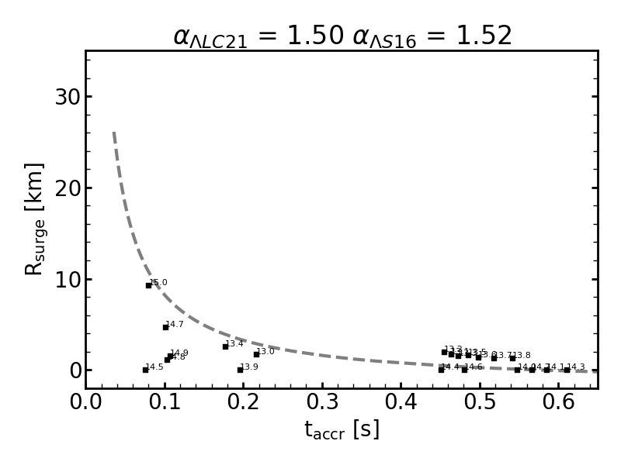
Comparison with previous studies
12 $≲$ M $≲$ 15:
Ertl (2016):
Small accretion rates $⇒$ Small luminosities that result in explosions
This work:
They either have large t_{accr}, and therefore result in failed SN or they have small t_{accr} but also small R_{surge} and result in failed SN

Slide 19
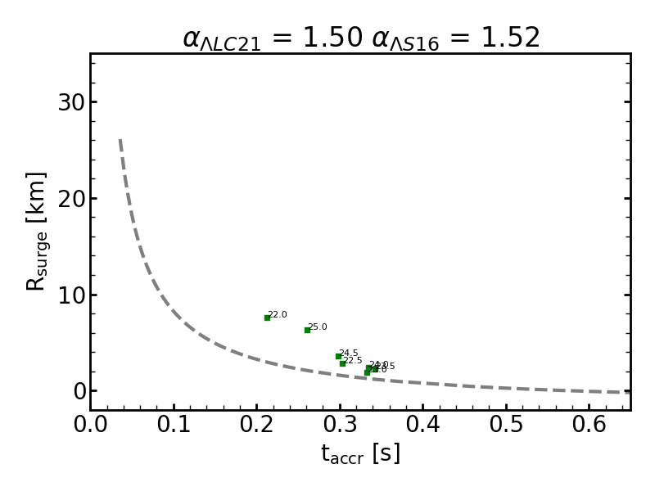
Comparison with previous studies
22 $≲$ M $≲$ 25:
Ertl (2016):
Large accretion rates $⇒$ Large luminosities that result in failed SN
This work:
Large accretion rates $⇒$ Prolonged heating and therefore even with large(-ish) t_{accr} they result in explosions

Slide 20
Conclusions
Explodability strongly depends on how the progenitor star was evolved
We presented a criterion based on full SN simulations that predicts the explodability of the star only from the entropy and density gradients before collapse
Depending on how the explosion is triggered (this work vs. Ertl) one finds different properties of the progenitor star as being key to the explosion mechanism

