Slide 1
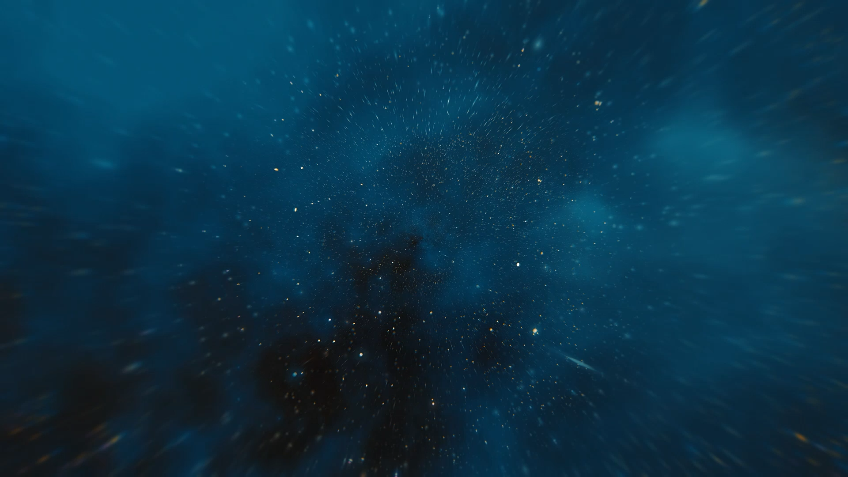



Post-AGB stars as probe for dust production and mass-loss mechanisms
Silvia Tosi
Flavia Dell’Agli, Devika Kamath, Paolo Ventura, Hans Van Winckel & Ester Marini

Slide 2
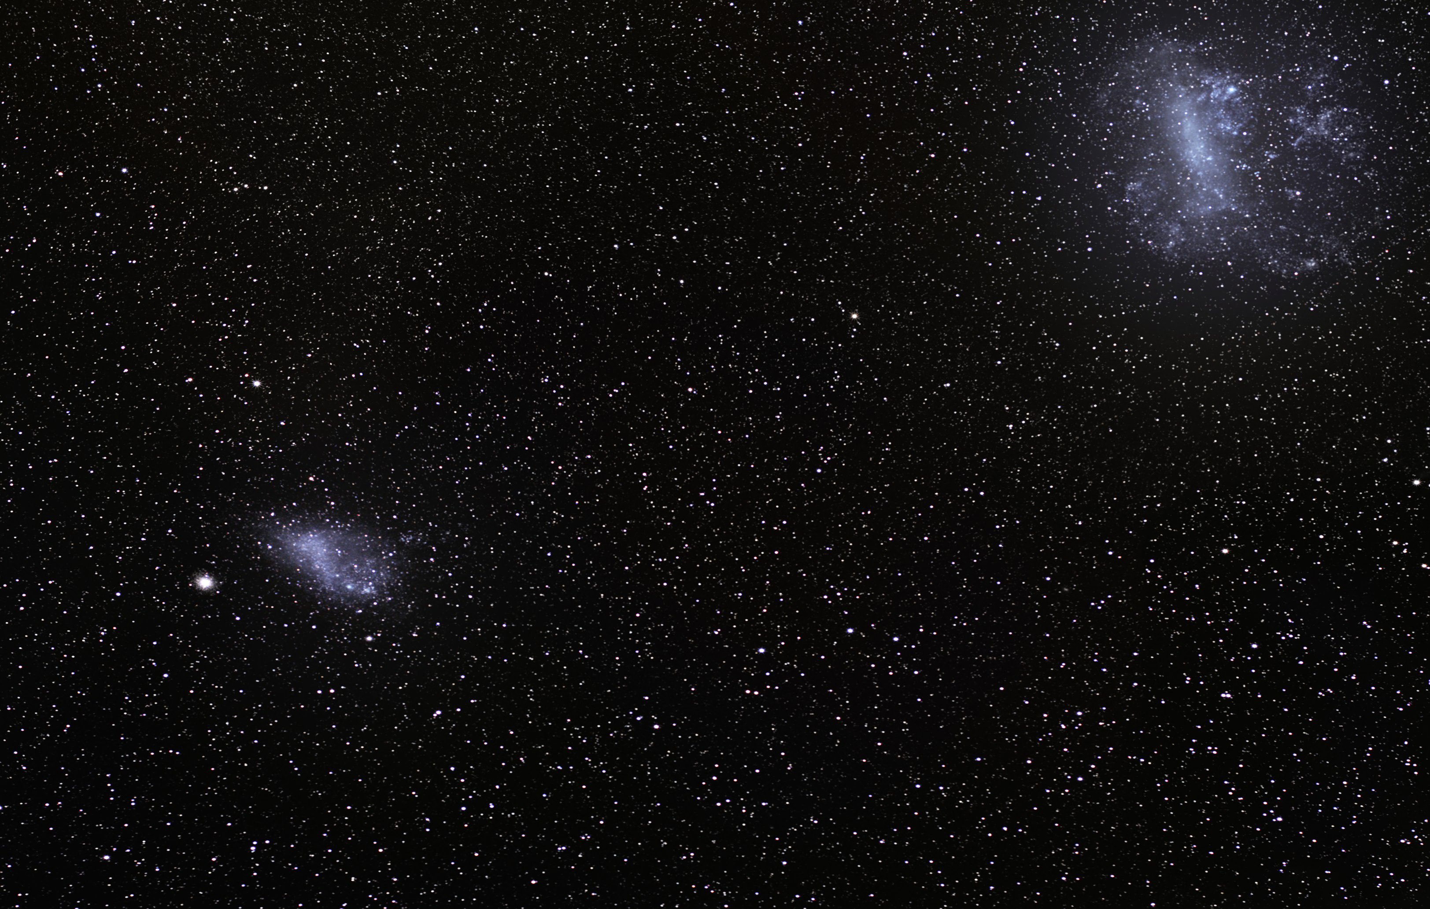
Summary
Why study post-AGB stars?
Characteristics of the sample
.
Methodology
Discussion focus on:
  Intermediate mass carbon stars
  low mass carbon stars
  oxygen rich stars

Slide 3
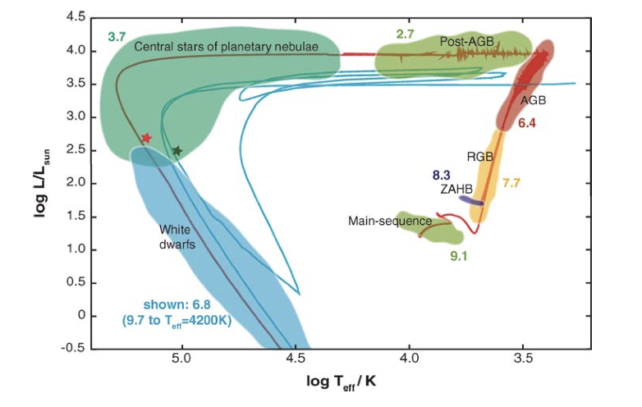
Why study post-AGB stars?
1) Their chemical composition represents the final outcome of the AGB evolution and associated internal enrichment processes
2) Post-AGB stars provide the unique opportunity to obtain chemical abundances of a wide range of elements: CNO, Fe-peak, s-process elements and also obtain isotopic ratios of C, N and O

Slide 4
Characterization of the post-AGB sample
14 single stars in LMC & SMC
(from Kamath et al. 2014, 2015)
Distances
Luminosities
Initial masses

Slide 5
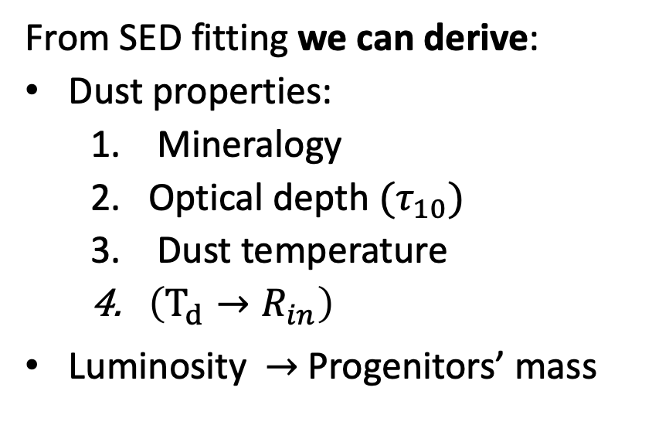
Starting point:
(Kamath et al. 2014, 2015)
Effective temperature
Metallicity
Carbon
DUSTY code
Nenkova et al. (1999)
From SED fitting we can derive:
Dust properties:
  Mineralogy
  Optical depth $(τ_{10})$
  Dust temperature
  $\left(T_{d}→R_{in}\right)$
Luminosity $→$Progenitors’ mass
Crystalline
silicates
Notes:
ATON?????

Slide 6
Starting point:
(Kamath et al. 2014, 2015)
Effective temperature
Metallicity
DUSTY code
Nenkova et al. (1999)
From SED fitting we can derive:
Dust properties:
  Mineralogy
  Optical depth $(τ_{10})$
  Dust temperature
  $\left(T_{d}→R_{in}\right)$
Luminosity $→$Progenitors’ mass
Notes:
ATON?????

Slide 7
Starting point:
(Kamath et al. 2014, 2015)
Effective temperature
Metallicity
DUSTY code
Nenkova et al. (1999)
From SED fitting we can derive:
Dust properties:
  Mineralogy
  Optical depth $(τ_{10})$
  Dust temperature
  $\left(T_{d}→R_{in}\right)$
Luminosity $→$Progenitors’ mass
Notes:
ATON?????

Slide 9
Progenitors’ mass determination
* Evolutionary tracks from ATON Ventura et al. (1998)

Slide 10
Dust properties
*Tosi et al. 2022, submitted A&A

Slide 11
The dust
Van Aarle et al. (2013)

Slide 12

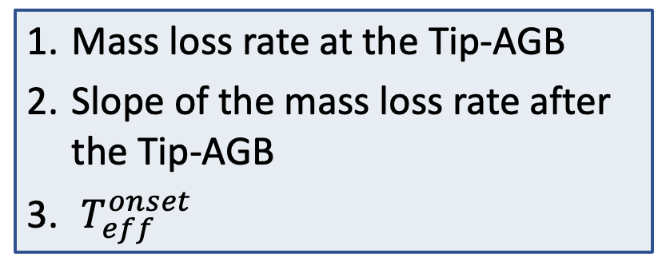




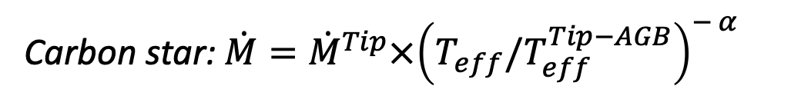



The methodology
Carbon star: $\dot{M}={\dot{M}}^{Tip}×{\left(T_{eff}{/T}_{eff}^{Tip−AGB}\right)}^{− α }$
$$T_{eff}^{onset}$$
$$τ_{10}^{onset}$$
$$R_{in}^{onset}$$
Mass loss rate at the Tip-AGB
Slope of the mass loss rate after the Tip-AGB
$T_{eff}^{onset}$
$$Δt$$
$$α=7$$
Wachter et al. (2002, 2008)
$$T_{eff}^{current}$$
$$τ_{10}^{current}$$
$$R_{in}^{current}$$
*Not in scale

Slide 13
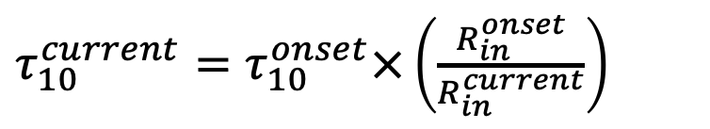

The methodology
Carbon star: $\dot{M}={\dot{M}}^{Tip}×{\left(T_{eff}{/T}_{eff}^{Tip−AGB}\right)}^{− α }$
$$T_{eff}^{onset}$$
$$τ_{10}^{onset}$$
$$R_{in}^{onset}$$
$v=R_{in}^{current}/Δt$
$$Δt$$
$τ_{10}^{current}=τ_{10}^{onset}×\left(\frac{R_{in}^{onset}}{R_{in}^{current}}\right)$
$$α=7$$
Wachter et al. (2002, 2008)
$$T_{eff}^{current}$$
$$τ_{10}^{current}$$
$$R_{in}^{current}$$
*Not in scale

Slide 14
The methodology
Carbon star: $\dot{M}={\dot{M}}^{Tip}×{\left(T_{eff}{/T}_{eff}^{Tip−AGB}\right)}^{− α }$
$$T_{eff}^{onset}$$
$$τ_{10}^{onset}$$
$$R_{in}^{onset}$$
$v=R_{in}^{current}/Δt$
$$Δt$$
$τ_{10}^{current}=τ_{10}^{onset}×\left(\frac{R_{in}^{onset}}{R_{in}^{current}}\right)$
$$α=7$$
Wachter et al. (2002, 2008)
$$T_{eff}^{current}$$
$$τ_{10}^{current}$$
$$R_{in}^{current}$$
22/06/22, 13th Torino Workshop
*Not in scale

Slide 15
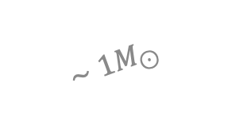
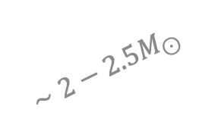
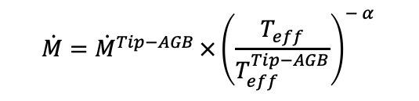
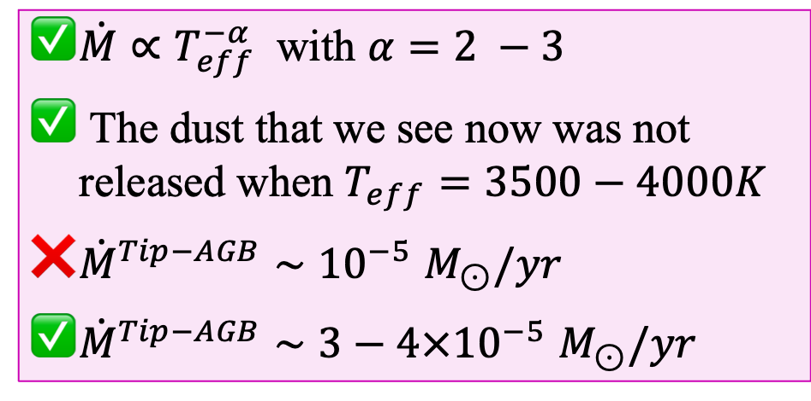
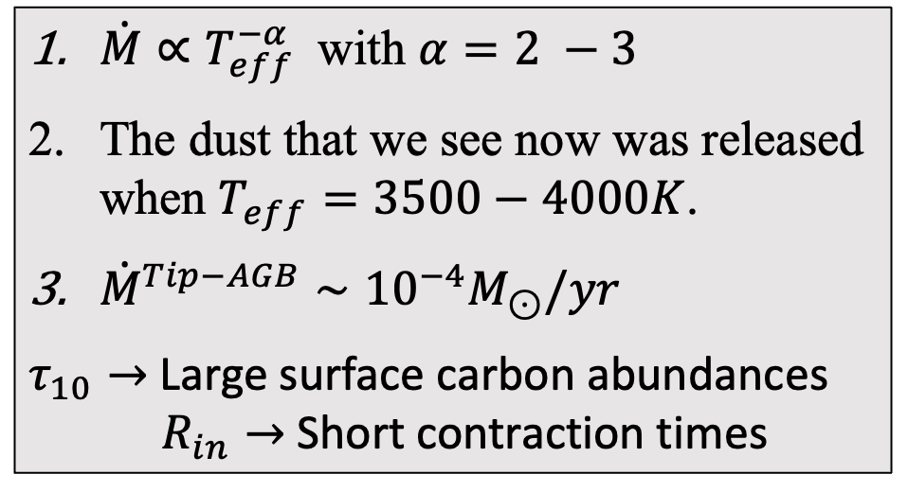
Carbon stars
$\dot{M}∝T_{eff}^{−α}$ with $α=2 −3$
The dust that we see now was released when $T_{eff}=3500−4000K$.
${\dot{M}}^{Tip−AGB}∼{10}^{−4}M_{⊙}/yr$
$τ_{10}→$ Large surface carbon abundances
$R_{in}→$Short contraction times
$$\dot{M}={\dot{M}}^{Tip−AGB }×{\left(\frac{T_{eff}}{T_{eff}^{Tip−AGB}}\right)}^{− α }$$
$$∼2−2.5M_{⊙}$$
$\dot{M}∝T_{eff}^{−α}$ with $α=2 −3$
The dust that we see now was not released when $T_{eff}=3500−4000K$
${\dot{M}}^{Tip−AGB}{∼10}^{−5}M_{⊙}/yr$
${\dot{M}}^{Tip−AGB}{∼3−4×10}^{−5}M_{⊙}/yr$
$$∼1M_{⊙}$$

Slide 16
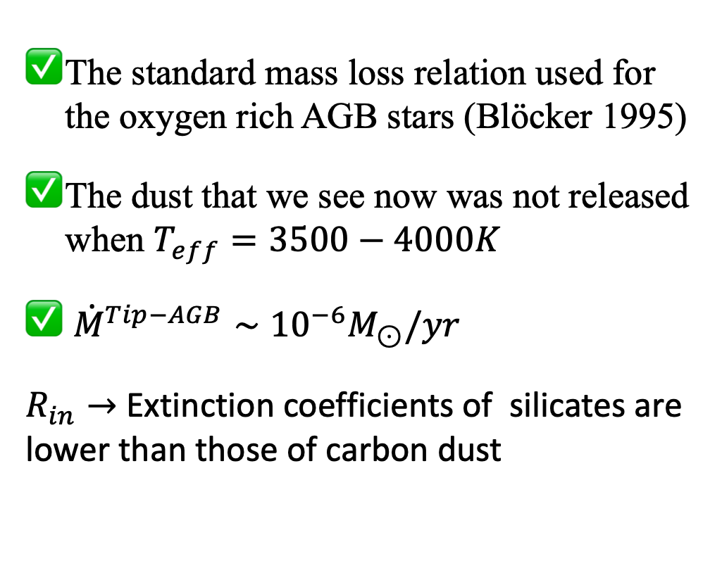

Oxygen stars
The standard mass loss relation used for the oxygen rich AGB stars (Blöcker 1995)
The dust that we see now was not released when $T_{eff}=3500−4000K$
${\dot{M}}^{Tip−AGB}∼{10}^{−6}M_{⊙}/yr$
$R_{in}→$Extinction coefficients of silicates are lower than those of carbon dust
$$∼1M_{⊙}$$

Slide 17




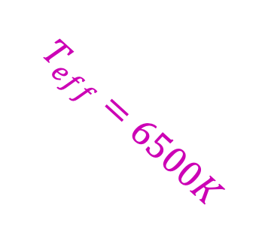
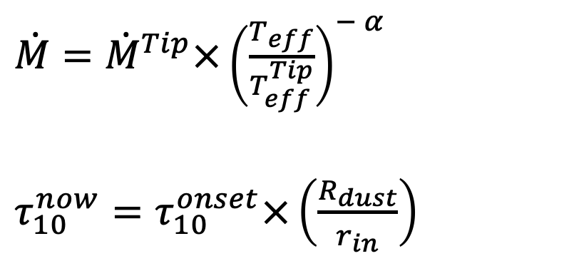
Massive carbon star
$\dot{M}={\dot{M}}^{Tip}×{\left(\frac{T_{eff}}{T_{eff}^{Tip}}\right)}^{− α }$
$τ_{10}^{now}=τ_{10}^{onset}×\left(\frac{R_{dust}}{r_{in}}\right)$
$$τ_{10}^{onset}$$
$$τ_{10}^{now}$$
$$T_{eff}=6500K$$
$$R_{dust}$$
$$r_{in}$$

Slide 18




Massive carbon star
$$v=r_{in}/Δt$$
Fit
Stellar modelling
$$α=2$$
$$α=7$$
$$T_{eff}=6500K$$

Slide 19
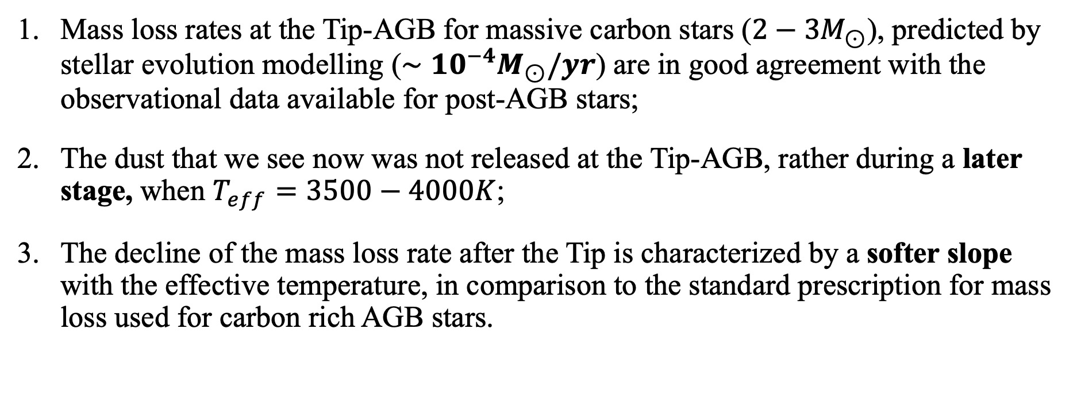
What we can learn with this analysis?
Mass loss rates at the Tip-AGB for massive carbon stars ($2−3M_{⊙}$), predicted by stellar evolution modelling ($∼{10}^{−4}M_{⊙}/yr$) are in good agreement with the observational data available for post-AGB stars;
..
The dust that we see now was not released at the Tip-AGB, rather during a later stage, when $T_{eff}=3500−4000K$;
..
The decline of the mass loss rate after the Tip is characterized by a softer slope with the effective temperature, in comparison to the standard prescription for mass loss used for carbon rich AGB stars.

Slide 20
Low-mass carbon star

Slide 21
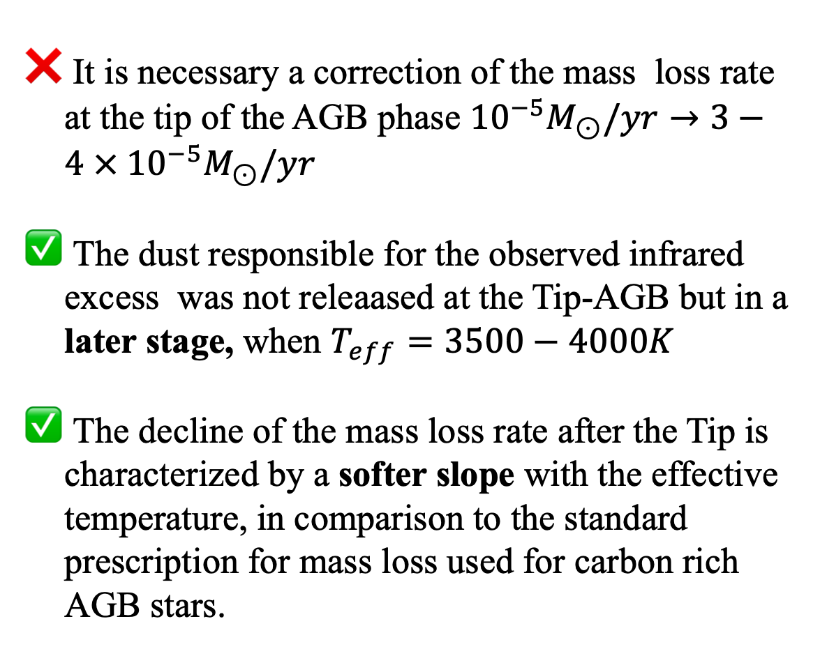
Low-mass carbon star
It is necessary a correction of the mass loss rate at the tip of the AGB phase ${10}^{−5}M_{⊙}/yr→3−4 × {10}^{−5}M_{⊙}/yr$
The dust responsible for the observed infrared excess was not releaased at the Tip-AGB but in a later stage, when $T_{eff}=3500−4000K$
The decline of the mass loss rate after the Tip is characterized by a softer slope with the effective temperature, in comparison to the standard prescription for mass loss used for carbon rich AGB stars.

Slide 22
Oxygen star

Slide 23
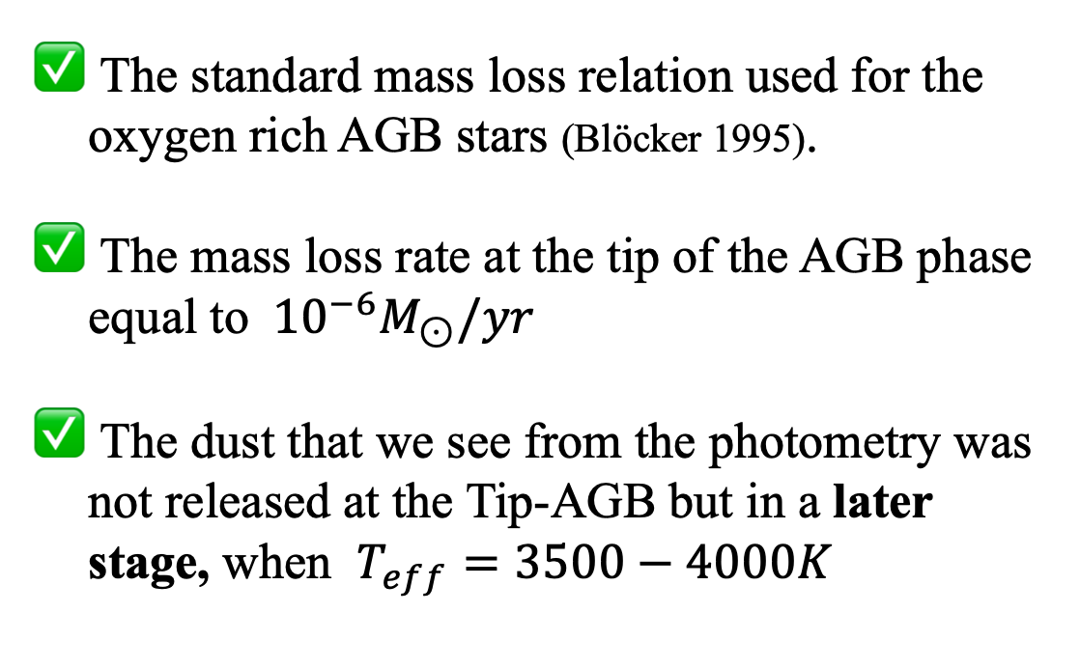
Oxygen star
The standard mass loss relation used for the oxygen rich AGB stars (Blöcker 1995).
The mass loss rate at the tip of the AGB phase equal to ${10}^{−6}M_{⊙}/yr$
The dust that we see from the photometry was not released at the Tip-AGB but in a later stage, when $T_{eff}=3500−4000K$

Slide 24
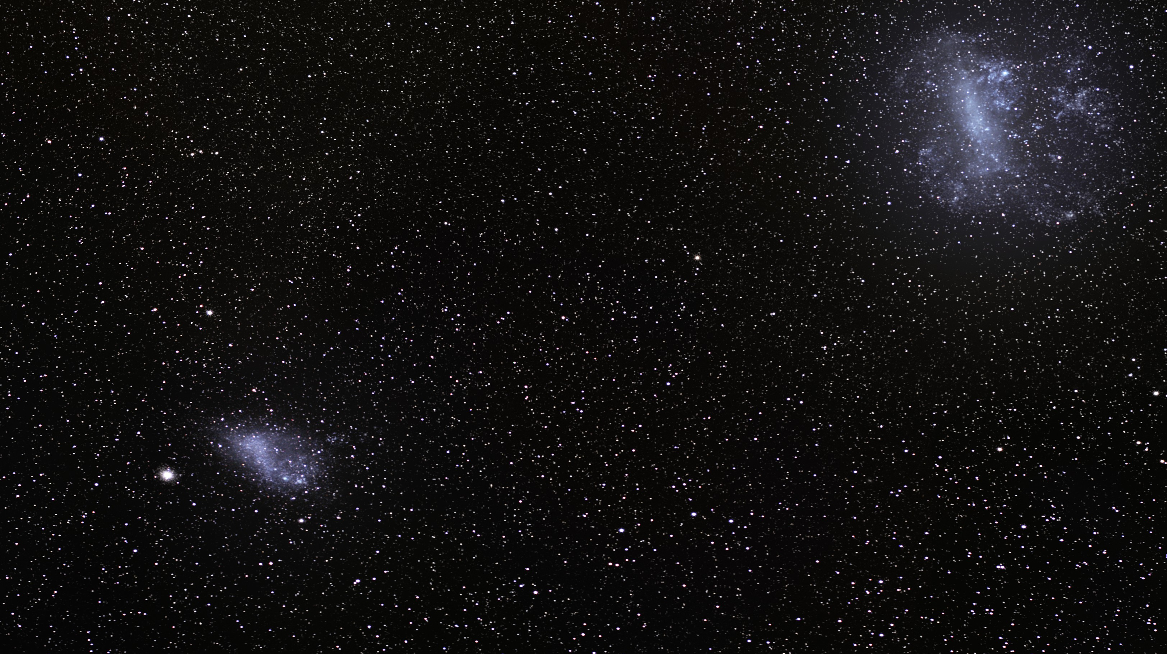
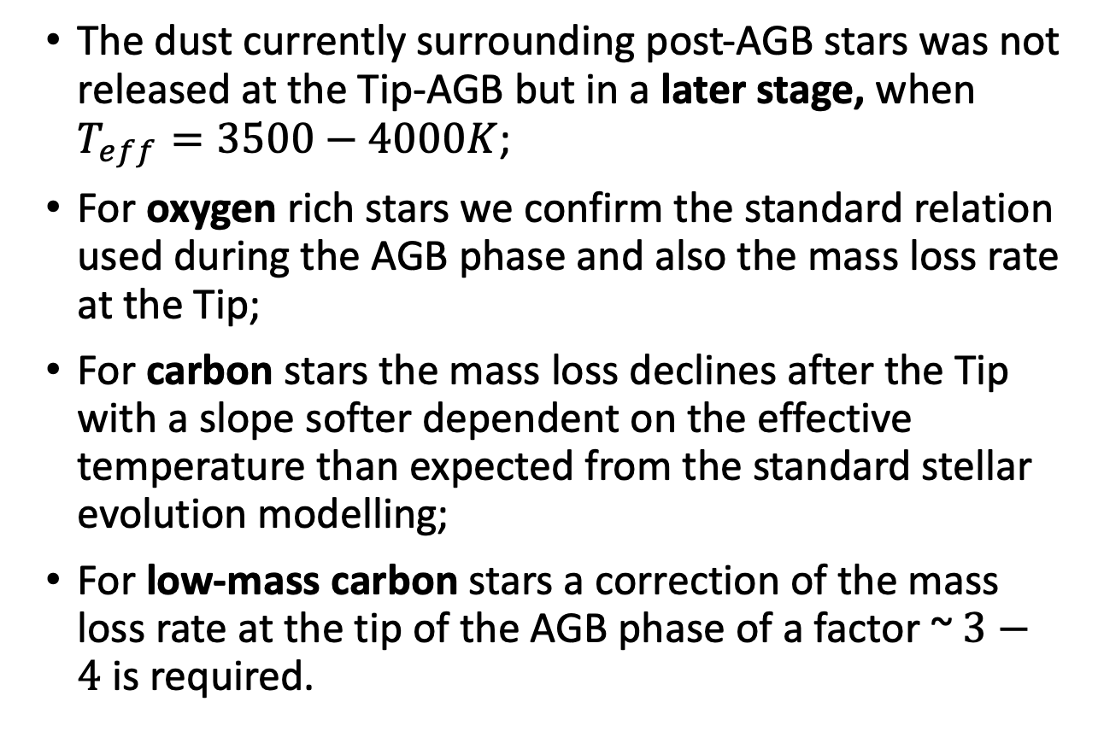
Conclusions.
The dust currently surrounding post-AGB stars was not released at the Tip-AGB but in a later stage, when $T_{eff}=3500−4000K$;
For oxygen rich stars we confirm the standard relation used during the AGB phase and also the mass loss rate at the Tip;
For carbon stars the mass loss declines after the Tip with a slope softer dependent on the effective temperature than expected from the standard stellar evolution modelling;
For low-mass carbon stars a correction of the mass loss rate at the tip of the AGB phase of a factor ~ $3−4 \text{is} \text{required}$.

Slide 25
Future prospectives
Galaxy sample (from Kamath et al. 2022)
Binary systems
Thank you!

Slide 26
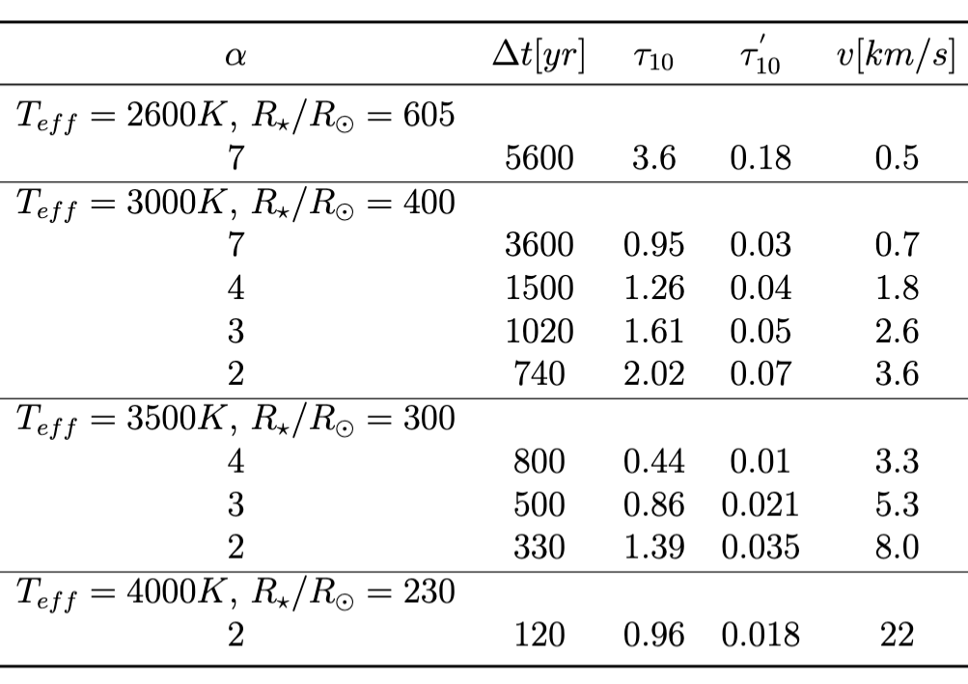
onset
current

Slide 27
I
R
J
V
Wise 4
H
Mips
K
Wise 3
Irac (8µ)
B
Irac (3,6µ)
Wise 1
Irac (5,6µ)
Irac (4,5µ)
Wise 2

