Slide 1


New clues for heavy element nucleosynthesis
Sophie Van Eck
In collaboration with
Drisya Karinkuzhi, Shreeya Shetye, Alain Jorissen,
Arthur Choplin, Lionel Siess, Stéphane Goriely, Hans Van Winckel
Workshop in honour of Maurizio M. Busso

Slide 2
New clues for heavy element nucleosynthesis
s-process along the AGB:
                - Technetium detection
                - s-process abundances
                “Cold cases”: extrinsic stars
Some open problems
Workshop in honour of Maurizio M. Busso

Slide 3
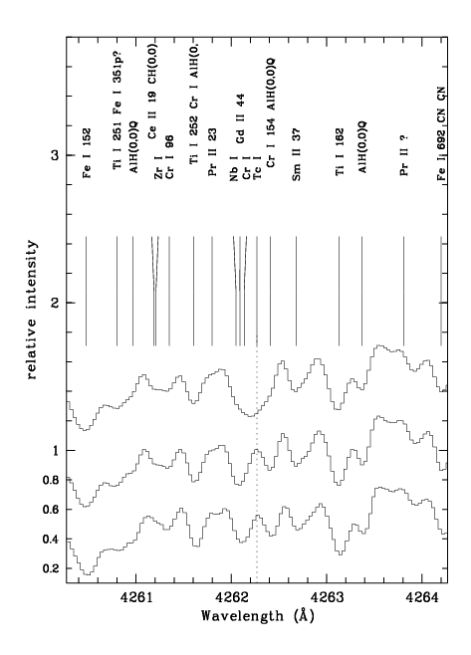
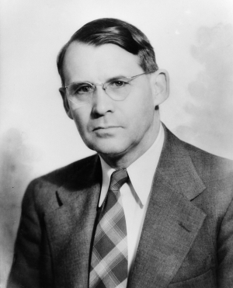
Technetium
1952: Observation by Paul Merrill of Tc I lines in the photosphere of S stars (R And, R Gem, AA Cyg)
13th Torino workshop – M. Busso - June 2022

Slide 4
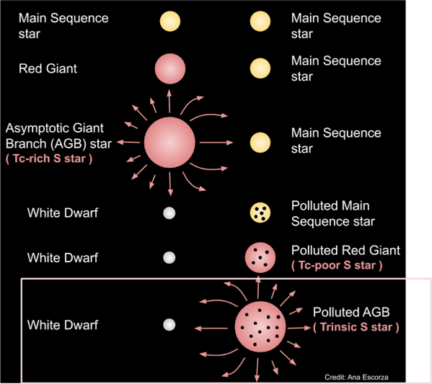
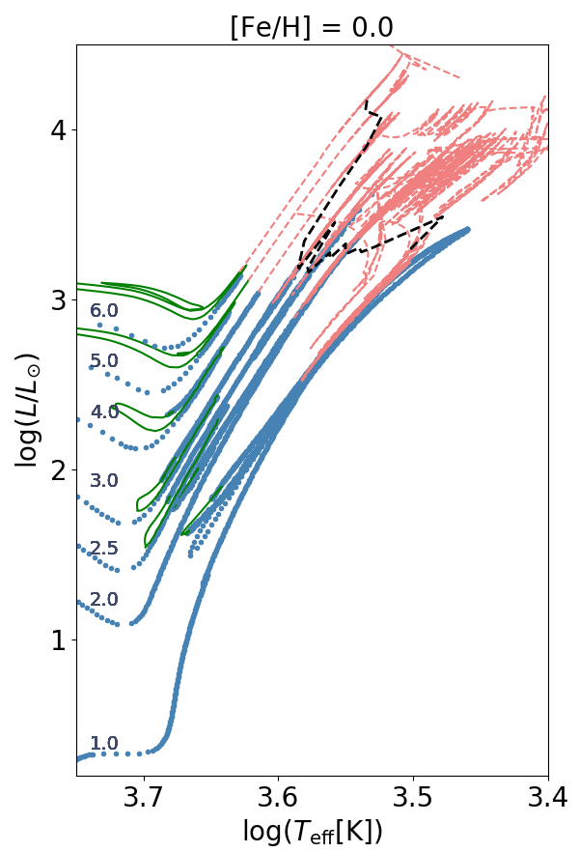
Technetium: where it should be detected
C-
stars
C-
stars
SC stars
3rd dredge-up
onset line
S-type stars
S-type stars
Intrinsic
(S or C)
star
M-type stars
M-type stars
( Nb-rich S star )
Shetye et al.2021
13th Torino workshop – M. Busso - June 2022

Slide 5

Technetium: where it should be detected
Intrinsic
(S or C)
star
Barium stars
CH stars
CEMP-s
CEMP-sr
Extrinsic stars
13th Torino workshop – M. Busso - June 2022

Slide 6
Technetium: where it should be detected
Intrinsic
(S or C)
star
Barium stars
CH stars
CEMP-s
CEMP-sr
Extrinsic stars
Shetye et al.2021
13th Torino workshop – M. Busso - June 2022

Slide 7
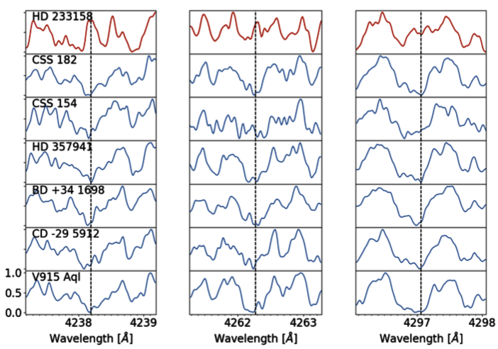
Technetium: where it is detected
Tc I searched in TP-AGB stars and detected (as expected):
Tc I: 3 resonance lines 4238, 4262, 4297A
Extrinsic (no-Tc) star shown for comparison
Tc
✖
✔
✔
✔
✔
✔
✔
In TP-AGB
S stars
HERMES@Mercator spectra
Shetye et al. 2021
13th Torino workshop – M. Busso - June 2022

Slide 8
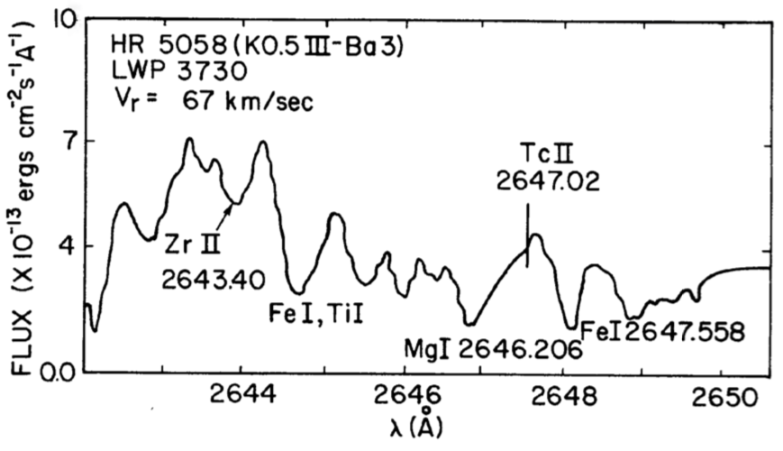
Technetium: where it is not detected
Tc II searched in Barium stars: no detection (as expected)
Tc II: 2647.02, 2610.00 and 2543.24 (IUE spectra)
Tc
✖
Little-Marenin & Little (1987)
13th Torino workshop – M. Busso - June 2022

Slide 9
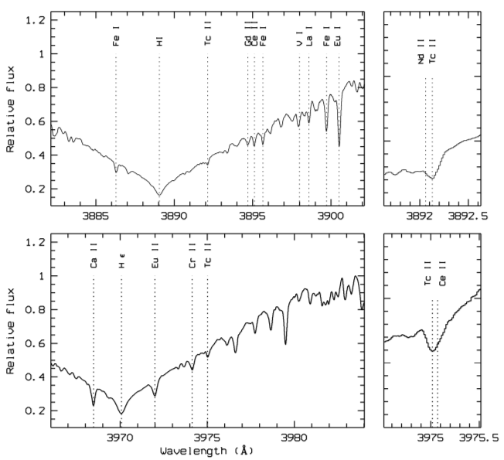
Technetium: where it should not be detected
Searched in Ap stars: inconclusive results
Tc II: 3892.129 and 3975.017 A
Tc
✔?
✔?
Eu–Cr A1 star HD 125248
Palmeri et al. 2007
See also Boyarchuk & Snow (1978):
no Tc in Ap stars
13th Torino workshop – M. Busso - June 2022

Slide 10
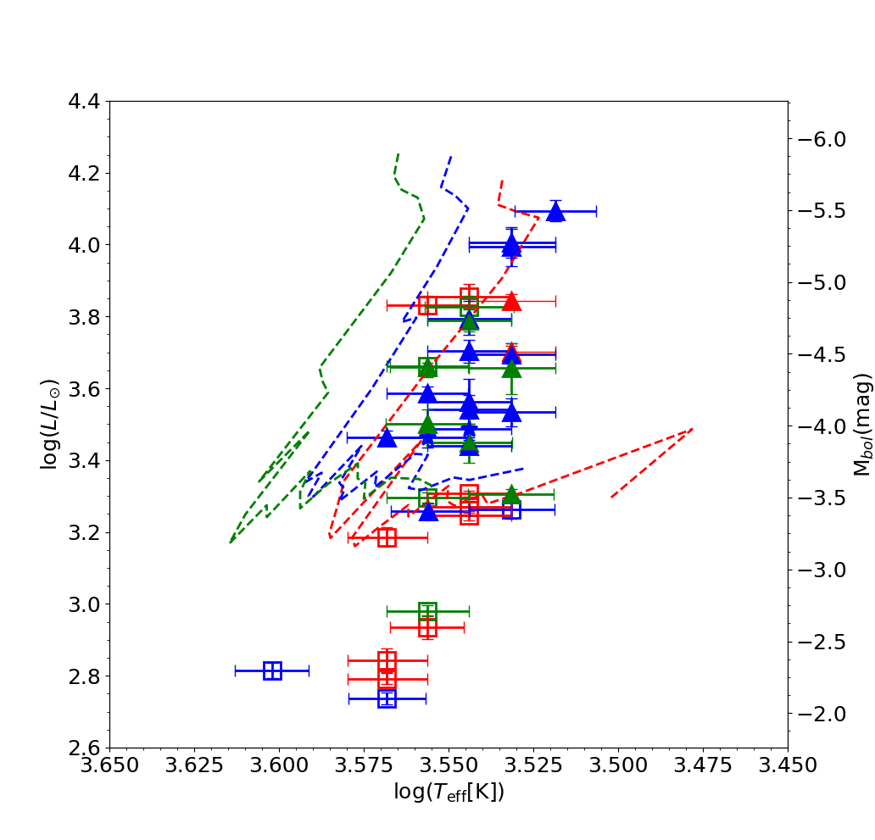
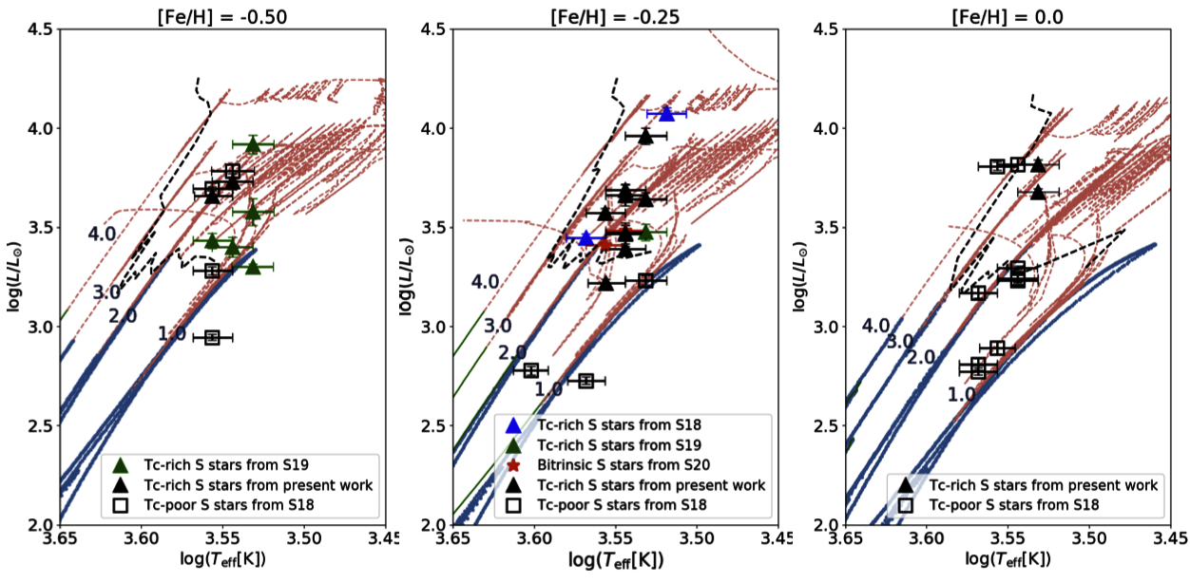
s-process along the AGB
S stars
HR diagram (Gaia eDR3)
Good agreement between Tc detection and
TP-AGB location (STAREVOL tracks)
TDU onset for
[Fe/H] = 0
= -0.25
= -0.5
TPAGB
RGB
Shetye et al. 2021
Van Eck, Shetye & Siess 2022
13th Torino workshop – M. Busso - June 2022

Slide 11
s-process along the AGB
S stars
Contribution of low-mass AGB stars (M<1.5)
Discovery of low-mass Tc-rich S stars thanks to Gaia DR2 and eDR3
(Shetye et al. 2019)
Name M_{current} M_{init}
CSS 154 1.4 1.6
BD +34 1698 1.2 1.4
V 915 Aql 0.8 1
CSS 182 1.1 1.3
BD-29 5912 1.3 1.5
13th Torino workshop – M. Busso - June 2022

Slide 12
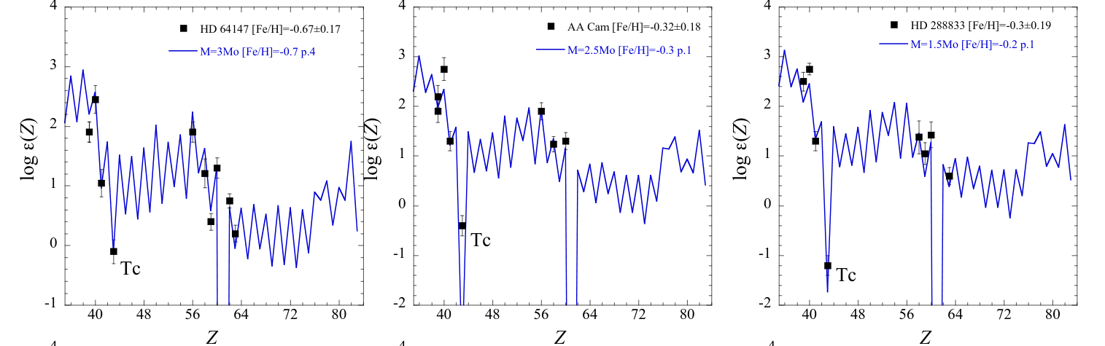
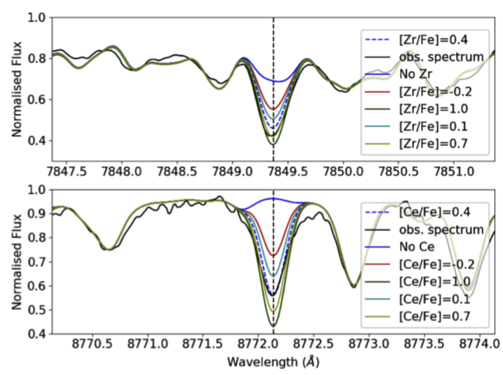
s-process along the AGB
S stars:
MARCS model atmosphere of S stars
(Van Eck et al. 2017)
Good agreement between s-process abundances and s-process models
First measurement of Tc abundances
Zr I 7849.37 Å
Shetye et al.
2019, 2021
Ce II 8772.16 Å
13th Torino workshop – M. Busso - June 2022

Slide 13
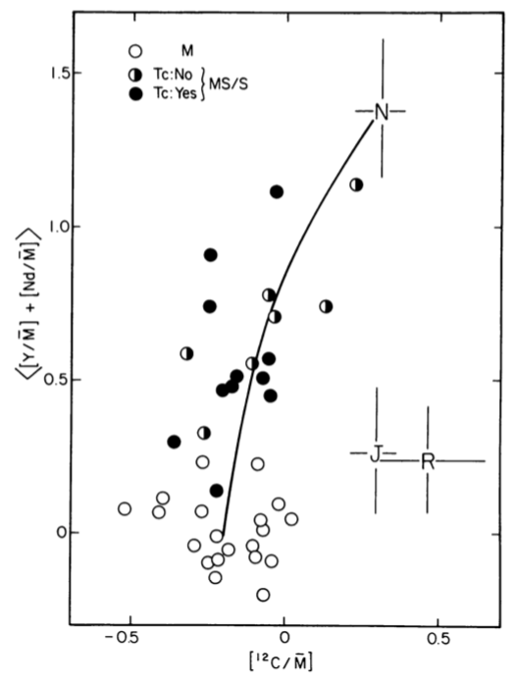
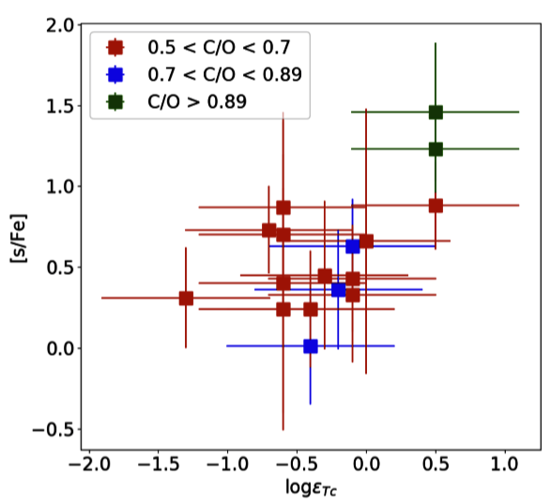
s-process along the AGB
S stars
Loose tendency to have
largest [s/Fe] for largest C/O:
Loose tendency to have largest Tc for largest C/O and largest [s/Fe]
Smith & Lambert 1990
Shetye et al. 2019, 2021
13th Torino workshop – M. Busso - June 2022

Slide 14
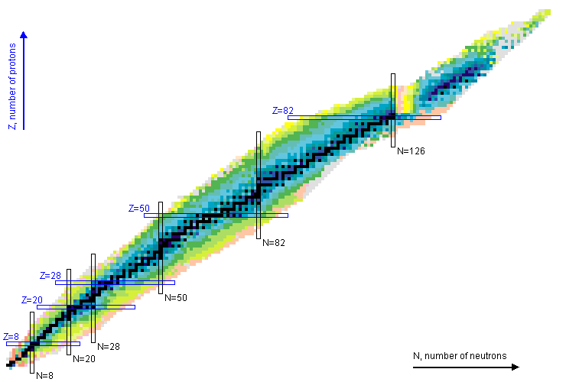
s-process
⁹³Zr → ⁹³Nb (mono-isotopic) (τ_{1/2} = 1.53 10⁶ yrs)
⁹⁹Tc → ⁹⁹Ru (τ_{1/2} = 0.21 10⁶ yrs)
Radio-isotopes allowing to derive information on the
timescales of the s-process
Ru
Tc
Mo
Nb
Zr
Y
N
13th Torino workshop – M. Busso - June 2022

Slide 15
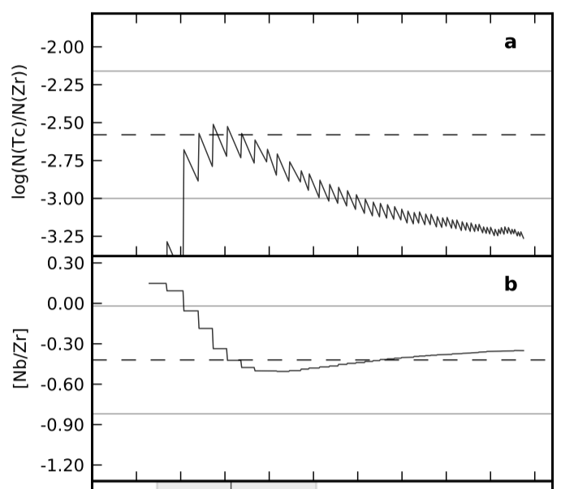
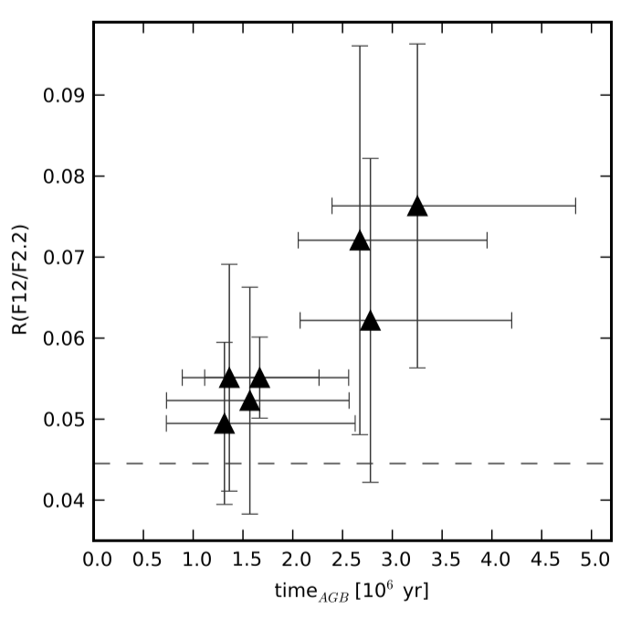
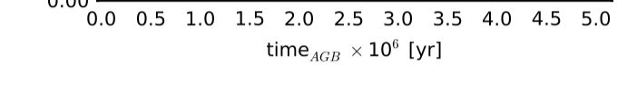
s-process along the AGB
Intrinsic S stars: Using the Zr→Nb and Tc→Ru chronometers,
        determination of ages since the s-process nucleosynthesis onset
        Constraint on s-process temperature operation in S stars: T< 250 10⁶ K →¹³C (α, n) neutron source
Measured value
Theoretical
prediction
13th Torino workshop – M. Busso - June 2022
Neyskens et al. 2015

Slide 16
The binary scenario
Intrinsic
(S or C)
star
( Nb-poor S star )
Barium stars
CH stars
CEMP-s
CEMP-sr
( Nb-rich S star )
Extrinsic stars
Shetye et al.2021
13th Torino workshop – M. Busso - June 2022

Slide 17
Processus s: température? source de neutrons? chronologie?
s-process: binary paradigm
Nb I
Tc I
log(N_{Nb}) =0.92
(~solar)
Intrinsic:
Tc-rich
Nb-solar
log(N_{Tc}) = -0.20
log(N_{Nb}) = 1.62
Extrinsic:
No Tc
Nb-rich
No Tc
13th Torino workshop – M. Busso - June 2022

Slide 18
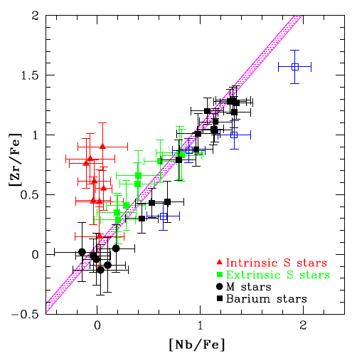
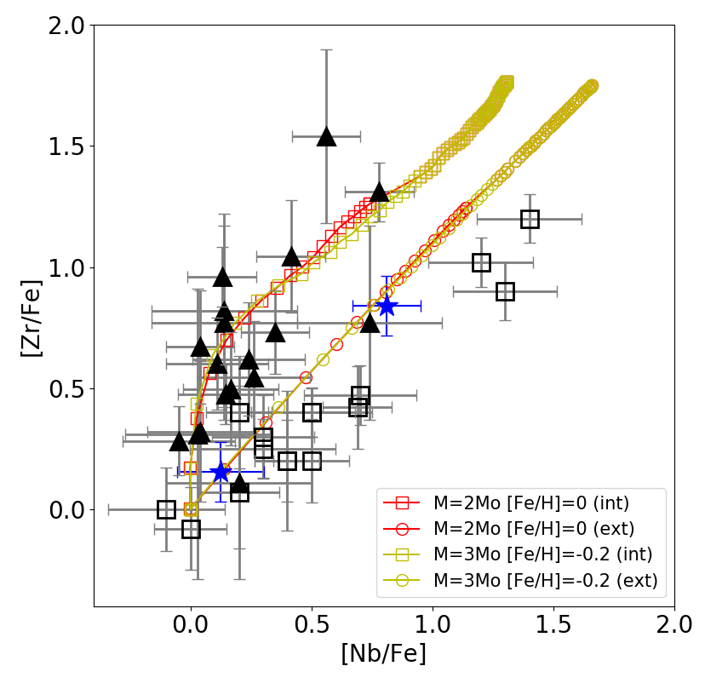
s-process: extrinsic stars
Extrinsic S stars
Validation in S-type stars, barium stars, CEMP-s stars:
Nb and Zr follow the expected trends
⁹³Zr → ⁹³Nb decay
(during AGB)
STAREVOL
predictions
Tc-rich
Nb-poor
Karinkuzhi, et al. 2018
Tc-poor
Nb-rich
Shetye et al. 2021
13th Torino workshop – M. Busso - June 2022

Slide 19
s-process: Bitrinsic stars
Reheated
cold case
Discovery of bitrinsic stars:
Stars that have experienced 2 pollutions:
One external, one internal
BITRINSIC star
Shetye et al. 2021
13th Torino workshop – M. Busso - June 2022

Slide 20
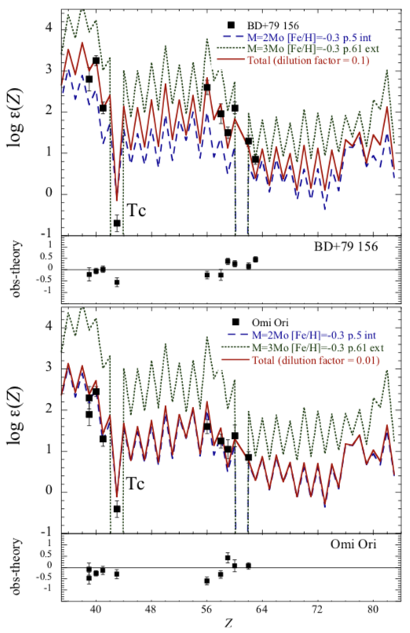
s-process: Bitrinsic stars
Reheated
cold case
Discovery of bitrinsic stars:
Stars that have experienced 2 pollutions:
One external, one internal
BITRINSIC star
Shetye et al. 2021
13th Torino workshop – M. Busso - June 2022

Slide 21
Two words of caution
13th Torino workshop – M. Busso - June 2022

Slide 22
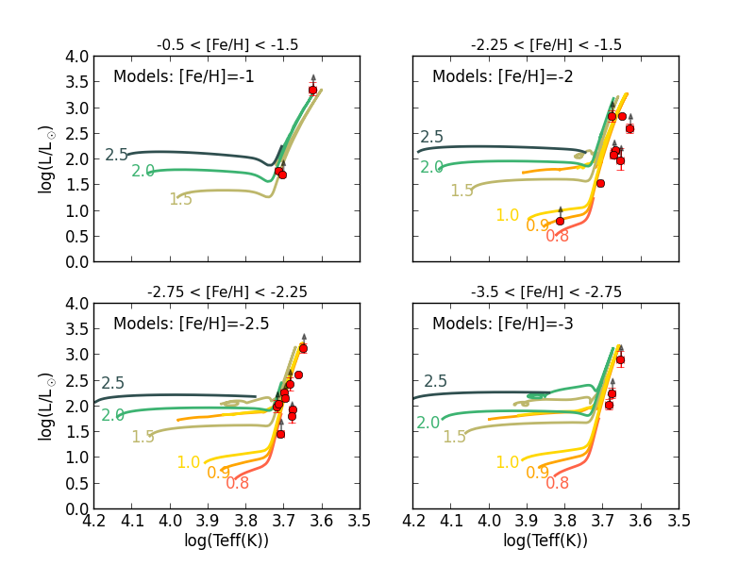
1. HR diagrams: models vs measured stars
Non-solar chemical composition
→impact photospheric opacities
→impact Teff
Example: Comparison CEMP stars with Starevol (L. Siess)
Karinkuzhi et al. 2021
13th Torino workshop – M. Busso - June 2022

Slide 23
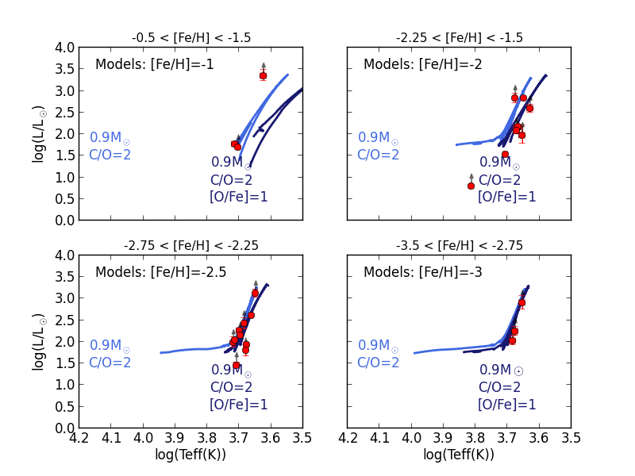
1. HR diagrams: models vs measured stars
Non-solar chemical composition
→impact photospheric opacities
→impact Teff
Example: Comparison CEMP stars with Starevol (L. Siess)
Karinkuzhi et al. 2021
13th Torino workshop – M. Busso - June 2022

Slide 24
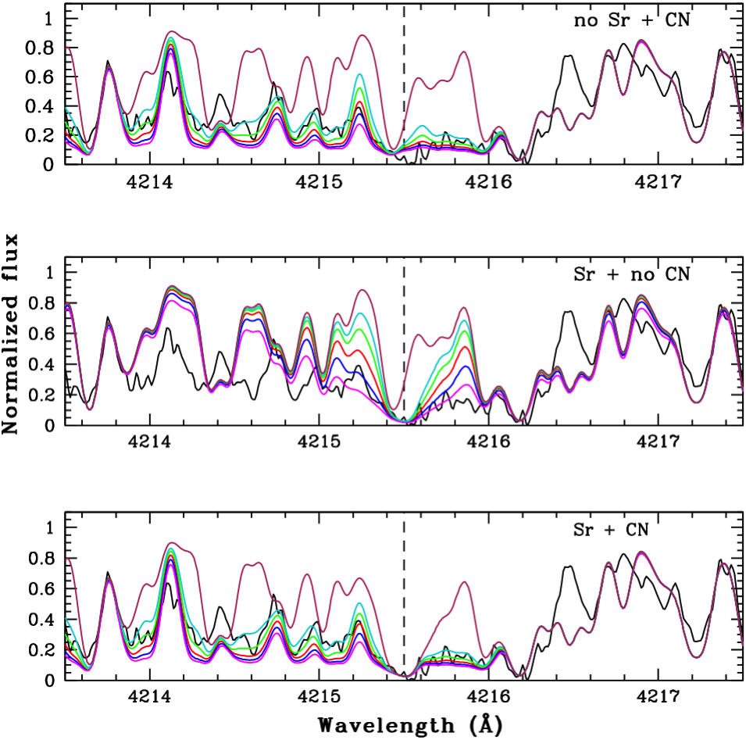
2. Machine-learning s-process line identification
Re-analysis of 15 bright Barium stars uncovered in LAMOST using machine-learning (Norfolk 2019)
HERMES@Mercator spectra
3 strong barium stars
8 mild barium stars
4 non-enriched stars
→ 25% misclassification
Reasons: Sr II 4215.519Å line
- heavily saturated
- blended with CN 4216Å
Karinkuzhi et al. 2021
HD 7863

Slide 25
Some open questions
13th Torino workshop – M. Busso - June 2022

Slide 26
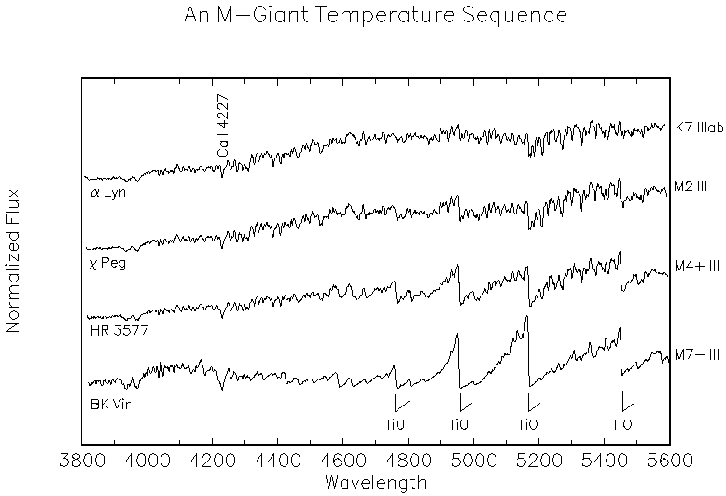
1. Tc-rich M stars
intrinsic
stars
Tc-rich M-type stars
C-
stars
C-
stars
SC stars
SC stars
S-type stars
S-type stars
TiO bands
M-type stars
M-type stars
Gray, http://ned.ipac.caltech.edu/level5/Gray/
Shetye et al. ***
13th Torino workshop – M. Busso - June 2022

Slide 27
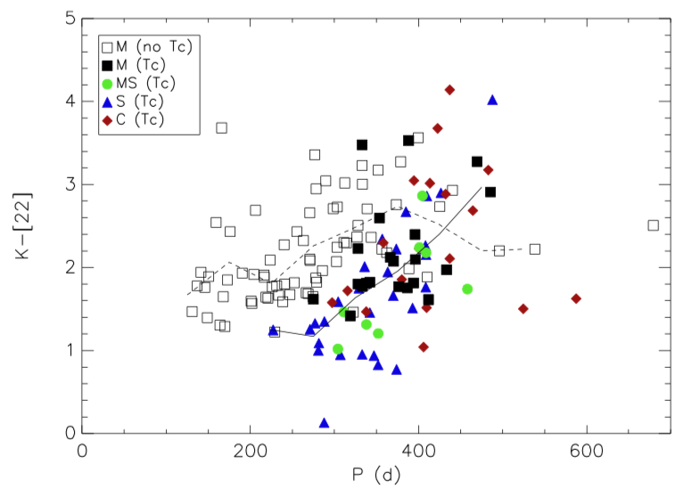
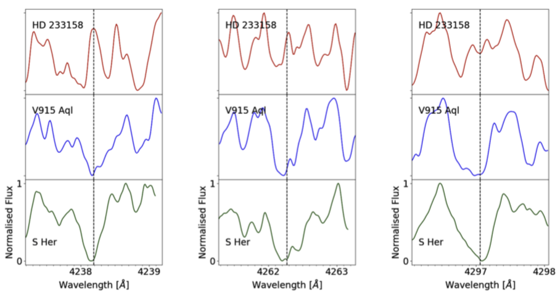
1. Tc-rich M stars
intrinsic
stars
Uncovered by Little-Marenin & Little 1979
No (prominent) s-process enrichment
No Tc S
Tc-rich S
Tc-rich M
Shetye et al. 2021
                →Only a (few) thermal pulses?
                →or a different s-process?
Uttenthaler et al.2019
13th Torino workshop – M. Busso - June 2022

Slide 28
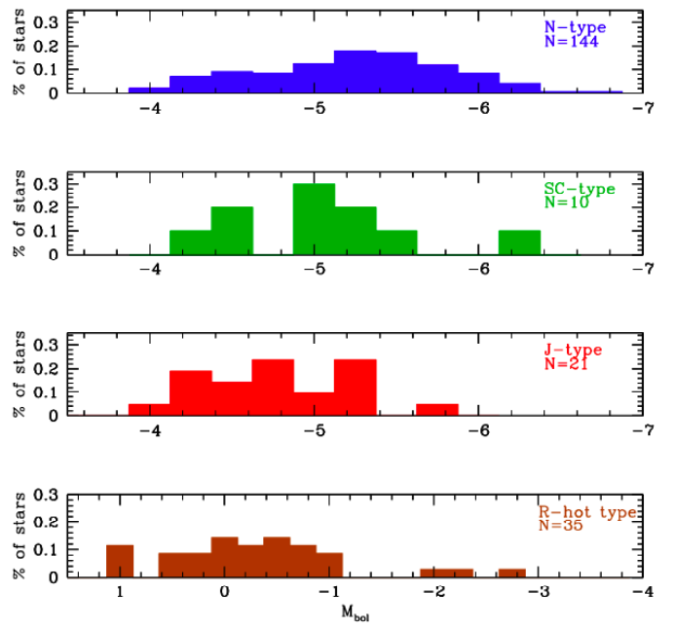
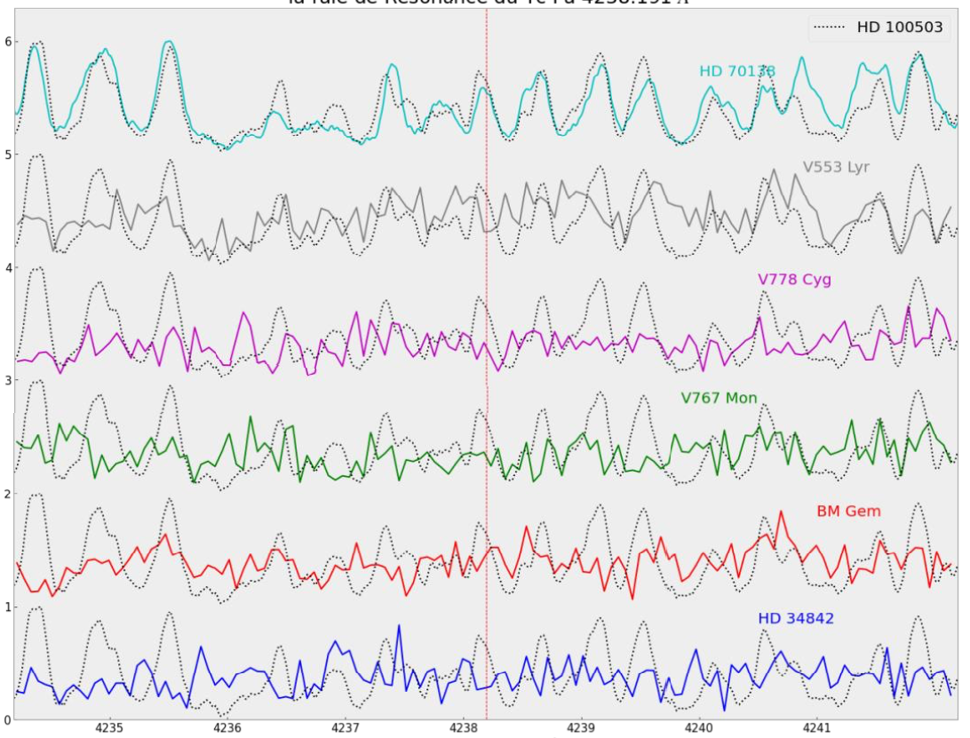
2. Technetium in C stars
Mystery of J-type stars (=¹³C-rich C stars):
Abia et al. 2020: J-type stars have TP-AGB luminosities →
Abia & Isern 2000: 5924A lines: UV Cam, Y CVn, RX Peg: no Tc
No Tc
Tc
Shetye 2021
HD 70138: C5,5 J star
HD 100503: comparison Tc-poor C-R star
HERMES spectra
No Tc
13th Torino workshop – M. Busso - June 2022

Slide 29
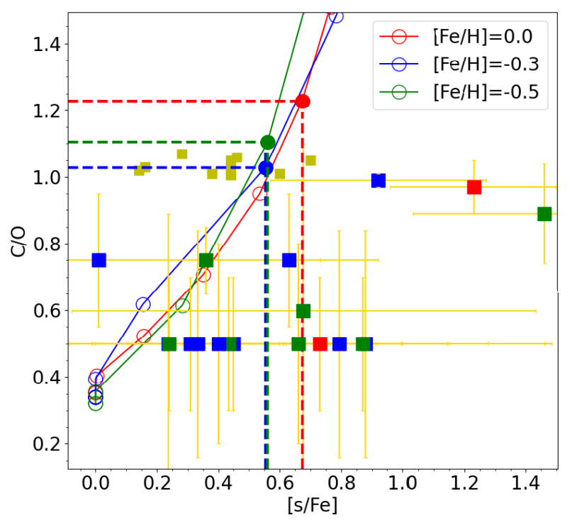
3. s and C increase
intrinsic
stars
Simultaneous increase of s and C
Stellar evolution model
(STAREVOL) predictions
13th Torino workshop – M. Busso - June 2022

Slide 30
3. s and C increase
intrinsic
stars
Simultaneous increase of s and C
C/O>1
Stellar evolution model
(STAREVOL) predictions
13th Torino workshop – M. Busso - June 2022

Slide 31
3. s and C increase
intrinsic
stars
Simultaneous increase of s and C
C stars (Abia et al.)
S stars (Shetye et al.)
C/O<1
13th Torino workshop – M. Busso - June 2022

Slide 32
3. s and C increase
intrinsic
stars
Simultaneous increase of s and C
Stars with such C/O
should have [s/Fe]≥0.6
C stars (Abia et al.)
Stars with such [s/Fe]
should have C/O>1
S stars (Shetye et al.)
C/O<1
Shetye et al. 2020
13th Torino workshop – M. Busso - June 2022

Slide 33
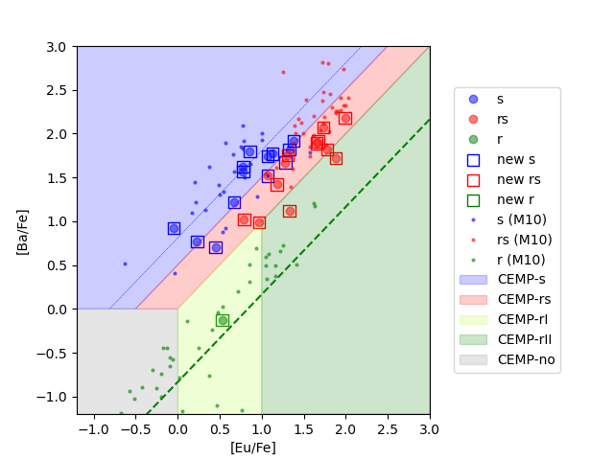
4. More extrinsic stars
CEMP-sr:
- Binaries
- Overabundances in s and r elements
- Classification
r+s
s-process
s
rII
rI
Karinkuzhi et al., 2021
r-process
13th Torino workshop – M. Busso - June 2022

Slide 34
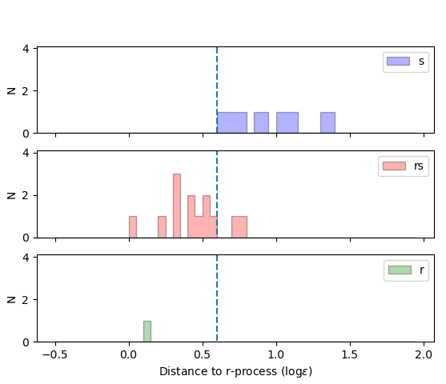
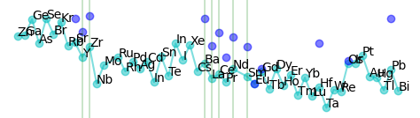
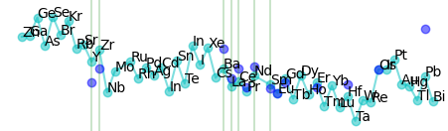
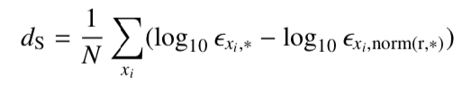
4. More extrinsic stars
CEMP-sr:
- Classification
CEMP-s
CEMP-sr
New classification scheme
Using Y, Zr, Ba, La, Ce, Nd, Sm, Eu
13th Torino workshop – M. Busso - June 2022

Slide 35
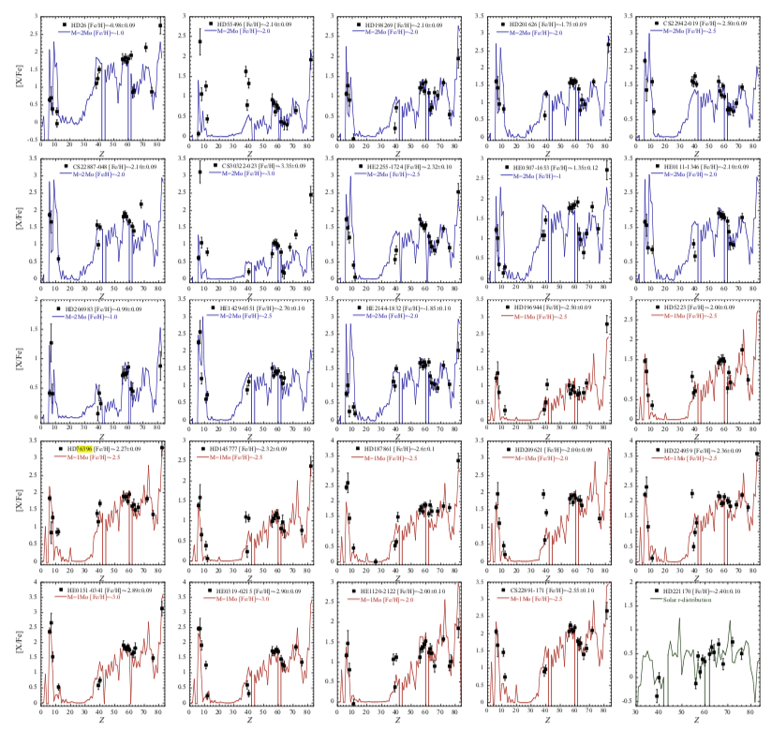
4. More extrinsic stars
CEMP-s
CEMP-sr
Double event scenario? (Gull et al. 2018)
              Or
  Low-metallicity and low- mass thermally-pulsing AGB stars
  (Iwamoto et al. 2004; Lugaro et al. 2012, Choplin et al. 2021)
HD 100503: analog to
CEMP-rs star
but at [Fe/H]=-0.7
Karinkuzhi et al. 2018
CEMP-rs
13th Torino workshop – M. Busso - June 2022

Slide 36
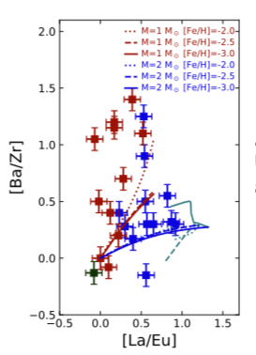
4. More extrinsic stars
Radiative s-process
during interpulse
CEMP-rs
    Particular manifestation of the s-process (at low [Fe/H])
    Easier to detect at low [Fe/H]
    HD100503: analog to CEMP-rs star at [Fe/H]=-0.7
    Mixed profile also found in V4334 Sagittarri (Sakurai’s object)
    Some SC stars have a high Eu overabundance (0.5 to 1 dex) (Abia & Wallerstein 1998) as well as some Ba stars
1 M⊙ models with proton ingestion
CEMP-s
Karinkuzhi D. et al., 2021, A&A 645, 61
13th Torino workshop – M. Busso - June 2022

Slide 37
Perspectives
Methods:
Non-LTE abundances (La, Ce, Sr, Y, Zr…)
3D abundances
Systematics from large surveys: to come
Targets: Mainly 5 types of s (and i ? ) -process stars:
                Intrinsic TP-AGB (S, SC, C)
              Extrinsic (S, C, Ba, CH, CEMP-s and sr)
              Bitrinsic stars (S, SC?, C?)
              *Some* post-AGB objects
              GCE stars (Galactic Chemical Evolution) stars
13th Torino workshop – M. Busso - June 2022

Slide 39
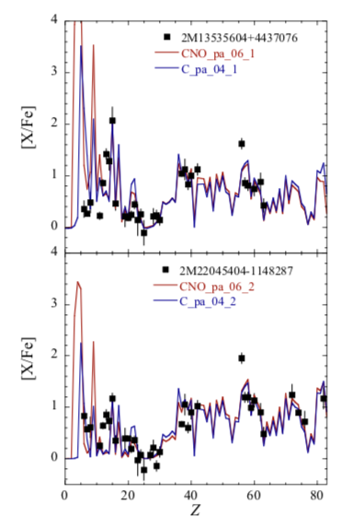
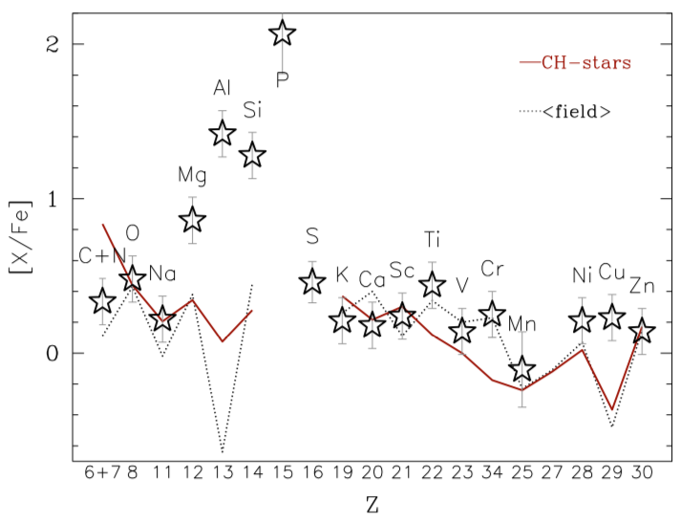
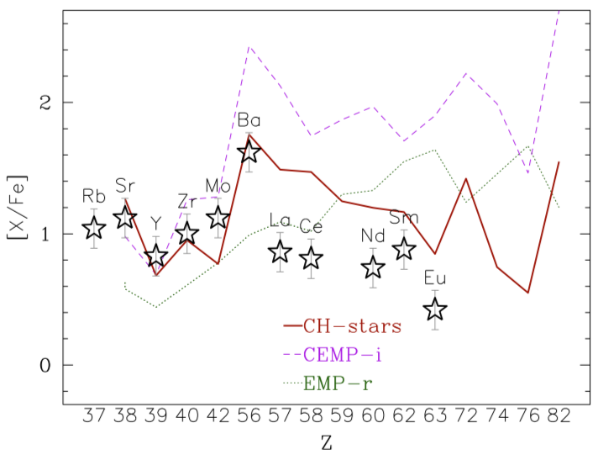
More puzzles to come from surveys
Phosphorus-rich stars
15 K giants
[Fe/H]~-1
Apparently single stars
1 shows C+N enhancement
Masseron et al. 2020
Spallation: non-thermal processes resulting from the interaction of C-rich or CNO-rich material with energetic protons and/or α-particles (Goriely 2022)

