Slide 1
Neutron capture and total cross measurements on ^{94,95,96}Mo at n_TOF and GELINA
Riccardo mucciola

Slide 2
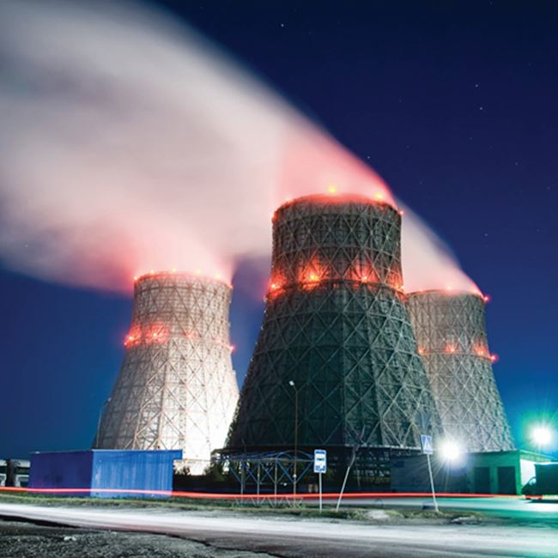
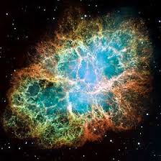
Importance of molybdenum
Fission product in nuclear power plants;
Nucleosynthesis of heavy elements: pollution in presolar SiC grains;
Transport casks, irradiated fuel storage;
Research reactors and Accident Tolerant Fuels.

Slide 3
Presolar grain composition
Comparison of SiC grains composition versus stellar model (FRUITY Torino model)
MACS form KADoNiS v1.0
Slight discrepancy between model and isotopic composition
Possible overestimation of MACS in KADoNiS.
N. Liu, et al., ApJ 881 (2019) 28.

Slide 4
SANDA project
SANDA WP2:

Slide 5
Objective of experiments
Improve capture cross section accuracy for neutron energies from thermal (10 meV) to hundreds keV
Submit results to EXFOR to improve nuclear data libraires (ENDF, JEFF, JENDL ecc.)

Slide 6
Experimental campaigns
Transmission measurement
Carried out at GELINA
Total cross section measurement
Natural and enriched samples
10m and 50m flight path
Radiative capture measurement
Carried out at GELINA and n_TOF
Neutron capture cross section
Both experimental areas of n_TOF
10m station of GELINA

Slide 7
Facilities and technique

Slide 8
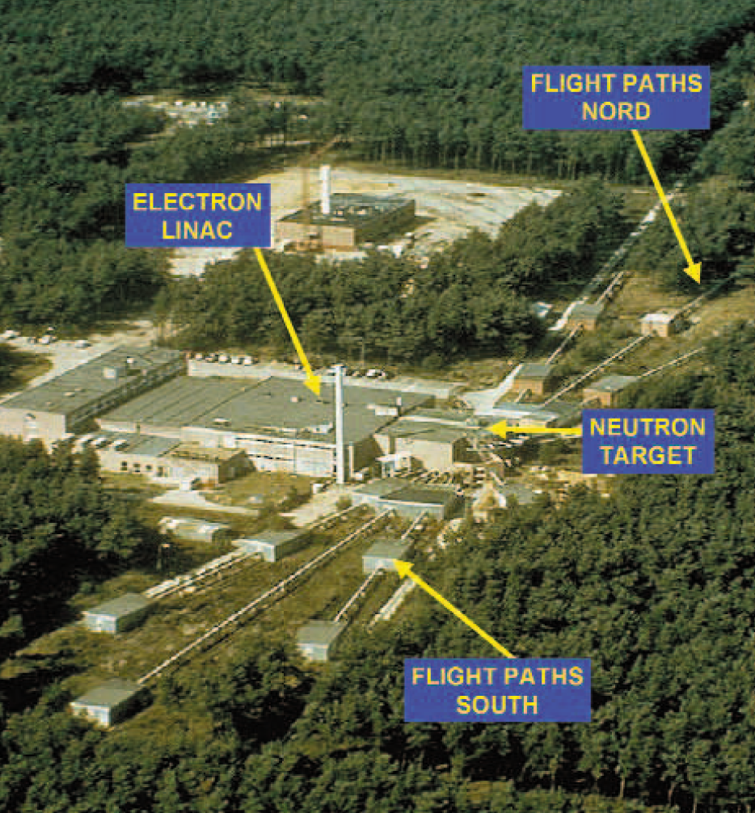
GELINA
Located at JRC-Geel
Multi-user time-of-flight facility
Electron beam produced by LINAC (E = 140 MeV)
Rotating uranium target
Production of neutrons via ($γ,$n) or ($γ,$f)
Pulsed neutron source (10 meV < E < 20 MeV)
Water moderators

Slide 9
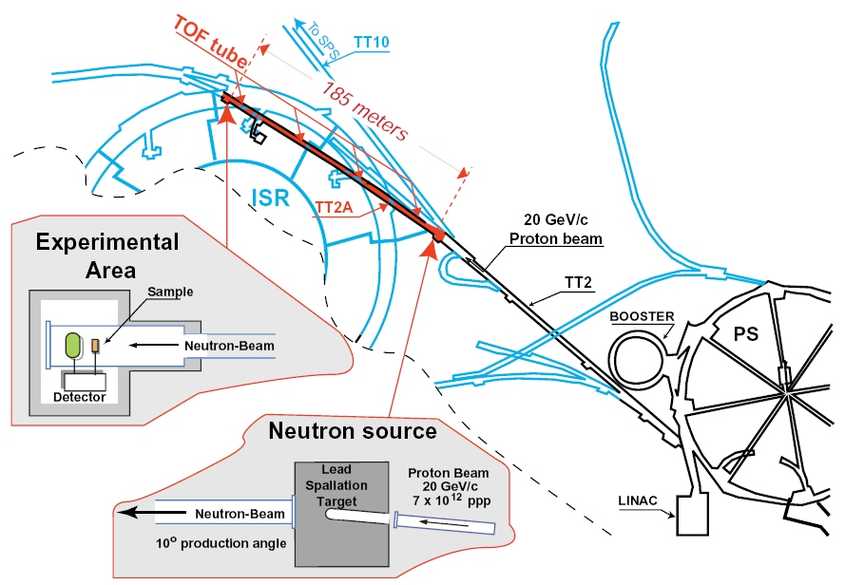
n_TOF
Located at CERN
Neutron beam produced using PS proton on lead target
Production of neutrons via spallation
Pulsed neutron source (10 meV < E < 1 GeV)
Three experimental areas (EAR1, EAR2 and NEAR)

Slide 10
Time-of-flight technique
$$E_{n}=mc^{2}\left(γ−1\right)≈\frac{1}{2}mv^{2}$$
Flight path
$$v=\frac{L}{t}$$
$$t=\left(T_{s}−t_{0}\right)−(t_{γ}−L/c)$$
Time-of-flight
$$\frac{ΔE}{E}=\left(1+γ\right)γ\frac{Δv}{v}≈2\frac{Δv}{v}=2\sqrt{{\left(\frac{Δt}{t}\right)}^{2}+{\left(\frac{ΔL}{L}\right)}^{2}}$$
$$T_{s}$$
$$t_{0}$$

Slide 11
Experimental measurements
Transmission
Percentage of neutrons that traverses a samples without interacting with it
Related to total cross section:
$T=N\frac{C_{in}\left(t\right)−{KB}_{in}(t)}{C_{out}\left(t\right)−{KB}_{out}(t)}=\frac{φ_{n}e^{−nσ_{tot}}}{φ_{n}}=e^{−nσ_{tot}}$
Radiative capture (capture yield)
Percentage of neutrons that undergoes capture reaction in the sample
Related to capture cross section via:
$$Y_{exp}=N\frac{C_{γ}\left(t\right)−B_{γ}(t)}{ C_{φ}\left(t\right)−B_{φ}(t)}Y_{φ}= (1−T)\frac{e^{−nσ_{γ}}}{e^{−nσ_{tot}}}$$

Slide 12
Resonance Shape Analysis
Determination of the resonance parameter $E_{0}$, $Γ_{γ}$, $Γ_{n}$
Simultaneous fit of transmission and capture data
Fit performed using R-Matrix formalism
Parametrization of cross section using resonance parameters

Slide 13
Resonance parameters evaluation

Slide 14
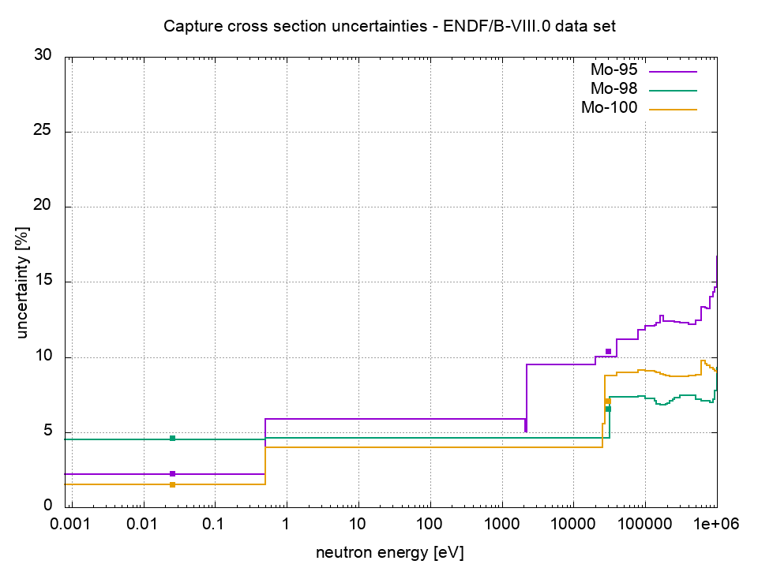
Cross section uncertainties in ENDF/B-VIII

Slide 15
Improved RP for ^{94,95,96,nat}Mo
Study transmission and capture data for Mo reported in the literature:
compilation of resonance parameters based on these data
Transmission cross section measurements using ^{nat}Mo samples at 50m GELINA:
adjust the compiled resonance parameter file by RSA with REFIT
Experiments with enriched ^{94,95,96}Mo samples:
Transmission and capture measurements at GELINA
Capture measurements at n_TOF
Final resonance parameter file by a simultaneous analysis of GELINA and n_TOF data

Slide 16
Mo literature study
Transmission |  |  | Capture
Wang | ^{nat}Mo | POHANG (<200 eV) | Weigmann | ^{nat}Mo | GELINA (<25 keV)
Pevzner | ^{92,94,95,96,97,98,100}Mo | DUBNA (<10 keV) | Weigmann | ^{92,94,95,96,97,98,100}Mo | GELINA (<5 keV)
Wynchank | ^{nat}Mo | Columbia Univ. (<5 keV) | Musgrove | ^{92,94,95,96,97,98,100}Mo | ORELA (>3keV)
Shwe | ^{95,97}Mo, ^{nat}Mo | Argonne (<1.5 keV) | Wasson | ⁹²Mo | ORELA (<30 keV)
Chrien | ⁹⁸Mo | ORELA (<50 keV)
Babich | ⁹⁸Mo | 90m chopper (<2.5 keV)
Leinweber | ^{nat}Mo | RPI (<2 keV)
Wasson | ⁹²Mo | ORELA (<30 keV)
Weigmann | ¹⁰⁰Mo | ORELA (<4keV)

Slide 17
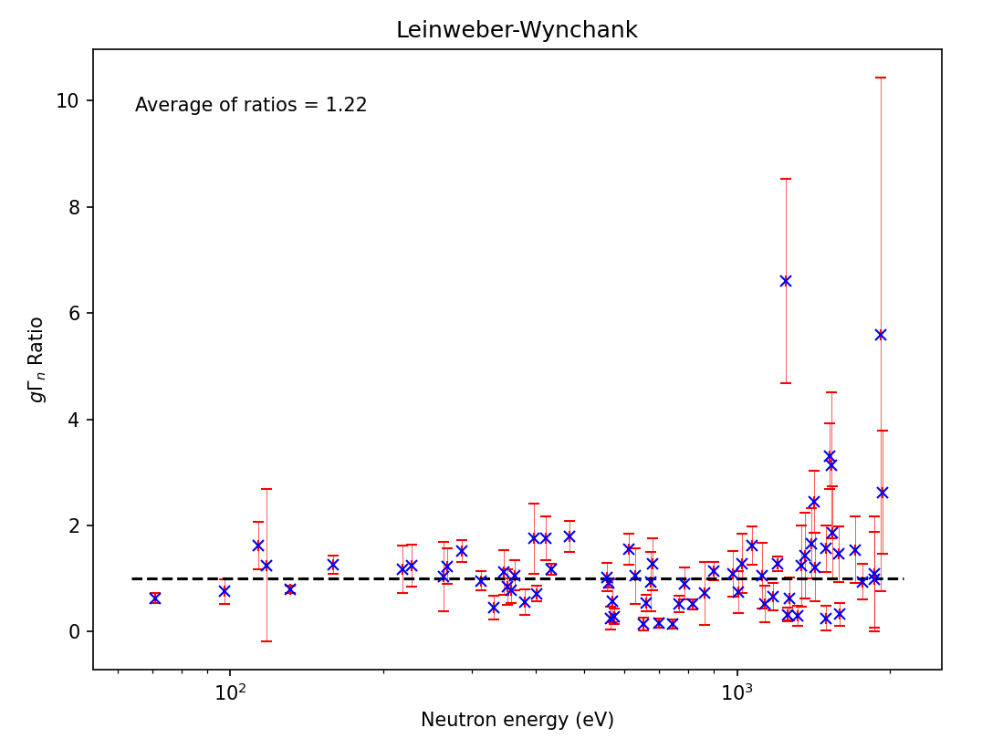
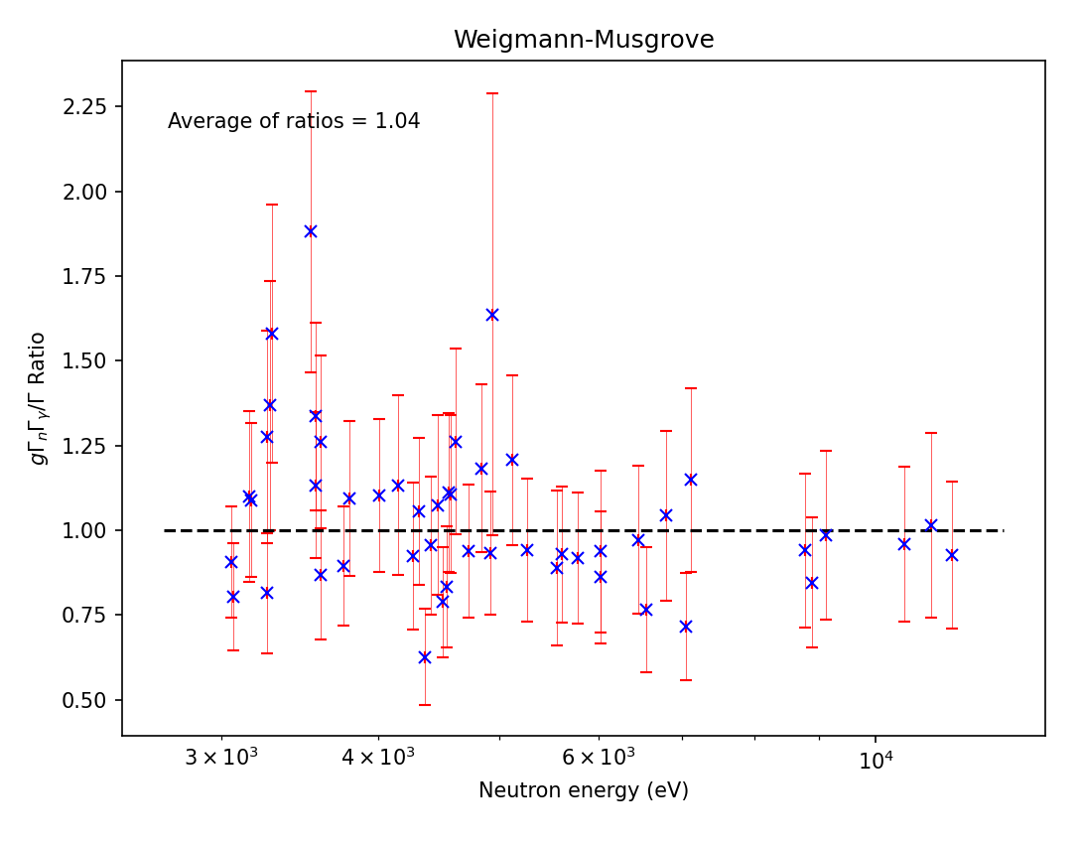
Mo literature comparison
Ratio of neutron width for transmission
Check parameters consistency
Ratio of resonance kernel for capture

Slide 18
RP compilation from literature
Define consistent energy scale:
Weigmann et al. (capture experiments at GELINA)
Select g$Γ_{n}$ reference:
E < 2keV: Leinweber
E > 2keV: Whynchank
Select $\frac{gΓ_{γ}Γ_{n}}{Γ}$ reference:
Weigmann
Musgrove for odd isotopes and E>3keV
Compilation of RP file from literature data
^{nat}Mo transmission measurements at GELINA to validate and improve RP file

Slide 19
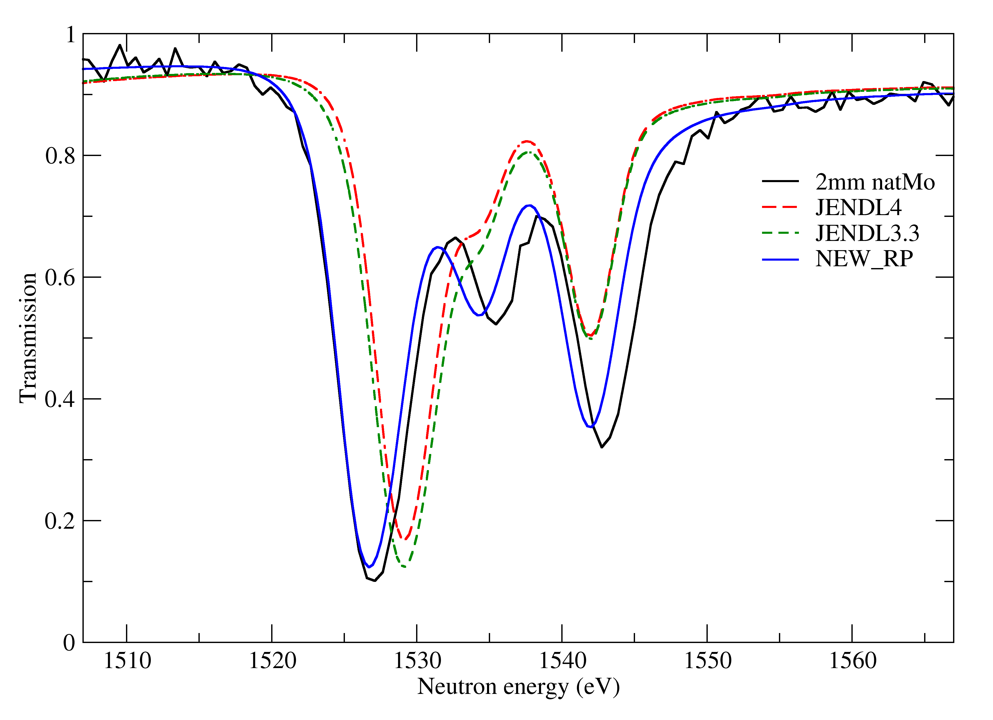
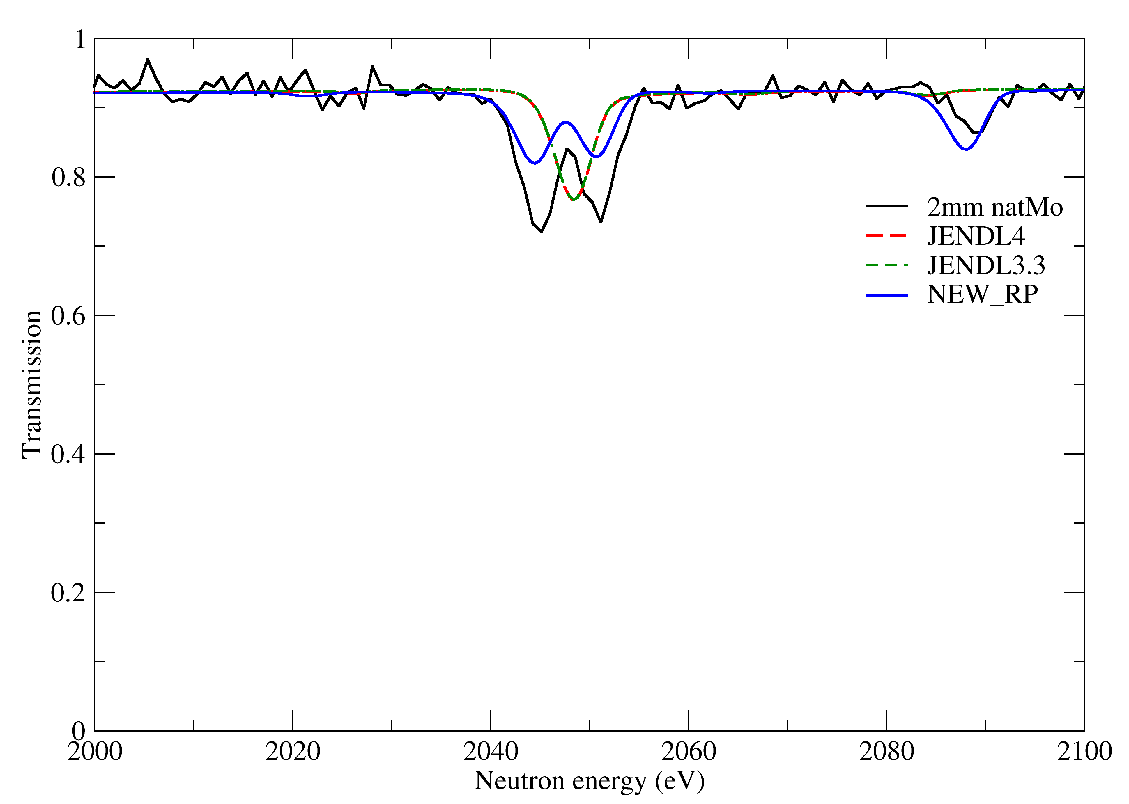
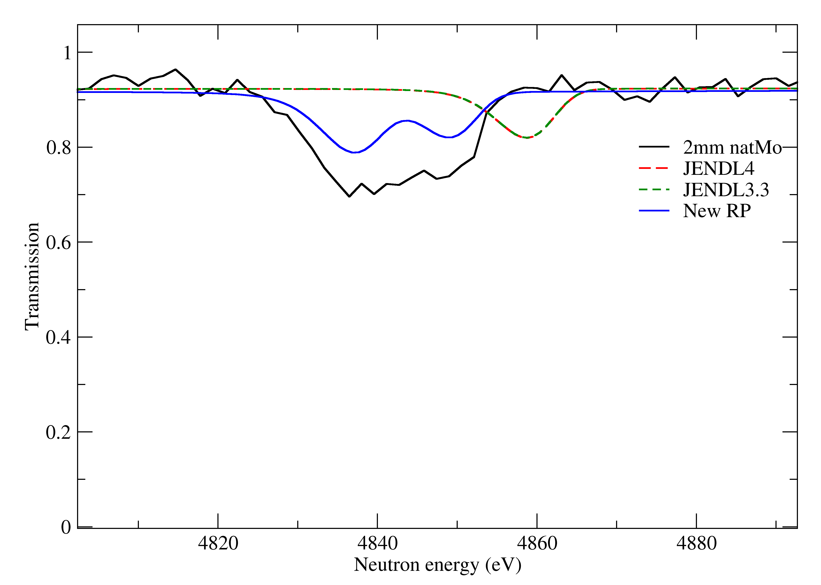
Validation of compiled RP file
RP file verified by transmission data (50 m) of 2mm and 5mm thick ^{nat}Mo samples
Missing resonances in libraries reported in literature data
Literature parameters more consistent with transmission data
New RP file improve data description.

Slide 20
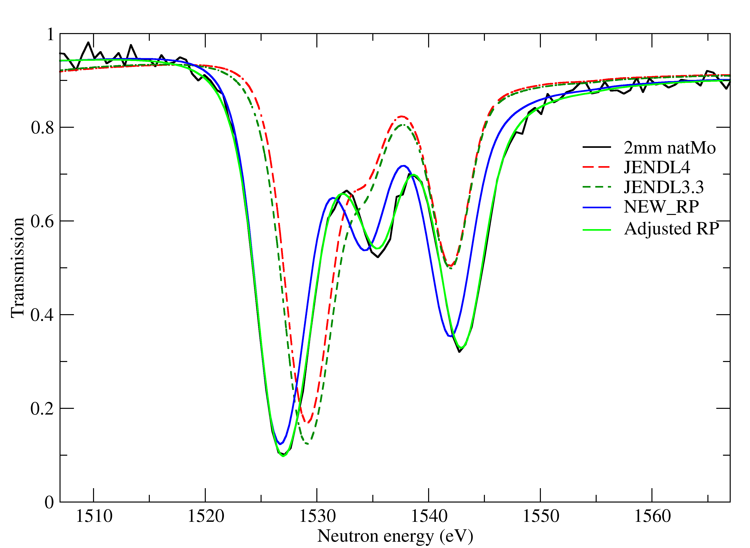
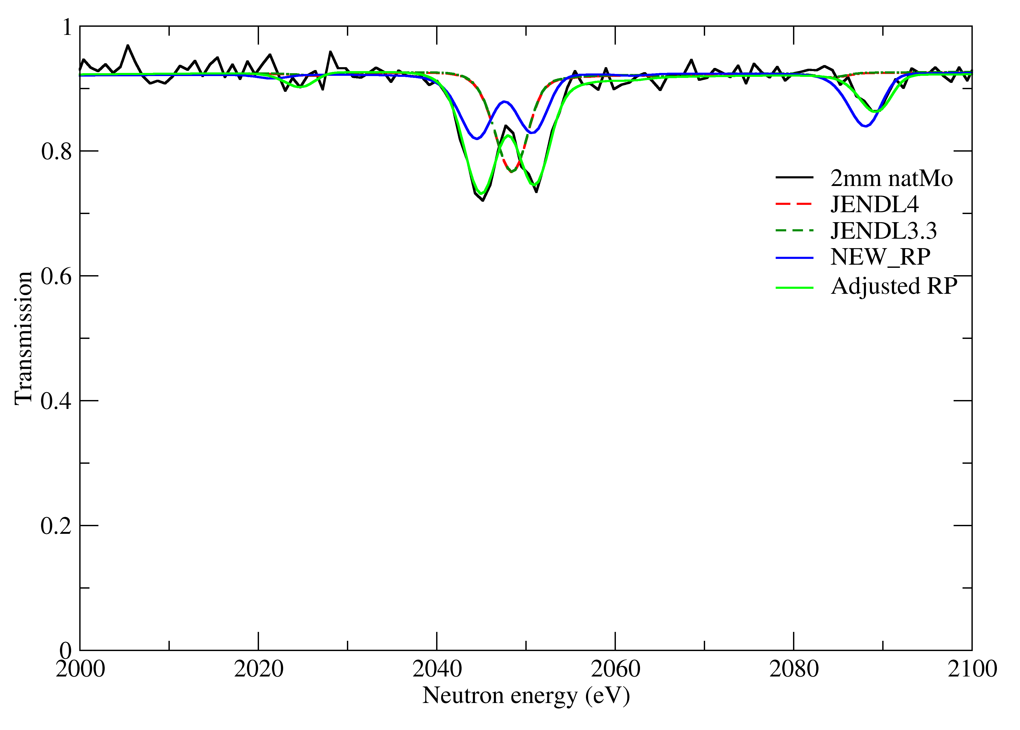
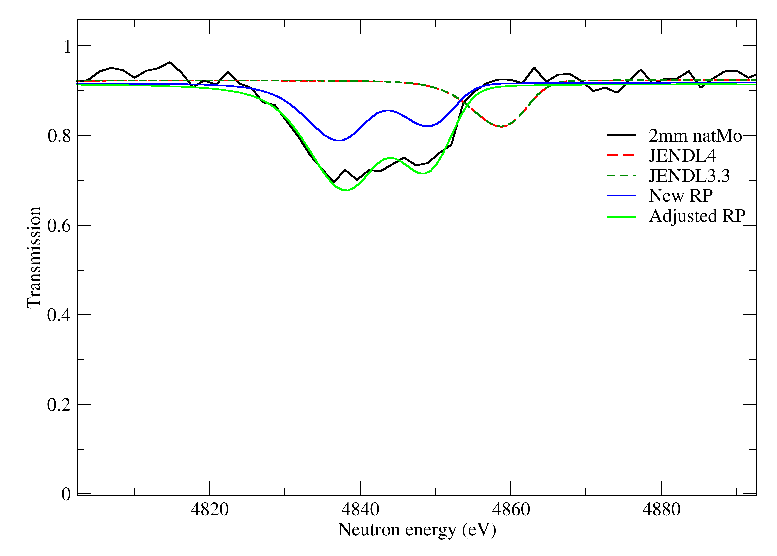
Improvement of RP file
RP file improved by an adjustment to transmission data using REFIT
Fit of resonances up to 5 keV
Final paper ready for submission

Slide 21
Dissemination of results
Results of resonance parameters compilation submitted for publication
EXFOR submission under preparation
Collaboration with additional experiment performed in another facility
Evaluated data file will be proposed for new version of JEFF!

Slide 22
Enriched samples campaign

Slide 23
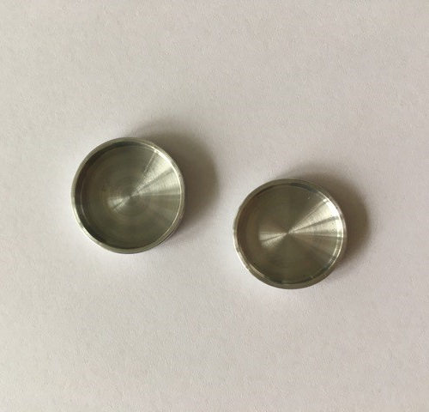
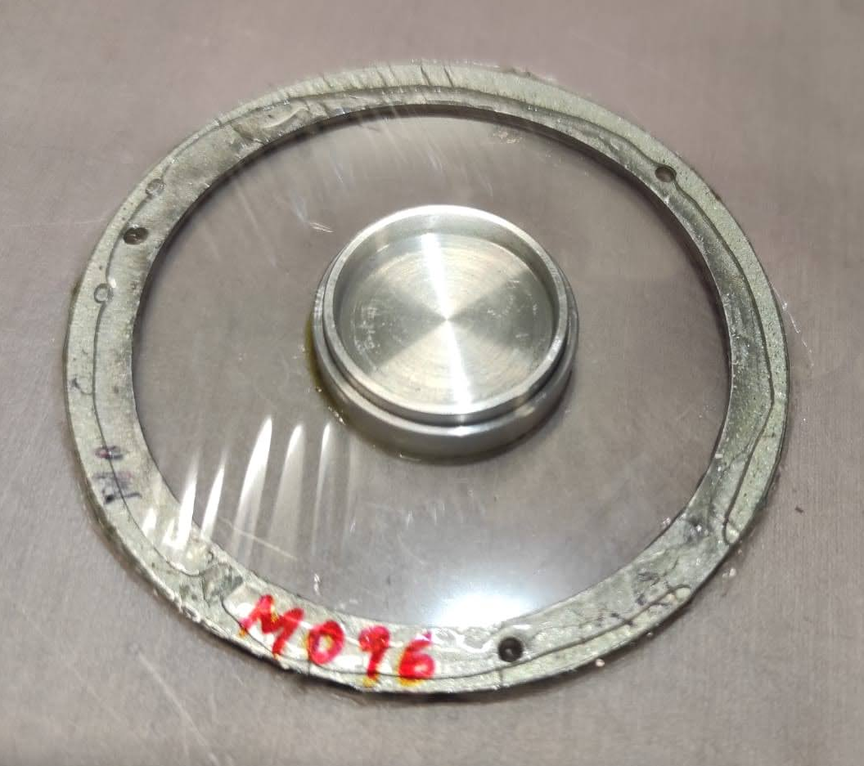
Mo powder @ n_TOF
Metallic powder in metallic capsules;
Capsule fixed to mylar disk using Kapton foil;
2g of powder available for each isotope;
Capture measurements performed at n_TOF in October 2021.

Slide 24
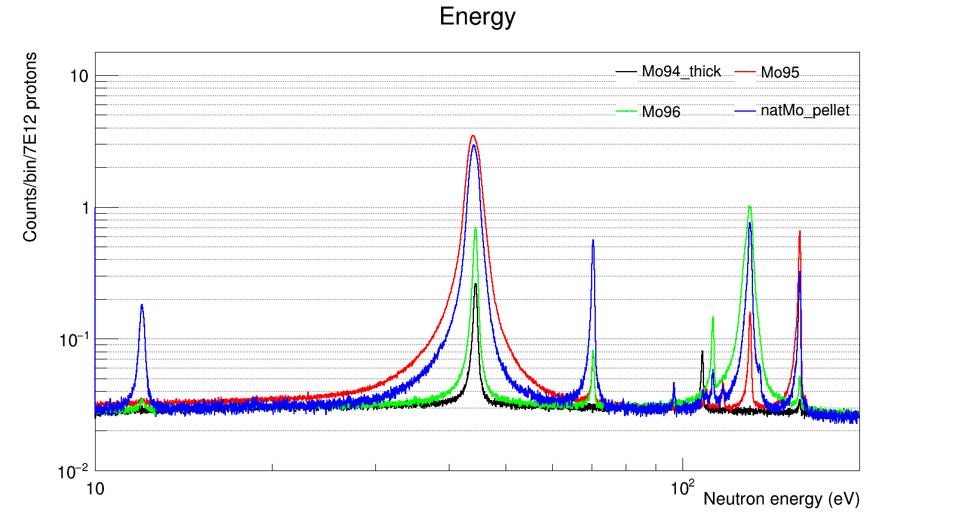
Energy spectra
Contaminants effect visible
Notes:
97Mo content: 0,51% in 95Mo, 1% in 96Mo

Slide 25
Energy spectra
Good signal to noise ratio at thermal energy
Notes:
Thermal cross section: 94Mo~350mb; 95Mo~13b; 96Mo~620mb

Slide 26
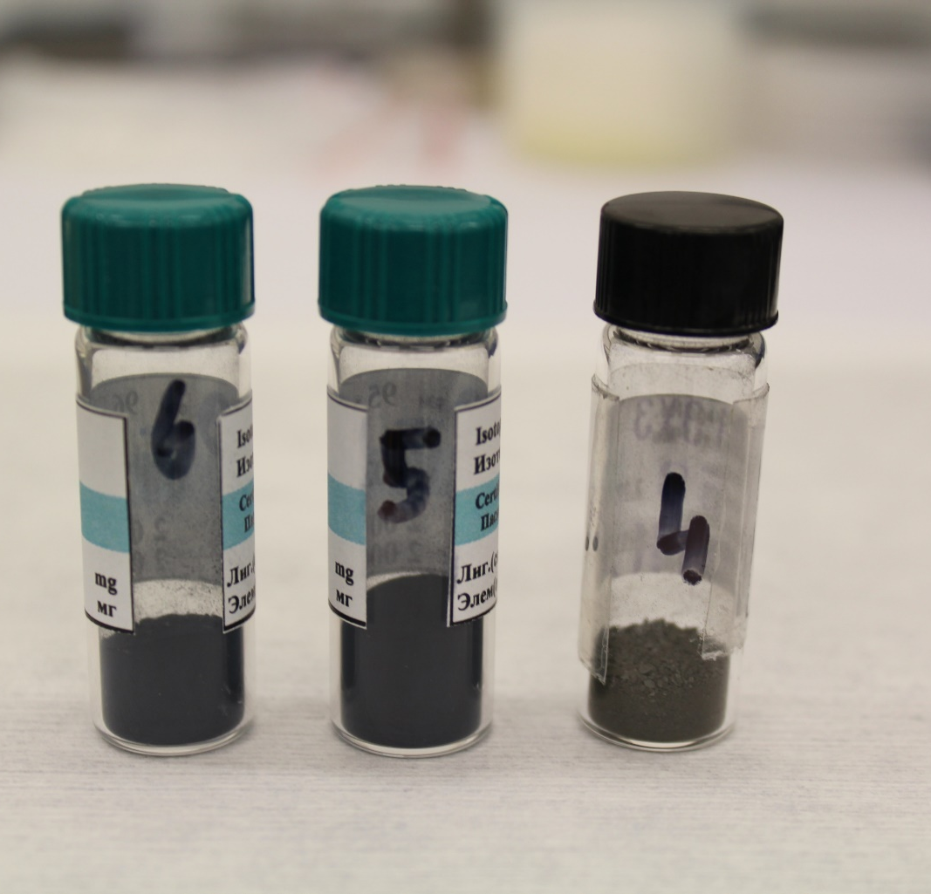
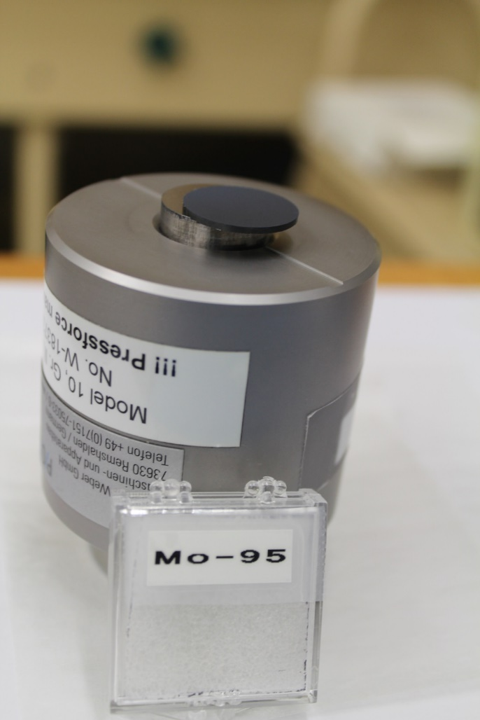
Enriched pellets preparation
Samples prepared
⁹⁴Mo | ⁹⁵Mo | ⁹⁶Mo
99% | 95% | 96%
Pressed pellets prepared using enriched powder
Pellets prepared at JRC-Geel
Self sustaining pellets of ~ 2g
Additional ^{nat}Mo samples prepared using powder with different grain sizes
Samples used in EAR1 campaign at n_TOF

Slide 27
Mo samples
Atomic % | ⁹²Mo | ⁹⁴Mo | ⁹⁵Mo | ⁹⁶Mo | ⁹⁷Mo | ⁹⁸Mo | ¹⁰⁰Mo
⁹⁴Mo | 0,63% | 98,97% | 0,36% | 0,01% | 0,01% | 0,01% | 0,01%
⁹⁵Mo | 0,31% | 0,69% | 95,40% | 2,24% | 0,51% | 0,65% | 0,20%
⁹⁶Mo | 0,28% | 0,24% | 1,01% | 95,90% | 1,00% | 1,32% | 0,25%
Isotope | Mass (g) | Areal density (atoms/b)
⁹⁴Mo | 1,9526 | 3,9592E-03
⁹⁵Mo | 1,9745 | 3,9558E-03
⁹⁶Mo | 1,9175 | 3,8064E-03
^{nat}Mo-5 μm | 2,014 | 4,0059E-03
^{nat}Mo-350 μm | 1,989 | 3,9584E-03

Slide 28
Transmission with enriched Mo
Transmission measurement at 10m with enriched samples performed

Slide 29
Transmission with enriched Mo
Preliminary results of transmission @10m for enriched pellets;
Resonance parameters from new compilation;
Deviation on ⁹⁵Mo content from declared abundance;
Abundance of biggest contaminants fitted with REFIT.

Slide 30
Transmission with enriched Mo
Nominal | ⁹²Mo | ⁹⁴Mo | ⁹⁵Mo | ⁹⁶Mo | ⁹⁷Mo | ⁹⁸Mo | ¹⁰⁰Mo
⁹⁴Mo | 0,63% | 98,97% | 0,36% | 0,01% | 0,01% | 0,01% | 0,01%
⁹⁵Mo | 0,31% | 0,69% | 95,40% | 2,24% | 0,51% | 0,65% | 0,20%
⁹⁶Mo | 0,28% | 0,24% | 1,01% | 95,90% | 1,00% | 1,32% | 0,25%
Fitted | ⁹²Mo | ⁹⁴Mo | ⁹⁵Mo | ⁹⁶Mo | ⁹⁷Mo | ⁹⁸Mo | ¹⁰⁰Mo
⁹⁴Mo | 0,63% | 97,61% | 0,35% | 0,01% | 0,01% | 0,01% | 0,01%
⁹⁵Mo | 0,31% | 0,69% | 84,10% | 2,24% | 0,51% | 0,65% | 0,20%
⁹⁶Mo | 0,28% | 0,24% | 1,25% | 94,50% | 1,08% | 1,00% | 0,25%

Slide 31
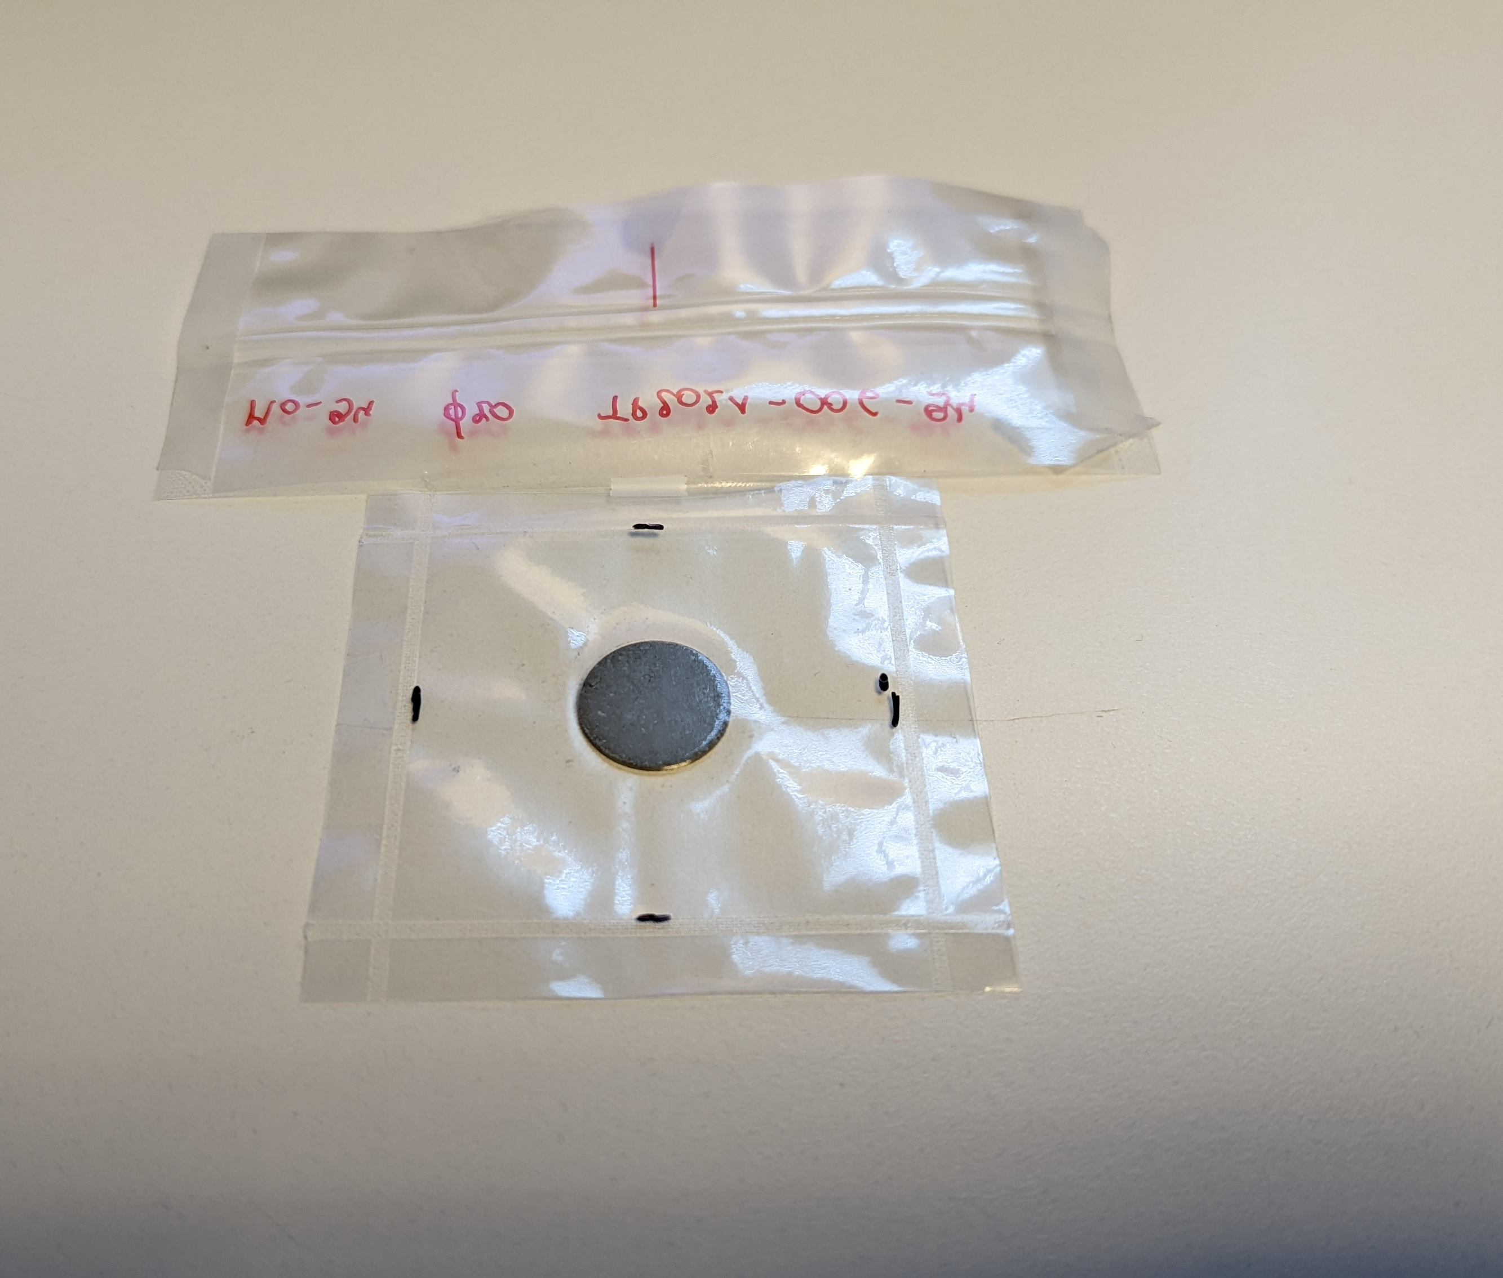
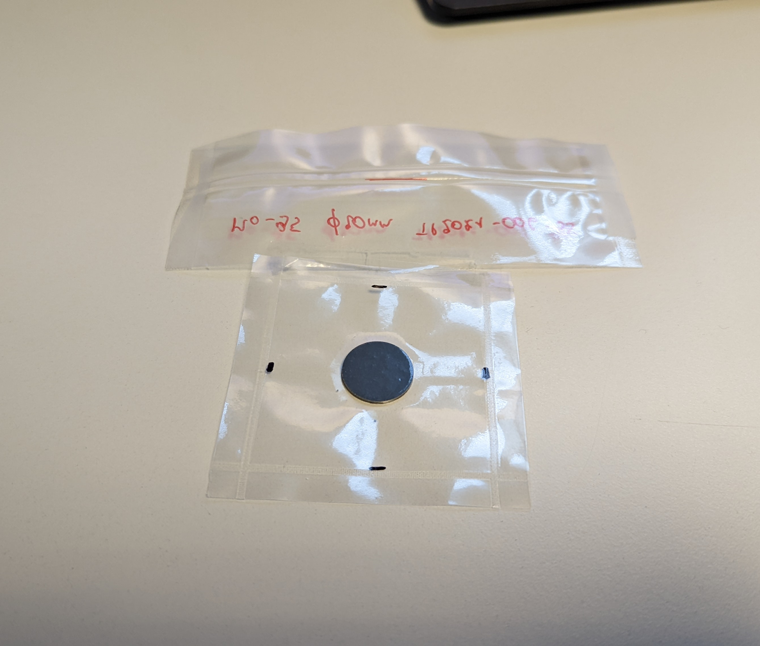
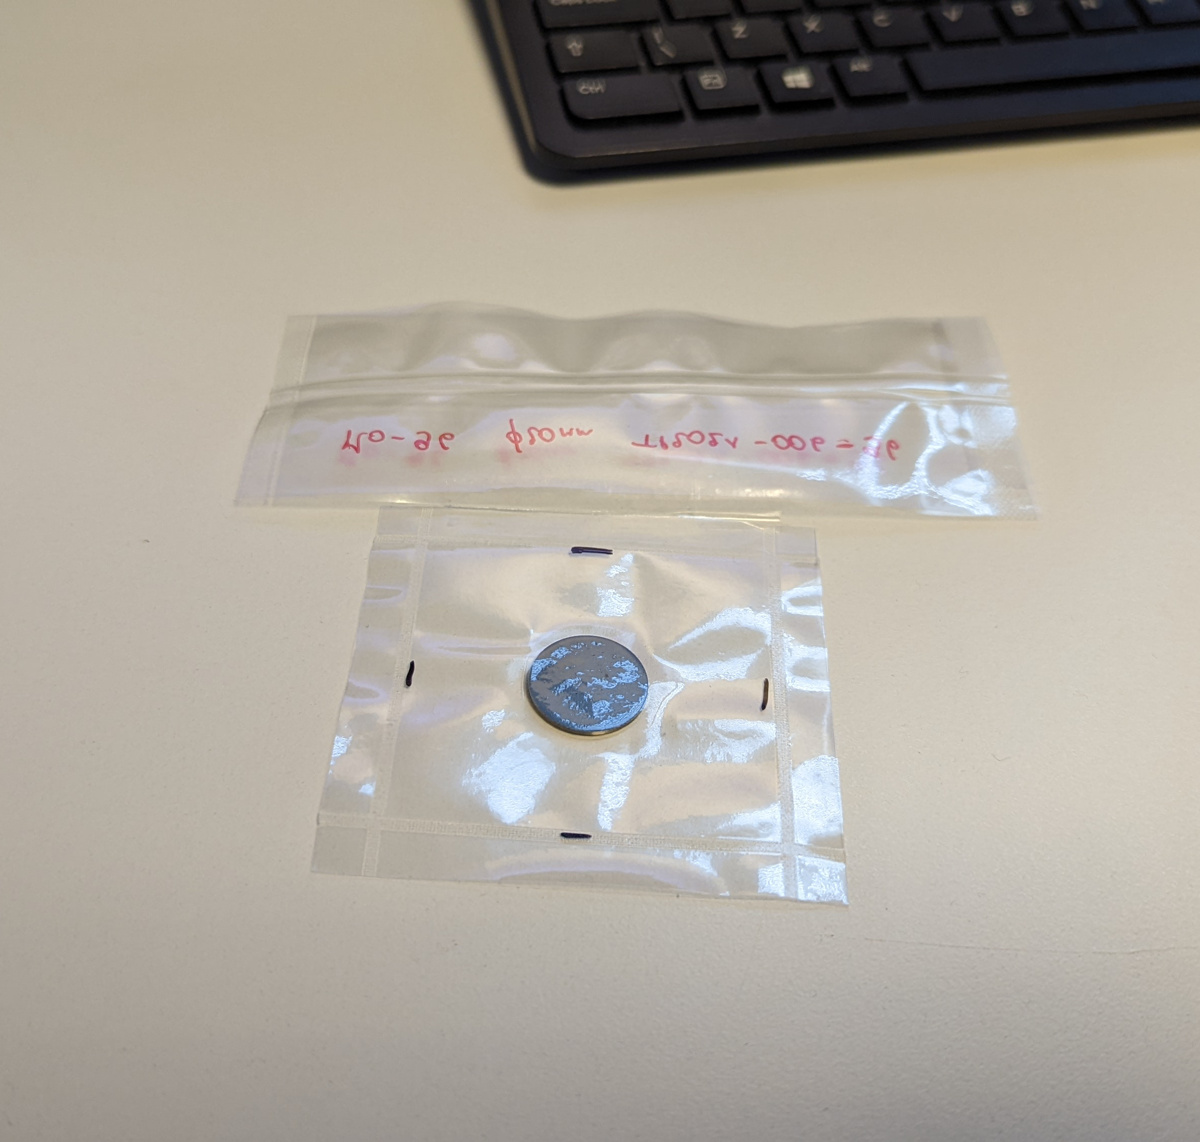
EAR1 samples
⁹⁴Mo
⁹⁵Mo
⁹⁶Mo

Slide 32
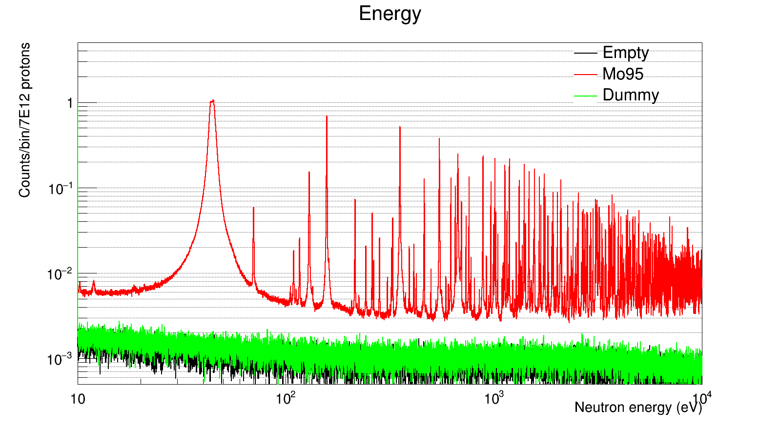
EAR1 measurements
First results of EAR1 campaign

Slide 33
Summary and outlook
What is done:
Compilation and validation of new resonance parameters file for all molybdenum isotopes
Preparation of article describing the reccomended resonance parameters
Capture measurements at n_TOF (EAR2) and transmission measurements at GELINA using enriched samples
What is left to do:
Full analysis of capture and tramsission data of enriched samples
Additional capture measurements at n_TOF (EAR1) and GELINA
Preparation of results for EXFOR submission

Slide 34
Thank you for your attention!
This project has received funding from the Euratom research and training programme 2014-2018 under grant agreement No 847594 (ARIEL).

Slide 35
Backup

Slide 36
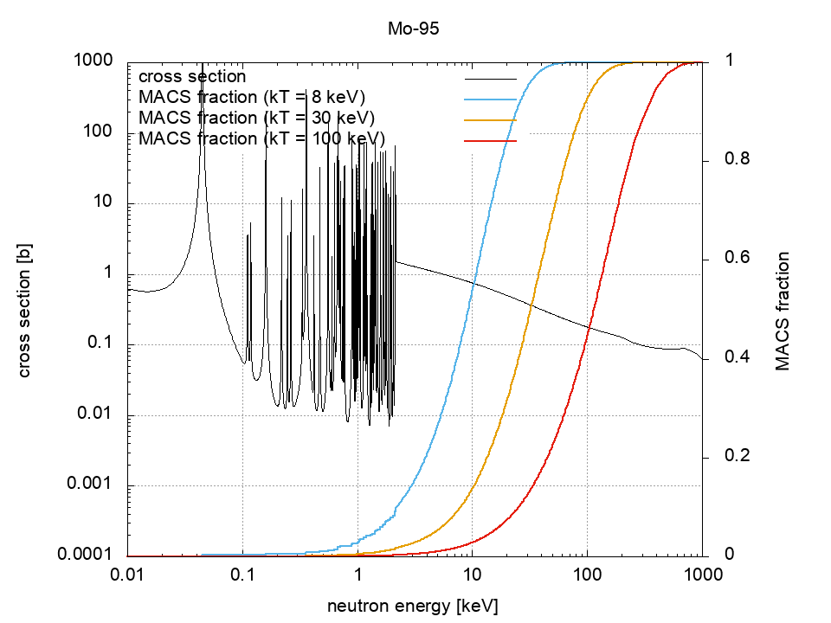
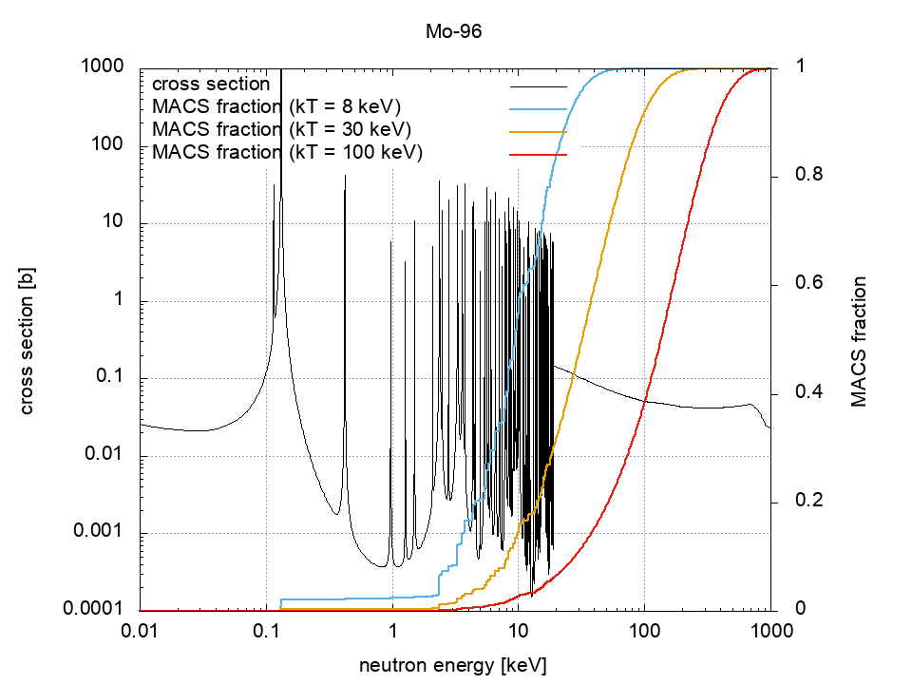
MACS fractions

Slide 37
Capture cross section ENDF/B-VIII
Thermal cross section:
⁹⁴Mo ~ 350mb
⁹⁵Mo ~ 13b
⁹⁶Mo ~ 620mb
⁹⁴Mo
⁹⁵Mo
⁹⁶Mo

Slide 38
Libraries sources
Isotope | JENDL-3.3 | JENDL-4 | ENDF-B/VIII | JEFF-3.3
⁹²Mo | Wasson, Weigmann, Musgrove | Wasson, Weigmann, Musgrove | Mughabghab | JENDL-4
⁹⁴Mo | Weigmann, Musgrove | Weigmann, Musgrove, Wang | JENDL-3.3 | JENDL-4
⁹⁵Mo | Weigmann, Shwe | Weigmann, Shwe, Wang | Mughabghab | Mughabghab
⁹⁶Mo | Weigmann, Musgrove | Weigmann, Musgrove, Wang | JENDL-3.3 | JENDL-4
⁹⁷Mo | Weigmann, Shwe | Weigmann, Shwe, Wang | JENDL-3.3 | JENDL-4
⁹⁸Mo | Weigmann, Musgrove, Chrien | Weigmann, Musgrove, Chrien, Babich, Wang | JENDL-3.3 | JENDL-4
¹⁰⁰Mo | Weigmann, Musgrove, Weigmann | Weigmann, Musgrove, Weigmann, Wang | JENDL-3.3 | JENDL-4

Slide 39
Backup - ^{nat}Mo abundances
Isotope | Abundance
⁹²Mo | 14.84%
⁹⁴Mo | 9.25%
⁹⁵Mo | 15.92%
⁹⁶Mo | 16.68%
⁹⁷Mo | 9.55%
⁹⁸Mo | 24.13%
¹⁰⁰Mo | 9.63%

Slide 40
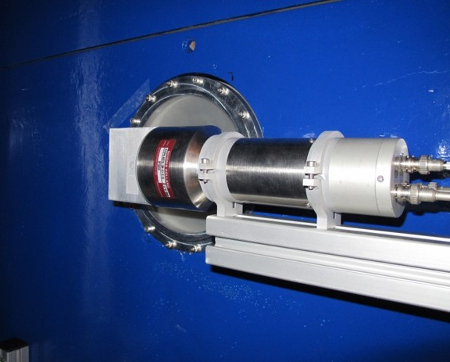
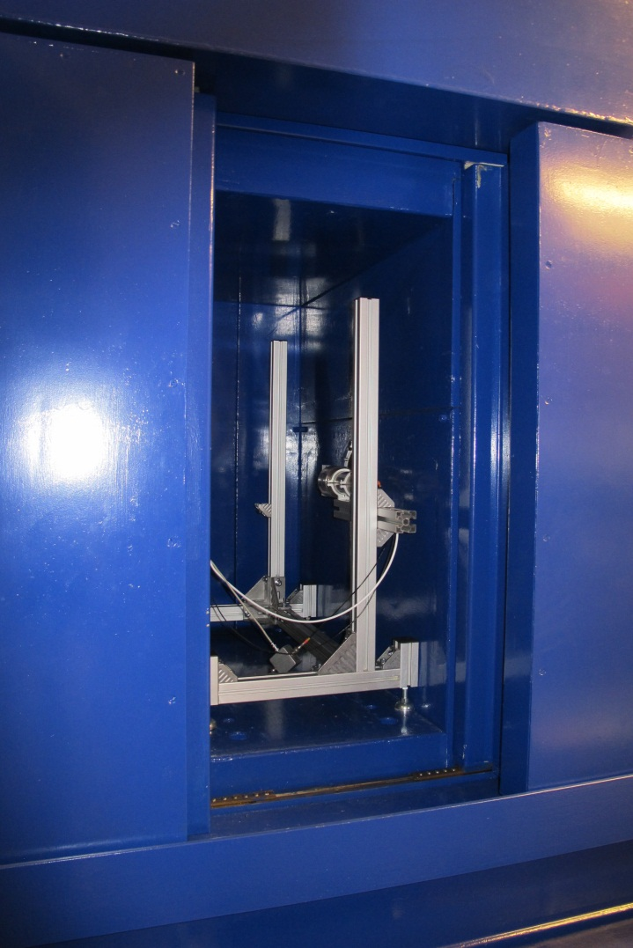
Detection system
Li glass scintillators
Enriched to 95% in ⁶Li
Placed inside metallic “castle” to reduce background
Amplitude and time signals
Time resolution 4,21 ns
Scintillator
Castle

Slide 41
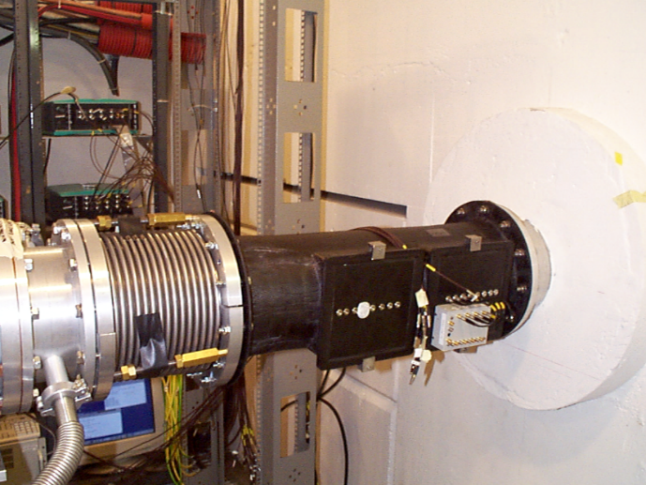
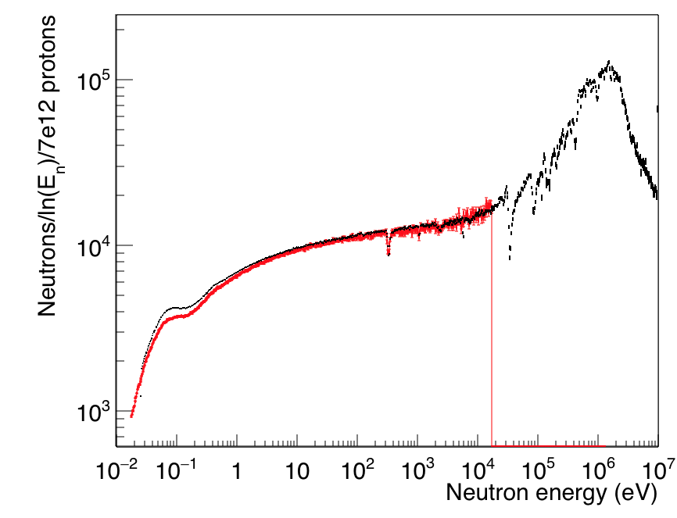
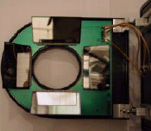
Neutron flux monitor
Neutron flux continuosly monitored
SiMON (Silicon MONitor) in beam
Silicon detector facing mylar foil coated in litium
Minimal reduction of neutron flux
Flusso 2014
Flusso Gd

Slide 42
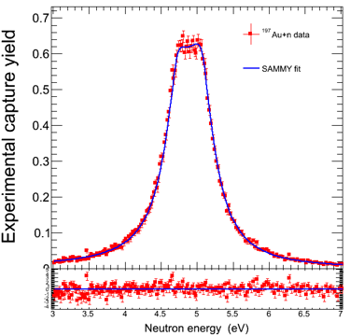
Normalization
Au sample
Black resonance at 4.9 eV
$Γ_{γ}≫Γ_{n}$
${ Y}_{c}≈1$
Extract normalization factor from saturated resonance

Slide 43
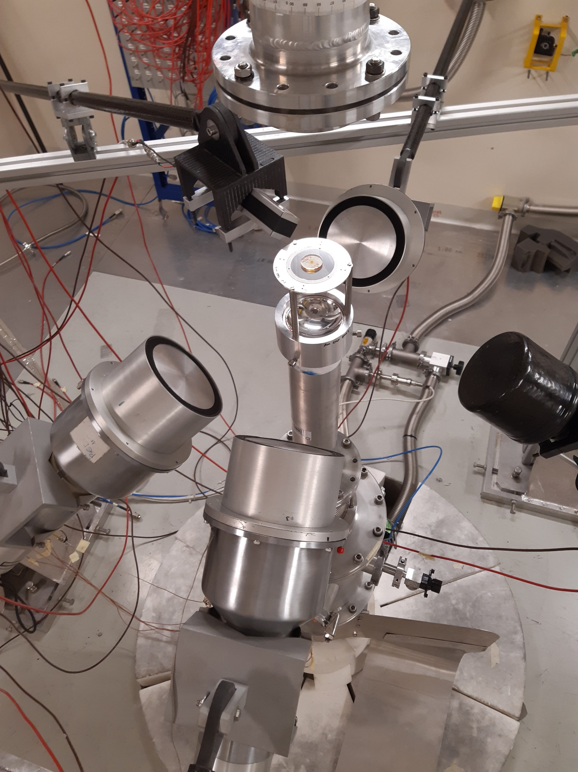
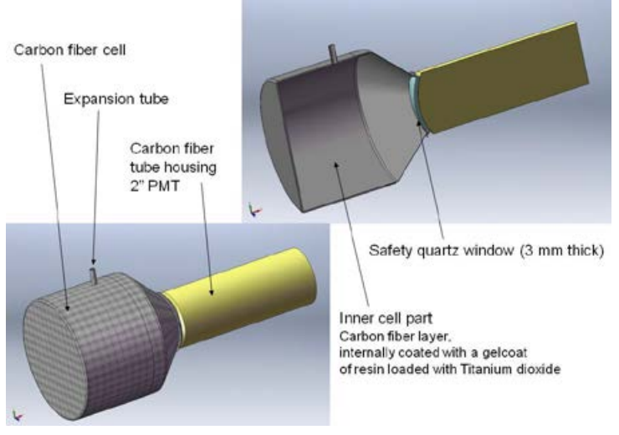
Capture detectors
Five gamma detectors
4 C6D6 liquid scintillators
1 sTED prototype
Low sensitivity to scattered neutrons
Fast recovery from gamma flash

Slide 44
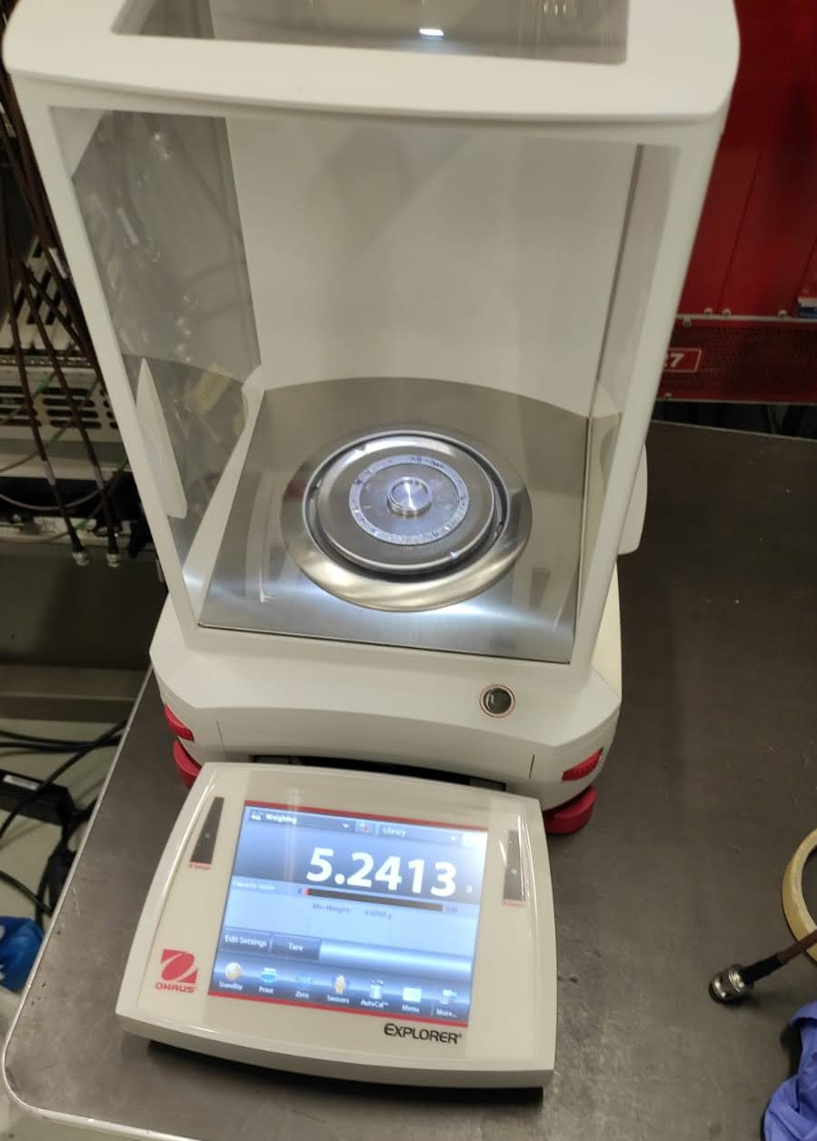
Backup - EAR2 samples
Sample | Mass | Areal density
⁹⁴Mo | 1737,5 mg | 3,47E-3
⁹⁵Mo | 929,2 mg | 1,86E-3
⁹⁶Mo | 1611 mg | 3,22E-3
^{nat}Mo pellet | 2003,3 mg | 4,00E-3
^{nat}Mo powder | 985,7 mg | 1,97E-3
Notes:
Capsule hold in place by Kapton foil. Mylar substrate in Al ring. Mass of capsule~1900mg.
natMo pellet prepared at JRC-Geel from natMo powder pressed in a 2mm disk of ,88mm thickness.

Slide 45
Time of flight spectra
Gold
⁹⁵Mo
Empty

Slide 46
Backup – EAR2 Measurements
Sample | Protons
⁹⁴Mo (thick) | 4,9E17 (2,8E17)
⁹⁵Mo | 3,7E17
⁹⁶Mo | 4,2E17
^{nat}Mo | 2,1E17
Au | 7,3E15
Dummy | 1,1E17
Empty | 1,1E17
Pb | 4,3E16
Filters (Ag, Bi, Cd) | 7,3E16
TOTAL | 1,84E18

