Slide 1
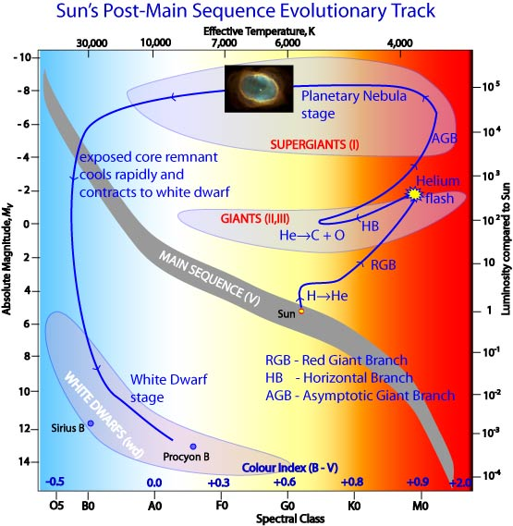
Dissection of Post-AGB binaries
Hans Van Winckel
Institute of Astronomy
KU Leuven University
Belgium
Jacques Kluska; Devika Kamath; Akke Corporaal; Dylan Bollen;
Glenn-Michael Oomen; Olivier Verhamme; Kateryna Andrich, Valentin Bujarrabal;
Orsola De Marco; Jonathan Ferreira

Slide 2
Outline:
Conclusion
Dissecting Post-AGB Binaries:
- SED
- Circumbinary Disc
- Inner Rim Circumbinary Disc
- Central Binary
- Circum-companion Jet
- Central Star(s)
Why would be bother?

Slide 3
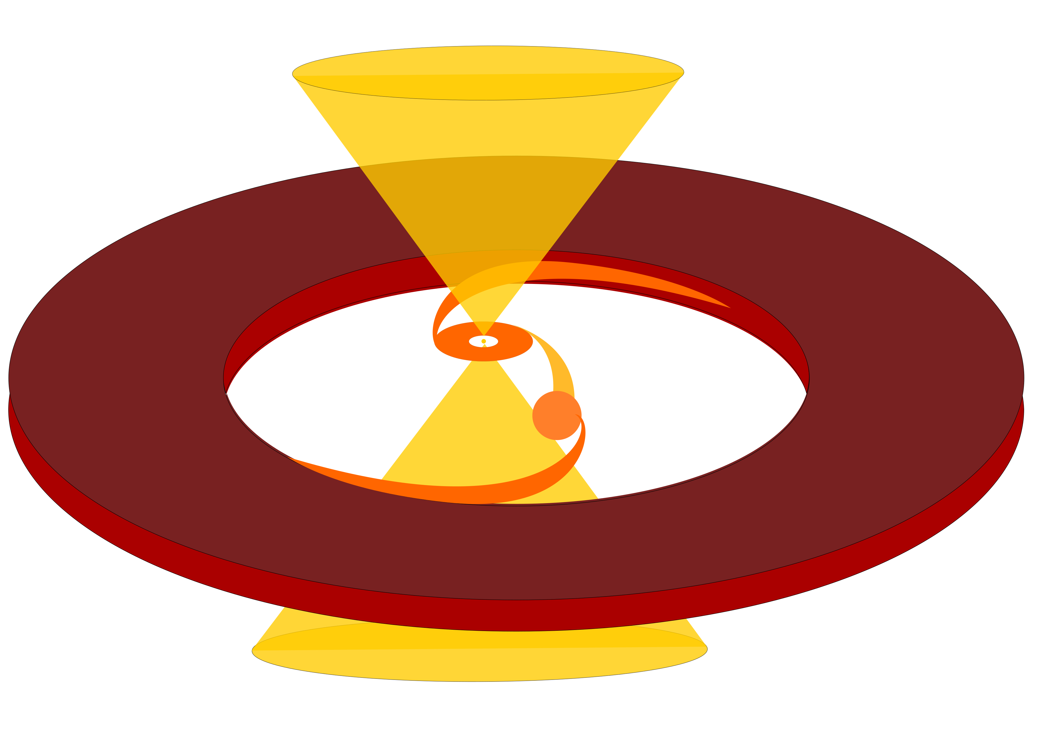
Conclusion

Slide 4
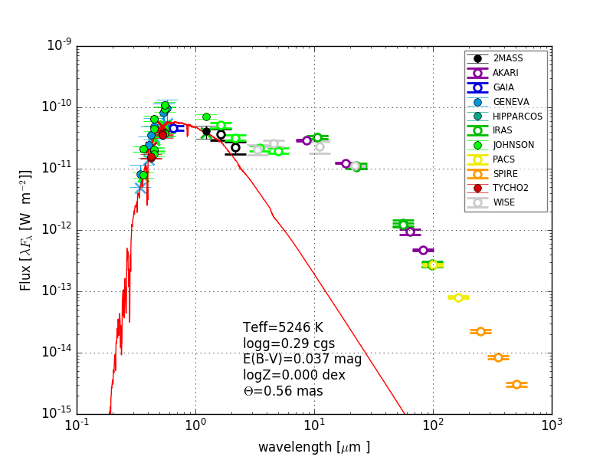
SED of a post-AGB binary: disc sources
Central star is
typically F-K star
No current
dust production
Hot dust component
is indicative of
Keplerian disc
Long wavelength
spectral index: large
grains.
Van Winckel 2018, Kluska et al. 2022

Slide 5
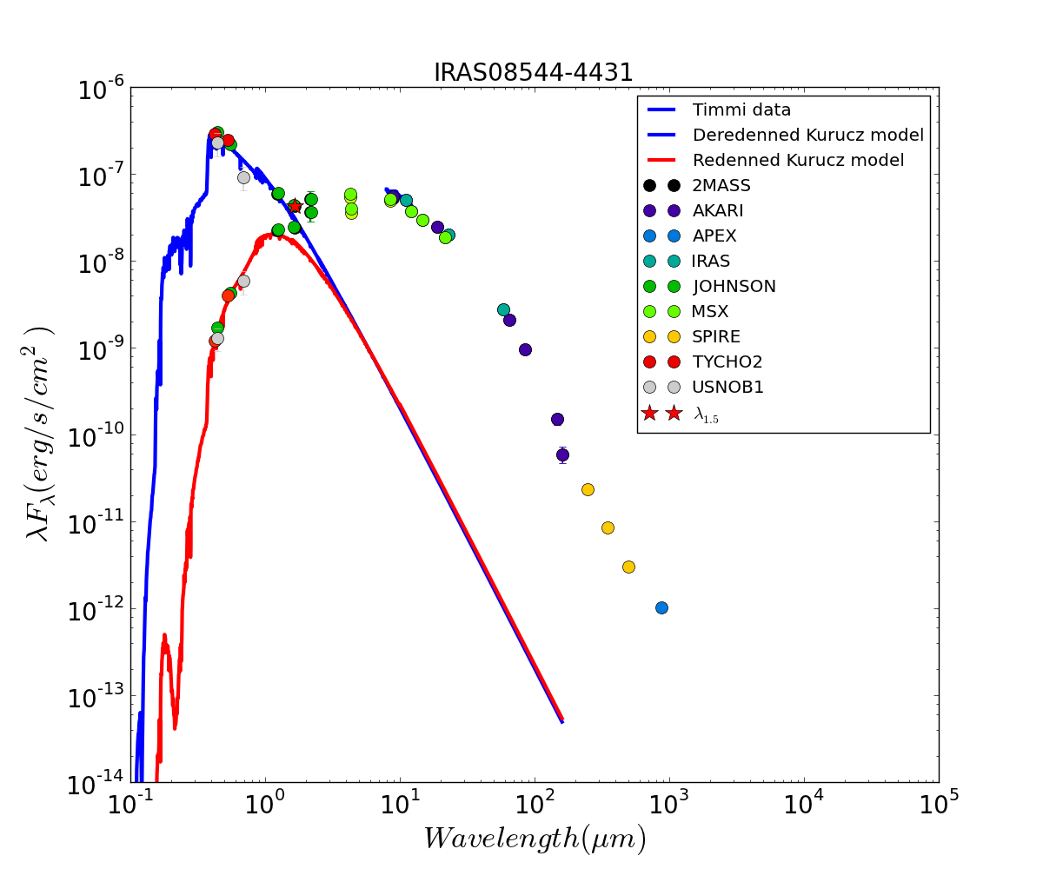
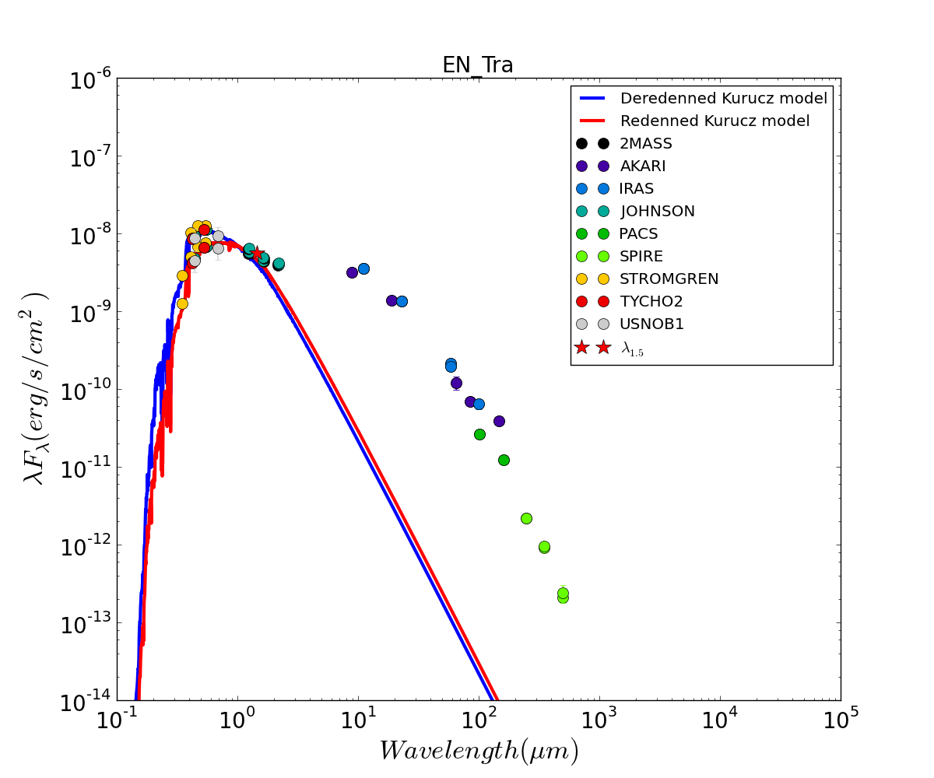
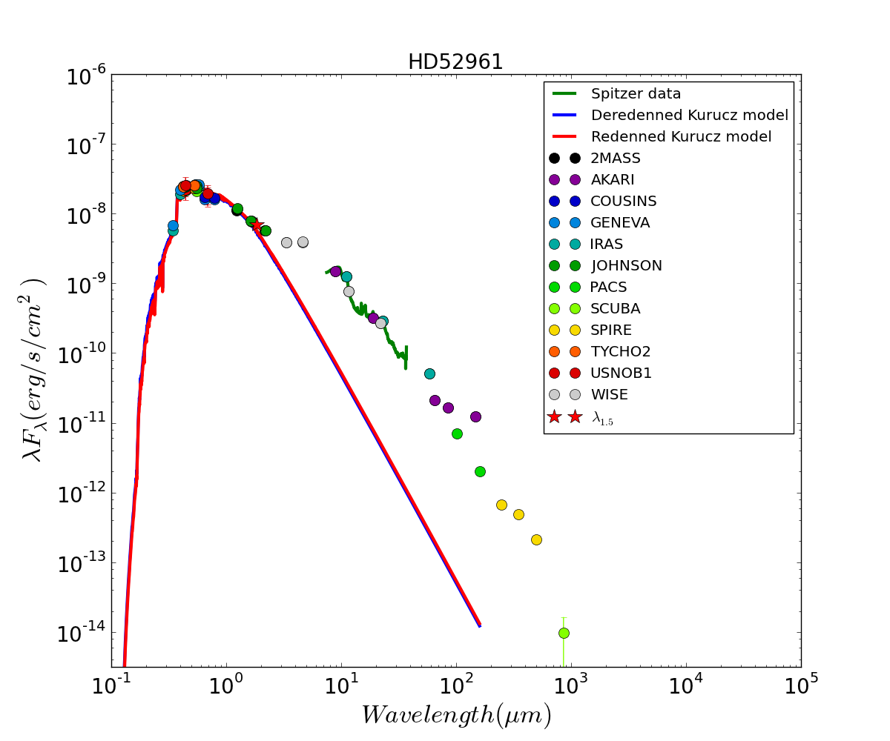
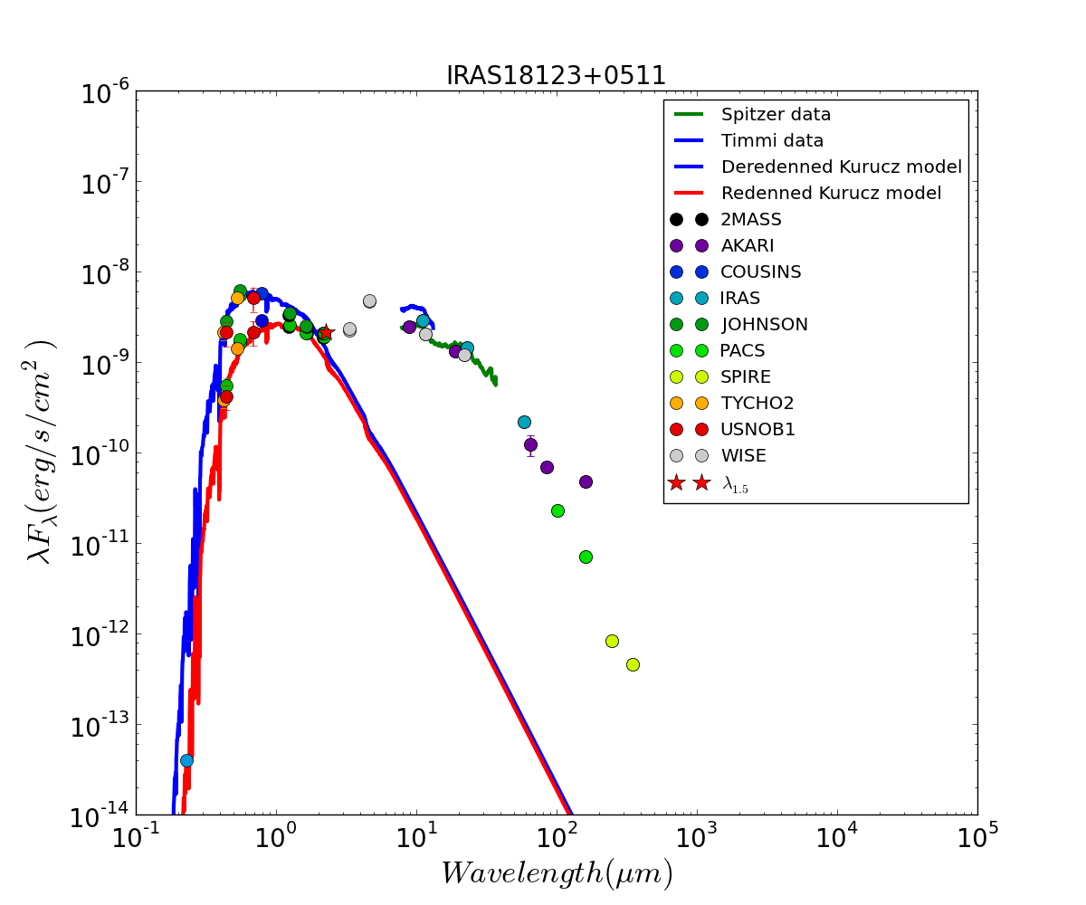
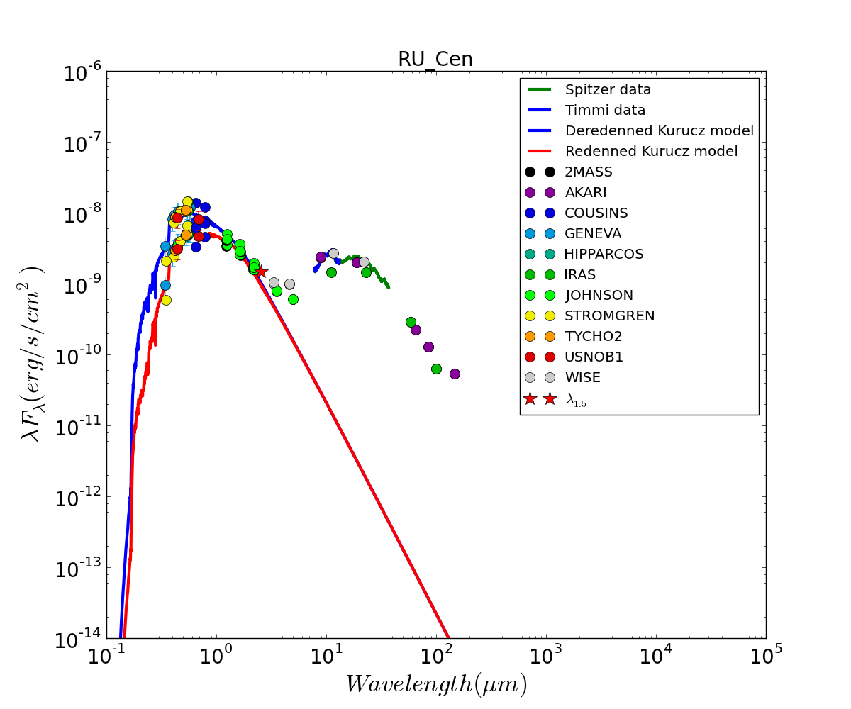
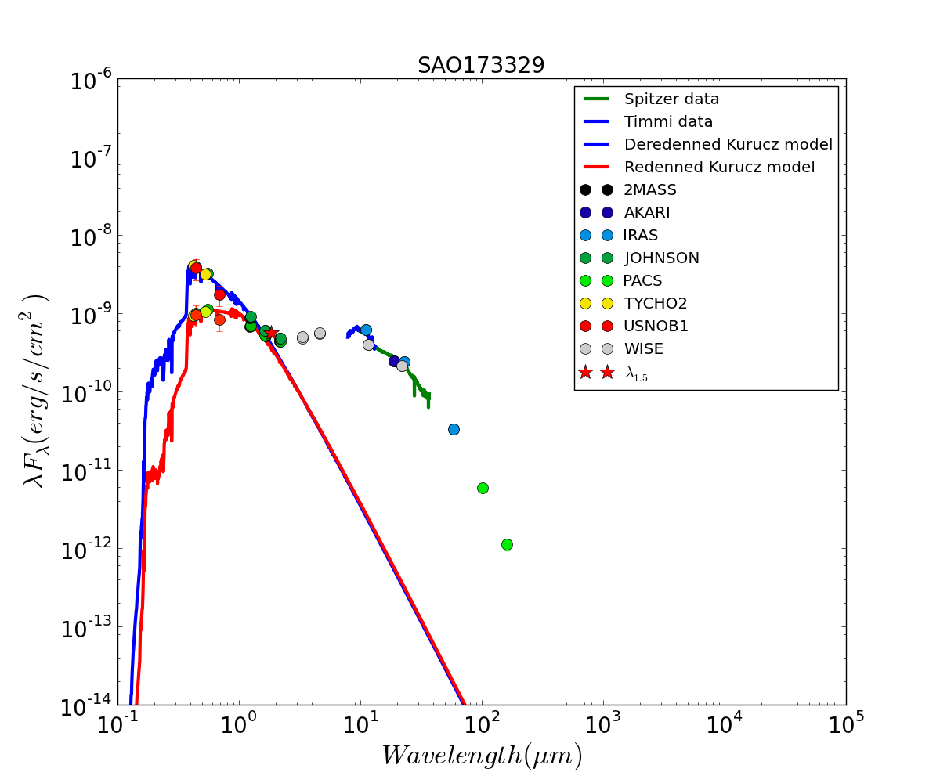
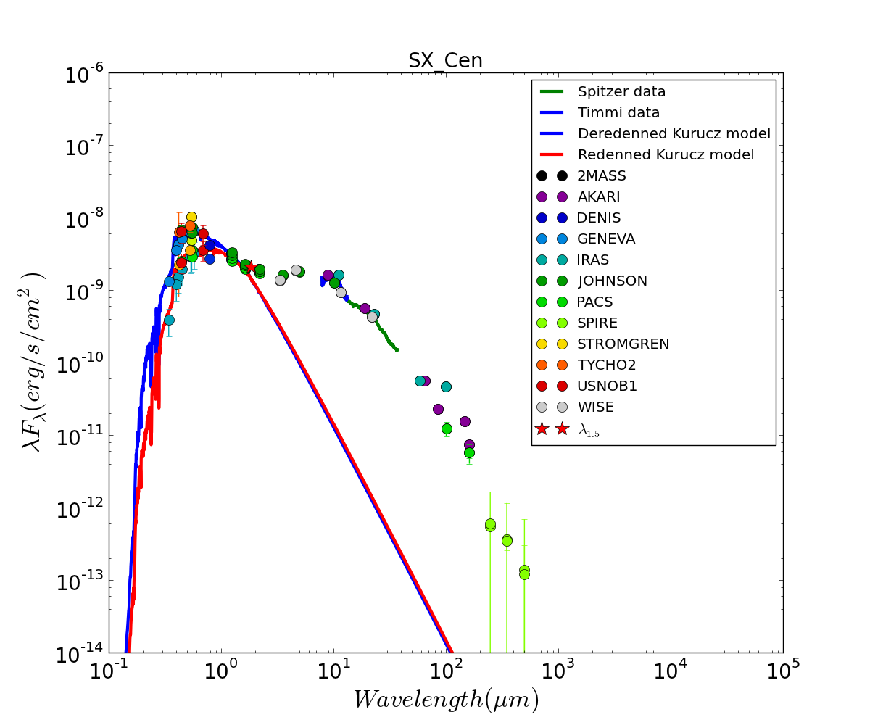
SED : commonly observed
SED very similar :
Dust excess stars near sublimation T
No present dusty mass loss
Galactic sample: +/- 90 sources
LMC and SMC sample is large !
Kluska et al., 2022; Kamath et al., 2014, 2015

Slide 6
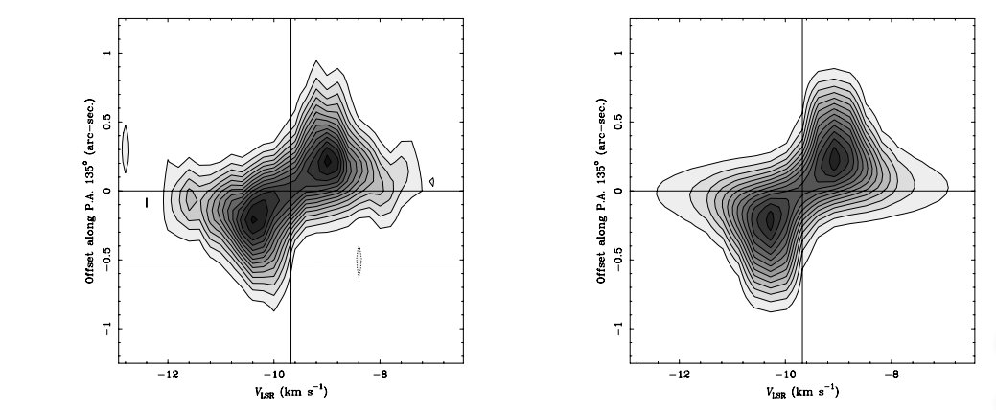
ALMA-PdB: rotation resolved
Single dish: narrow CO profiles omnipresent
Interferometric CO: Keplerian rotation is resolved
Bujarrabal et al., 2017; Cava et al., 2021

Slide 7
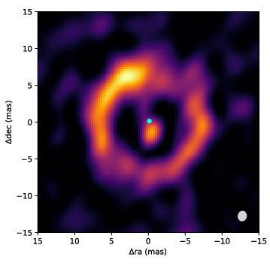
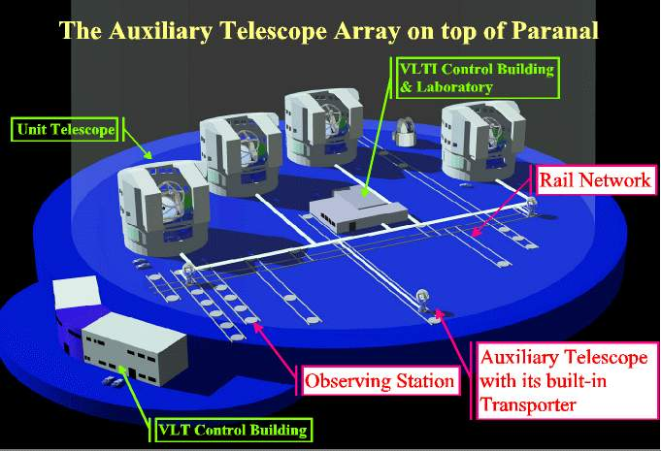
CB-discs: Near & Mid-IR interferometry
Interferometric Image Reconstruction: 1mass resolution!
Hot inner rim at sublimation radius
Main star is removed from image
Secondary is resolved: circum-companion disk
Kluska et al., 2020, 2019, 2018 ; Hillen et al., 2016

Slide 8
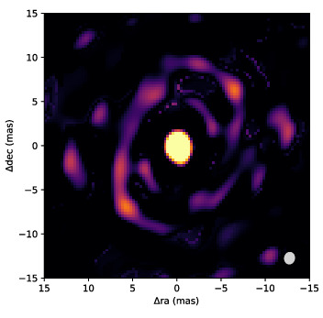
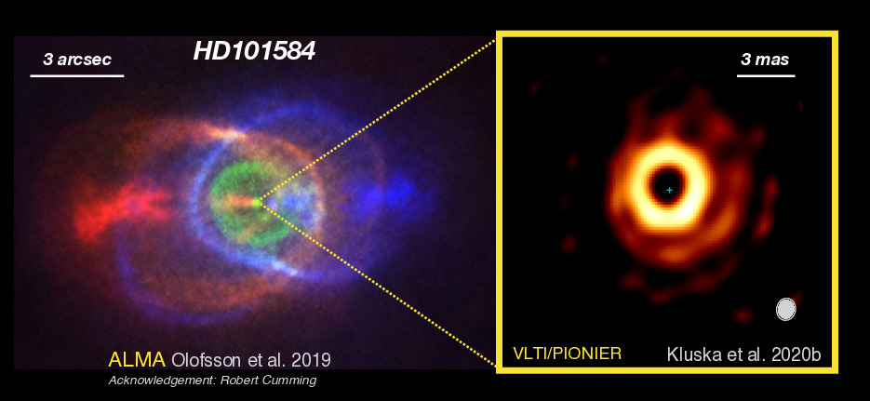
CB-discs: near & mid-IR interferometry
ESO large programme at VLTI
PI: Jacques Kluska
Resolving the inner rim ! (covid delayed programme)
Kluska et al., 2020, 2021, 2022 in prep

Slide 9
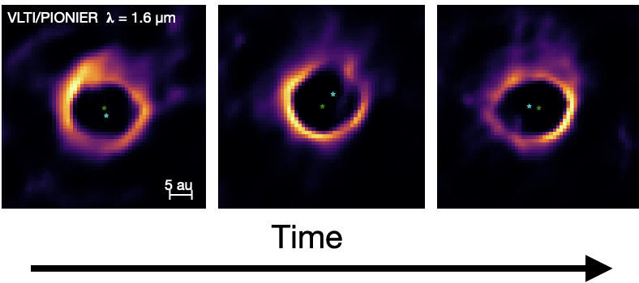
CB-discs: time-resolved interferometry
Kluska et al., 2022 in prep

Slide 10
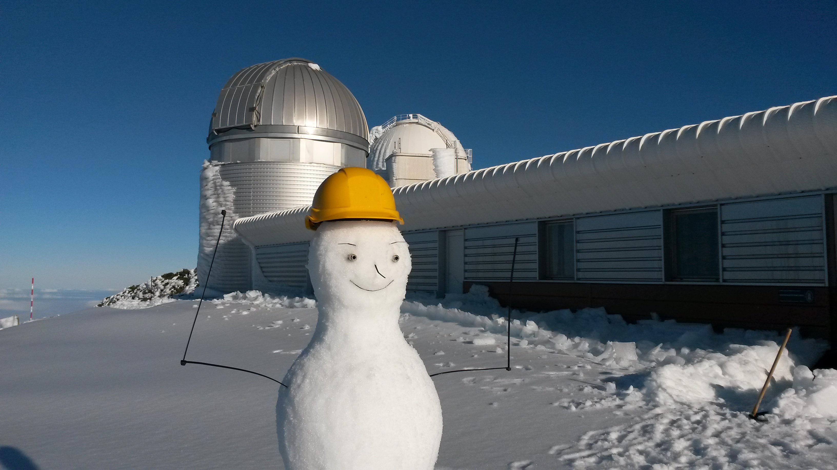
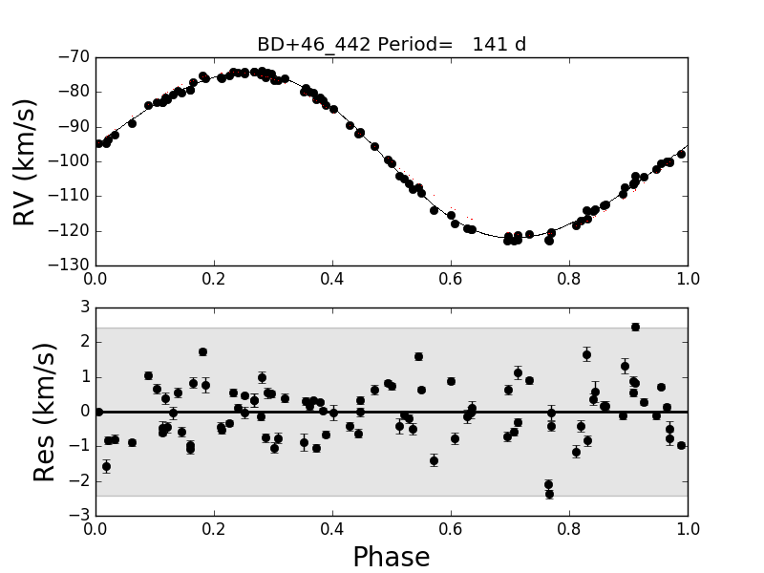
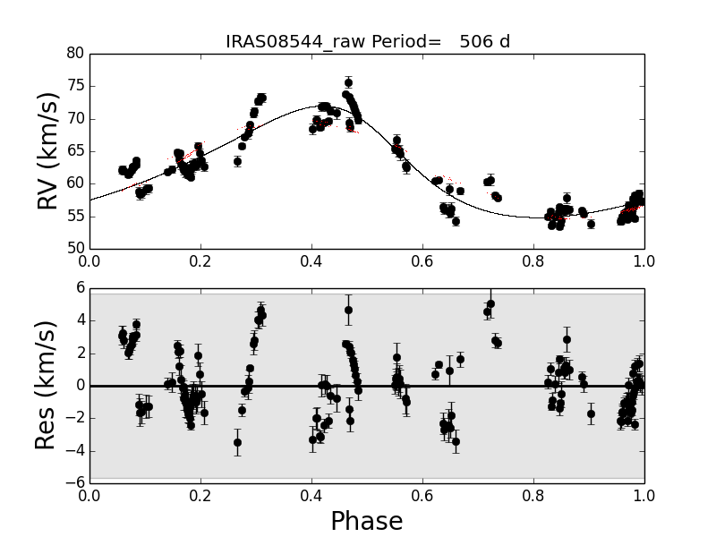
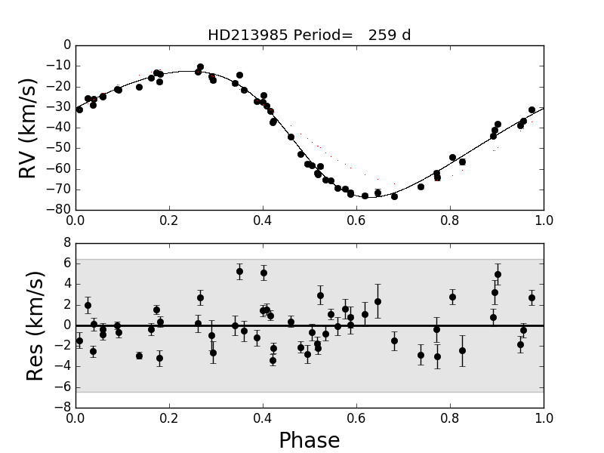
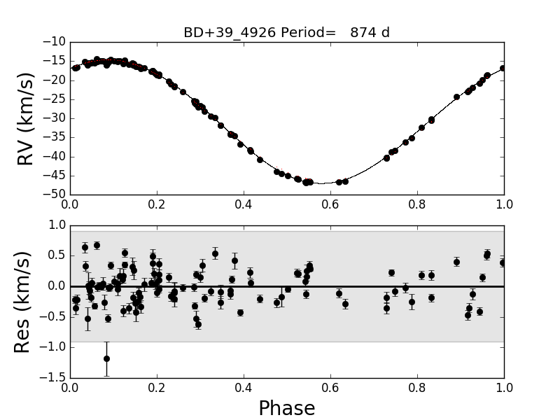
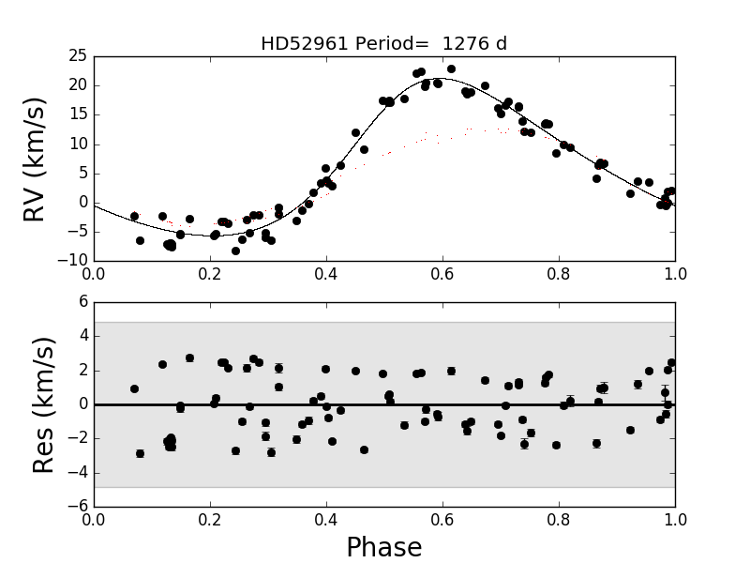
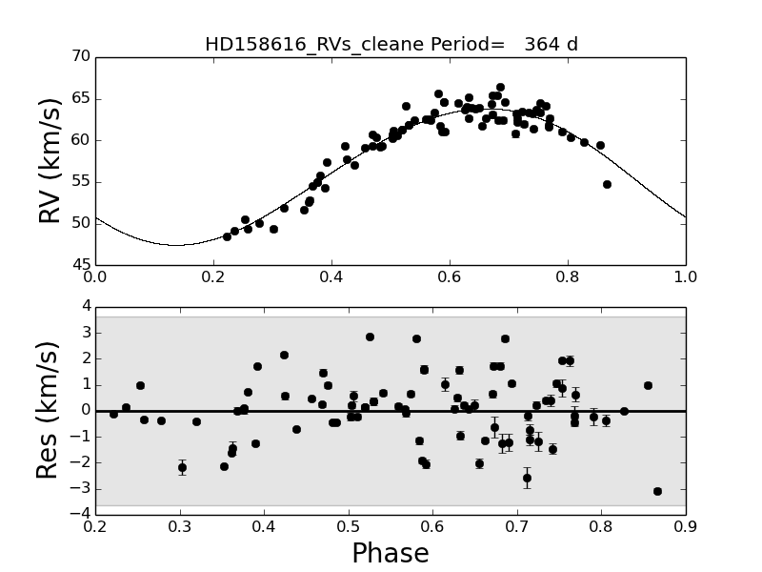
Binaries: ranges in P and e
Oomen et al., 2018

Slide 11
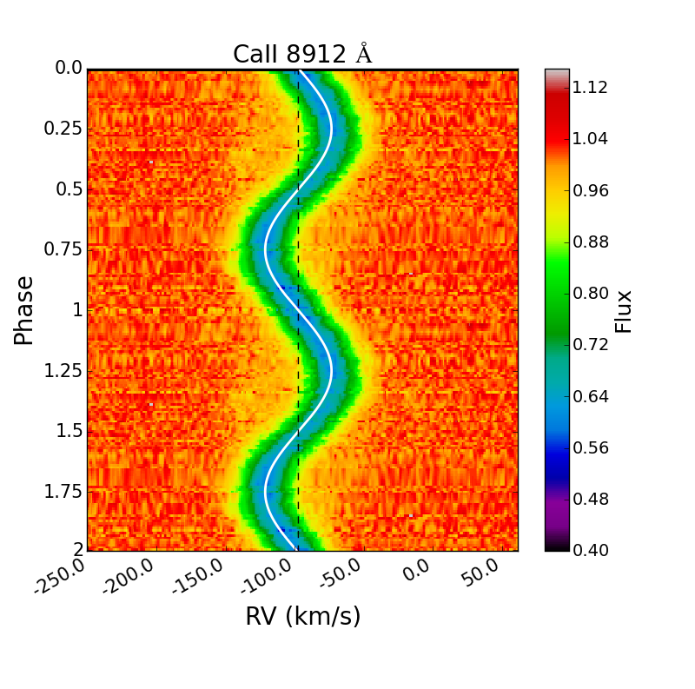
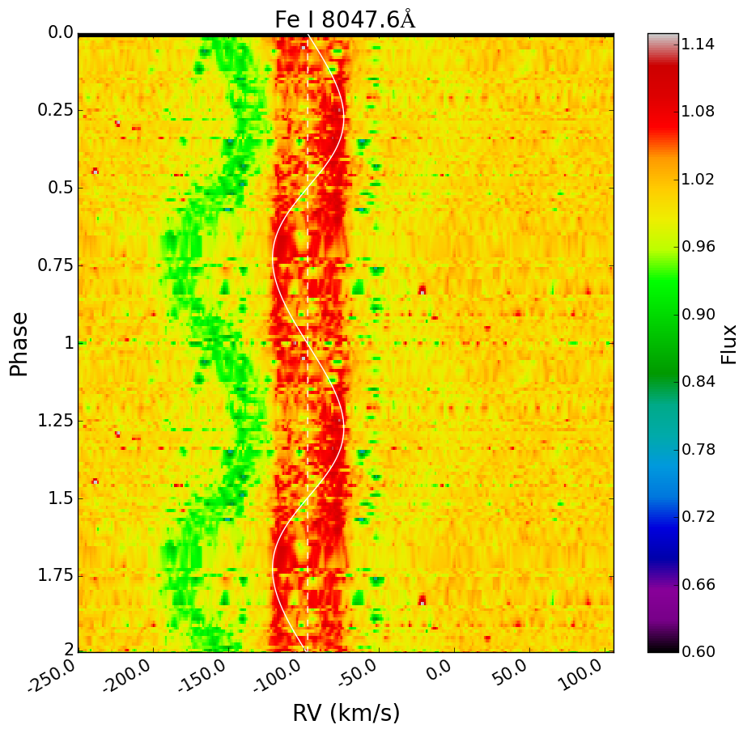
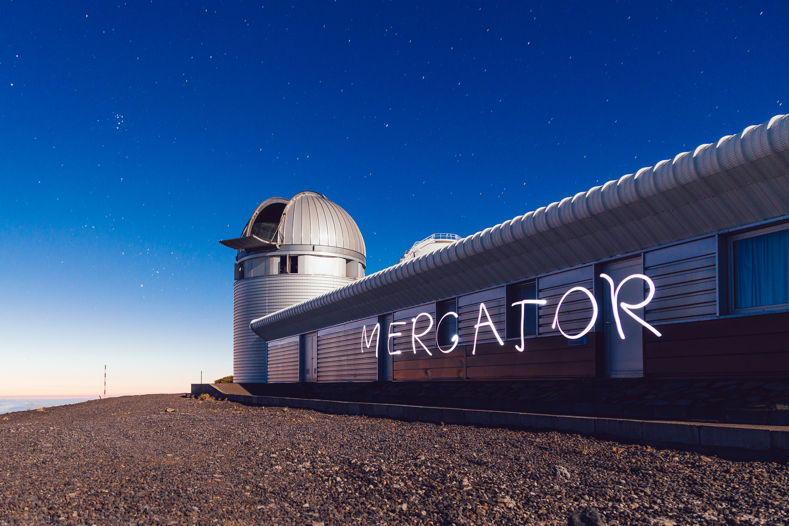
Dynamic Spectra: time resolved spectroscopy

Slide 12
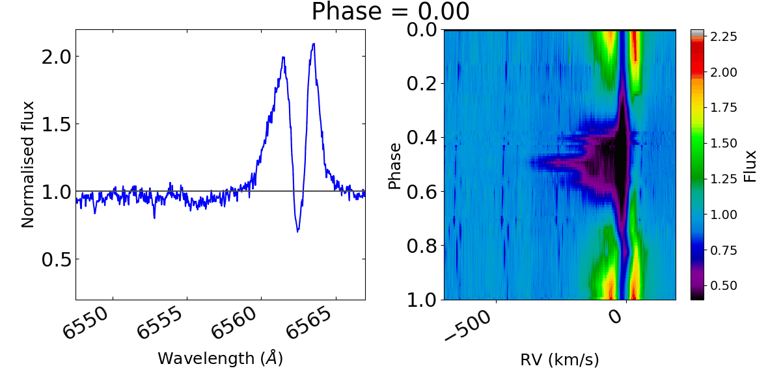
Dynamic Spectra

Slide 13
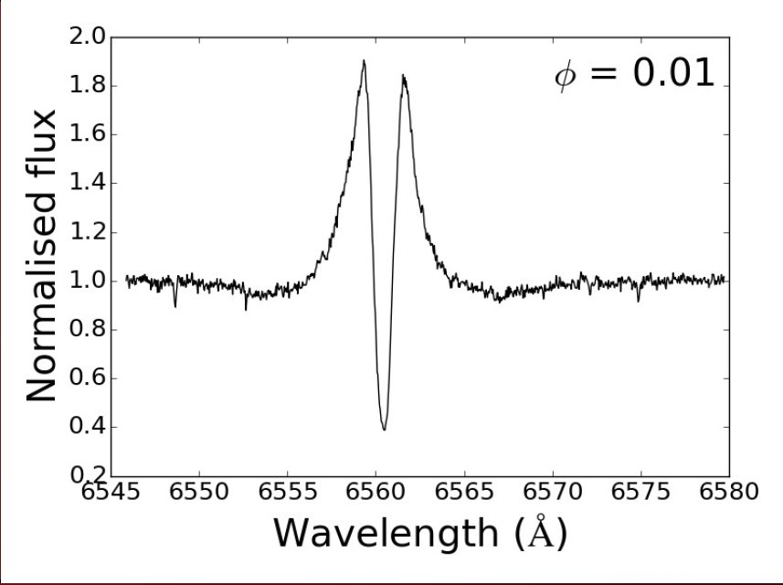
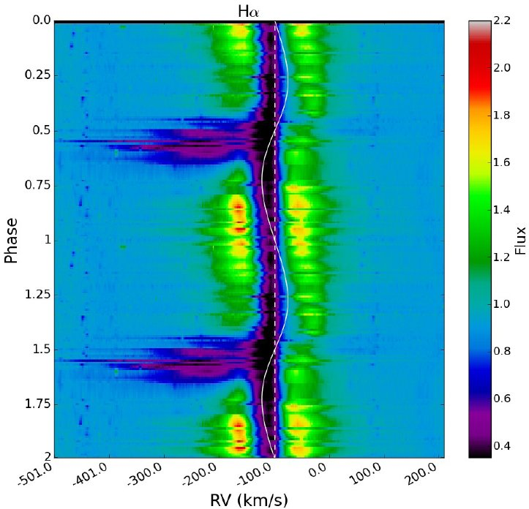
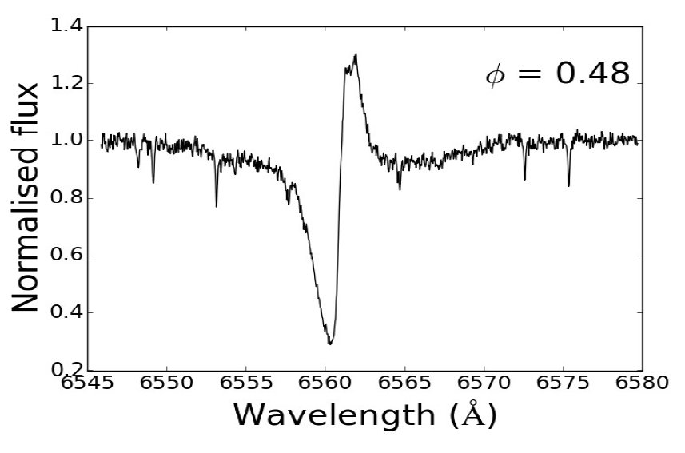
Dynamic Spectra

Slide 14
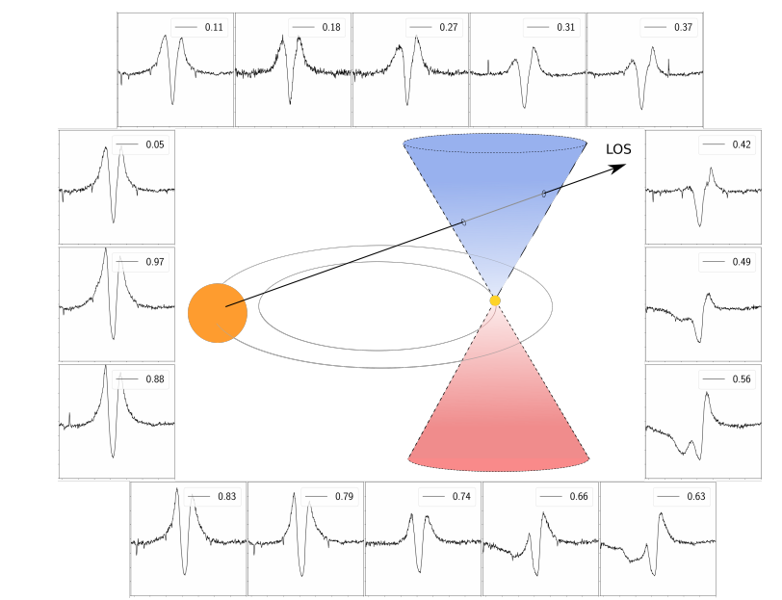
Jet configuration
Bollen et al., 2016

Slide 15
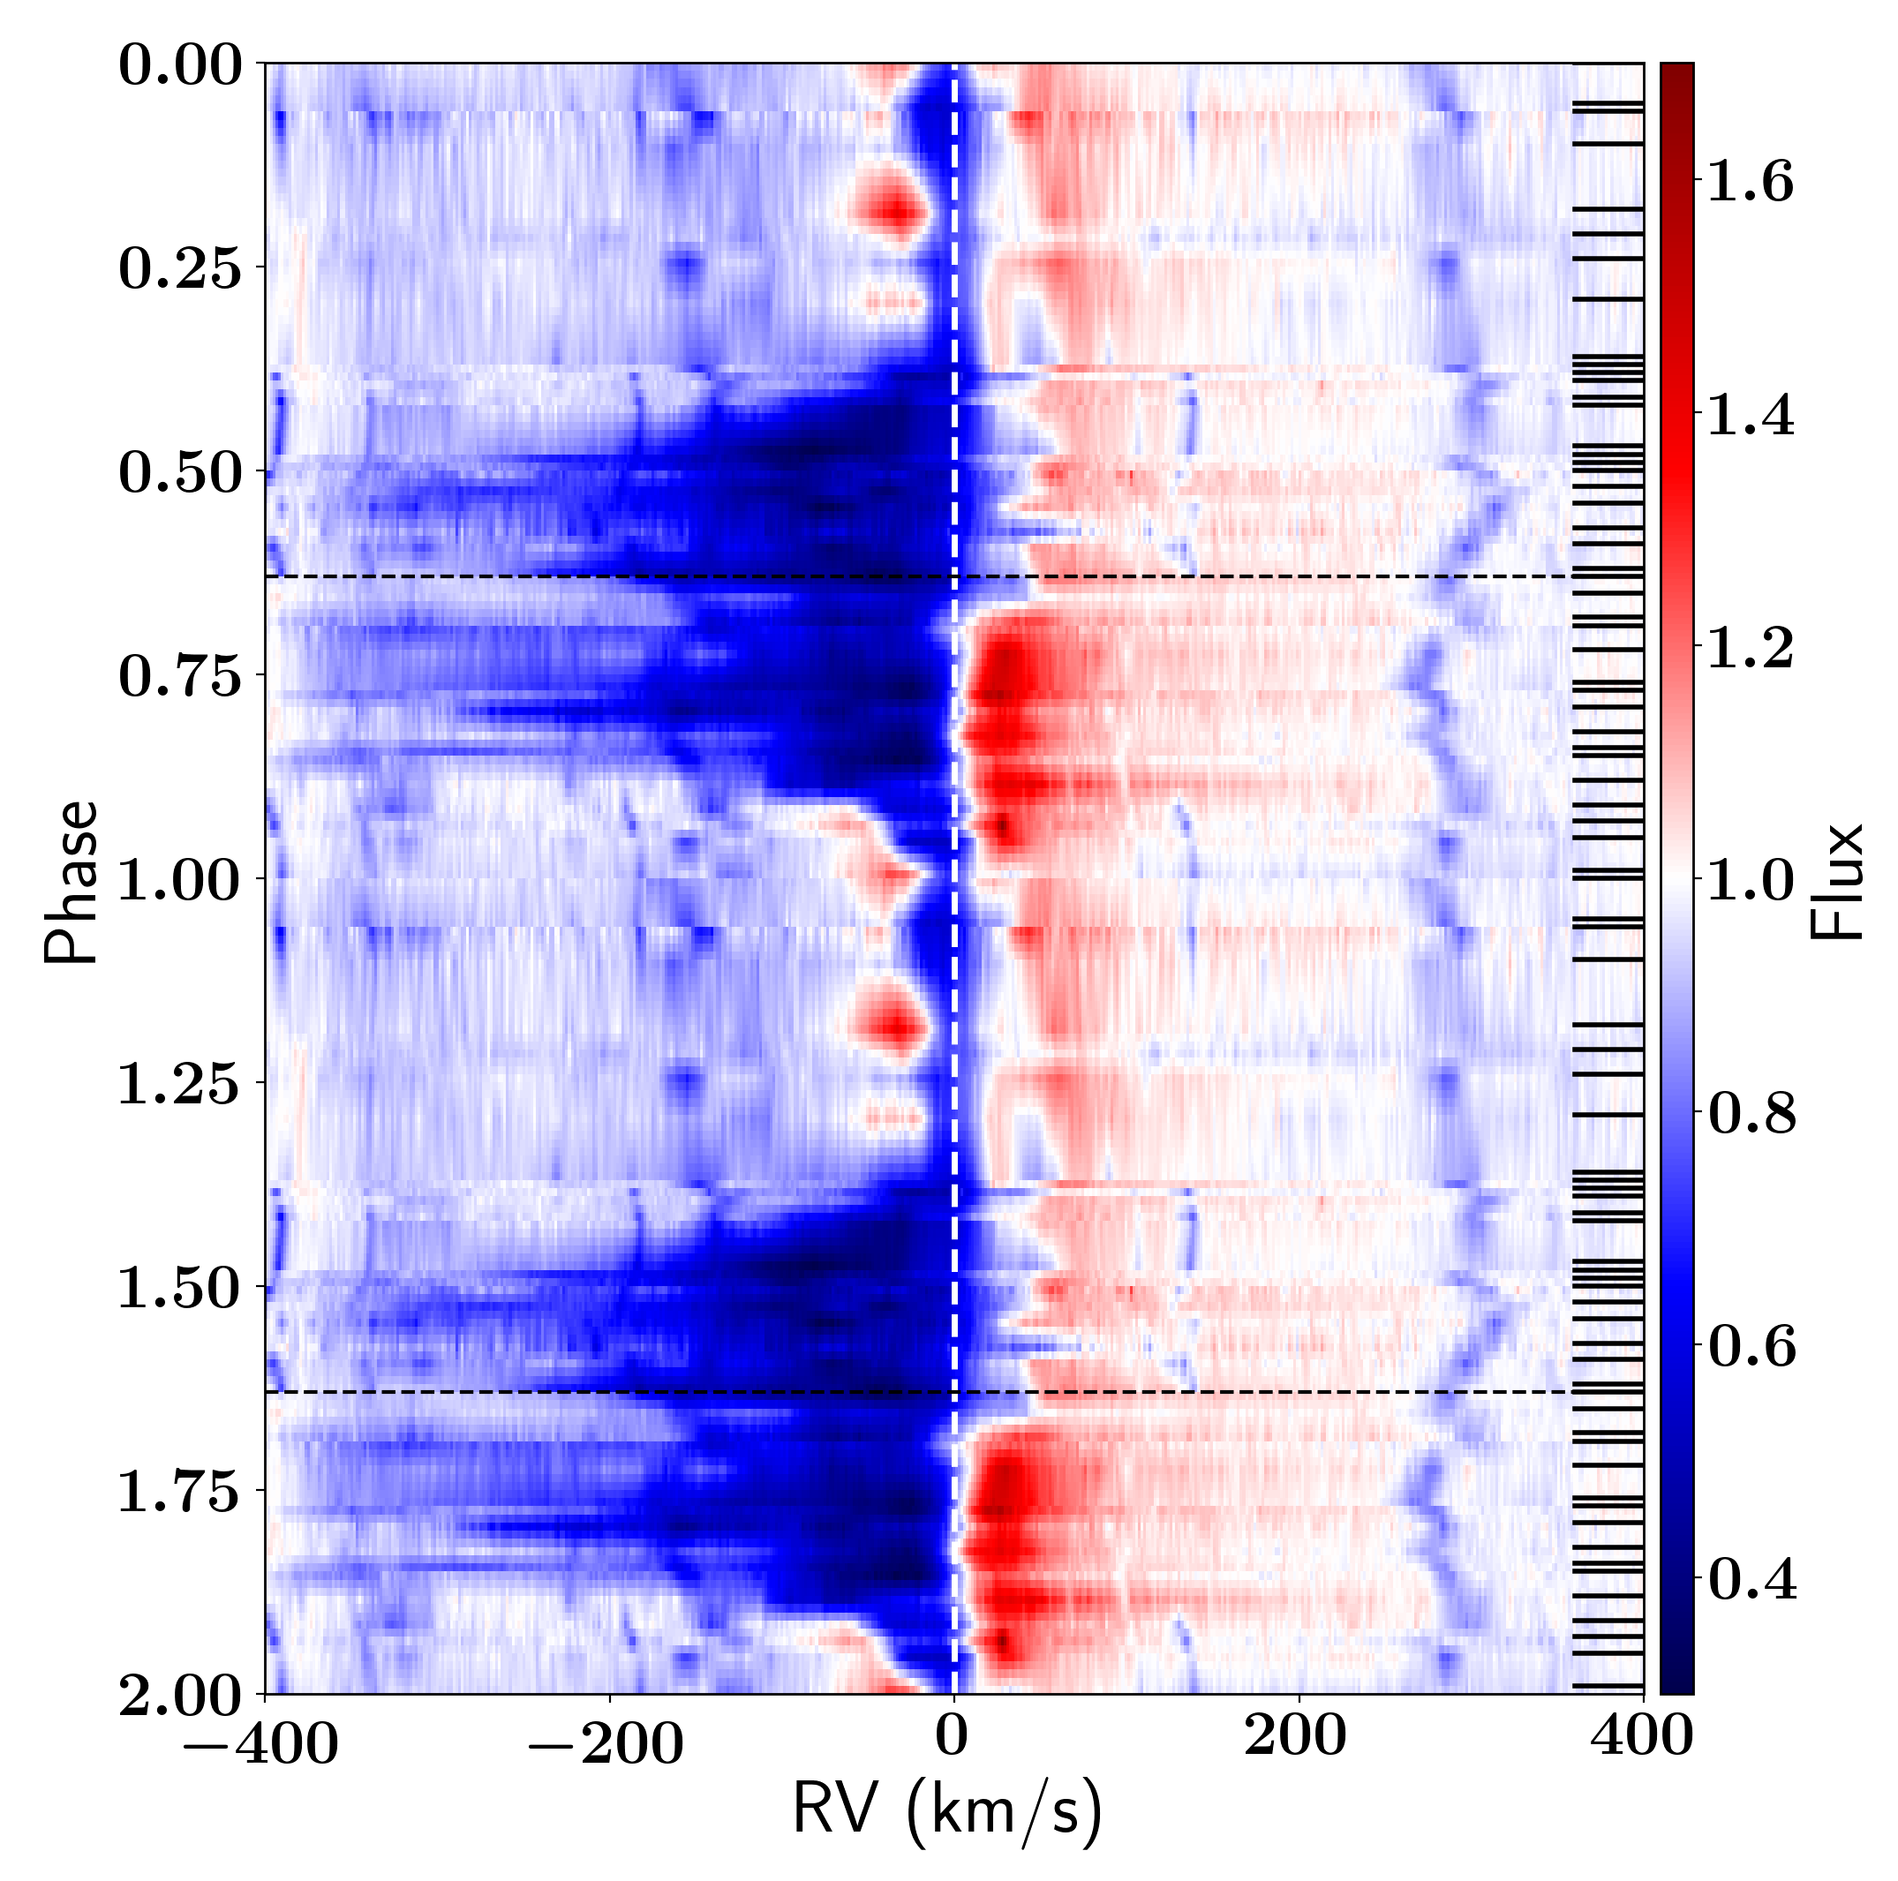
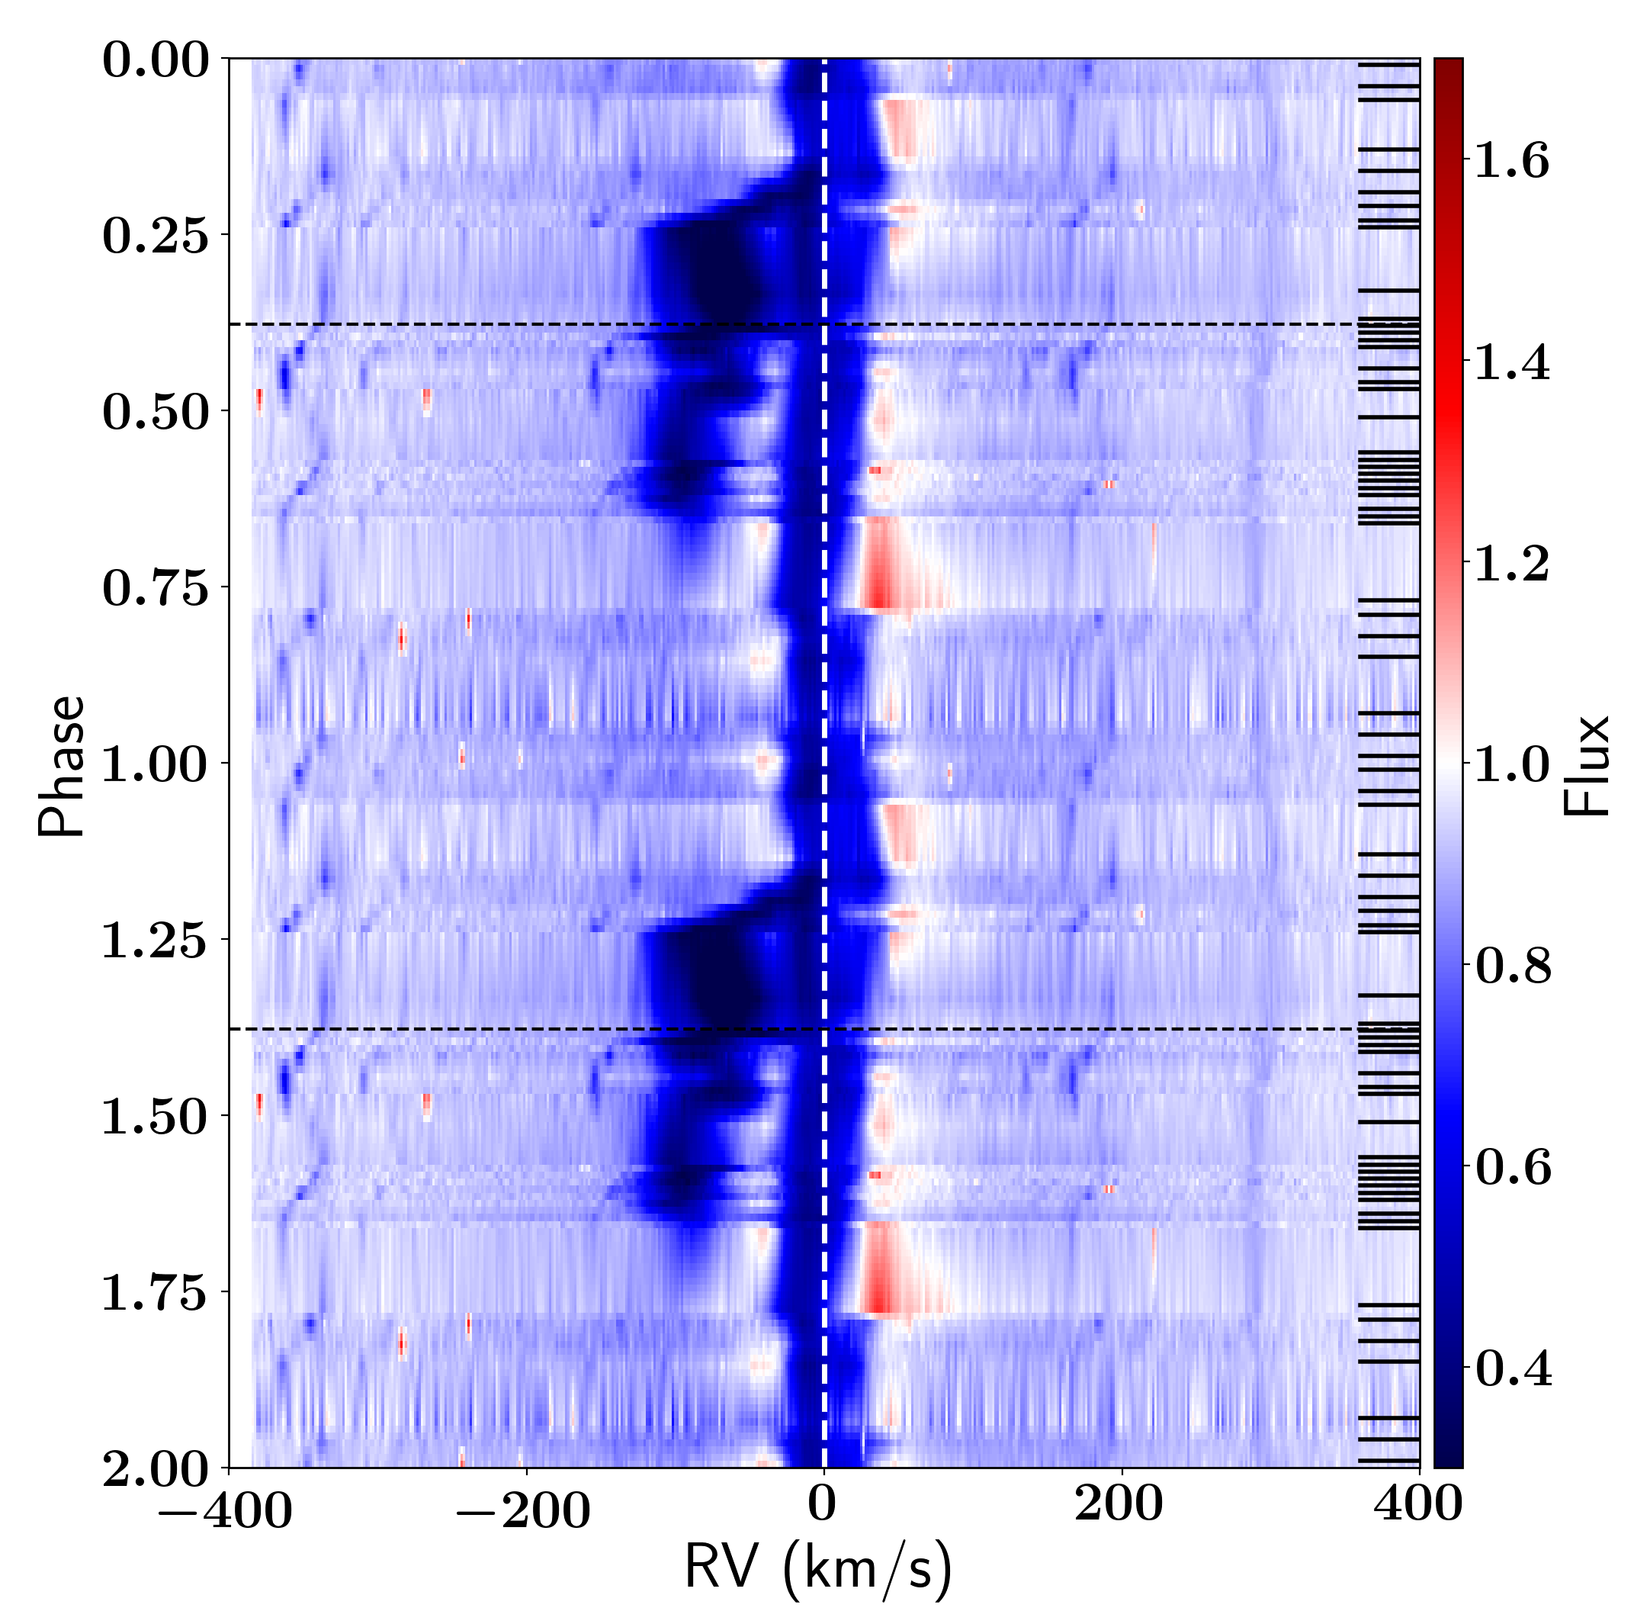
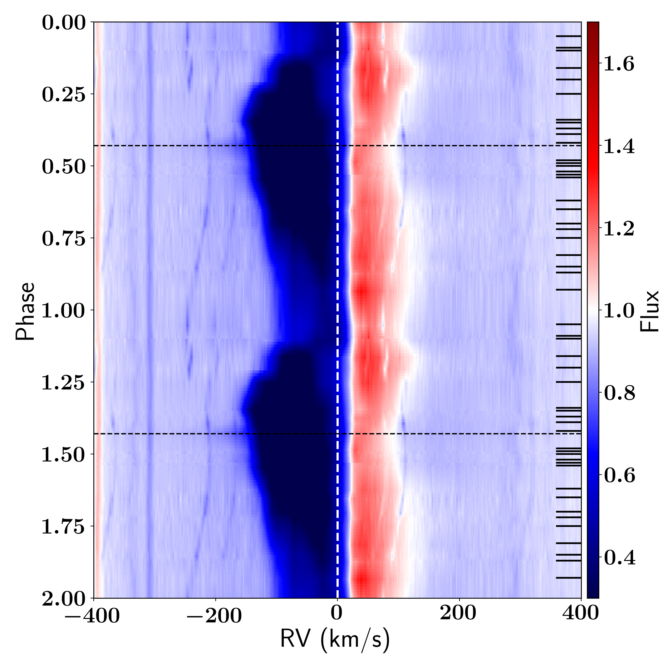
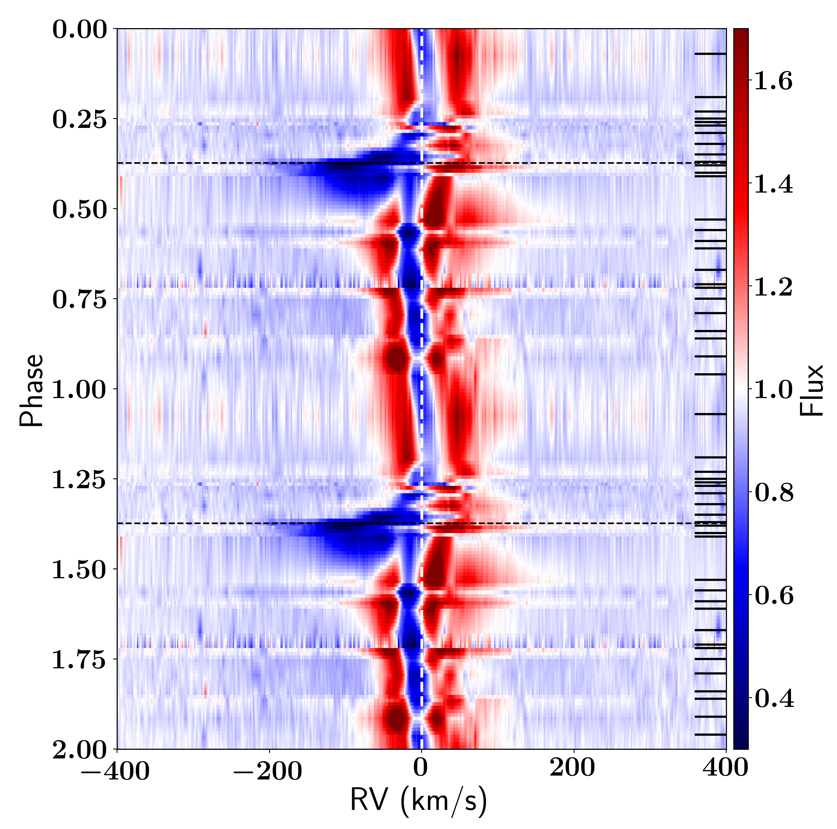
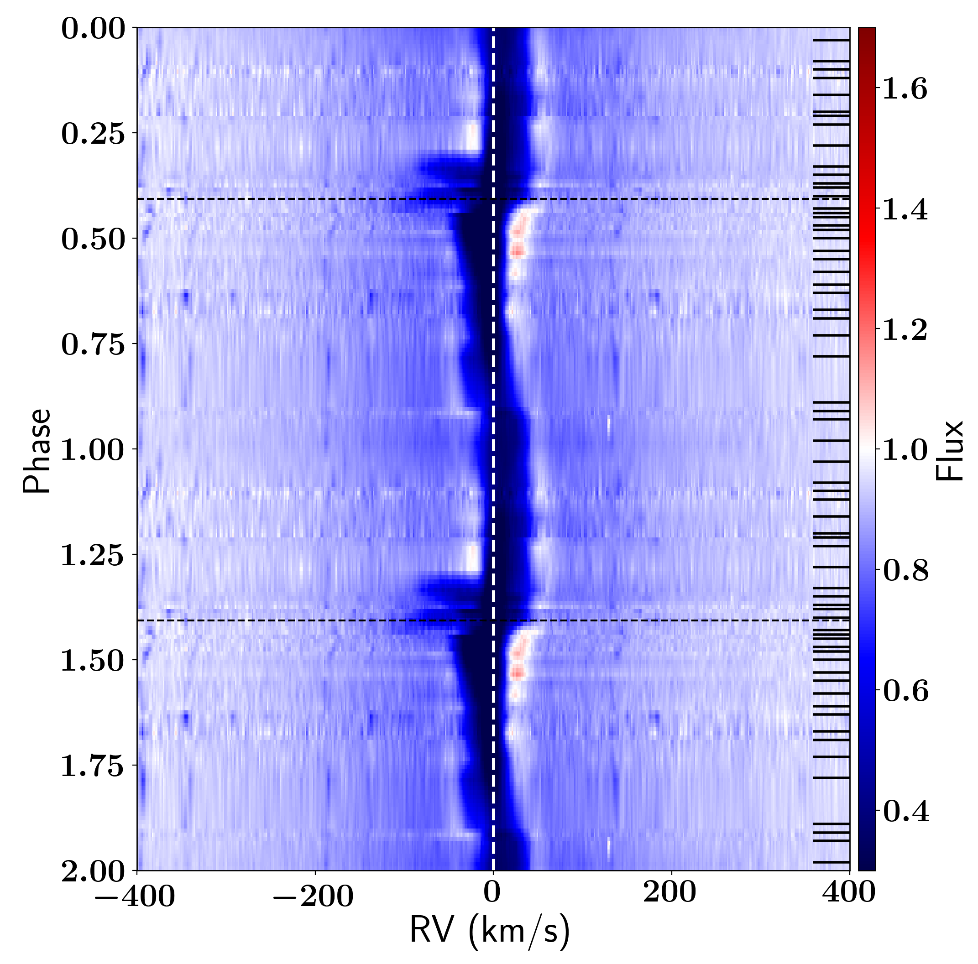
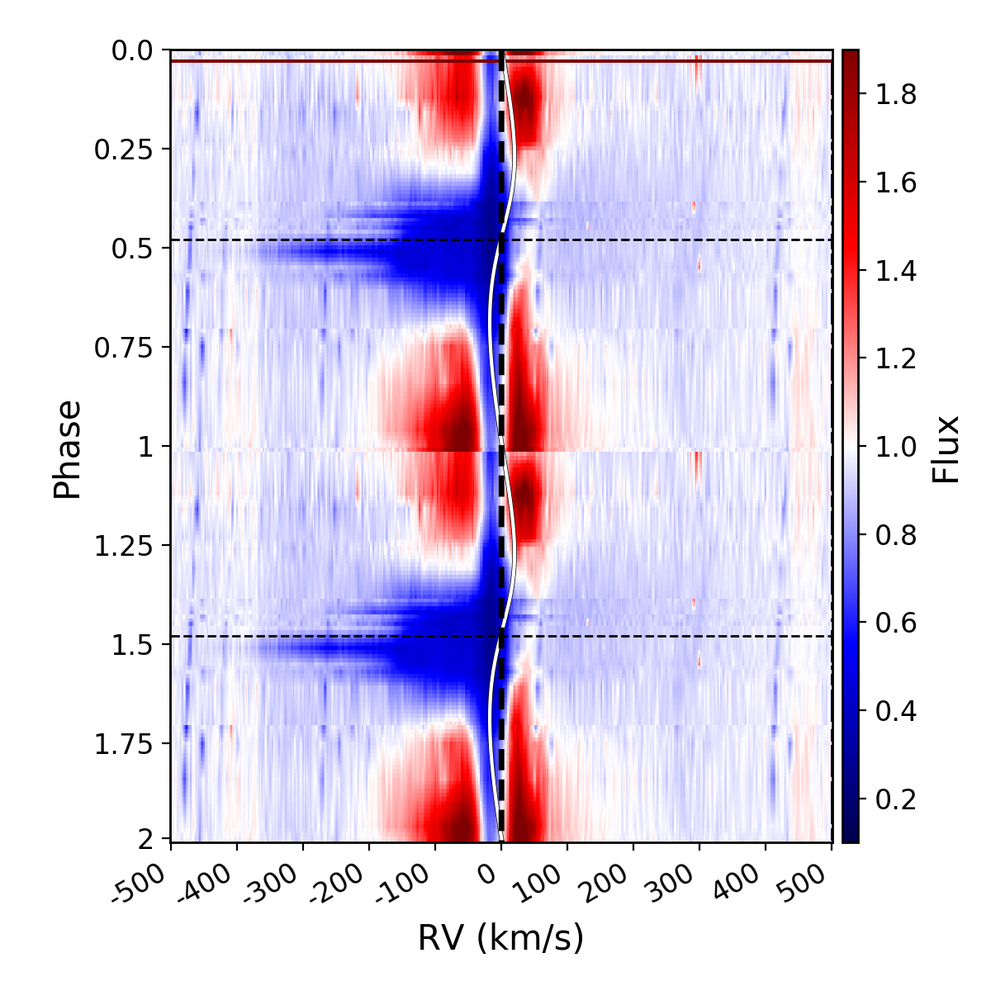
Commonly Observed
IW Car
HP Lyr
89 Her
EP Lyr
HD46703
IRAS19135

Slide 16
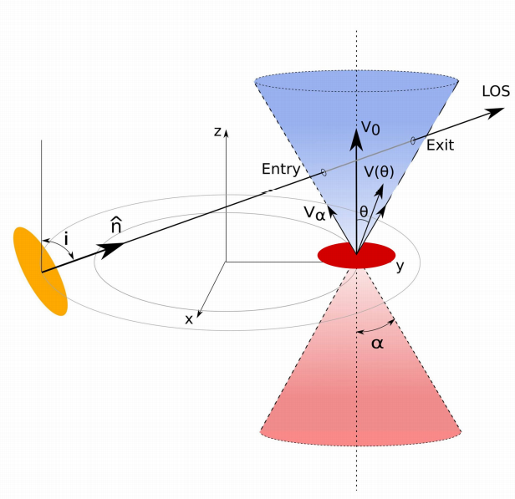
Modeling in several steps
Time-resolved spectroscopy:
- spatio-kinematic (geometric modelling)
- RT (constrains are the Balmer lines)
- testing with self-similar jet models from
YSOs
Jet opening angle
Jet tilt
Angular Velocity structure
Density structure
Binary (radius components, orbit)
Bollen et al., 2017; 2019; 2020, 2021

Slide 17
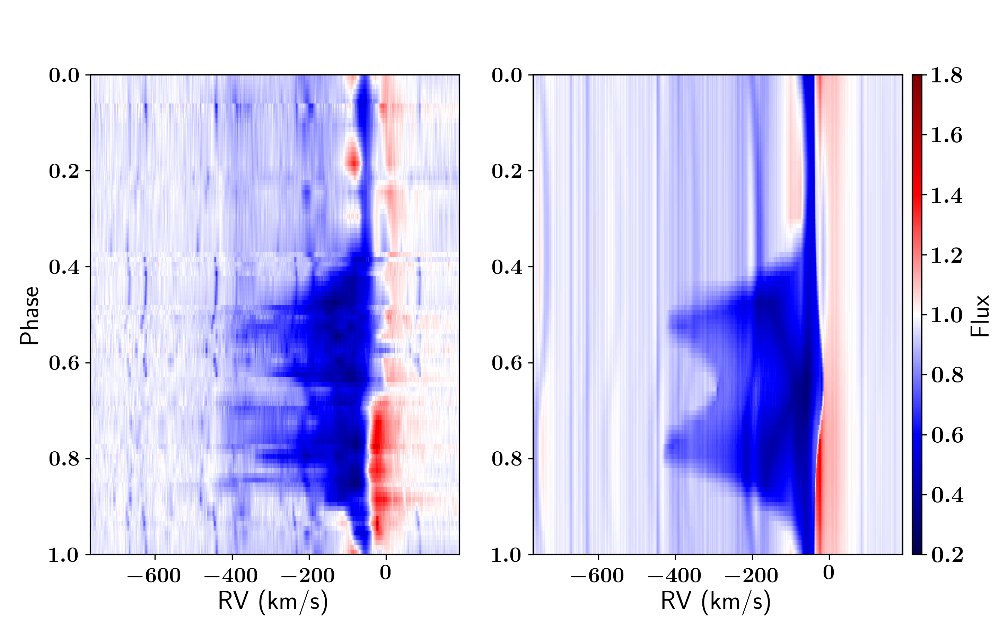
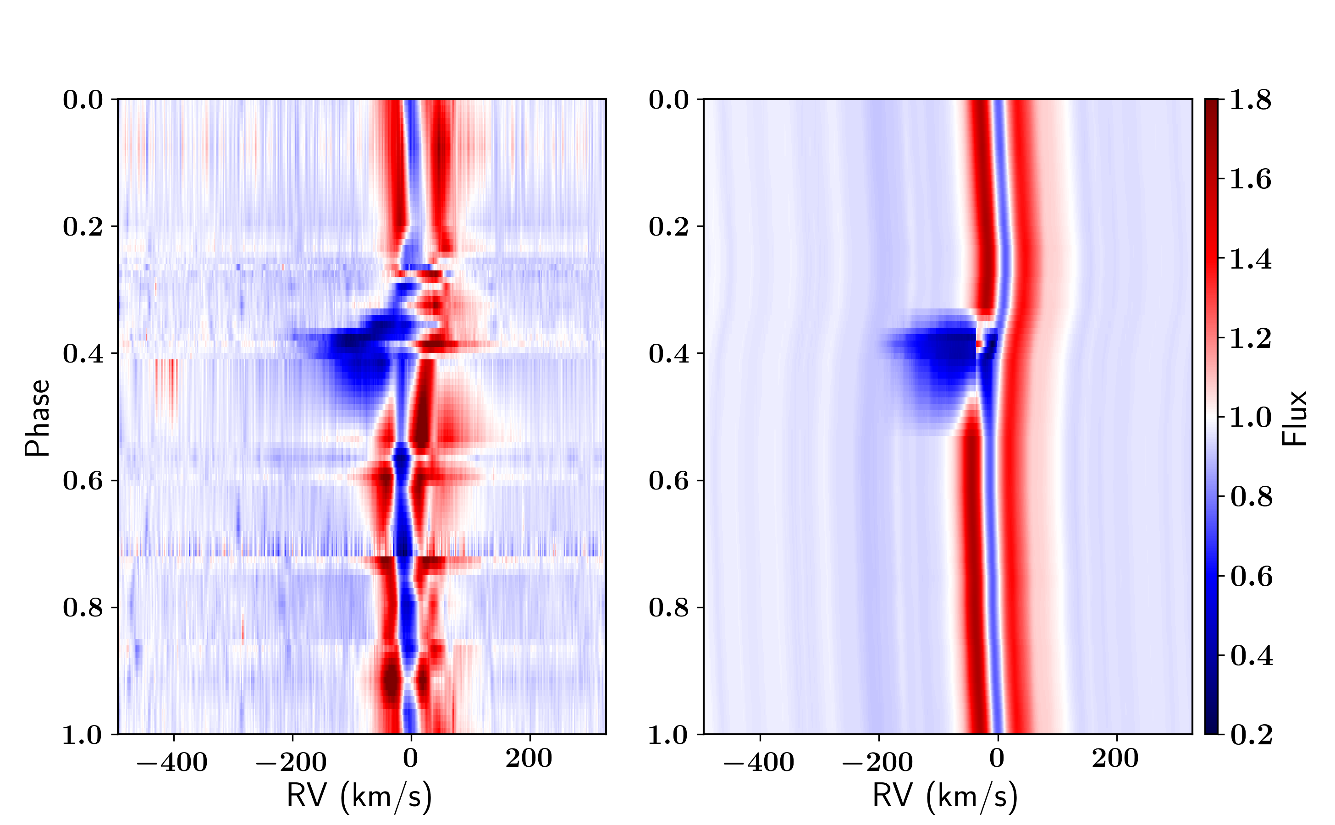
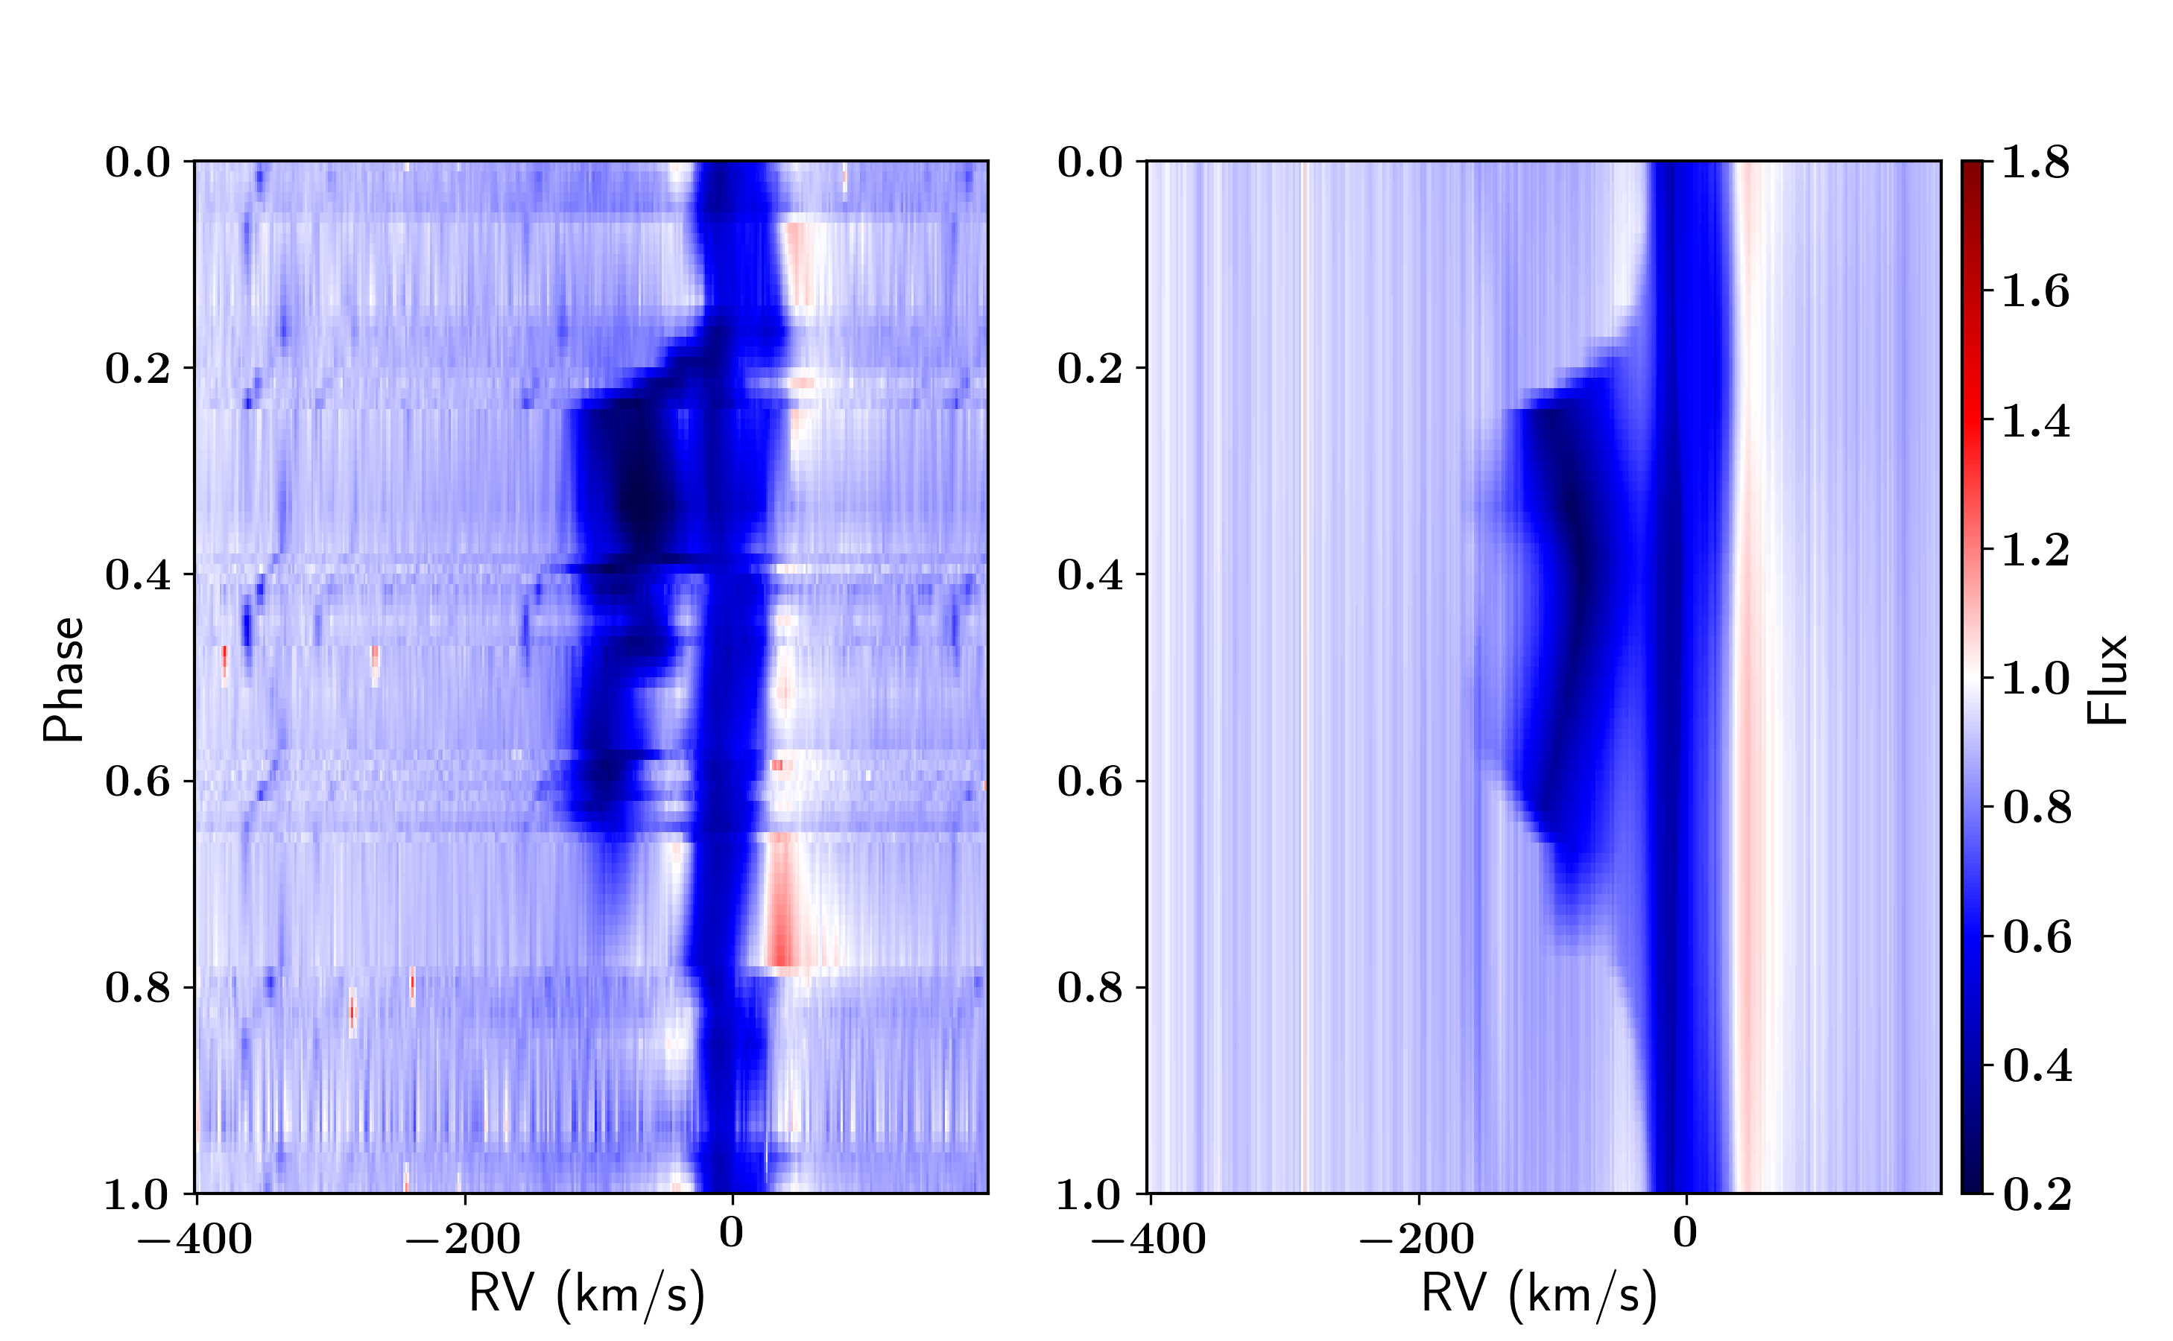
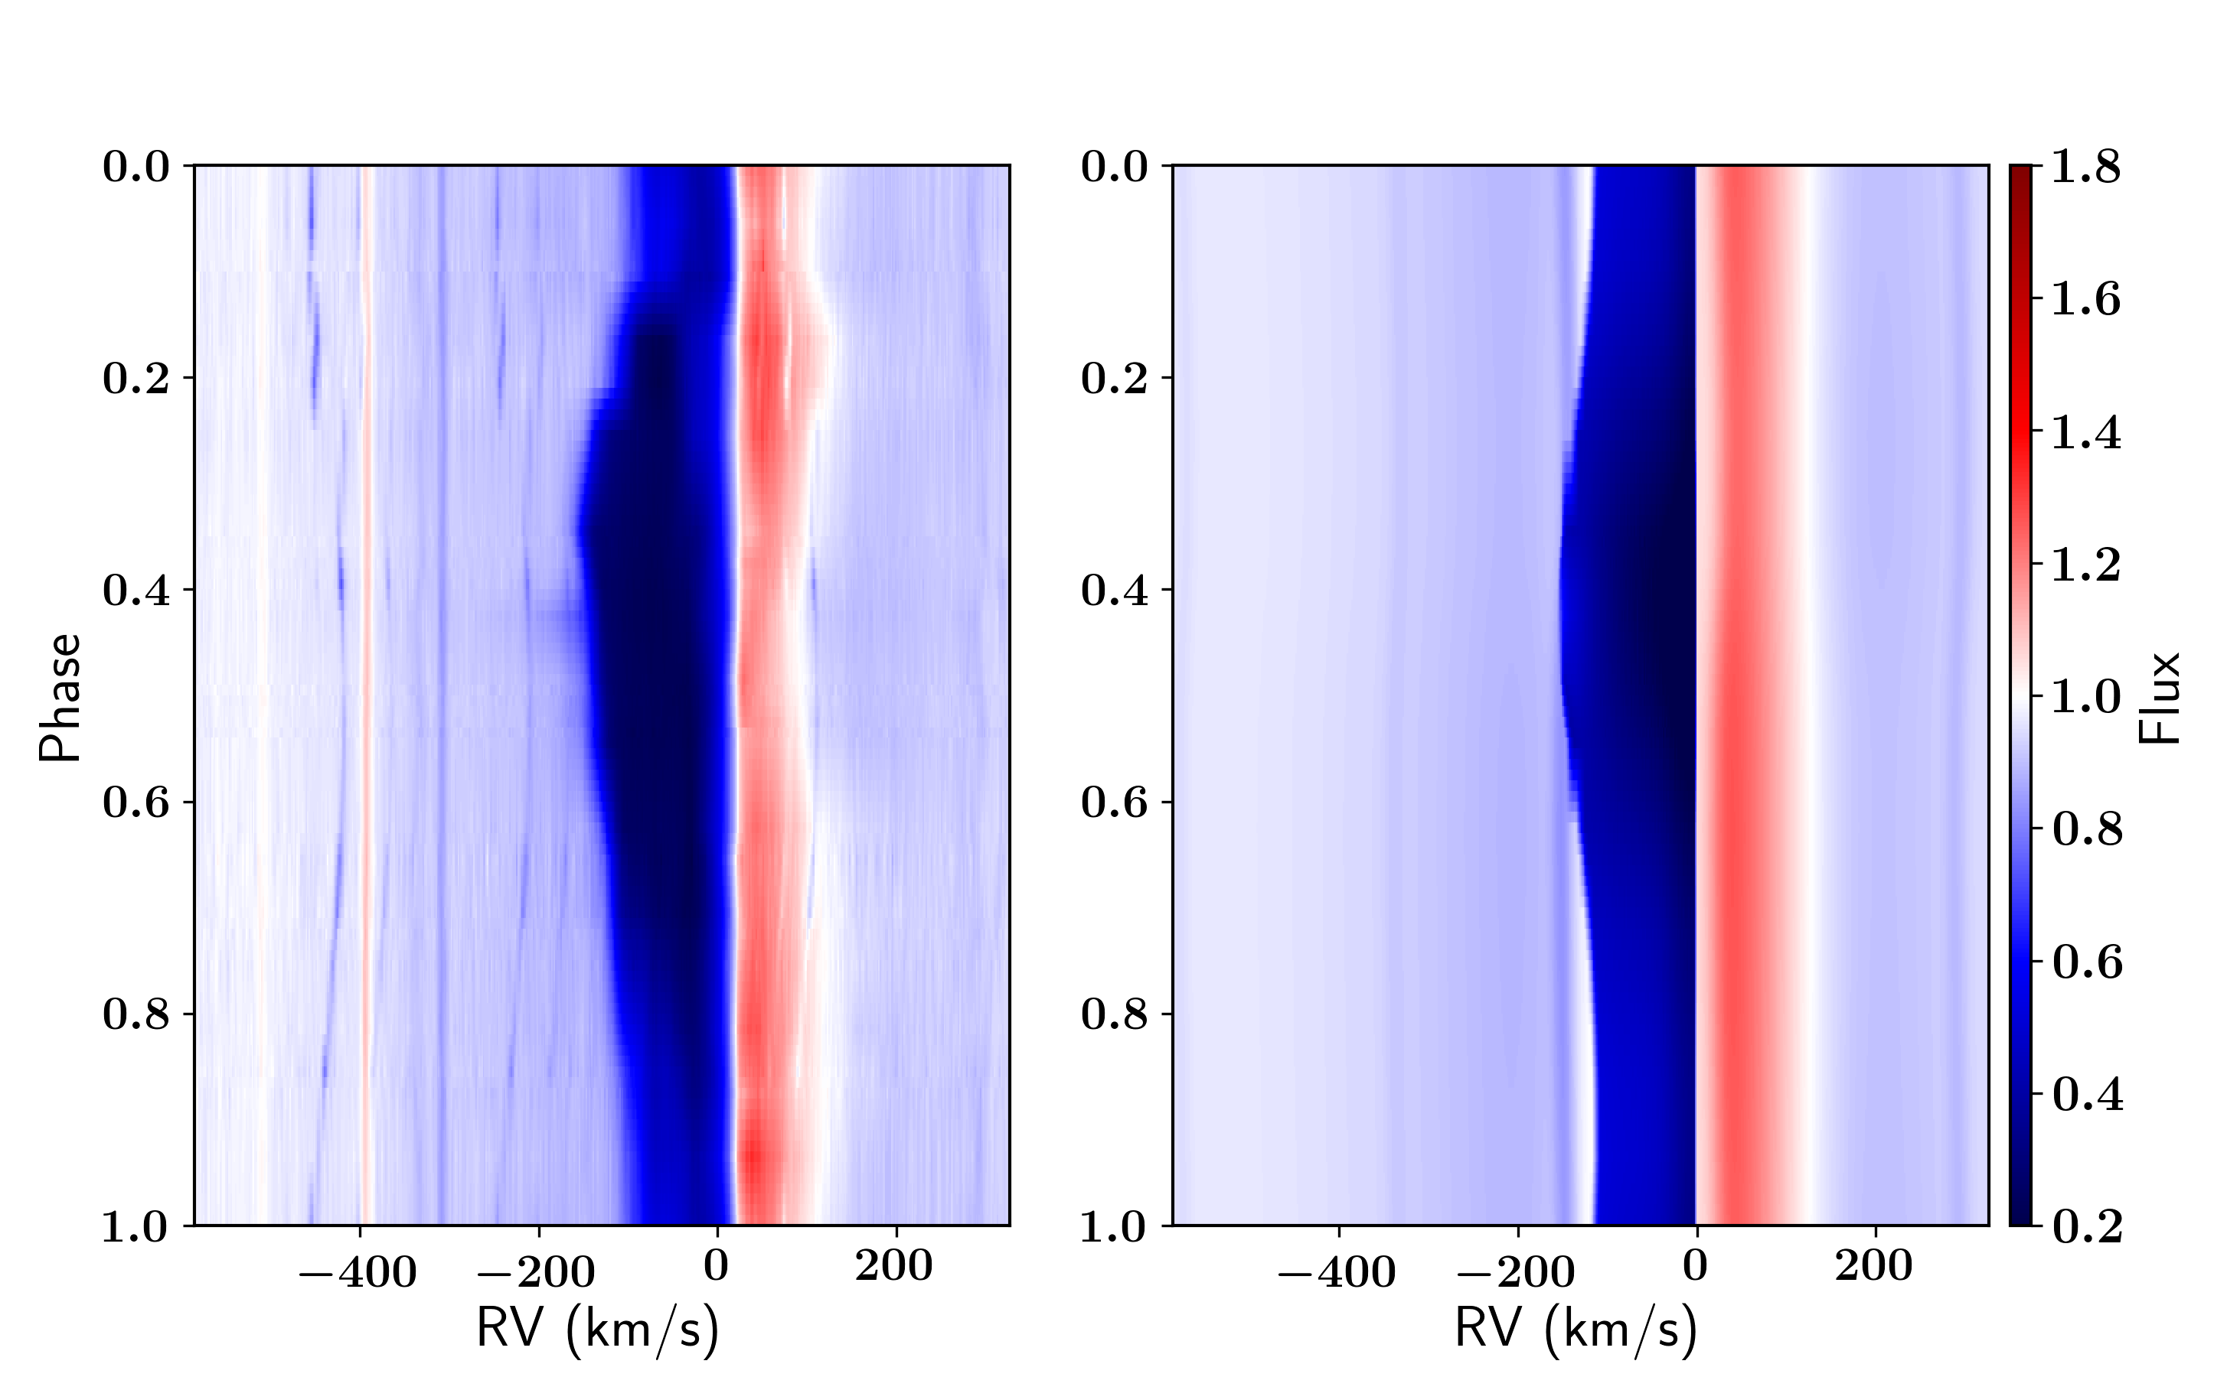
Geometric model fits

Slide 18
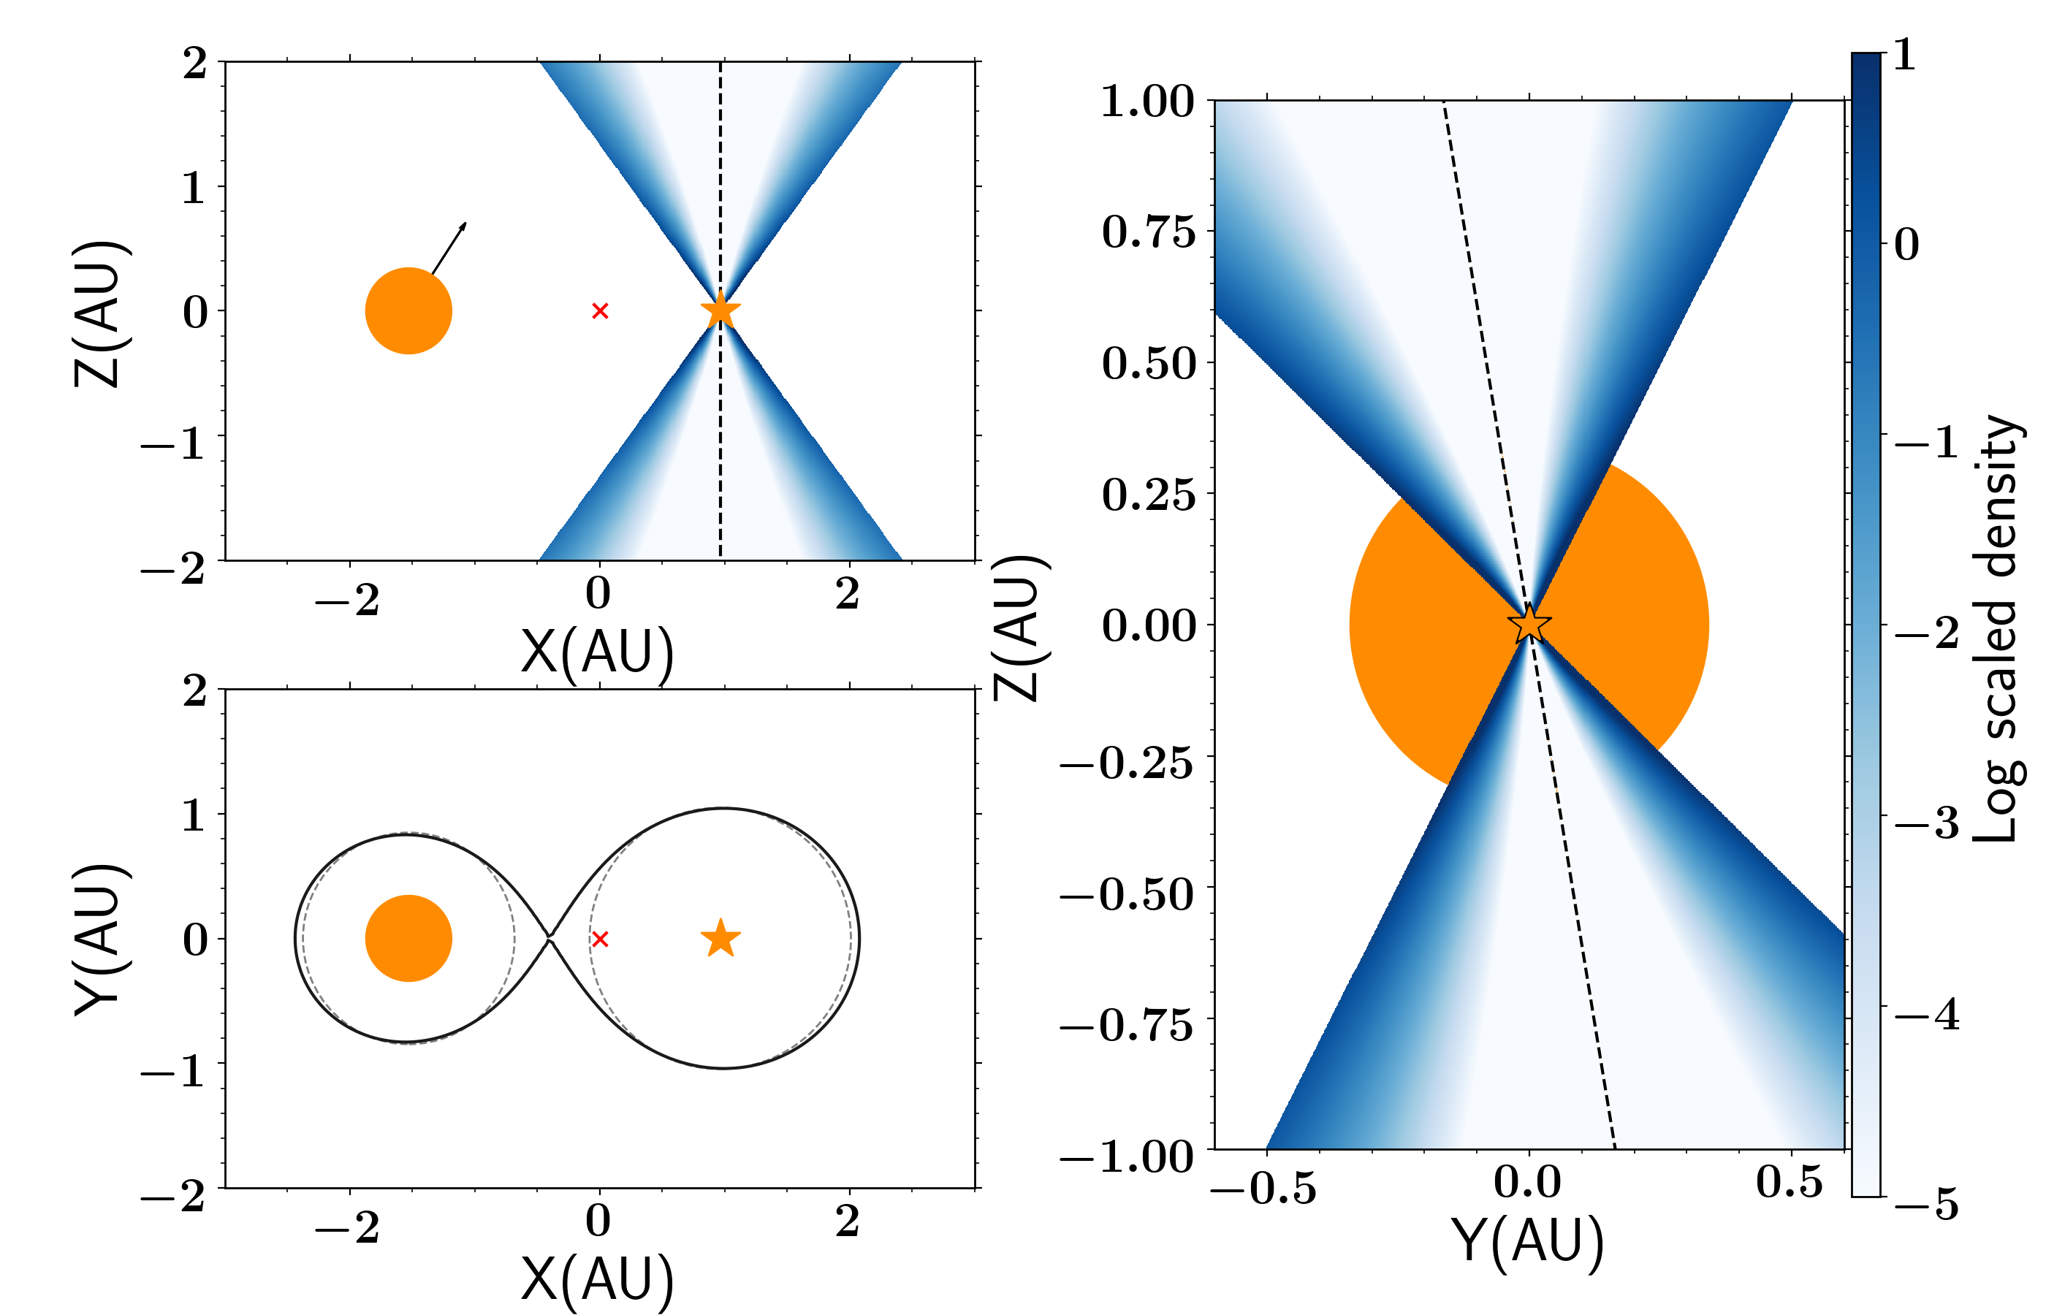
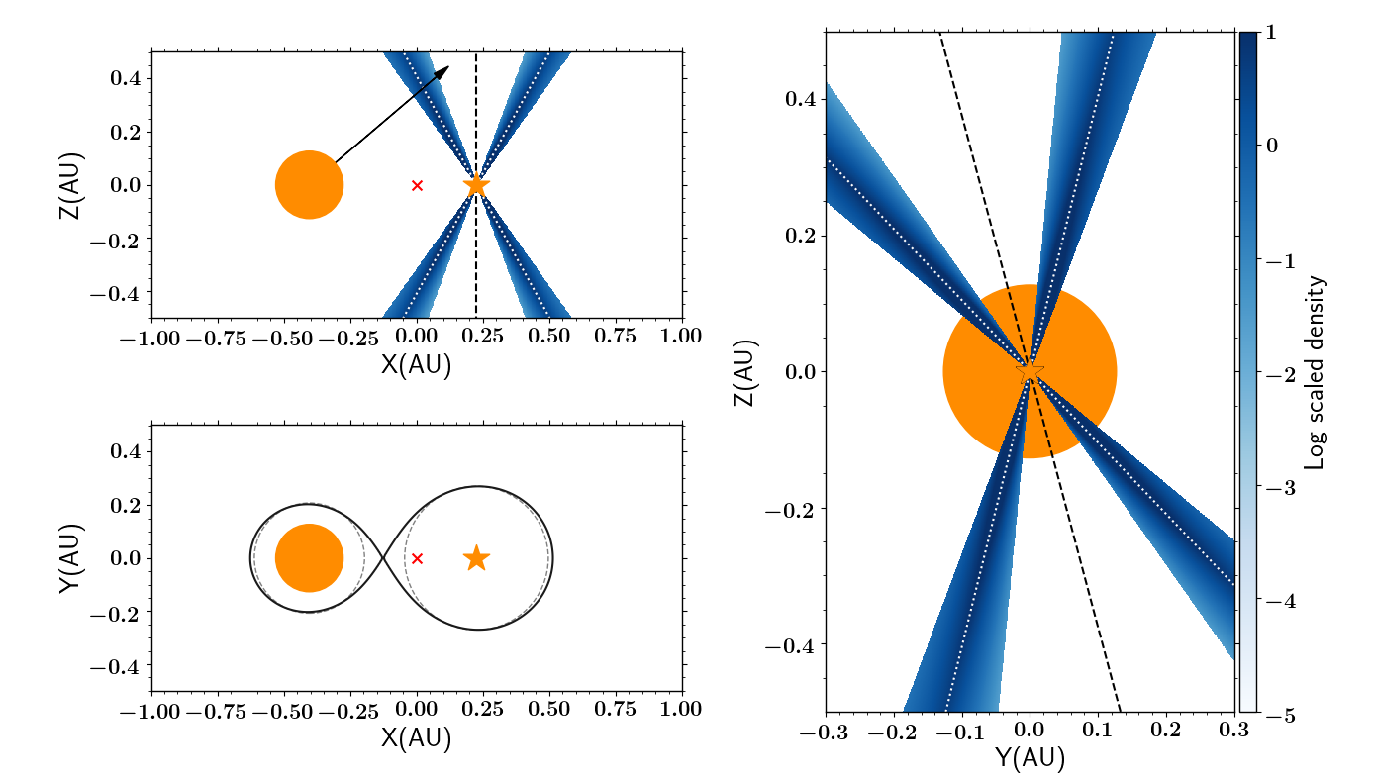
High velocity outflow: geometric model
- wide opening angle
- inclination dependent
- angle dependent velocity law
in cone
- deprojected outflow velocity escape velocity of MS not WD
Bollen et al., 2017; 2019; 2020; 2021, 2022 (sub)

Slide 19
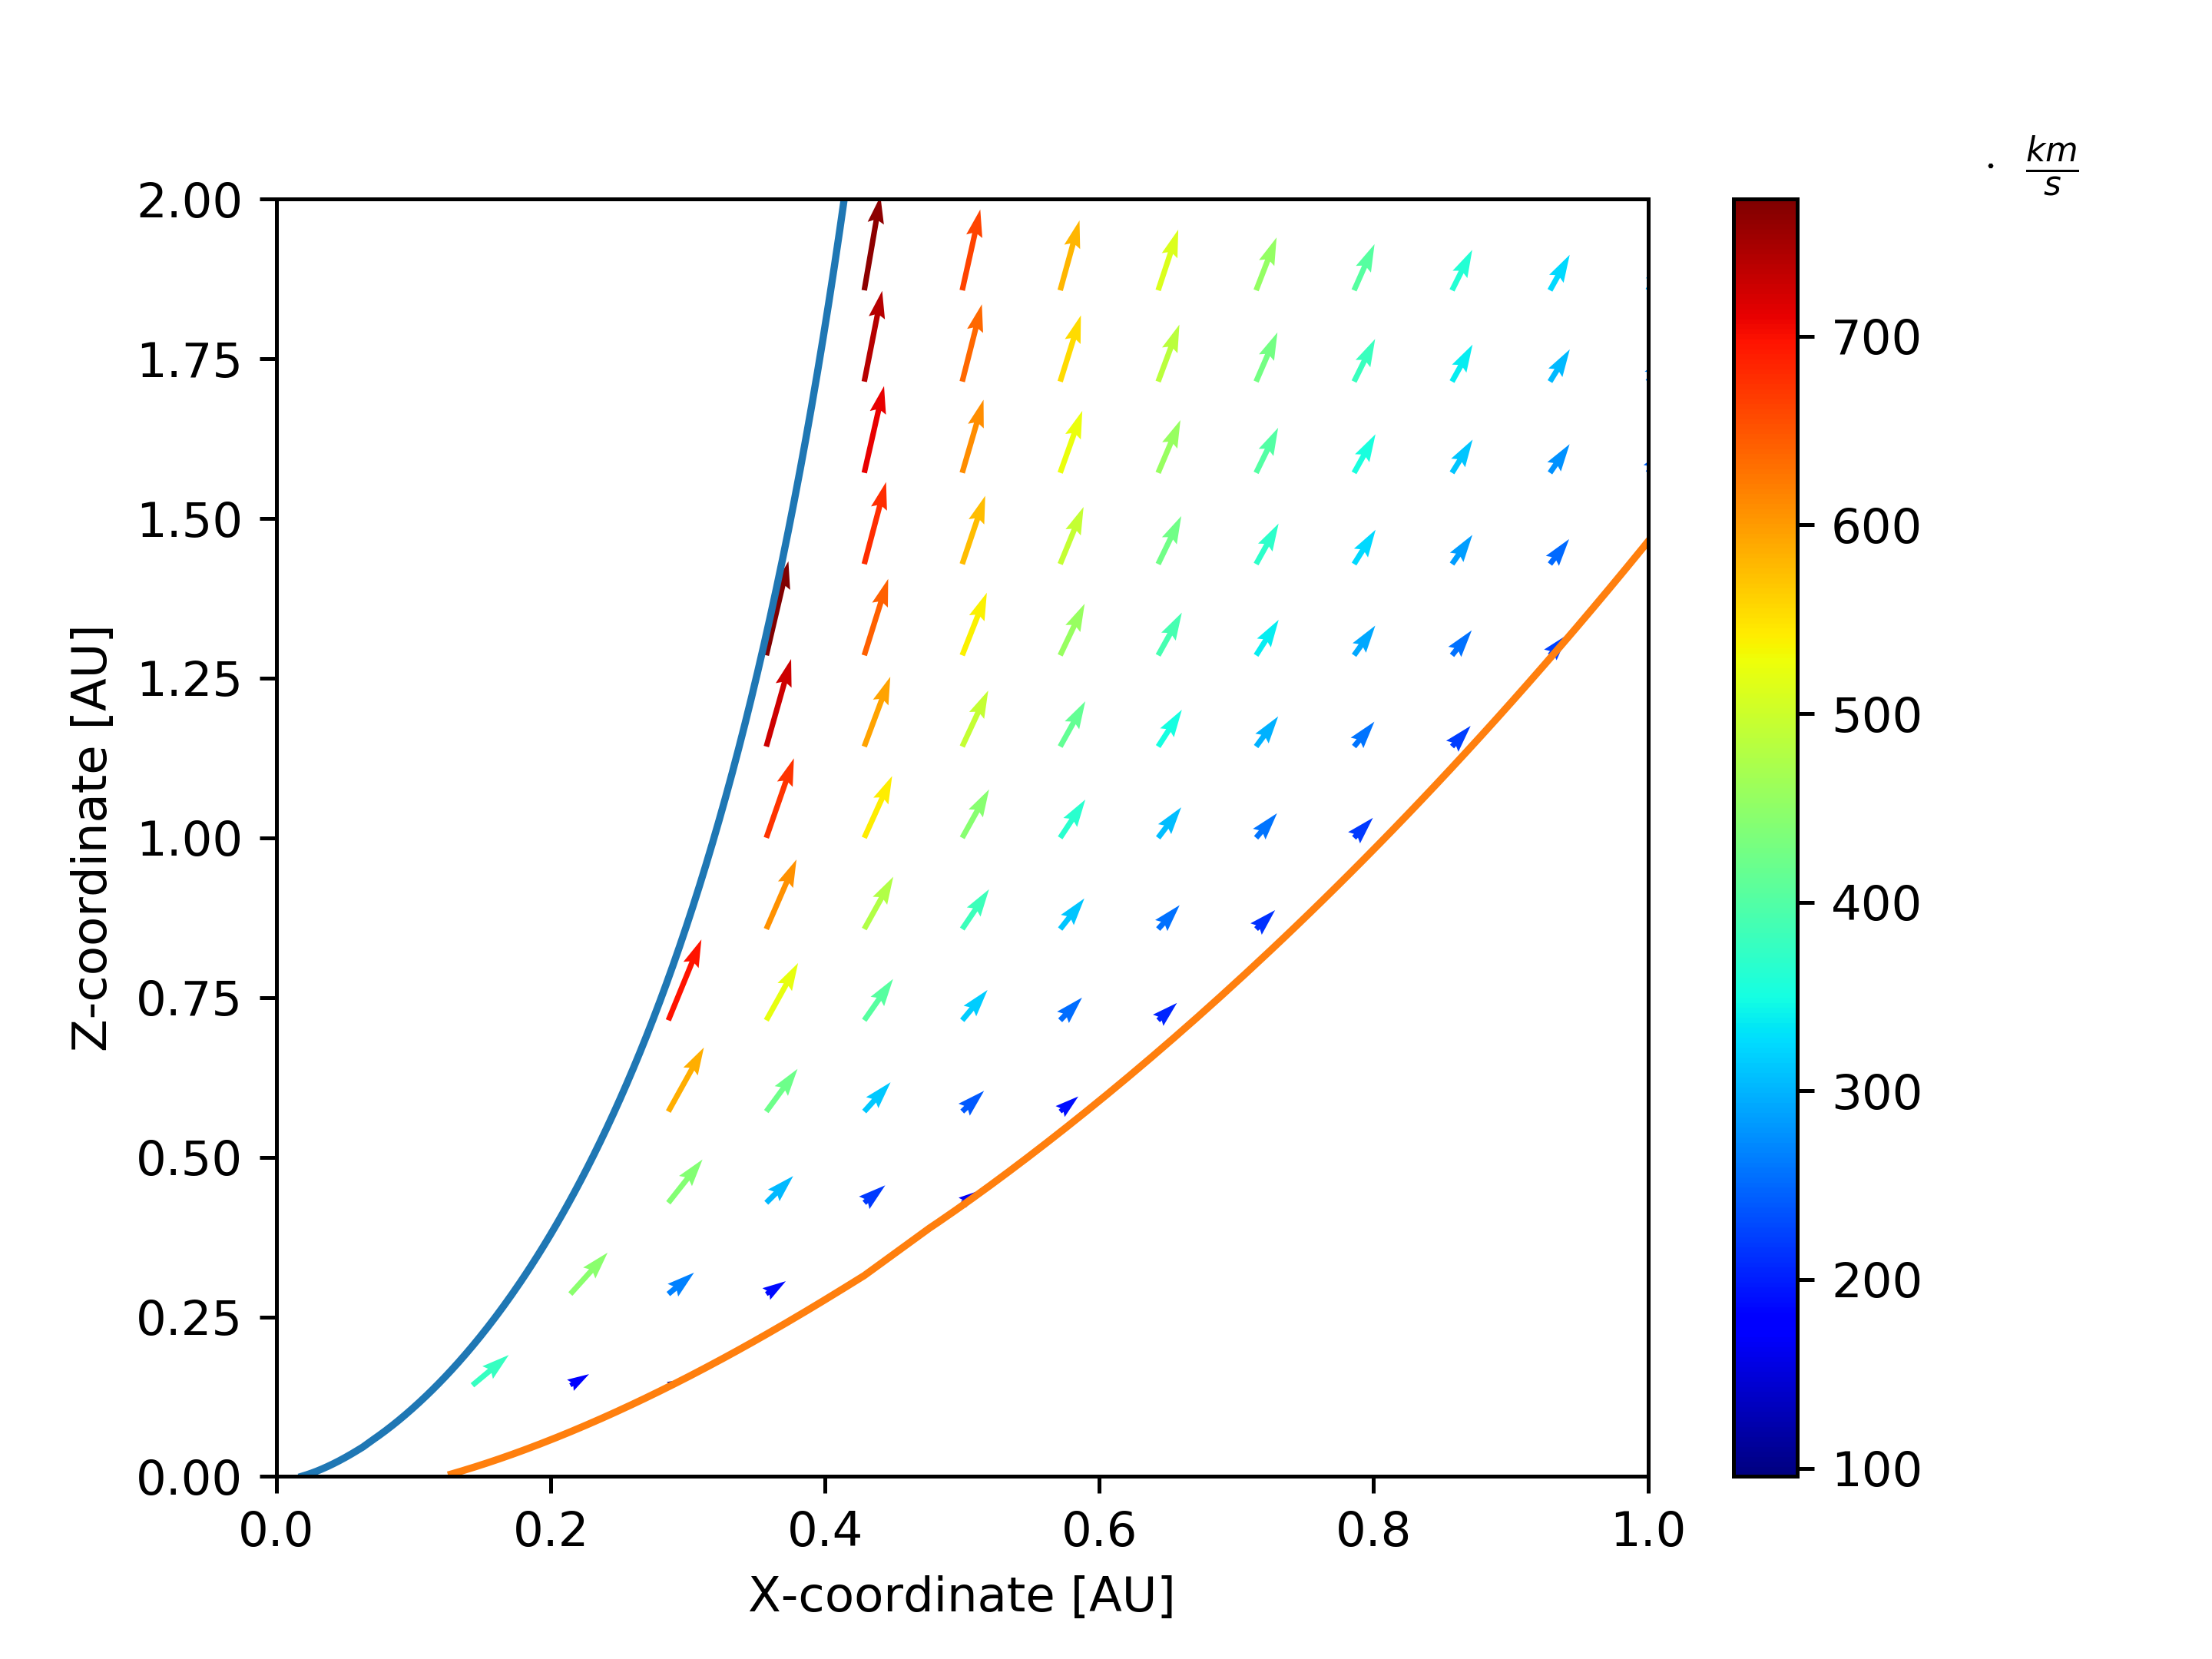
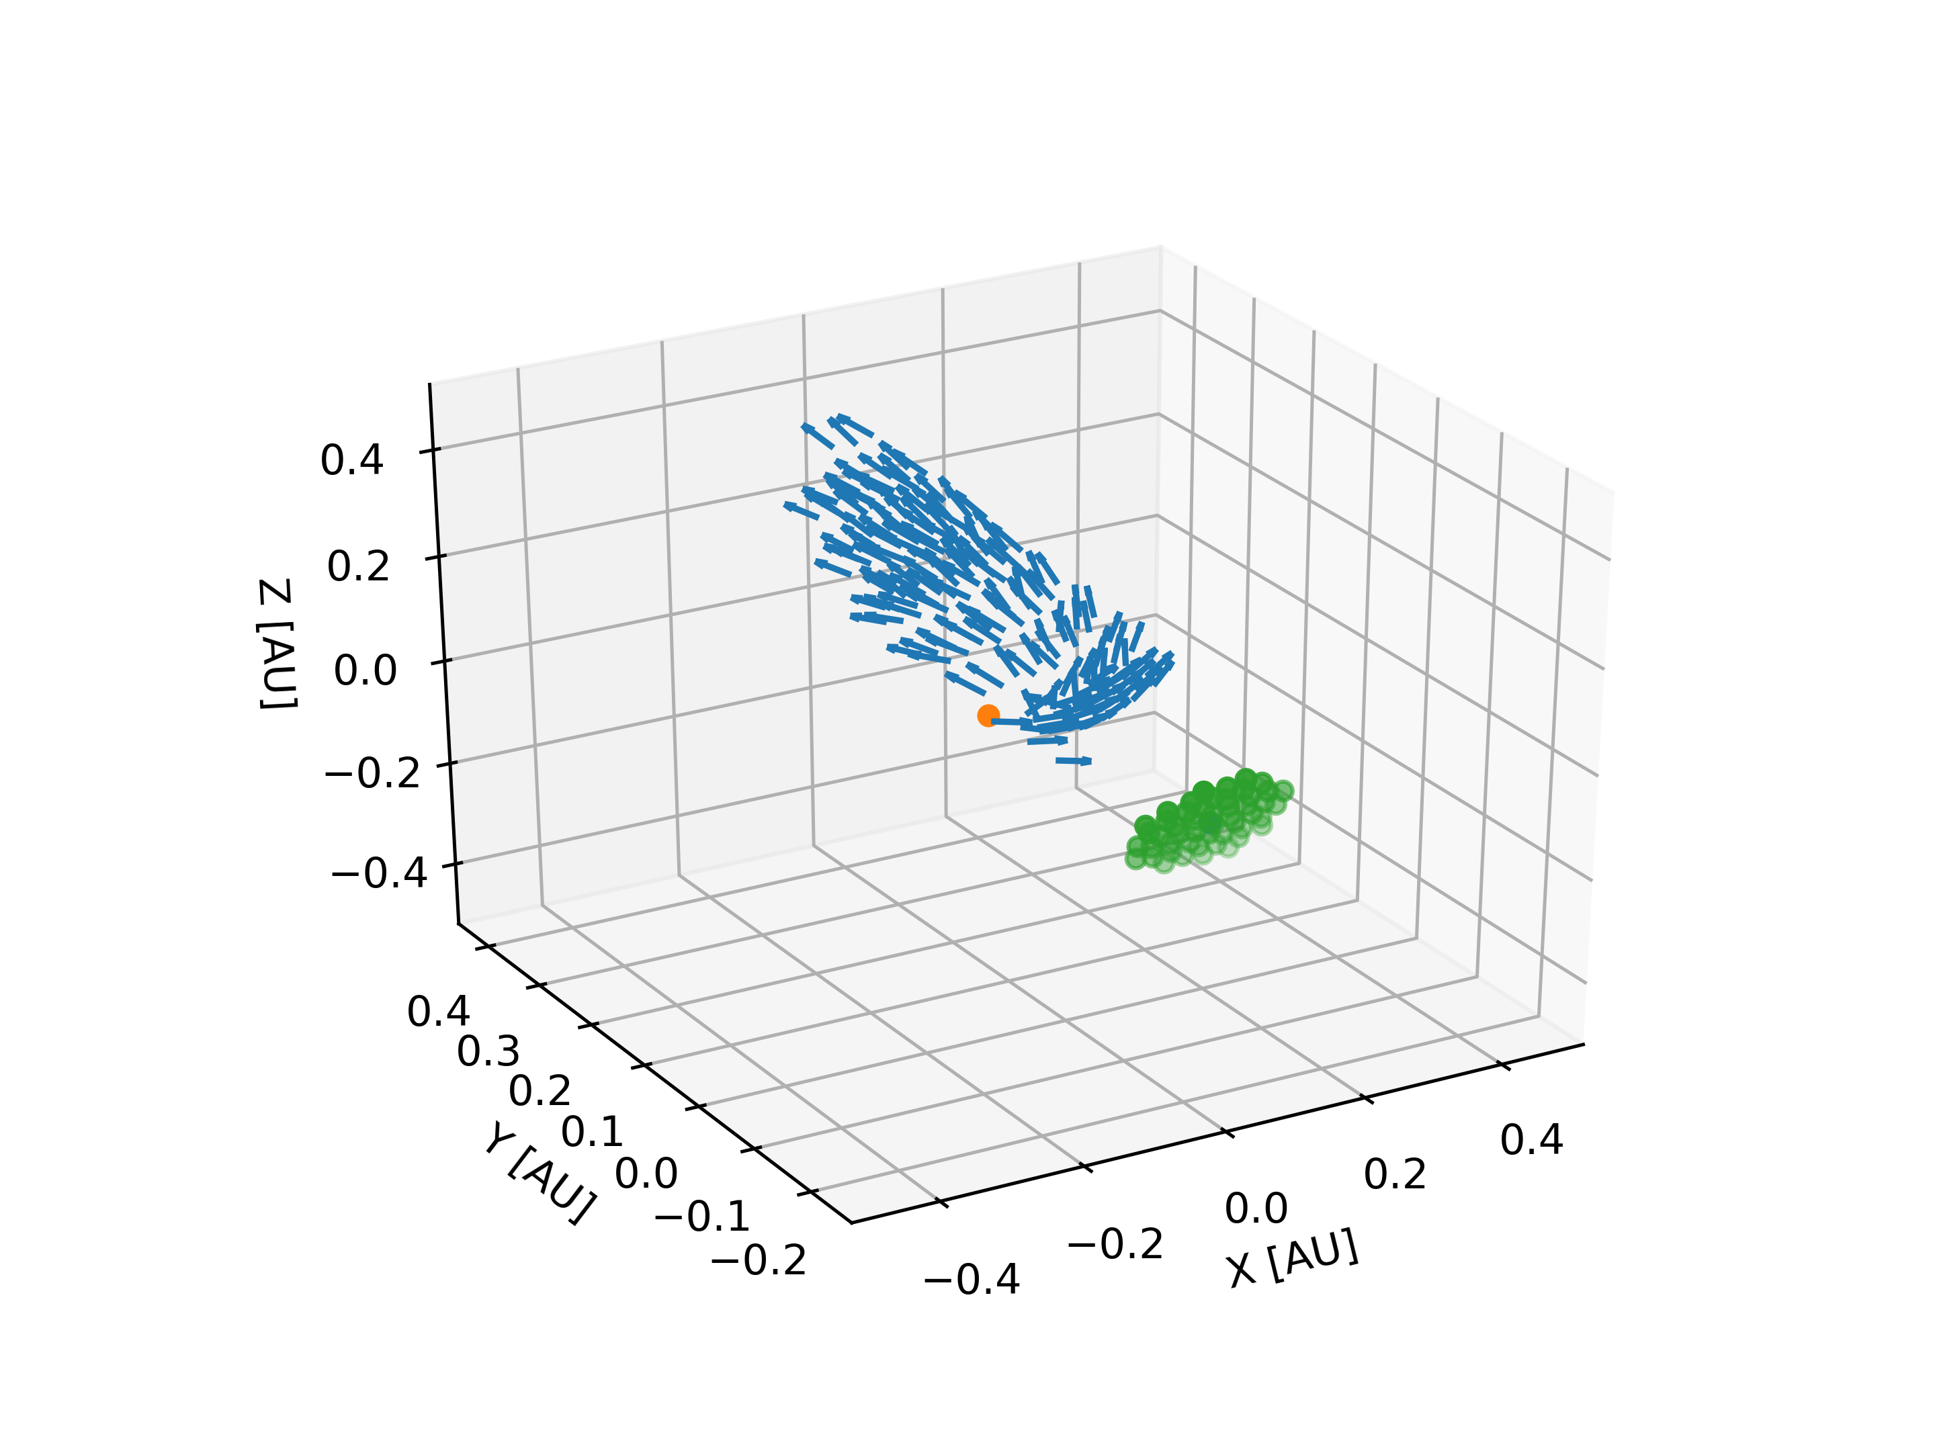
MHD self-similar models
models turning into observables
Verhamme et al., in prep

Slide 20
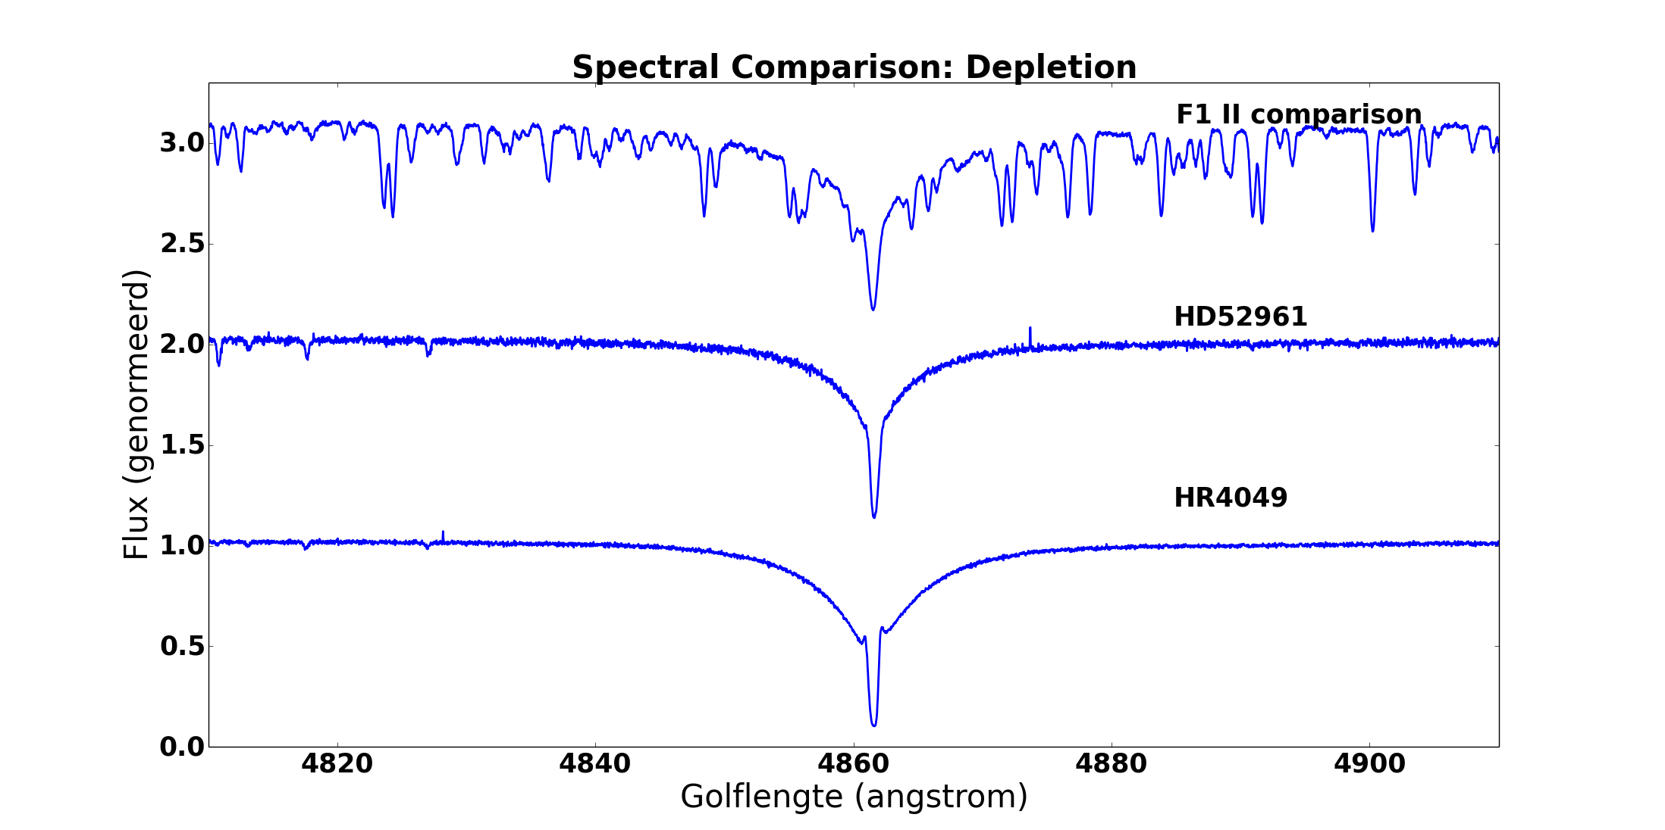
Photospheres: special chemical anomaly
Almost no Fe
nor other elements
down to
[Fe/H]=-4.8 !!
Rich in
CNO, S, Zn...

Slide 21
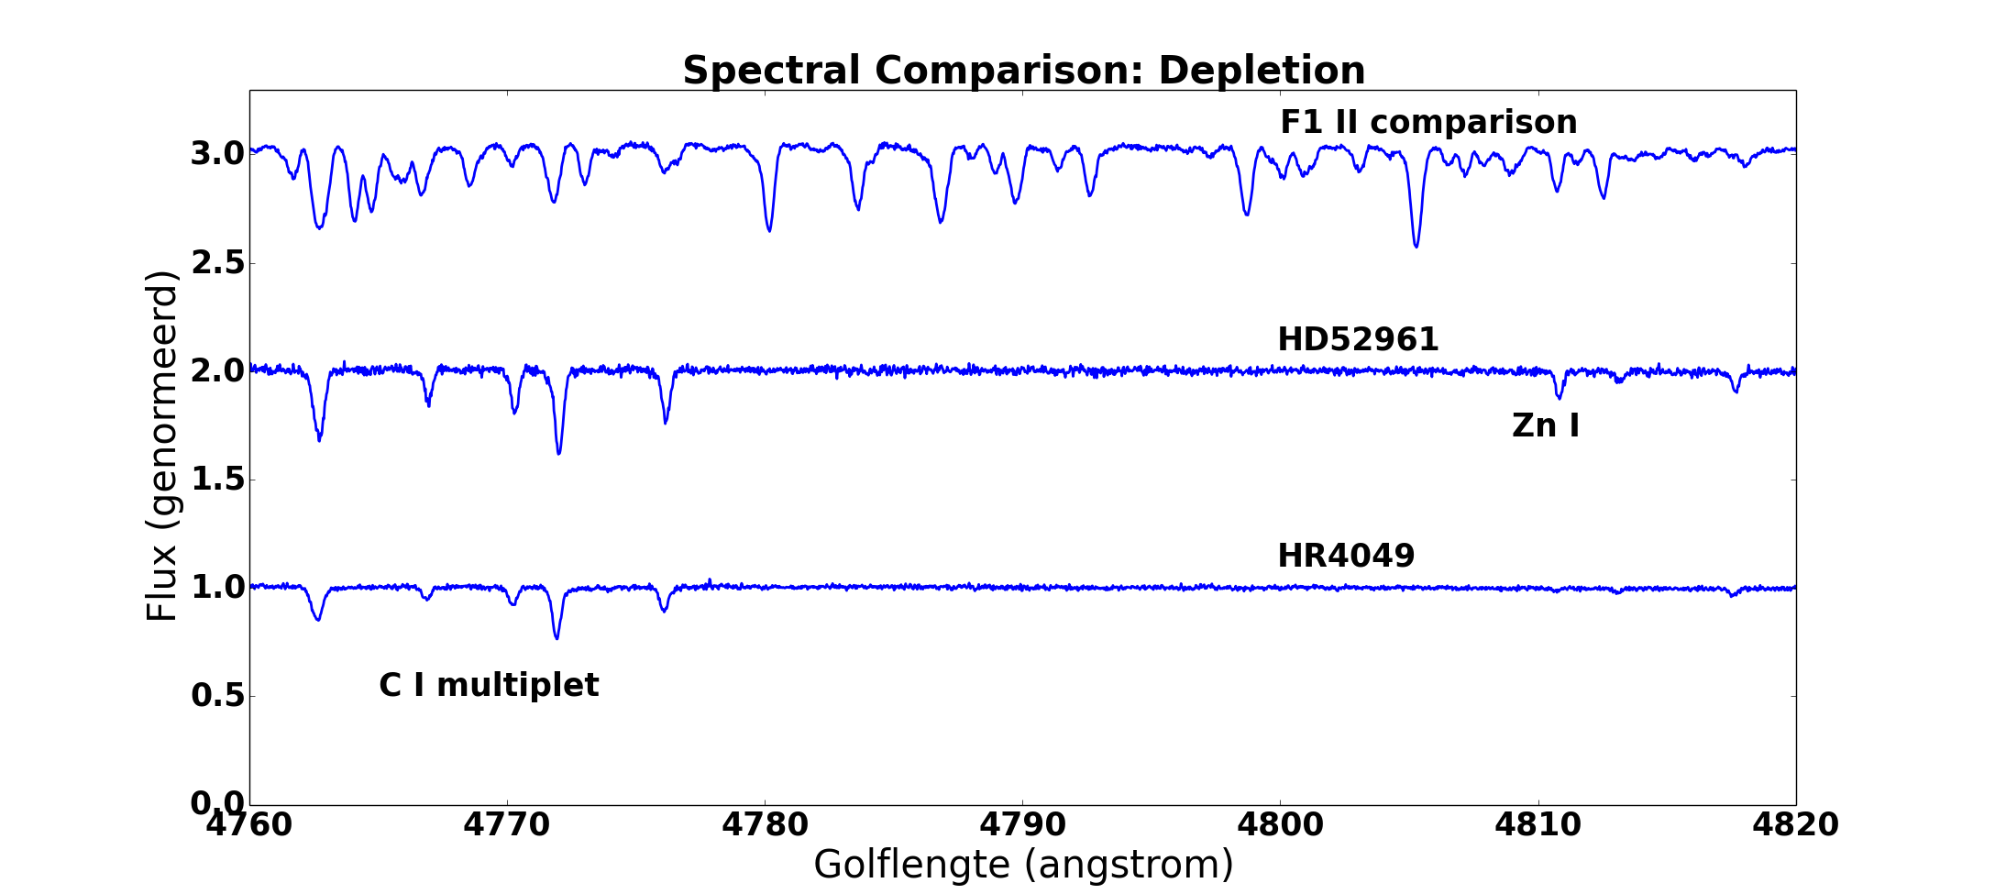
Photospheres: special chemical anomaly

Slide 22
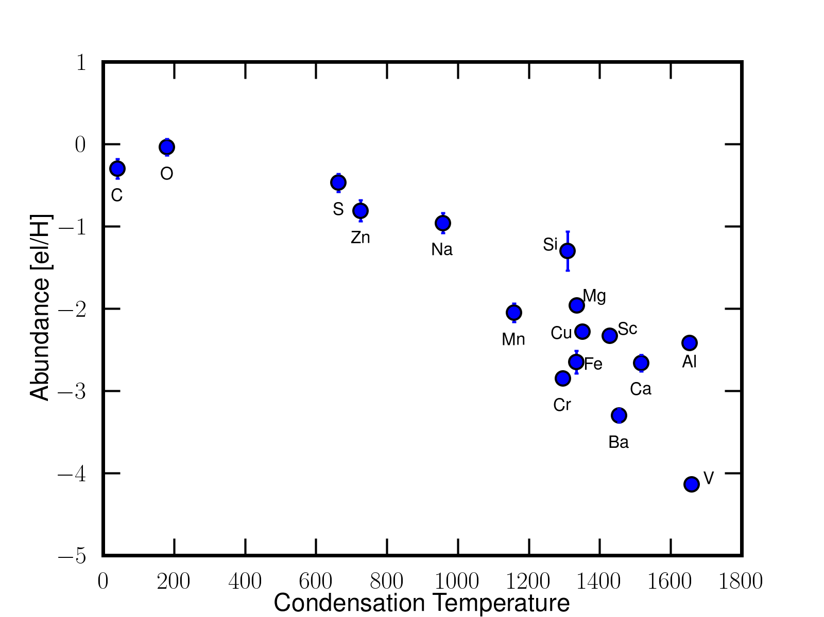
Photospheric Depletion: Feedback from disc
Abundance patterns ~
gas phase abundance of ISM
You lose the nucleosynthetic history
Can be very efficient
(down to [Fe/H]=-4.8)
Accretion of circumstellar gas hence
you slow down the evolution
Disc is needed to guarantee low
density and long timescale.
Waters et al., 1992; Van Winckel et al., 1992, 2003 ; Giridhar et al., 2005; Gielen et al., 2009, Rao 2013
Gezer et al. 2015; Van Winckel 2018; Kamath 2019

Slide 23
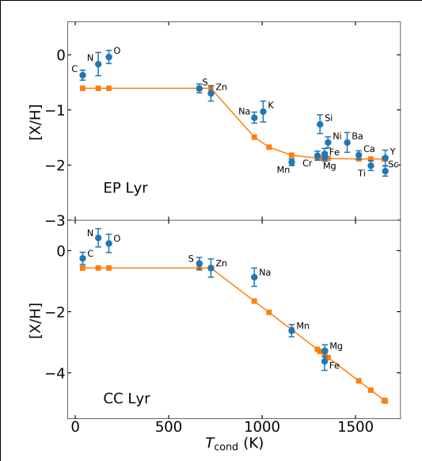
Photospheric Depletion: Feedback from disc
Modelling + stellar evolution
Many saturated profiles
Impact on evolutionary time in
some cases
Oomen et al., 2019; 2020

Slide 24
Conclusion

Slide 25
Why bother?
Population Synthesis of binaries
Prediction: bimodal distribution
Common Envelope Results: inspiraling
Wind transfer
Nie et al., 2012;

Slide 26
Why bother ?
Pop. synthesis Nie et al., 2012
What we observe

Slide 27
Why bother ?: holistic approach

