Slide 1
The ²⁶Al/ ²⁷Al isotopic ratio in stellar grains and the stars of the AGB
Soós Benjámin 2022.06.22
13th Torino Workshop, Perugia, Italy

Slide 2
Introduction
Important reactions from the point of ²⁶Al
New measurements at CERN (n_TOF)
The effect
The importance of temperature and the ²²Ne(α,n)²⁶Mg reaction
Comparison with stellar grains
Summary

Slide 3
²⁶Al production
²²Ne(α,n) ²⁶Mg as a neutron source

Slide 4
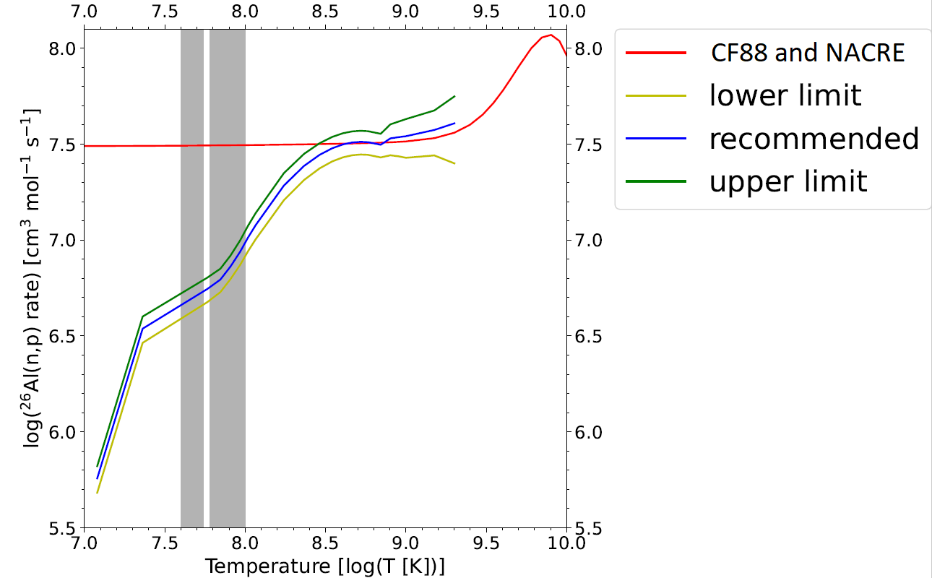
New measurements at CERN (n_TOF)
What do we expect from the smaller cross-section for ²⁶Al?
➔ less efficient ²⁶Al destruction
➔ higher ²⁶Al^{/27}Al ratio

Slide 5
What is the effect?
Higher temperature

Slide 6
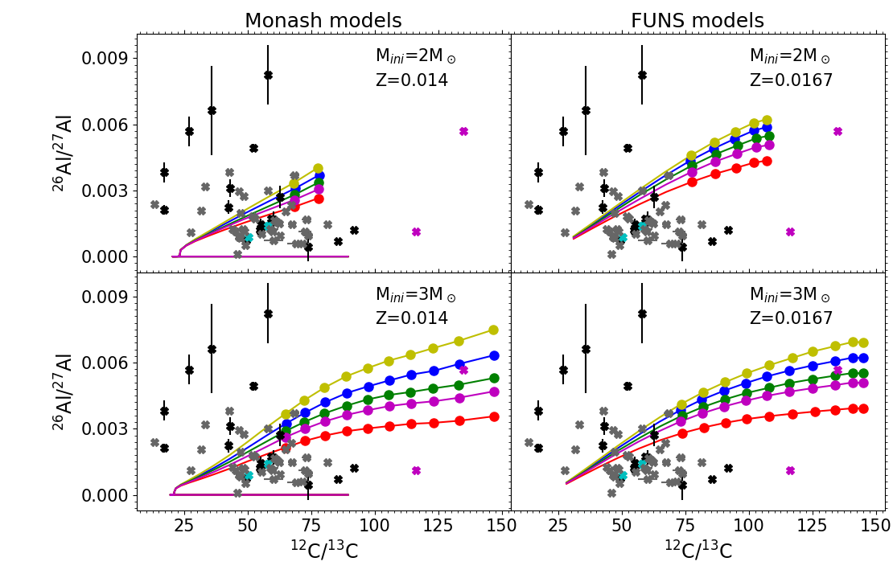
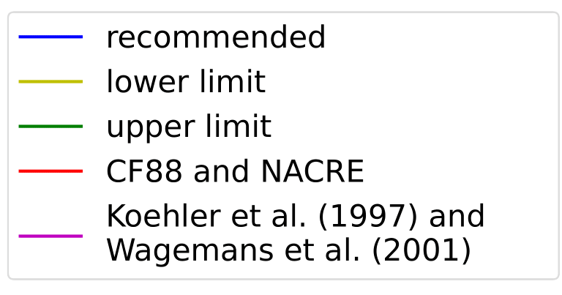
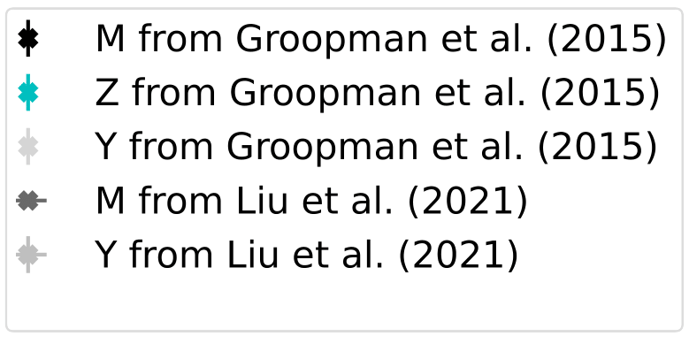
Different codes

Slide 7
Different codes

Slide 8
New ²²Ne(α,n)
Iliadis et al. (2010)
Adsley et al. (2020)
Adsley et al. has an approximately half as low reaction ratio
➔
This results in less free neutrons
➔
Less free neutrons result in more ²⁶Al

Slide 9
Grains

Slide 10
Summary
The measurement of neutron-capture cross-section of ²⁶Al by n_TOF
Smaller cross-sections
Higher ²⁶Al/ ²⁷Al ratio
Strong dependence on
Temperature
²²Ne(α,n)²⁶Mg
Uncertainty in grain data

