Slide 1
Dust production around carbon-rich stars: the role of metallicity
Dr. Ambra Nanni
National Centre for Nuclear Research (NCBJ), Warsaw (DINGLE project)
Main contributors: S. Cristallo (OAA), J. Th. van Loon (Keele University), M. A. T. Groenewegen (ROB)

Slide 2
The metal enrichment of galaxies
Different evolutionary time-scale according to the initial stellar mass:
>8-10 M☉ → evolve in <30 Myrs; explode as Type II supernovae (SNe II).
∼<6-8 M☉ → evolve in >100 Myrs; lose their envelope (mass-loss) during the thermally pulsing asymptotic giant branch (TP-AGB) phase.
Notes:
Tempo di vita sole: 10 miliardi di anni, 10Msun=30 milioni!
2

Slide 3
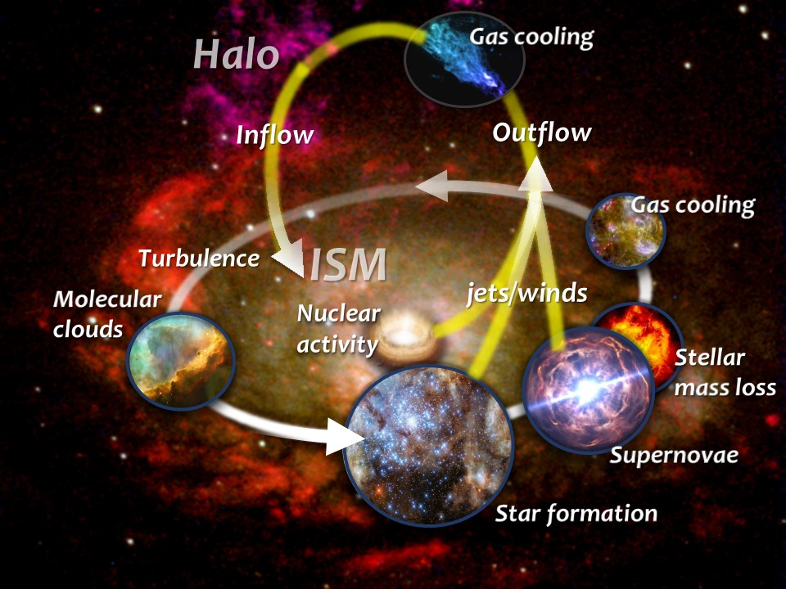
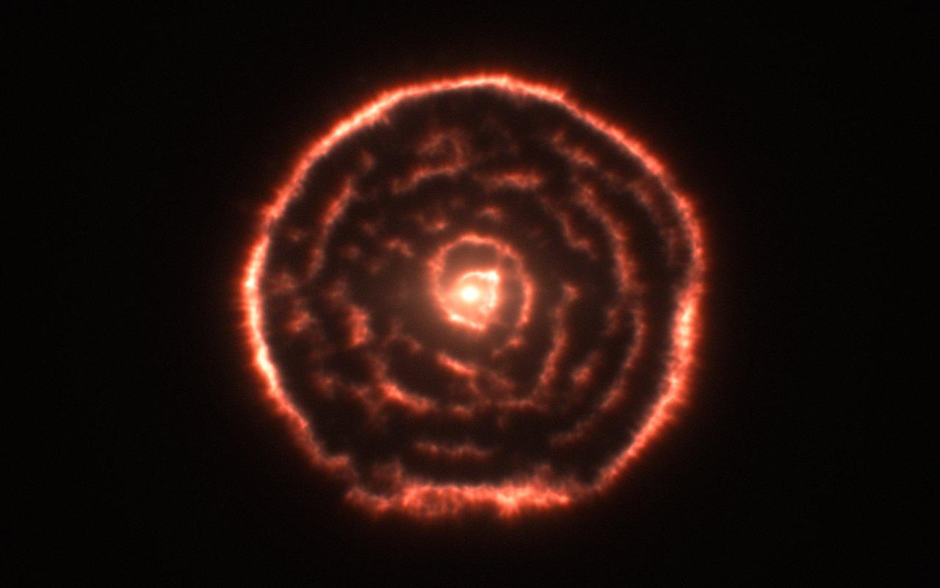
Dust evolution in the interstellar medium (ISM) of galaxies
R Sculptoris
Maercker et al.
Dust around evolved stars
Very luminous (up to 10,000 L☉): they largely contribute to the emission of galaxies
Dust in the interstellar medium of galaxies
Different evolutionary time-scale according to the initial stellar mass:
>8-10 M☉ → evolve in <30 Myrs; explode as Type II supernovae (SNe II).
∼<6-8 M☉ → evolve in >100 Myrs; lose their envelope (mass-loss) during the thermally pulsing asymptotic giant branch (TP-AGB) phase.
Notes:
Tempo di vita sole: 10 miliardi di anni, 10Msun=30 milioni!
3

Slide 4
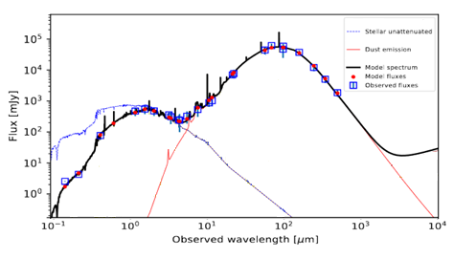
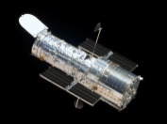
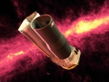
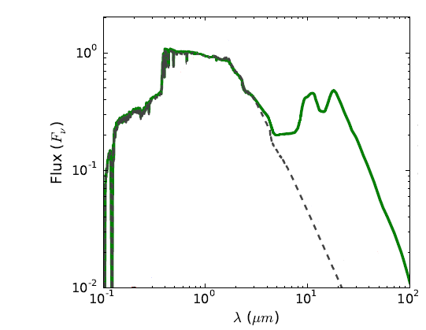
The pancromatic view of galaxies
NGC1569
Local galaxy
HST
Spitzer
Herschel
ALMA
NOEMA
Warm
dust
Cold dust
Stars
Evolved stars
UV-optical-Near IR
Mid-IR
Far-IR
With dust
Nanni+20
No dust
Multi-wavelength observations available!
Villaume+15
At ~3-4 µm they provide 21% of the Small and Large Magellanic Clouds emission (Melbourne & Boyer 2013)

Slide 5
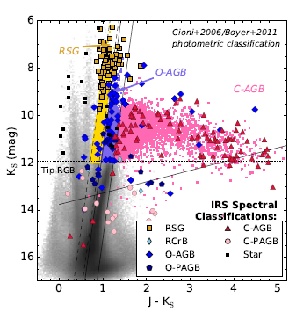
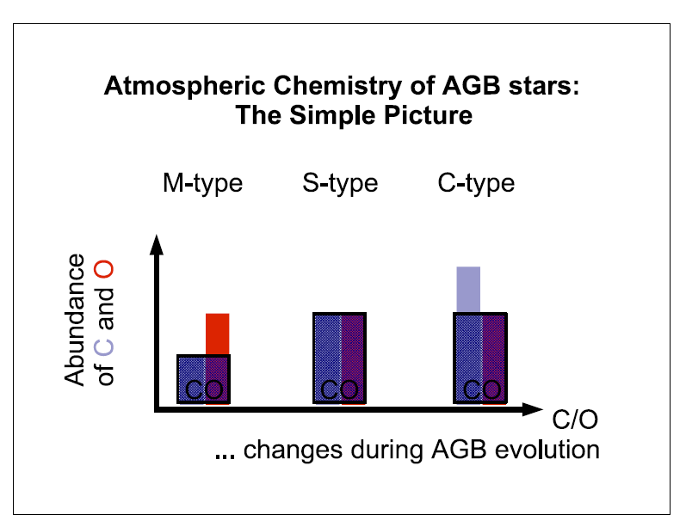
Classification
Hoefner 2009
Boyer et al. 2011; Jones et al . 2017

Slide 6
Circumstellar envelopes
C/O<1
C/O>1
Maercker PhD thesis (adapted from Habing & Olofsson 03)
Nucleation & accretion: uncertain reaction path (e.g. Gobrecht et al. 2017);
Dust-driven wind & mass-loss: momentum transferred to the dust grains (silicate/carbon dust for M/C stars respectively, Bladh et al. 2015);
Expansion velocity: measured, i.e. CO lines, OH maser emission (e.g. Groenewegen et al. 2016; Goldman et al. 2017)
Notes:
Expansion velocity of th outflow is proportional to the amount of dust formed, measured expansion velocities!

Slide 7
C-stars: spectral features
IRS on Spitzer 5.2 -38 µm
Sloan et al. 2016
C-stars:
Acetylene molecules (C₂H₂)
Amorphous carbon → Featureless; wind driver
Silicon Carbide (SiC) → Feature at 11.3 μm
Magnesium Sulfide (MgS) → Bump at 30 μm
Iron (?) → Featureless
∝ (C-O) due to 3rd dredge-up processes
∝ Z

Slide 8
Dust composition around C-stars
Hoefner 2009
Credits: Diego Vescovi (PhD thesis)
C-stars
Acetylene molecules (C₂H₂)
Amorphous carbon → Featureless
Silicon Carbide (SiC) → Feature at 11.3 μm
Magnesium Sulfide (MgS) → Bump at 30 μm
Iron (?) → Featureless
Proportional to the carbon-excess due to 3rd dredge-up processes
Proportional to Z

Slide 9
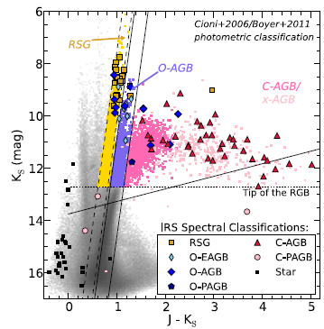
Magellanic Clouds-Observations
SAGE + Spitzer IRS
SMC
LMC
Boyer et al 2011; Ruffle et al. 2015
Boyer et al. 2011; Jones et al . 2017
Plenty of C-stars in the MCs: extreme stars have been confirmed to be predominantly carbon rich from spectral classification
More data coming soon from JWST!
Notes:
9

Slide 10
Motivation
C₂H₂
Sloan et al. 2016
The equivalent width of acetylene feature & SiC feature strength change as a function of the metallicity and of mass-loss rate.
Molecule & dust growth models (Nanni et al. 2013) should be coupled with stellar evolutionary models (FRUITY, Cristallo et al. 2009) in order to take into account the evolution of stellar parameters with time.

Slide 11
Motivation
Galactic
LMC
ALMA observations for the LMC sources (Groenewegen et al. 2016)
Galactic extremes (Ramstedt&Olofsson 2014; Danilovich et al. 2015)
V_{exp} is predicted to be proportional carbon-excess by models
(Mattsson et al. 2010; Eriksson et al. 2014; Bladh et al. 2019).
However C-stars at lower-Z have lower V_{exp} (Groenewegen et al. 1997; Lagadec et al. 2010).
Observations in a larger range of stellar parameters are needed!

Slide 12
Motivation
Increasing C-O
Galactic
LMC
Ramsted&olofsson 2014; Danilovich et al. 2015, Groenewegen et al. 2016
The theory says that V_{exp} depends carbon-excess rather than on the metallicity (Mattsson et al. 2010; Eriksson et al. 2014; Blah et al. 2019);
C-stars in the LMC seem to have lower V_{exp} than C-stars in the Milky Way in agreement with observations in the Galactic halo (e.g. Lagadec et al. 2010);
Observations in a larger range of stellar parameters are needed!

Slide 13
Objective
Interpret the variation of acetylene, SiC and wind speed by employing models of dust growth (Nanni et al. 2013) coupled with stellar evolutionary tracks (FRUITY, Cristallo et al. 2009).

Slide 14
Model & constraints

Slide 15
Model
Dust growth for several dust species coupled with dust-driven wind, see Nanni et al. 2013 (Ferrarotti&Gail 2006; Ventura et al. 2012)
Time-averaged effect of shocks, see Cristallo et al. 2020 (Cherchneff et al. 1992)
Coupled with Radiative transfer code “More of DUSTY”, see e.g. Nanni et al. 2019
(Groenewegen 2012; Ivezic&Elitzur 1997)
Input:
stellar parameters: L, dM/dt, M, T_{eff} , C/O;
dust optical properties;
seed particle abundance (affects the grain size).
Nanni et al. 2016; Nanni 2019
Output: circumstellar envelope:
dust composition;
dust production rate;
wind speed (v_{exp});
spectra.
Our assumptions have been tested against different observations.

Slide 16
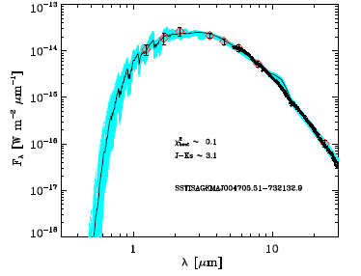
Constraints: SED fitting
Nanni et al. 2018, 2019
We employed the combinations of optical constants and grain sizes that simultaneously reproduce the infrared and Gaia DR2 photometry
(Nanni al. 2016; Nanni 2019).
Mass-loss rate
Dust production rates
Gas-to-dust ratio (ψ)
∼3000 C-stars in the SMC
∼8000 C-stars in the LMC

Slide 17
Constraints: pre-solar grains
Cristallo et al. 2020
The prescriptions for dust growth and wind dynamics have been coupled with FRUITY evolutionary tracks (Cristallo et al. 2009).
By including the time-average effect of pulsation (and suitable seed particle abundance), the size distribution of SiC grains is fairly well reproduced by stars of M ∼ 2 M☉ and Z ∼ Z☉(Cristallo et al. 2020).

Slide 18
Results
Acetylene, SiC and wind speed

Slide 19
Acetylene content: general trend
C₂H₂
Halo
M=2 M☉
SMC
LMC
MW
Sloan et al. 2016
Nanni et al., 2021
Dust growth and wind dynamics coupled with FRUITY evolutionary tracks.
C₂H₂ & carbon dust ↑ if Z ↓: due to the increase of free carbon (more efficient 3rd dredge-up).
More carbon dust @ low-Z, but it remains low enough to allow C₂H₂ ↑ if Z ↓ (dust driven wind).
Good qualitative agreement with observed trends.
Halo
SMC
LMC
MW
M=3 M☉

Slide 20
Acetylene content: scatter
C₂H₂
Halo
SMC
LMC
MW
Nanni et al., 2021
The observed scatter may be explained by the presence of different initial stellar masses.
Sloan et al. 2016

Slide 21
SiC content
SiC/(amC+SiC)
MW
Sloan et al. 2016
LMC
SMC
Halo
τ (1 μm)
Nanni et al., 2021
The SiC mass fraction is Z-dependent (Si↑).
Similar trends are found when similar dust growth models are applied to different stellar tracks (e.g. Nanni et al. 2013; Ventura et al. 2016).

Slide 22
Results: wind speed
1.5 M☉
2 M☉
3 M☉
1.5 M☉
2 M☉
3 M☉
1.5 M☉
2 M☉
3 M☉
1.3 M☉
1.5 M☉
2 M☉
3 M☉
Observations are fairly well reproduced by our predictions.
If confirmed, the observed trend V_{exp}↓ Z↓ is obtained in the 3 M☉ model rather than in the 1.5-2 M☉.

Slide 23
Conclusions & Future plans
Our dust prescriptions couple with FRUITY stellar tracks qualitatively well reproduce the observed trends as a function of the metallicity (acetylene & SiC content and wind speed).
A step forward will be to reproduce the mid-infrared spectra as a function of the stellar parameters.
Modelling the mid-infrared features of dust as a function of the stellar parameters is relevant to compute the total mid-infrared emission of the stellar population of a few Gyrs of age.
→ DINGLE project @ NCBJ (PI Dr. A. Nanni, funded by the National Science Centre, PL)

Slide 24
Thank you!

Slide 25
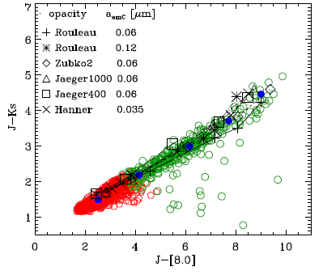
Constraints: dust optical properties
J-Ks
C-stars
X-stars
Observed
Nanni 2019
Nanni et al. 2016
Only 2 combinations out of 50: simultaneously reproduces the infrared observations as well as the trends obtained by combining 2MASS and Gaia DR2 photometry (Lebzelter et al. 2018).
Small (spherical) grains (0.04-0.1 μm) + optical data sets from Hanner 88; Jaeger+98 (1000°C)
Notes:
25
Nanni A. CS19

