Slide 1
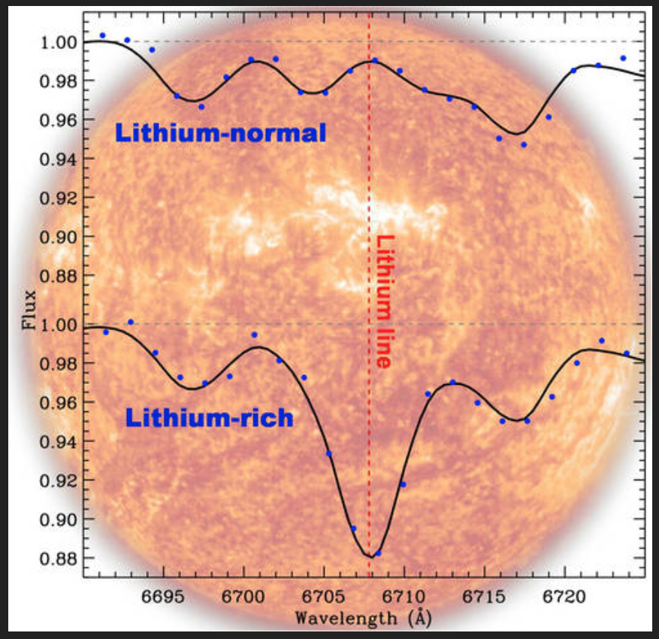
The Active Chromospheres of Lithium-Rich Red Giant Stars
Chris Sneden
University of Texas at Austin
Melike Afşar, Zeynep Bozkurt
Ege University, Izmir
Monika Adamów
University of Illinois
Suvrath Mahadevan
Penn State University

Slide 2
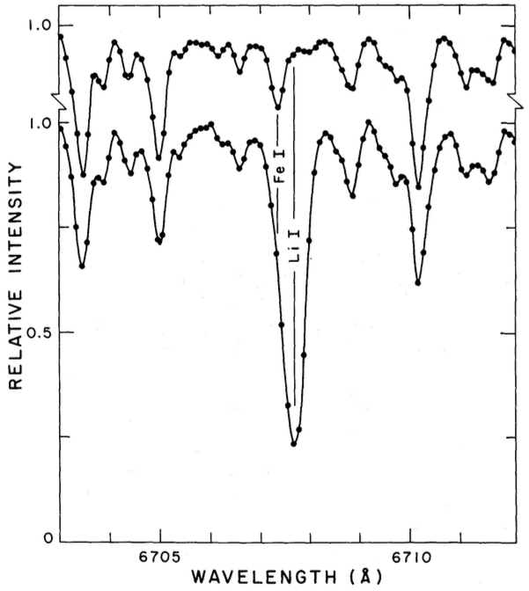
George Wallerstein discovered the 1st Li Red Giant
μ Leo
Wallerstein & Sneden 1982, ApJ, 255, 577
HD 112127
2 prominent explanations: (1) convective dredge-up of freshly made Li from the interior; (2) swallowing of an inner terrestrial planet
He hated the planet-swallowing idea ... so the last line of the paper:
“Such putative planetary systems, however, might be good candidates for the search for extraterrestrial intelligence ^{because the inhabitants of} their outer planets might be screaming for help as they watch their inner planets disappear into their central star.”

Slide 3
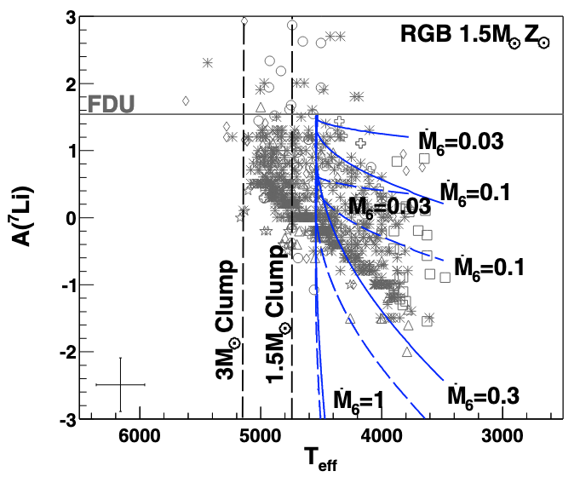
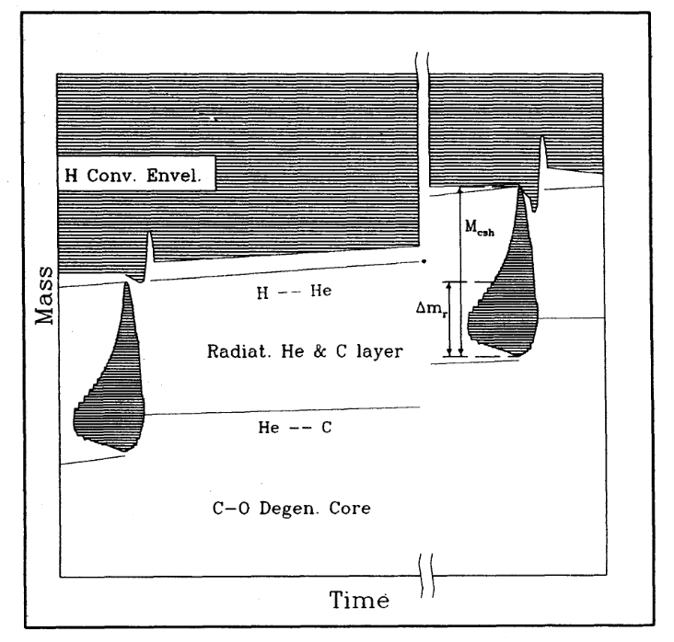
Why is this relevant here?
Maurizio has considered Li creation and destruction throughout his career
Palmerini+ 2011, ApJ, 741, 26
the constraints on extra-mixing “phenomena previously derived from heavier nuclei … coupled to recent updates in stellar structure models … are suitable to account for the observations of Li abundances below log ε(Li) ≃ 1.5”
Busso+ 1995, ApJ, 446, 792
mostly concerned about AGB nucleosynthesis & mixing
considered the Li abundance issue with Ba stars (recipients of ejected AGB material)
often with a view to understanding the sometimes very large Li abundances in C stars and similar AGB stars

Slide 4
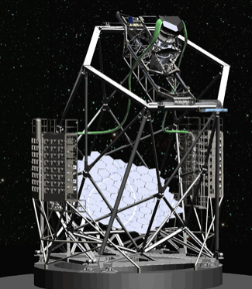
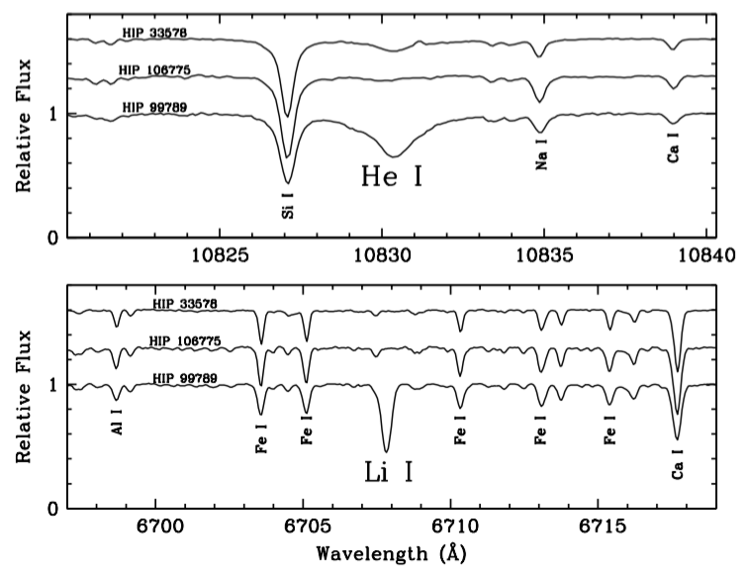
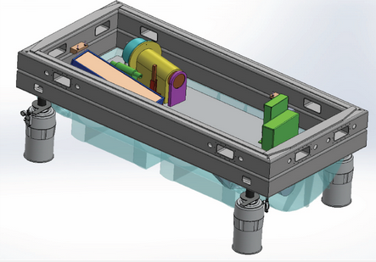
A 1μ high-res study of red giants turned up a surprise
Hobby-Eberly 10m Telescope at McDonald Observatory
Habitable Zone Planet Finder:
high-res spectra in 0.85-1.25𝝻 range
Melike Afşar: exploring spectra of clump/RHB stars at 1μ
one of her targets was a rare Li-rich red giant

Slide 5
This suggested a He I 𝜆10830 survey of Li-rich giants
Li rich stars: a heterogeneous sample from the literature
Li-poor stars: surveys of Adamów+2014, Afşar+2018
HET/HPF (Mahadevan+2012,2014)
R ≡ 𝜆/Δ𝜆 ≃ 55,000
S/N ≃ 80 to >200
reductions and analyses too boring for discussion here
a simple desired outcome: the relation (?) between Li abundances and He I line strengths
our collaboration:
Melike Afşar, Zeynep Bozkurt & me, Monika Adamów, Anohita Mallick, Bacham E. Reddy, Steven Janowiecki,
Suvrath Mahadevan, Brendan Bowler, Keith Hawkins, Andrea Dupree, Joe Ninan, Neel Nagarajan,
Gamze Böcek Topcu, Cynthia Froning, Chad Bender, Ryan Terrien, Larry Ramsey, Karin Lind, Greg Mace

Slide 6
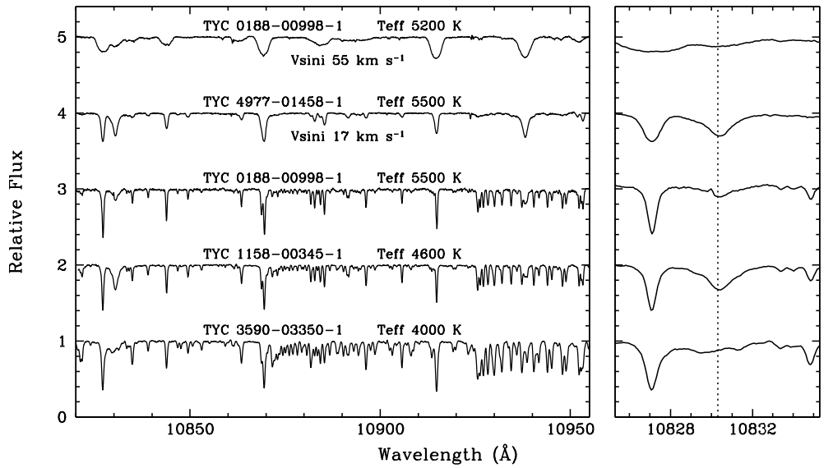
we included a variety of red giants
He I 10830
Li-rich and Li-poor
warm and cool
some are rotating
mostly disk pops
lots of other species:
Na, Si, Ca, Fe
CN
CN

Slide 7
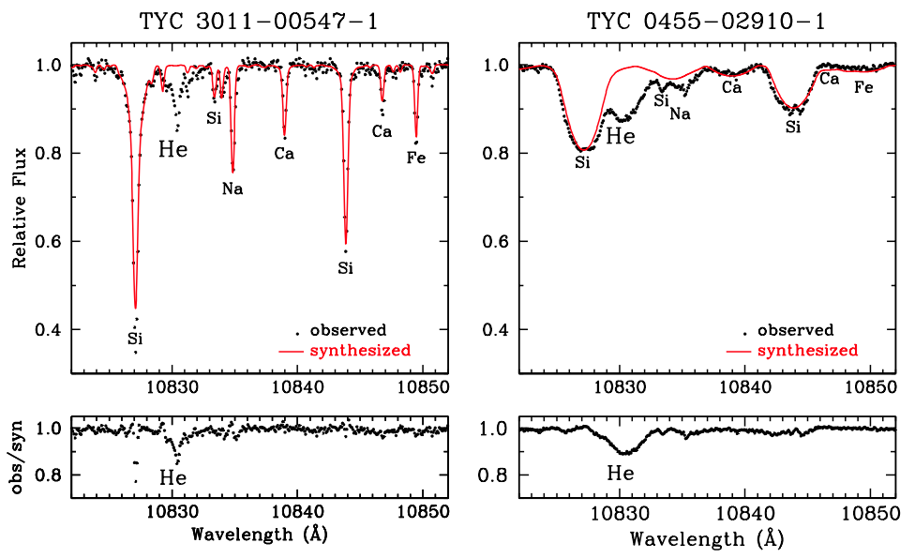
Just a little of the analytical details
raw spectra are a mess, with need to excise night sky OH emission and H₂O telluric absorption
resulting stellar spectrum sometimes has major photospheric contaminants crowding the chromospheric he I 𝜆10830 very broad line
this is a real problem for rapid rotators
we construct synthetic photospheric spectra to match and divide out that part of the total, leaving only 𝜆10830
This process is purely empirical!
We desire “good enough” equivalent widths of 𝜆10830

Slide 8
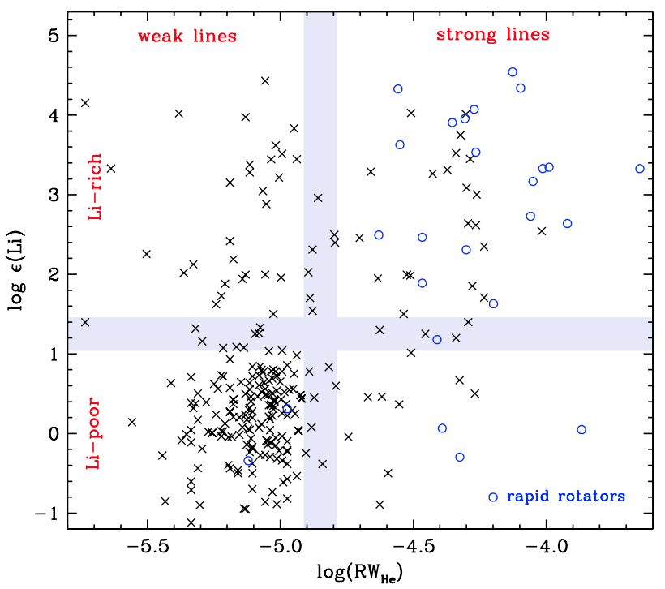
The main result: He I 𝜆10830 often accompanies large Li abundances in red giants
horizontal lavender bar splits Li-rich from Li-poor (normal) stars … near to the “traditional” dividing line
vertical bar separates weak from strong 𝜆10830 absorption lines … this is purely empirical
note the many rapid rotators in the
Li-rich, big 𝜆10830 quadrant
log(RW_{He}) ≡ log₁₀(EW/10830)

Slide 9
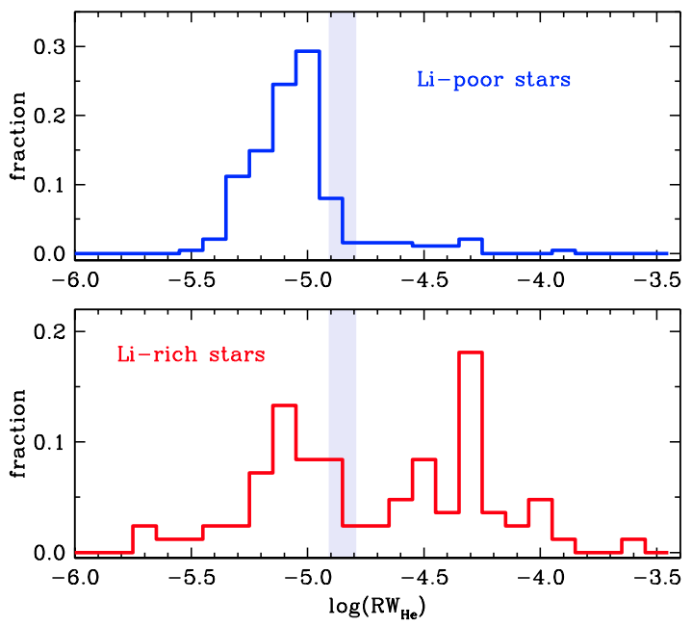
expressing in histograms
90% of Li-poor red giants have
log(RW_{He}) < -4.85
generally in line with pioneering investigation of O’Brien & Lambert 1986
possibly special explanation(s) can account for the other 10%
53% of Li-rich red giants have
log(RW_{He}) > -4.85
this plot does not distinguish rapid rotators, which populate the high end
the approximate 𝜆10830 strength break is easy to see with these histograms

Slide 10
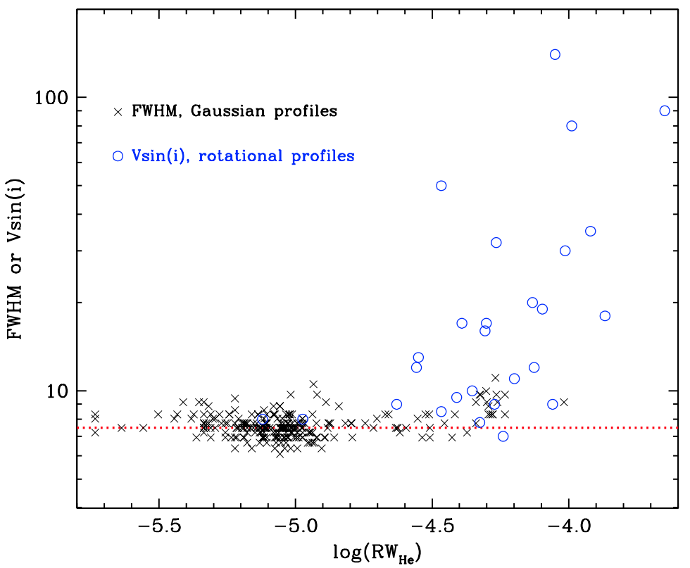
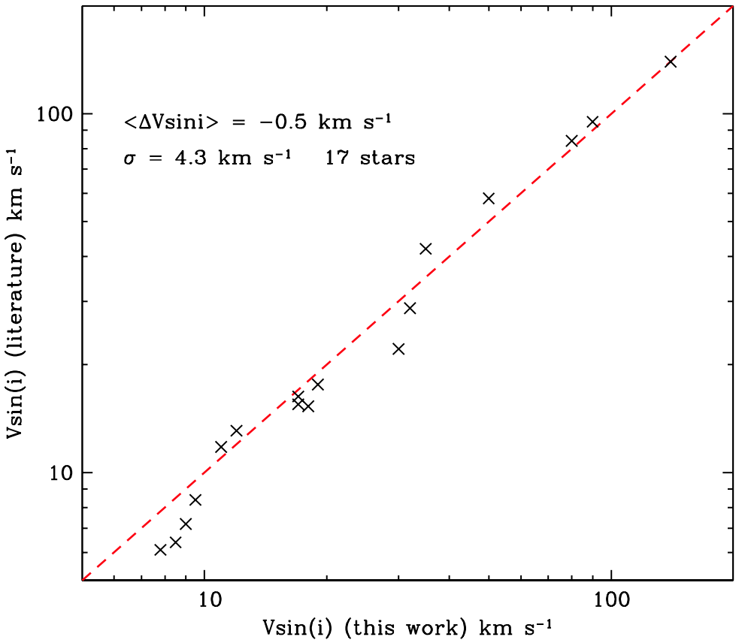
rapid rotator vsin(i) values derived with synthetic spectra
they match well the scattered rotational velocities found in the literature
the literature values are not well controlled!
line profile half-widths for ”non-spinning” red giants

Slide 11
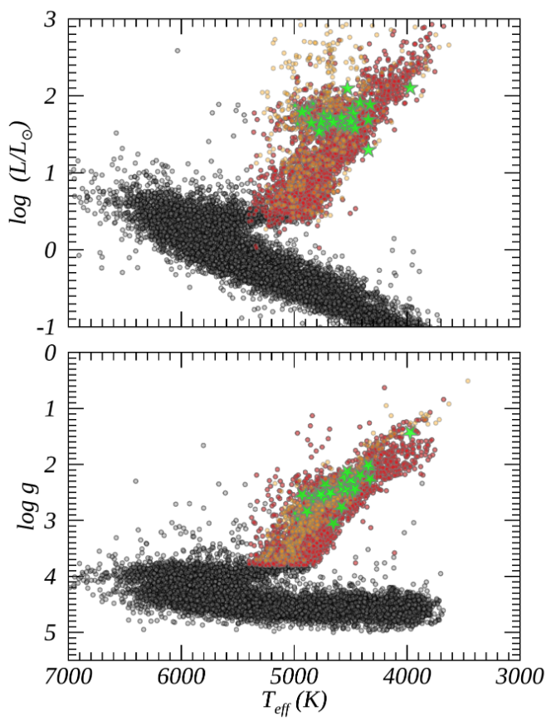
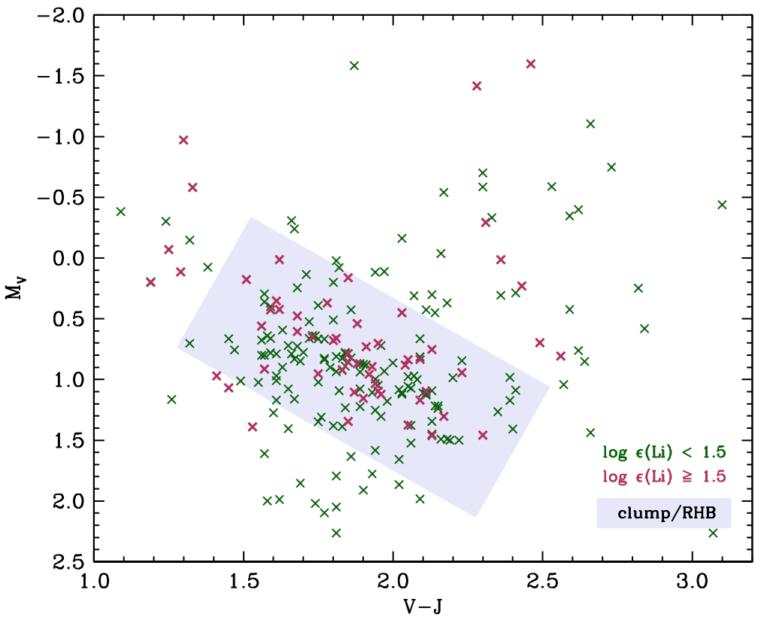
Li-rich stars are mostly clump (red horizontal branch)
in the literature
and in our own sample
Li-rich
Li-rich
Magrini+2021
80% of Li-rich stars are in the clump/RHB box

Slide 12
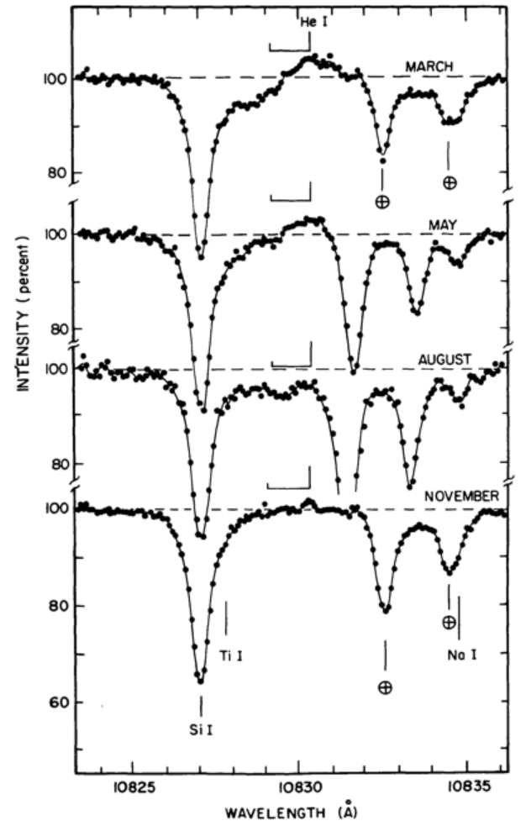
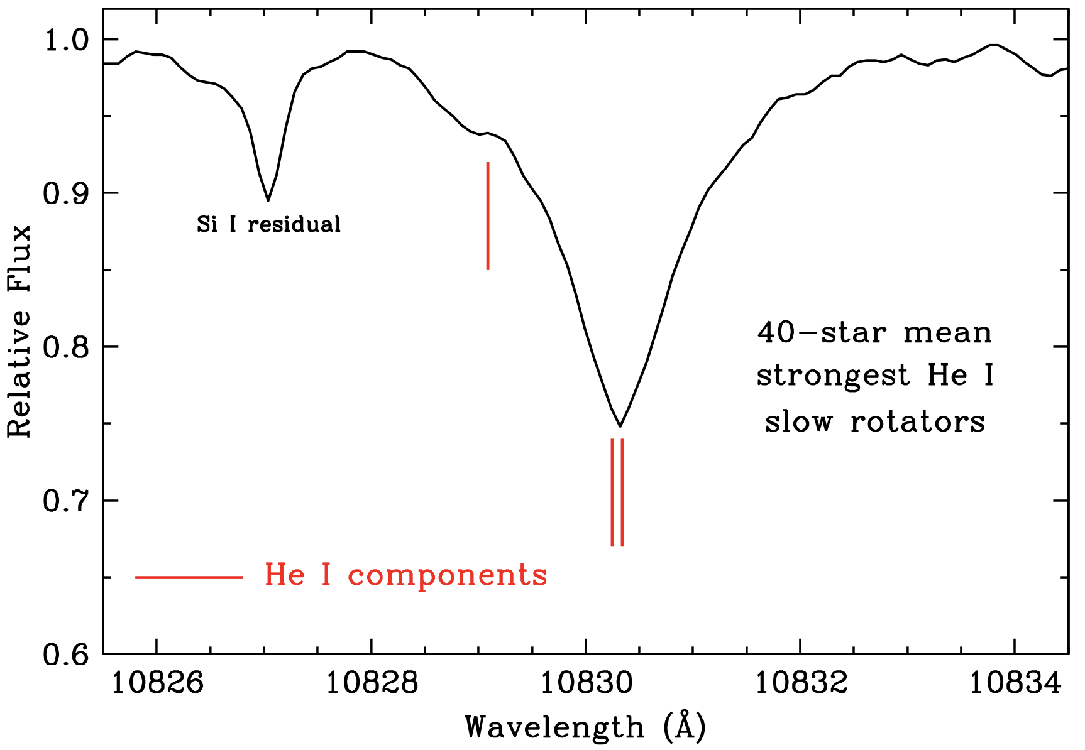
some red giants show blue-shifted 10830 profiles … mass loss signature
Arcturus has significant and variable blue-shifted 10380
But Li-rich giants show no 10830 profile anomalies; no evidence for significant mass loss
O
O’Brien & Lambert 1986

Slide 13
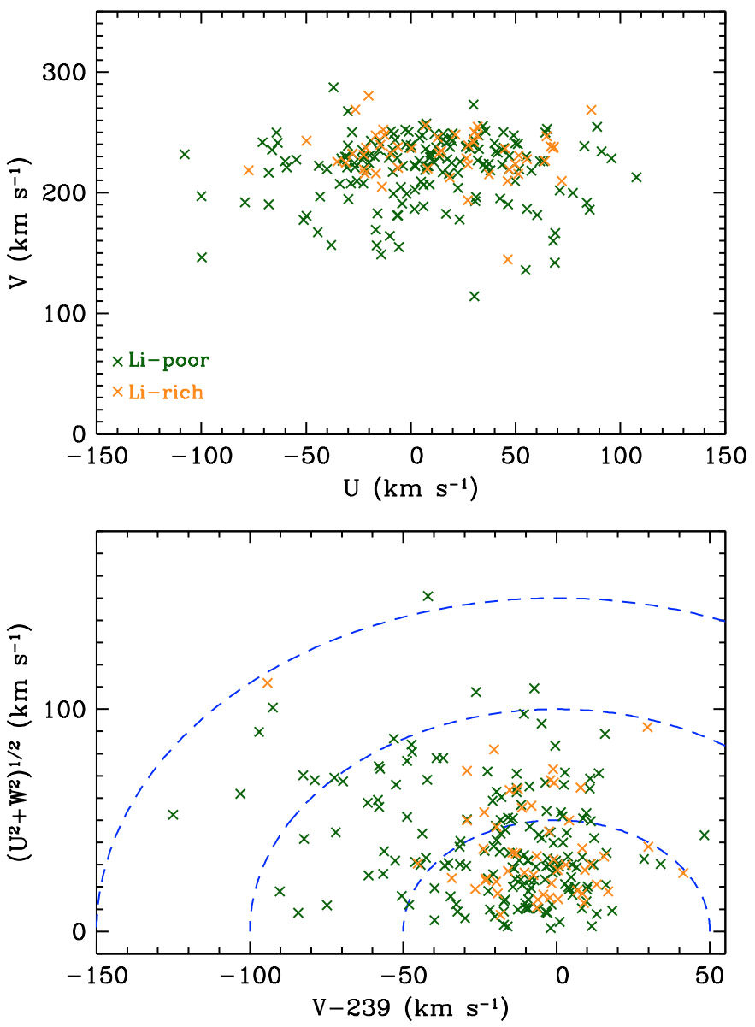
what ISN’T the probable main cause: Galactic population
Li-rich stars have essentially circular velocities in accord with the Sun’s motion
departures from this are if anything less than those of Li-poor stars
same story with a Toomre diagram
nearly all Li-rich stars have V_{total} < 70 km/s, so most are kinematically thin disk
there are more Li-poor thick disk stars (higher V_{total}) than Li-rich stars

Slide 14
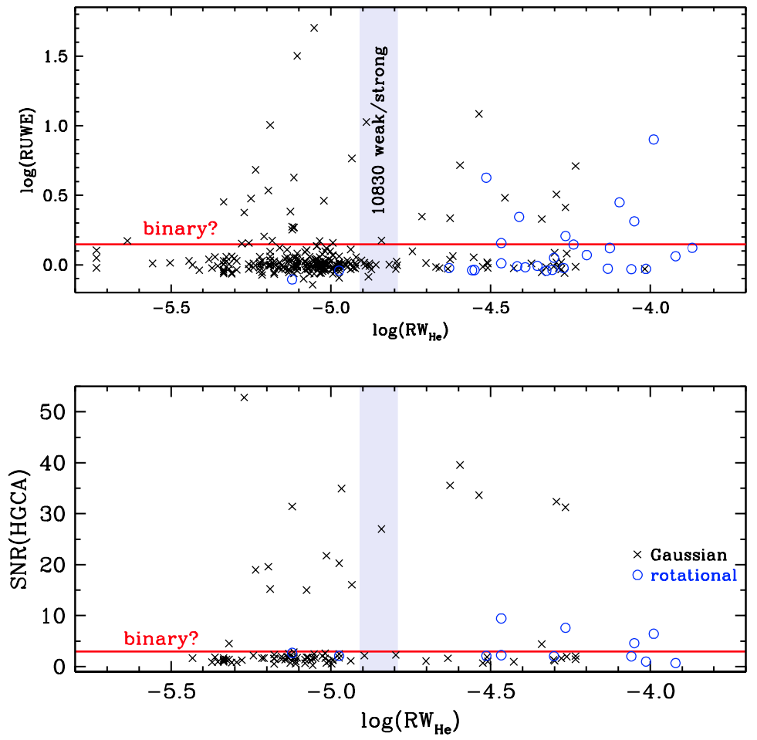
what might be involved: binarity
RUWE = Renormalised Unit Weight Error from Gaia; assessment of how well a single star fits their astrometric data
RUWE > 1.4 suggests binary motion?
https://gea.esac.esa.int/archive/documentation/GDR2/Gaia_archive/chap_datamodel/sec_dm_main_tables/ssec_dm_ruwe.html
HGCA = Hipparcos-Gaia Catalog of Accelerations; did something change a star’s proper motion between Hipparcos & Gaia?
HGCA > 3 suggests binary motion?
Brandt+ 2021;
https://ui.adsabs.harvard.edu/abs/2021ApJS..254...42B/abstract
He-strong stars have a higher binary fraction than He-weak stars

Slide 15
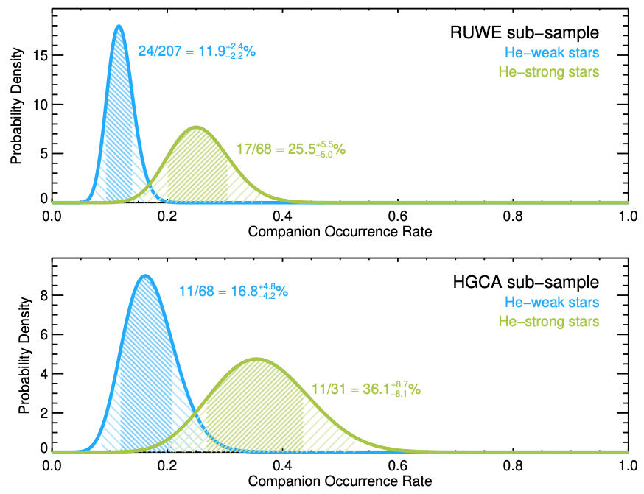
expressing as binarity probability distributions
maybe double/triple the binary rate for Li-rich stars?

Slide 16
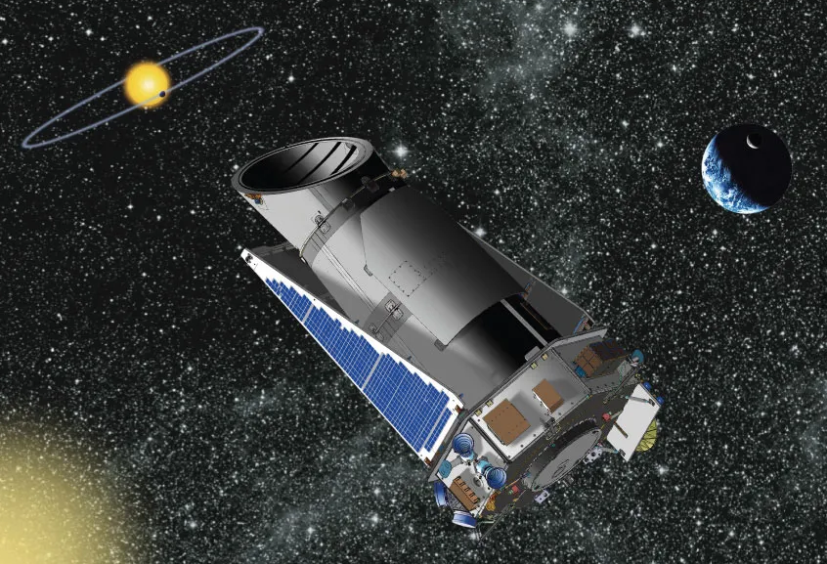
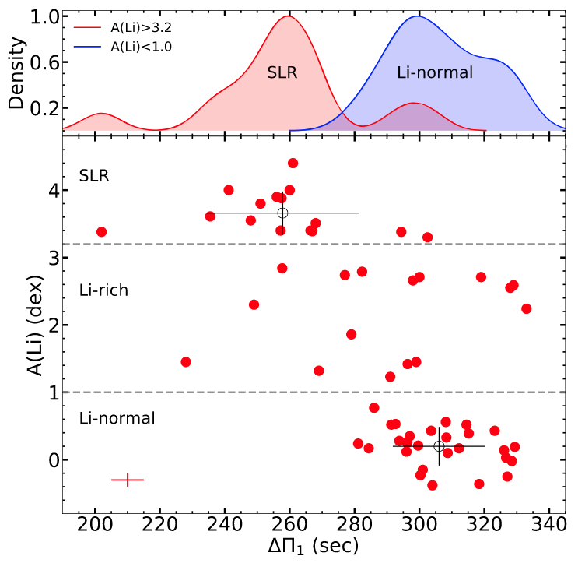
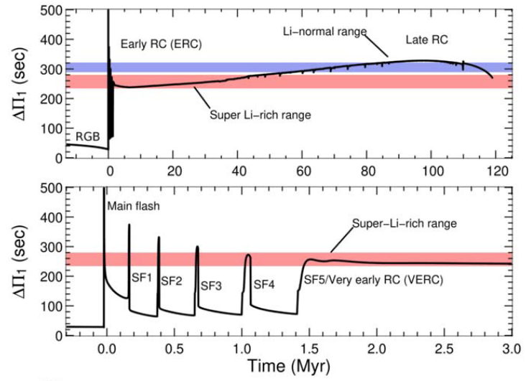
more promising: association with clump/RHB “youth”?
Singh+ 2021
asteroseismology of Kepler field yields period spacings Δ𝚷
which relate to evolutionary states and approximate timelines
Singh+2021 show that Li-rich stars are mostly ”young” clump stars
We are observing Kepler red giants with HPF this summer

Slide 17
summary
an accidental discovery of He I 10830Å in a Li-rich red giant
a semi-blind survey of He absorption in a variety of giants
almost all Li-poor stars have very weak 10830
more than half of Li-rich stars have strong 10830
most Li-rich giants are clump and horizontal branch
more suspected binaries among Li-rich stars
stay tuned: a Kepler region survey is underway
Thanks for the opportunity to share this work with you!

Slide 18
fred

Slide 19
fred

Slide 20
fred

Slide 21
fred

Slide 22
fred

Slide 23
fred

Slide 24
fred

