Slide 1
Technetium in and Mass Loss from Mira Stars
Stefan Uttenthaler, Vienna
XIII. Torino Workshop on AGB Stars and III. Perugia Workshop on Nuclear Astrophysics
Notes:
I am going to present the results from my 2019 paper and follow-up work still in preparation on the topic of mass loss from Mira variables in connection with their Tc content.

Slide 2
Based on:
Uttenthaler (2013, A&A)
Uttenthaler, Iain McDonald, Klaus Bernhard, Sergio Cristallo, David Gobrecht (2019, A&A)
Uttenthaler, in preparation
XIII. Torino Workshop on AGB Stars and III. Perugia Workshop on Nuclear Astrophysics
Notes:
The work I am presenting is based on the following papers. My co-authors are Iain McDonald (from the UK), Klaus Bernhard (an amateur astronomer from Austria); Sergio Cristallo, and David Gobrecht, the two latter of which are in the audience.

Slide 3
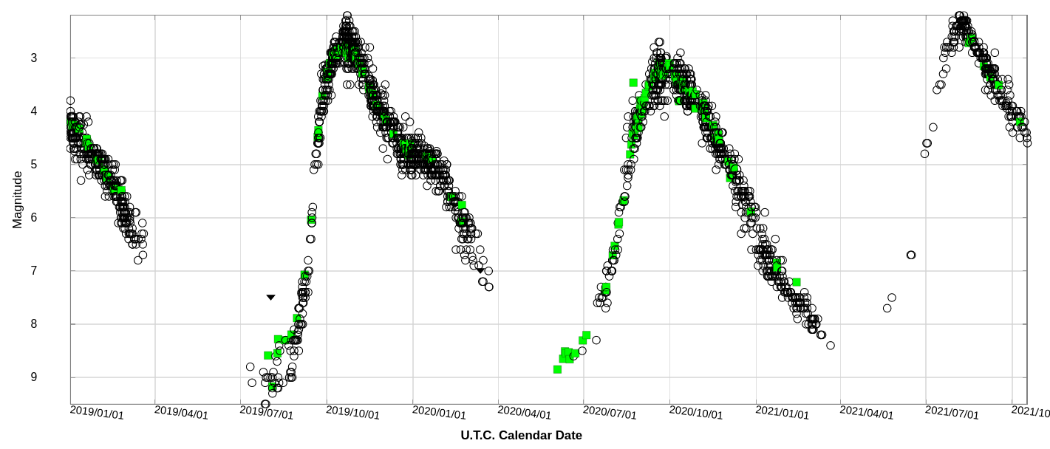
Miras are:
Long-period (P ≈ 100-1000d), large-amplitude (ΔV>2.5m) variables
Fundamental-mode pulsators
Mostly AGB stars
Mira (o Cet)
Notes:
Briefly explain what Miras are: Miras are large-amplitude variables with visual amplitudes greater than 2.5 mags, and long periods roughly between 100 and 1000 days, and even longer in some cases. The figure shows an AAVSO light curve of the prototype of the class of Mira stars, namely Mira (o Cet) itself. Also, Miras are TP-AGB stars that undergo nucleosynthesis and deep mixing processes in their interior.

Slide 4
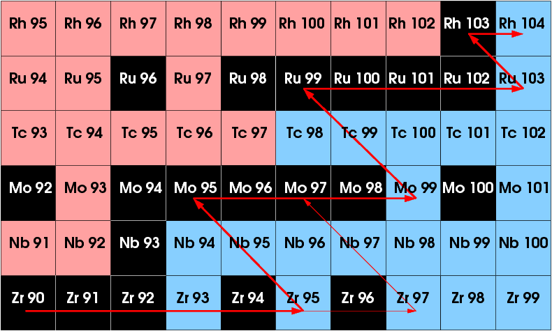
The s-process path in the vicinity of ⁹⁹Tc (τ_{1/2}=2×10⁵ yrs)
XIII. Torino Workshop on AGB Stars and III. Perugia Workshop on Nuclear Astrophysics
Notes:
The s-process path in the vicinity of 99Tc. Also some 100Tc is produced, but it is very short-lived. The other Tc isotopes cannot be reached by the s-process path, so 99Tc is the only Tc isotope that can be observed on the surface of AGB stars. It has a half-live time of about 200.000 years, so it lives long enough between 3DUP episodes to not decay, but short enough that none remains from the birth of the star. Thus, we can be sure that it has been created in situ by the star! It is an indicator of nucleosynthesis and 3DUP going on in that star.

Slide 5
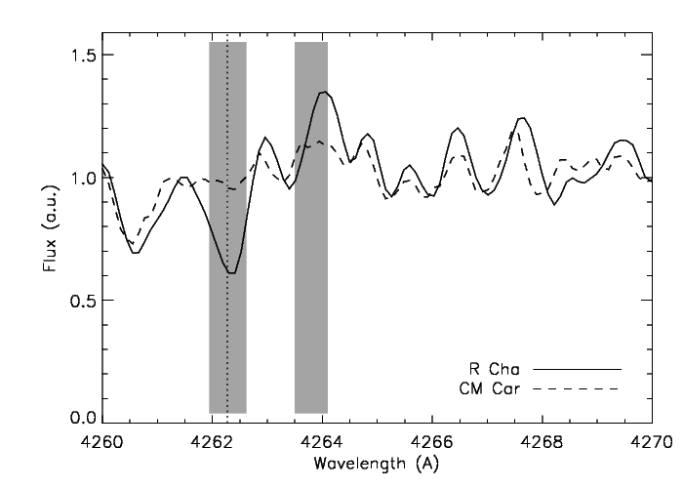
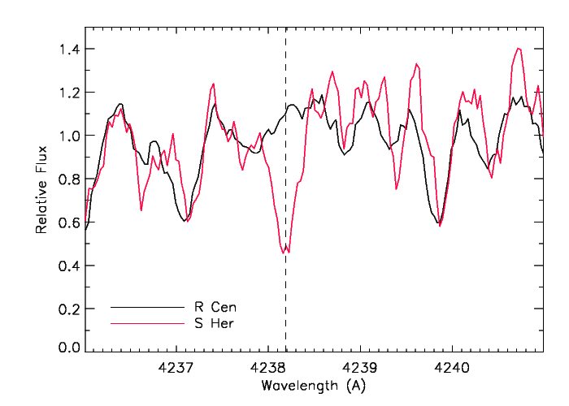
The radioactive element Tc,
produced in the s-process,
can be detected in spectra of Miras.
Uttenthaler et al., 2019
García-Hernández et al., 2013
Notes:
The radioactive element Tc, which is produced in the s-process in TP-AGB stars, can be detected in some Mira stars in their optical spectra. Two illustrations are shown here that compare Tc-poor and Tc-rich Miras around the laboratory wavelengths of Tc lines. The example spectra on the right have been observed with the X-SHOOTER on the VLT.

Slide 6
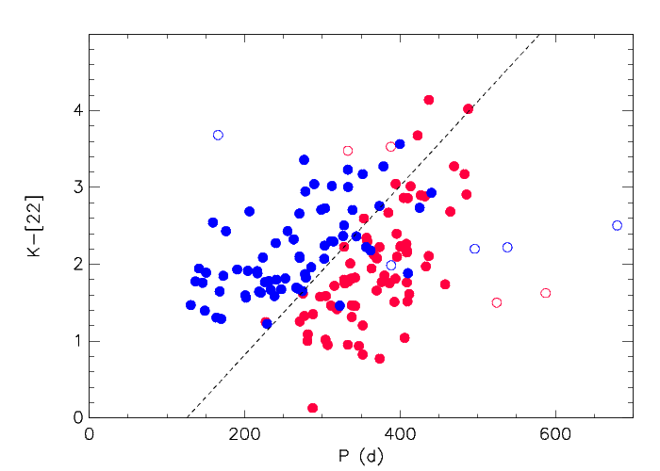
Let‘s inspect the K-[22] colour (~dust mass-loss rate)
as a function of period
Tc-poor
Tc-rich
Uttenthaler et al., 2019
Notes:
If we plot the mass-loss rate indicator K-[22] as a function of period, we expect a direct relation because the mass loss is crucially set by the pulsation period (and amplitude). Indeed we see a positive correlation. However, a curious pattern emerges if we distinguish between Tc-poor and Tc-rich stars.
What happens if we inspect the dust mass-loss indicator K-[22] as a function of pulsation period and distinguish the stars by their Tc content? Here, [22] is the 22-micron band of the WISE infra-red space observatory, also called WISE4. Quite surprisingly, the two groups of Miras separate very well, with the Tc-poor Miras having higher (!) K-[22] colours than Tc-rich ones. This is unexpected and a completely accidental finding. Intuitively, one might expect the opposite, since Tc-rich Miras are more evolved than Tc-poor ones, and mass loss also increases along the evolution on the AGB. Pulsation is driving the mass loss from Miras, the pulsation period is an important property, as we can see from the generally increasing trend of K-[22] with period. There are a few outliers (binaries, HBB candidates).

Slide 7
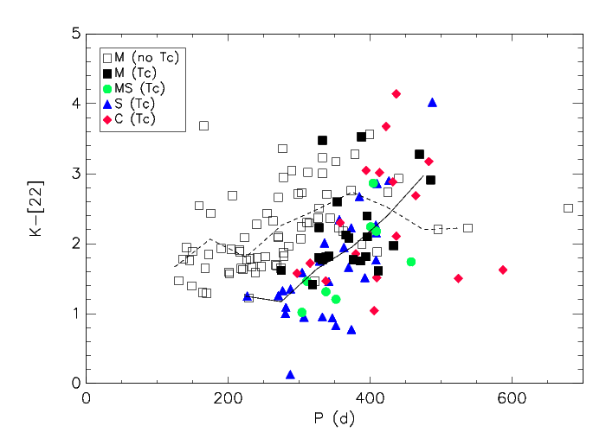
Also Tc-rich M-type Miras have lower K-[22]
compared to Tc-poor – it is not a C/O effect!
Uttenthaler et al., 2019
Notes:
This is the same diagram as before, but now the different spectral types (see legend) are identified. The spectral types reflect an evolutionary sequence. Important: M-type, Tc-rich Miras that have no detectable C/O enhancement in their spectra, still their K-[22] colours are considerably lower than that of M-type, Tc-poor Miras at similar pulsation periods, save for a few binaries (o Cet, R Aqr).

Slide 8
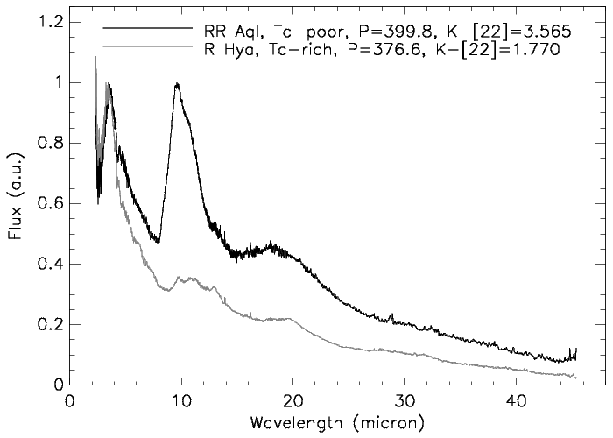
ISO dust spectra:
Tc-poor Miras IR-brighter in a wide spectral range
Uttenthaler et al., 2019
Notes:
ISO mid-IR dust spectra of selected stars show that the difference is not restricted to the WISE [22] band, but that Tc-rich Miras have a lower IR emission in a wide spectral range.

Slide 9
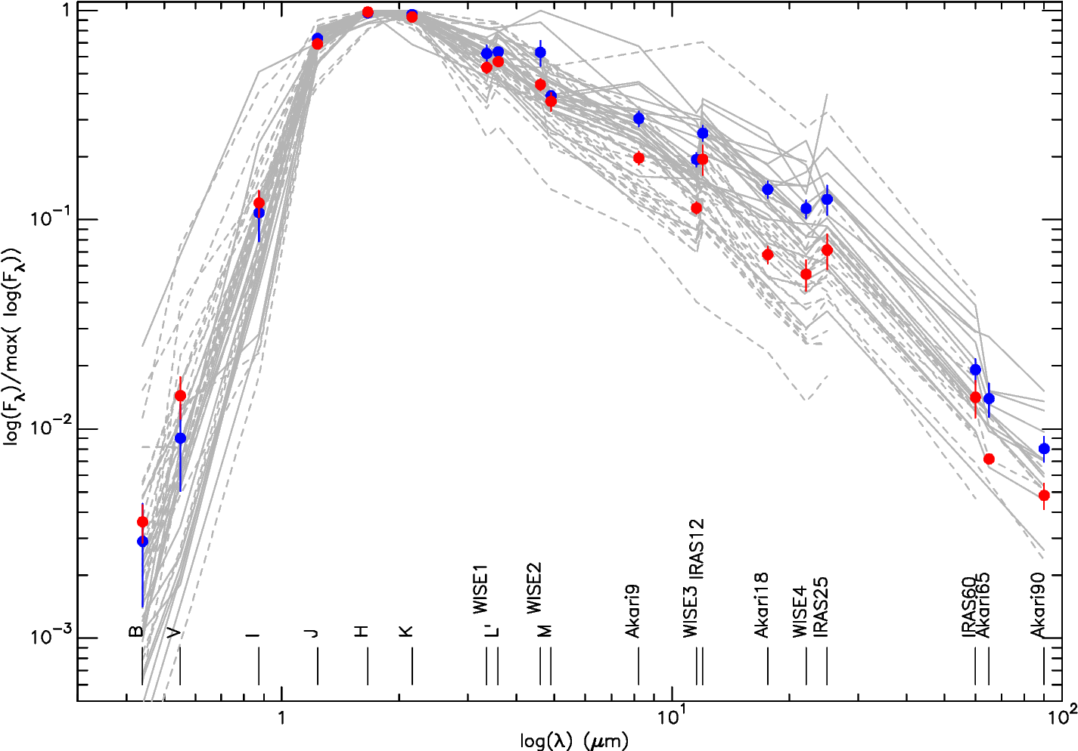
Average SEDs of Tc-poor & Tc-rich Miras in 280<P<350d
Uttenthaler et al.,
in preparation
Notes:
Average SEDs of 21 Tc-poor and 26 Tc-rich Miras in the period range 280 – 350 d. The inspection of normalised and averaged spectral energy distributions of Tc-poor and Tc-rich Miras shows that there is not much difference between the two groups in the optical and near-IR range. However, in the mid-IR, where most of the emission comes from dust, the Tc-poor Miras are brighter than the Tc-rich ones by about a factor of two! Thus, the difference is not related to the 22-micron band or a specific dust feature in that band, but reflects a flux difference in a very broad spectral range.

Slide 10
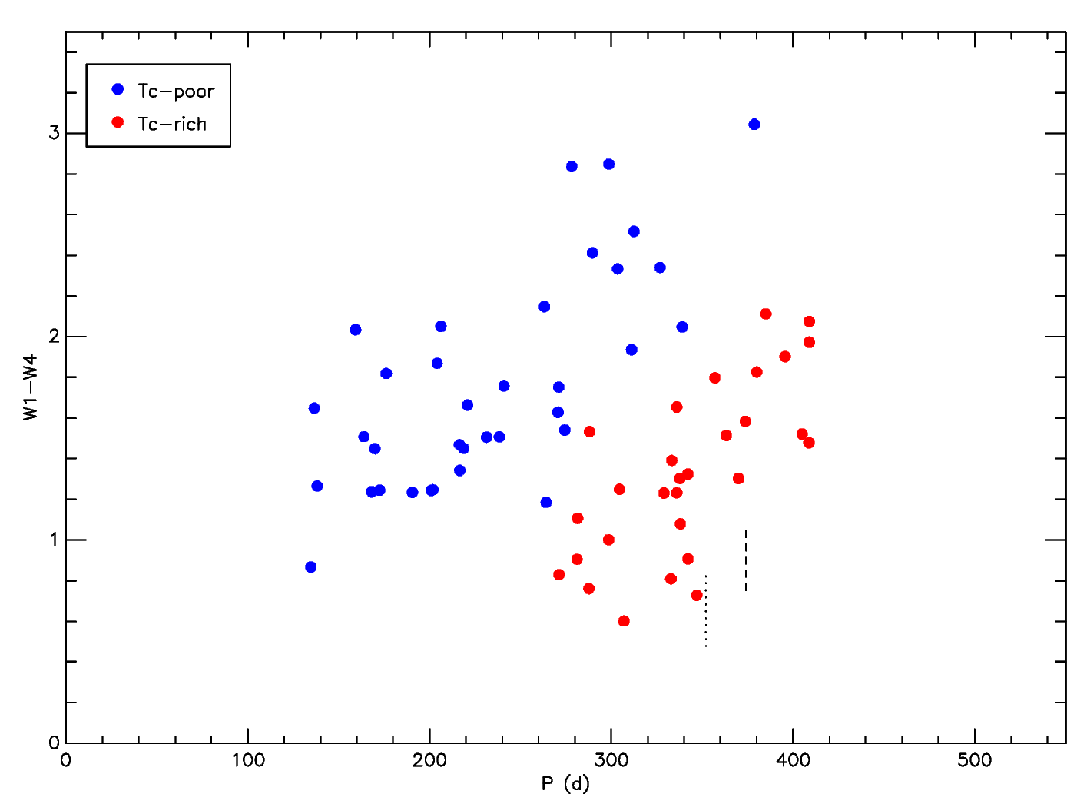
If you are not yet convinced: Look at W1-W4 vs. period!
Uttenthaler et al.,
in preparation
Notes:
If you are still not convinced that Tc-poor and Tc-rich Miras differ in their IR emission, take a look at this plot that involves the W1 band at ~3.4 micron instead of the K-band: The two groups separate extremely well! Note that the sources of the data are very different: periods come from optical light curves (e.g. AAVSO), the colour from the WISE space observatory, and the Tc information from various individual literature sources. The sample shown here is smaller than the one in the K-[22] diagram because many Miras are saturated in W1 (~3.4 micron) and cannot be plotted.

Slide 11
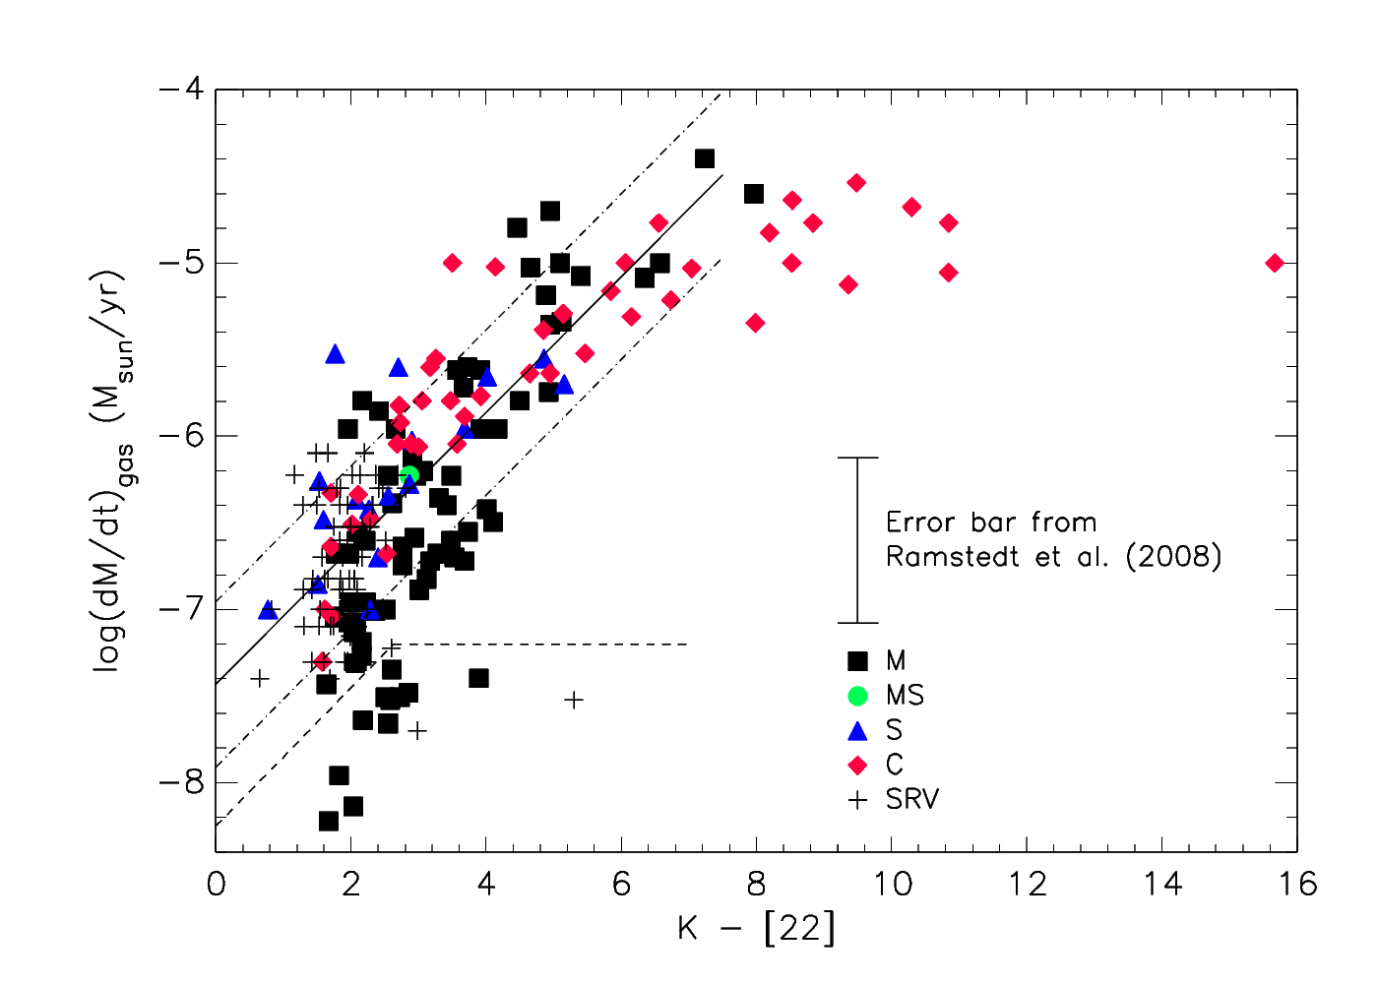
What about the gas mass-loss rate?
Uttenthaler et al., 2019
Notes:
K-[22] (or W1-W4) is an indicator of the dust mass-loss rate. However, most of the mass is lost in the form of gas. So what about the gas mass-loss rate? Do Miras show a similar split in the gas MLR? The gas MLR is measured from radio lines of the CO molecule. Despite some scatter, there is a good correlation between K-[22] and the gas mass-loss rate. There is some saturation at the high end, and a few lowMLR outliers. Thus, one might expect to see a similar split of sequences in gas MLR vs. P if the gas mass-loss rate was affected by the dredge-up (Tc).

Slide 12
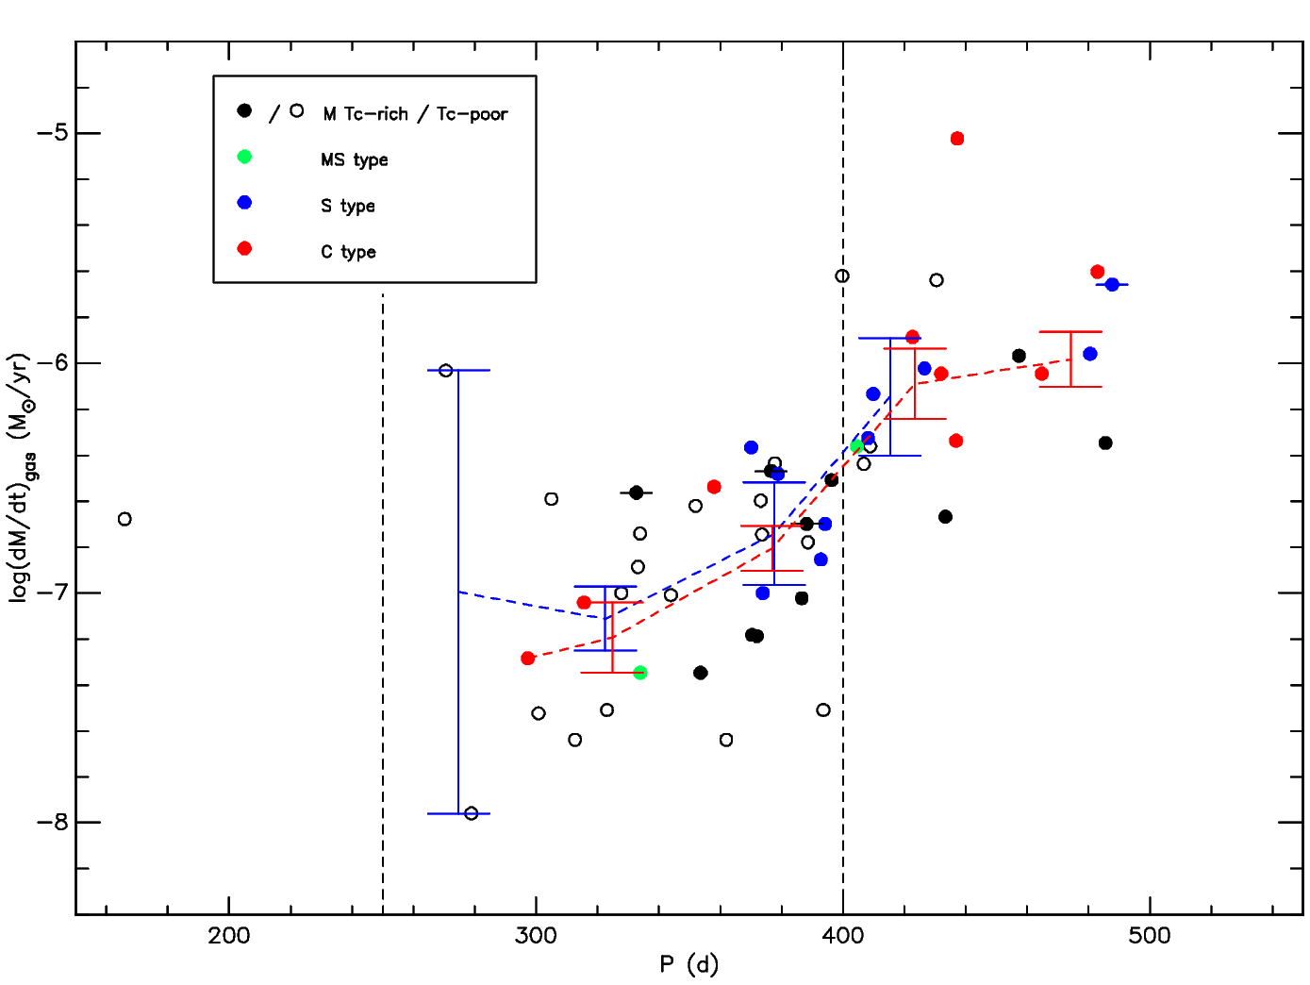
No difference in the gas mass-loss rate!?
Uttenthaler et al.,
in preparation
Notes:
Unfortunately, there are not many Miras for which both is known, Tc content and gas MLR. We just increased the sample size with dedicated spectral observations. The number of Miras in the relevant period range is still small. In any case, there is no split between the two groups, the error bars in the period bins strongly overlap.
Point out the Miras (symbols with dashes)!

Slide 13
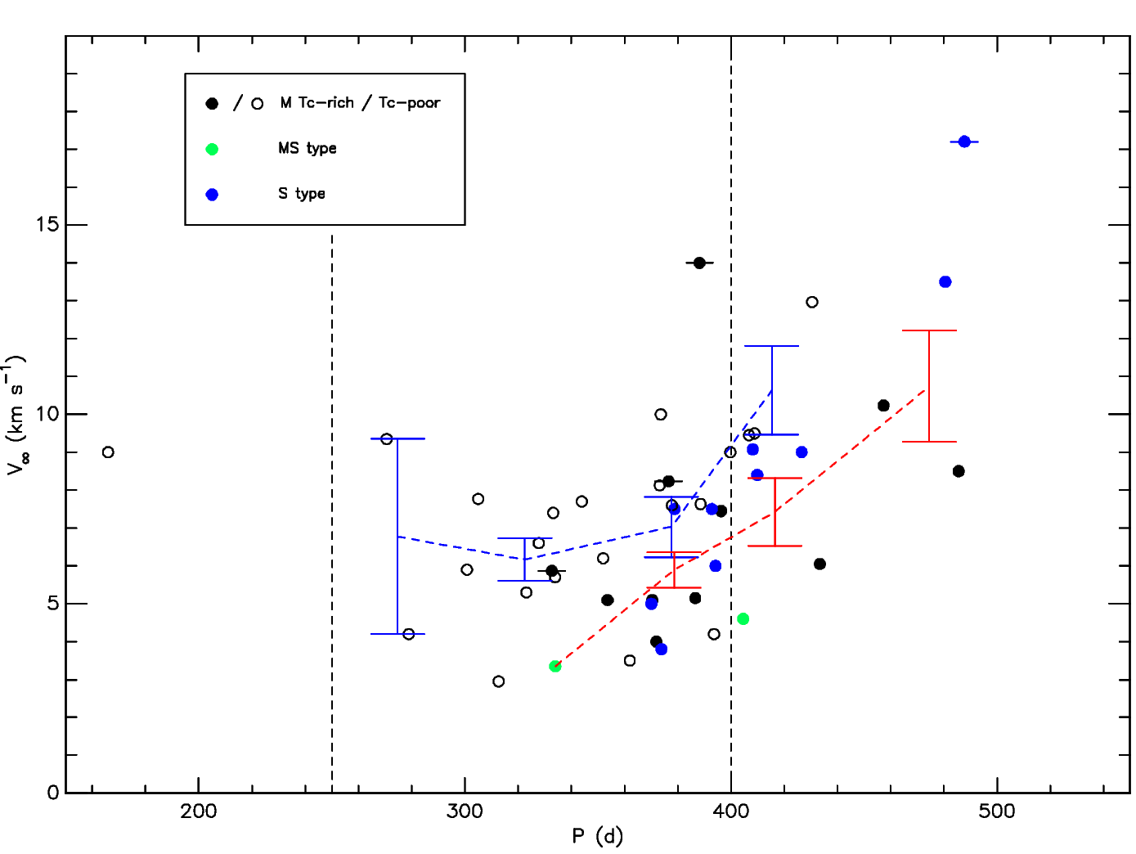
Slightly higher CO expansion velocity of Tc-poor stars?!
Uttenthaler et al.,
in preparation
Notes:
Besides the gas mass-loss rate, also the expansion velocity of the circumstellar envelope is an important property of the mass loss. If we look at this, it seems that the Tc-poor Miras have slightly higher expansion velocity than the Tc-rich ones. C stars are left out here because of potentially different drift velocity.
Point out the Miras (symbols with dashes)!

Slide 14
Höfner et al., 2022:
Gradual Fe enrichment of wind-driving silicate grains
Tc-poor stars = Fe-enriched grains & Tc-rich stars = Fe-poor grains
Optical & near-IR photometry moderately affected ✓
Mid-IR flux higher by Fe-enrichment ✓
Gas mass-loss rate unaffected ✓
Wind velocity slightly higher by Fe-enrichment ✓
XIII. Torino Workshop on AGB Stars and III. Perugia Workshop on Nuclear Astrophysics
Notes:
Up to now, I presented to observational evidence. Now it becomes a bit speculative. How can we understand all of this?
Höfner et al. (2022, https://ui.adsabs.harvard.edu/abs/2022A%26A...657A.109H/abstract) explore the effect of Fe-enrichment (a few % of Fe) of wind-driving silicate grains on the wind and spectral properties. The light absorption by Fe leads to a balance of grain formation and evaporation due to stellar heating. The hotter grains show a stronger silicate dust emission than Fe-free grains.
If we now assign the Tc-poor stars to have grains with Fe-enrichment and Tc-rich stars to have Fe-poor grains, this nicely fits the picture of mass loss explored by Höfner et al. (2022)!

Slide 15
Comparison with Fe-free DARWIN models (Höfner et al.)
Uttenthaler et al.,
in preparation
Notes:
Let‘s have a look again at the W1-W4 vs. P diagram: DARWIN models without Fe in the grains have quite blue colour, only fitting the bluest Tc-rich stars. We expect that Fe-enrichment would give a better fit here to the Tc-poor Miras. Unfortunately, the WISE colours haven‘t yet been calculated for these models.

Slide 16
What is at the bottom of all of this?
Is ²⁶Al the culprit???
HBB candidates (Li-rich) indicate so.
XIII. Torino Workshop on AGB Stars and III. Perugia Workshop on Nuclear Astrophysics
Notes:
Note that Tc is only an indicator of 3DUP and nucleosynthesis. In a 2 Msun FRUITY model (Cristallo et al., 2009), 26Al is the source of ~92% of all the decay energy that radioactive isotopes deposit in the circumstellar envelope. Does this somehow affect dust formation? Note that Al is a constituent of alumina, which is a candidate for triggering the onset of dust formation in O-rich stars. About 10^7 ions per second per gram of gas are created by the decay of 26Al. Maybe these ions affect the formation of dust, or the incorporation of Fe into silicate grains? Note that Li-rich HBB candidates that should contain a lot of 26Al are also relatively blue, but a larger sample is needed.
A. Glassgold (1995, https://ui.adsabs.harvard.edu/abs/1995ApJ...438L.111G/abstract) investigated the effect of 26Al decay on circumstellar envelopes, in particular in the carbon star IRC +10 216 and on the abundance of the HCO+ molecular ion. “The gamma-rays emitted by the product nucleus Mg-26 escape most envelopes, but the beta-decay positrons are stopped and can ionize and heat the gas.” He obtained an upper limit on 26Al/27Al that is consistent with that in pre-solar grains of the same 12C/13C ratio.
Do theoreticians take into account the role of radioactive decays or ions in the formation of dust? Could they have a close look at this?

Slide 17
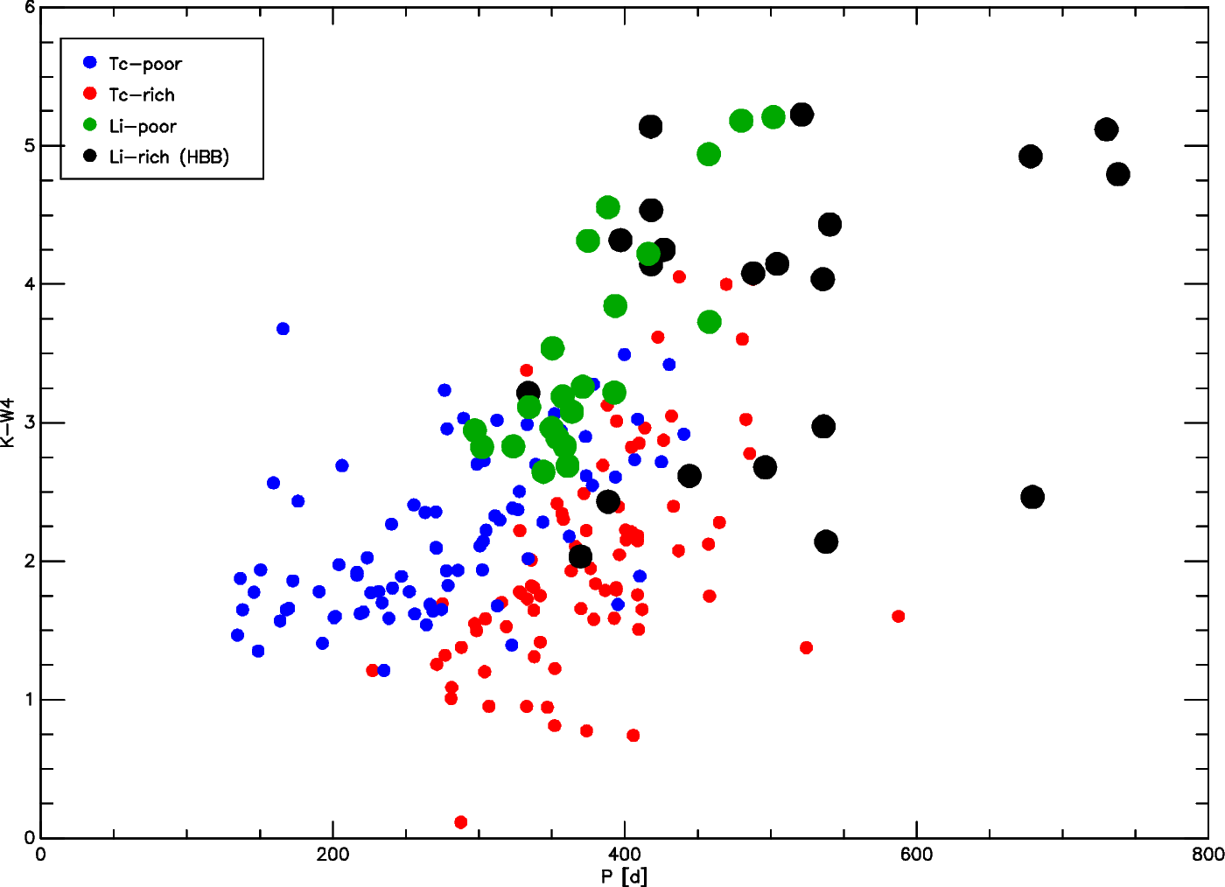
Including Li-rich HBB candidates in the K-W4 vs. P diagram:
Data from García-Hernández et al.
2007 & 2013
Preliminary
analysis!
Notes:
What happens if we inspect the dust mass-loss indicator K-[22] as a function of pulsation period and distinguish the stars by their Tc content? Here, [22] is the 22-micron band of the WISE infra-red space observatory, also called W4. Quite surprisingly, the two groups of Miras separate very well, with the Tc-poor Miras having higher (!) K-[22] colour than Tc-rich ones. This is unexpected and a completely accidental finding. Intuitively, one might expect the opposite to be true, since Tc-rich Miras are more evolved than Tc-poor ones, and mass loss also increases along the evolution on the AGB. There are a few outliers (binaries, HBB candidates). Pulsation period is important for mass loss, as we can see from the generally increasing trend of K-[22] with period.
Note that Li can also be formed by other sources (extra-mixing, see Plaut 3-45, Uttenthaler et al., 2007).

Slide 18
Thanks for your attention!
XIII. Torino Workshop on AGB Stars and III. Perugia Workshop on Nuclear Astrophysics

Slide 19
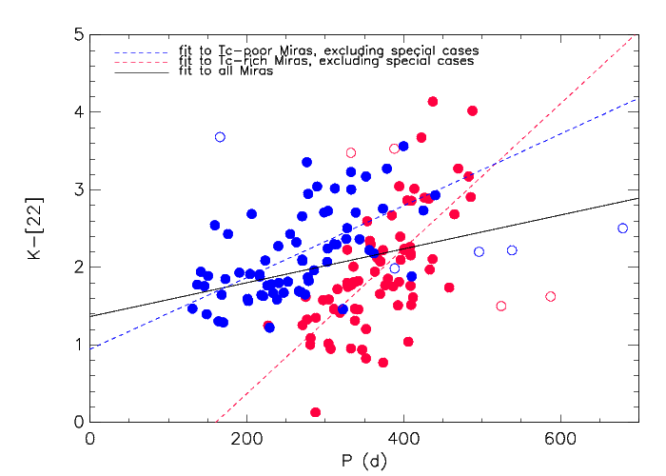
XIII. Torino Workshop on AGB Stars and III. Perugia Workshop on Nuclear Astrophysics
Notes:
Back-up slide

Slide 20
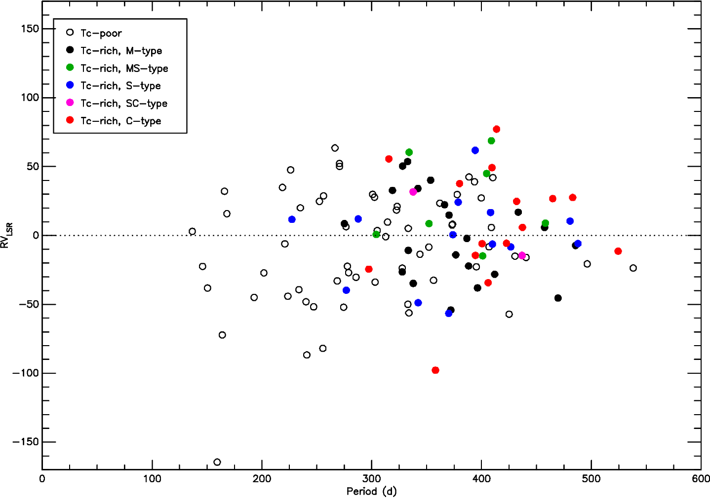
XIII. Torino Workshop on AGB Stars and III. Perugia Workshop on Nuclear Astrophysics

Slide 21
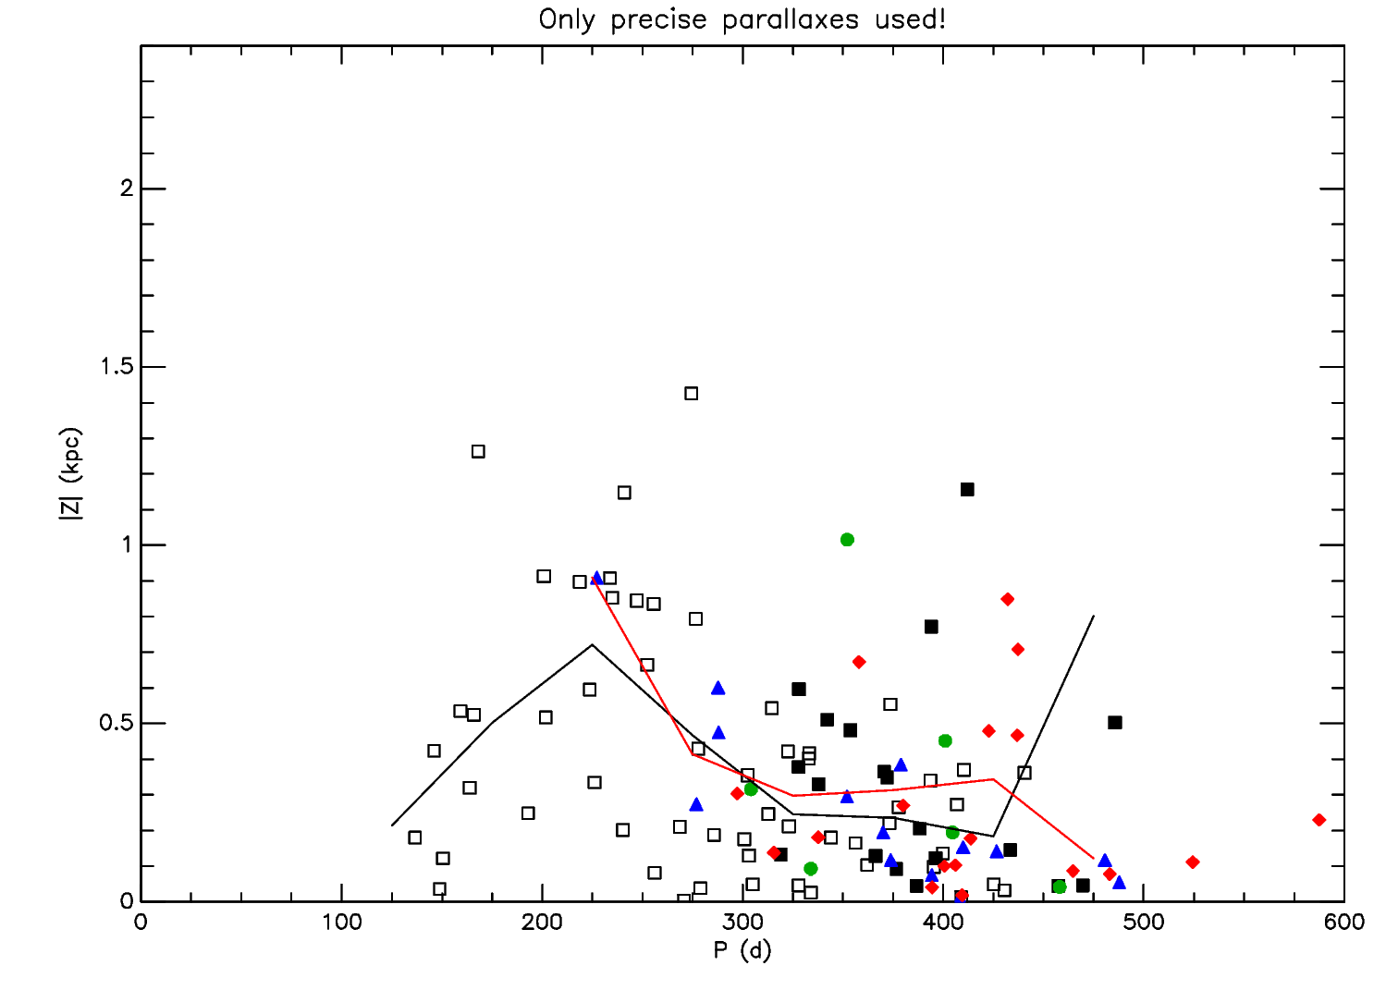
XIII. Torino Workshop on AGB Stars and III. Perugia Workshop on Nuclear Astrophysics

