Slide 1
Important of Asymptotic Giant Branch Stars (AGB)
In Astrophysics
Mounib El Eid
American University of Beirut, Department of Physics
Beirut, Lebanon
Adjunct Professor, Department of Physics & Astronomy,
Clemson University, SC, USA
(meid@aub.edu.lb)
Perugia, June 19, 2022

Slide 2
Outline
What are AGB stars (for nonexperts)-
Why are they important
2. Nucleosynthesis in AGB phases
3. Conclusions
Happy to honor Prof. Maurizio Busso with the present contribution

Slide 3
1. What are AGB stars
AGB stars represent the final evolutionary stages of low and intermediate-mass stars in the mass range (1-- 8) M_{Ꙩ}. They are progenitors of the C-O white dwarfs.
Super AGB stars are linked to the mass range (9--12) M_{Ꙩ.}.
They are the progenitors of the O-Ne-Mg white dwarfs.
This is a result of the nuclear processing during helium burning in the low mass range, and carbon burning in the higher mass range.
The thermal pulsations in AGB phases create rich environment of nuclear processing.
This leads to the formation of about half of the heavy elements down to
mass number A=90 via the s-process nucleosynthesis
AGB stars are major contributors to the integral luminosity of stellar systems,
and they are helpful for extragalactic populations.
Remarkable:
strong link between modeling the evolution toward the AGB’ phase and observation. This has been emphasized during this meeting
Excellent reviews on AGB’s are presented by [1, 2, 3].

Slide 4
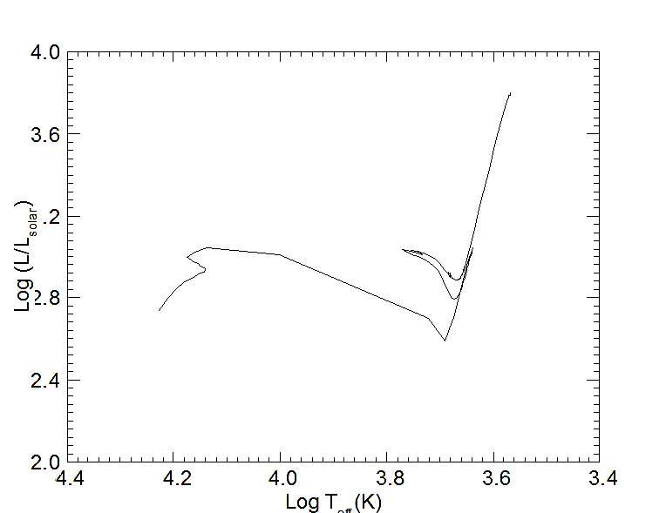
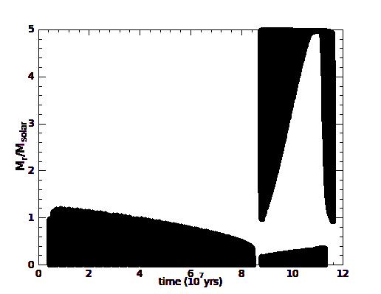
1a. Evolution to the AGB phase
Black areas: convective
Early AGB
5 M
2nd Dredge up
•7
Fig. 1: HRD (left) and evolution of Internal structures (right) , solar-like initial composition. Details of this calculations in in [4].
3 •
6•
• 5
1st Dredge up
•2
1•
• 4
Positions 1 to 2: core hydrogen burning: H to He.
Positions 2 to 3: overall gravitational contraction, increasing temperature initiates
shell hydrogen burning (SHB) starting about position (3) surrounding the hydrogen depleted core.
Position 4: SHB inflates the star which then evolves to the red giant branch (RGB)
where core helium burning ignites.
Position 5: Ensuing expansion increases the opacity which leads to the formation of a convective envelope with a maximum depth reached at position (5). first dredge up occurred modifying surface composition of the star, (SHB are mixed up to the surface).

Slide 5
Position 6: The expansion weakens the SHB, luminosity decreases after position 5.
in ensuing evolution, blue loop forms ending at position 6.
Blue loops: common in the mass range (4-12) M_{Ꙩ}. The main reason triggering these loops is the enforcement of SHB. As argued in [4], blue loops sensitive to convective mixing and nuclear reactions. The occur in the region of the Cepheid’s instability
Early AGB
5 M
2nd Dredge up
•7
3 •
6•
• 5
1st Dredge up
•2
1•
• 4
Observations may be used for testing the theory of their formation.

Slide 6
Position 7
core helium burning ends after position 6, the star evolves back to the RGB,
were envelope convection developing again. This is the
second dredge up shown before.
The star enters the early AGB phase, which has the following remarkable features.
After core helium burning, the core composed mainly of C and Contracts, still the temperature in the core is not high enough to ignite carbon burning.
(b) The hydrogen shell is the main source of the star’s luminosity.
(c) Due to contraction, helium burning ignites in a thin shell surrounding the C/O core.
Why thin He-shell?
• helium fusion needs a temperature in excess of 10⁸ K.
• helium burning via the triple-alpha process is extremely temperature dependent, the resulting large energy flux cannot be transported by radiative diffusion, instead convective instability takes over. This is described next

Slide 7
To summarize:
helium burning being confined to a thin region becomes violent, and this triggers the thermal pulsation characterizing the AGB stars as the progenitors of white dwarfs in the Galaxy.
Next section: fascinating feature of thermal pulsation.

Slide 8
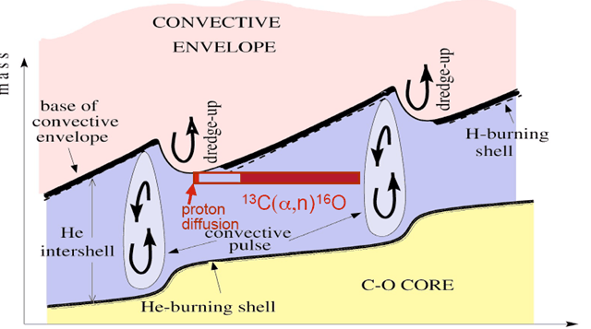
1b. Thermal Pulsations
Pulse 1
Pulse 2
• Above the C-O core is the Helium burning shell,
• The hydrogen burning shell is located close to the base of the convective envelope.
• The expansion leads to a deeper penetration
of the convective into the region processed
by helium burning.
This is the third dredge up (TDUP)
• TDUP mixes ¹²C to the surface and protons to the He-rich layers. This leads to carbon-rich envelope, and this enables the formation of carbon stars believed to be the progenitor of the mainstream silicon carbide grains.
Again, the connection to observations is clear
Fig. 2: Two thermal pulsations, and third dredge up and the proton diffusion

Slide 9
Challenging
Difficult situation : protons must diffuse beyond the edge of the convective envelope as determined by the Schwarzschild criterion for convective instability, ∇_{rad}>∇_{ad}, .
Getting the right amount of ¹³C as neutron source for the main component of s-process nucleosynthesis via the reaction ¹²C (p, γ) ¹³C ?. Clearly, sufficient abundance of protons needed originating from the hydrogen-rich envelope.
Too many diffused protons are not desirable, since the full CNO cycle will produce mostly ¹⁴N.
Insufficiently diffused protons will not generate the right amount of ¹³C.
Maurizio Busso and collaborators have made great contribution to explain this issue.
A flavor of this effort will be described below.
thermal pulsations on the AGB leads to the production of various nuclear species like
⁷Li, ¹²C, ¹⁴N, ¹⁶O, ¹⁹F, ²²Ne, ²³Na
These products are mixed to the surface by the successive third dredge episodes as seen in Fig.2.

Slide 10
2. Nucleosynthesis in AGB phases
2.1 Example from the s-Process
• s-process relies on a relatively low neutron number density of at least 10⁸ cm⁻³ .
•β—decay always follows the neutron capture , so that branching to neutron-rich nuclei is inhibited.
• Still, branching possible through the following Illustration:
⁹⁰Mb
14.8
⁹⁴Mb
9.25
⁹⁵Mb
15.9
⁹⁶Mb
16.7
⁹⁷Mb
9.55
⁹⁸Mb
24.1
⁹⁹Mb
66 h
¹⁰⁰Mb
9.63
⁹³Nb
100
⁹⁴Nb
20 Ky
⁹⁵Nb
35 day
⁹⁶Nb
23 h
N=50
Yellow boxes radioactive
⁹⁰Zr
51.5
⁹¹Zr
11.2
⁹²Zr
17.22
⁹³Zr
1.5 Myr
⁹⁵Zr
64 day
⁹⁶Zr
2.80
⁹⁷Zr
17 h
⁹⁴Zr
17.4
Main path: thick line
Numbers : half-life times, or
Abundance fraction of stable isotopes. Fig. from [1]
^{• 93}Zr has relatively long half-life lifetime of 1.5 x10⁶yr.
^{• 95}Zr has half-life lifetime of 64 days.
• At a neutron density below 3x10⁸ cm⁻³, ⁹⁵Zr decays into ⁹⁵Mo over ⁹⁵ Nb,

Slide 11
for higher neutron density the reaction ⁹⁵Zr(n,γ) ⁹⁶Zr effective and leads to subsolar ratio of ⁹⁶Zr/⁹⁴Zr as found in SiC grains, which seems to have been formed in the carbon-rich envelopes of AGB stars [5]

Slide 12
Important Insight
The neutron source driving the previous flow path is delivered by the reaction
²²Ne (α, γ) ²⁵Mg, with ²²Ne already existing in the helium zone.
The activation of this source seems to need extra mixing, a kind of overshooting at the base of the pulse driven convective helium zone
This is an interesting link between mixing and nuclear burning in AGB stars. Clearly well studied nuclear reaction rates are needed to explore this scenario.

Slide 13
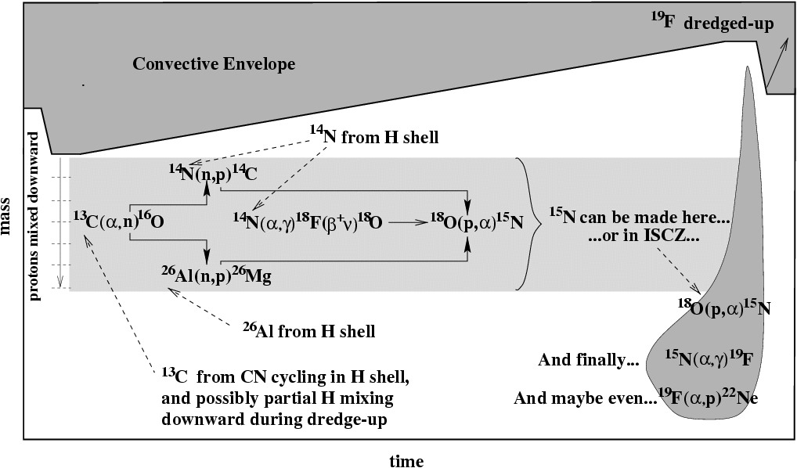
2.2 Fluorine (¹⁹F) production
Main steps:
• Start with ¹³C left over from CNO burning and additional mixing of protons
Neutrons released by ¹³C(α,n)¹⁶ O. These neutrons facilitate the s-process and are captured especially by ¹⁴N and ²⁶Al produced by the H-burning shell between the pulses
•The following reactions proceed:
¹⁴N( n, p)¹⁴C and ¹⁴N(α,γ) ¹⁸F(β⁺ν) ¹⁸O
protons and ¹⁸O are produced, so that
¹⁸O(p,α)¹⁵N(α,γ)¹⁹F
But where?
In the PDRCZ in low mass stars (< 3 solar masses ?)
OR
In the intershell region of the more massive stars .
(2-3)x10⁸ K needed

Slide 14
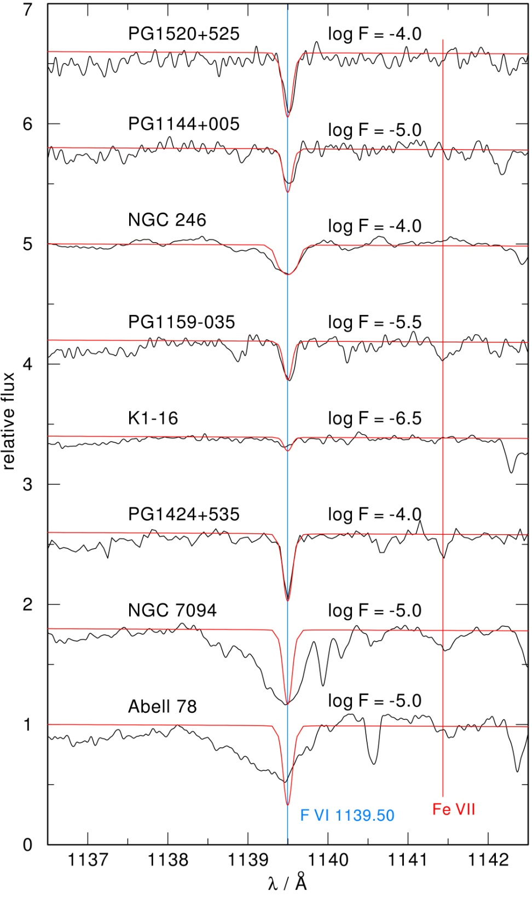
observation
First discovery of fluorine in
hot post-AGB stars:
F VI 1139.50 Å
F abundance in
PG1159 stars up to
200 times solar

Slide 15
2.3 Hot Bottom Burning: HBB
Lithium (⁷Li) Production in AGB Stars
a. The HBB is a delicate process: it is convective envelope burning at top of hydrogen-burning shell
b. HBB dependent on the initial metallicity.
Very sensitive to mass loss during pulsations,
decreasing envelope mass shuts off the process
c. The temperature required for the HBB is at least 2x10⁷K,
which means only very small mass range of about 10⁻⁴ M_{Ꙩ} is involved
d. difficult to describe, requires time-dependent mixing coupled to
nuclear reactions
Importance
⁷Li production, and the prevention of forming carbon stars (e.g. [7]), since carbon is processed to nitrogen by the fully operating CNO cycle.
Thus, understanding the nature of the HBB helps to constrain the mass range of carbon stars. Again, link to observation

Slide 16
Lithium and Astrophysical connection
The Lithium production is a challenging process in the universe:
its .production is tightly linked to the abundance of ⁷Be
The scenario
Early works [12 ,13] have shown that ³He builds up to large abundance
beyond the hydrogen burning shell.
If the H-envelope is mixed down to 10⁸ K with local mixing time of few hours, and the lifetime of ³He (α, γ) ⁷Be is also few hours near 8x10⁷ K, then ³He will be converted to ⁷Be. Most of it will mixed to cooler regions to undergoes electron capture to form ⁷Li.
Important
Most of the Lithium is of cosmological origin as a result of the big bang nucleosynthesis (BBN). Recent work [8] focused on the so calle
“cosmological lithium problem” (the predicted primordial lithium abundance by the standard assumption is higher by at least a factor of three compared with what is observed in metal-poor halo stars

Slide 17
Last not least
2.4 New Insight to produce the ¹³C reservoir in AGB stars
Due to the initiative of Maurizio Busso, new aspect of the formation and distribution of the ¹³C pocket was introduced
The basic idea is: formation of the ¹³C- reservoir is triggered by a circulation started by magnetic buoyancy which promotes the down flows of envelope material for mass conservation during the occurrence of the third dredge up episodes. Details of this approach is found in the works [9, 10].
Main Results
Proton penetration is small but extended over a large fractional mass of the He-layers,
the ¹³C-pocket comprises about 10⁻³ M_{Ꙩ} (estimated on observational ground) has received a possible physical explanation.
Conclusion
The magnetic field plays a decisive role in determining the
s-process nucleosynthesis during the thermal pulsation of the AGB stars.

Slide 18
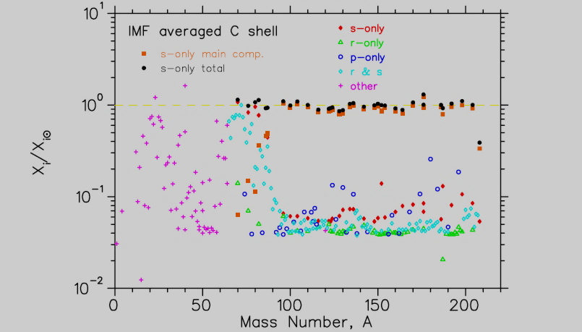
2.5 Some Results
Arlandini etal. (1999)
Solar
abundances
AGB’s and Heavy Elements
Main component
Weak
component
Massive Stars
AGB Stars
Massive stars: Overproduction factors of the IMF-averaged stars (15,20,25,30) M_{sun.} The, El Eid and Meyer (2007)
Weak component rather sensitive to shell carbon burning, in particular
in the Sr-Zr region.

Slide 19
AGB Stars and Solar Grains

Slide 20
3. Conclusion- Future work
We tried to show how important the AGB stars in Astrophysics,. The effort of Maurizio Busso and his collaborator is appreciated and highlighted.
Some Remaining problems are:
a. Structure of the convective zones during a pulse cycle.
b. Depth of the Third Dredge Up, still model-dependent
c. ¹³C- pocket: mixing of protons into the C-rich region creates ¹³C . Formation and extension of tis pocket remains to be understood. The role
of the magnetic field is an essentials ingredient.
Thank you for your attention

Slide 21
References
1. Herwig, F. Evolution of Asymptotic Giant Branch Stars. ARA&A, 2005, 43, 435
2. Lattanzio, J.; Wood, P.R. Asymptotic Giant Branch Stars, editors: H.J. Habing and H.O. Olofsson, 2004, Springer, 23.
3. Busso, M.; Gallino, R.; Wasserburg, G.J. Nucleosynthesis in Asymptotic Giant Branch Stars: Relevance for Galactic Enrichment and Solar System Formation, ARA&A, 1999, 37, 239
Halabi, G.; El Eid, M.; Shampgane, A. Effect of the ¹⁴N (p, gamma)¹⁵O reaction on the blue loop in Intermediate Stars,
Astrophys. J., 2012, 761, 10
5. Laugaro M. et al., Astrophys. J., 2003, 593, 486
6. Siess, L.; Livio, M.; Lattanzio, J., Structure, Evolution, and Nucleosynthesis of Primordial tars,
Asrophys J., 2002, 570, 329
7. BlÖcker, T.; Herwig, F.; Trirebe, T. TP-AGB evolution with overshoot for low-mass stars as a function of metallicity, Memorie della Societa Astronomia Italiana}, 2000, Vol. 71, 711
8. Makki, T.; El Eid M.; Mathews, G.J., Structure, Evolution, and Nucleosynthesis of Primordial Stars , Modern Physics Letters A, 2019, Vol 34, No. 24, 1950194
9. Nucci, M.; Busso, M., Magneto hydrodynamics and Deep Mixing in Evolved Stars. I. Two- and Three-dimensional Analytical Models for the Asymptotic Giant Branch, Astrophys. J, 2014, 781, 141
10. Trippella, O. etal., s-Processing in AGB Stars Revisited. II. Enhanced ¹³C Production through MHD-induced Mixing, Astrophys. J., 2016, 818, 125
11. Hernandes, G. et al. Hot bottom burning and s-process nucleosynthesis in massive AGB stars at the beginning of the thermally-pulsing phase, A&A, 2013, L3 12. Iben, I. Jr., Astrophys. J., 1965, 142, 1447 13. Cameron, A.G.W., Fowler, W.A., Astrophys. J., 1971, 164, 111, 10

Slide 22
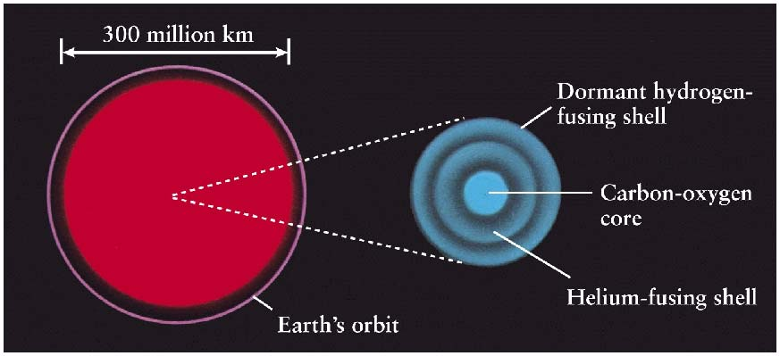
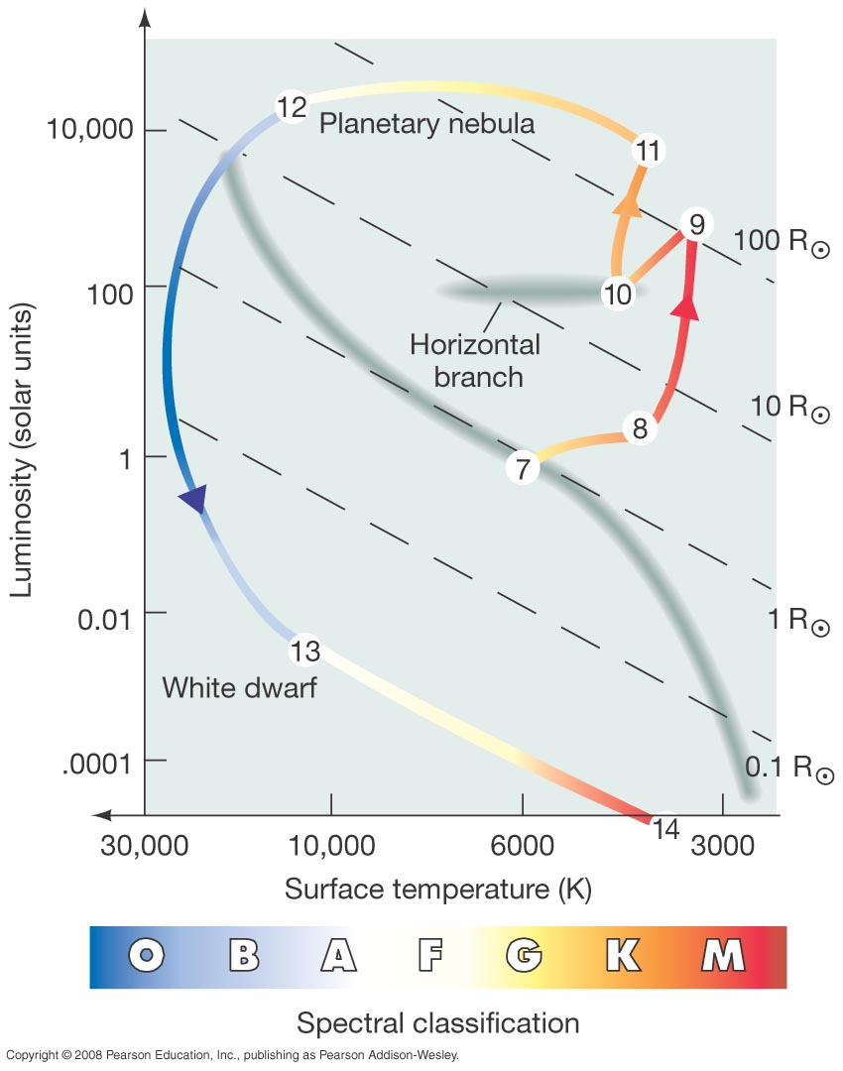
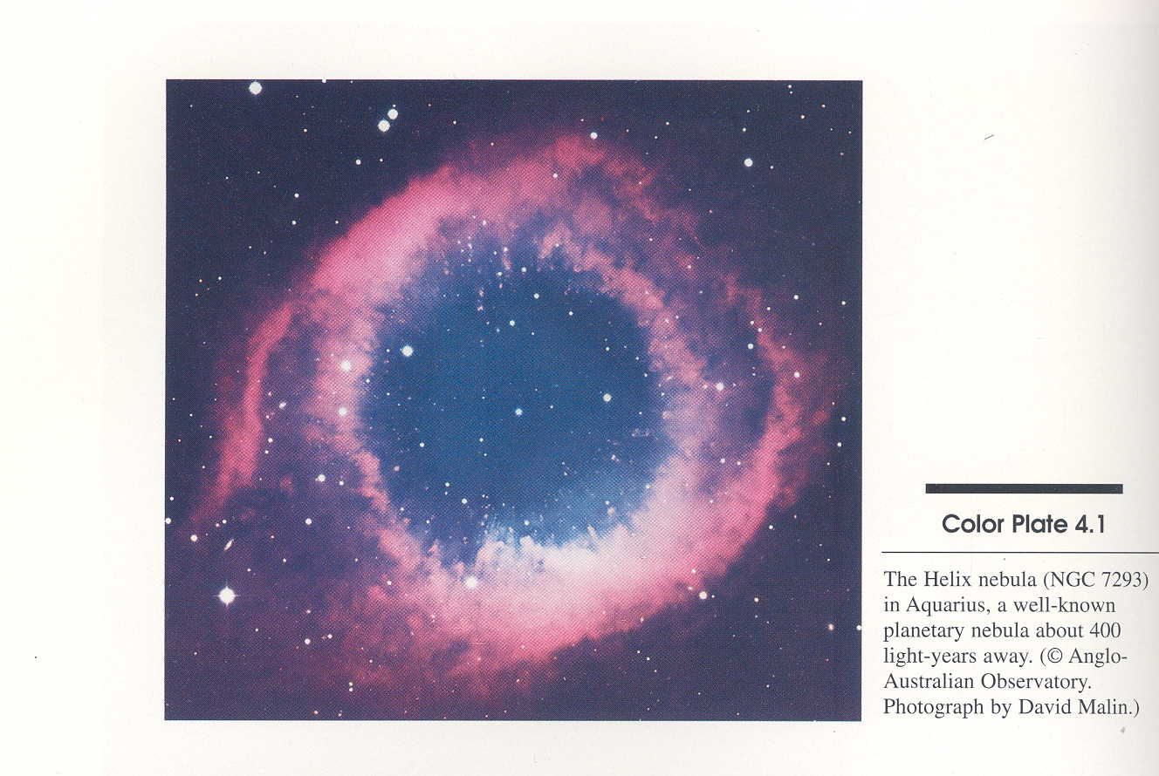
s-process in AGB Stars
In HR Diagram
“Cat Eye” planetary nebula
after the AGB phase
Asymptotic
Giant Branch
White dwarf

Slide 23
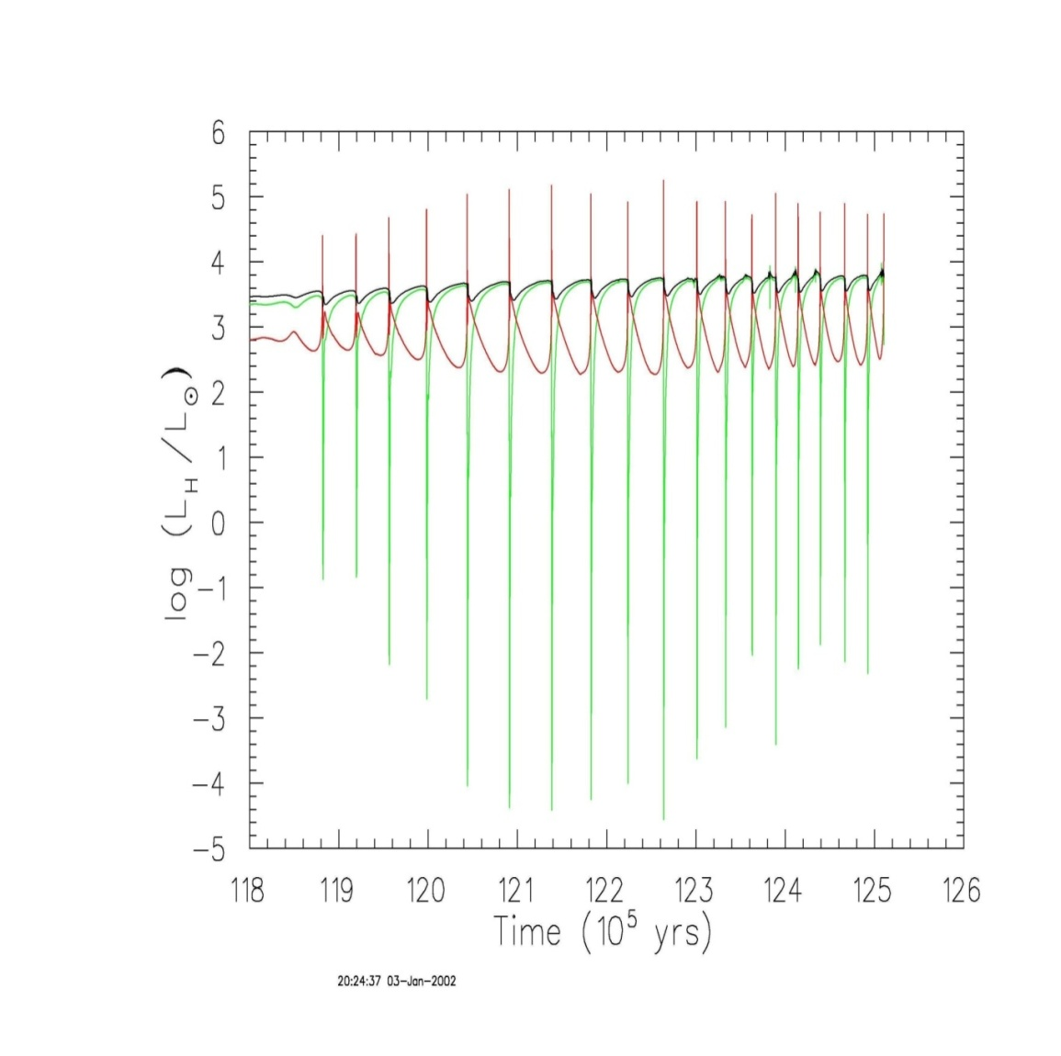
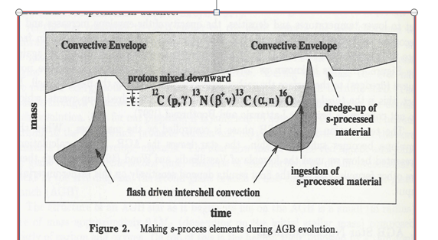
Look inside:
:
Protons are mixed to carbon, or to the He-burning zone
In a pulsating machine
Neutron Source
Star’s luminosity
He-luminosity
H-luminosity

Slide 24
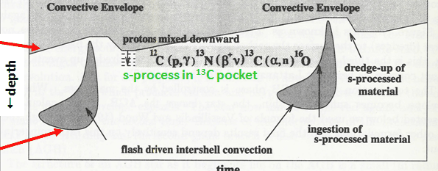
The ¹³C Pocket
H-shell
He-shell
convective
If proton “diffusion” occur into the ¹²C-rich-region, then ¹²C(p,γ)¹³C occurs and the released neutrons lead to the s-process mainly in the intershell region and are brought to surface during the next pulse.
Really tricky:
• Too many mixed protons not desirable , since the full CN cycle would operate producing ¹⁴N
Few protons also not desirable, since not enough amount of ¹³C is produced.
• But how are the proton mixed and hoe extended is the mixed region

Slide 25
Thermal pulsations & nucleosynthesis
P-nucleus cannot be produced by the s-process
Role of

