Slide 1



Hard X-rays from energetic flare ions
Alec MacKinnon
School of Physics and Astronomy, University of Glasgow, UK
Sergio Szpigel, Jordi Tuneu, Guillermo Gimenez de Castro
CRAAM, Universidade Presbeteriana Mackenzie, Brazil
Notes:
1

Slide 2
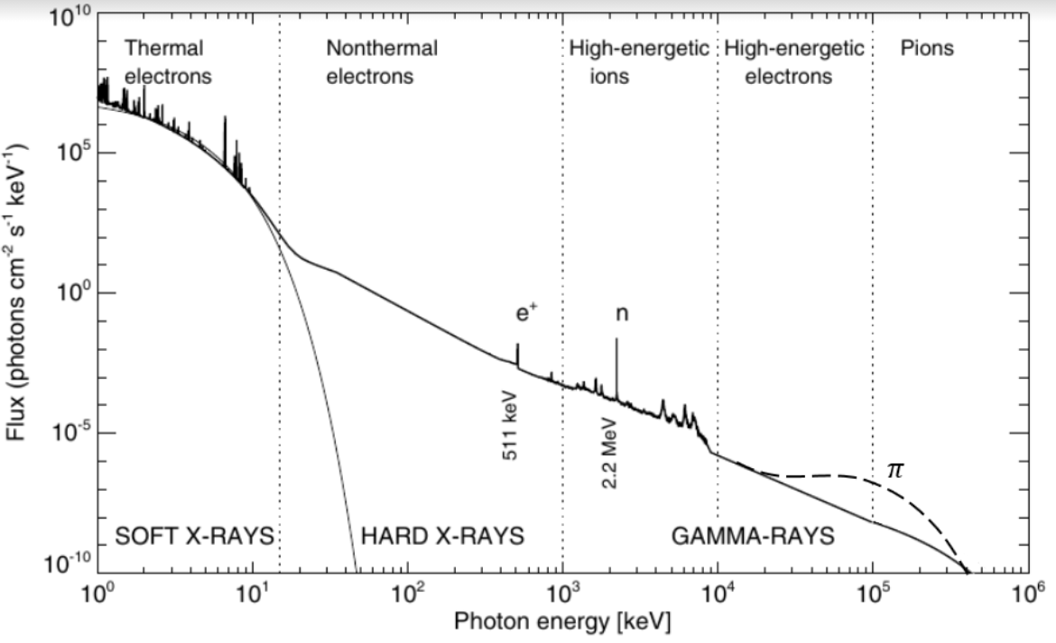
Flare spectrum from X- to γ-rays
Notes:
Flare gamma-ray lines tell us about flare ion acceleration. Different features have a range of different significances.

Slide 3


Flare spectrum from X- to γ-rays
What will we see if there are no primary electrons?
Can we learn something about the primary ions?
Notes:
Flare gamma-ray lines tell us about flare ion acceleration. Different features have a range of different significances.

Slide 4
Primary Ion Hard X-Ray (HXR) mechanisms
Compton scattered gamma-ray photons | Murphy and Share (2018)
Bremsstrahlung from pion decay positrons and electrons | Murphy et al. (1987)
Bremsstrahlung from knock-on electrons
Bremsstrahlung from Compton scattering recoil electrons
Bremsstrahlung from products of pair creation
Ion-electron bremsstrahlung | Heristchi (1987); Emslie and Brown (1985)
Notes:
Flare gamma-ray lines tell us about flare ion acceleration. Different features have a range of different significances.

Slide 5
“Knock-on” electrons
Ion, mass M, has total energy
Maximum scattered electron energy is
e.g. 1 GeV proton produces secondary electrons up to 3.3 MeV

Slide 6
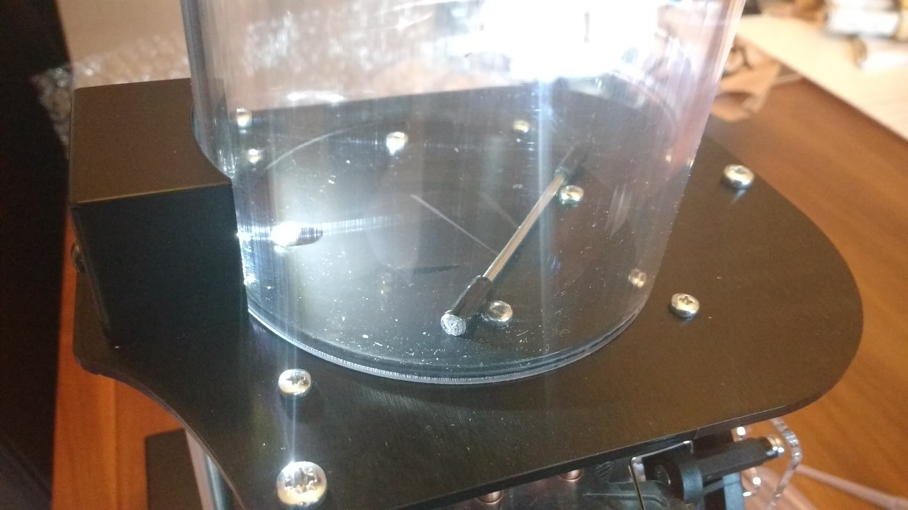

Slide 7
Cross-section (Bhabha, 1938)
Proton population like
produces electrons at a rate

Slide 8

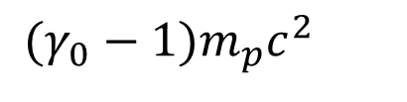
Protons injected into a thick target
Proton population like
$$(γ_{0}−1)m_{p}c^{2}$$
normalised to N₀ particles above
Injected into a thick target, results in an electron population
where
$$T_{0}=4(γ_{0}−1)m_{e}c^{2}$$

Slide 9
Protons injected into a thick target
Proton population like
Injected into a thick target, results in an electron population
Observing HXR’s (or microwaves) from this electron population would immediately tell us the ion energy distribution

Slide 10
Example: 4 June 1991
(Murphy et al., 1997)
6.7×10³² protons above 30 MeV with δ = 4
Gives 8×10³⁰ electrons above 65 keV, also with δ = 4
Or 1.4×10³² electrons above 25 keV
- Four orders of magnitude below the number needed for the HXR flux in this flare

Slide 11
Example: 4 June 1991
(Murphy et al., 1997)
6.7×10³² protons above 30 MeV with δ = 4
Gives 8×10³⁰ electrons above 65 keV, also with δ = 4
Or 1.4×10³² electrons above 25 keV
- Four orders of magnitude below the number needed for the HXR flux in this flare

Slide 12
However (1)
Observed spatial displacement of HXR and γ-ray sources (Hurford et al., 2003):
Ion and electron interaction sites are spatially distinct, in at least some flares
Possibility of imaging HXR’s associated with ion precipitation

Slide 13
However (2)
Over-the-limb Fermi/LAT events:
Jin et al. (2018); 01/09/14 event
Pesce-Rollins et al. (2015) 11/10/13 event

Slide 14
FLUKA
FLUktuierende KAskade
Detailed nuclear physics models for production of secondaries, well validated cf. laboratory experiment
Transports hadrons, mesons, leptons, neutrinos, photons….
….in a wide variety of materials
www.fluka.org

Slide 15
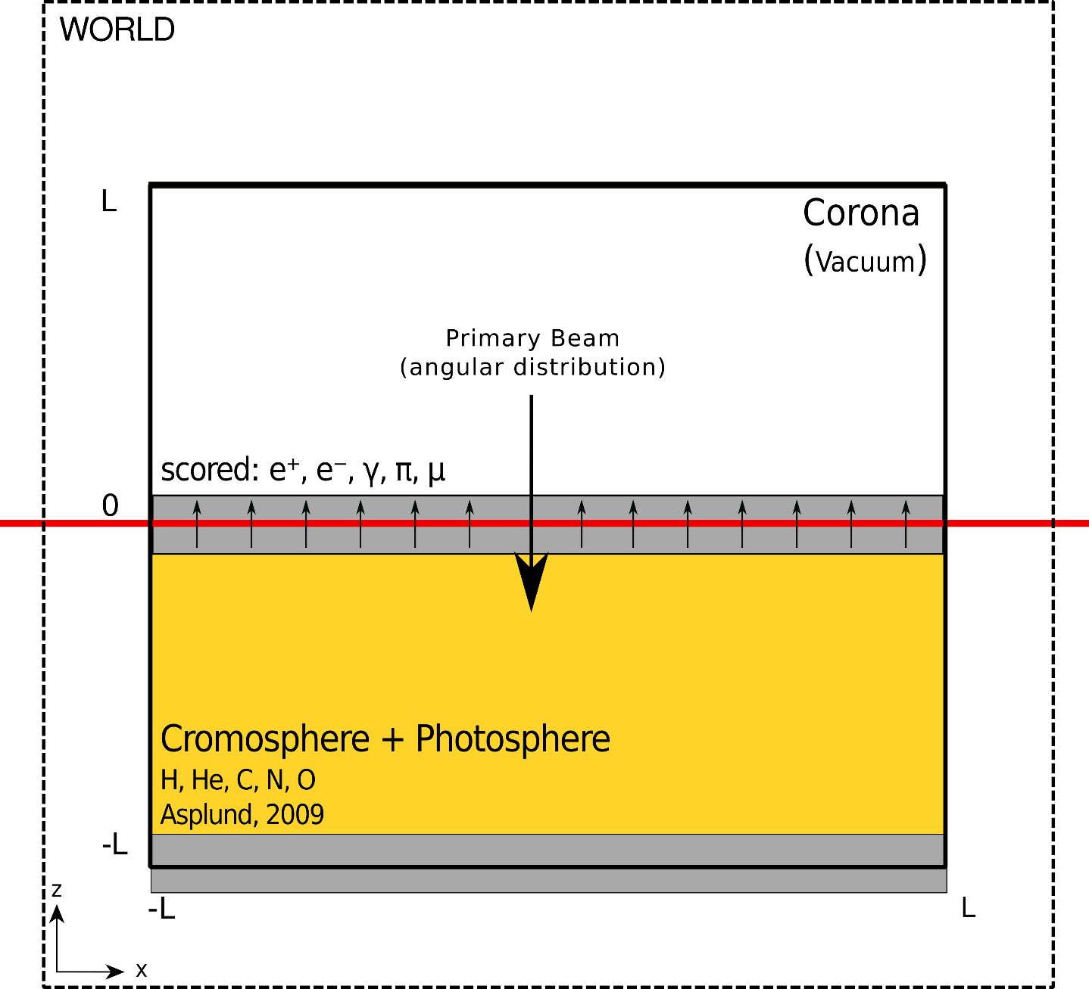
FLUKA for solar purposes
Tusnski et al. (2019) SP 294, 103
  deexcitation lines
  also Malagoli Thereza et al., this Workshop
MacKinnon et al. (2020) SP 295, 174
  pion decay continuum; directionality

Slide 16
Thin target secondary production with FLUKA
MacKinnon et al. (2020) SP 295, 174; 1 GeV p⁺ in 0.084 g cm⁻² H sphere
Electrons (b): π⁻ decay
π⁰ → e⁺e⁻γ (Dalitz) decay
π⁺ decay e⁺ (Bhabha) scattering of e⁻
black is total; note knock-on e⁻ below 3.3 MeV (Abraham et al. 1966)

Slide 17
Pion decay gamma-ray directivity
MacKinnon et al. (2020) SP 295, 174

Slide 18
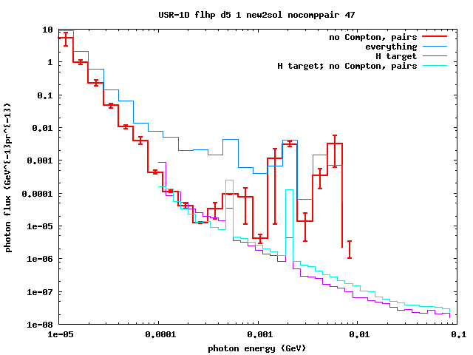
X- and γ-rays from secondary electrons
Energetic protons:
Downward isotropic energy power-law with δ=5
10 MeV – 1 GeV
H target vs. Asplund;
With and without Compton scattering and pair creation

Slide 19
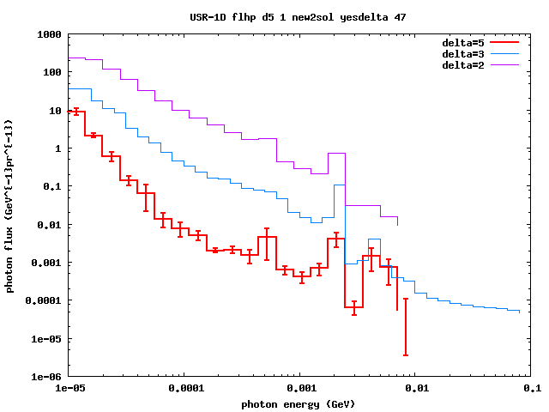
X- and γ-rays from secondary electrons
Energetic protons:
Downward isotropic energy power-law with δ=5
10 MeV – 1 GeV
Asplund abundances
Compton scattered contribution dominates 10 – 100 keV except for the largest δ

Slide 20

Limb HXR imaging?
From knock-on e⁻
HXR’s
From Compton scattered γ-ray photons

Slide 21
Hudson et al. (2020)
MNRAS 491, 4852
Bifrost MHD modelling of magnetised atmosphere
Field lines in the chromosphere may encompass 10 g cm⁻² or more; cf. 4-6 g cm⁻² vertical depth of the photosphere

Slide 22
Tuneu et al. (2017): microwaves from ion secondaries

Slide 23
Conclusions
“Knock-on” electrons have an energy distribution that directly reflects primary ions
Observation of their HXR or microwave radiation would open up a new window on ion energy distributions
Need to avoid primary e⁻ HXR’s; also has to compete with Compton scattered spectral component
May be possible with HXR imagers (STIX, FOXSI?), or possibly in over-the-limb events

