Slide 1
Gamma-ray Observations of Impulsive Flare-Accelerated Electrons and Ions on 2017 September 10
Gerry Share, Ron Murphy and Kim Tolbert
RHESSI-20 Working Group 2
Ion Studies and Fermi LAT
July 8, 2021

Slide 2
In this brief report we update measurements of the 2017 September 10 eruptive event by the Fermi/LAT and GBM instruments discussed earlier (e.g. Omodei et al. 2018, Kouloumvakos et al. 2020, Kocharov, et al. 2020).
We focus on the GBM measurements. This instrument has limited spectroscopic capabilities for solar flare observations. We fit the spectra >300 keV for most time intervals from 15:54-16:11 UT with a simple two-component photon model: a power-law x exponential (electron bremsstrahlung component) and a nuclear-line component.
The flare-produced bremsstrahlung starts minutes earlier and ends minutes after the nuclear-lines but their fluxes peak both within a minute of one another and the intense peak >100 MeV gamma rays observed by LAT. Kouloumvakos et al. 2020 have shown that the >100 MeV peak is likely produced by protons accelerated by the CME shock.
Here we study the spectral evolution of the electron bremsstrahlung. The spectrum is very steep during the onset of the emission and hardens rapidly within 3-4 minutes. The spectrum gradually softens after the peak in hard X-rays.

Slide 3
Black data points show the time history of the >100 MeV gamma-ray emission along with the calculated history of protons accelerated by the accompanying CME shock onto field lines returning to the Sun (Kouloumvakos 2020).

Slide 4
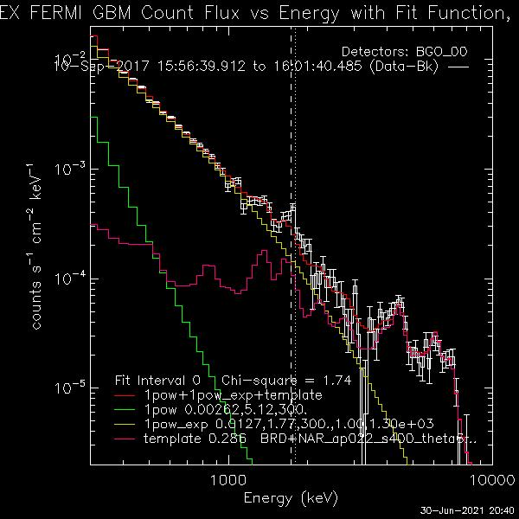
Fit to a five minute accumulation of the 2017 September flare spectrum observed by Fermi/GBM with power-law x exponential (index -1.7, exponential energy 1.3 MeV) and nuclear line components (a weak steep power law improves the fit for 2 minutes near the peak).

Slide 5
Time histories of bremsstrahlung, nuclear line, and >100 MeV gamma-rays observed by Fermi LAT and GBM. The electron spectrum is very steep up until 15:55 after which time it hardens rapidly (in agreement with a comment in Chen et al. 2021) until the peak near 16:00 UT, after which time it softens. The flare-produced nuclear line flux rises and peaks earlier than the >100 MeV pion decay flux, that we attribute to CME/shock accelerated protons returning to the Sun.

