Slide 1
The Extreme-ultraviolet late phase of a solar flare triggered by injection of nonthermal electrons to the footpoints of coronal loops
Jiale Zhang¹, Bin Chen², Sijie Yu², Hui Tian^{1，3}, Yuqian Wei², Yingjie Luo², Guangyu Tan¹, Hechao Chen¹, Xingyao Chen³
¹School of Earth and Space Sciences, Peking University, Beijing 100871, China
²Center for Solar-Terrestrial Research, New Jersey Institute of Technology, Newark, NJ 07102, USA
³Key Laboratory of Solar Activity, National Astronomical Observatories, Chinese Academy of Sciences, Beijing 100012, People's Republic of China
RHESSI-20 workshop

Slide 2
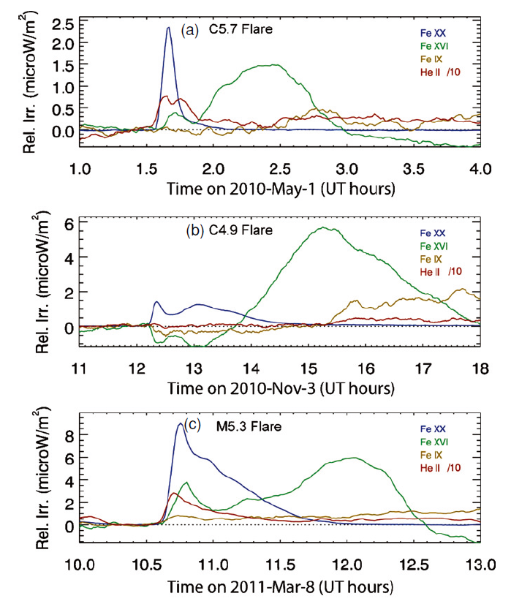
Introduction to ELP (The Extreme-ultraviolet late phase)
Second EUV emission enhancement
Often appears at warm EUV emission lines
(particularly Fe XVI 335Å, ~3MK)
Hour-long time delay
Woods et al. 2011
slide 1

Slide 3
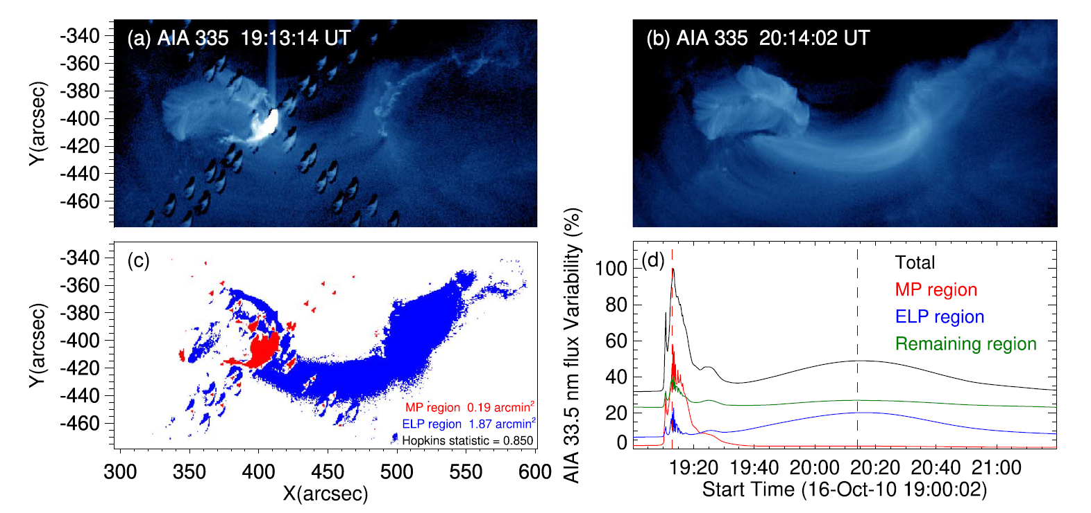
Introduction to ELP
Distinct configurations
Extended loops, distinguishing from main phase loops
Chen et al. 2020
slide 2

Slide 4
Origin of ELP (still in debate)
Additional heating
Long-term mild energy release process
Initial heating and prolonged cooling
Cooling time lengthens with the increase in loop length
Two mechanism can be both at work
slide 3

Slide 5
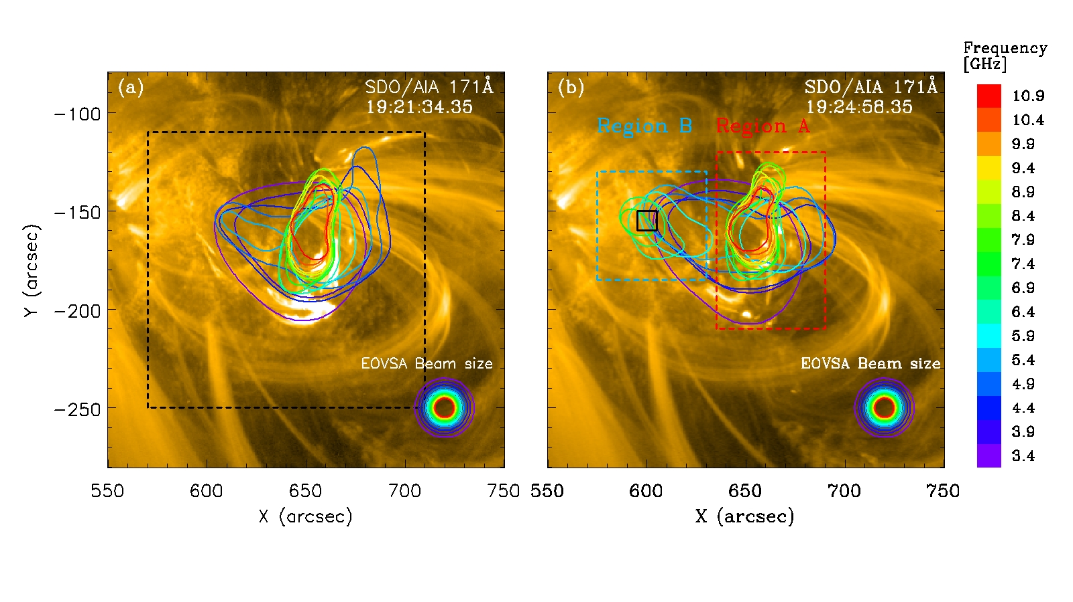
Observation of a C1.4 solar flare
The C1.4 flare took place around 19:21 UT on 2017-7-14 at NOAA AR 12665
A radio source appears at the flaring region at first, and then evolves into two separate sources.
slide 4

Slide 6
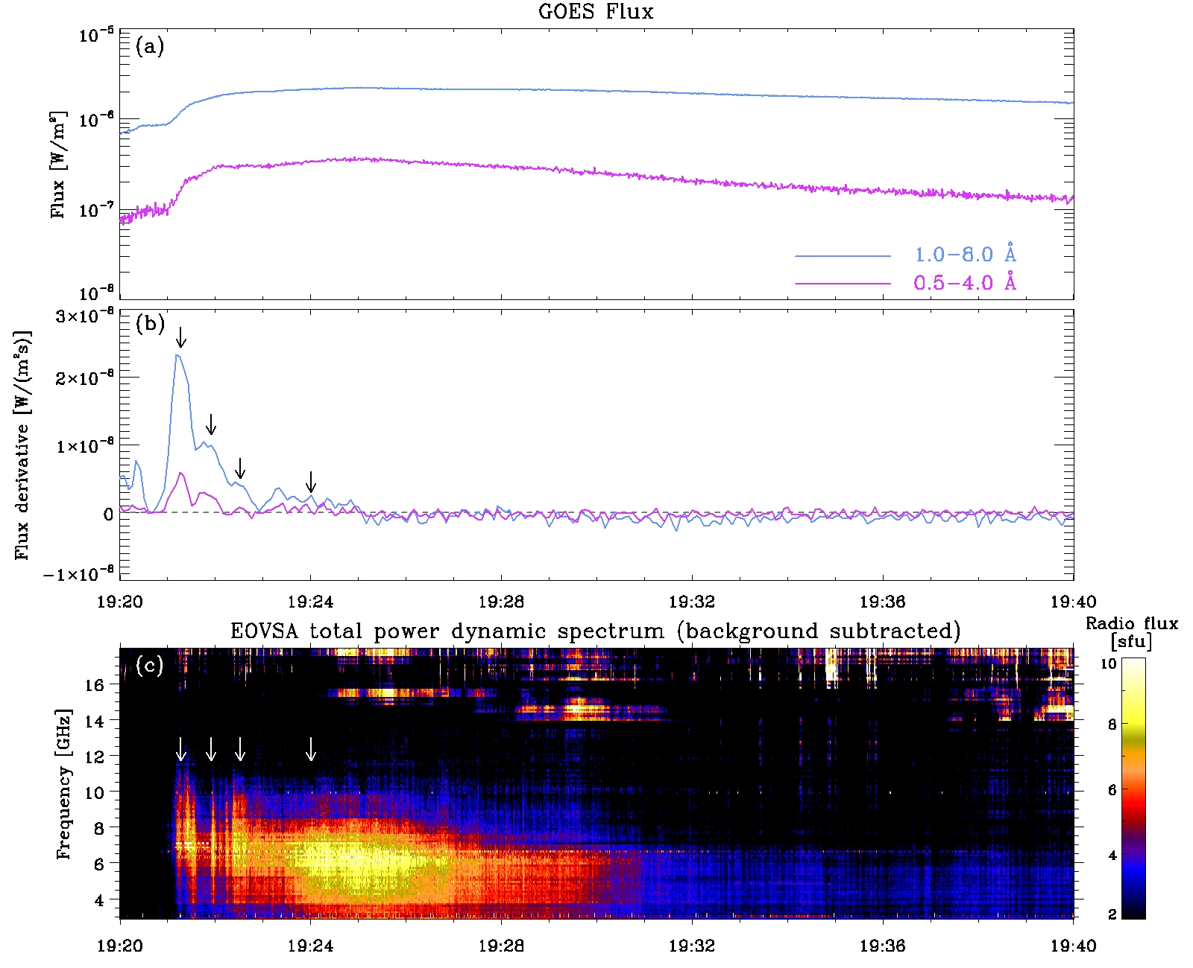
Observation of a C1.4 solar flare
SXR derivative V.S. microwave flux
Spike-like emission V.S. continuum emission
A long-lasting microwave emission during the flare gradual phase.
spike-like emission
continuum emission
slide 5

Slide 7
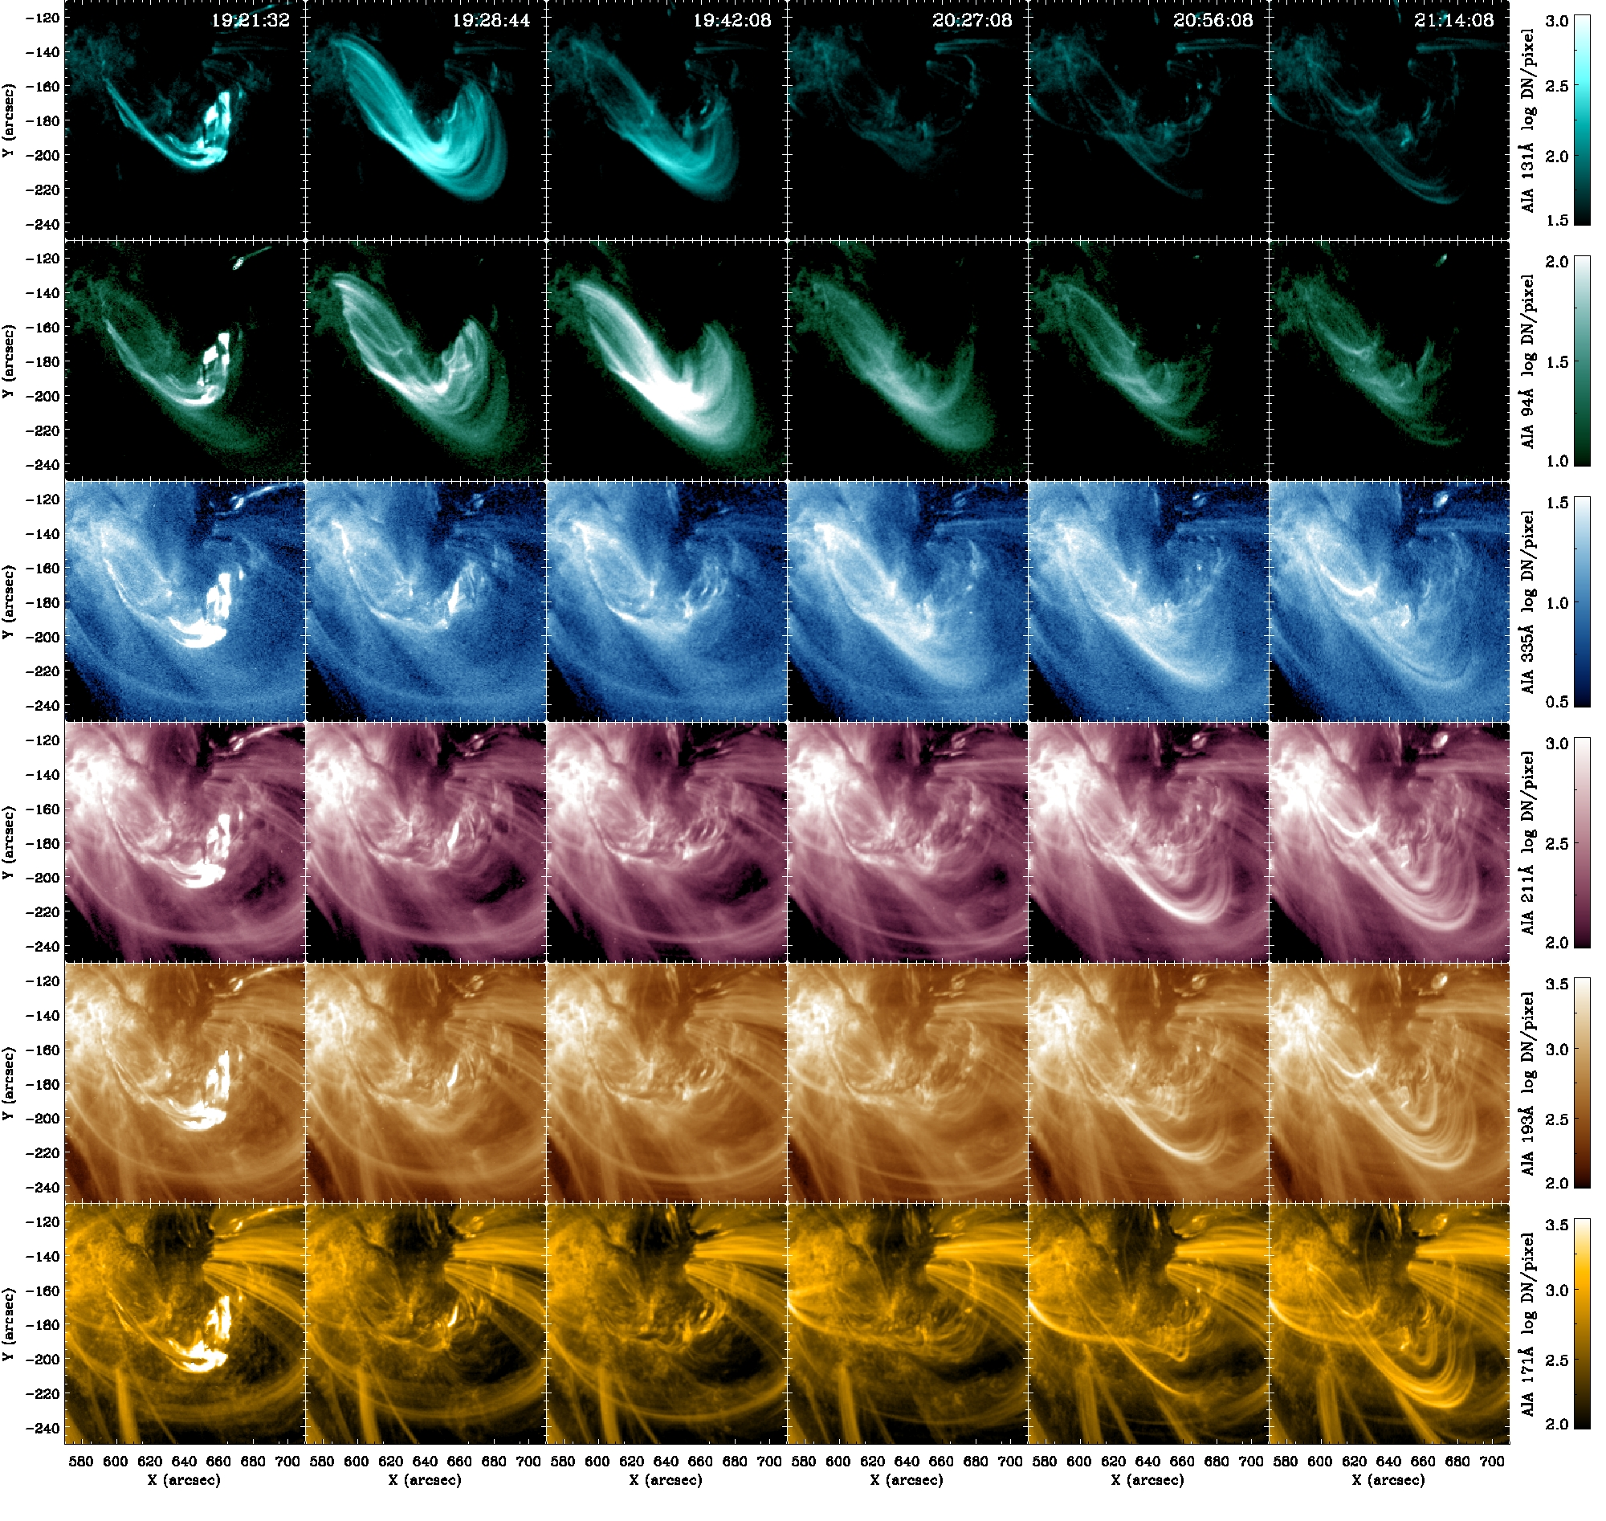
Main phase
EUV late phase
Late phase loops
Late phase loops can be seen in six AIA bands.
Late phase loops are higher compared to main phase loops.
The loops brighten up in sequential order.
slide 6

Slide 8
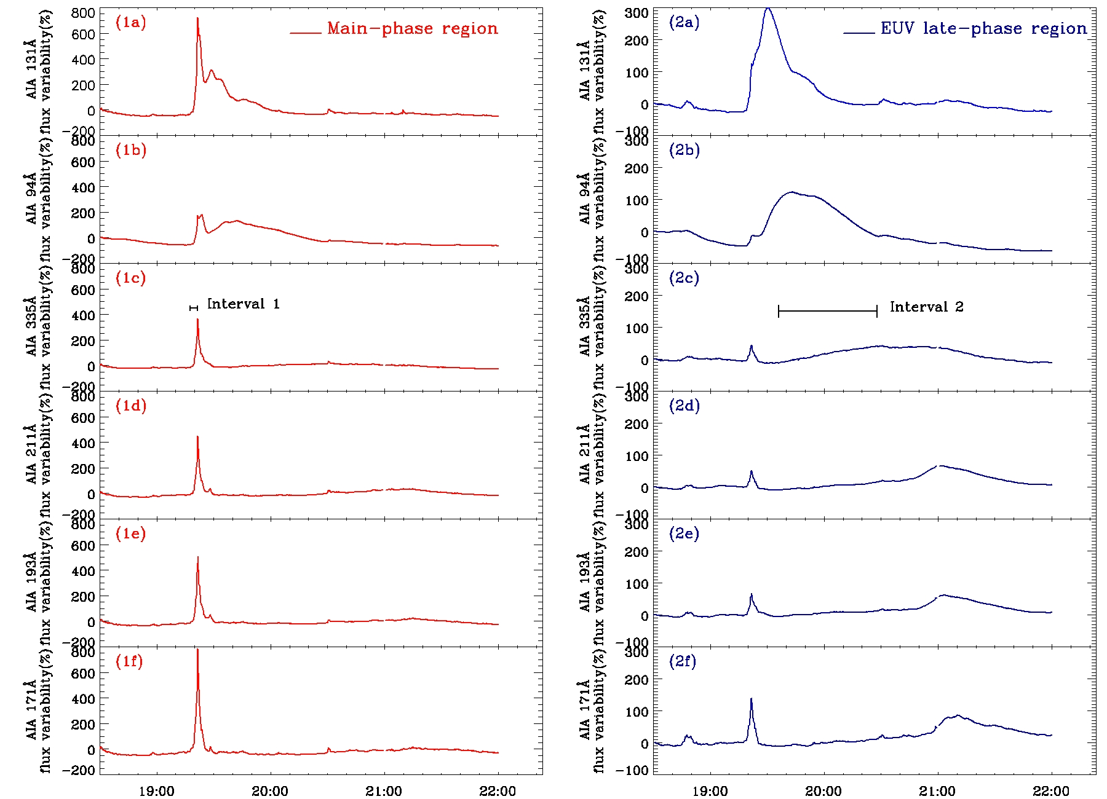
Late phase loops
Apply AIA 335Å images to define the Main phase region and EUV late phase region.
Different peak time of different bands indicate a slow cooling process
slide 7

Slide 9
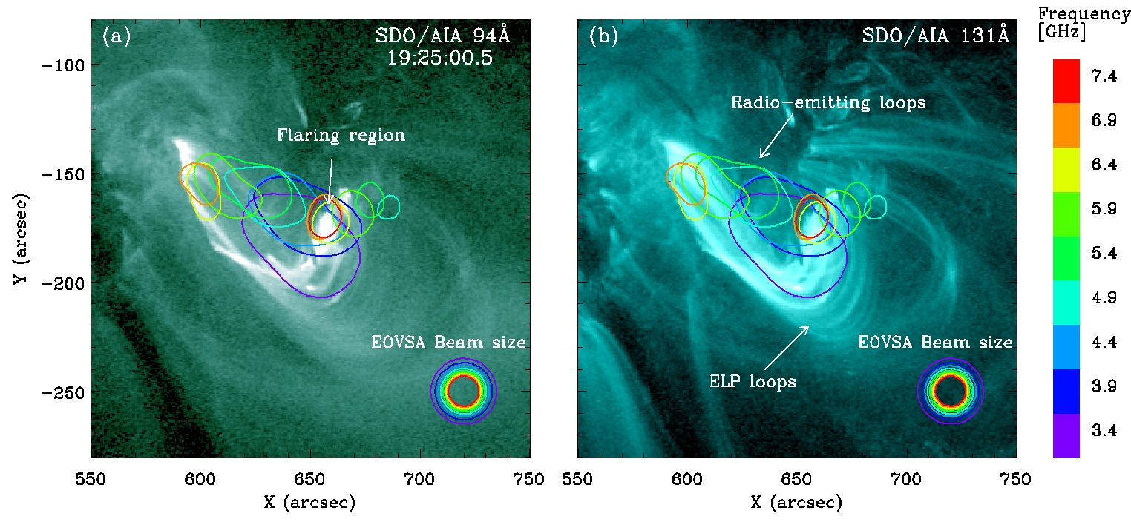
Late phase loops
AIA 131Å and 94Å show second emission enhancement the same time or shortly after the microwave enhancement.
The background-subtracted microwave image demonstrates a radio-emitting loop structure apart from the ELP loops.
slide 8

Slide 10
Late phase loops
Heating at coronal loop footpoints
Chromospheric heating seen from AIA 1600Å
Evaporated plasma from the left footpoints fills in the ELP region.
Credit: Mark Cheung & Yang Su DEM code
slide 9

Slide 11
Electron transportation and spectral fitting
Simultaneous emission peaks in the two regions
Colored lines - time for spectral fitting
slide 10

Slide 12
Electron transportation and spectral fitting
Kappa distribution – a Maxwellian distribution with a nonthermal tail
Increase in population of electrons with energy of ~keV
slide 11

Slide 13
Discussions
The microwave enhancement is due to gyrosynchrotron emission from the nonthermal electrons trapped in the loop structures
What causes the microwave enhancement to last for 8-minute-long?
1. Initial injection and electron trapping
Trapping time of nonthermal electrons in the weak diffusion limit. (Metcalf et al.
1999)
2. Continuous ejection and electron trapping
Post-reconnection acceleration mechanism
Speculation: wave-particle interactions
slide 12

Slide 14
Discussions
Microwave enhancement reveal additional heating process, but it is not long enough to explain the hour-long delay of EUV late phase.
Main cause: extended cooling in ELP loops
Cooling time of semi-circular coronal loops (Cargill et al. 1995)
Energy budget
Nonthermal energy does not account
for all the thermal energy for ELP loops.
Acceptable.
slide 13

Slide 15
Summary
Summary
First analysis of a solar flare with EUV late phase using radio observation.
The EUV late phase of the flare is proceeded by an eight-minute long microwave enhancement.
The microwave enhancement indicates the presence of non-thermal electrons, which heat the chromosphere and lead to evaporation of the heated plasma into the ELP loops
Thank you for your attention!
slide 14

