Slide 1
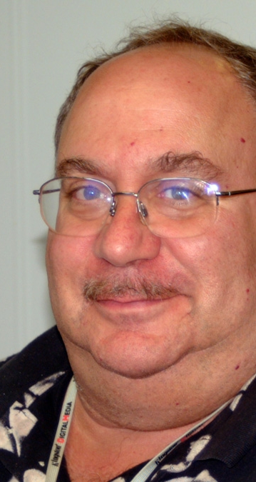
In Memoriam
Reuven Ramaty by Brian Dennis
Bob Lin by Albert Shih
John Brown by Alec Mackinnon
Richard Schwartz by Anna Maria Massone

Slide 2
Reuven Ramaty 1937-2001
GSFC Laboratory for High Energy Astrophysics 1967 - 2001
Developed theoretical framework for solar gamma-ray line spectroscopy.
RHESSI - first spacecraft to be named after a NASA scientist.
Died in 2001 from Lou Gehrig's disease.

