Slide 1
Neptune Roma
Status and plans for last year of the project
@ 16/2/2021

Slide 2
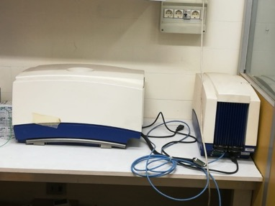
Goals of WP2 (imaging)
Evaluate bio-distributions of fluorinated tracers using ¹⁹F-MRI
¹⁹F-MRI performances limited by low SNR ratio
Possible hardware improvements to ¹⁹F-MRI
- low noise RF coil
- software defined radio technology
for signal digitization
- new pre-amp & cooling
Possible sofware improvements to ¹⁹F-MRI
- use of deep learning to denoise and analyse images
Choice of fluorinated molecules
- tests on animals to have samples
with correct concentrations
test-stand: 0.35 T scanner
9T spectrometer

Slide 3
Status new antenna
Design of 1-2-3 loops using CST simulations
Prototypes of antenna box built, some modifications to the design were found
necessary and have been made
3D printing of boxes with final design in polycarbonate (NMR compatible material)
currently underway
To do:
- repeat the simulations for the determination of the tuning and matching circuits
components with the modified box design
- build the tuning and matching circuits
- test the antenna with the low field scanner and compare with Brucker antenna
- CT of Brucker antenna with ISS CT scanner

Slide 4
Status SDR
SDR system bought and installed
Original idea was to use SDR to process NMR signal before demodulation
=> this was not found possible on the low field Brucker scanner
=> some data were taken from the above scanner (echo signals)
Andrea made available some FID signals from the high field Brucker Scanner
Base signal receiving, transmission and manipulation implemented in GNU radio
=> e.g. tested band pass filter successfully

Slide 5
”Software” improvements
Selected F-BPA as fluorinated tracer
Measured internalization in vitro in our reference (PANC-1) => article almost ready for submission
Detailed study of (Rician) MRI noise, mostly on simulated images and in some real images (not on ¹⁹F-MRI images due to lack of data)
=> Rician noise can be better eliminated with a denoiser in k-space
Due to several problem, first tests in ¹⁹F microimaging modality only in October 2020
=> 13.6 mM F-BPA in blood and water
=> cannot see ¹⁹F signal in blood
=> some field disomogeneities present in the field of view

Slide 6
Ex- vivo tests
Limited time in Jan-Feb due Brucker high field spectrometer dismounting at the end of February
We decided to perform first ex vivo tests in ¹⁹F-MRS (spectroscopy)
=> on-going (6 mice)
From this tests we want to prove that F-BPA can be internalized in pacreas, at the
desired initial concentration and produces measurable ¹⁹F signal
=> first steps toward micro-imaging

