Slide 1
LNF-IPHC
INNER TRACKER MECHANICS
February 16° 2021

Slide 2
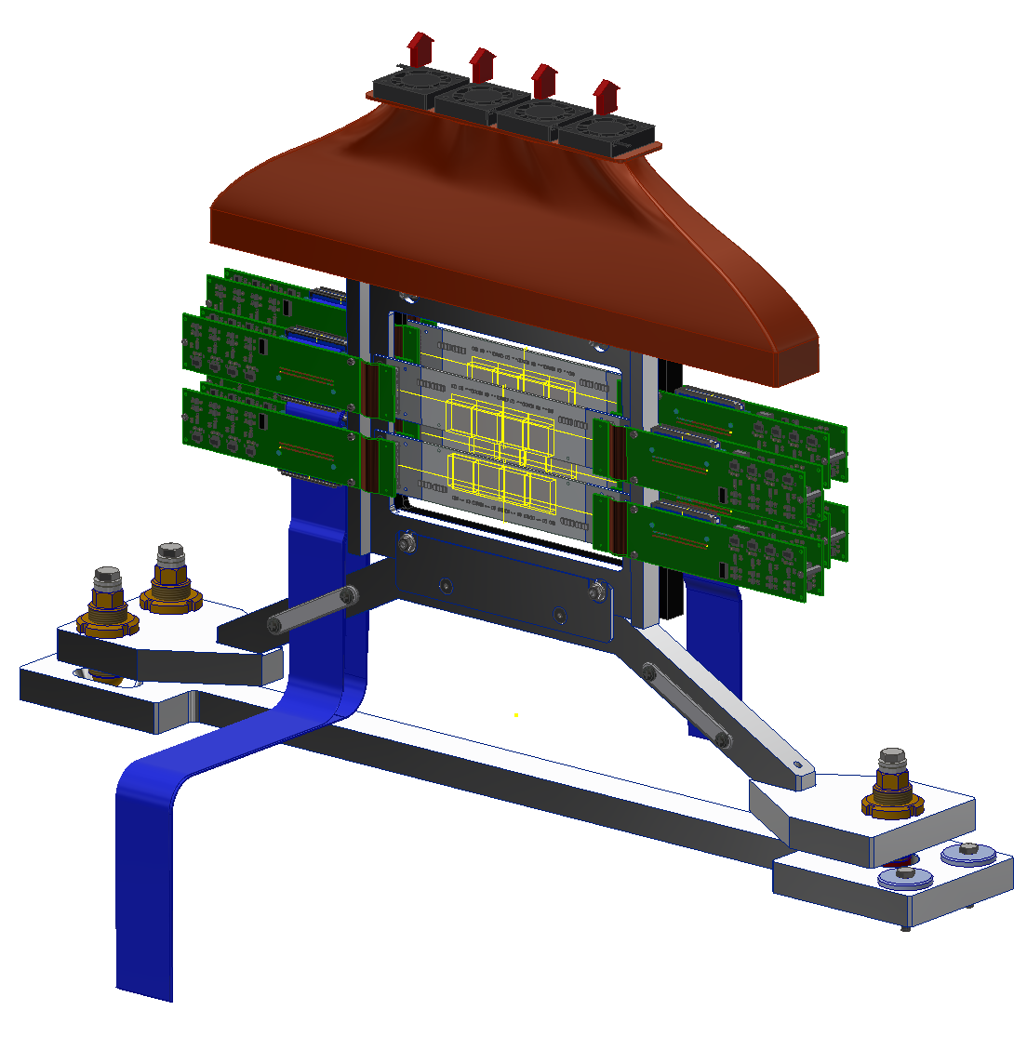
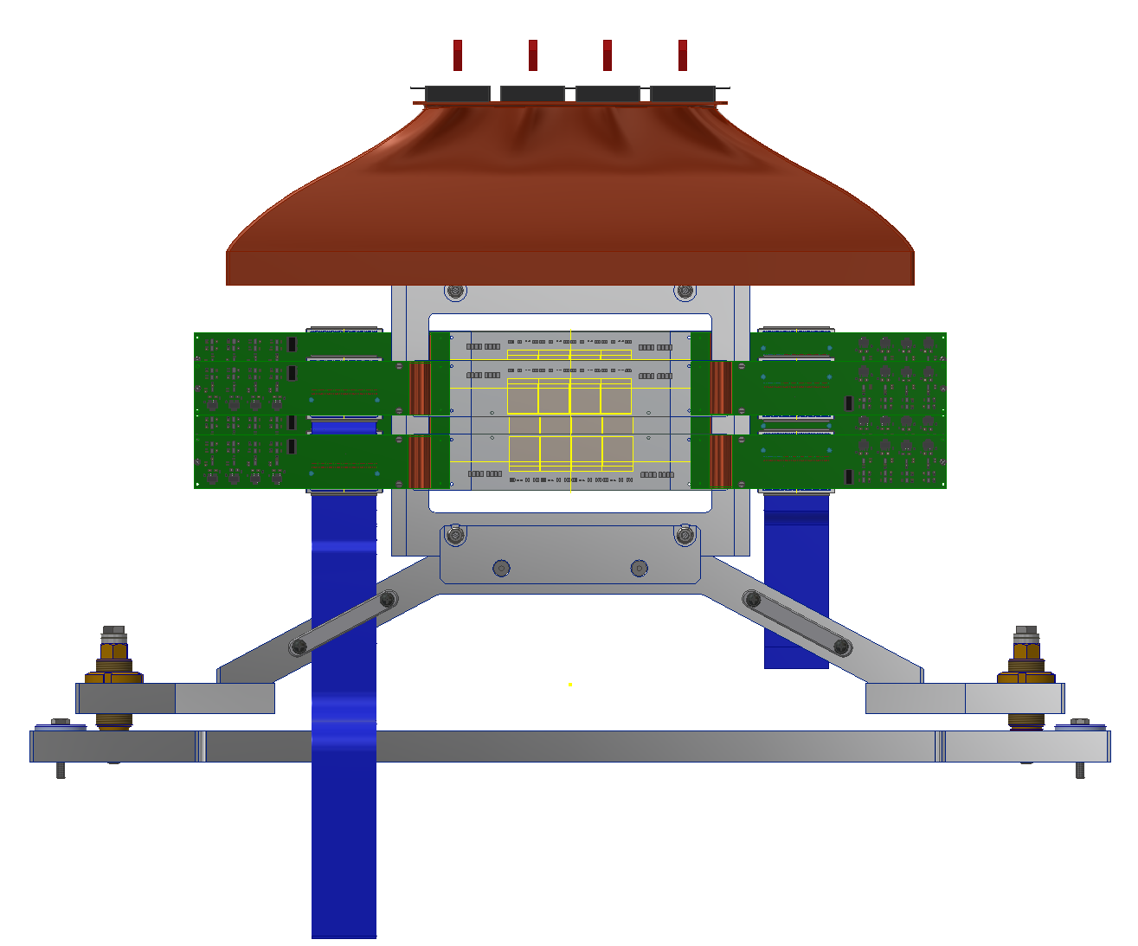
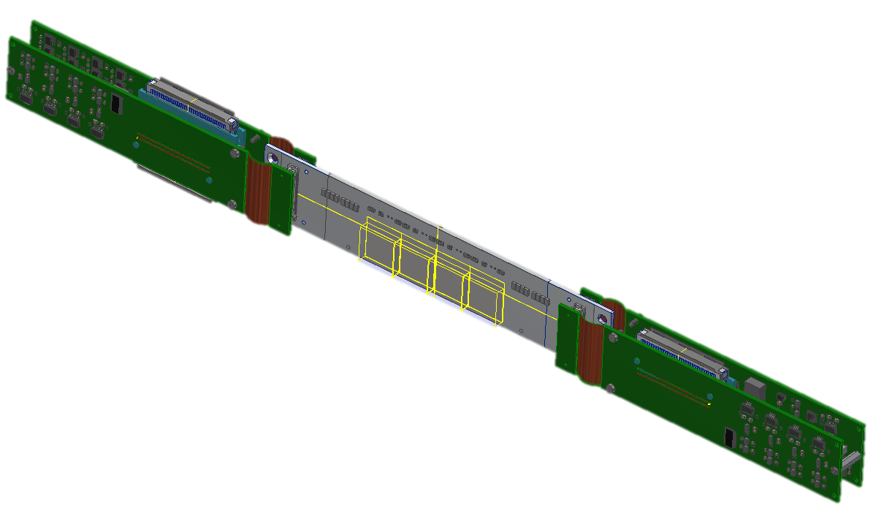
IT 1/2
Ladder

Slide 3
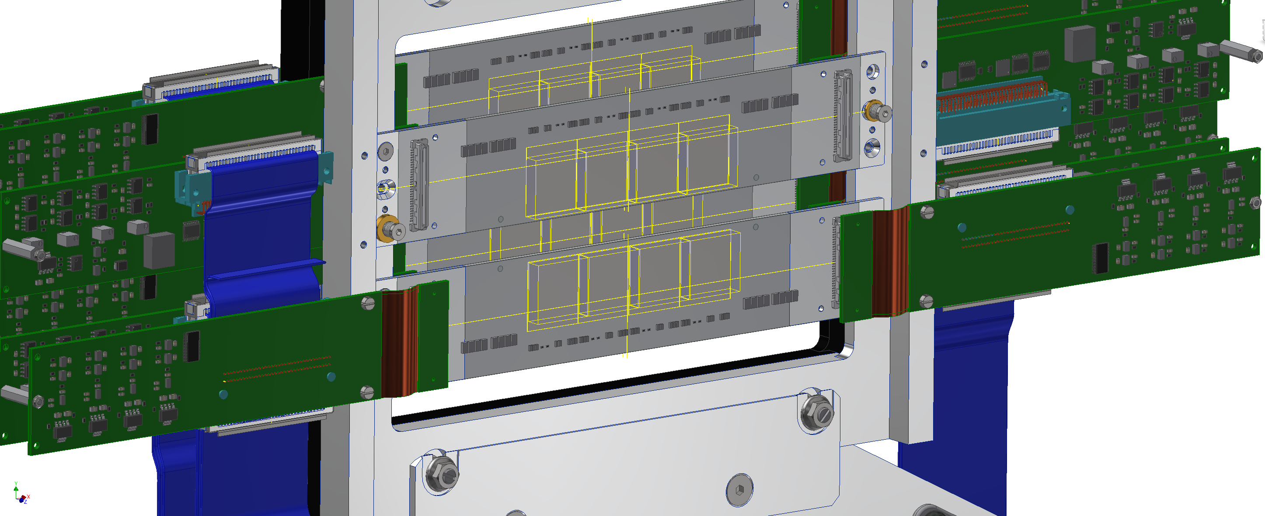
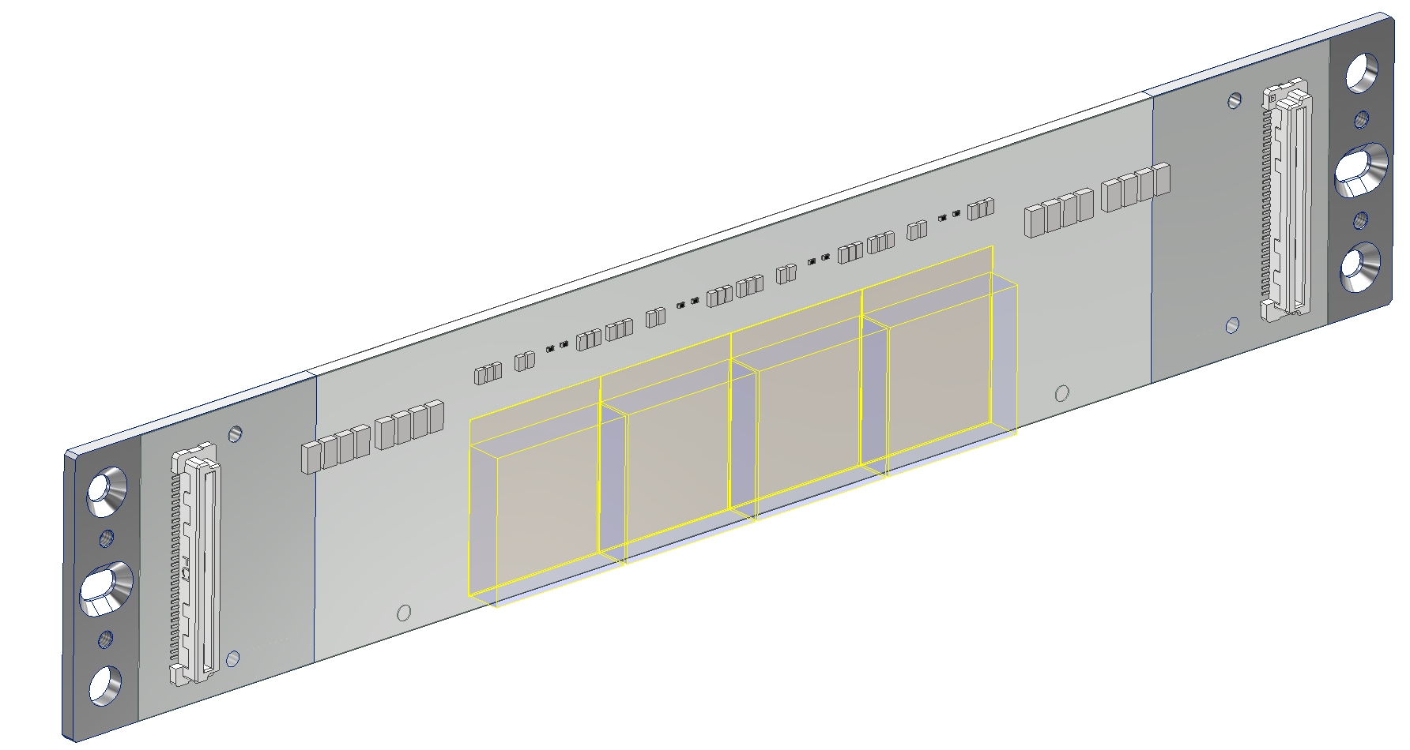
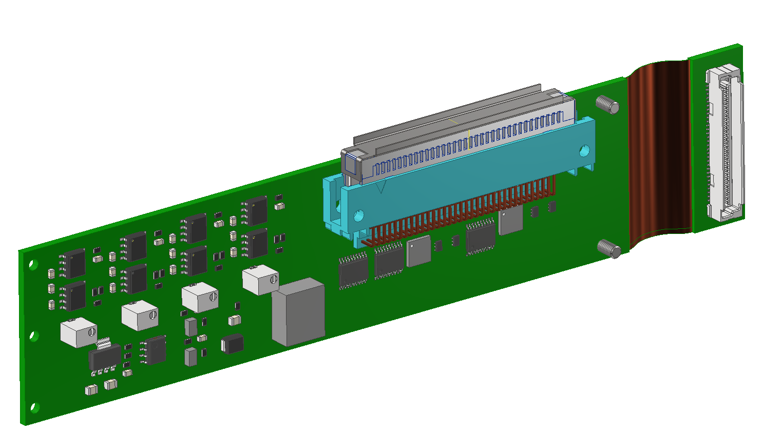
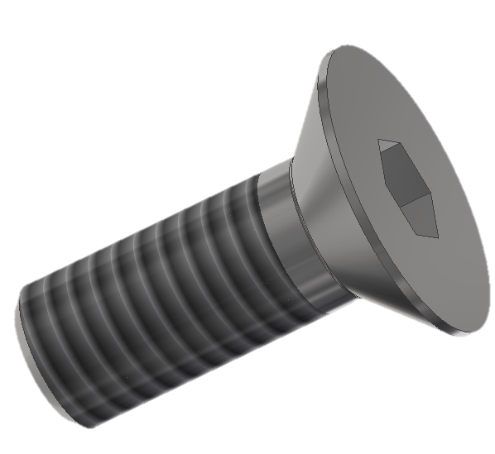
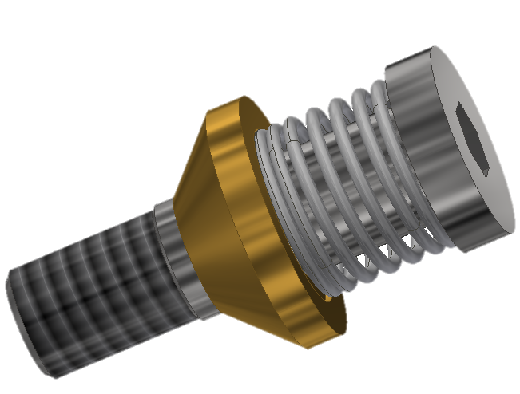
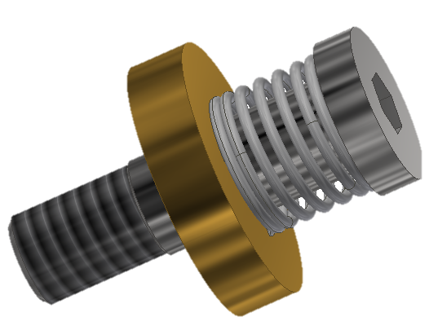
IT 2/2

Slide 4
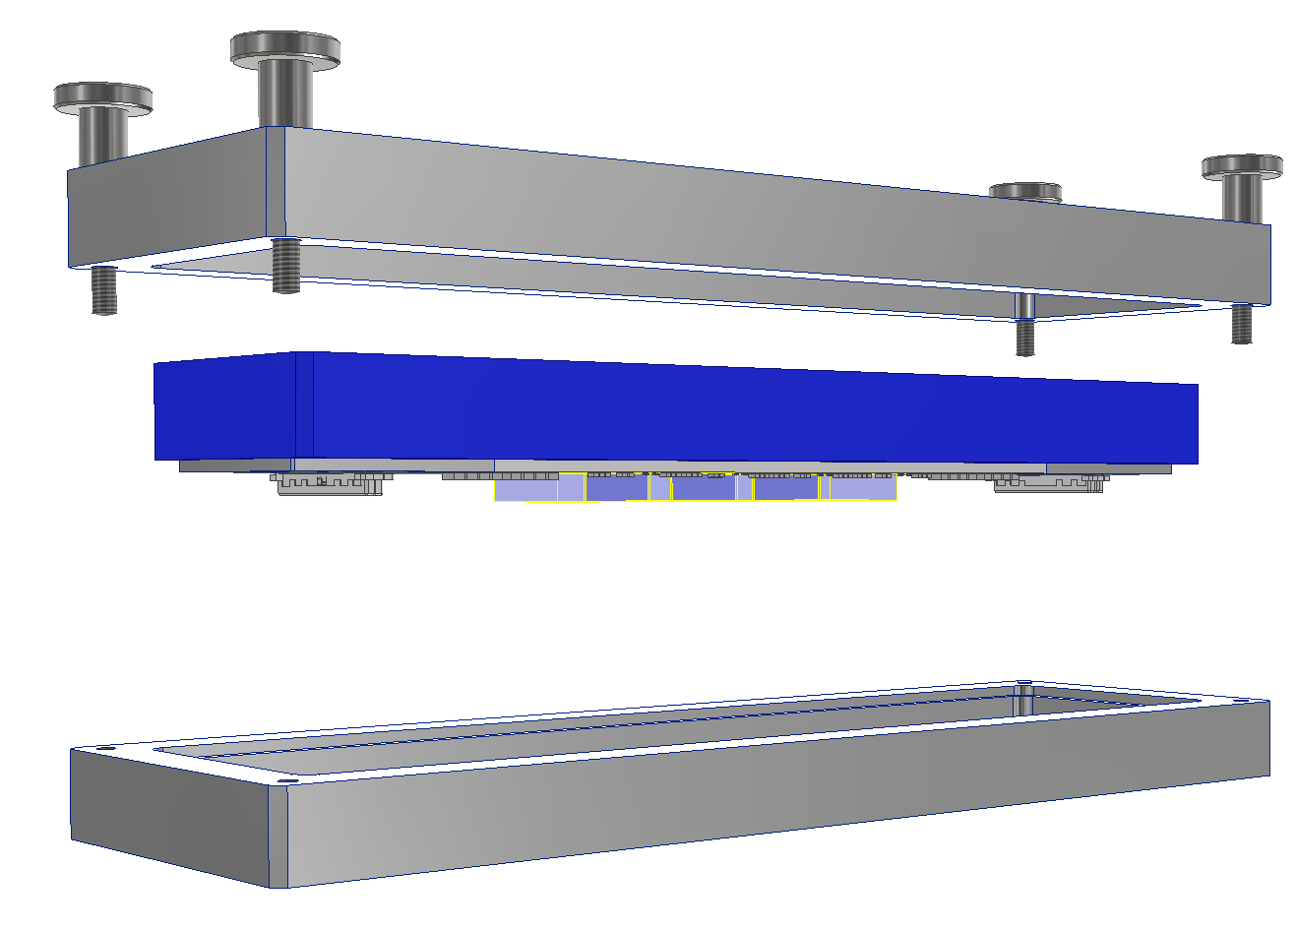
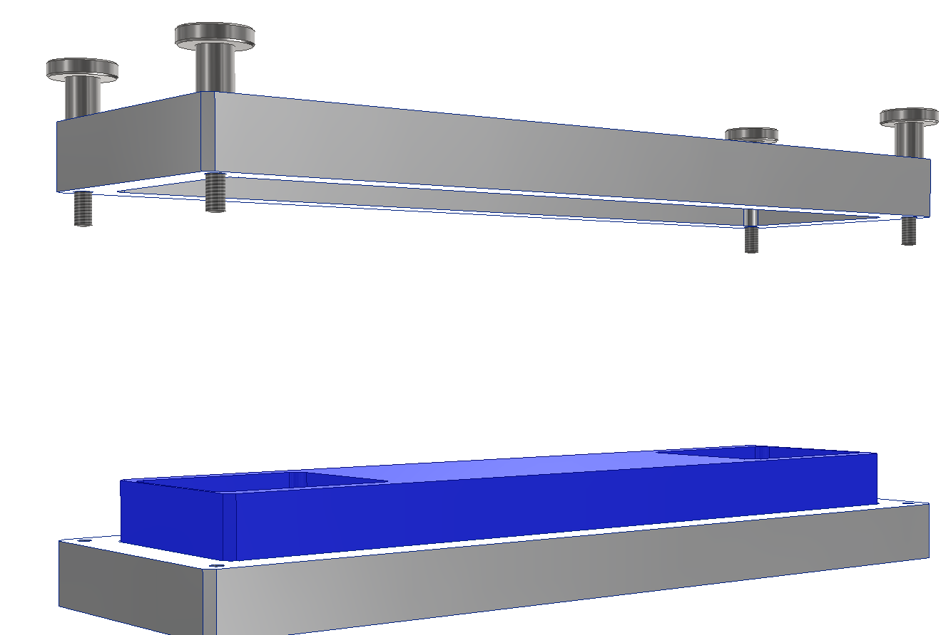
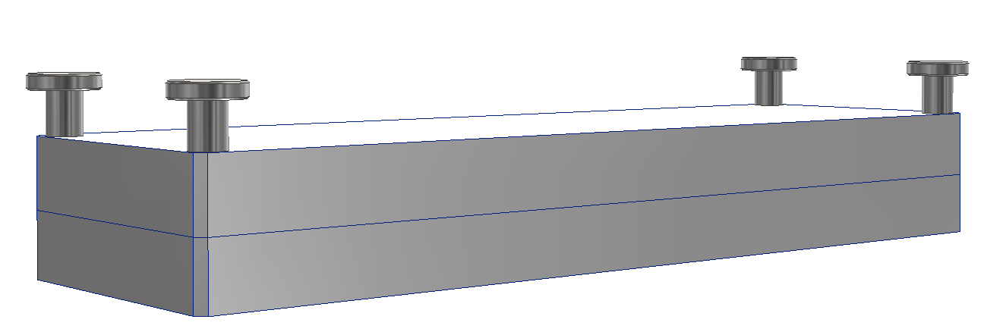
LADDER STORAGE AND TRANSPORTATION TOOL
The Blue support is placed into the grey base
The grey cover is closed.
The inside is free to move few tens of millimeter
The assembled ladder is fixed to the blue support.
The blue part is a strong-back to give stiffness to the ladder

Slide 5
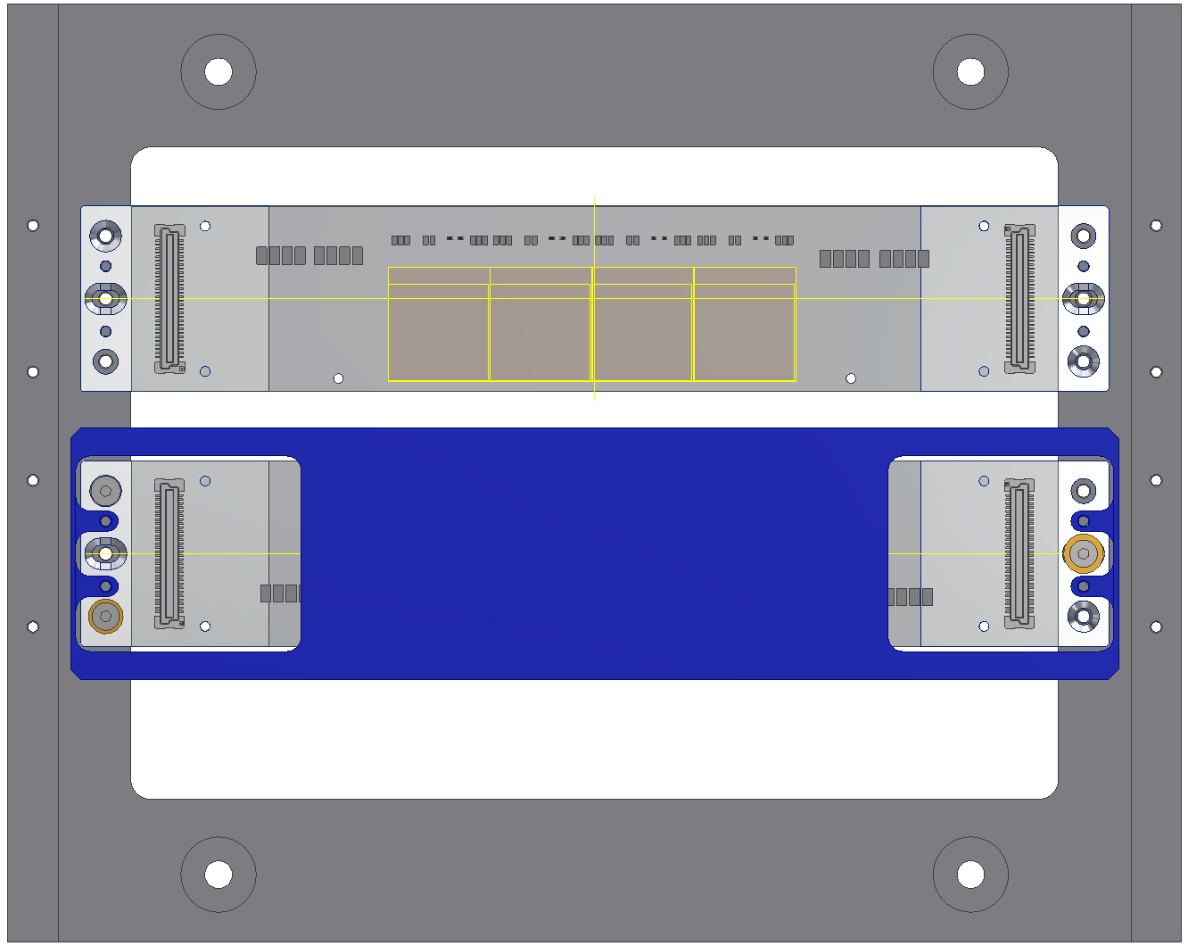
LADDER TRANSFER TO THE FRAME

Slide 6
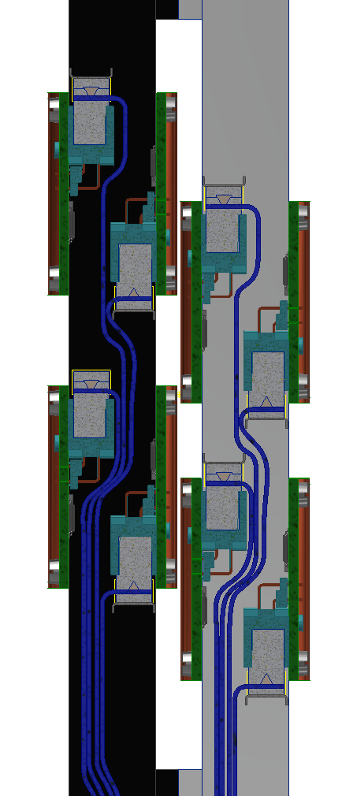
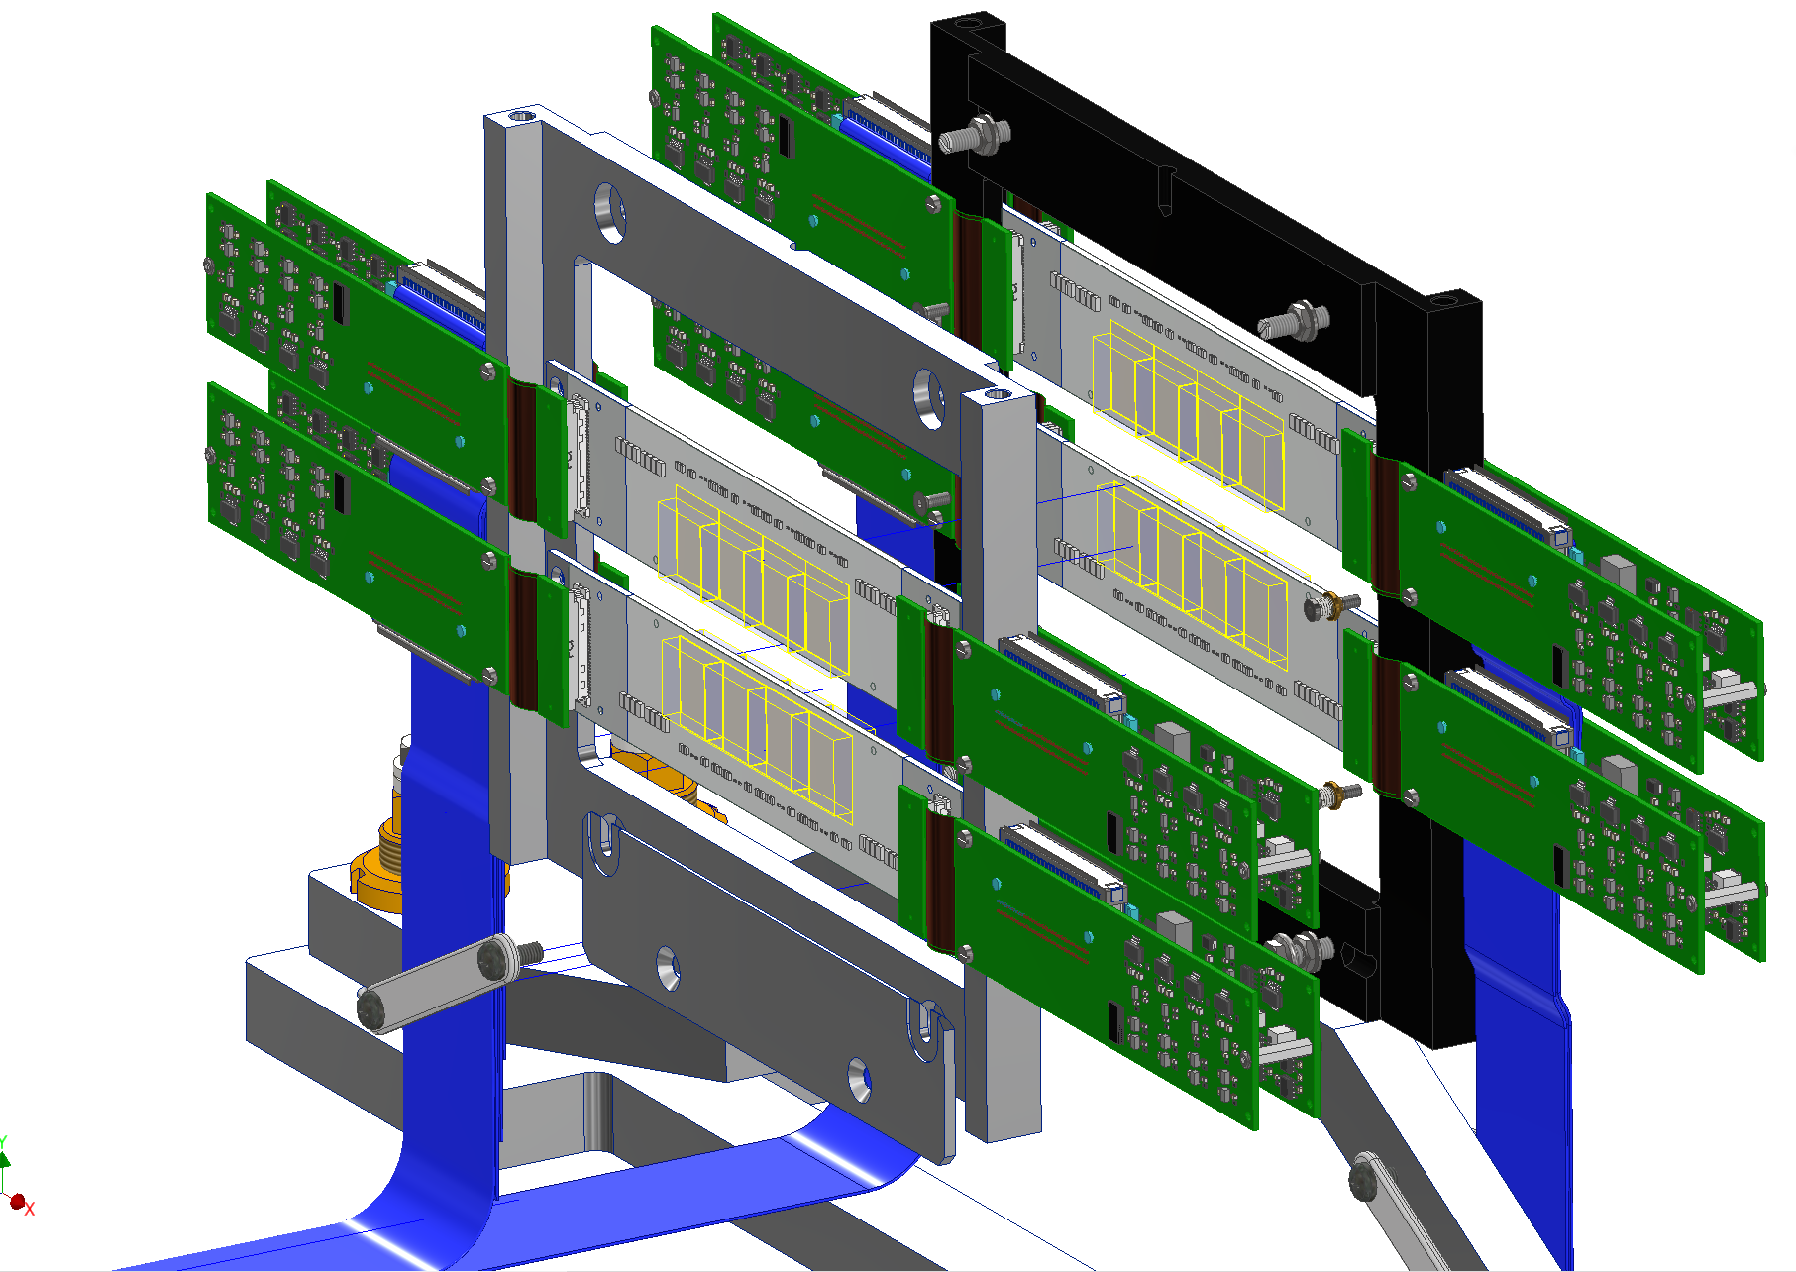
FRAME INTEGRATION

Slide 7
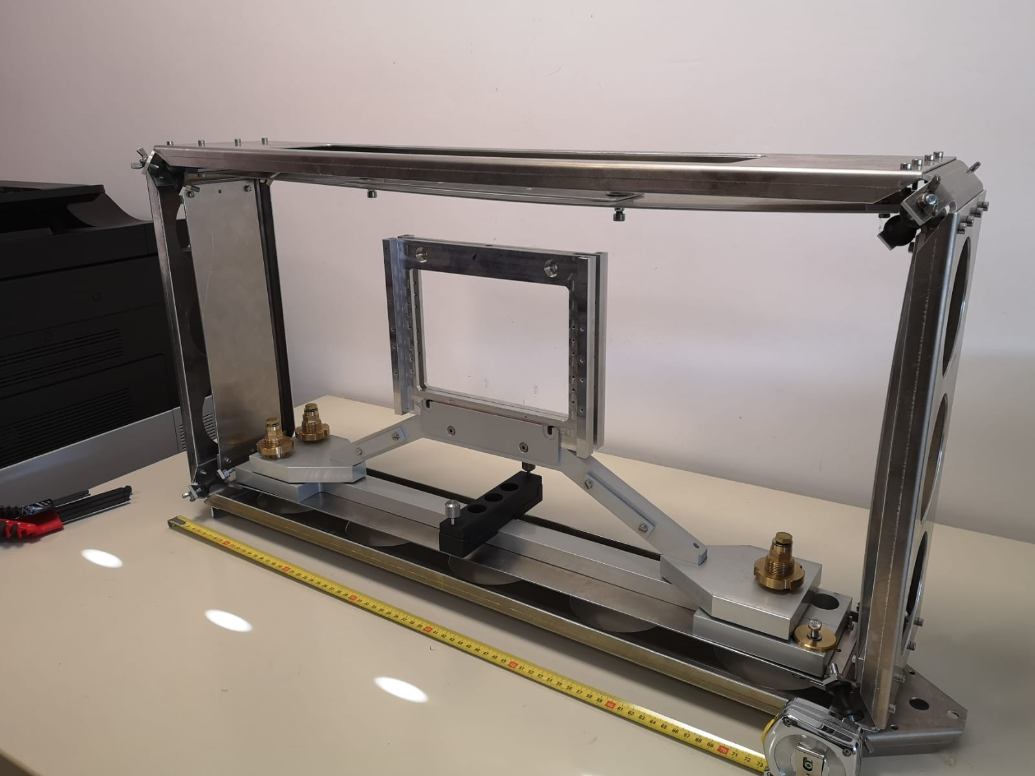
Transportation Tool
(flight case not procured yet)
The IT support is already produced
The damped transportation tool is manufactured
The flight case to be procured

