Slide 1
Simulation on cell saturation and timing

Slide 2
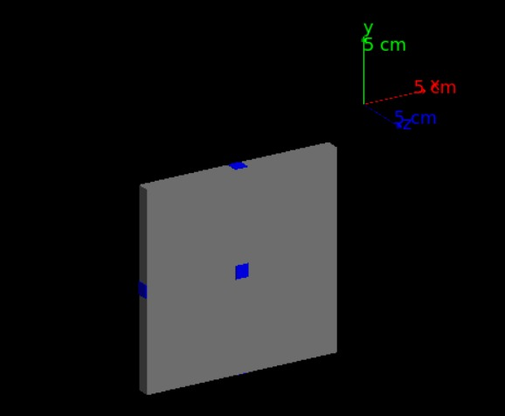
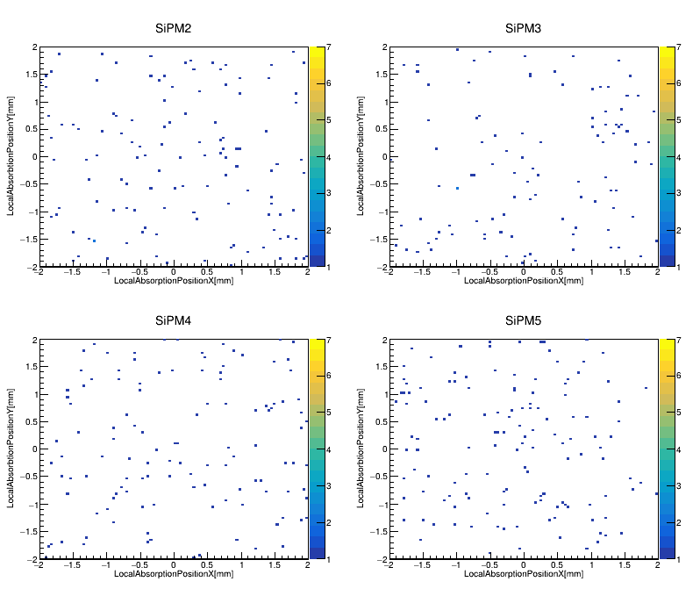
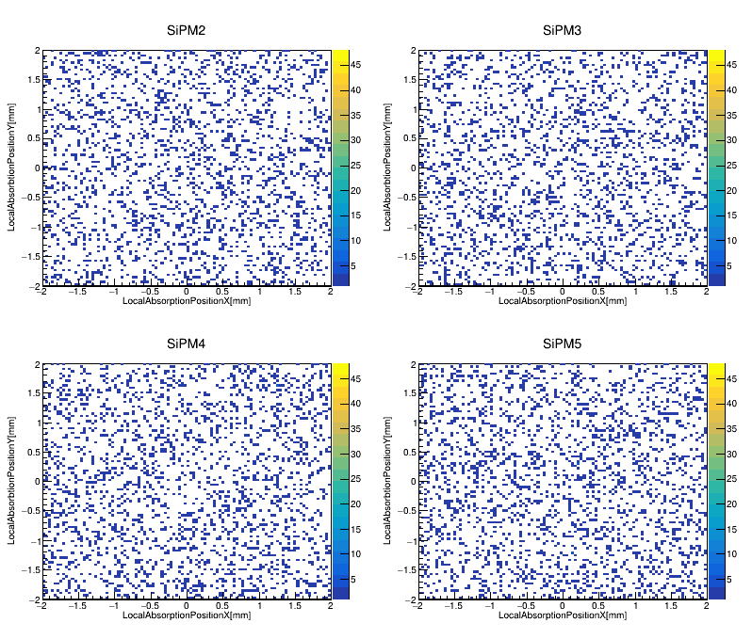
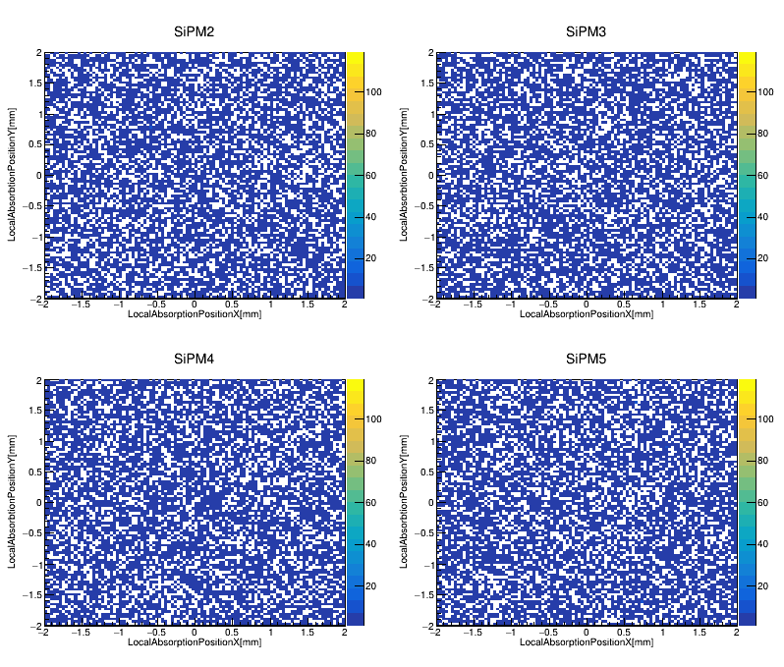
We have developed a simulation that tracks every optical photon generated by scintillation in a tile. The code is based on GEANT4.
We have simulated a tile 10x10x1 cm³ wrapped with a diffuse reflector
The tile is equipped with 4 SiPM 4x4 mm² with 40 um cell placed on the four sides
The simulation code takes into account the Birks saturation effect
We have simulated particles crossing the tile in the center
Each square is a SiPM
Proton
Carbon
Iron
SIDE
Photons 120
Fired Cells 120
SIDE
Photons 2300
Fired Cells 2000
SIDE
Photons 11000
Fired Cells 6500
Increasing cell saturation

Slide 3
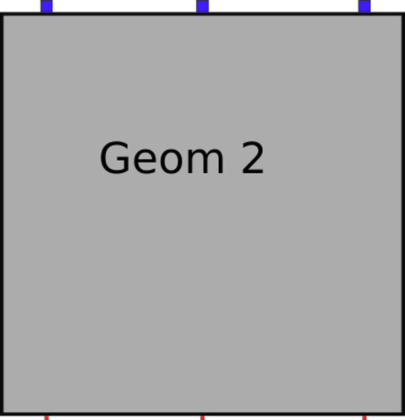
The tile is equipped with 3 SiPM 3x3 mm² on one side and 3 SiPM 1x1 mm² on the other site
In the following plots you can see the fraction of photons lost due to cell saturation as function of cell size for different particle species and for two particle crossing positions
0
1
2
The saturation effect is the same for SiPM of different size since it is only related to the photon density on the sensor
3
4
5
0
1
2
3
4
5

Slide 4
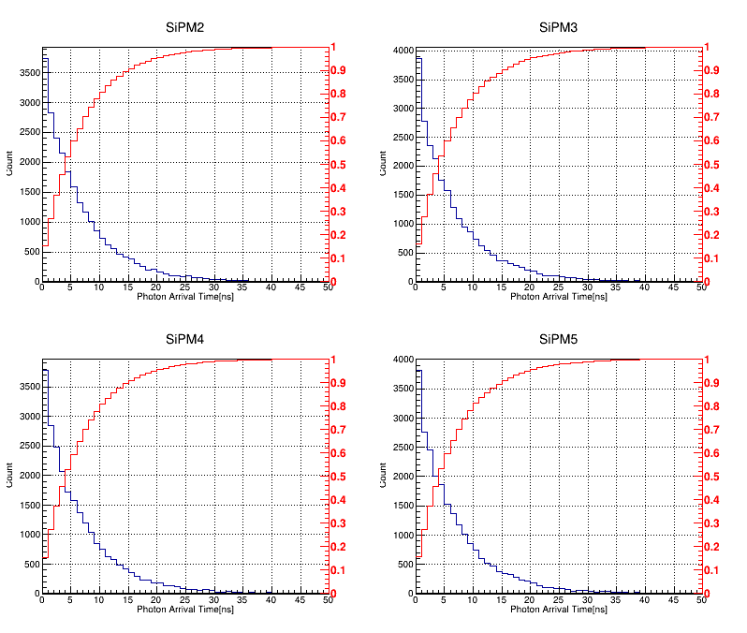
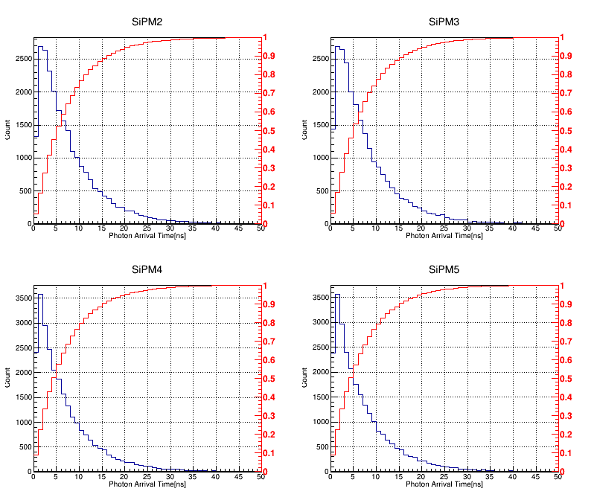
We have simulated a tile 10x10x1 cm³ wrapped with a diffuse reflector
The tile is equipped with 4 SiPM 4x4 mm² with 40 um cell placed on the four sides
Center
Corner
50% of photons are collected in 5ns
80% of photons are collected in 10ns
The collection time does not change with particle species

Slide 5
Sr90 test in Bari

Slide 6
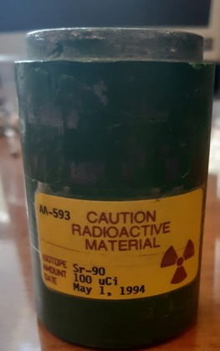
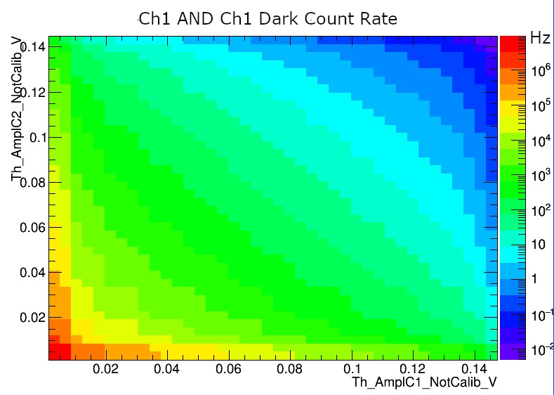
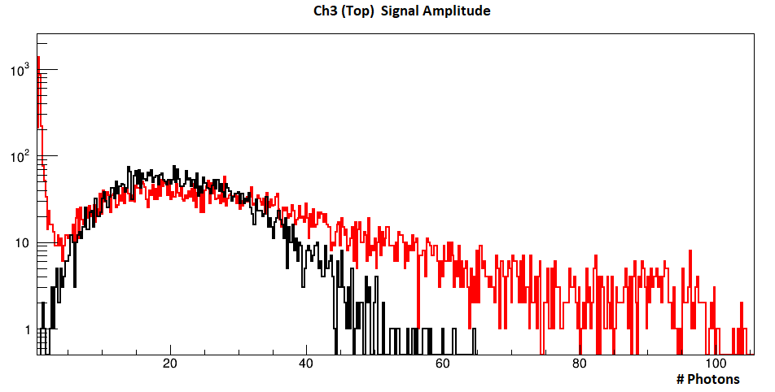
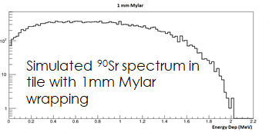
BC-404 scintillator 10x10x1 cm³ tile tested with Cosmic rays and ⁹⁰Sr radioactive source coupled to AdvanSid NUV SiPMs (4x4 mm 40um cell)
  Activity 39,5 uCi -> 1.49 GBq
AdvanSid trans-impedance preamplifier
Trigger obtained from logic AND of two opposite SiPMs
  Threshold set to reduce the noise trigger rate due to coincidence of dark noise of two SiPMs
Preliminary
Cosmic Rays
⁹⁰Sr Source
1 kHz ( ⁹⁰Sr 1MHz)
50 mV
50 mV

Slide 7
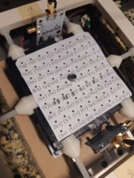
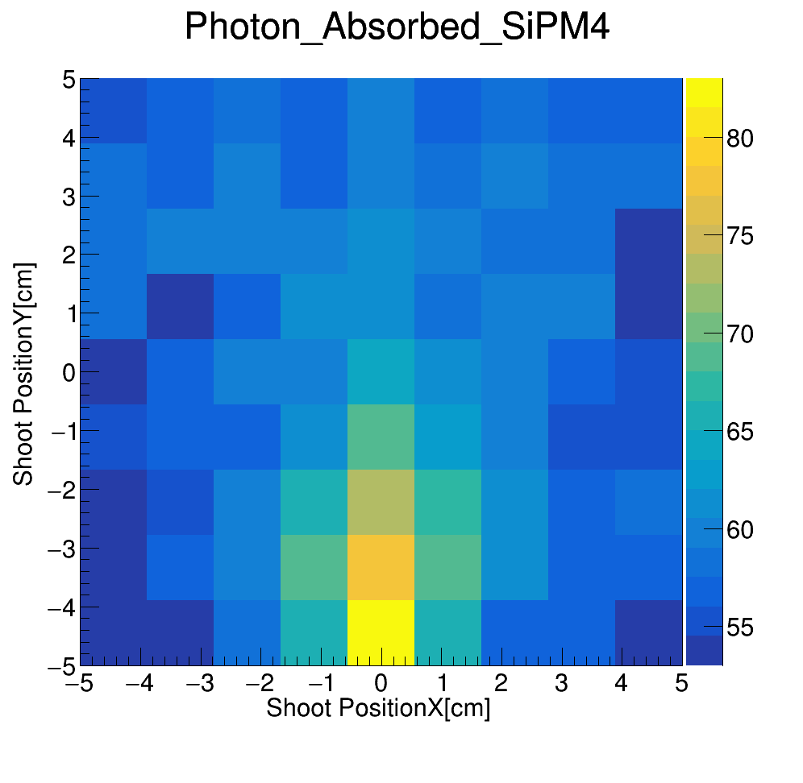
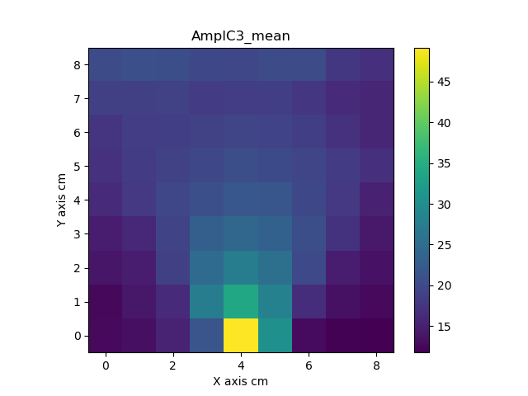

⁹⁰Sr radioactive source placed in different positions with a 1 cm step in both X and Y to study the uniformity in light collection
The radioactive sources was simulated in different position with 1mm step in both X and Y and the results have been clustered in 1cm step
Laboratory
Simulation
Preliminary
(Ph)
Preliminary
(Ph)
Similar distributions, but simulation does not take into account SiPM/Scintillator optical coupling and real wrapping reflectivity.

Slide 8
CNAO Beam test

Slide 9
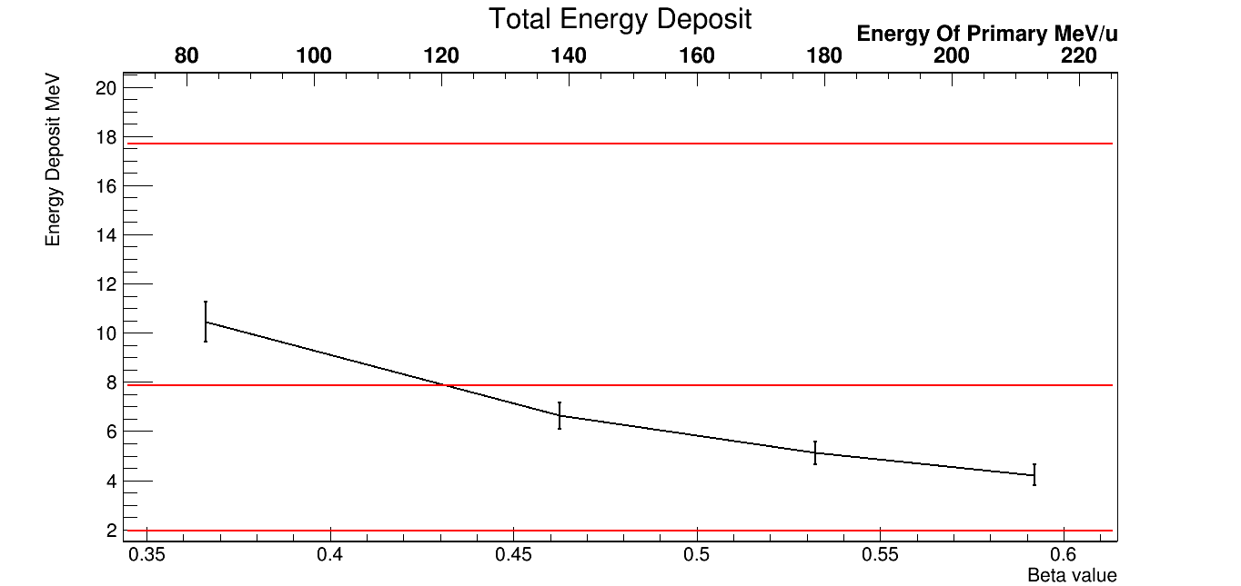
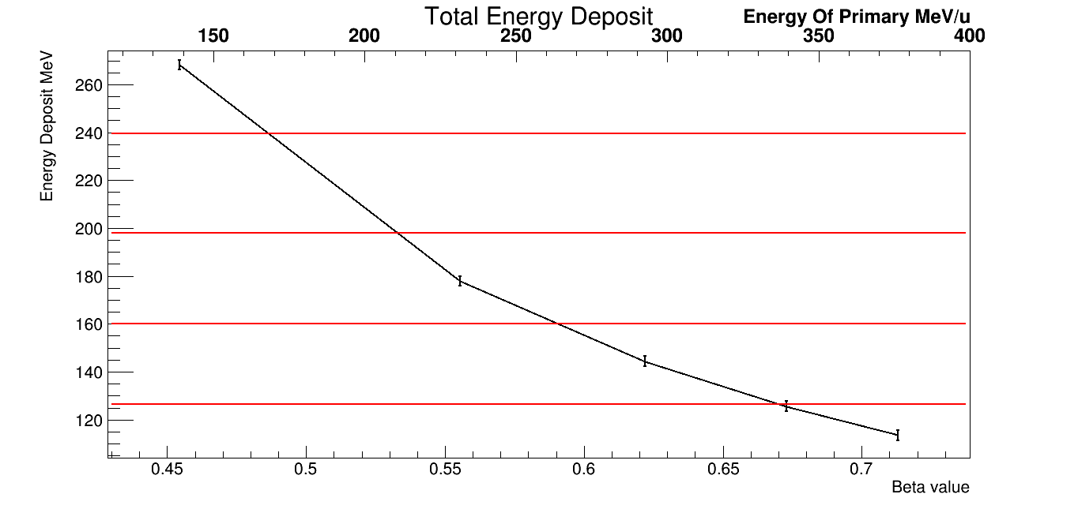
We have performed a beam test @ CNAO in July 2020
The energy release of high Z particle with β=1 in plastic scintillator can be mimicked by low Z low β protons and C nuclei.
At CNAO we can request different beam configuration with proton energies ranging from 80 MeV/n to 220 MeV/n and C nuclei energies ranging from 140 MeV/n to 380 MeV/n
Li*
Na*
C
Ne*
p⁺
He*
F*
O*
H*
* Kinetic Energy 150GeV/n, β ~ 1
* Kinetic Energy 150GeV/n, β ~ 1

Slide 10
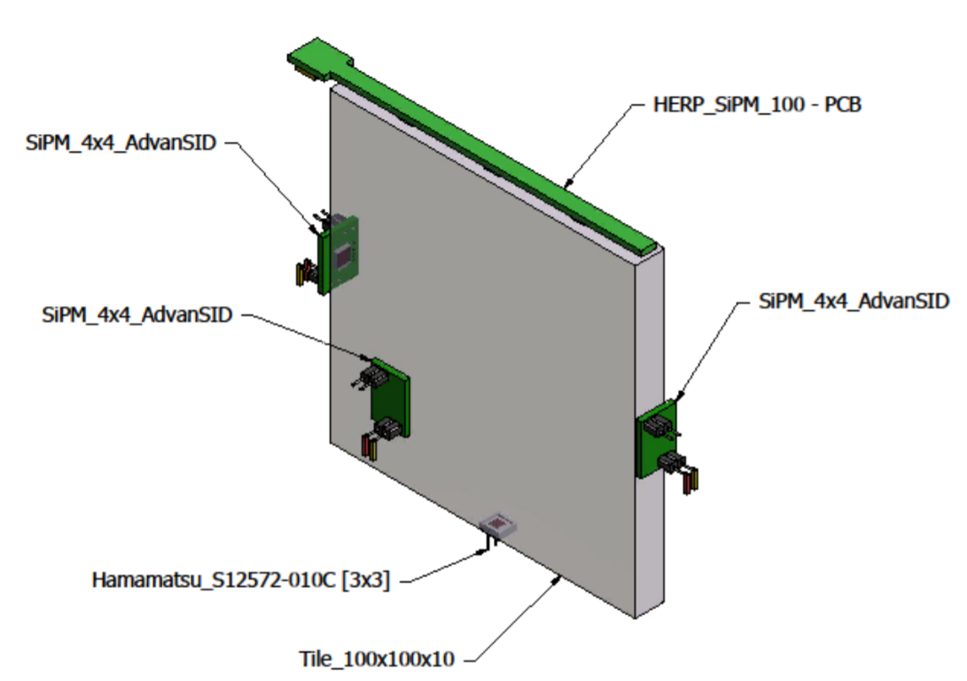
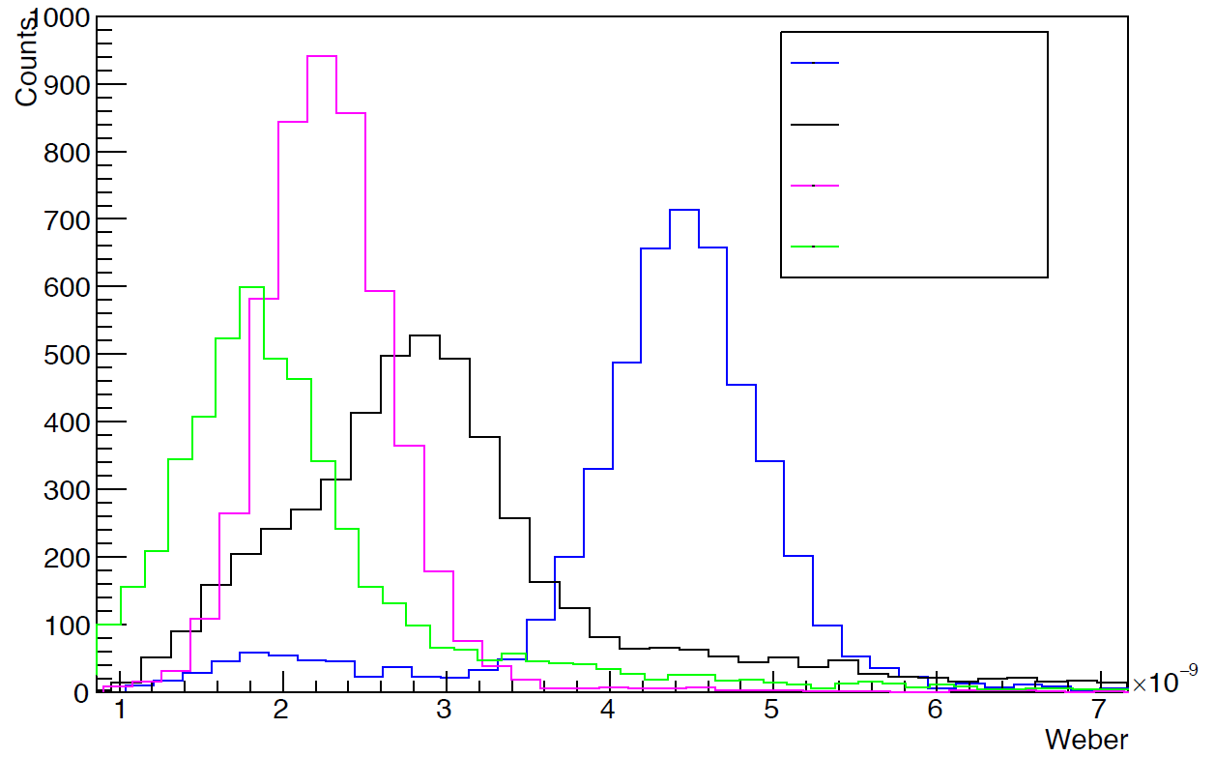
BC-404 tile coupled with Hamamatsu SiPMs 3x3 mm (15 and 50 µm cell)
Trigger obtained from logic AND of two opposite AdvansSID SiPMs
3 x S13360-3050 3x3mm - 50 μm cell
Data (a.u.)
Simulation (Ph)
Preliminary
Proton beam
3 x S13360-3050 3x3mm - 50 μm cell
Proton beam
70 MeV
S12572 3x3 mm-15 μm cell
120 MeV
170 MeV
Data (a.u.)
226 MeV
Simulation (Ph)
Preliminary
Proton beam
Integrated signal
V x s

Slide 11
Preliminary studies on CAEN DT550W DAQ board

Slide 12
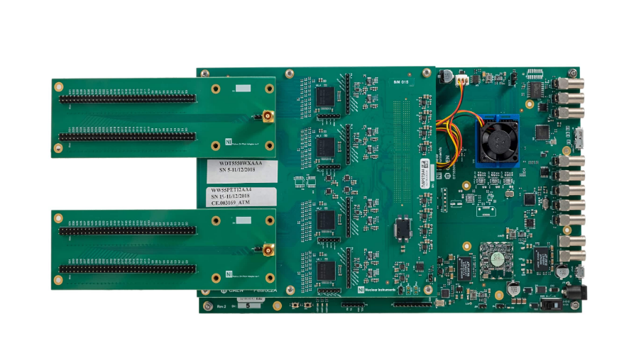
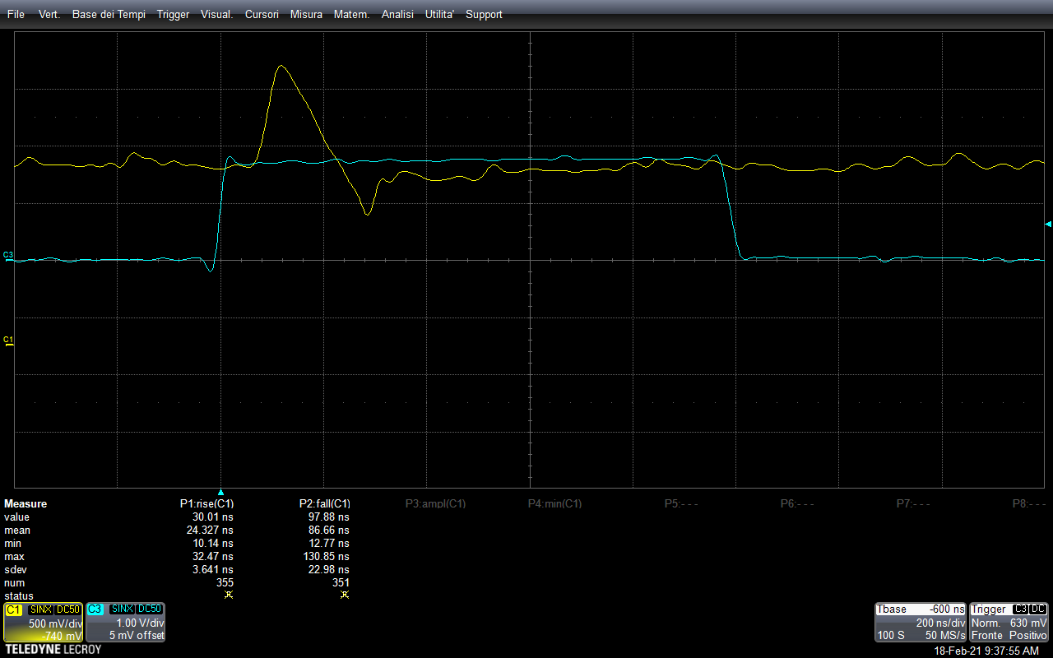
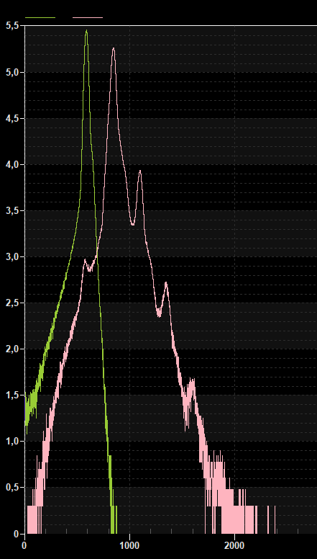
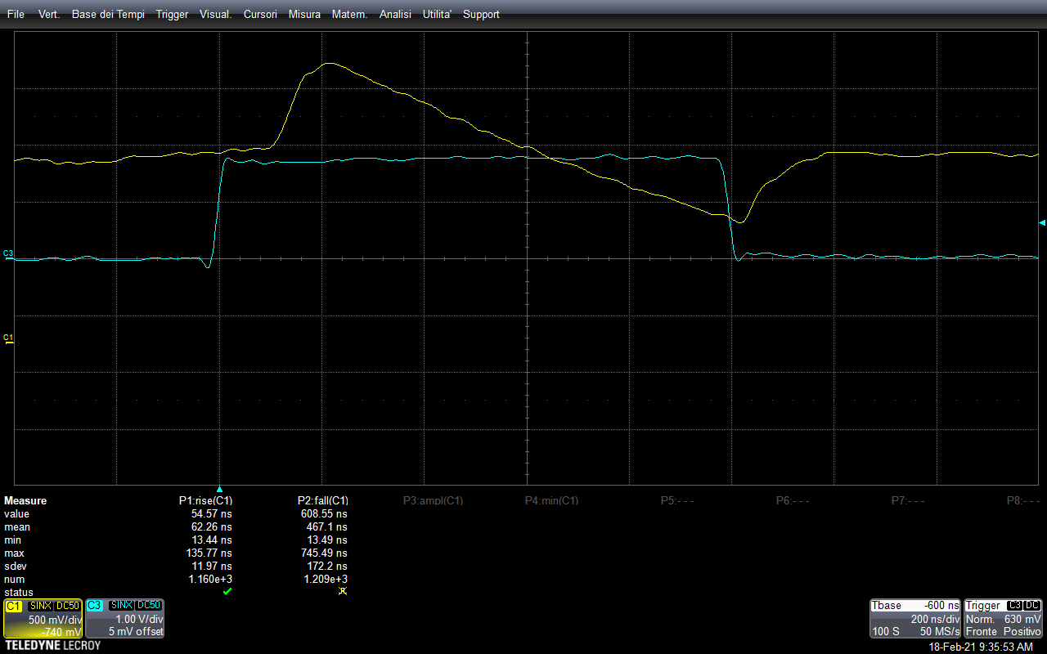
We plan to use the CAEN DAQ board DT550W equipped with 4 CITIROC chip to readout the PSD prototypes at 2021 CERN beam test
We are performing some very preliminary test with SiPM in order to understand better all the functionality
S13360-3050CS
1 pe
2 pe
Fast shaper output for triggering
Pedestal
3 pe
4 pe
We plan to write a new FPGA firmware to implement the PSD prototype in the onlina DAQ system @ beam test
High Gain shaper output
HV: 55V
Ampl Gain: x600

Slide 13
Beam test mechanics

Slide 14
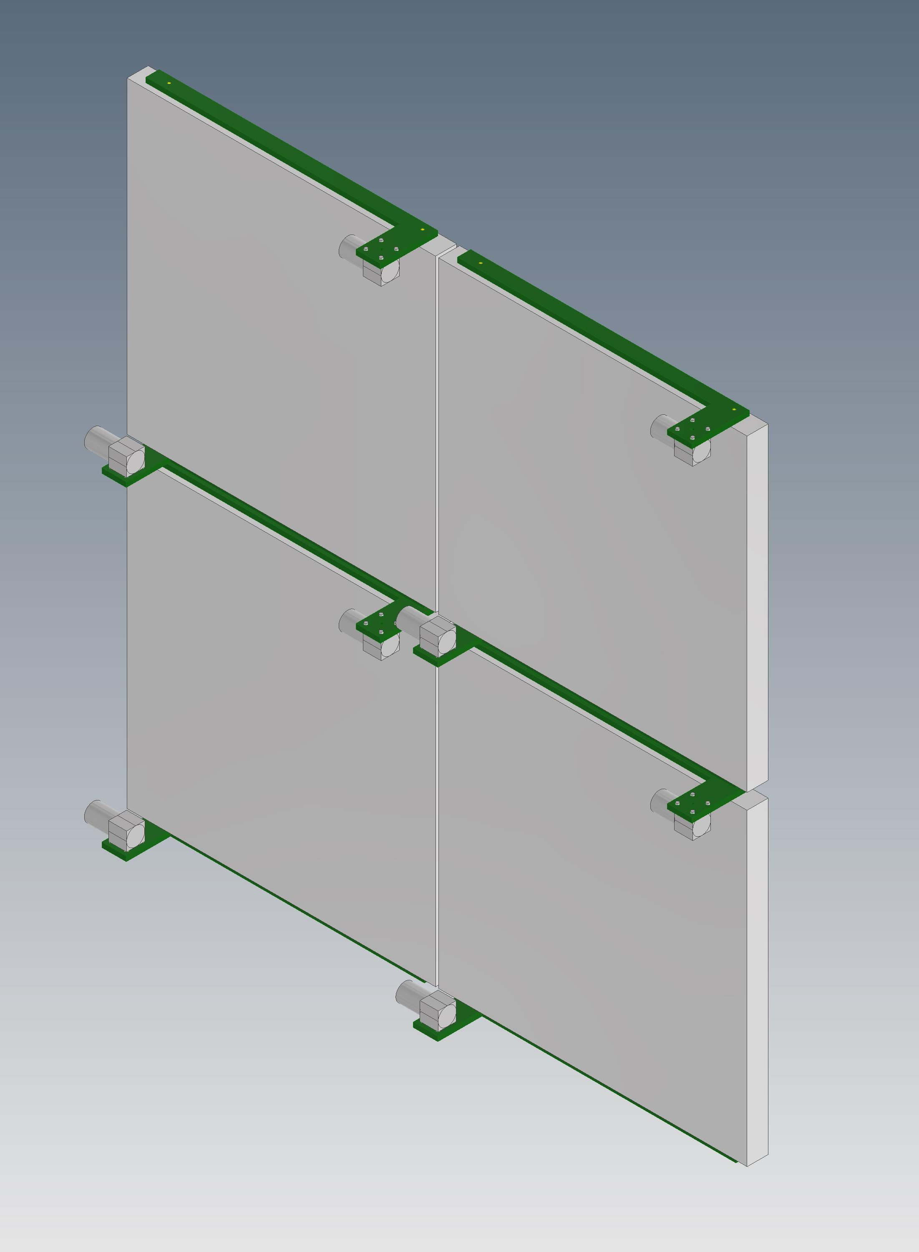
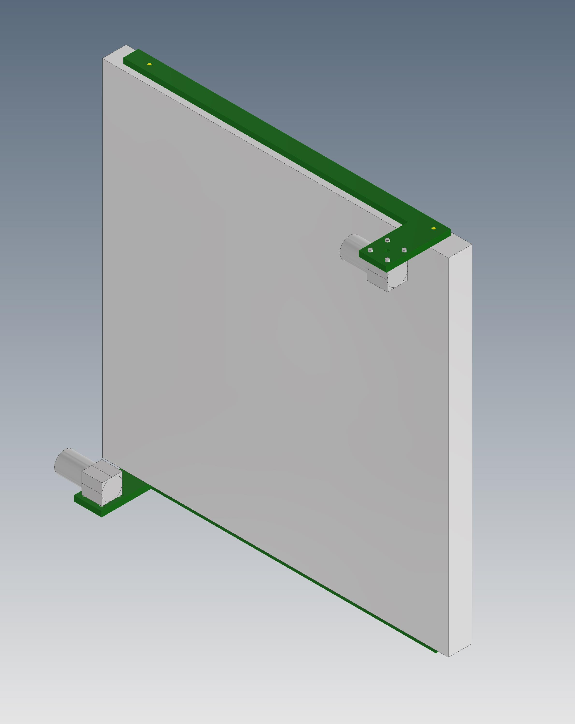
We plan to build a tile prototype with two different kind of Tile+PCB configuration: one from Pavia and one from Bari
PV Ladder: 5 Scinitllating tile (10x10cm)+ 1 long PCB (10x60cm)
BA Ladder: 5 Scinitllating tile (10x10cm)+ 10 short PCB two per tile
Tile protoype active area 50x50cm
With the support of our engineer collegues we will design a mechanics similar to the one designed for the bars prototype

