Slide 1
Advanced beam diagnostics
Alessandro Cianchi
On behalf of SPARC_LAB collaboration
WA 1-2-3
WG 1-13-14-19

Slide 2
Outline
Diagnostics definition for the current layout
R&D on compact devices
More from daily experience
New advanced solutions

Slide 3
Layout
Definition of three main areas of diagnostics for 6D phase space characterization compatible with space occupancy and CDR requirements
  Laser heater zone
  Bunch compressor
  Before undulators
Fine tuning of the elements distance in order to accommodate the diagnostics

Slide 4
General issues for the devices
Compact → small devices
Short bunches, few fs, very close each other, ps level → Polarix
Weak, few pC → Combo-Turbo-ICT toroids
Small, few microns → high resolution
Plasma accelerated → innovative solutions

Slide 5
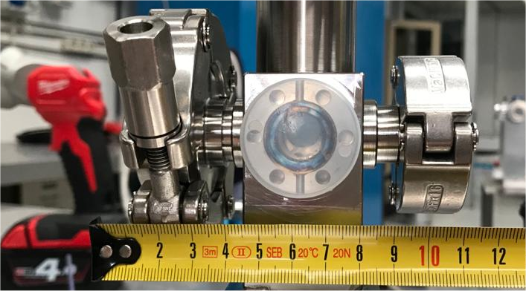
New View Screen vacuum chamber
First Prototype
Maybe we can gain still a little bit, in the order of 5 mm

Slide 6
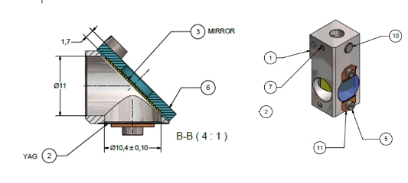
New View Screen holder
Courtesy Valerio Lollo
First prototype new view screen holder
It very compact.
We need a reference to mount correctly the YAG screen
It will be installed with other monitors in the new SPARC GUN
Also some of them will be installed in the EXIN interaction chamber

Slide 7
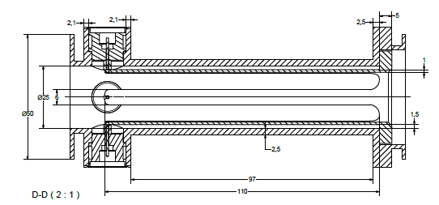
New stripline prototype
WP 14 (A. Stella, G. Franzini) have just started to develop a new compact striplines, with an outer diameter of 30 mm and length of about 110 mm
Drawing by G. Di Raddo
After completion and vacuum feedthrough procurement, a prototype will be built and tested on bench to check electrical properties (strips characteristic impedence, transfer impedance, output voltage level)
PAL has developed a striplines 30 mm diameter and 160 mm length, so this is a more compact version.
The design is preliminary, maybe it could be possible to reduce still a little bit
We consider to test under beam in about one year

Slide 8
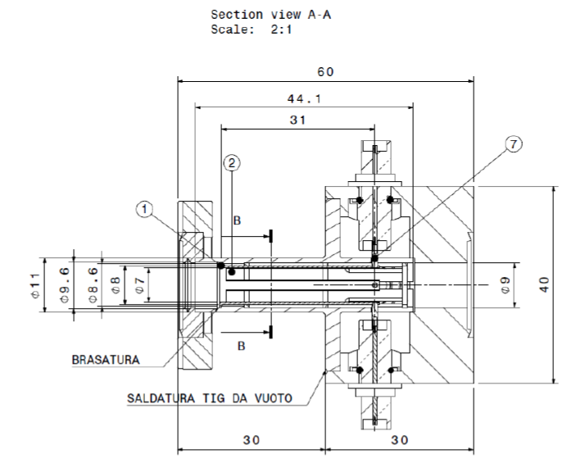
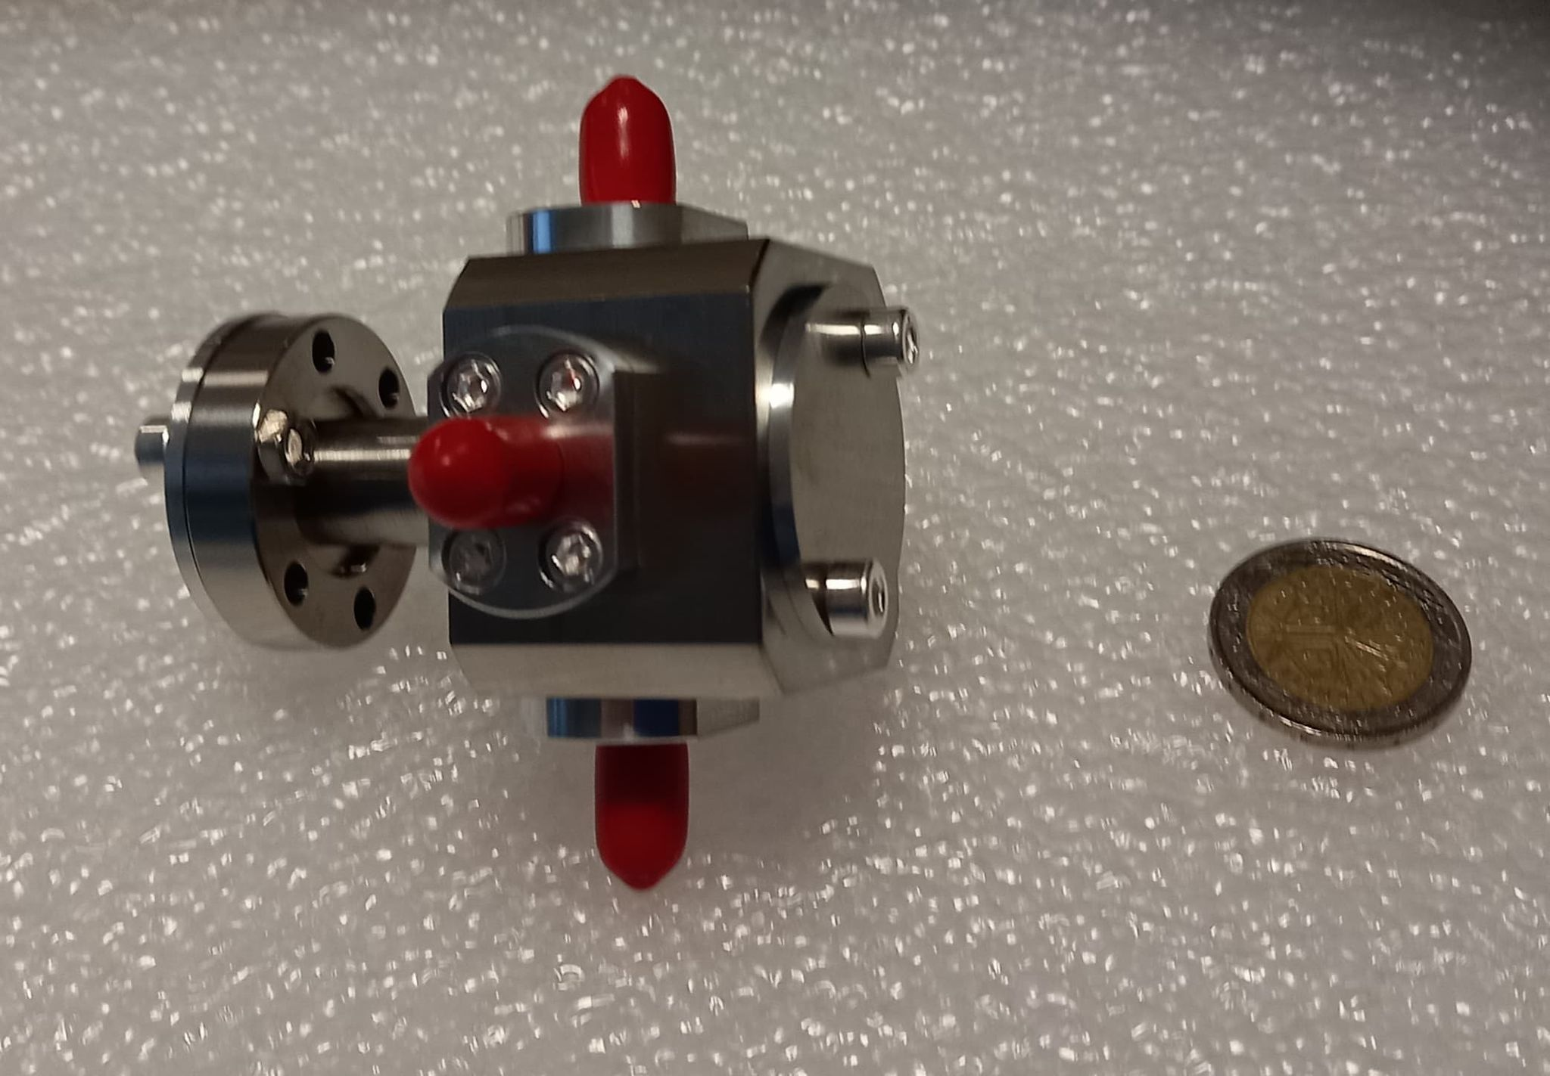
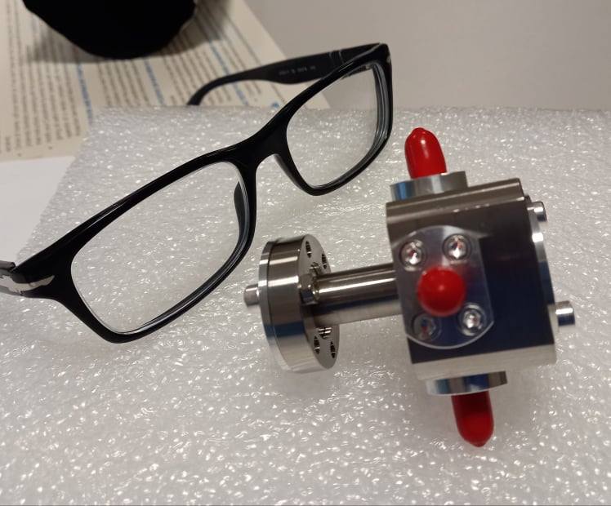
New miniature BPM
Fermi is developing a revolutionary compact stripline
11 mm diameter and 70 mm length.
It could be a very compact device.
Installation on the machine is ongoing
There is now a collaboration to help in the development of this device, we’ll start to join them in the first measurements with beams
We plan to realize a double copy of the second prototype and to test one also here at SPARC

Slide 9
Weak charge
Precise measurement of the beam charge looking at the correct launch phase in the gun is mandatory for proper beam injection.
Bergoz developed a new toroid, called Turbo- Toroid, working in frequency and not in time able to discriminate between dark current and beam current
The resolution is at level of tens of fC
But the radiation protection needs to know also the dark current at any time and having a second toroid is not a good choice for compactness

Slide 10
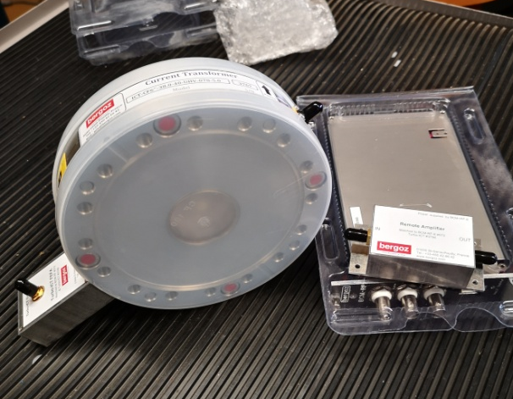
New Combo Toroid
A dedicated toroid with a conventional one and a turbo toroid (Turbo+ICT), has been designed and realized for us by ‘Bergoz Instrumentation’ equipped with dedicated hardware/software acquisition system
We planned to use for the new injector for the new SparcLab injector
But we have realized that need to know the beam charge at pC level also before and after the plasma module.
The system has been tested on bench and will be installed and tested next month.
If the test will be successful, we plan to replace the toroids with this new device

Slide 11
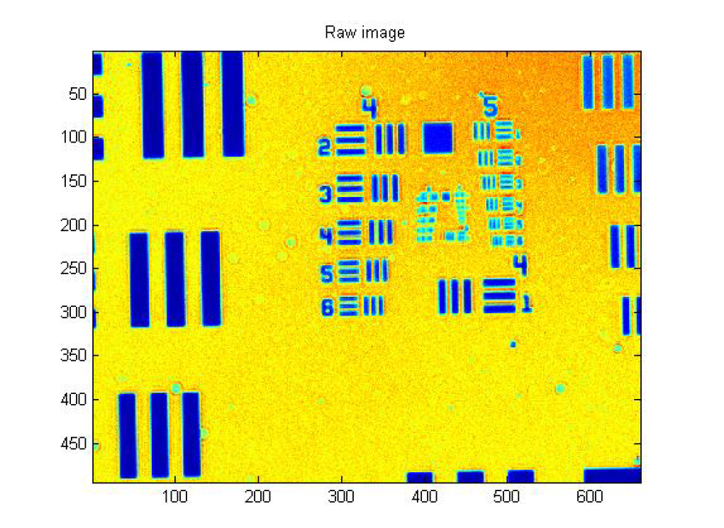
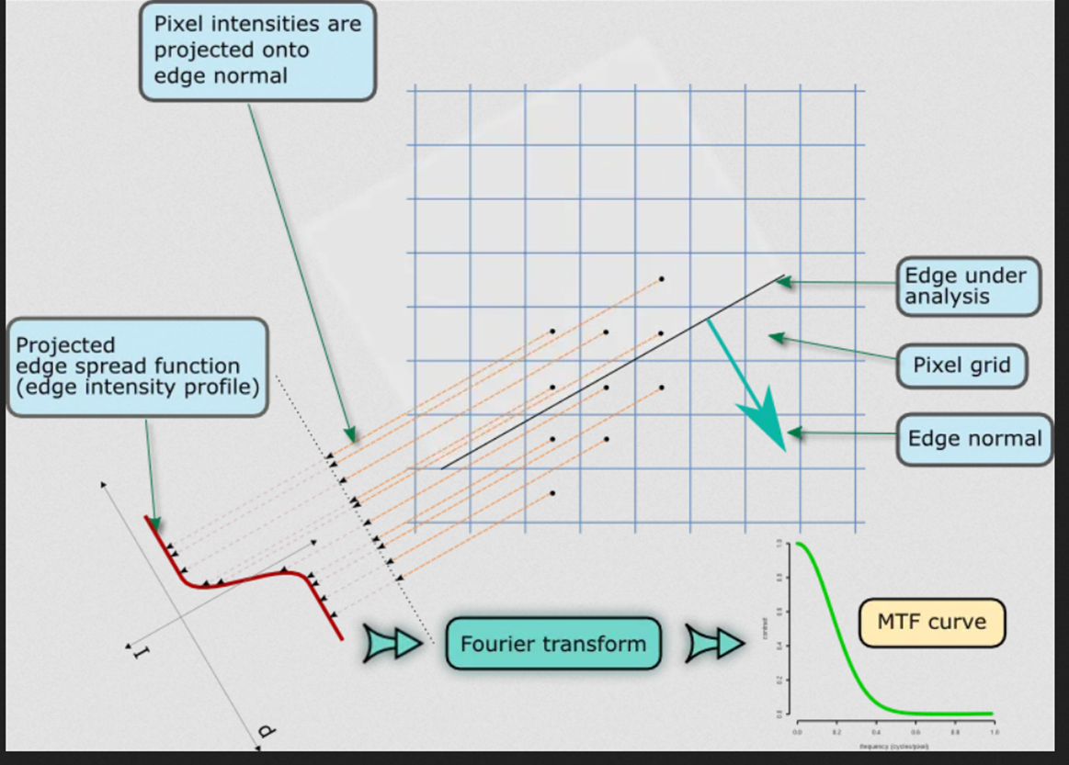
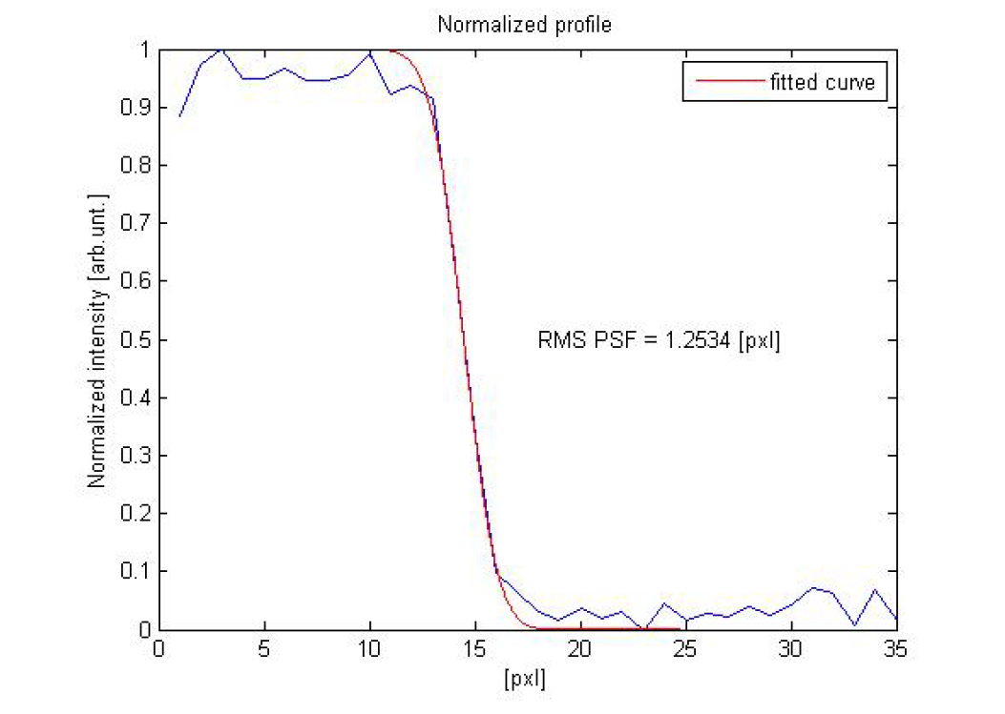
Resolution
Testing of several optic equipment in lab to measure the ultimate resolution
Collaboration with Fermi (Marco Veronese, Mario Ferianis), Modified Slanted Edge Method
Courtesy M. Veronese
Defense Technical Information Center Compilation Part Notice ADPO 11345

Slide 12
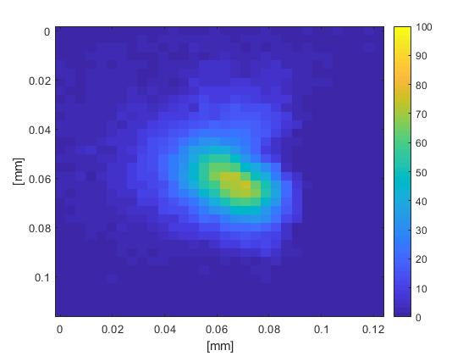
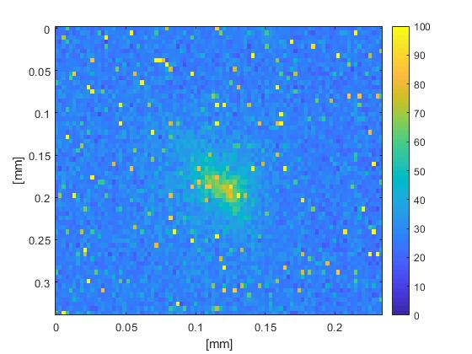
Witness size dimensions
We cannot measure witness just switching off driver because during the path they cross each other
But Vladimir Shpakov had a very simple and clever idea.
First, we take an image of both driver and the witness at the injection point.
The laser comb technique allows easily block the witness beam, thus we can take a shot of the driver alone.
The image of the driver alone is then subtracted as a background (average of 100 shots) from the image of the both driver and witness, thus leaving only the image of the witness.
The resulted image already can be used to extract the size of the witness.
Further measurements are ongoing to validate the method, to extend to beam envelope and transverse emittance
The witness, after subtraction of the driver
11.9×13.8 μm
Witness alone, driver is absent completely
41.8×66.4 μm

Slide 13
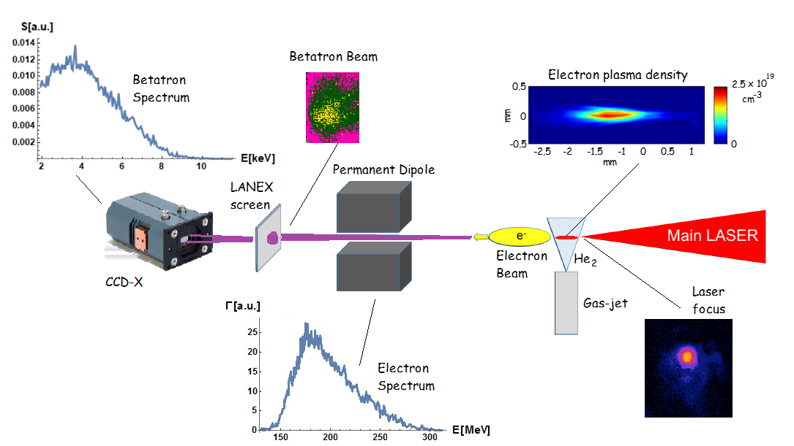
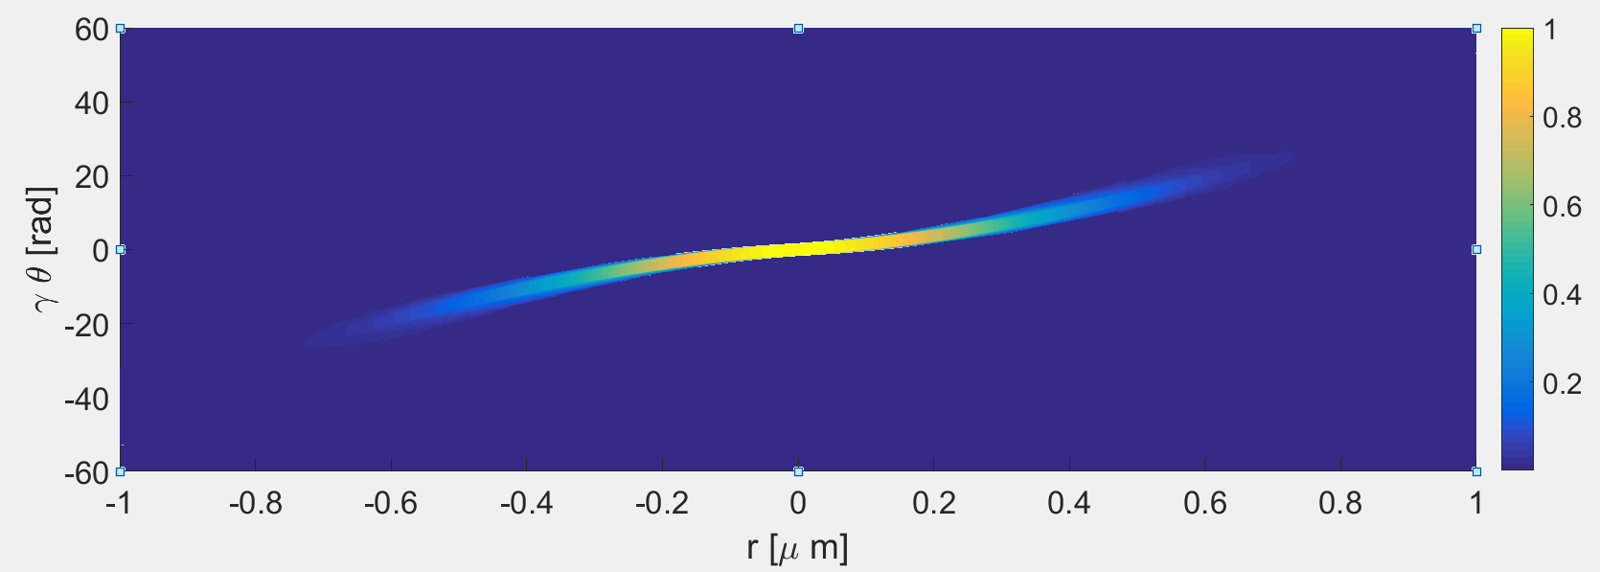
Betatron radiation analysis
Some year ago we performed the first measurement of the emittance including the correlation term using the betatron radiation
The beam profile is retrieved not simply the average dimensions
Simultaneous measurement of radiation spectrum and electron spectrum gives the possibility to retrieve the phase space.
Interesting system to monitor the driver properties inside the plasma
Curcio, A., et al. "Trace-space reconstruction of low-emittance electron beams through betatron radiation in laser-plasma accelerators." Physical Review Accelerators and Beams 20.1 (2017): 012801.

Slide 14
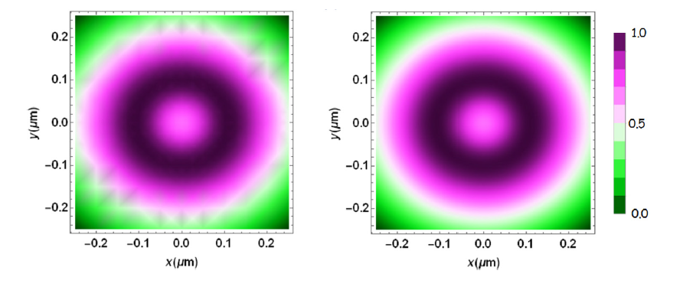
From 1D to 2D
2D beam profile monitor could be therefore possible only when the correlated angular-spectral distribution of the betatron radiation is detected
Retrieved
Simulation
Curcio, A., et al. "Single-shot non-intercepting profile monitor of plasma-accelerated electron beams with nanometric resolution." Applied Physics Letters 111.13 (2017): 133105.
Notes:
Synthetic data

Slide 15
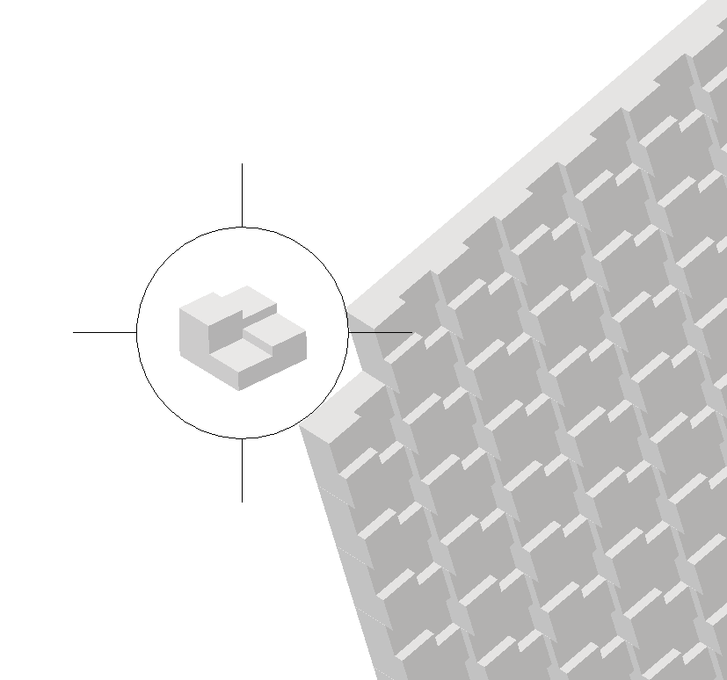
Mask under development
It is a 2x2 cm² aluminum matrix on a 100 µm substrate.
Each element is 400x400 um², divided into one 4x4 submatrix with thicknesses of 100,150, 200, 250 µm.
We will make 3 different matrices starting from a substrate of 100 µm, 200 µm and 300 µm.
Courtesy M. Galletti and G. Costa

Slide 16
Conclusions
We are doing R&D on several fields in order to improve the diagnostics and to adapt them to a new and compact machine
Having SPARC_LAB and Flame to test ideas and devices is very important for us.
Every success will decrease the machine length and it will improve the diagnostics performances while already today we have just enough diagnostics and space to run a facility

