Slide 1
INFN Cloud Getting Started
Notes:
benvenuti in questa serie di video dove mostriamo come accedere e utilizzare le risorse di INFN CLOUD. Oggi vediamo i passaggi necessari per iscriversi a INFN Cloud

Slide 2
INFN-Cloud in practice
All INFN staff and associates can exploit INFN-Cloud resources
This means storage and compute services. Compute means not only simple VMs but also composed services ( such as the Jupyter-based one used by ML_INFN ). You can also customize and personalize your own environment [see later]
By default, a INFN-Cloud user has a fixed and limited quota (i.e. #Cores/RAM)
Experiments/collaborations follow a different path!
If you are interested either to continue working as you did during the hackathon or even to do something else visit here

Slide 3
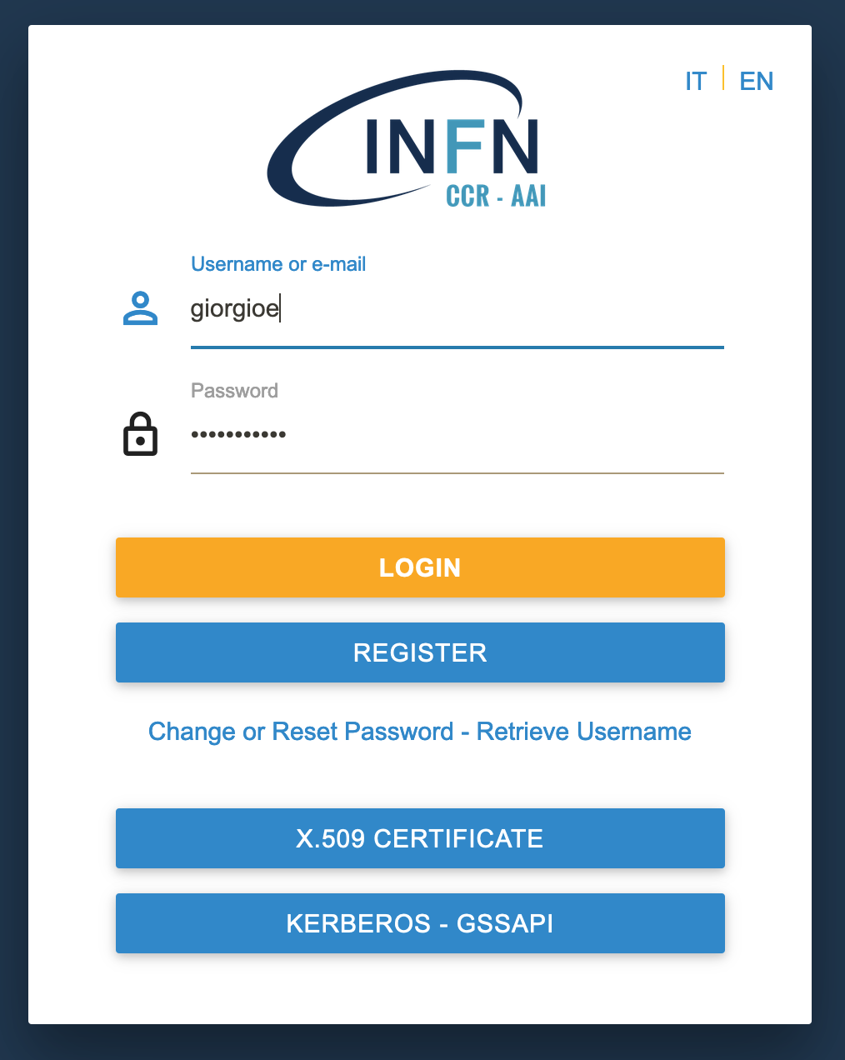
Once you click you will be redirected to the IAM account registration
Don’t “Apply for an account” but
Sign in with your own INFN AAI identity
NOTE: Once done you’ll be contacted by INFN-Cloud support team
Notes:
assumendo che questi prerequisiti siano soddisfatti, la registrazione viene fatta sul sito iam.cloud.infn.it. viene mostrata questa home page, cliccate su sign in with INFN AAI (e non su apply for an account). Verrete rediretti alla solita pagina di login di INFN AAI, e se il login va a buon fine

Slide 4
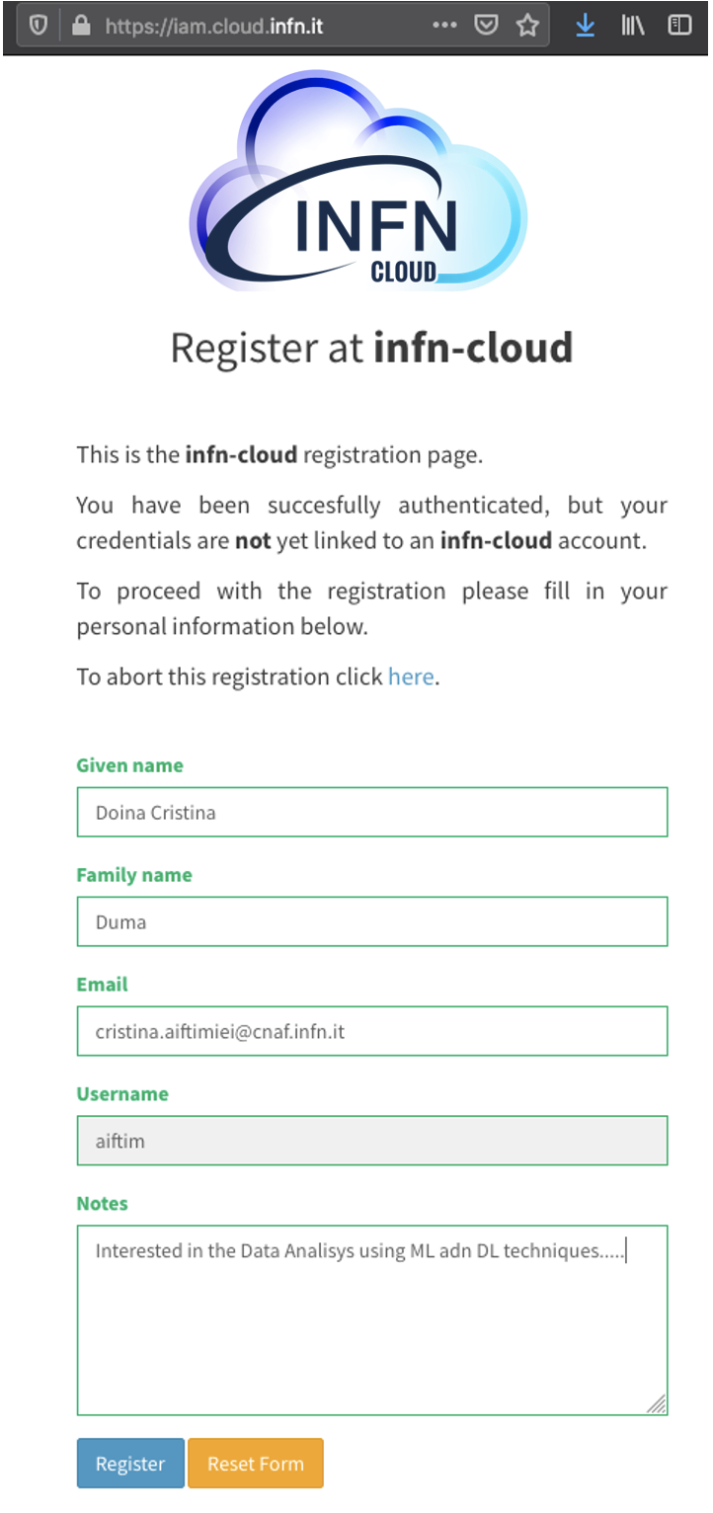
IMPORTANT
There are two pre-requistes
Digital identity on INFN AAI and acceptance of INFN usage rules for IT resources
INFN staff or associates meet these requirements by default
Others see https://signup.app.infn.it/
Designation as ‘System administrator’ for INFN Cloud granted by your own INFN Director.
Consult your local INFN section or laboratory for further details
If you don’t want/can’t get the Designation, we are working for you :)..
We are releasing a Jupyter as a Service instance that can be used even without Designation!
When you register, just be sure you fill the note with this and we will contact you
I volunteer to test the Jupyter as a Service
Notes:
Per cominciare a usare le risorse di INFN Cloud ci sono due aspetti fondamentali da soddisfare :il primo e' avere un'identita' digitale su INFN AAI, con annessa l'accettazione del disciplinare per l'uso delle risorse informatiche infn. Per dipendenti INFN e associati questo requisito e' soddifatto per definizione, mentre esterni dovranno registrarsi su INFN AAI a questo link.
Il secondo requisito e' la nomina, da parte del proprio Direttore di struttura, ad utente amministratore per INFN Cloud, analogamente a quanto accade per l'amministrazione di risorse locali.

Slide 5
And for those who wants to raise the bar
INFN-Cloud allows you to implement new services and/or customize existing one
Examples:
“I want to build MY Jupyter-based workflow and possibly share it within my collaboration”
“ I would like to use INFN Cloud but I don’t need/like Jupyter, I would rather like to run my small cluster ...“
In such a case please contact us at: cloud-support@infn.it and you will be redirected to the proper INFN Cloud support team.

Slide 6
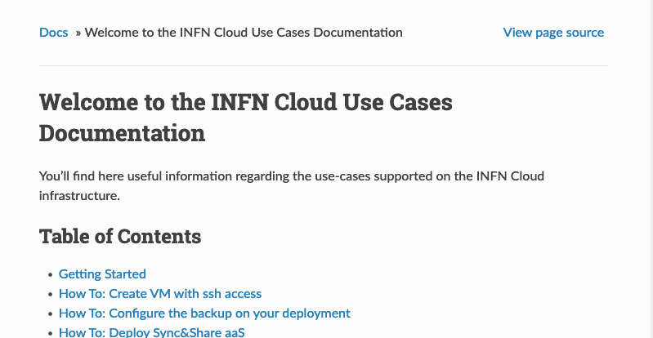
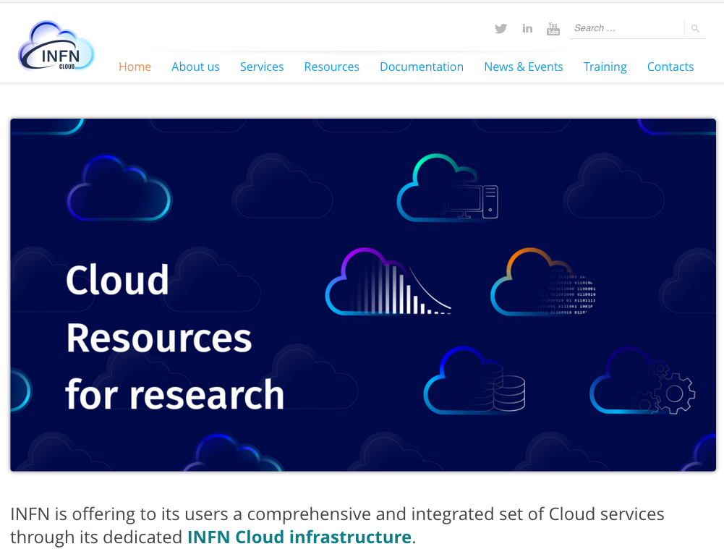
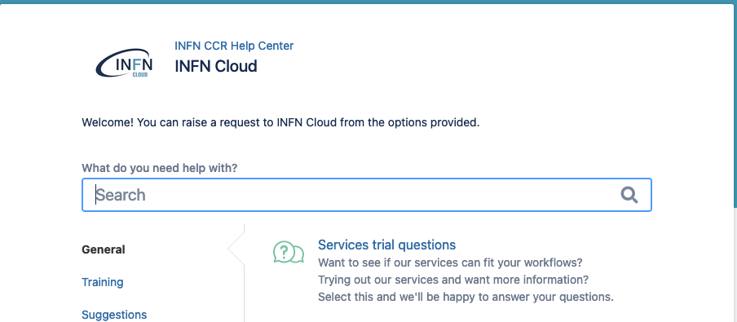
Reference
Documentation :
https://guides.cloud.infn.it/docs/users-guides/en/latest/
Web site:
https://www.cloud.infn.it
Support :
https://servicedesk.cloud.infn.it or cloud-support@infn.it
Notes:
vi lascio con dei riferimenti per ulteriori approfondimenti.
il sito web di infn cloud, punto di accesso informativo per infrastruttura, con tutti i puntatori necessari, e in particolare i link alla documentazione e al sistema di supporto.

