Slide 1
Classification of lesions in Medical Physics
Brief description of the exercise for the MED hackathon groups

Slide 2
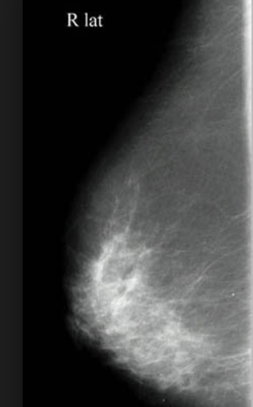
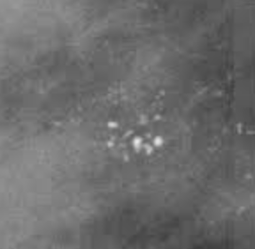
Objective
The aim of this exercise is to create and train a simple Convolutional Neural Network (CNN) for deep-learning based classification of normal tissue vs. tissue containing microcalcification clusters in mammograms.

Slide 3








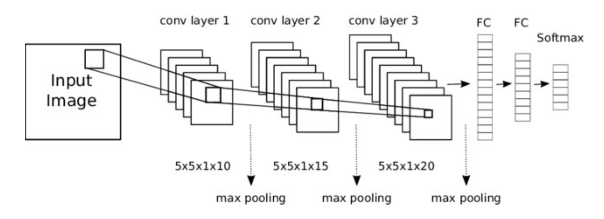









The analysis pipeline
Input data
CNN classifier
Output
Label 1: images with microcalcifications
(0, 1)
Label 0: images of normal tissue
Output = 1
This image contains microcalcifications
You have to design, train and test the CNN

Slide 4
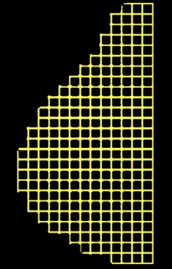
The CNN you will develop could help …
Identify and locate regions suspected of containing a microcalcification cluster
… and finally build an AI-based system capable of supporting radiologists in reading screening mammograms

Slide 5
Implementation steps
Load and visualize image data
Define the CNN model
Compile and train the CNN model on the training data
Predict the labels of the validation/test data samples
Calculate the classification accuracy
Create the ROC curve and calculate the AUC
Compare the performance of different models

Slide 6
Training, Validation and Test sets
Data sample
split
(*)
Training set
Test set
split
(**)
training set
validation set
The model learns its internal weights from the training set
It is used to tune the hyper-parameters
Independent validation of the performance of the trained model
(*) The Training and Test sets will be identified since the beginning of the exercise. This partition is kept fixed.
(**) The Training split into the training and validation sets is made with a dedicated function (train_test_splitting):
This partitioning can be kept fixed to make direct comparisons among different models/training options
Additionally, the impact of the training data variability on the classifier performance can be evaluated by training and evaluating the CNN performance several times and providing the average and standard deviation of the performances

Slide 7
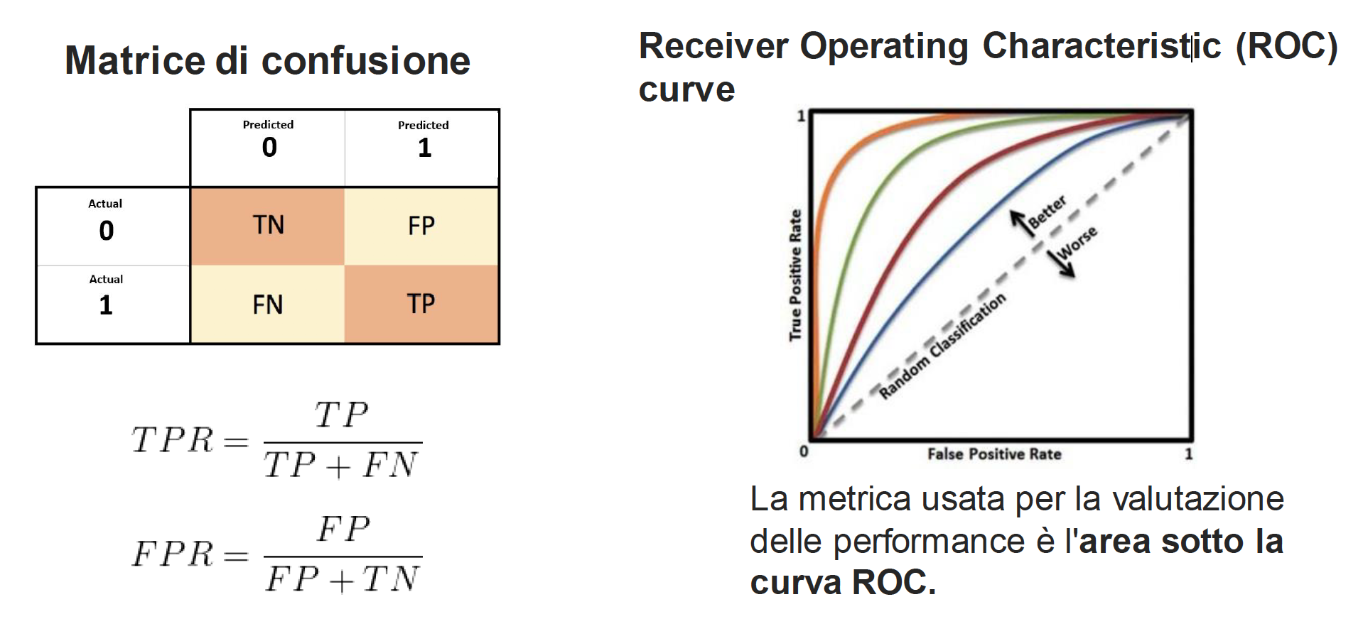
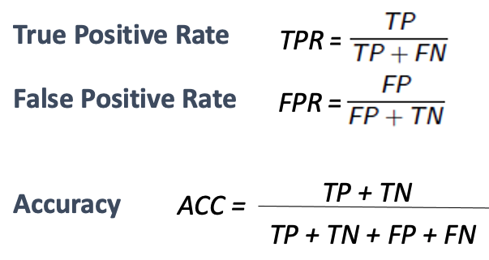
Figures of merit
Confusion matrix
The Area Under the ROC Curve (AUC) is a global metric to evaluate the performance of a classifier
AUC = 1 for a perfect classifier
AUC = 0.5 for a random classifier

Slide 8
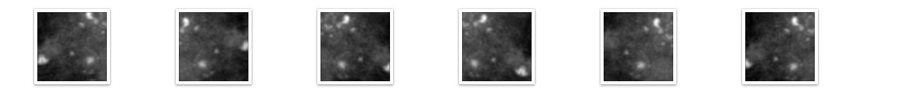
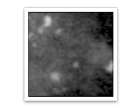
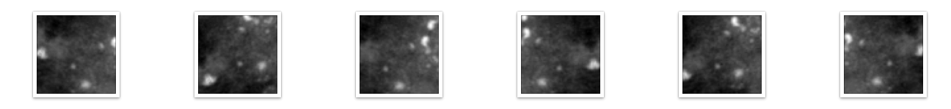
If you have extra time …
You can also try to implement a data augmentation strategy to improve the classification performance
BE CAREFUL:
  The augmented training set should retain the same “properties” of the original medical images.
  Augmented images should be realistic and consistent with their labels.
  Physical and quantitative information contained in the images should not be lost or ruined during data augmentation, otherwise you risk losing the relationship between the image content and its clinical relevance.
augmentation

Slide 9
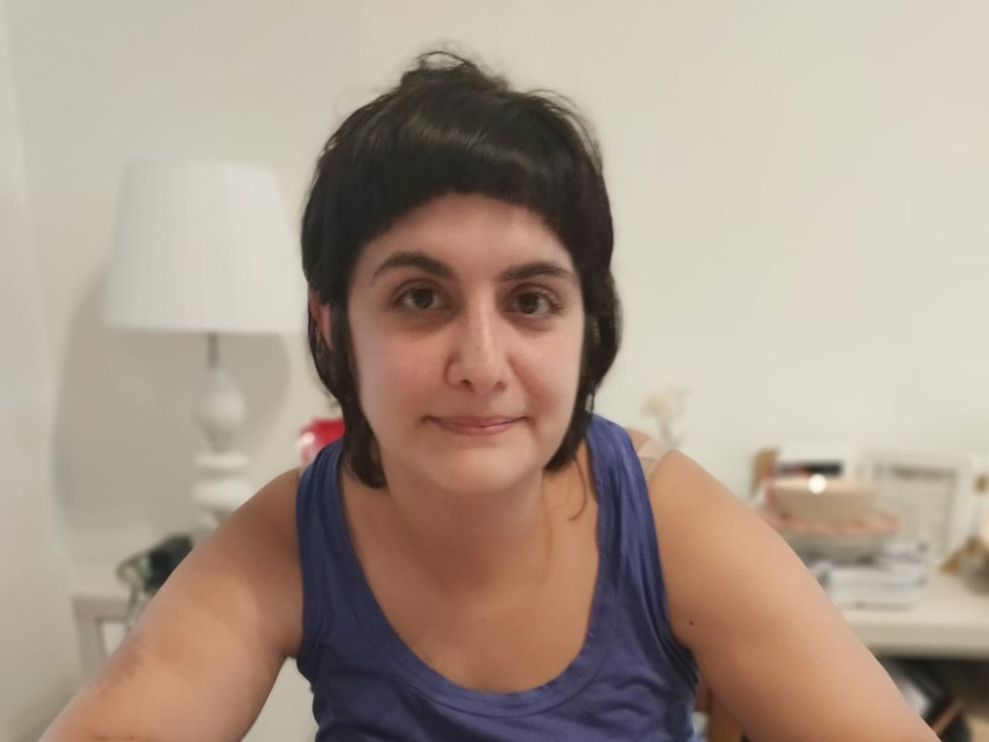

Working in a group and reporting
You are free to organize the work within your group as you like
However, you are supposed to interact with each other and collaborate to arrive to a shared solution
Remember to fill in the template_Use_case_MED_Report.pptx
If the group is stuck because of any reason, feel free to ask to the tutors:
Francesca (group 7), Damiano (group 8) and Sara (group 9)
… and finally …
ENJOY THE HACKATHON !!!

