Slide 1
Calibration system
Fixation strategy
Featuring: cable, glove box, motor box, pipes, valves, hooks…
All good souls (and brains) willing to participate to the discussion
19th February 2021
Calibration system meeting

Slide 2
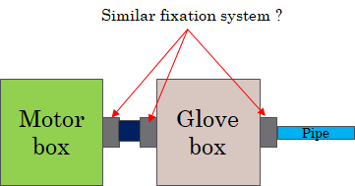
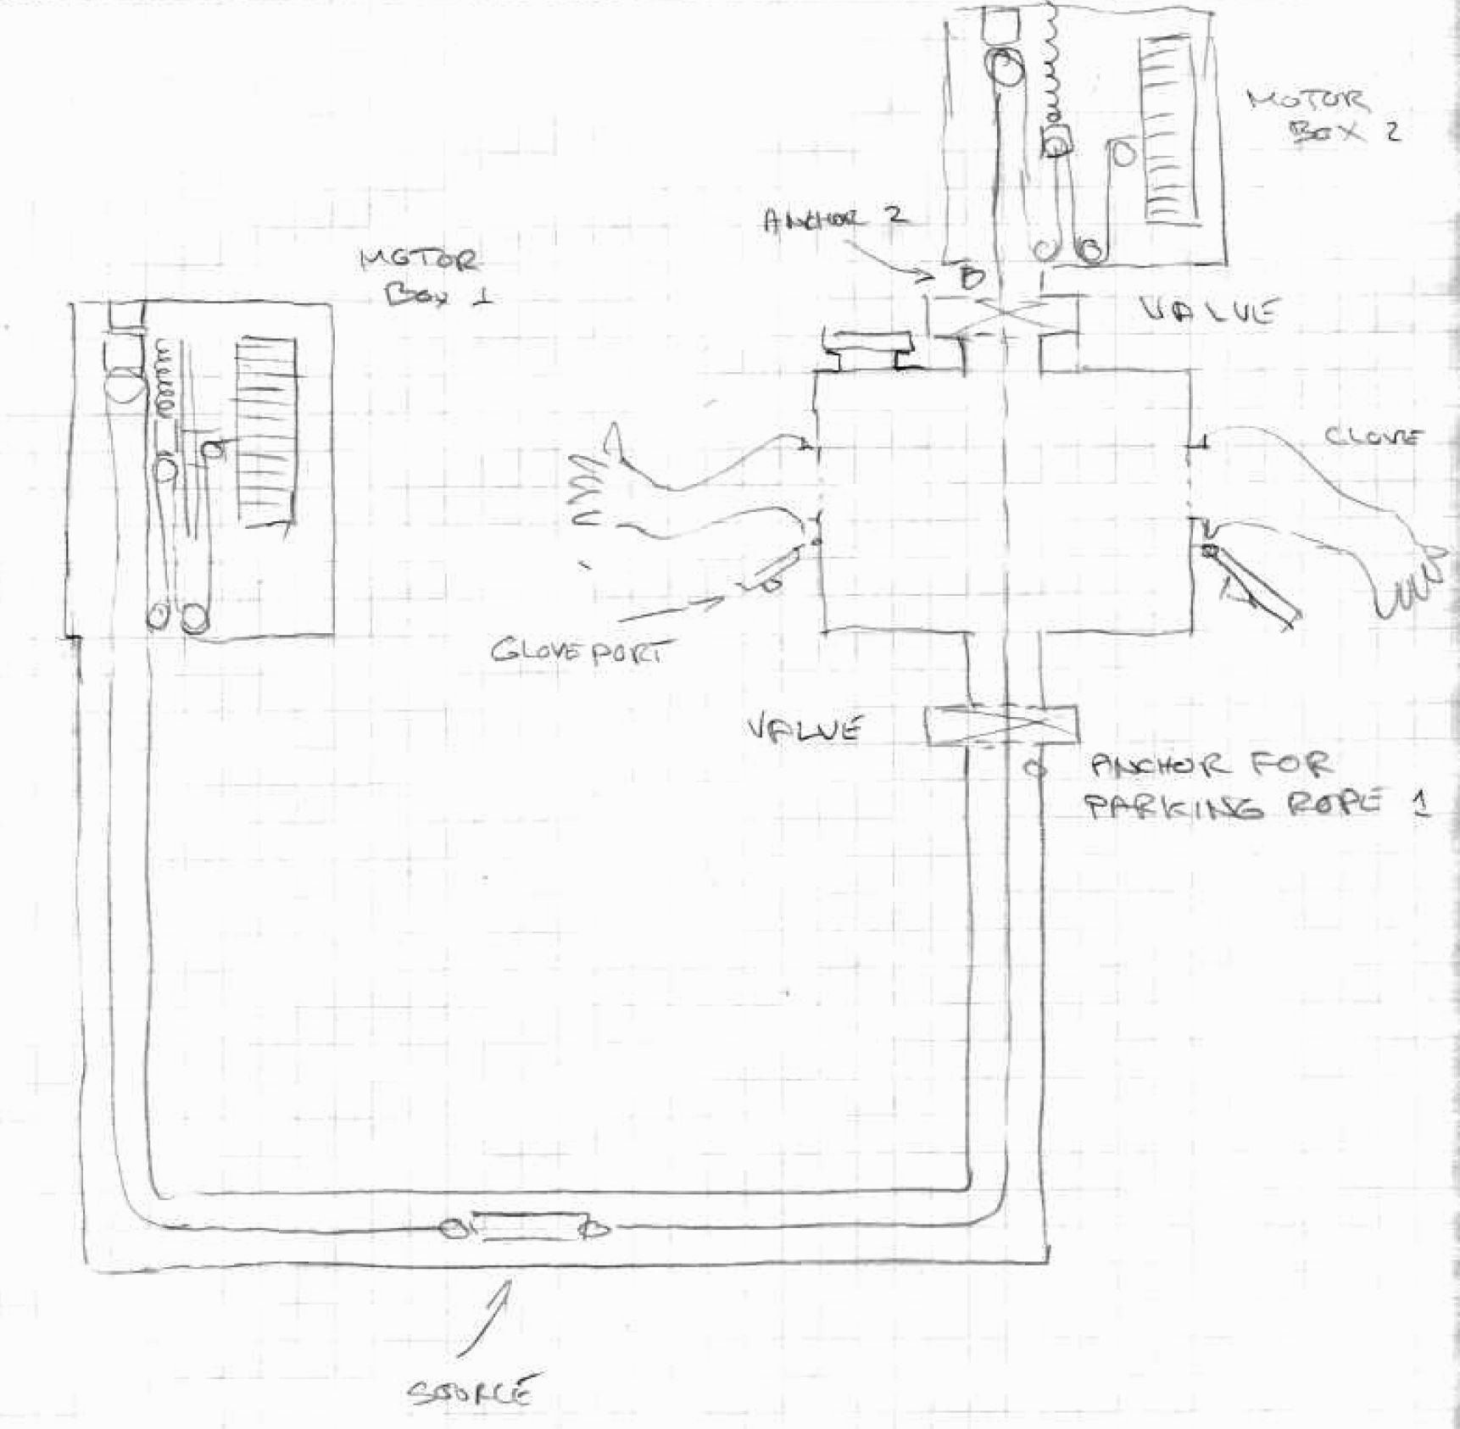
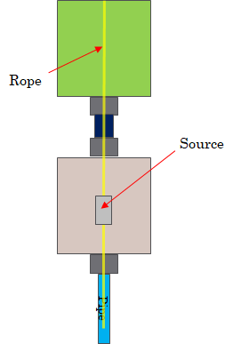
Design journey
Calibration meeting 20/10/2020
Schematic from Pierre
Sketch from Peter
CAD from Marco
Presented at calibration meeting
24/11/2020

Slide 3
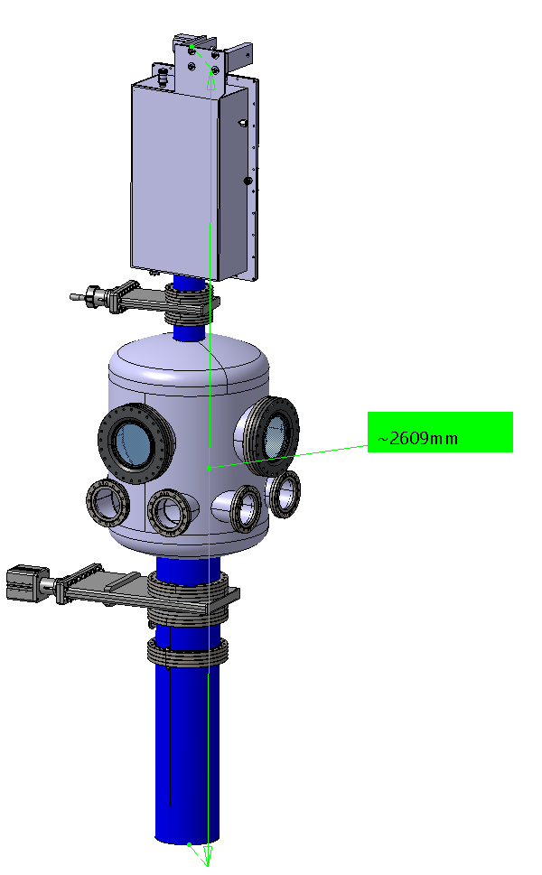
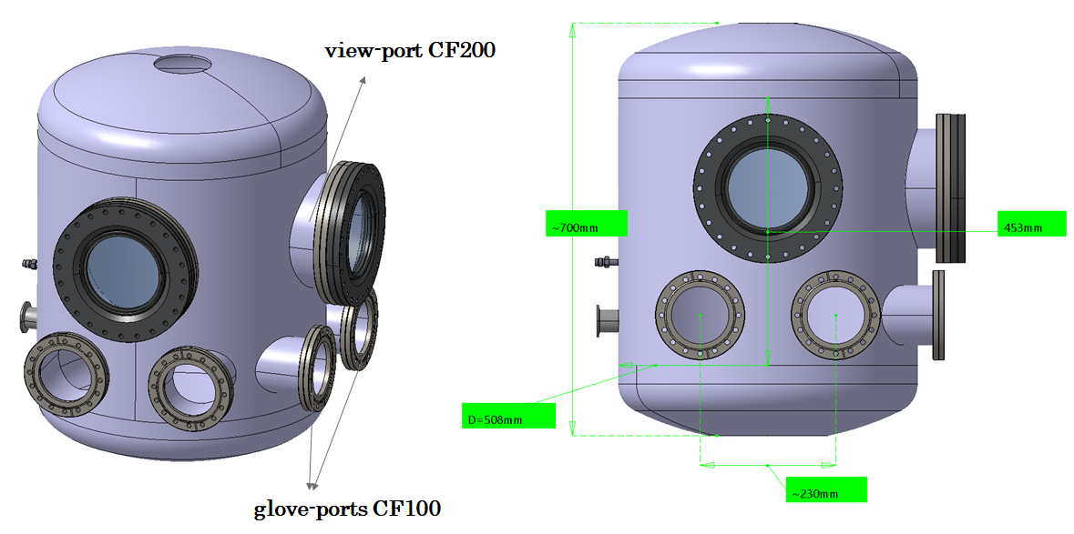
Current design
CAD from Marco
Presented at calibration meeting
14/01/2021

Slide 4
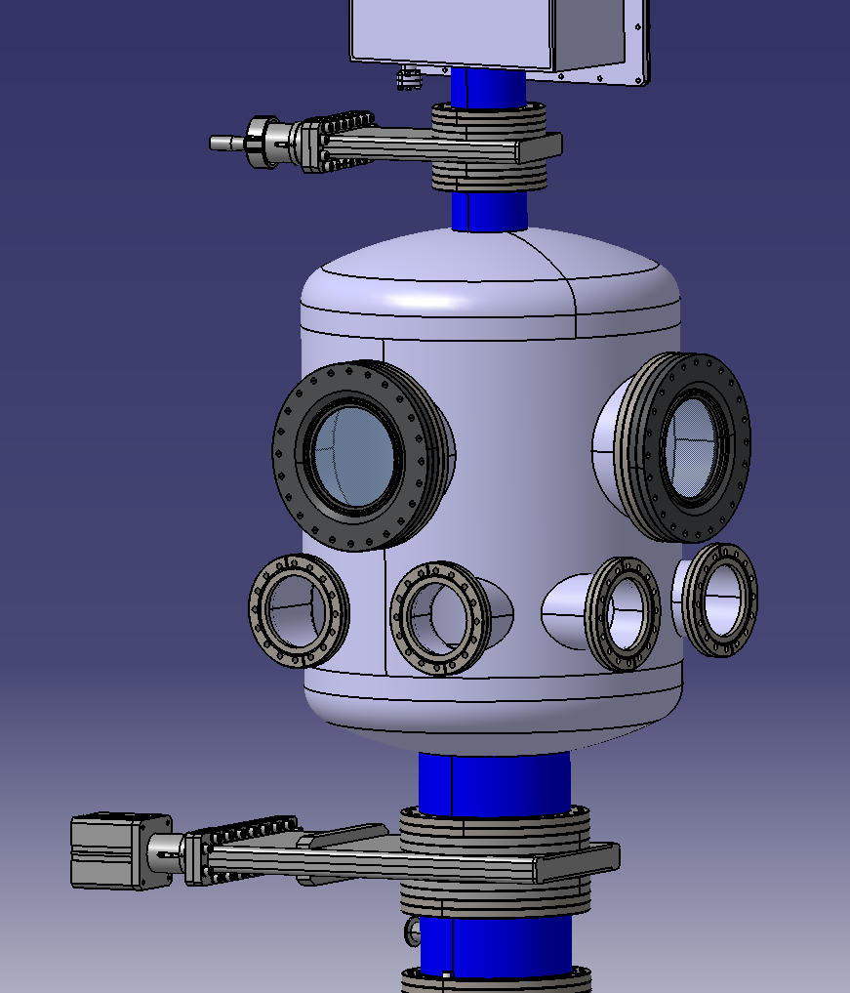
Problematic
Motor box
The cables will be in two configurations:
  Garage mode: no source fixed, valves closed (to be discussed), cables hooked on two sides (to be defined)
  Calibration mode: a source is fixed, the valves are opened to let the cables go through
Gate valve
View port
?
Glove box
?
Glove port

Slide 5
Problematic
Motor box
The cables will be in two configurations:
  Garage mode: no source fixed, valves closed (to be discussed), cables hooked on two sides (to be defined).
  Calibration mode: a source is fixed, the valves are opened to let the cables go through
Gate valve
View port
Glove box
Glove port

Slide 6
Problematic
Motor box
The cables will be in two configurations:
  Garage mode: no source fixed, valves closed (to be discussed), cables hooked on two sides (to be defined)
  Calibration mode: a source is fixed, the valves are opened to let the cables go through
In garage mode:
  Where should we hook the cables ?
  Hooks located inside the glove box to reach them easily ?
  Hooks located beyond the gate valves so that we can close them when the system doesn’t work ? But how can we reach them from the glove box as it is ?
From garage to calibration mode:
  How can we secure the fixation of the source to the cables without risking dropping the cable inside the pipe ?
From calibration to garage mode:
  How can we secure the fixation of the cables to the hooks ?
Gate valve
View port
?
Glove box
?
Glove port

Slide 7
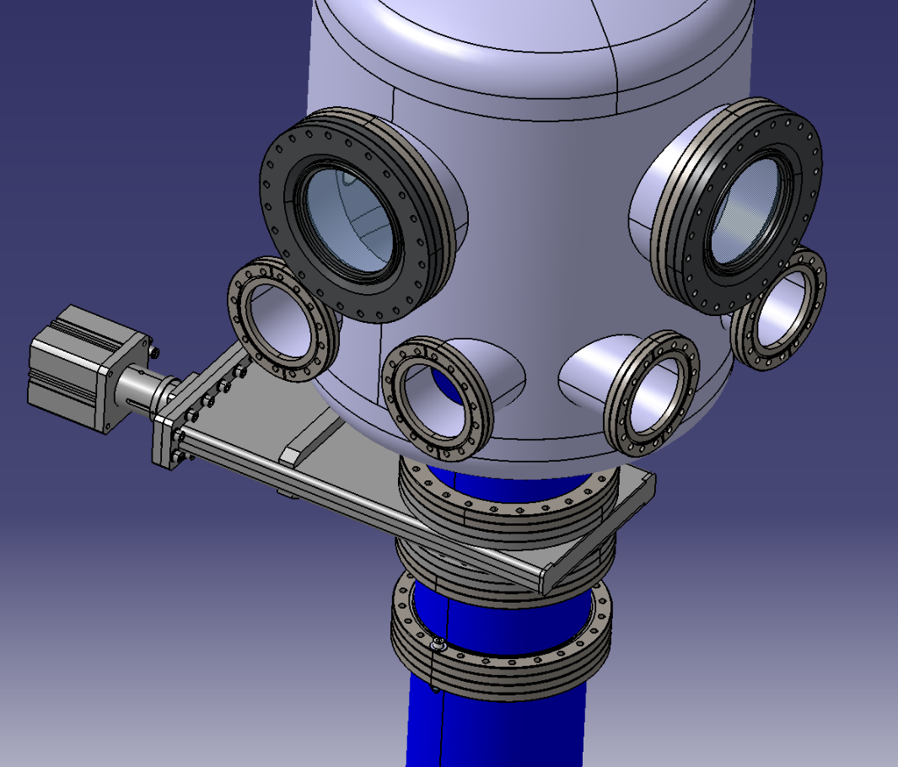
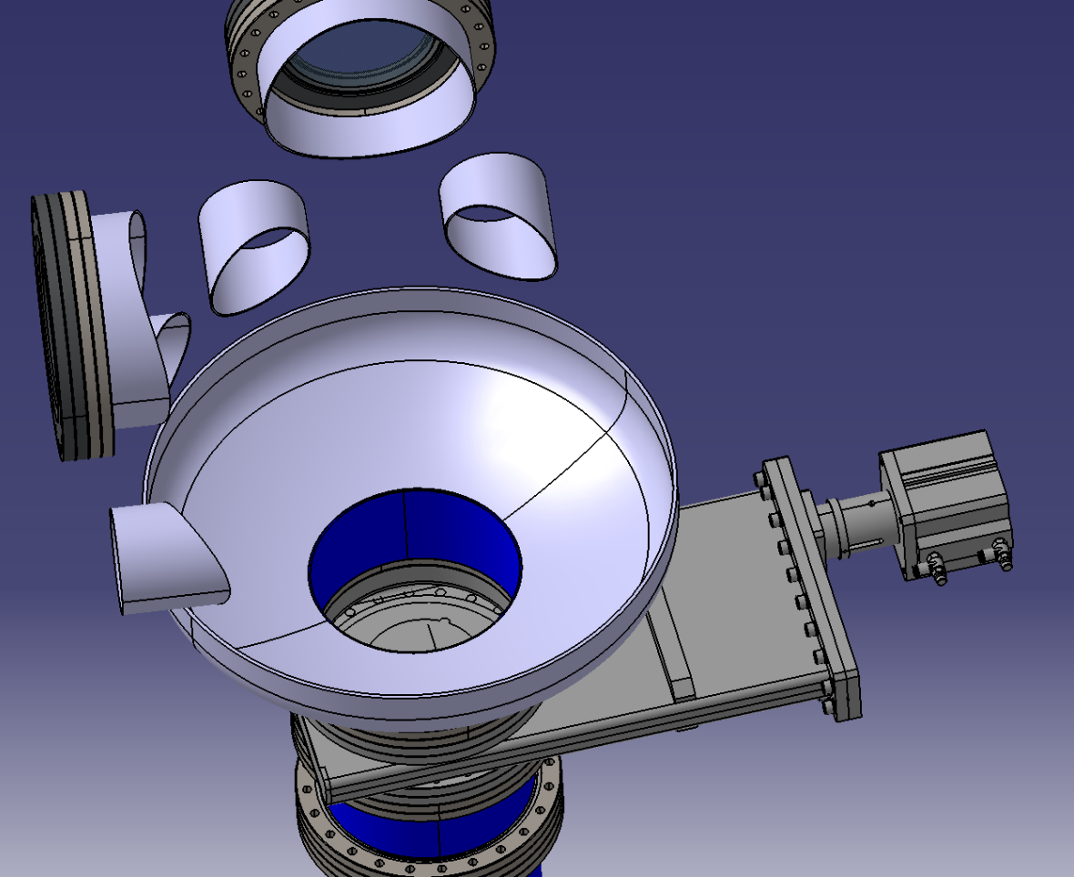
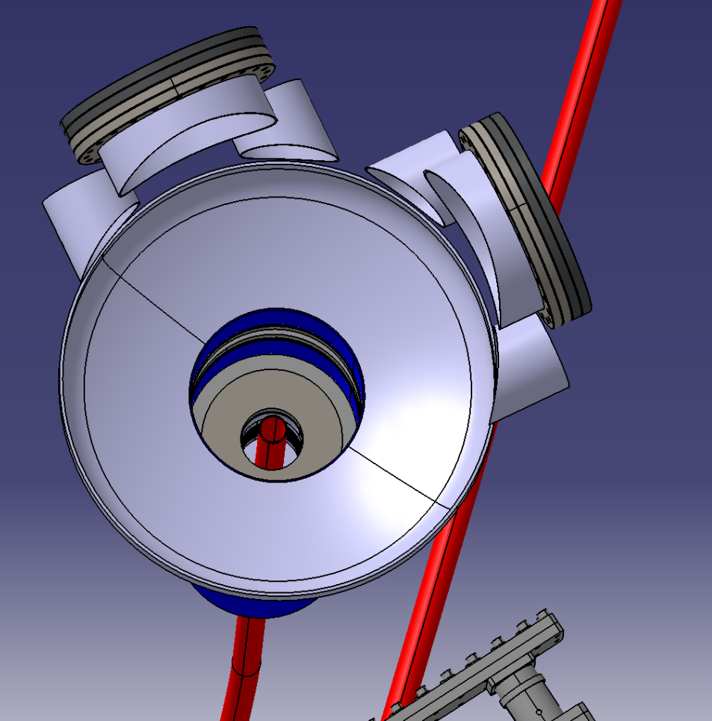
Additional captures of the CAD

Slide 8
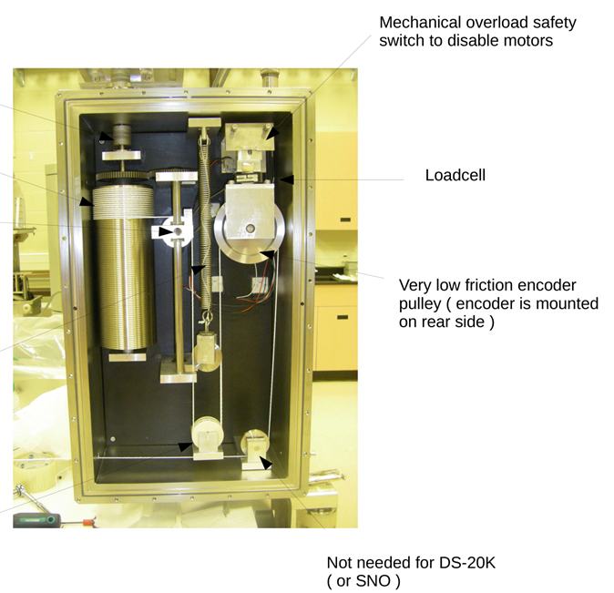
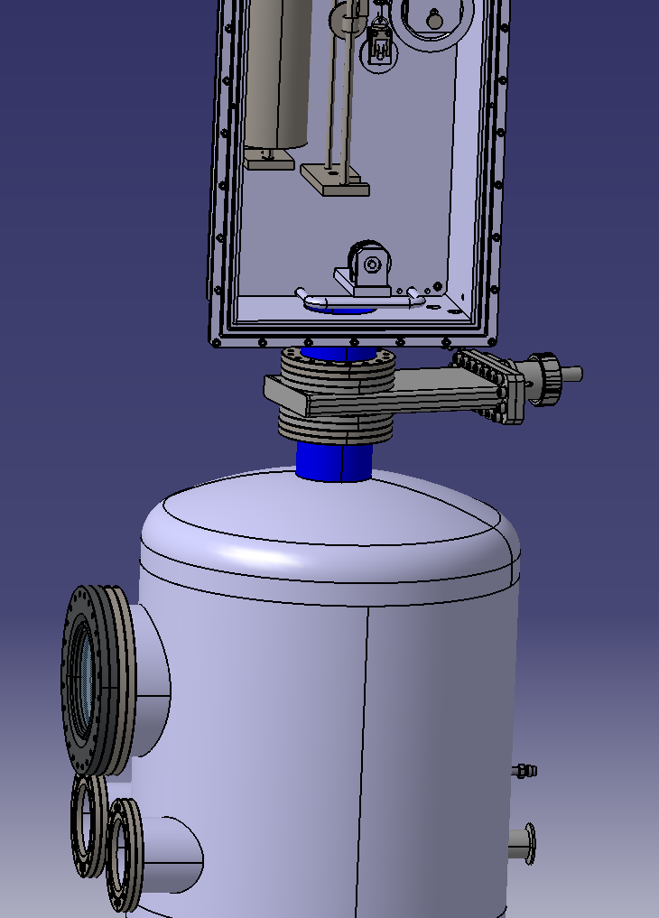
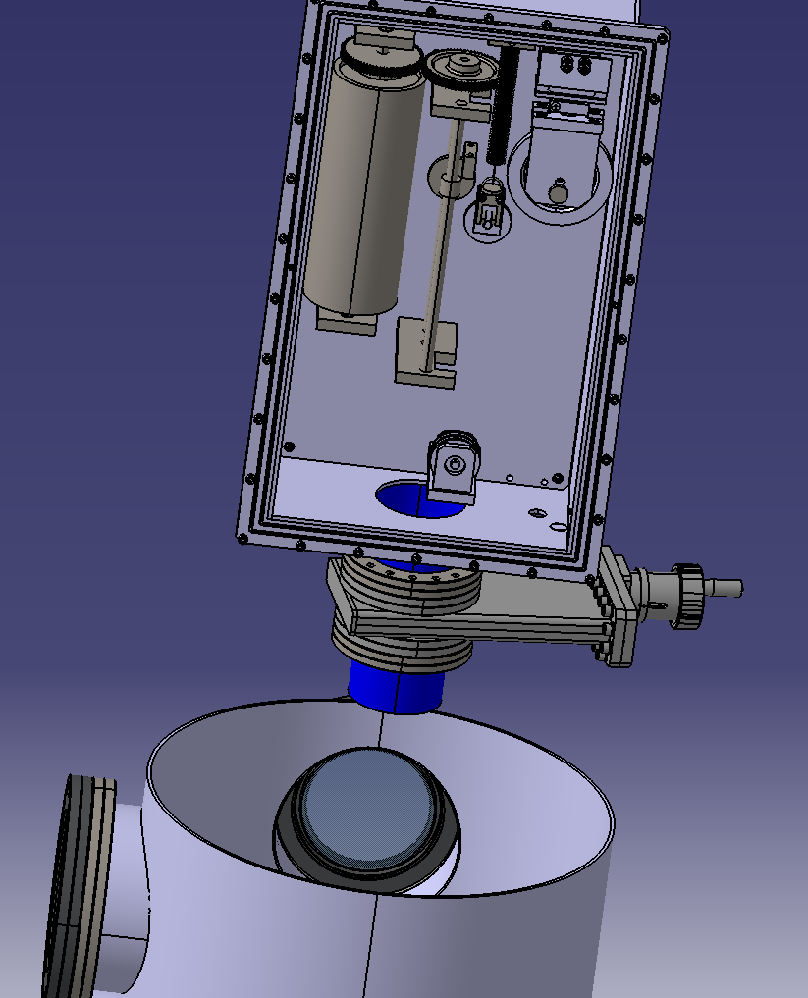
Additional captures of the CAD
SNO+
NB: the cable is supposed to exit from the motor box through this hole

