Slide 1
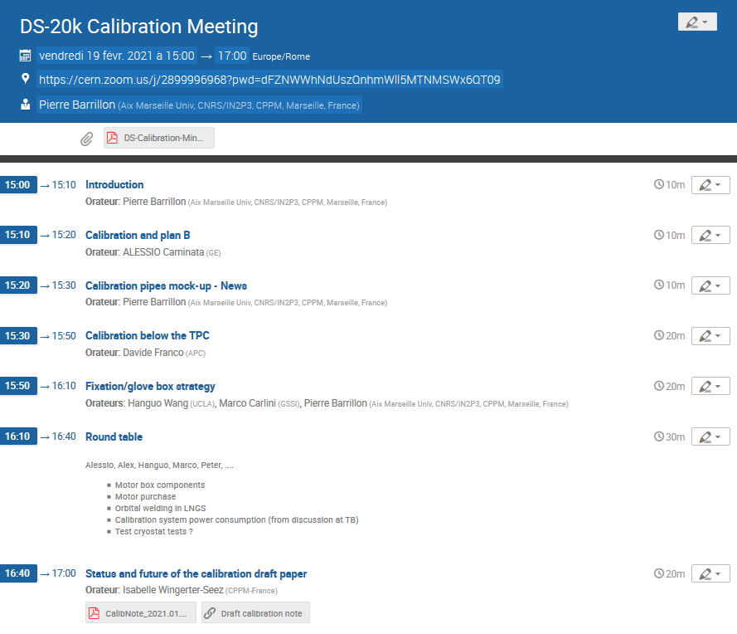
Dense agenda…
so let’s start right away !

Slide 2
Calibration system Mock-up status
P. Barrillon, F. Hubaut, P. Pralavorio, I. Wingerter-Seez
19th February 2021
Calibration system meeting

Slide 3
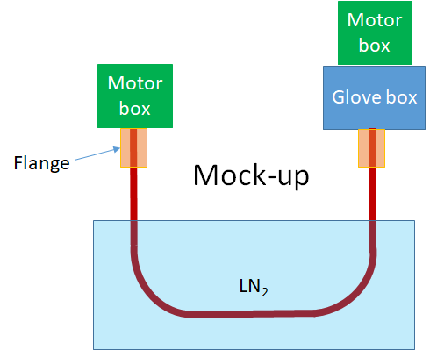
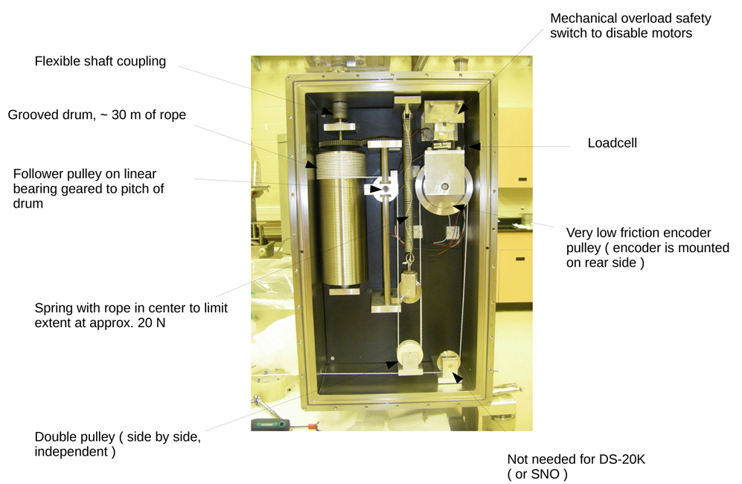
Reminder: Mock-up
Testing the principle of the calibration system is mandatory
The idea is to test most of the aspects of the calibration system with a U-pipe of shorter length (~ 3m) but baseline dimensions (30 mm diameter, 1.5 mm thickness) and curvature (40 cm radius) immersed in liquid nitrogen.
The mock-up should include the final motor box and glove box (could be included later) + the pipe-box fixation system.
The mock-up will be the ideal set-up to develop and test the control-command system.
It seems imperative to perform long duration tests to assess the robustness of the system.
Cold tests must be carried out to check the impact of cold environment on the system.
Considering a test with vacuum pump

Slide 4
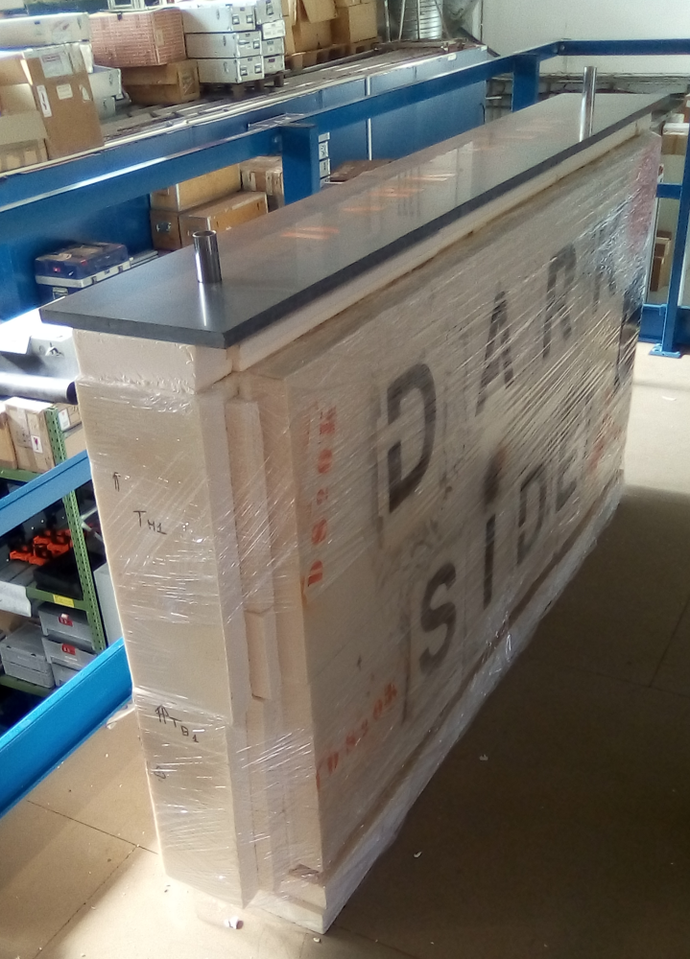
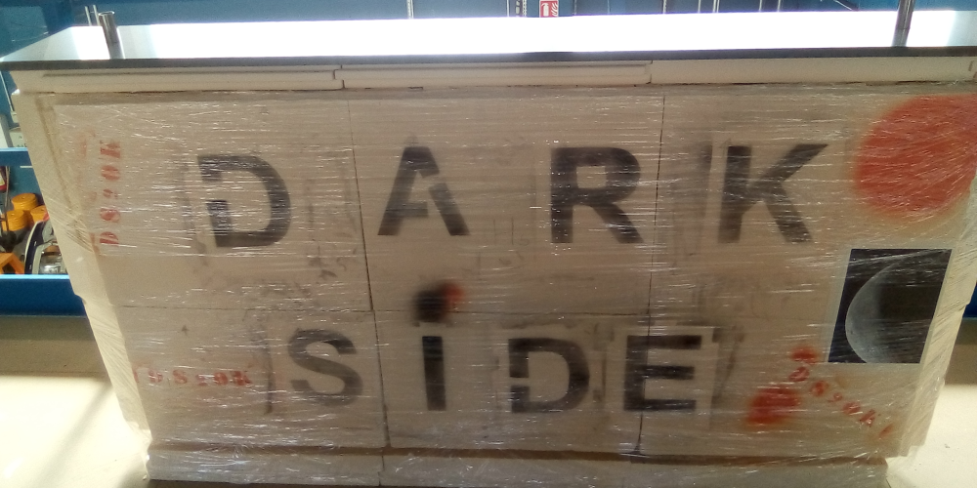
Status and plans
Tank wrapped up with cling film to improve isolation.
Strain gauges, adhesive and solder wire (coping with low temperature) ordered.
NI modules (9237 and 9217) foreseen to readout the strain gauges and temperature sensors (PT100).
Initial tests with a small (10 cm) piece of pipe with one strain gauge + one PT100 foreseen early March, to check the functioning and help developing the software.

