Slide 1
New ideas for a precision measurement of the W boson mass at the LHC
Lorenzo Bianchini

Slide 2
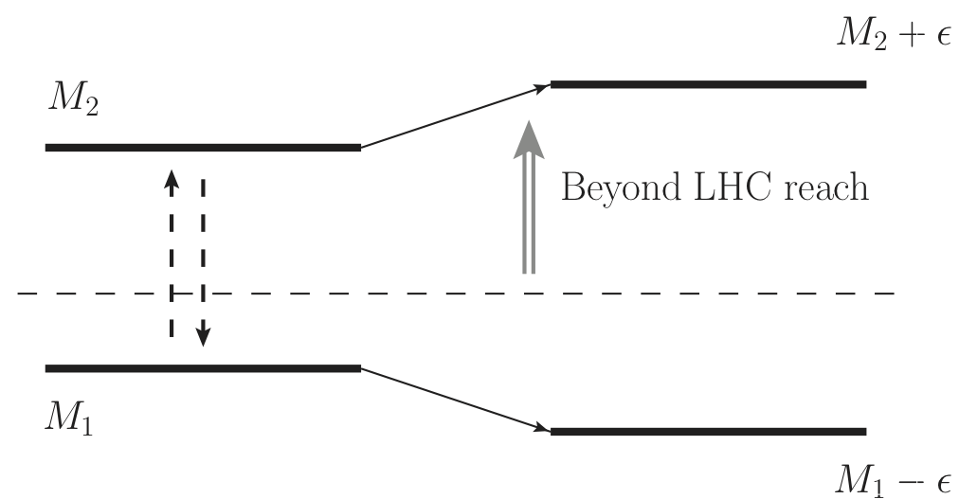
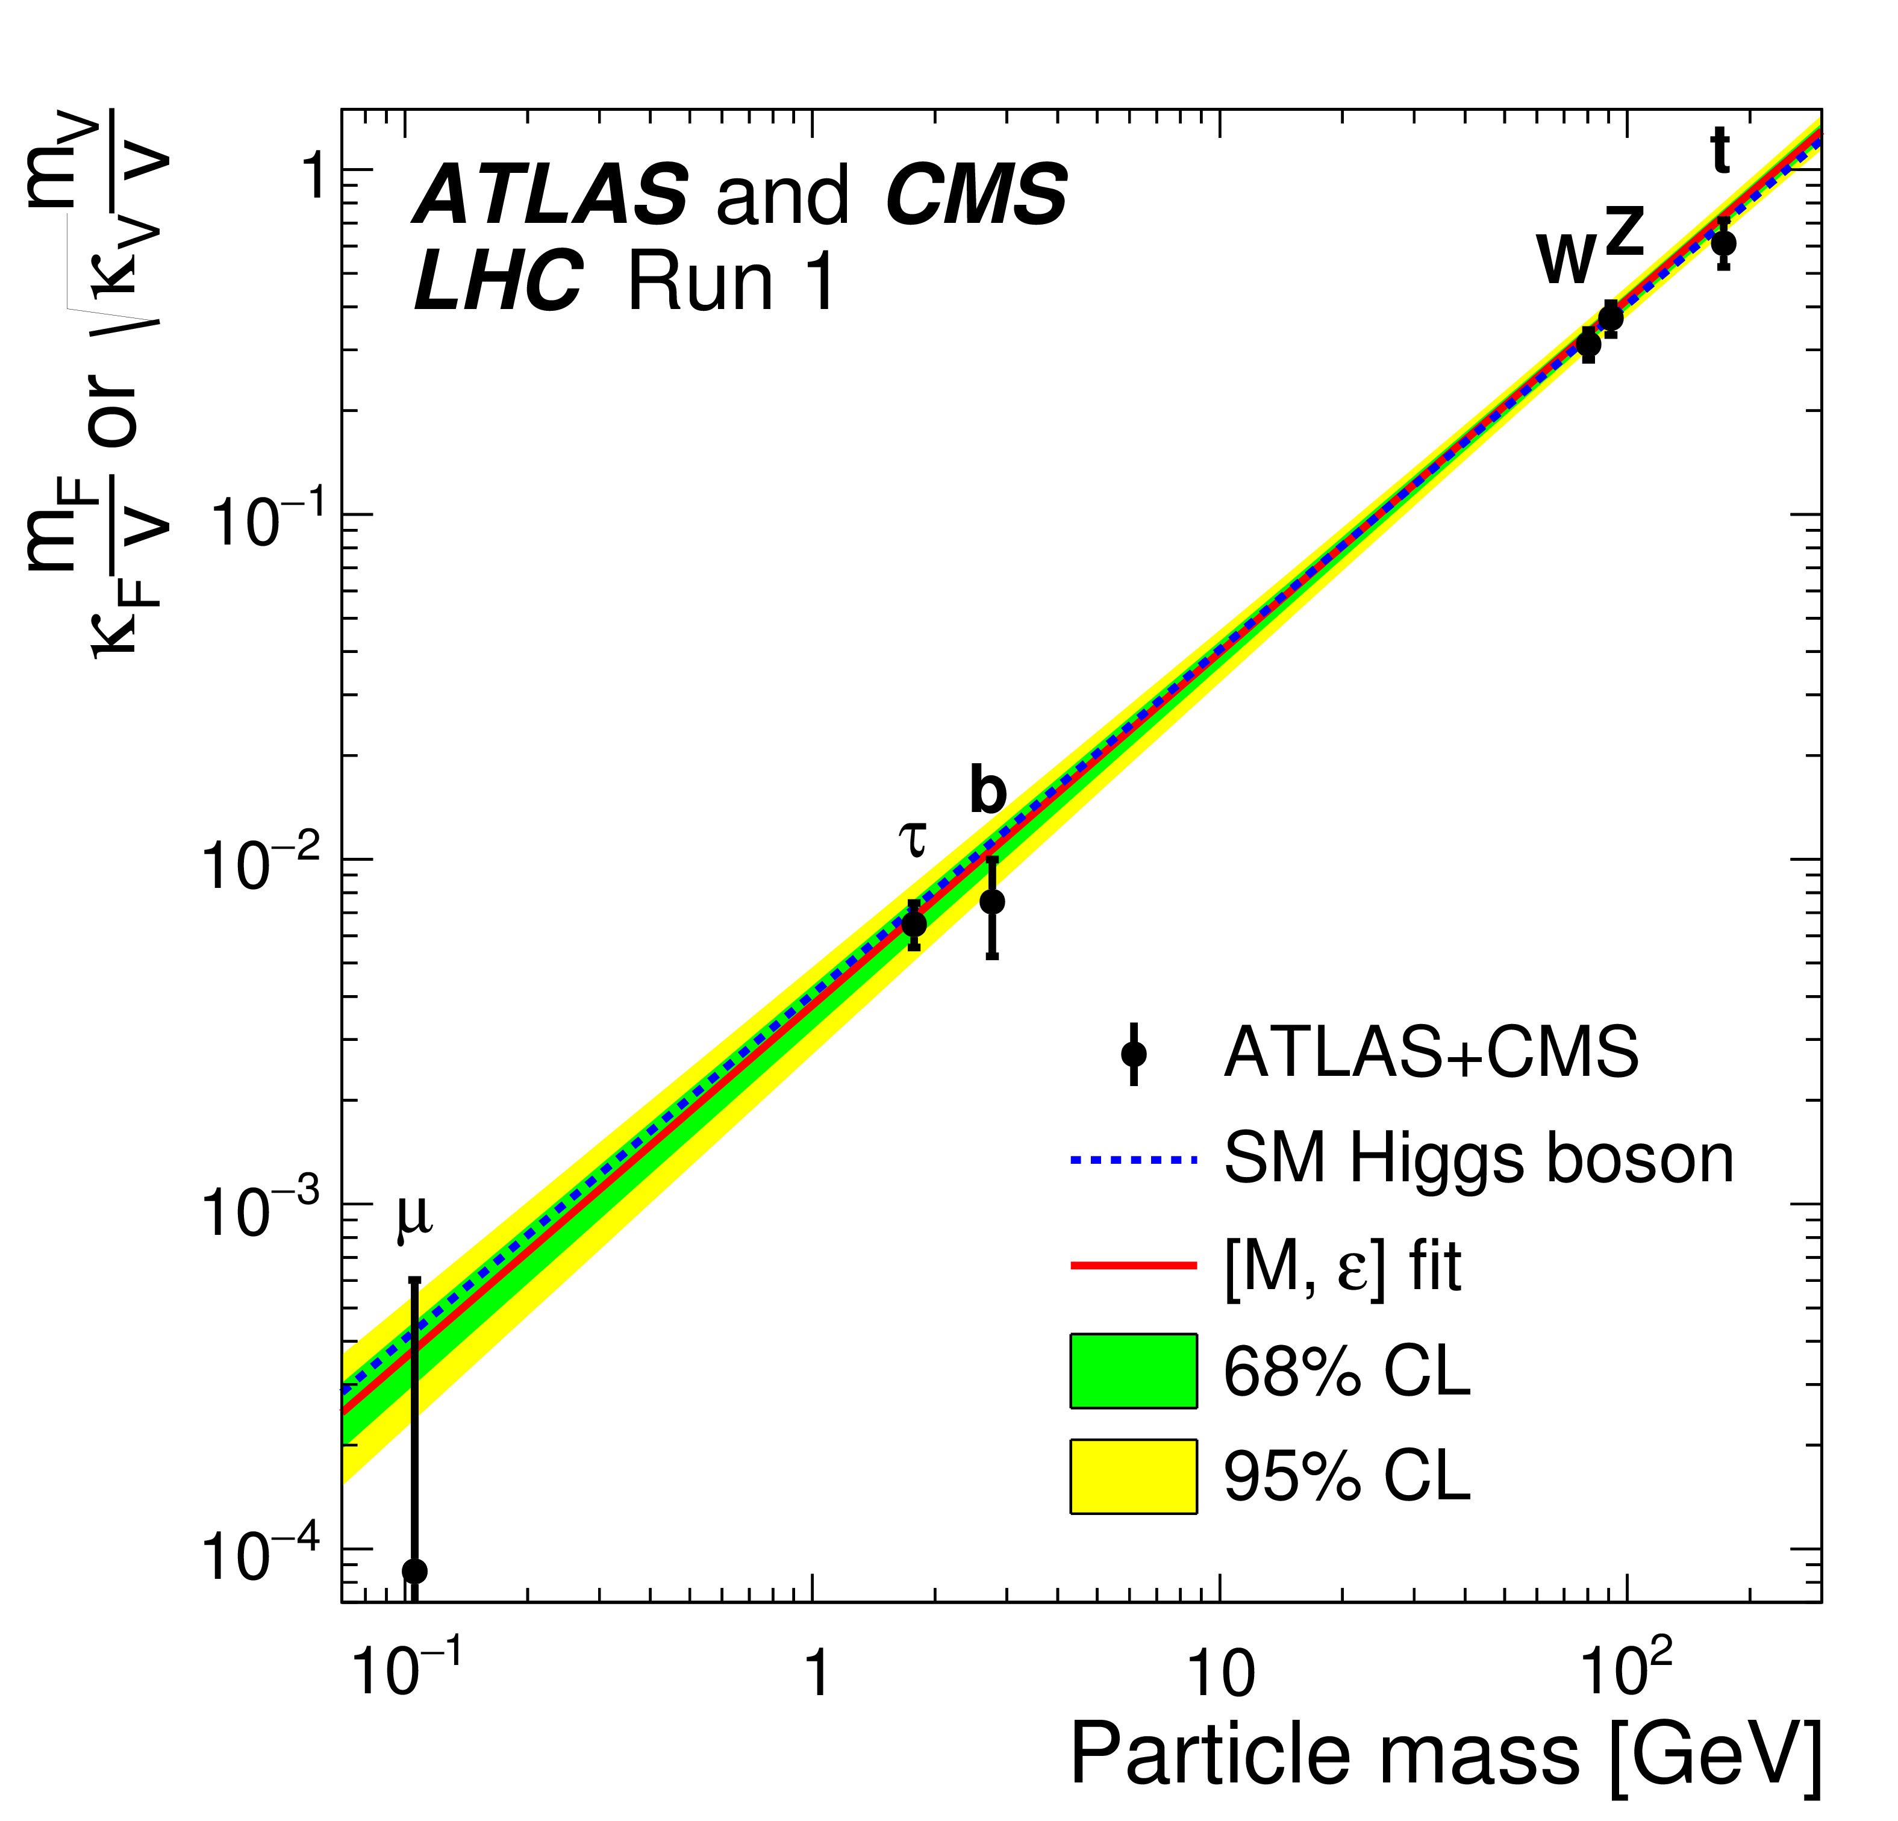
Why M_{W} matters
W mass is an Electroweak Precision Observable
  Stress-test of the SM → indirect search of NP
Why is M_{W} remarkable?
  Phenomenology
    High sensitivity and robustness of SM prediction.
  Opportunity
    Theory more precise than experiment.
  Case
    Slight tension with SM prediction.

Slide 3
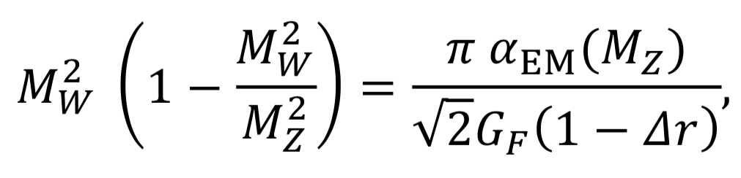
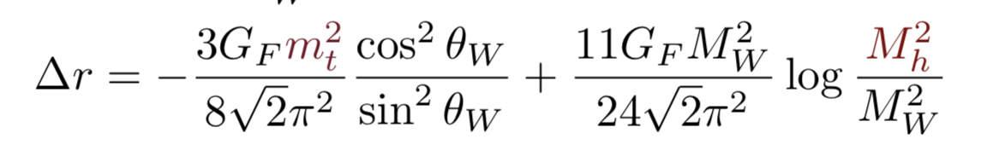
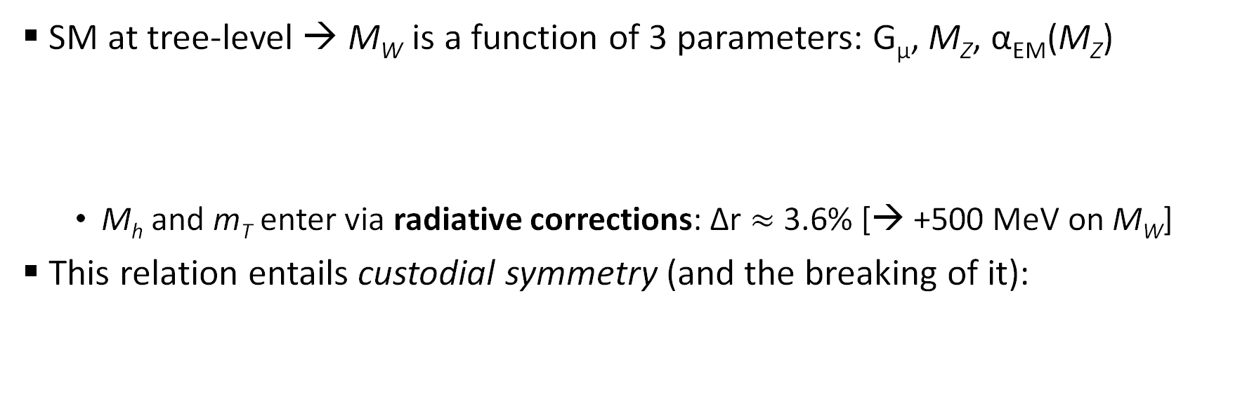
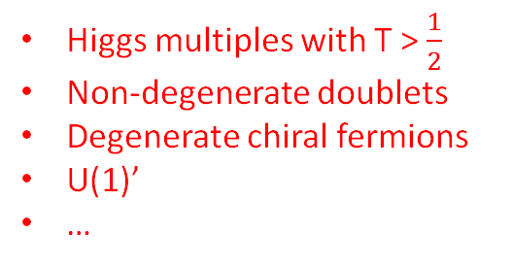
What we can learn from M_{W}
SM at tree-level → M_{W} is a function of 3 parameters: G_{μ}, M_{Z}, α_{EM}(M_{Z})
  M_{h} and m_{T} enter via radiative corrections: Δr $≈$ 3.6% [→ +500 MeV on M_{W}]
This relation entails custodial symmetry (and the breaking of it):
Higgs multiples with T > $\frac{1}{2}$
Non-degenerate doublets
Degenerate chiral fermions
U(1)’
…
+
SM
BSM ?

Slide 4
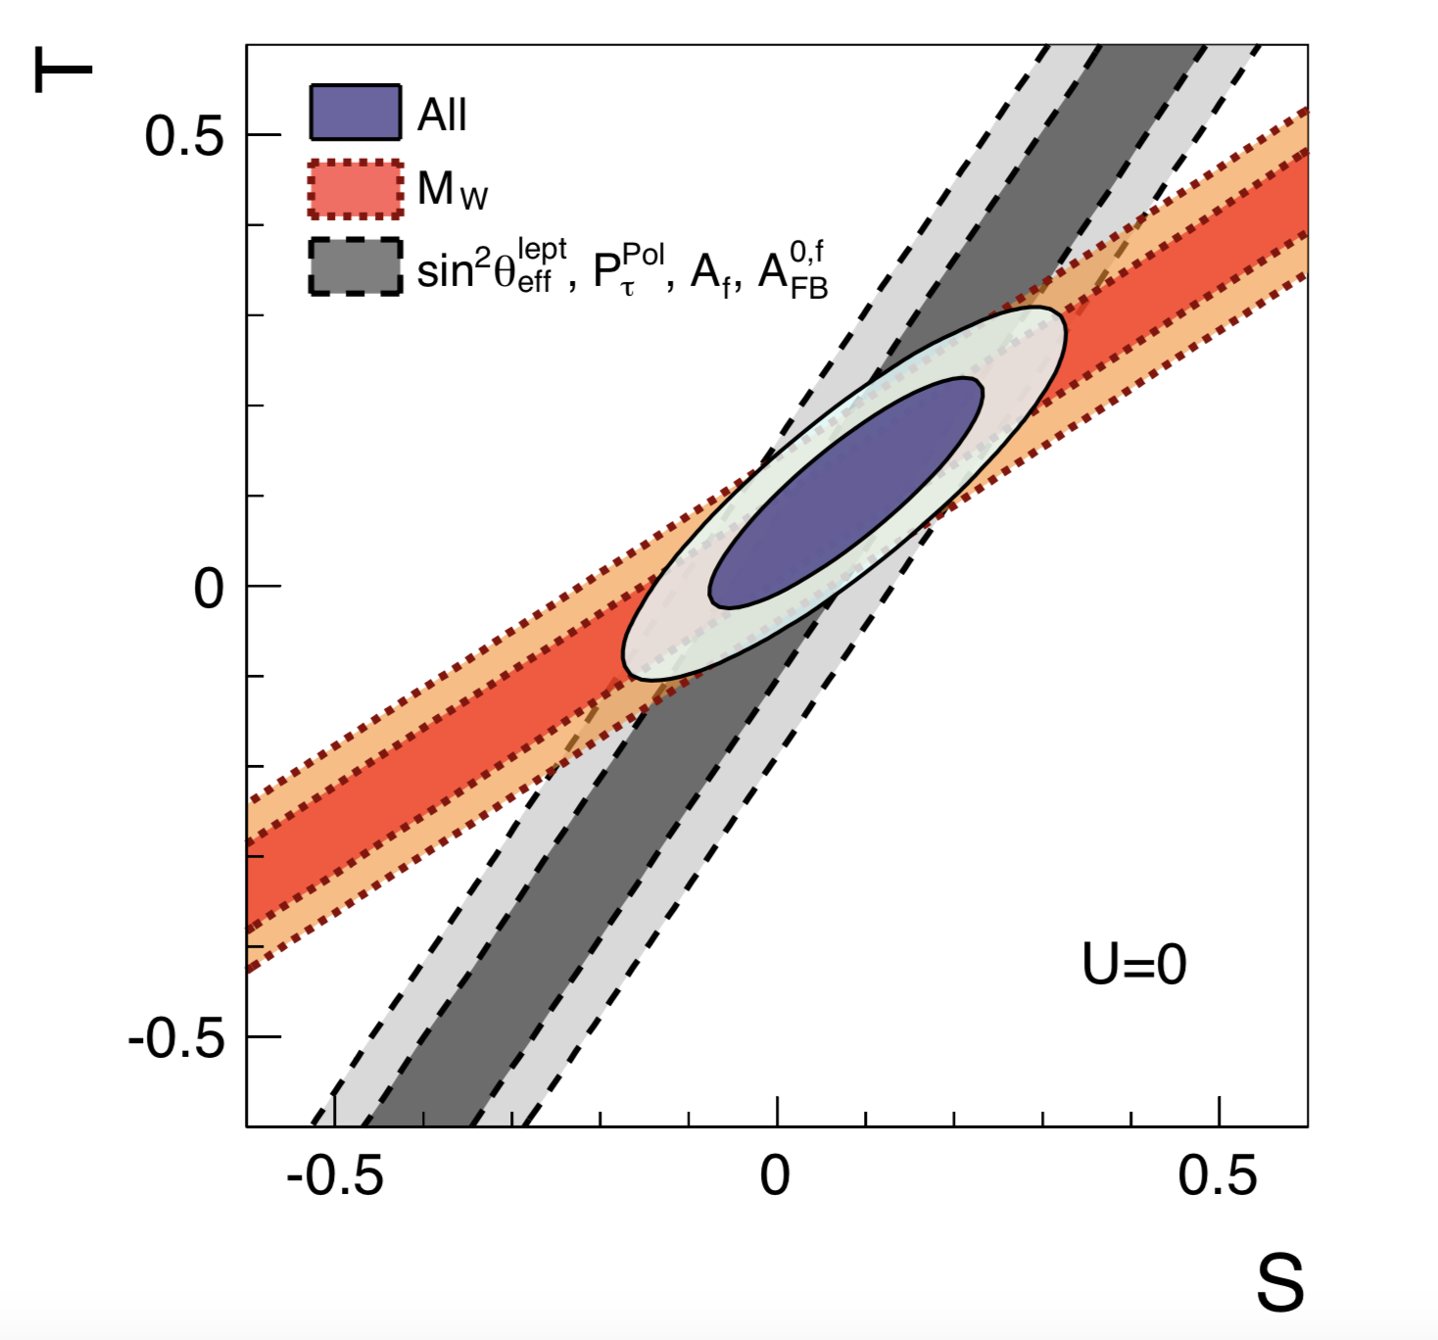
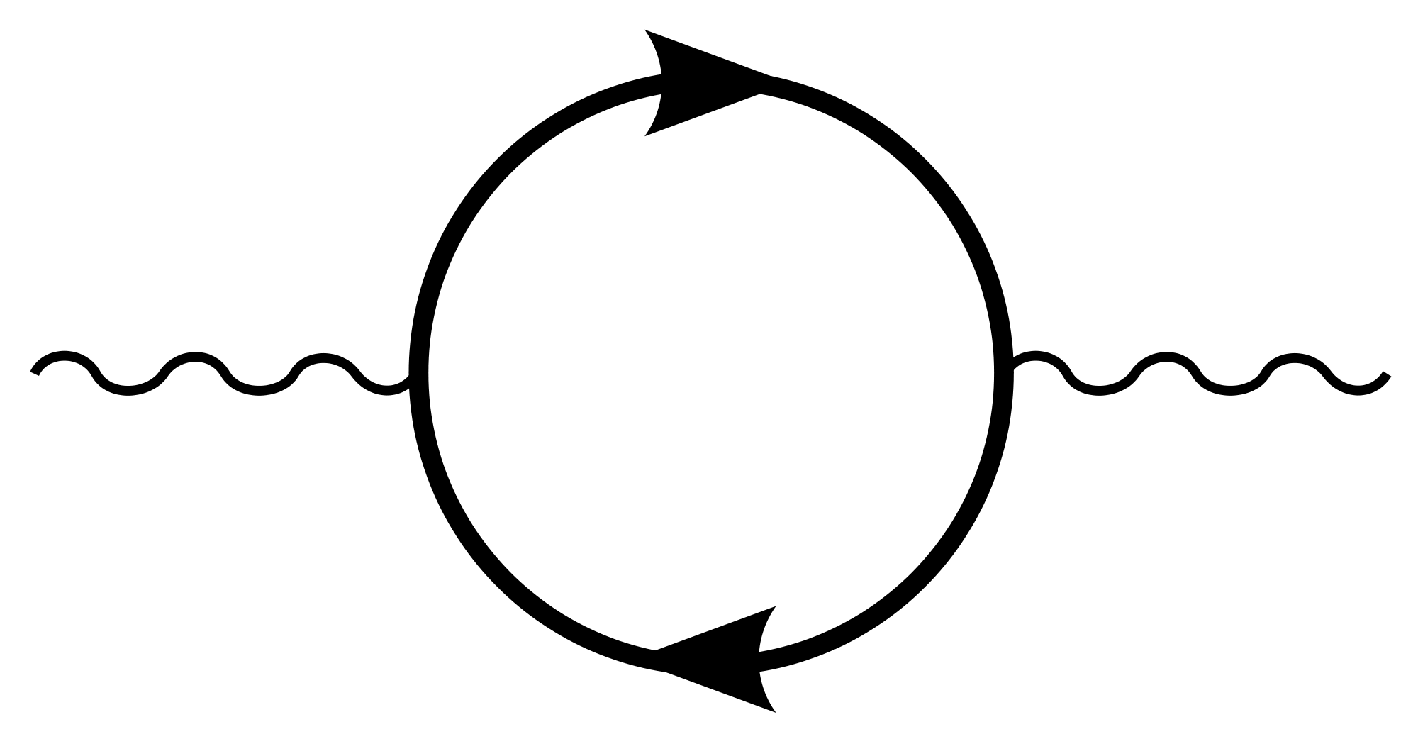
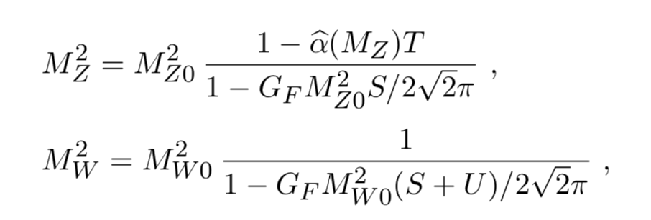


M_{W} as a probe of NP
JHEP12(2016)135
Pivotal role in the determination of oblique parameters S,T,U
$$V_{μ}$$
$$V_{μ}$$

Slide 5
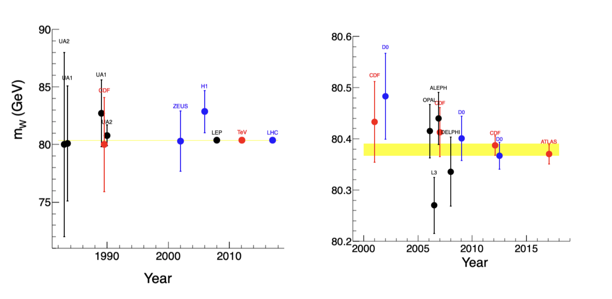





M_{W} in the history of colliders
$p\overline{p}$
$$e^{−}p$$
$$e^{+}e^{−}$$
$p\overline{p}$
$$pp$$
5 %
Relative uncertainty
0.02 %

Slide 6
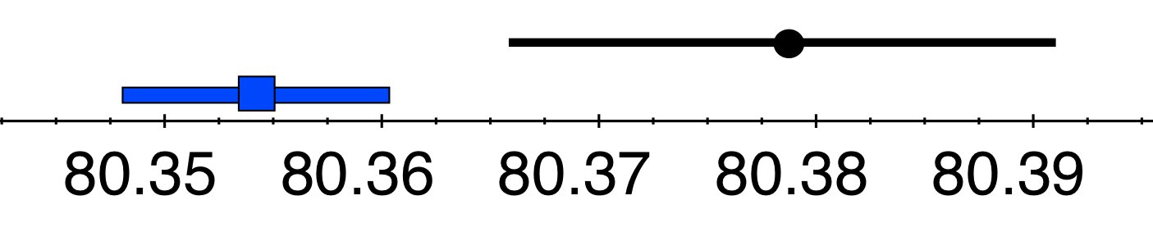
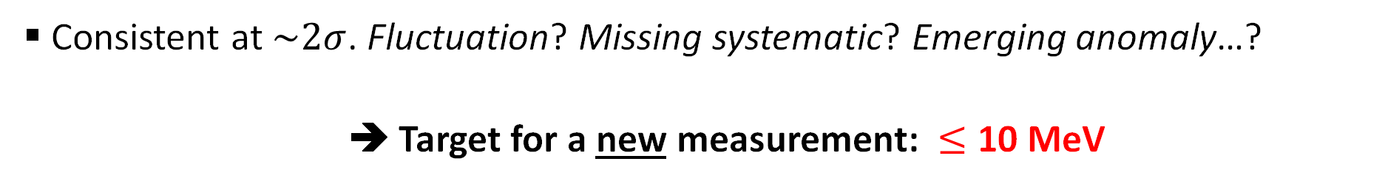
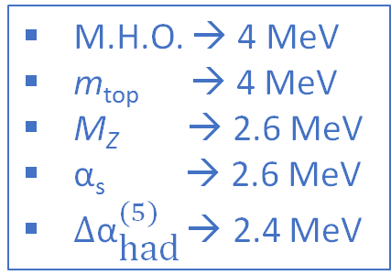
What we know today and what is a useful target
M.H.O. → 4 MeV
m_{top} → 4 MeV
M_{Z} → 2.6 MeV
α_{s} → 2.6 MeV
$∆{\text{α}}_{\text{had}}^{(5)}$ → 2.4 MeV
Tevatron → 15 MeV
LHC → 19 MeV
LEP → 33 MeV
PDG:
80379 ± 12 MeV
SM:
80354 ± 7 MeV
Consistent at $\sim 2σ$. Fluctuation? Missing systematic? Emerging anomaly…?
  ➔ Target for a new measurement: $≤$ 10 MeV

Slide 7
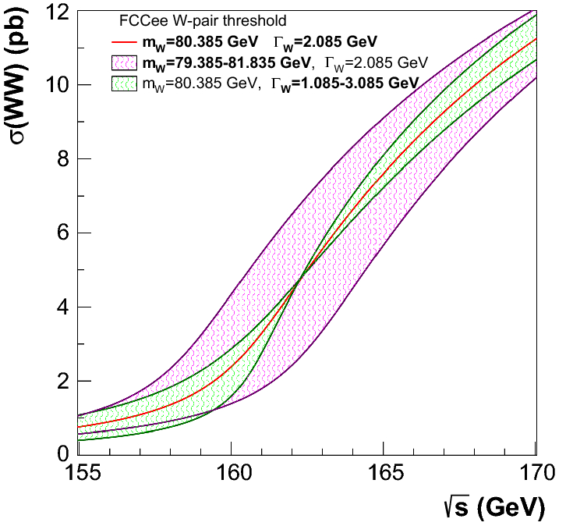
Which future for M_{W}?
EPJC 79 (2019) 474
Ultimate precision from next-generation of lepton colliders (>2040)
  FCC-ee + 2y at threshold → 0.5 MeV
  Beyond the reach of hadron colliders
LHC has analyzed just a tiny fraction of its data for M_{W}
  Strong mandate to probe its limits.

Slide 8
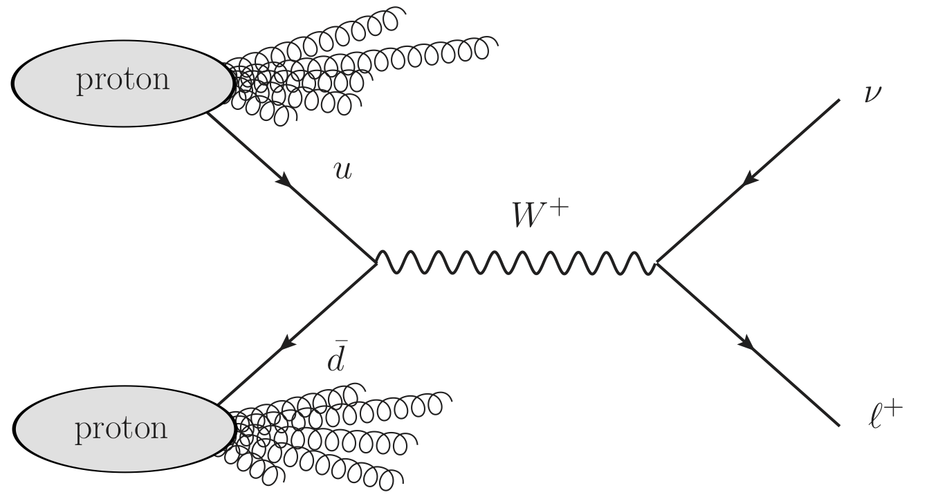
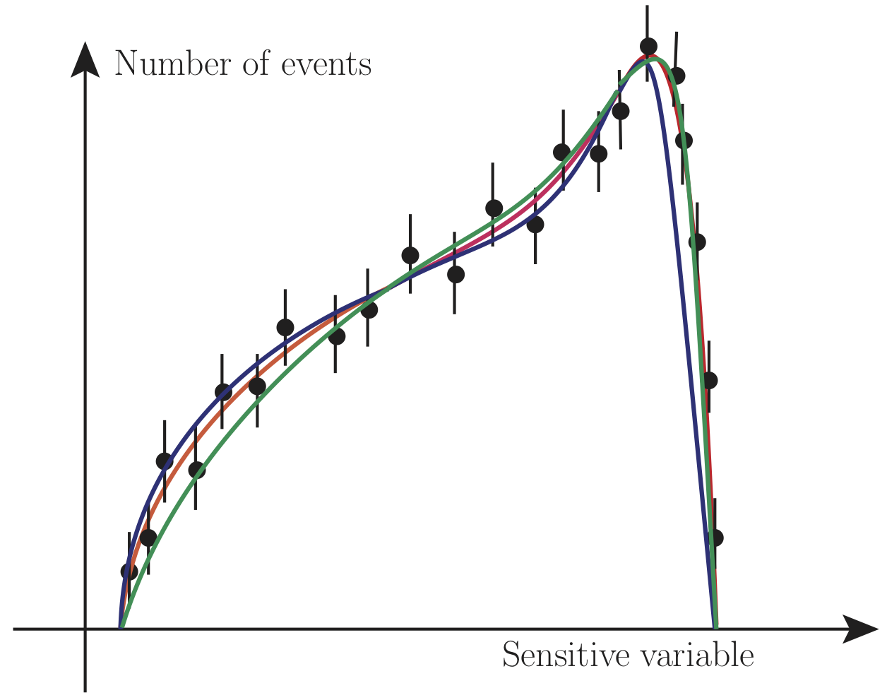
M_{W} at hadron colliders
Direct production: pp → W± → l± ν
  Continuous spectrum of W momenta
  Neutrino p₄ unreconstructed
No “invariant mass” estimator
  Use of kinematic variables sensitive to M_{W} (NOT Lorentz-invariant)
Comparison of experimental distributions to model-dependent templates
  Fit for the “best” M_{W}
M₁
M₃
M₂

Slide 9
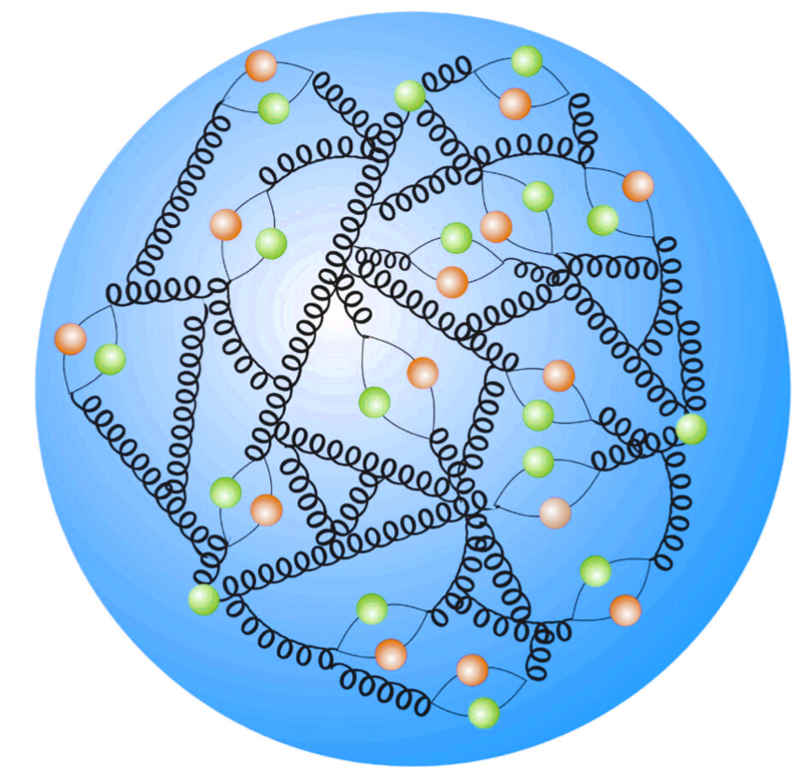
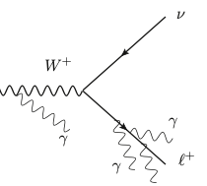
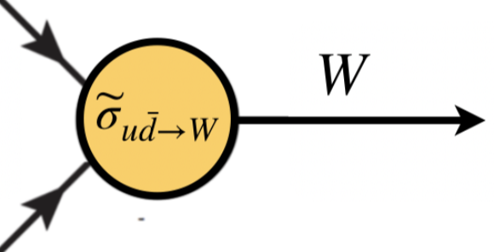
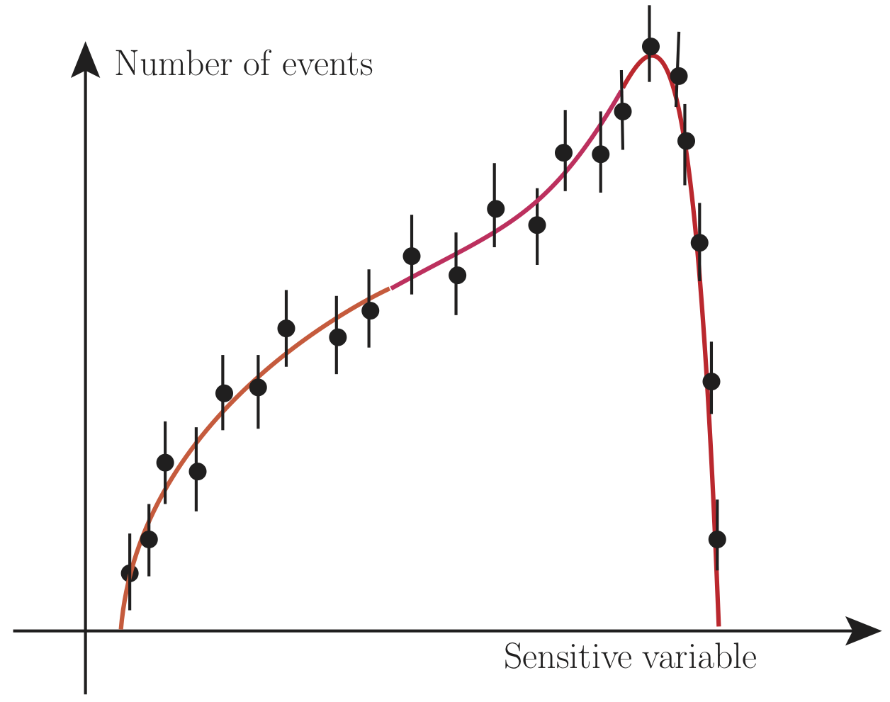
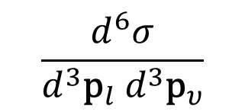


Models of W production
Proton PDFs
Perturbative QCD
Perturbative
QED
$$⊗$$
$$×$$
p.d.f. of sensitive variable
$$\frac{d^{6}σ}{d^{3}{\text{p}}_{l}{ d}^{3}{\text{p}}_{υ}}$$

Slide 10
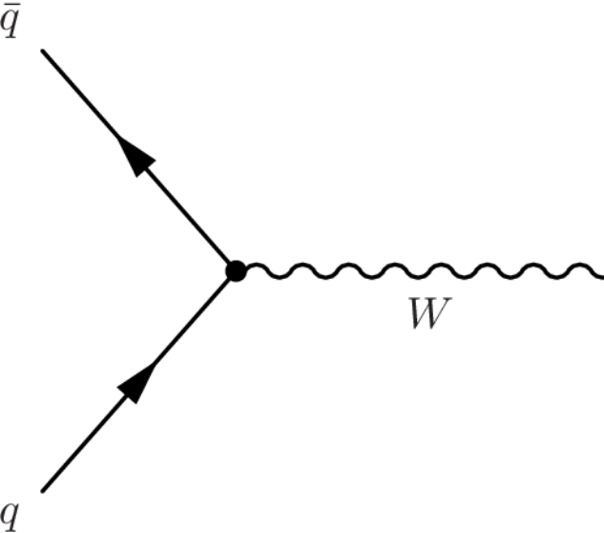
Interlude: notation
Rapidity
(~ velocity along beam)
Virtuality
( ~ M_{W})
$$\left(E,\vec{\text{q}}\right) = \left(\sqrt{q_{T}^{2}+Q^{2}}\cosh{y}{, }q_{T} , \sqrt{q_{T}^{2}+Q^{2}}\sinh{y}\right)$$
Transverse momentum
(to the beam)

Slide 11
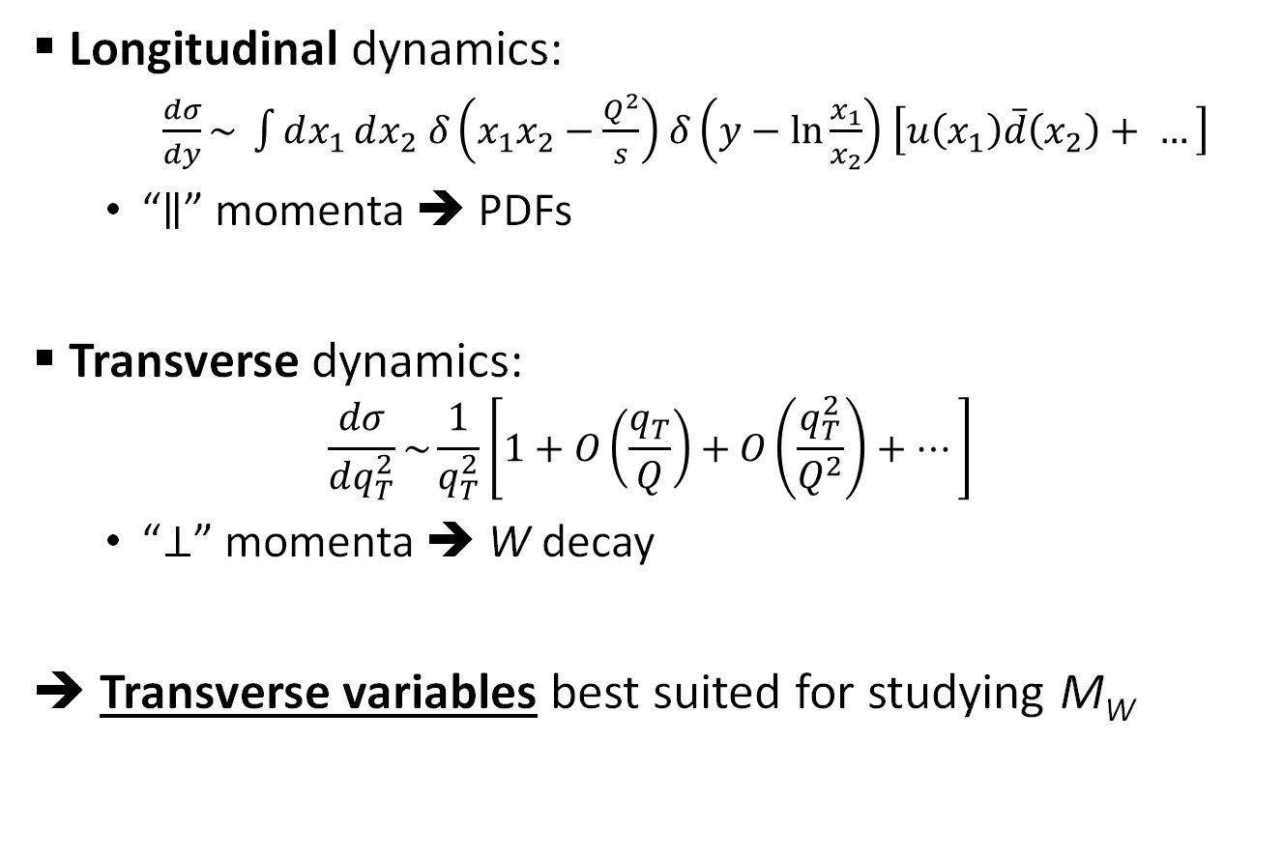
W boson dynamics in the lab
Longitudinal dynamics:
  $\frac{dσ}{dy}\sim \int{dx_{1}}dx_{2} δ\left(x_{1}x_{2}−\frac{Q^{2}}{s}\right)$ $δ\left(y−\text{ln}\frac{x_{1}}{x_{2}}\right)$ $\left[u\left(x_{1}\right)\overline{d}\left(x_{2}\right)+ …\right]$
  “$∥$” momenta ➔ PDFs
Transverse dynamics:
$$\frac{dσ}{dq_{T}^{2}}\sim \frac{1}{q_{T}^{2}}\left[1+O\left(\frac{q_{T}}{Q}\right)+O\left(\frac{q_{T}^{2}}{Q^{2}}\right)+…\right]$$
  “$⊥$” momenta ➔ W decay
➔ Transverse variables best suited for studying M_{W}

Slide 12
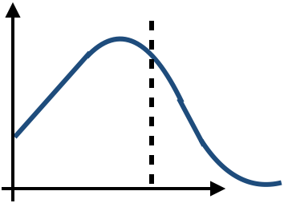



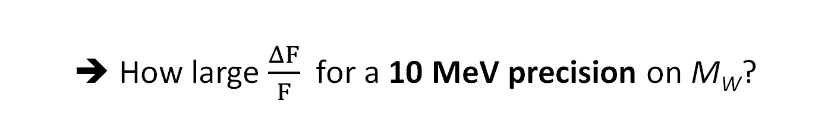

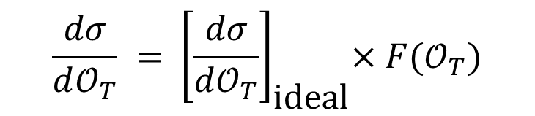

The PDF uncertainty
Why longitudinal dynamics matters?
  Mostly an acceptance artefact
$$\overline{d}$$
$$u$$
$$y>0$$
$$\frac{dσ}{d𝒪_{T}}$$
$$\frac{dσ}{d𝒪_{T}} ={ \left[\frac{dσ}{d𝒪_{T}}\right]}_{\text{ideal}}×F(𝒪_{T})$$
PDF dependence from here!
$$𝒪_{T}$$
➔ How large $\frac{ΔF}{F}$ for a 10 MeV precision on M_{W}?

Slide 13


Impact of PDF uncertainty on $p_{T}^{l}$ spectrum
PRD 91 (2015) 113005
Impact of 10 MeV shift of M_{W}
Impact of PDF uncertainty (%)
Green curve: 10 MeV → < 0.1%
➔ At the limit for standard detectors
($\left|η\right|<2.5$)

Slide 14
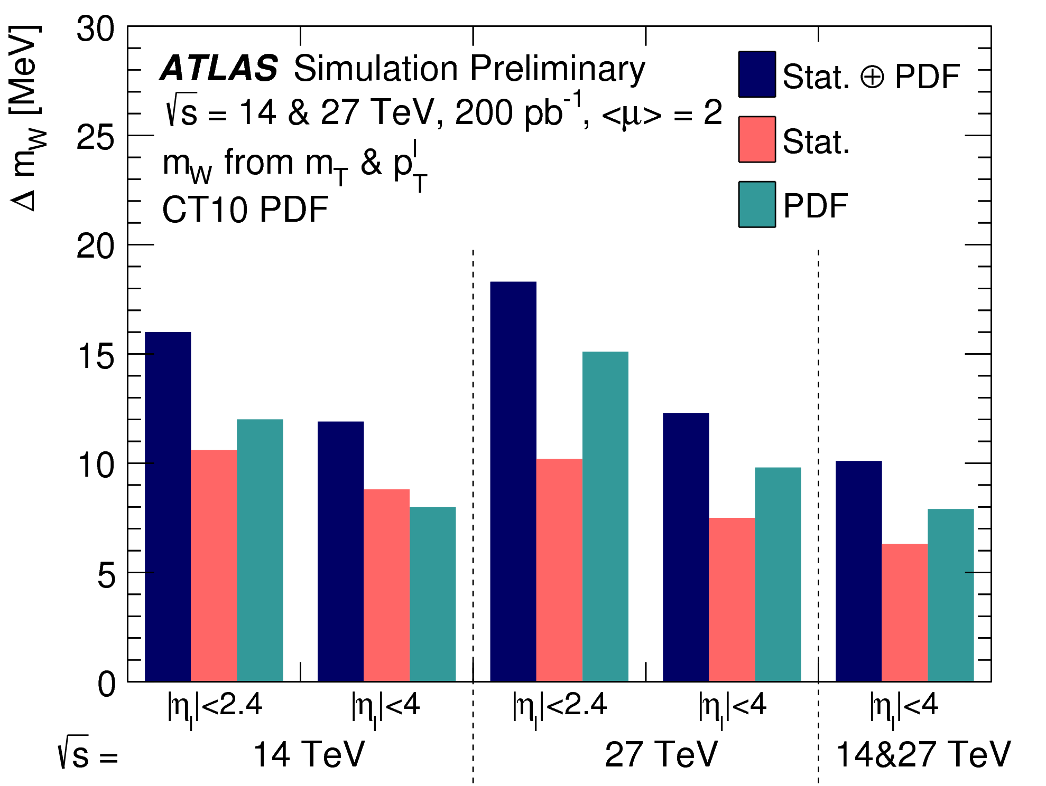
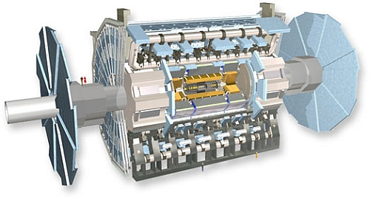
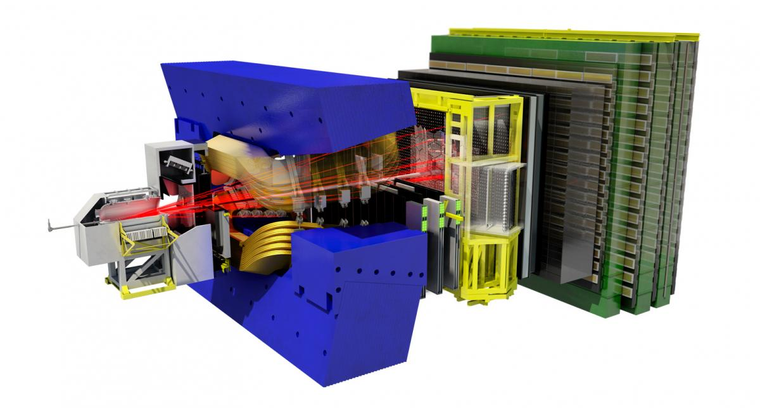
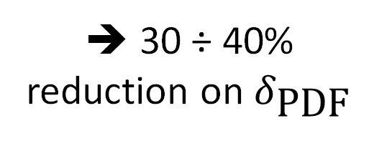
PDF mitigation: experimental perspective
Joining experiments:
Doing in situ:
ATL-PHYS-PUB-2018-026
EPJC 75 (2015) 601
ATLAS & CMS
LHCb
➔ 30 ÷ 40% reduction on $δ_{\text{PDF}}$

Slide 15
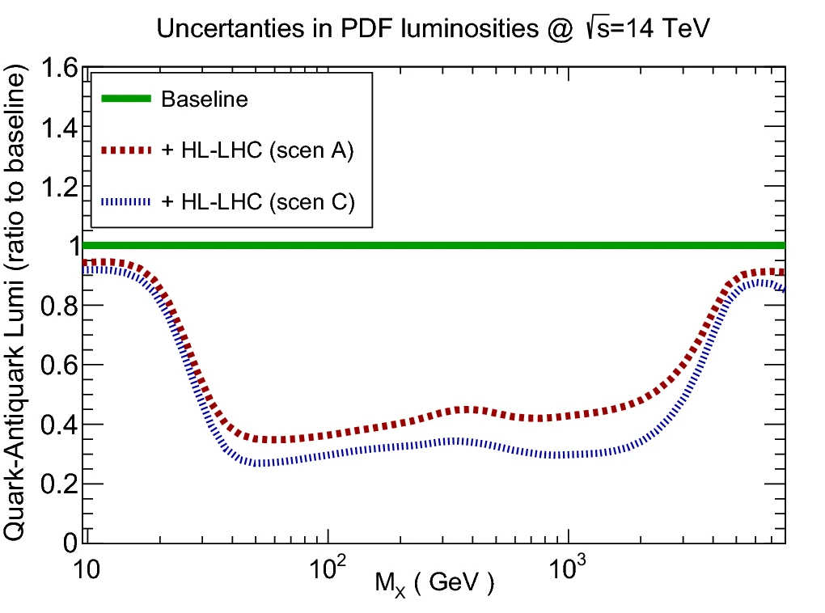

PDF mitigation: experimental perspective
EPJC 78 (2018) 962
PDFs will also evolve with luminosity
  Projecting these measurements at HL-LHC ➔ $≈$50% reduction on $δ_{\text{PDF}}$

Slide 16
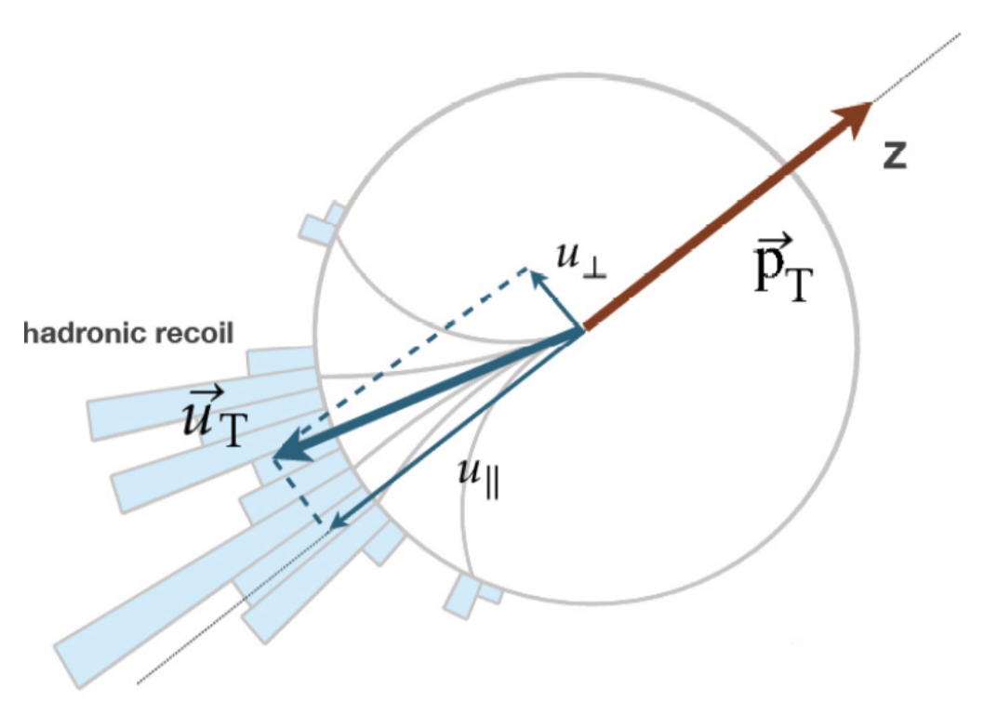

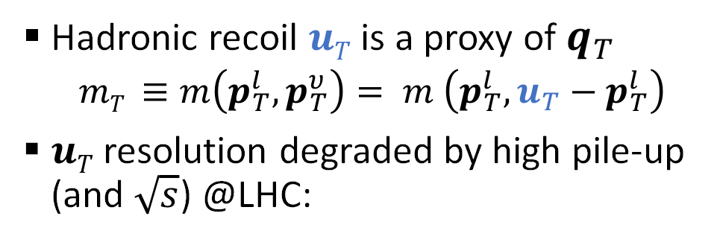
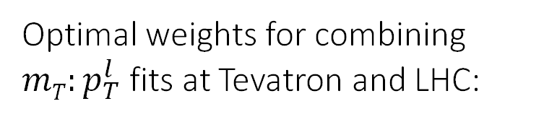

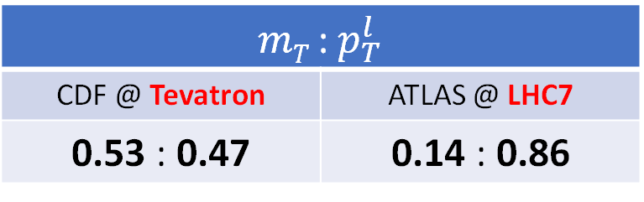
Transverse motion
Hadronic recoil $uT$ is a proxy of $q_{T}$
  $mT ≡m\left(p_{T}^{l},p_{T}^{υ}\right)= m \left(p_{T}^{l},u_{T}−p_{T}^{l}\right)$
$uT$ resolution degraded by high pile-up (and $\sqrt{s}$) @LHC:
$$q_{T}$$
Optimal weights for combining $mT{:p}_{T}^{l}$ fits at Tevatron and LHC:
$mT$ : $p_{T}^{l}$
CDF @ Tevatron | ATLAS @ LHC7
0.53 : 0.47 | 0.14 : 0.86
➔ Modeling of $q_{T}$ is critical at LHC!

Slide 17
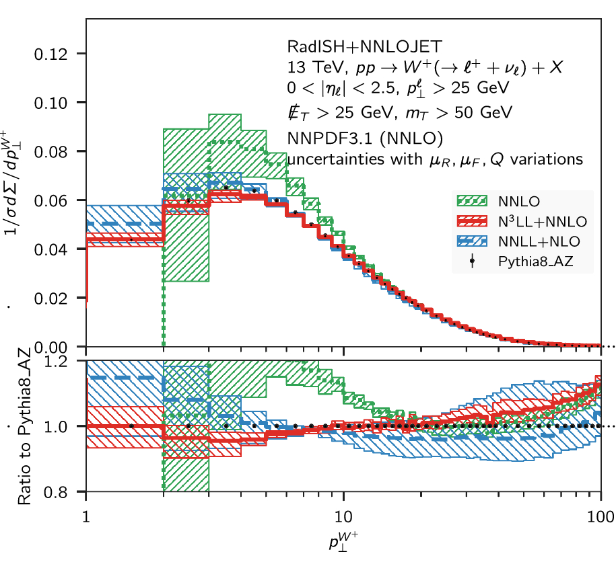
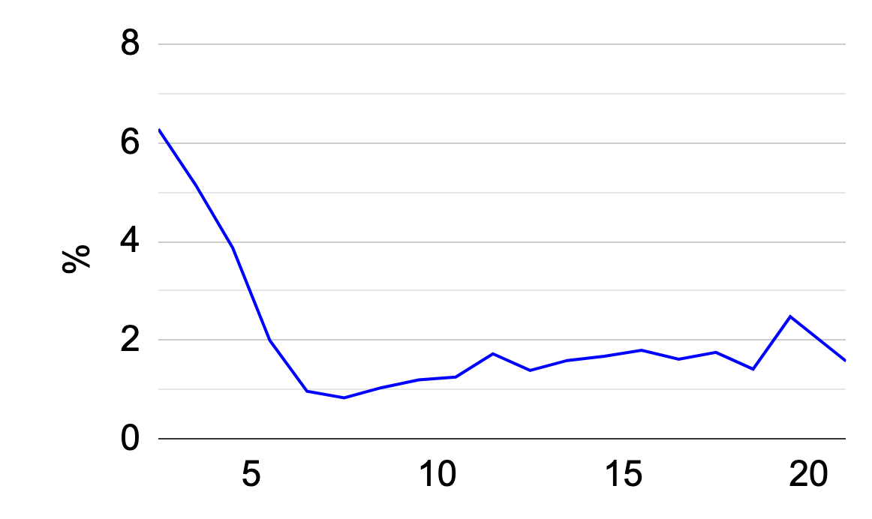
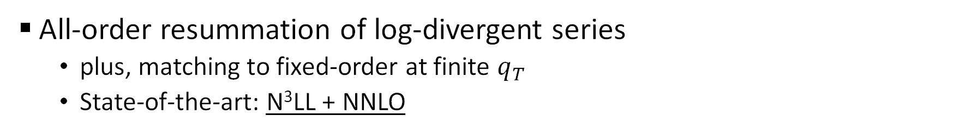
Theoretical prediction
EPJC 79 (2019) 868
and many others…
All-order resummation of log-divergent series
  plus, matching to fixed-order at finite $q_{T}$
  State-of-the-art: N³LL + NNLO
Best theoretical precision (%)
➔ Which precision needed for 10 MeV on M_{W} ?

Slide 18
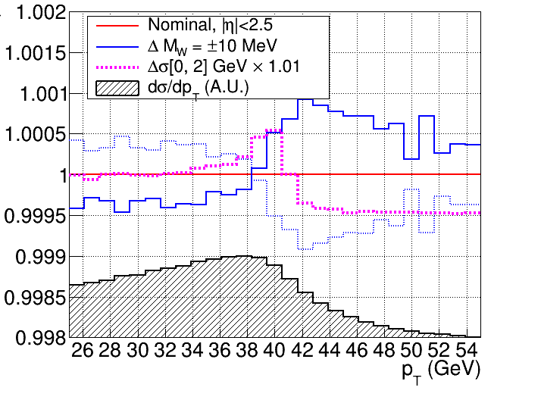
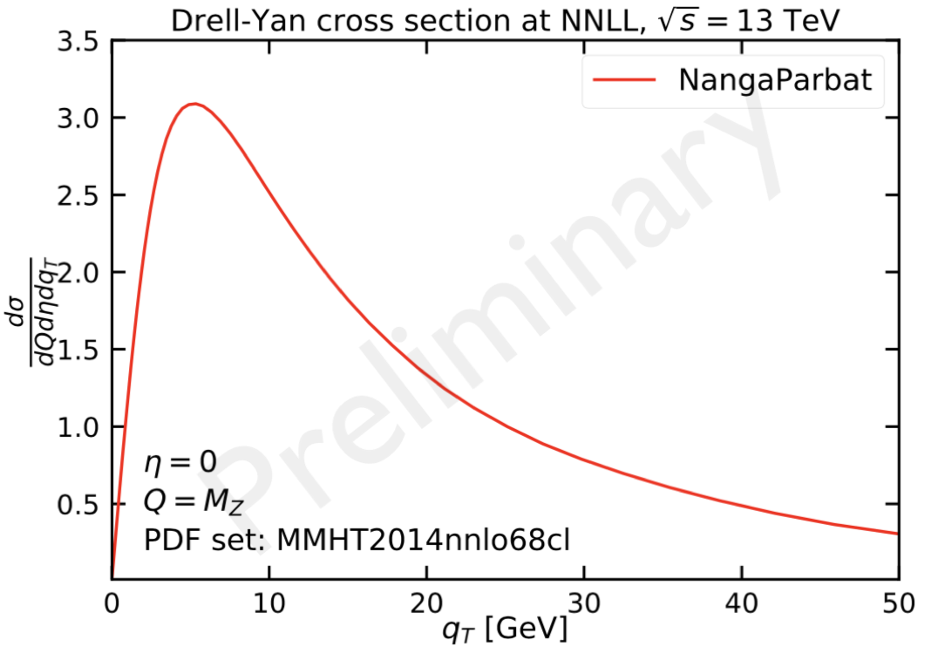
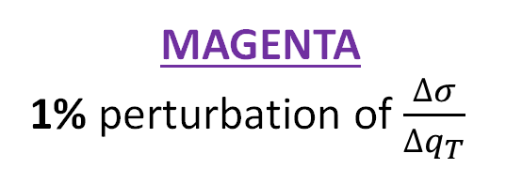

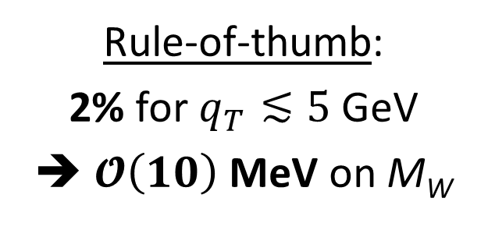
A qualitative assessment
BLUE
10 MeV shift of M_{W}
Rule-of-thumb:
2% for $q_{T}≲5$ GeV
➔ $𝓞\left(10\right)$MeV on M_{W}
MAGENTA
1% perturbation of $\frac{∆σ}{∆q_{T}}$
REMINDER
Best theoretical precision (%)
$p_{T}^{l}$ (GeV)

Slide 19
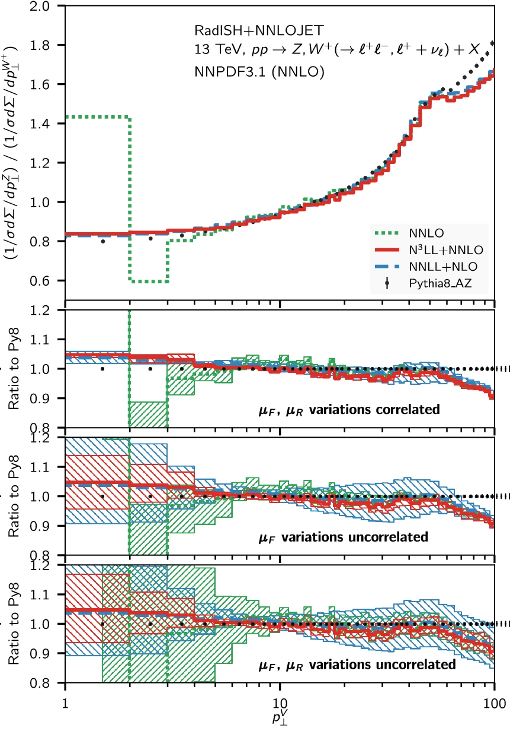
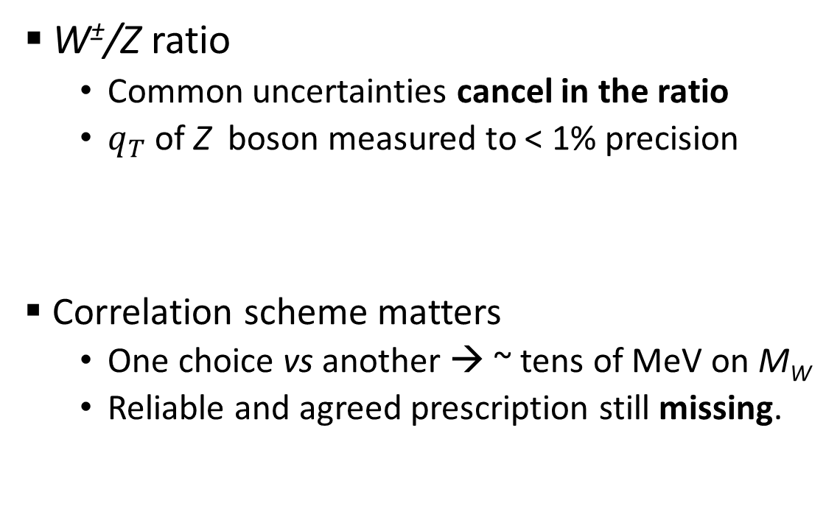

Enhancements to $q_{T}$ model: theory
EPJC 79 (2019) 868
W±/Z ratio
  Common uncertainties cancel in the ratio
  $q_{T}$ of Z boson measured to < 1% precision
Correlation scheme matters
  One choice vs another → ~ tens of MeV on M_{W}
  Reliable and agreed prescription still missing.
JHEP 12 (2019) 061

Slide 20
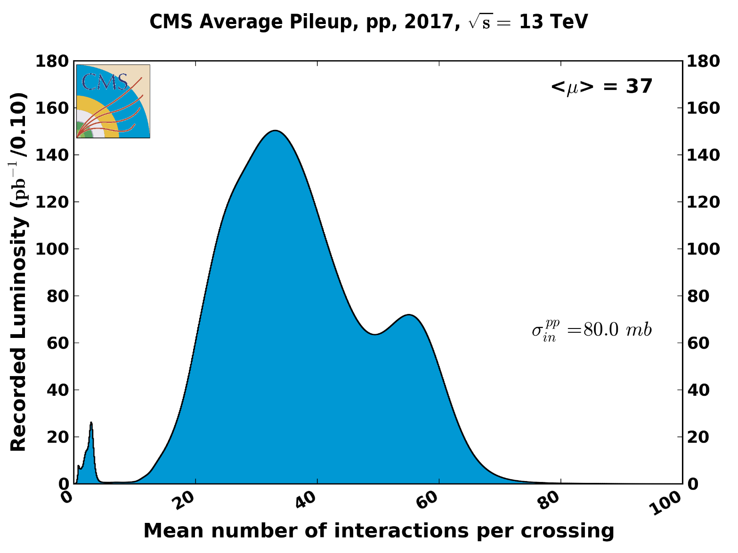
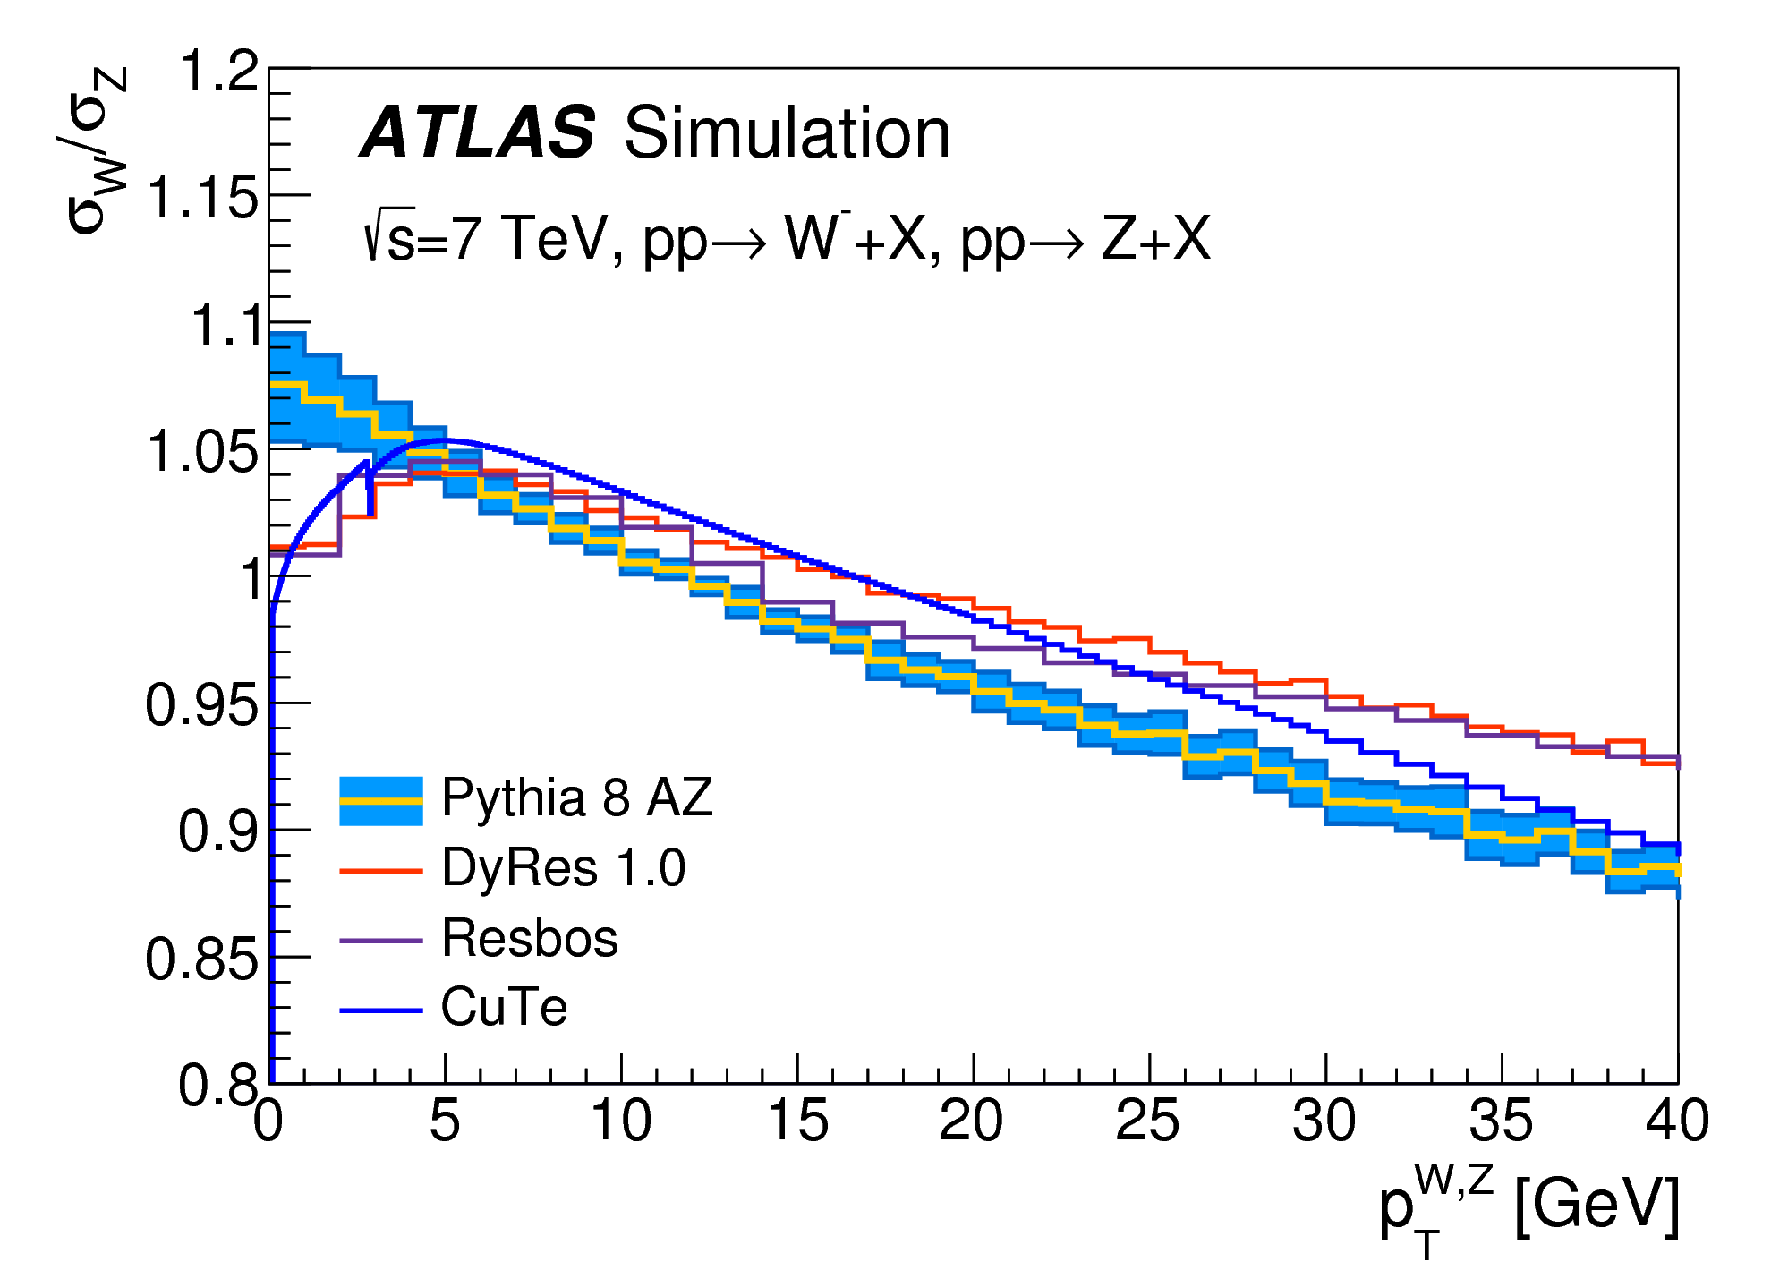


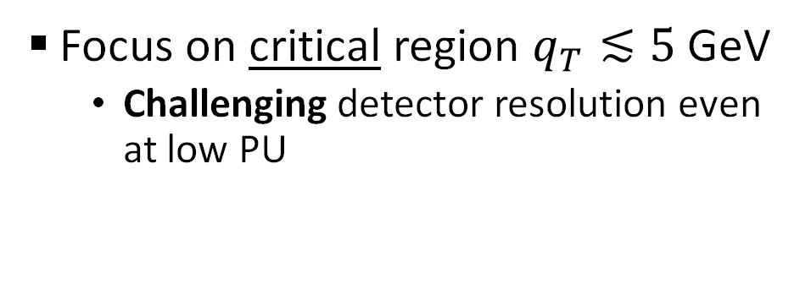
Enhancements to $q_{T}$ model: experiment
Precision measurement of W $qT$
  Special LHC runs can improve $σ(uT)$
Focus on critical region $q_{T}≲5$ GeV
  Challenging detector resolution even at low PU
EPJC 78 (2018) 110
200/pb

Slide 21

Wrapping up on model uncertainties
ATLAS measurement @ 7 TeV ➔ predominance of model uncertainties
  PDF, QCD contribute by ≃ 8, 9 MeV.
EPJC 78 (2018) 110
➔ Some breakthrough needed to reach the 10 MeV target!

Slide 22
The breakthrough: data!
LHC → high-luminosity discovery machine
  unprecedented statistical power for producing EWK bosons
 | LEP | Tevatron | LHC
# of W bosons | 80,000 | 3,000,000 | 1,000,000,000
× 300
× 30,000
How to make the best of it?

Slide 23




Ideas for an ancillary measurement
Measurement of the rapidity spectrum for the two helicity states of W±
  Observation: 2D spectrum $(p_{T}^{l}, η^{l})$ provides simultaneous information on rapidity and helicity of the W ±.
$y$ e h depend on quark flavor and momentum→ constraint in situ of PDFs
    Corroborated by recent CMS work [PRD 102 (2020) 092012]
  JHEP12(2017)130
$$p_{T}^{l}$$
W⁺ pos. helicity
W⁺ neg. helicity
See also:
EPJC 79 (2019) 497
$$η^{l}$$
$$η^{l}$$

Slide 24



Towards an agnostic model
Precision measurement of differential spectrum ➔ model constraint
  Can one push this paradigm to its limit?
First principles: generic cross-section for pp → V → l ν :
[1]
$$\frac{dσ}{d^{4}q d\cos{θ dφ}}=\frac{3}{16π}\sum_{i=−1}^{7}{\frac{dσ_{i}}{d^{4}q}g_{i}(θ,φ)}$$
$$=\frac{3}{16π}\frac{dσ_{−1}}{d^{4}q}\left(1+{\text{cos}}^{2}θ+\sum_{i=0}^{7}{A_{i}(q_{T},|y|)g_{i}(θ,φ)}\right)$$
Unpolarized cross-section
Angular coefficients

Slide 25

Towards an agnostic model
Eq. [1] → joint p.d.f. $(p_{T}^{l}, η^{l})$ as a linear combination of a finite and complete set of templates:
$$\frac{∆^{2}σ}{∆p_{T}^{l} {∆η}^{l}}=\sum_{Δq_{T}, Δ|y|}{\frac{∆^{2}σ_{−1}}{∆q_{T} ∆|y|}\left(T_{−1}\left(p_{T}, η \right| M_{W})+\sum_{i=0…4}{A_{i, ∆q_{T}, ∆\left|y\right|}×{ T}_{i}\left(p_{T}, η \right| M_{W})}\right)}$$
  Normalizations → W production & decay dynamics
  Template shape → M_{W}

Slide 26









Towards an agnostic model
$$φ^{∗}$$
$q_{T}$
$y$
$$\cos{θ^{∗}}$$
$$p_{T}^{l}$$
$$p_{T}^{l}$$
$$p_{T}^{l}$$
$$η^{l}$$
$$η^{l}$$
$$η^{l}$$

Slide 27





In practice
$q_{T}$
MC sample
pp → W± → l ± ν
QED
Detector simulation
$y$
$Q$
Use MC to populate this dimension
  EPJC 80 (2020) 328

Slide 28







In practice
$$(cos{θ^{∗}, φ^{∗})}$$
Q

Slide 29


Proof of concept
Which statistical precision on M_{W}?
  Studied on MC simulation (~1300 templates, ~300 free parameters)
TRADITIONAL
ASYMOW
Model uncertainties ➔
systematic bias > 10 MeV
Model uncertainties ➔
statistical uncertainty

Slide 30


Experimental challenges
ΔM_{W} (stat.) = 4 MeV → L_{int} ≃ 300/fb.
  Possible with Run2 + Run3
  $𝒪(100)$ more events than any M_{W} measurement to date
Challenge: keep experimental systematics under control
  Background subtraction
  Detector calibration
  Residual theory uncertainty
Experiment ➔ CMS
  Superior performance Tracker + μ-system:
  → Priority to measurement with muons

Slide 31



Example: momentum scale calibration
μ
Target: ${Δp}/p<{10}^{−4}$
  $\sim$300 nm biases on mean track curvature;
  unique use-case for such a precision!
Intense B-field + silicon tracker
  $J/Ψ$ as standard candle → closure on the Z
  $\sim 2×{10}^{−4}$ achieved at 7 TeV [CMS-PAS-SMP-14-007]
An historical & ongoing effort driven by CMS group @ SNS
1%

Slide 32

Expected performances
Three scenarios of increasing experimental success:
  ΔM_{W} ≃ 10 MeV appears to be a robust deliverable
  ➔ Possible by overcoming the model-dependence bottleneck
 |  | Stat. | Exp. | Bkg. | QCD | EW | PDF | Tot.
Reference (ATLAS @7 TeV) |  | 7 | 6 | 5 | 8 | 6 | 9 | 19
ASYMOW | Conservative | 4 | 8 | 5 | 3 | 3 | 3 | 11
 | Intermediate | 4 | 4 / 8 | 5 / 3 | 3 | 3 | 3 | 9 / 10
 | Aggressive | 4 | 4 | 3 | 3 | 3 | 3 | 8
$\sim$2 better than single-experiment to date

Slide 33



Not just M_{W}
Multi-differential model is a “nuisance”… but also a by-product
  Tighter PDF constraints
  Benchmark for precision calculations
    e.g., a recoil-free measurement of $q_{T}$
Examples of angular coefficients extracted together with M_{W}

Slide 34
One last idea…
ASYMOW → profile the full underlying production mechanism while measuring M_{W}
  Can it be done with fewer nuisances?

Slide 35



A subtle point of invariance
Remember the famous $π^{0}$ decay…

Slide 36


A subtle point of invariance
Remember the famous $π^{0}$ decay…
$$E^{∗}=\text{argmax}\left[\frac{dσ}{dE}\right]$$

Slide 37



A subtle point of invariance
JHEP 05 (2019) 044
What about a spin-1 particle?
  “footprint” (kink) in the second-order derivative $f^{(2)}$ of the energy spectrum
  ➔ Lorentz-invariant estimator of M_{W}

Slide 38


An energy-only M_{W} measurement?
JHEP 05 (2019) 044
  E-spectrum fit to 4th order polynomial.
  Take root of 3rd-order derivative (${\hat{x}}_{3}$)
  MC calibration needed to account for finite-width and QED radiation
$\sim 15$ MeV (stat.) feasible with full LHC data.
Further studies needed to assess feasibility.

Slide 39
Conclusions
Three ways towards a precision measurement:
  enhancements to theory models,
  enhancements to the experiments,
  a Third Way:
    Novel
    Challenging
    Competitive
    A project for the next years!
ASYMOW
PDG (2020)
SM
Grazie per la vostra attenzione!

Slide 40
Cosa possiamo imparare da mW
JHEP12 (2016) 135
Interpretazione in modelli specifici
  complementarietà con misure dirette (e.g. sez. d’urto dell’Higgs)
A. Wulzer, Granda Symposium

Slide 41

Predizione teorica

Slide 42













The PDF uncertainty
$${y=y}_{1}$$
$u\left(\frac{Q}{\sqrt{s}}e^{+y_{1}}\right)\overline{d}\left(\frac{Q}{\sqrt{s}}e^{−y_{1}}\right) ×$
Marginalize over all y values and $q \left(\overline{q}\right)$pairs
$${y=y}_{2}$$
$u\left(\frac{Q}{\sqrt{s}}e^{+y_{2}}\right)\overline{d}\left(\frac{Q}{\sqrt{s}}e^{−y_{2}}\right) ×$
+
$$y=…$$
Transverse variable
$\overline{d}\left(\frac{Q}{\sqrt{s}}e^{+y_{2}}\right)u\left(\frac{Q}{\sqrt{s}}e^{−y_{2}}\right) ×$
$$…$$
$$…$$

Slide 43







The PDF uncertainty
Why then longitudinal dynamics also matters?
  Mostly an acceptance artefact
$$\frac{dσ}{d𝒪_{T}}$$
$$u$$
$$\overline{d}$$
$$s_{z}=−\frac{1}{2}$$
$$s_{z}=−\frac{1}{2}$$
$$𝒪_{T}$$
$$y=0$$

Slide 44





The PDF uncertainty
Why then longitudinal dynamics also matters?
  Mostly an acceptance artefact
$$\frac{dσ}{d𝒪_{T}}$$
$$\overline{d}$$
$$u$$
$$s_{z}=+\frac{1}{2}$$
$$s_{z}=+\frac{1}{2}$$
$$𝒪_{T}$$
$$y=0$$
➔ Invariant under $q⟷\overline{q}$

Slide 45

The PDF uncertainty
Why then longitudinal dynamics also matters?
  Mostly an acceptance artefact
$$\frac{dσ}{d𝒪_{T}}$$
$$u$$
$$\overline{d}$$
$$s_{z}=−\frac{1}{2}$$
$$s_{z}=−\frac{1}{2}$$
$$𝒪_{T}$$
$$y>0$$
➔ Sculpted by the detector

Slide 46




The PDF uncertainty
Why then longitudinal dynamics also matters?
  Mostly an acceptance artefact
$$\frac{dσ}{d𝒪_{T}}$$
$$\overline{d}$$
$$u$$
$$s_{z}=+\frac{1}{2}$$
$$s_{z}=+\frac{1}{2}$$
$$𝒪_{T}$$
$$y>0$$
➔ Different under $q⟷\overline{q}$

Slide 47



Measurements of $q_{T}$ spectra
PRD 85 (2012) 012005
JHEP 02 (2017) 096

Slide 48

Measurements of $q_{T}$ spectra
EPJC 78 (2018) 110

Slide 49
PDF uncertainty vs acceptance
PRD 91 (2015) 113005

Slide 50

A new look at PDF uncertainty
PRL 126 (2021) 041801
$p_{T}^{l}$spectrum alone enough to constrain all the PDF uncertainty at high lumi
  Just use correlation pattern with${ p}_{T}^{l}$
  ${ δ}_{\text{PDF}}$ $→$ 1 MeV with 300/fb!
Looser constraints when detector included
  Also handling of $q_{T}$ not straightforward in this setup

Slide 51


Towards an agnostic model
From Eq. [1]: joint p.d.f. $(p_{T},η)$ as a linear combination of a finite and complete set of templates:
+
+
+
p_{T}
=
+
+
+ …
η

Slide 52

Master formula for spin-1 energy spectrum

Slide 53
Testing on MC

