Slide 1
EGS proposal for a LINAC based radioactive beam facility
A.Variola (INFN Roma1)

Slide 2
Project constraints
Find a new project that is not a ‘gamma source’
The project must fit the needs of the Romanian users comunity.
The performance and the physics case has to represent an added value in the present research framework.
The accelerator part should re use all the elements that have already been paid in phase 1 by IFIN-HH.
Hardware modifications should be minimized.
Robust project, no failure risks permitted

Slide 3
Among different proposals…….
1) an exotic radiation source (the present machine design is optimized for this configuration)
2) A polarised slow positron source
3) A photoproduction neutron source
4) A facility for radioactive beams (ALTO TYPE)

Slide 4
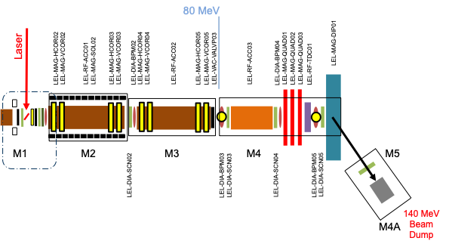
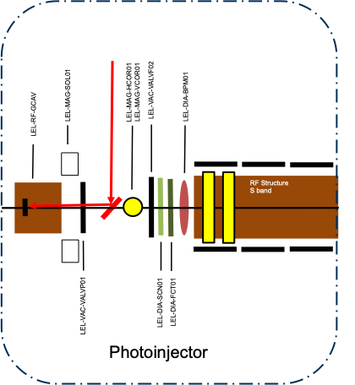
INJECTOR LAYOUT
80 MeV
80 MeV
Laser
LEL-MAG-DIP01
Laser
LEL-MAG-QUAD02
LEL-MAG-DIP01
LEL-MAG-QUAD03
LEL-MAG-SOL02
LEL-MAG-VCOR04
LEL-RF-TDC01
LEL-MAG-VCOR02
LEL-MAG-VCOR03
LEL-VAC-VALVP03
LEL-MAG-HCOR04
LEL-MAG-VCOR05
LEL-MAG-HCOR02
LEL-MAG-HCOR03
LEL-MAG-HCOR05
LEL-MAG-QUAD01
LEL-DIA-BPM02
LEL-DIA-BPM04
LEL-MAG-QUAD02
LEL-MAG-QUAD03
LEL-RF-ACC01
LEL-RF-ACC02
LEL-RF-ACC03
LEL-RF-TDC01
LEL-MAG-SOL02
LEL-MAG-VCOR04
LEL-MAG-VCOR02
LEL-MAG-VCOR03
LEL-VAC-VALVP03
LEL-MAG-HCOR04
LEL-MAG-VCOR05
LEL-MAG-HCOR02
LEL-MAG-HCOR03
LEL-MAG-HCOR05
LEL-MAG-QUAD01
LEL-RF-ACC01
LEL-DIA-BPM02
LEL-RF-ACC02
LEL-DIA-BPM04
LEL-RF-ACC03
M1
M2
M3
M4
M5
M1
M2
M3
M4
M5
LEL-DIA-SCN03
LEL-DIA-SCN04
LEL-DIA-SCN05
LEL-DIA-BPM03
LEL-DIA-BPM05
LEL-DIA-SCN02
LEL-DIA-SCN03
LEL-DIA-SCN04
LEL-DIA-SCN05
LEL-DIA-SCN02
LEL-DIA-BPM03
LEL-DIA-BPM05
140 MeV
Beam Dump
M4A
140 MeV
Beam Dump
M4A

Slide 5
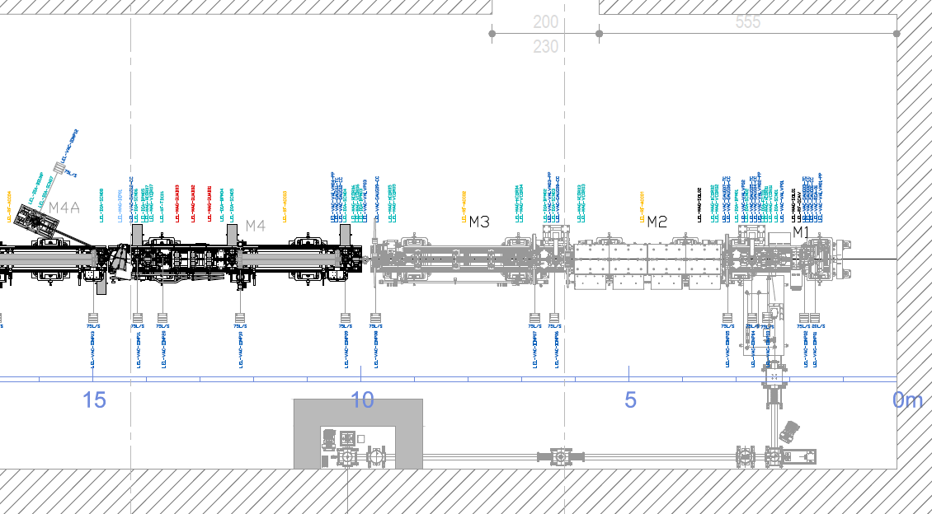
80 MeV
80 MeV
Laser
LEL-MAG-DIP01
Laser
LEL-MAG-QUAD02
LEL-MAG-DIP01
LEL-MAG-QUAD03
LEL-MAG-SOL02
LEL-MAG-VCOR04
LEL-RF-TDC01
LEL-MAG-VCOR02
LEL-MAG-VCOR03
LEL-VAC-VALVP03
LEL-MAG-HCOR04
LEL-MAG-VCOR05
LEL-MAG-HCOR02
LEL-MAG-HCOR03
LEL-MAG-HCOR05
LEL-MAG-QUAD01
LEL-DIA-BPM02
LEL-DIA-BPM04
LEL-MAG-QUAD02
LEL-MAG-QUAD03
LEL-RF-ACC01
LEL-RF-ACC02
LEL-RF-ACC03
LEL-RF-TDC01
LEL-MAG-SOL02
LEL-MAG-VCOR04
LEL-MAG-VCOR02
LEL-MAG-VCOR03
LEL-VAC-VALVP03
LEL-MAG-HCOR04
LEL-MAG-VCOR05
LEL-MAG-HCOR02
LEL-MAG-HCOR03
LEL-MAG-HCOR05
LEL-MAG-QUAD01
LEL-RF-ACC01
LEL-DIA-BPM02
LEL-RF-ACC02
LEL-DIA-BPM04
LEL-RF-ACC03
M1
M2
M3
M4
M5
M1
M2
M3
M4
M5
LEL-DIA-SCN03
LEL-DIA-SCN04
LEL-DIA-SCN05
LEL-DIA-BPM03
LEL-DIA-BPM05
LEL-DIA-SCN02
LEL-DIA-SCN03
LEL-DIA-SCN04
LEL-DIA-SCN05
LEL-DIA-SCN02
LEL-DIA-BPM03
LEL-DIA-BPM05
140 MeV
Beam Dump
M4A
140 MeV
Beam Dump
M4A

Slide 6
TRANSITION FROM ELI TO ALTO
Pass from a very high brillance LINAC to a high average current one
- Emittance can increase of a factor 100
- Energy spread can increase to 1 %
- Average current has to increase of a factor 20-30
Solutions:
- Change the gun cathode to increase the QE at the same laser wavelength
- Retune the LINAC and evaluate the beam loading effects to assure the eam quality with high current
- What about a thermoionic gun ? Difficult scenario (AMPLITUDE)

Slide 7
Beam Dynamics, Cathodes, Beam Loading
And BBU Calculated. Laser system analysed.
CONCLUSIONS
We proposed a feasible LINAC based on the precedent ELI-NP injector.
Tentative perfromances (to be validated in CDR) should be:
1) 10μA average current
2) Beam energy between 150 and 200 MeV
3) Normalized emittance lower than 10 π mm mrad
4) Energy spread 1%
5) Bunch length < 10 ps
6) 100 Hz, 32 bunches per train, 3nC per bunch
Beam dynamics and BL and BBU evaluations carried out.

Slide 8
MAIN MODIFICATIONS
Electron gun,
Cs₂Te cathode
Cathode Handling and transfer systems
RF power lines
Optical transfer lines
Local shielding
Dumps
Main integration conformal to radioprotection requirements.

Slide 9
Proposed WBS – Only DA
WP1
Activity | Sub Activity | Tasks | Durata | Responsible | Ressources | Requirements | Required Expertise | Comments | Deliverables
Global layout |  |  |  | tbd
 | Scheme |  |  | tbd |  |  | User |  | Scheme for the production of radioactive beams. Type of expected beams.
 | Experimental lines definition |  |  | tbd |  |  | User |  | Description of the required Experimental lines. Functional layouts
 | Facility Layout |  |  | tbd |  |  | All |  | Baseline layout of the facility
 | Accelerator Layout |  |  | tbd |  |  | Accelerators |  | Baseline layout of the accelerator
 | Transfer lines |  |  | tbd |  |  | Accelerators |  | Baseline layout of the transfer lines
 | Parameters tables |  |  | tbd |  |  | All |  | Radioactive beams and Accelerator/Lasers parameters tables

Slide 10
WP2
Activity | Sub Activity | Tasks | Durata | Responsible | Ressources | Requirements | Required Expertise | Comments | Deliverables
Accelerator |  |  |  | tbd
 | Modifications |  |  | tbd |  |  | Accelerators |  | List of the modifications required for the new baseline configuration.
 |  | RF Gun |  | tbd |  |  | Accelerators |  | Descritpion o of the new RF Gun Type
 |  | Cathodes |  | tbd |  |  | Accelerators |  | Description of the baseline cathode
 |  | Laser |  | tbd |  |  | Laser |  | Description of the modification of the Laser system
 |  | Optical transfer Lines |  | tbd |  |  | Laser |  | Description of the modification of the Optical Transfer Lines
 |  | RF Transfer lines |  | tbd |  |  | Accelerator |  | Description of the modification of the RF Transfer Lines
 | Working points |  |  | tbd |  |  | Accelerator |  | Description of the different working points of the machine. BBU and beam loading evaluations in the different configurations
 | Transfer lines |  |  | tbd |  |  | Accelerator |  | Design of the trasnfer lines for the experimental lines, up to target
 | Controls and MPS |  |  | tbd |  |  | Accelerator |  | Eventual modifications to the MPS

Slide 11
WP3
1006 | Costing |  |  |  | tbd |  | Total costing
1006.01 |  | Civil infrastructures |  |  | tbd |  | Descritpion of the cost methodology
1006.01.01 |  |  | Buildings |  | tbd |  | Costing of the buildings
1006.01.02 |  |  | Utilities |  | tbd |  | Costing of the Utilities
1006.02 | Experimental areas |  |  |  | tbd |  | Costing of the experimental areas
1006.03 | Accelerator |  |  |  | tbd |  | Estimated cost for the Accelerator modification and boundary conditions fo the material state

Slide 12
FTE Corrispondenti. Periodo 6 mesi per questa attività. Poi si valuterà lo scenario proposto.
WP 1, Global Layout.
This will come form the results of the work of the other WP. The coordination and integration wil be done by me. So there is no personnel request apart some occasional meeting with ELI-NP.
WP2, see next slide
WP3, costing. 0.2 FTE integrated. Distributed in all the partecipating elements.

Slide 13
 | Activity | Sub Activity | Tasks | Responsible | Required Expertise | Comments | Deliverables | FTE
1002 | Accelerator
1002.01 |  | Modifications |  | tbd | All |  | List of the modifications required for the new baseline configuration.
1002.01.02 |  |  | RF Gun | tbd | Gun expert |  | Descritpion o of the new RF Gun Type | 0.1 FTE
1002.01.03 |  |  | Cathodes | tbd | Cathde expert |  | Description of the baseline cathode | 0.1 FTE
1002.01.04 |  |  | Laser | tbd | Laser |  | Description of the modification of the Laser system | AMPLITUDE
1002.01.05 |  |  | Optical transfer Lines | tbd | Laser |  | Description of the modification of the Optical Transfer Lines | CNRS
1002.01.06 |  |  | RF Transfer lines | tbd | RF expert, Magnet expert |  | Description of the modification of the RF Transfer Lines | 0.2 FTE/0.1 FTE
1002.02 |  | Working points |  | tbd | Beam Dynamics expert, RF expert |  | Description of the different working points of the machine. BBU and beam loading evaluations in the different configurations | 0,1/ 0,1 FTE
1002.03 |  | Transfer lines |  | tbd | Beam dynamics expert |  | Design of the tranffer lines for the experimental lines, up to target | 0,2 FTE
1002.05 |  | Controls and MPS |  | tbd | Accelerator |  | Eventual modifications to the MPS | 0,05 FTE

Slide 14
Occasional work should be required to estimate eventual necessary modifications to:
1) LLRF 0.05 FTE
2) Diagnostics 0.05 FTE
3) Syncro 0.05 FTE
4) Vacuum 0.05 FTE
5) RF Power systems 0.05 FTE
The required profile is EXPERT
If major problems arises these quantities should be revised in future.

Slide 15
ATTENTION
In the case that the project starts thee is not a linear corrispondance
Material exist – Project done
It will be necessary to go through ALL the necessary phases fo a asuccessful project. At this time the requirements in manpower will exponentially increase…..
This has to be taken into account for the average term perspective.

Slide 16
END

