Slide 1

SPARC_LAB
G. Di Pirro (LNF-INFN) on behalf of SPARC_LAB

Slide 2
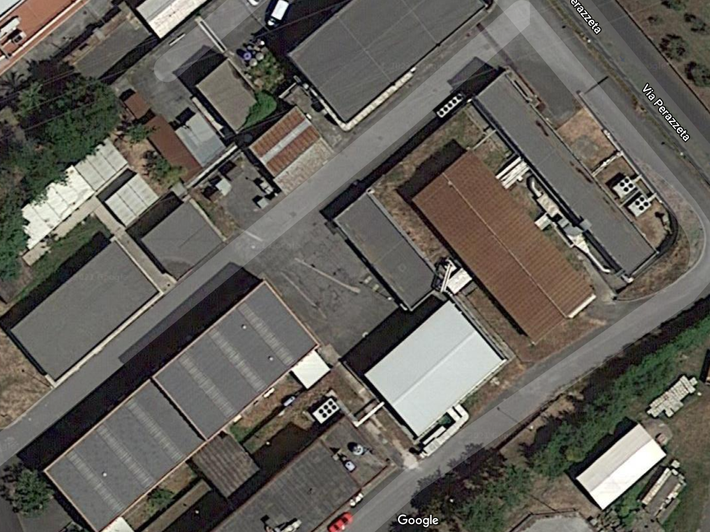
LATINO
SABINA
SPARC
Plasma_Lab
FLAME
PHOTOCATHODE LAB@ LNF

Slide 3
Attività
SPARC
FLAME
COMB_to_FEL
EXIN
Plasma_Lab
PHOTOCATHODE LAB@ LNF

Slide 4
SPARC
Accelerator development (SABINA)
  Installation
  New Gun 1/4/2021
  Arrival of materials
  New solenoids april 2022
  New modulator C band sept/octb 2021
  Moving laser from bunker to FLAME aèril 2022
  New low Level RF system S band october 2021
  Undulator Teraherz april 2022
  Study
  New timing system
  Cleaning and new electronic wiring SPARC

Slide 5
FLAME
Development of new acceleration techniques with laser
Using the laser for acceleration experiments laser driven
New control system (operational test !Chaos) in progres
Laser transport in SPARC bunker for EXIN experiment
Capillary tests

Slide 6
COMB_to_FEL
Development of new acceleration techniques beam driven
Experiment support eg. capillary replacement
Realization of a new transport system inside the existing room
Services
Vacuum
Mechanical Engineering
Electronics and Diagnostics
Laser

Slide 7
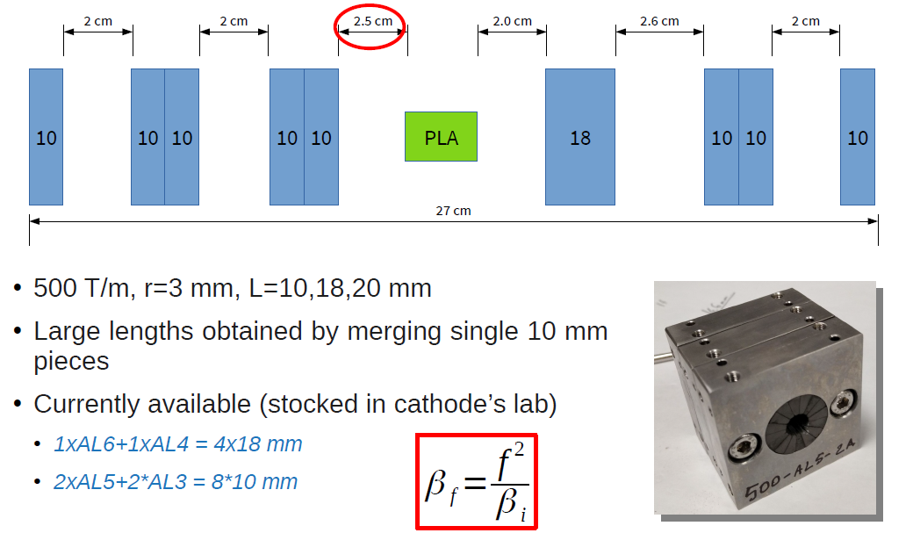
COMB_to_FEL
R. Pompili

Slide 8
EXIN
Development of new acceleration techniques laser driver
Line installation
Services
Vacuum
Mechanical Engineering
Electrotechnic Engineering
Electronics and Diagnostics
Laser

Slide 9
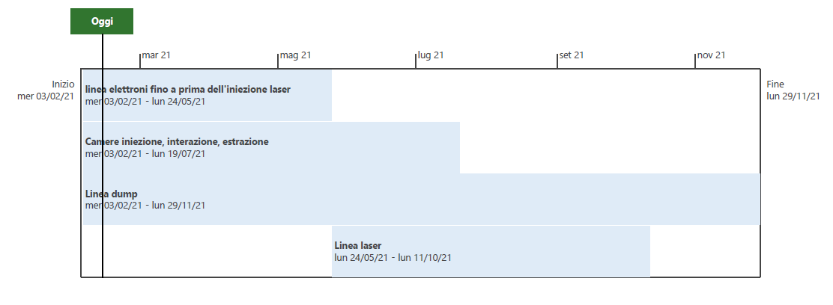
PIANO INSTALLAZIONE EXIN(MECCANICA-VUOTO) -IPOTESI DISTRIBUITA NEL TEMPO
1. Lavoro in sala nelle pause di funzionamento di SPARC
2. Parte del personale coinvolto partecipa ai turni
(L.Pellegrino)

Slide 10
Plasma Lab

Slide 11

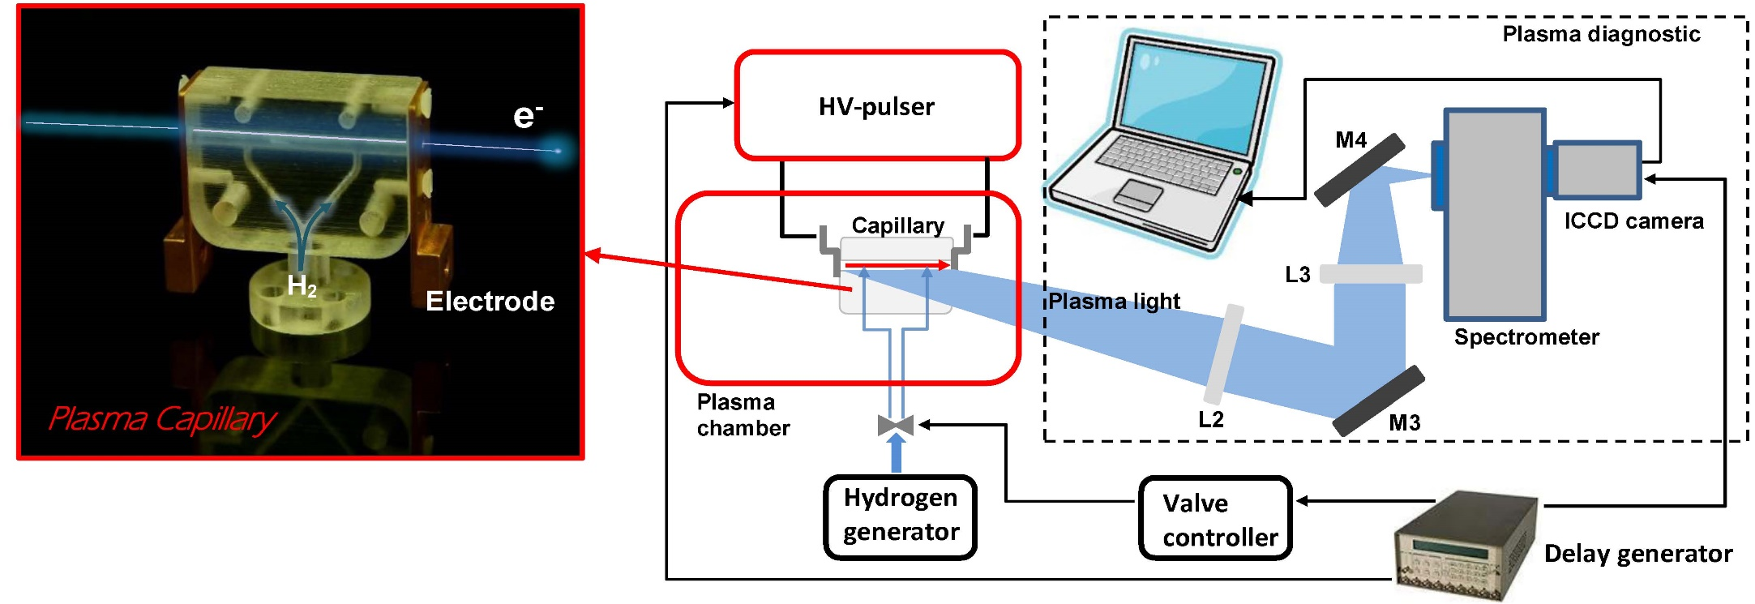
Plasm_lab activity
Plasma module
Accelerator Division support
    Plasma sources design and production ( Vacuum service and Mechanical engineering service)
    Design and production of the HV pulser (Electronic service)
    Plasma chamber design and production (Vacuum service and Mechanical engineering service)
A. Biagioni

Slide 12
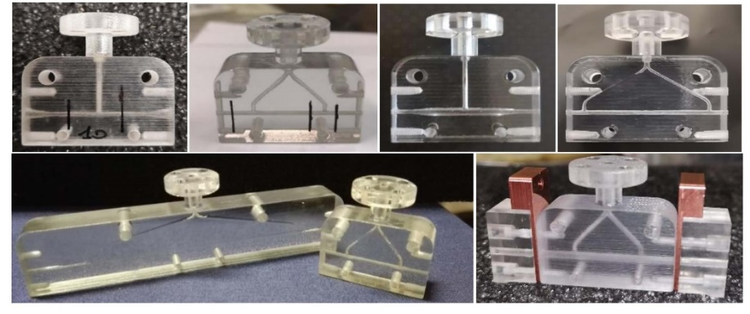
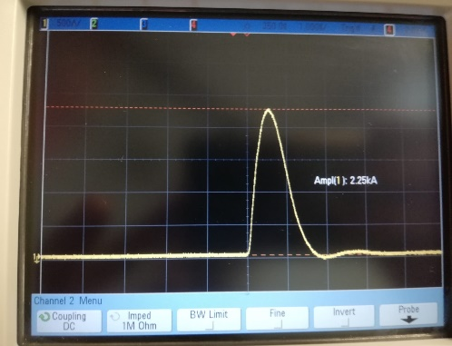
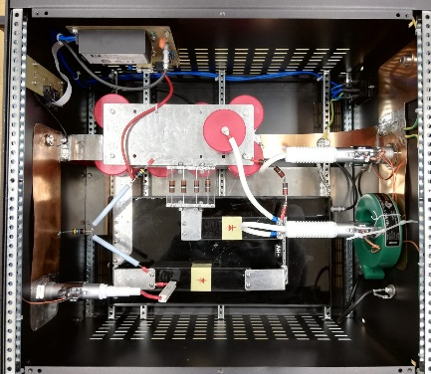
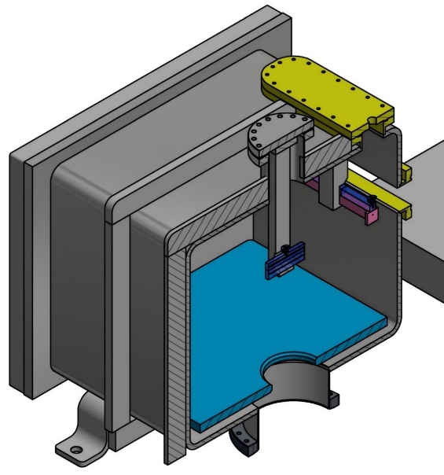
Plasma_lab activity
Accelerator Division support
Plasma sources design and production (Vacuum service and Mechanical engineering service)
    3D printing lab to produce new shapes of capillaries (plastic and glass in future)
    ...
Design and production of the HV pulser (Electronic service)
    Design and test of HV pulser to produce plasmas (standard/1 kA and Prototype up to 3-5kA)
    ...
Plasma chamber design and production (Vacuum service and Mechical engineering service)
    New plasma chamber to test plasma sources for Sparc_lab and EuPraxia project
    It will be ready at the end of March
Larger capillary
for EuSparc
(50 cm)
Smaller capillary
for Sparc_lab
(10 cm)
A. Biagioni

Slide 13
Plasma Lab

Slide 14
Motivation- Scientific activity (first step)
In the framework of EuPRAXIA project it’s important to have a R&D activity on electron emission physics (J. Scifo, D. Di Giovenale, A. Liedl: “Photo-Cathode Testing at Low Accelerating Field Laboratory: a New R&D Activity at INFN-LNF“, ACCDIV-02-2020, 03/07/2020
Emission studies of metal photocathodes: Quantum Efficiency measurements in terms of response time, emission uniformity and long lifetime that is essential to keep under control or increase the brightness of the electron beam.
Cathode material studies for NC guns:
Cu (Φ_{w} = 4.6 eV) cathode to study the laser beam quality
Y(Φ_{w} = 3.1 eV) film on Cu bulk at different λ_{laser}
Single layer graphene deposition on Cu cathode (SL_COMB2FEL ) (Liu, Fangze, et al. "Single layer graphene protective gas barrier for copper photocathodes." Applied Physics Letters 110.4 (2017): 041607)
J. Scifo A. Liedl

Slide 15
Photocathode lab services support
Diagnostic service for the HV system and the acquisition chain
Vacuum service for the UHV chamber and ancillary
Laser service for the Optical and Source systems
Control service for the control system of whole experimental set up
J. Scifo A. Liedl

