Slide 1
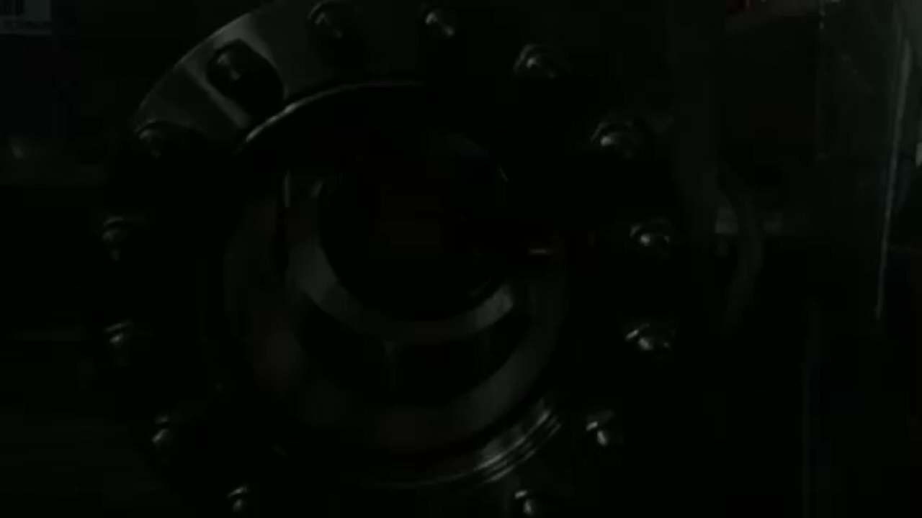
EuPRAXIA@SPARC_LAB
Massimo.Ferrario@lnf.infn.it
Undulators
1 GeV LINAC
Plasma module
RF power modules
FEL user area @3nm
Secondary
Sources
Beam user areas
0.5 PW Laser

Slide 2
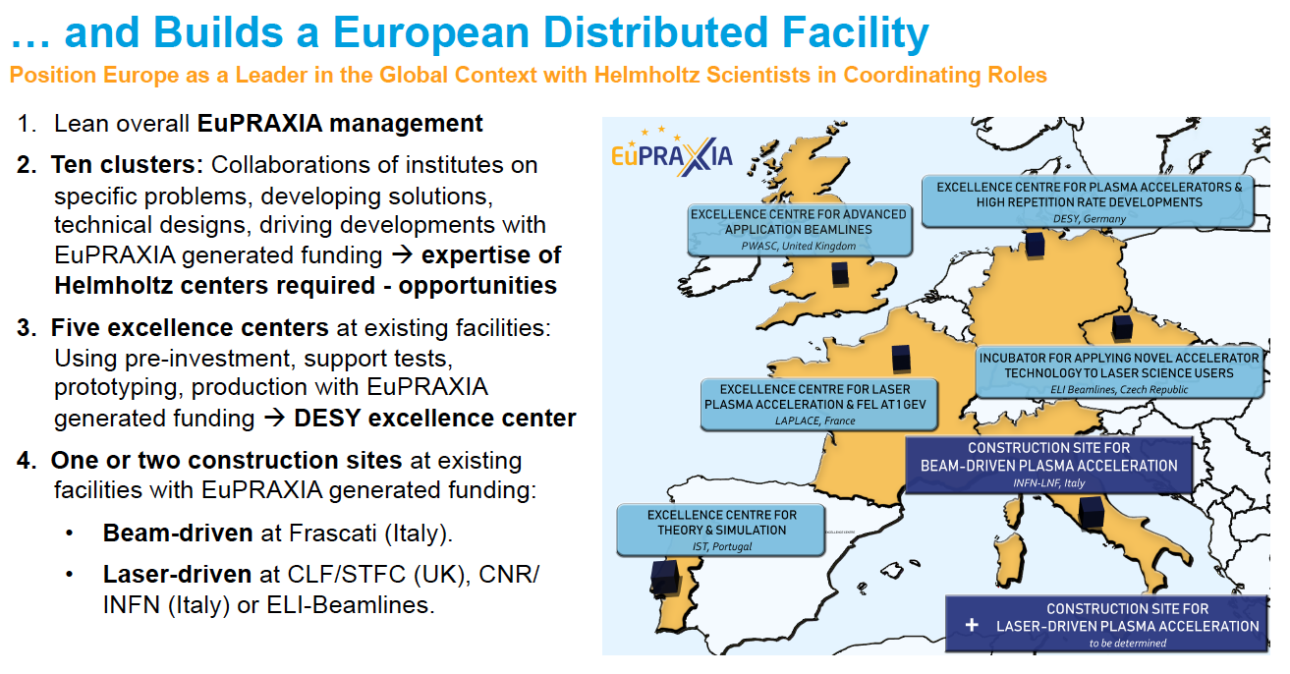
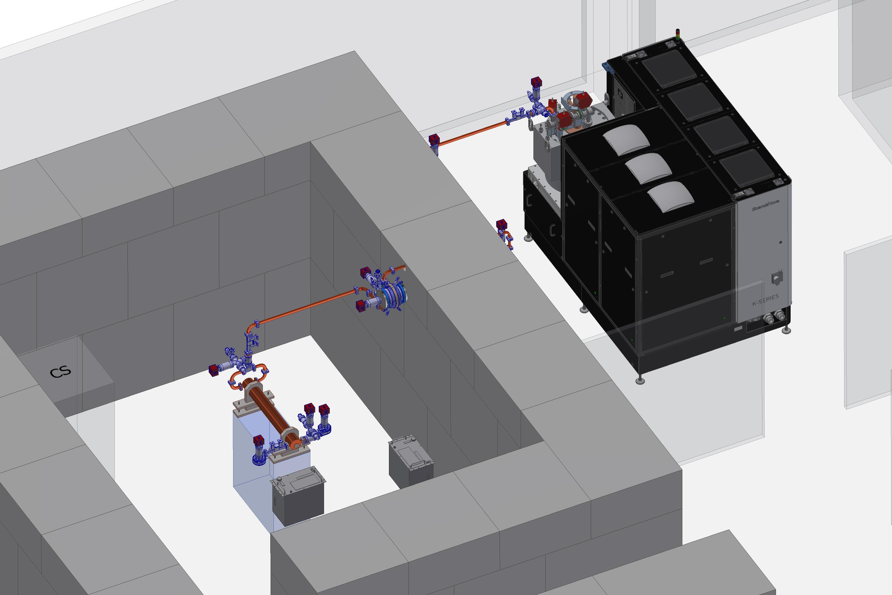
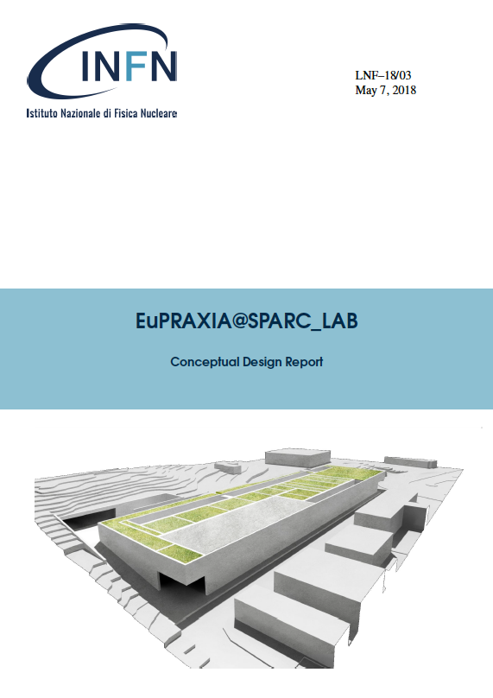
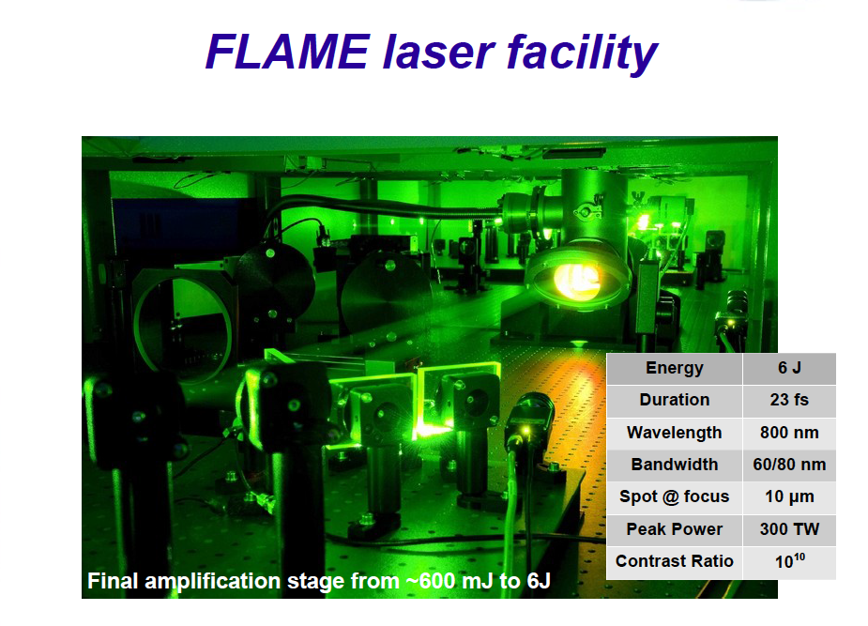
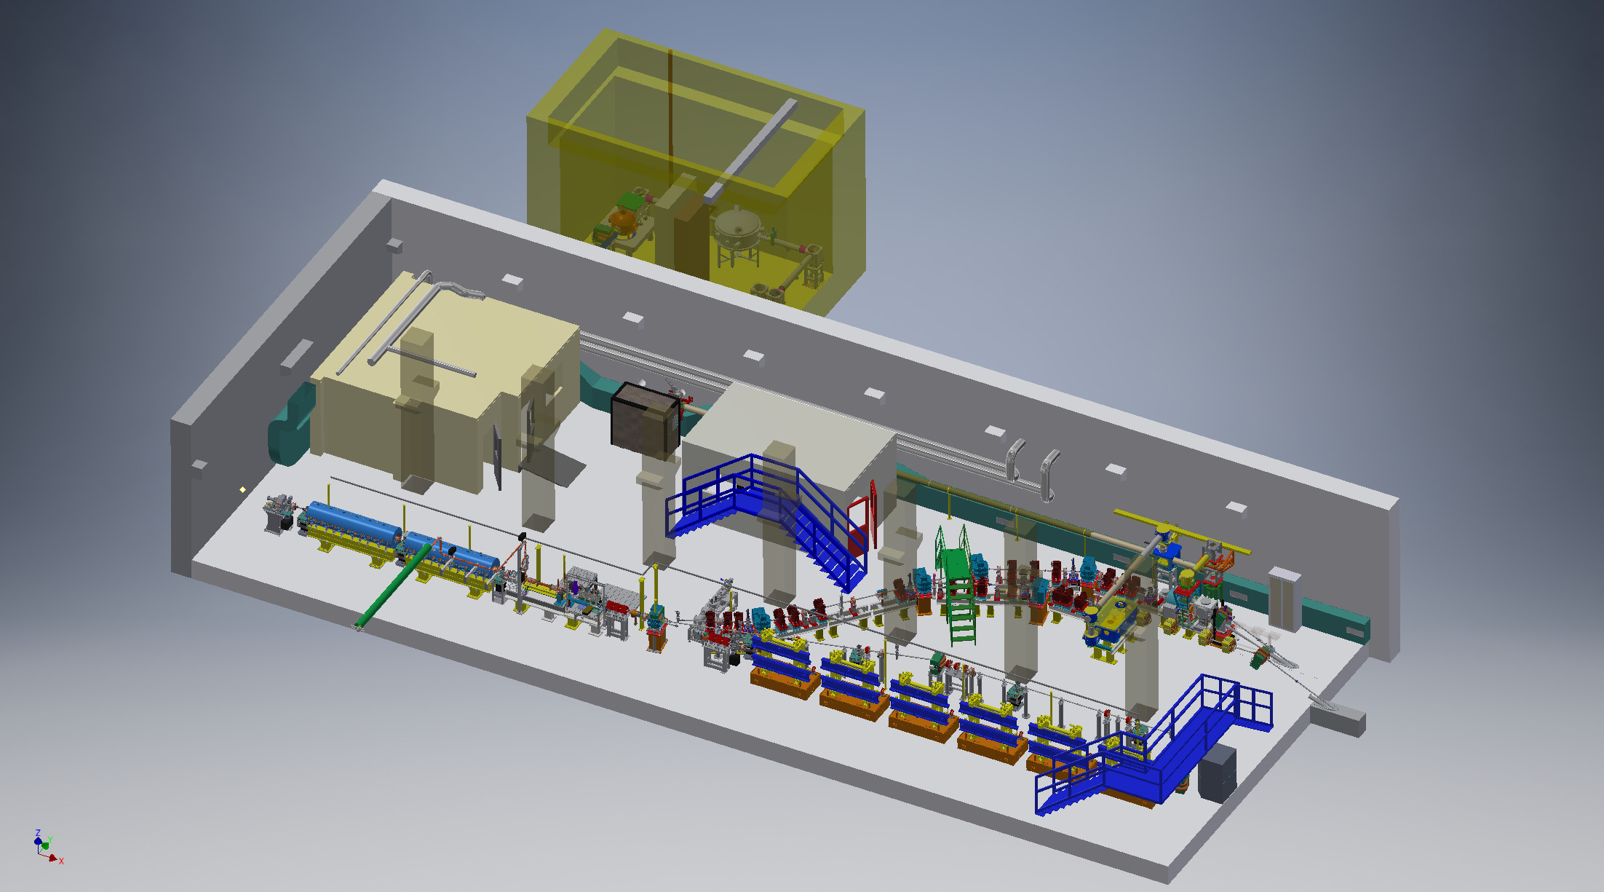
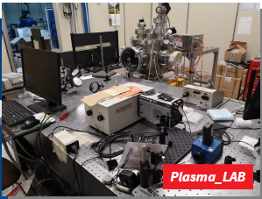
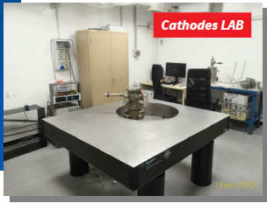
HEAD QUARTER @LNF
EuPRAXIA@SPARC_LAB
LATINO
TEX
Technical Design Report
SPARC_LAB
SABINA

Slide 3
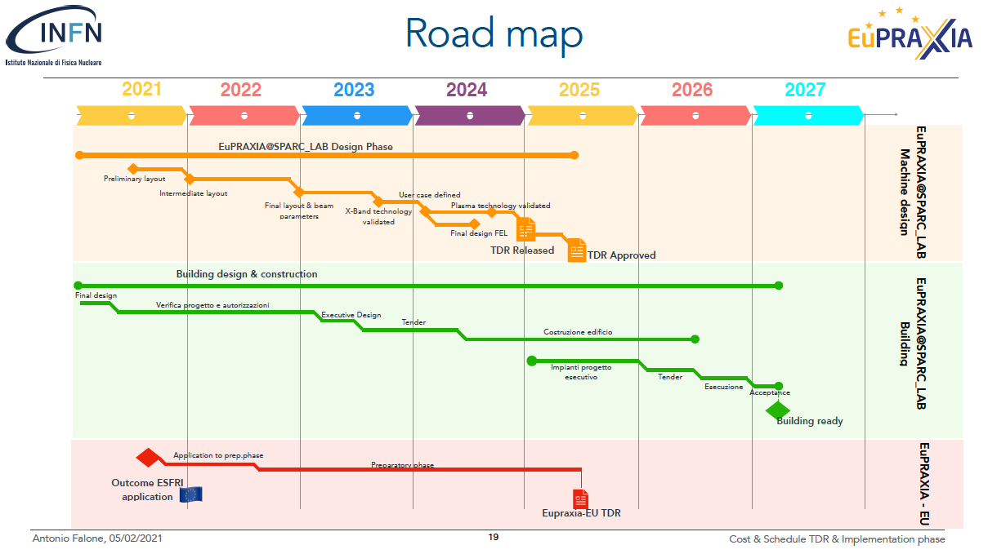
Courtesy A. Falone

Slide 4
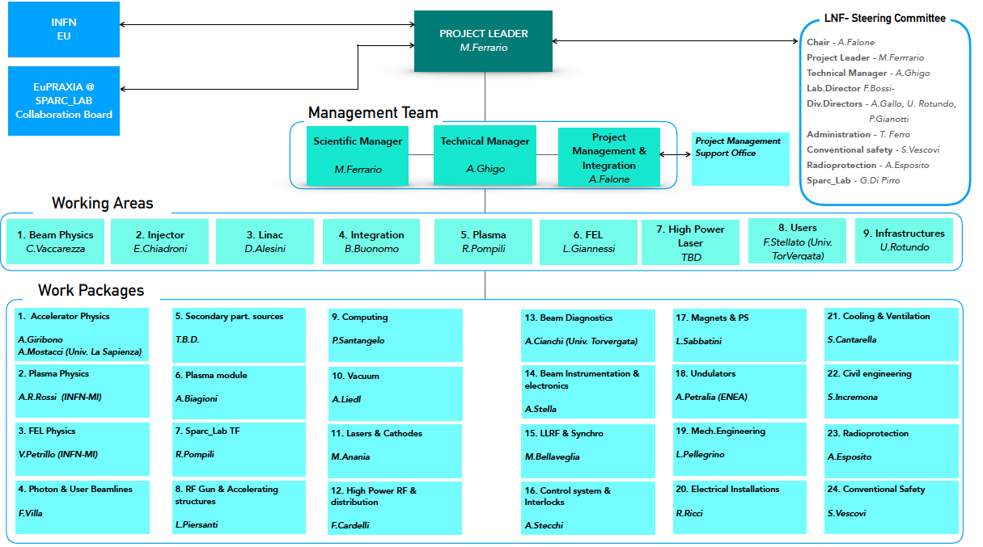

Slide 5
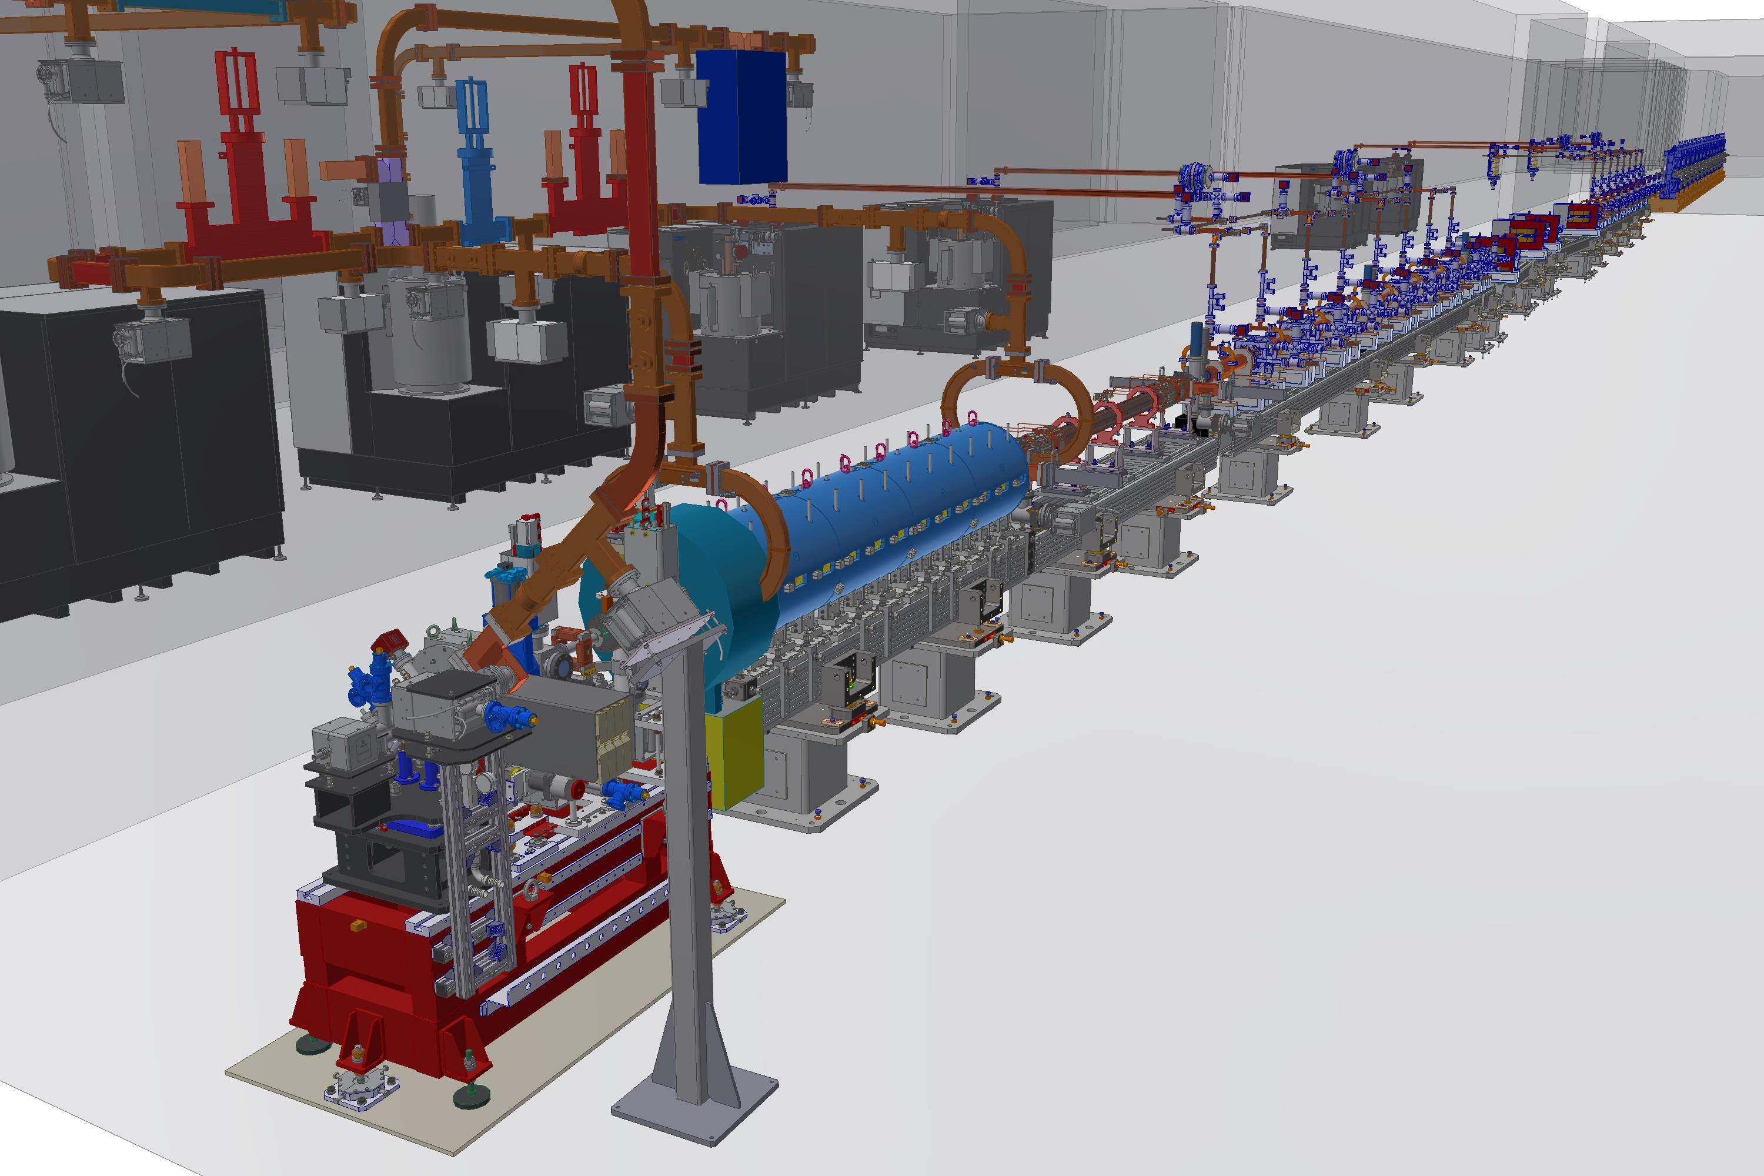
Courtesy A. Ghigo - E. Di Pasquale

Slide 6

Plasma module layout
End X-band
First PMQ
LINAC
300
25
50
100
250
Driver
Removing
FEL
Vimp
Vacuum X-band
Vacuum inside chamber
275
Vacuum Chicane
Plasma driver removing
Vacuum FEL
Further Vimp2
Chamber sizing depends on the vacuum constrains and capillary dimensions
Eupraxia chamber sizing starts from the current plasma chamber
Minimum length is 215 cm
Driver removing chamber properties depend on the technique used to remove the driver (Plasma or chicane)
Chamber/capillary factor is 5.5
New solutions will be studied to reduce the chamber/capillary factor by means of vacuum test and simulation
3 cm-long capillary@ne = 10¹⁶ - 10¹⁷ cm⁻³
 | Vgas (cm³) | VimpEXT | VimpINT | Tpumps | V_{C-band} | V_{chamber} | Wtime
1 Hz | 0.0236 | 2 x 6mm/15cm | 2 x 6mm/10cm | 1780 l/s | 10⁻⁷ mbar | 10⁻⁸ mbar | No limits
10 Hz | 0.236 | 2 x 6mm/15cm | 2 x 6mm/10cm | 1780 l/s | 10⁻⁷ mbar | 10⁻⁸ mbar | 1 hour
100Hz | 2.36
50 cm-long capillary@ne = 10¹⁶ - 10¹⁷ cm⁻³
x15
 | Vgas (cm³) | Vimp | Vimp2 | Tpumps | V_{X-band} | V_{Chamber} | Wtime
1 Hz | 0.314 | 2 x 6mm/15cm | 2 x 6mm/10cm | 7000 l/s
10 Hz | 3.14 | 2 x 6mm/15cm | 2 x 6mm/10cm | 7000 l/s
100Hz | 31.4
x100
Courtesy R. Pompili , A. Biagioni

Slide 7
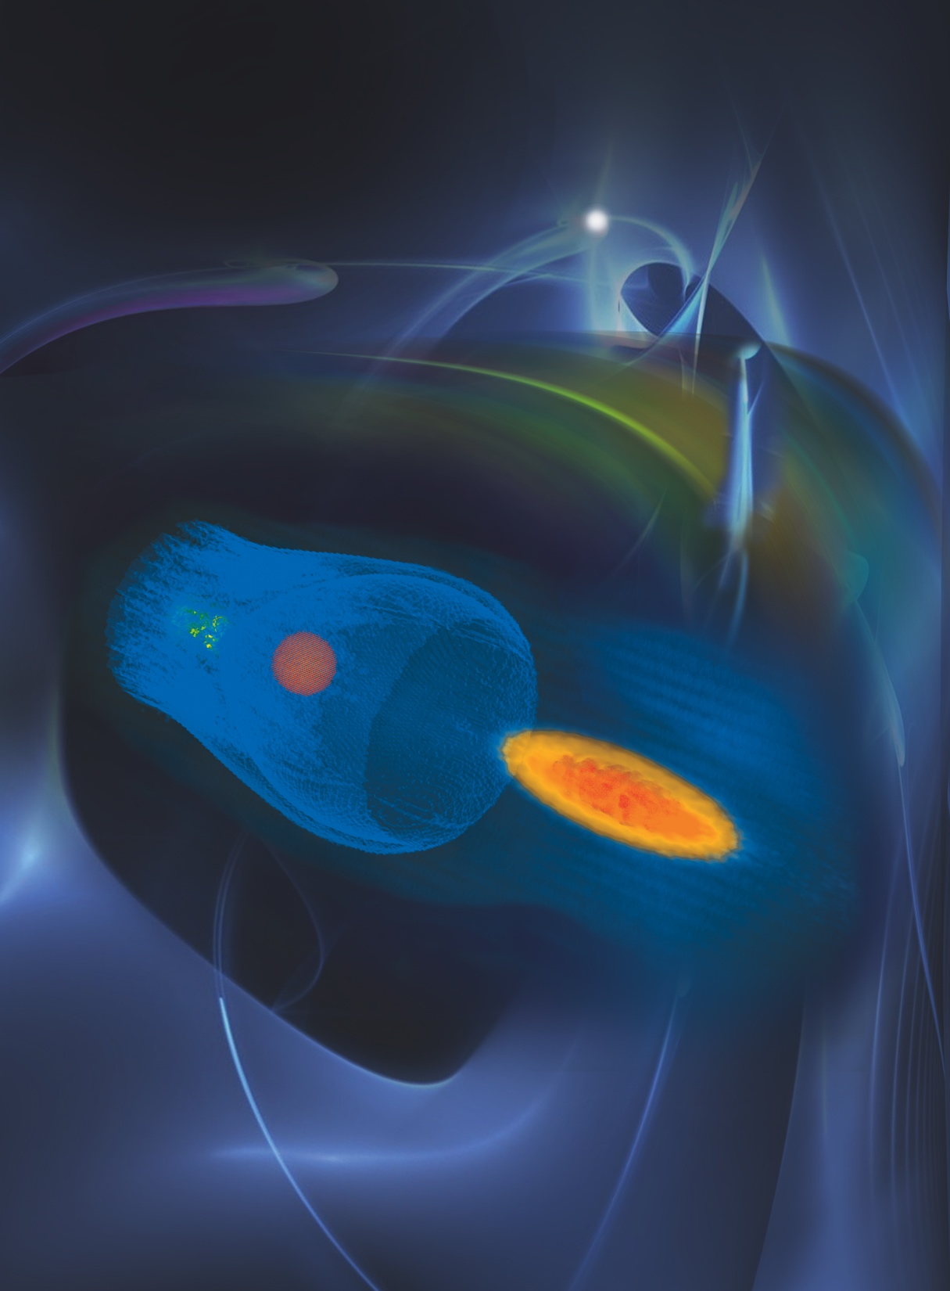

High Quality Facility
FEL requirement
(Undulators - Optics)
Plasma density
(Long Capillary – Diagnostics)
Bunch charge/length
(Cathodes – Laser – Injector)
Driver/Witness timing
(Compressors - Synchronization)

Slide 8
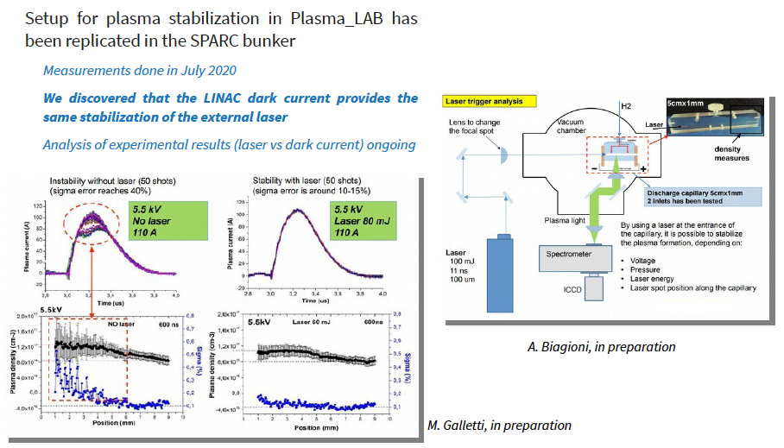
Plasma Characterization
Plasma Density measured by observing Stark broadening of hydrogen emission lines

Slide 9
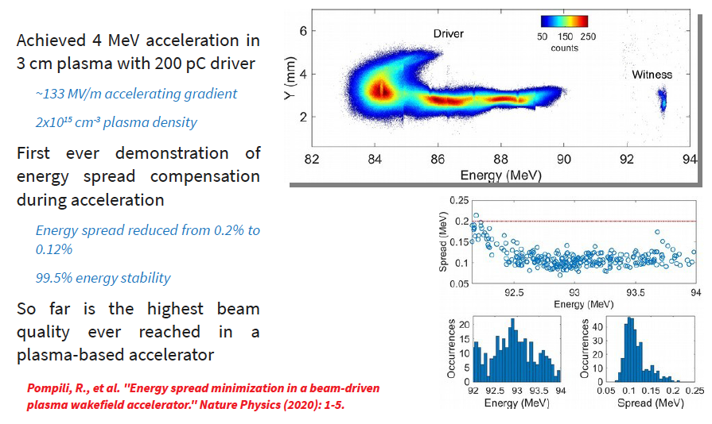
Assisted Beam Loading Energy Spread Compensation

Slide 10
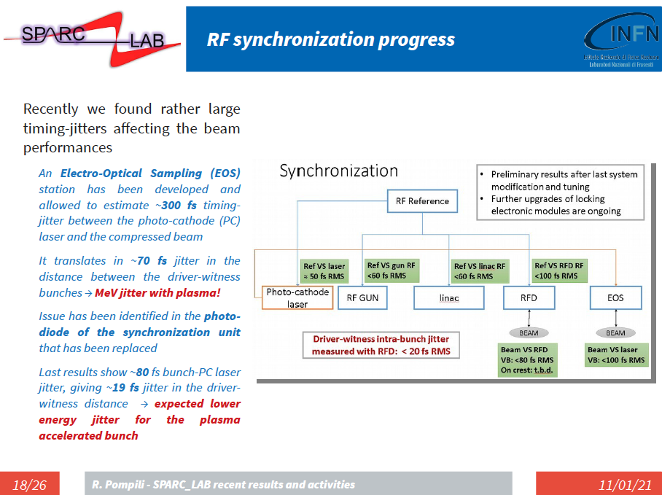

Slide 11
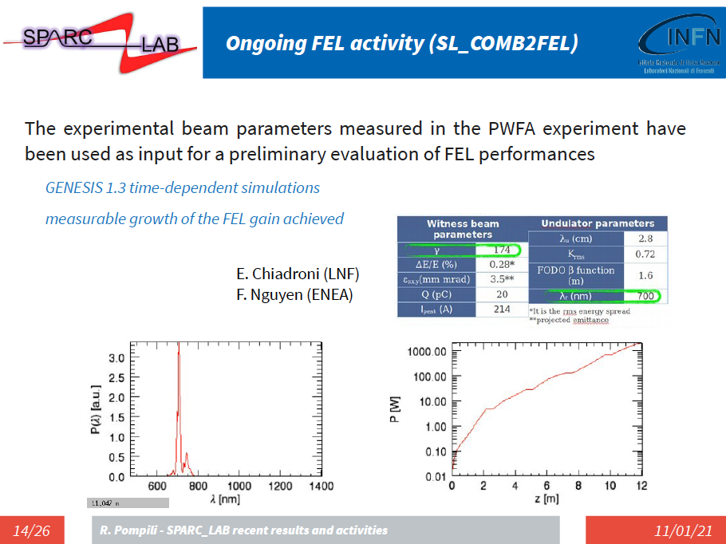

Slide 12
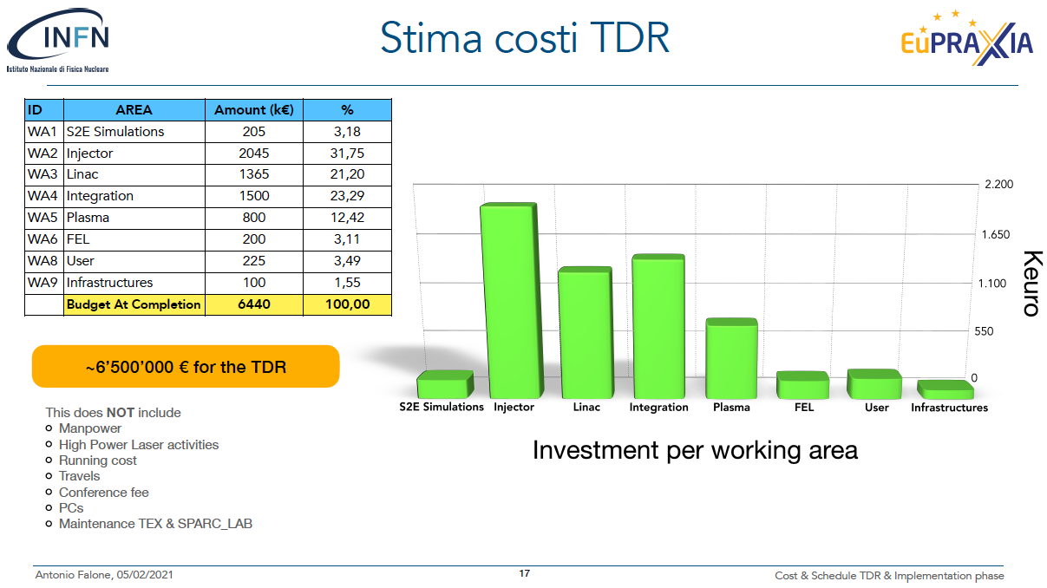

Slide 13
GRAZIE

