Slide 1
Readout and pre-processing scheme of drift chamber data
Gianluigi Chiarello

Slide 2
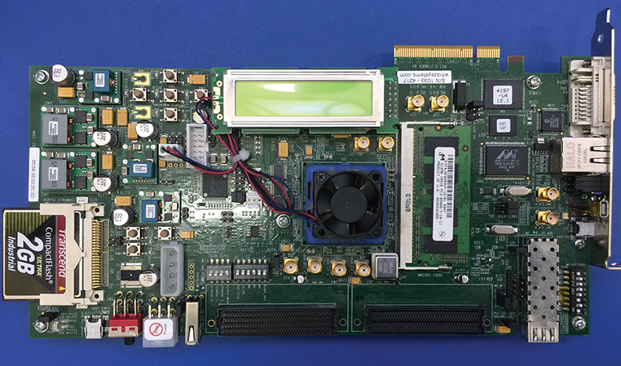
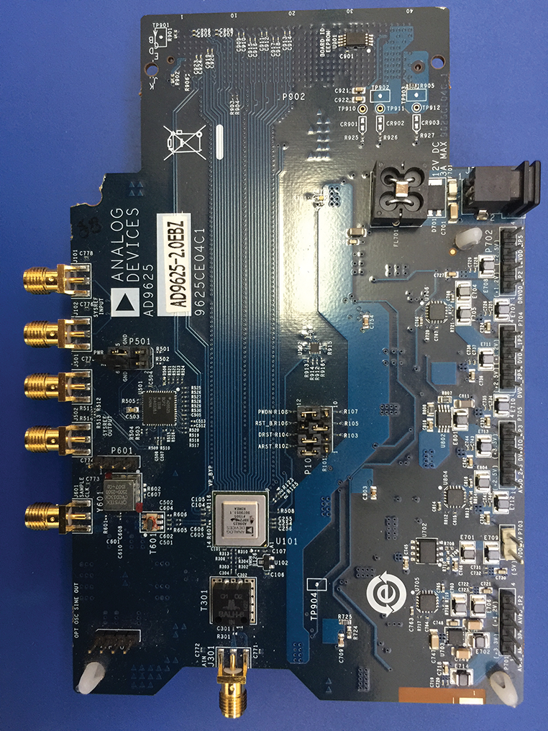
Cluster Counting board- old hardware
A board to test the cluster counting algorithm on a single channel of the drift chamber has been built;
To carry out this first test we used obsolete hardware
Xilinx ML605 Evaluation Board (Virtex 6)
Analog Devices AD9625-2.0EBZ
These tests were carried out with a demo license of the JESD204 which has now expired.
The algorithm with this hardware has a peak detection efficiency of 69%. In simulation, the efficiency is about 80%.
The difference in algorithm efficiency can be improved by increasing the signal-to-noise ratio, filtering the signal and increasing the data processing rate.
For this we have chosen a new hardware with higher resolution (you have to import the code into the new system with the different licensing issues)
FPGA
ADC

Slide 3
CLUSTEr counting algorithm: WHY?
if the waveform analysed from the ADC were stored without pre-processing would involve several disadvantages, such as:
a time window of observation of the event greatly reduced, because the internal memory of the FPGA would be filled very quickly;
a very long data transfer time from FPGA to PC for their post-processing, due to the very large amount of data to be transferred;
a very long time to post-process data.
The algorithm is able to process the data in real-time. In particular it
identifies, in the digitized signal,the peaks corresponding to the different ionization electrons;
stores each peak amplitude and timing in an internal memory;
sends the data stored to an external device when specific trigger signals occur.

Slide 4
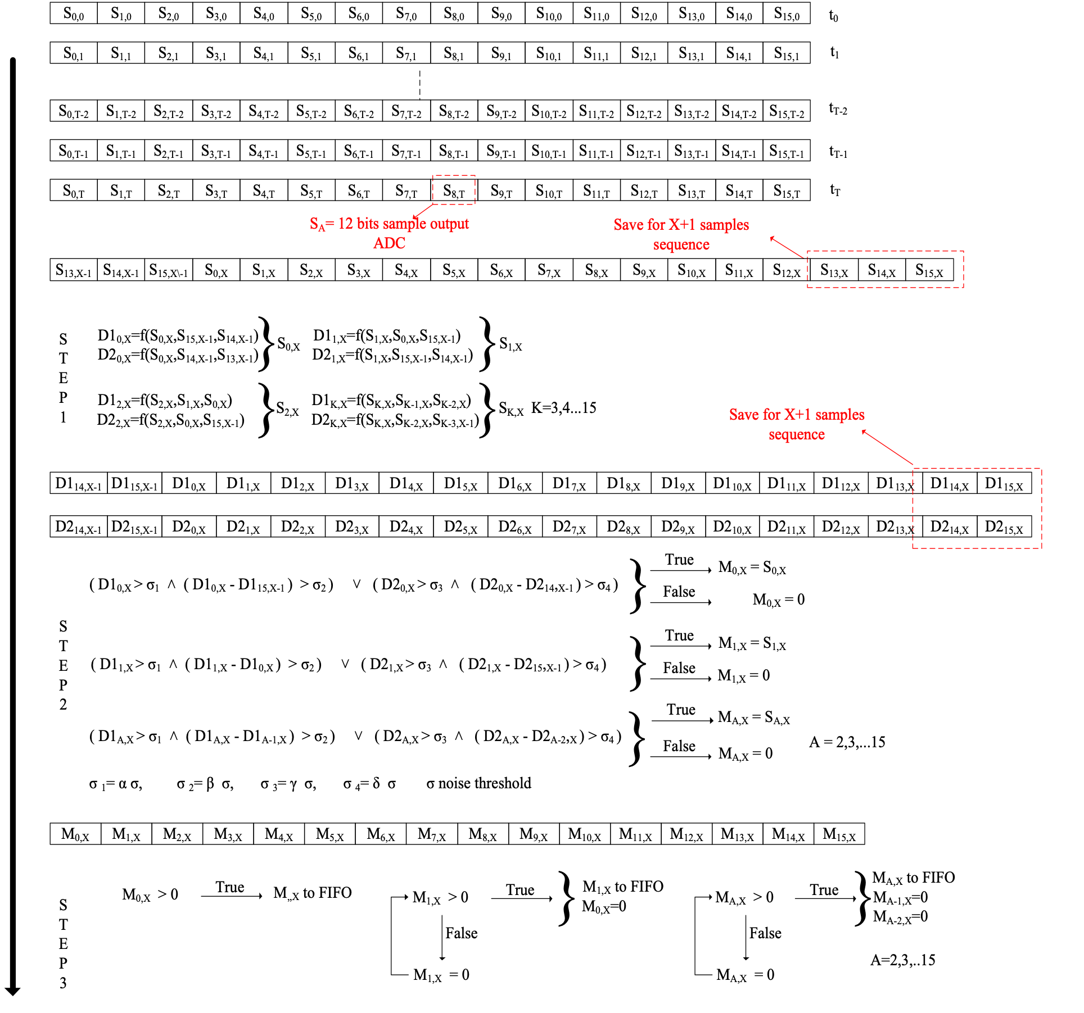
CLUSTEr counting algorithm
Sixteen samples SK,X at 125MHz to the FPGA input.
STEP 1: Of the Sixteen samples SK,X ,where K is the sample number among those available , and X is the time instant in which they are present, the functions D1K,X e D2K,X are calculated with use of the following equations :
STEP 2: The values of D1K,X and D2K,X and the differences between D1K,X and D1K-1,X and between D2K,X and D2K-1,X are compared with the thresholds proportional to the level of noise present in the input signal.
STEP 3: In order to transfer the data in memory , the last step before being sent to an external device is to check that there are no adjacent peaks

Slide 5
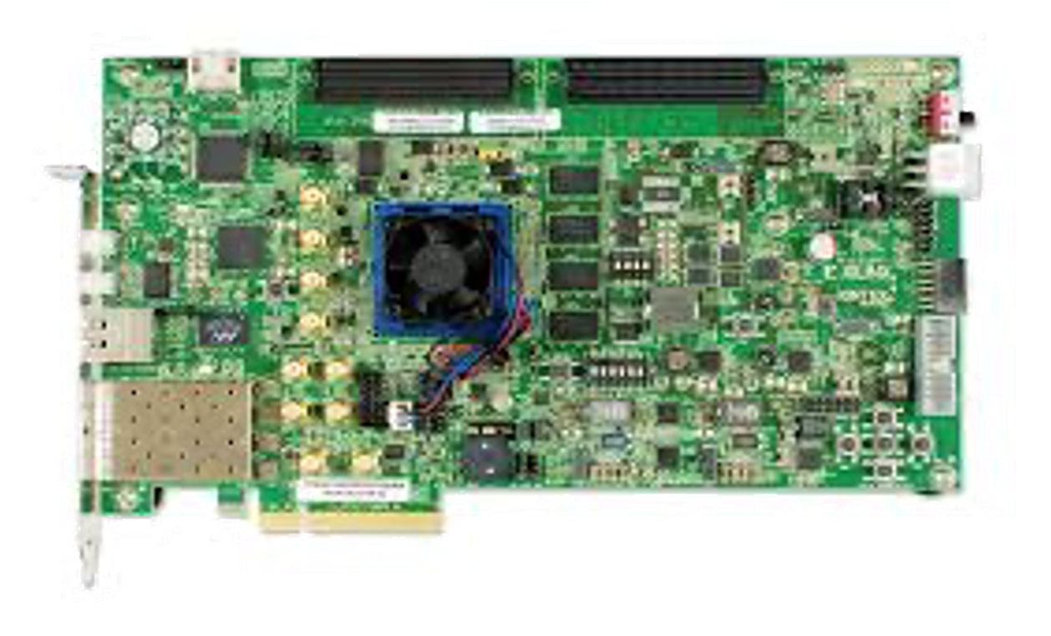
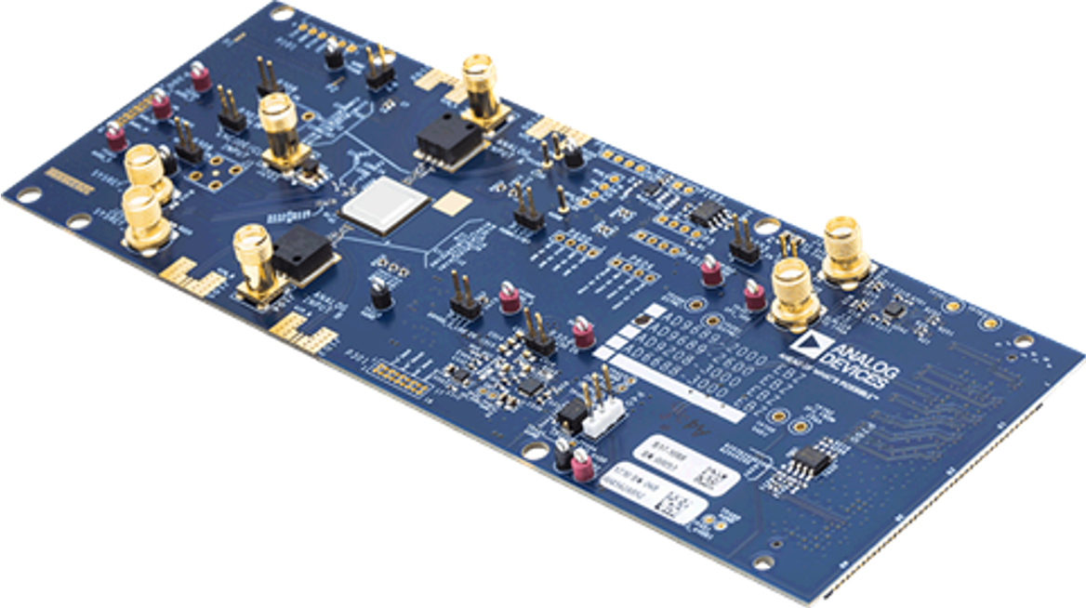
Cluster Counting board- new hardware
The new hardware to test the algorithm is:
Xilinx Kintex UltraScale FPGA KCU105 Evaluation Kit
The new FPGA was chosen based on the hardware used in CAEN's digitizers (partner in AIDAInnova)
AD9689 - 2000EBZ (dual channel)
The choice of the FPGA and ADC was made by choosing at that time the ADC that ensured good resolution and transfer capacity.
The new FPGA allows to have better time constraints.
The ADC has a higher resolution than the previous one and also it allows us to read 2 channels simultaneously.
Goal card with 4 channels:
two ADCs if the performance is satisfactory
Four-channel ADC

Slide 6
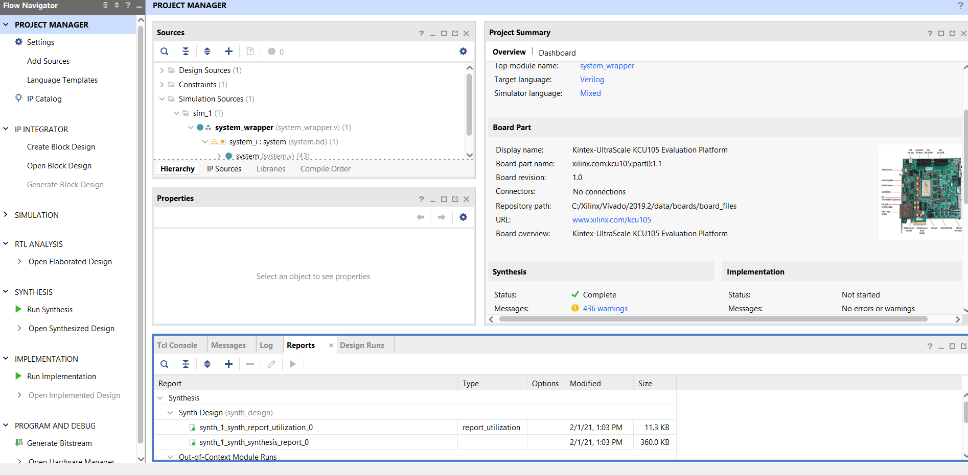
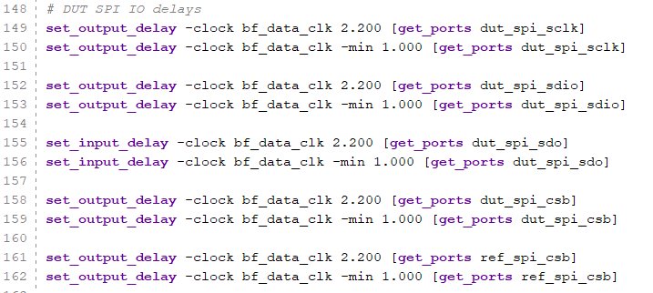
Status firmware
The old code was written in ISE, Xilinx has changed development frameworks, now it's Vivado.
Code migration (done)
New constraints for the new FPGA in progress
A big problem is the IP CORE license to communicate with the ADC.
We had a demo license (now expired)
We are trying to use something open source (not 100% compatible with the hardware). If the open source alternative does not guarantee the desired performance can we be licensed?
Vivado project
Constraint

Slide 7
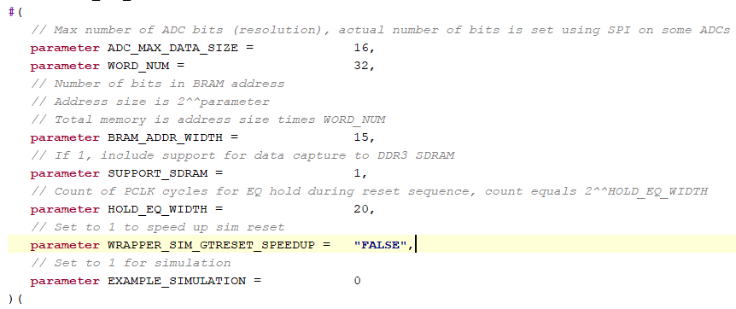
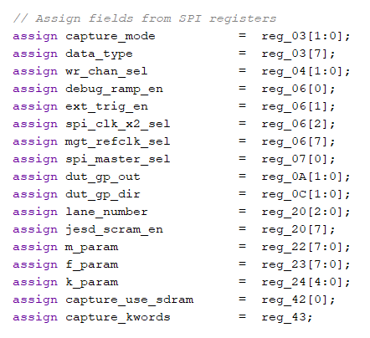
Status firmware - TEST to DO
1 ch
AWG
2 ch
ADC Evaluation BOARD
This part is critical we are testing the OPEN SOURCE version (otherwise we have to find the license)
FMC
JESD204B
Interface
SPI Configuration
Waveform
FMC
Workstation
FPGA Evaluation BOARD
Ethernet

Slide 8
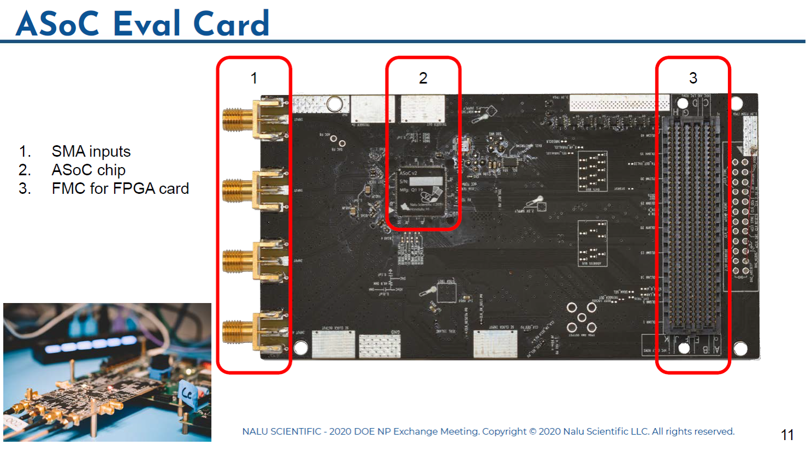
ASoC Project – NEW DIGITILIZATER
The SiRead Chip manufacturers themselves are developing a new digitizer (ASoC) with better performance compatible with our requests (4-channel).
We have contacted the company (Nalu Scientific) and most likely, after passing their quality tests, they will provide us with a demo board to test it.
Maybe we need a Xilinx Evalution Board (about 1k€) compatible with the board

Slide 9
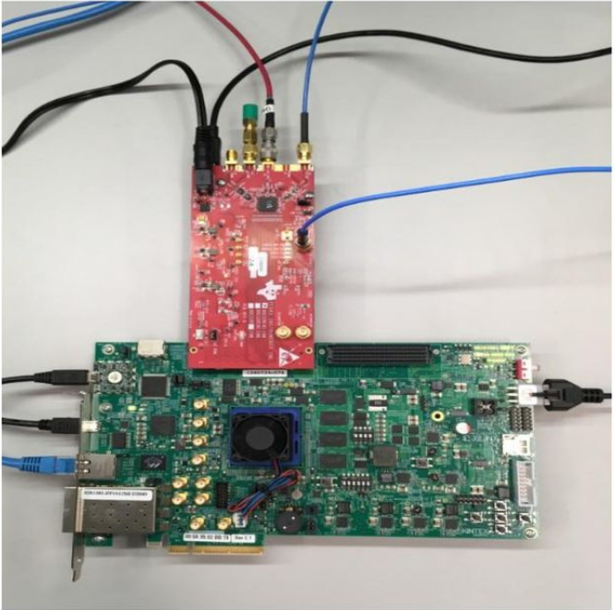
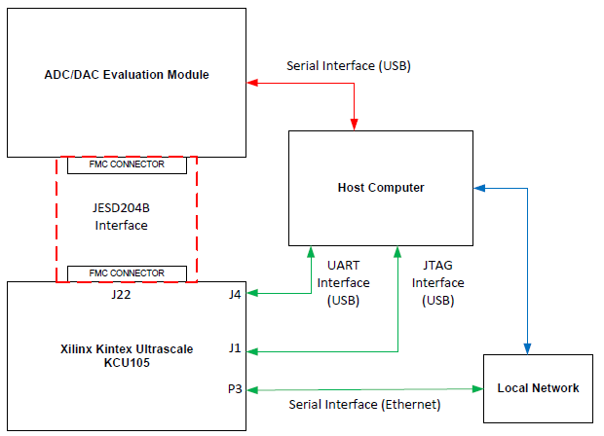
Possible new ADC
ADC with better characteristics and performance than the current one is from TEXAS INSTRUMENT ADC32RF45 Dual-Channel, 14-Bit, 3GSPS (about 2.5k€)
ADC is better at:
performance in terms of noise,
ENOB,
very low channel crosstalk
Compatible with our current FPGA

Slide 10
Conclusion
We have described the hardware and algorithm of the cluster counting and the results obtained with a first bench test
We presented the new hardware chosen to overcome the time criticality (clock and bandwidth) of the old hardware
The status of the firmware implementation in the new hardware and the tests we would like to carry out
Finally some digitizer solutions that we would like to try to improve the performers

