Slide 1
Hyperons in compact stars and the transition to quark matter
Alessandro Drago
University of Ferrara and INFN sez. Ferrara

Slide 2
Outline of the talk
Strong phase transitions in compact star matter
The scenario of two-families of compact stars
Hyperons as a trigger of deconfinement
A few tests of the two-families scenario

Slide 3
A map of the possibilities
There are two main classes of models for dense matter inside a compact star:
Models without a strong first order phase transition. It includes:
  Models with only nucleons
  Models with nucleons and hyperons
  Models with nucleons (+ resonances) and deconfined quarks at the center
Models in which there is a strong first order transition, typically to deconfined quark matter. It includes:
  Models in which quark matter occupies only the center of the star (twin stars)
  Models in which stars entirely made of strange quark matter can exist (two families)

Slide 4
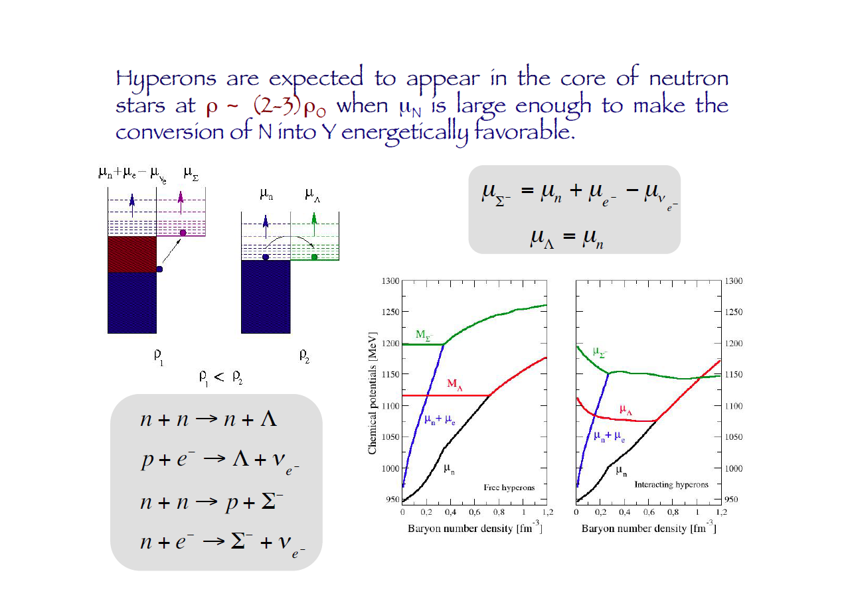
How to produce hyperons?
Borrowed from I. Vidana

Slide 5
Hyperonic stars: an example
Domenico Logoteta, Isaac Vidana and Ignazio Bombaci, EPJA (2019) 55: 207
Effect of the NNΛ nucleon-nucleon-lambda (NNΛ) three-body force recently derived within the framework of chiral effective field theory at next-to-next-to-leading order together with realistic nucleon-nucleon, nucleon-nucleon-nucleon and nucleon-hyperon interactions. The inclusion of the NNΛ force leads to an equation of state stiff enough that the resulting neutron star maximum mass is compatible with the largest currently measured (∼ 2 M) neutron star masses.
Hyperons can therefore be present at least in the more massive compact stars. Their presence softens the EoS and allows for smaller radii

Slide 6
Deconfined quark matter in compact stars?
A mixed phase of hadrons and quarks is soft
A pure phase of quarks can be very stiff
Hybrid stars: compact stars containing pure or mixed quark matter in the interior
Strange quark stars: compact stars made almost entirely of quark matter (their existence is based on Witten’s hypothesis).

Slide 7
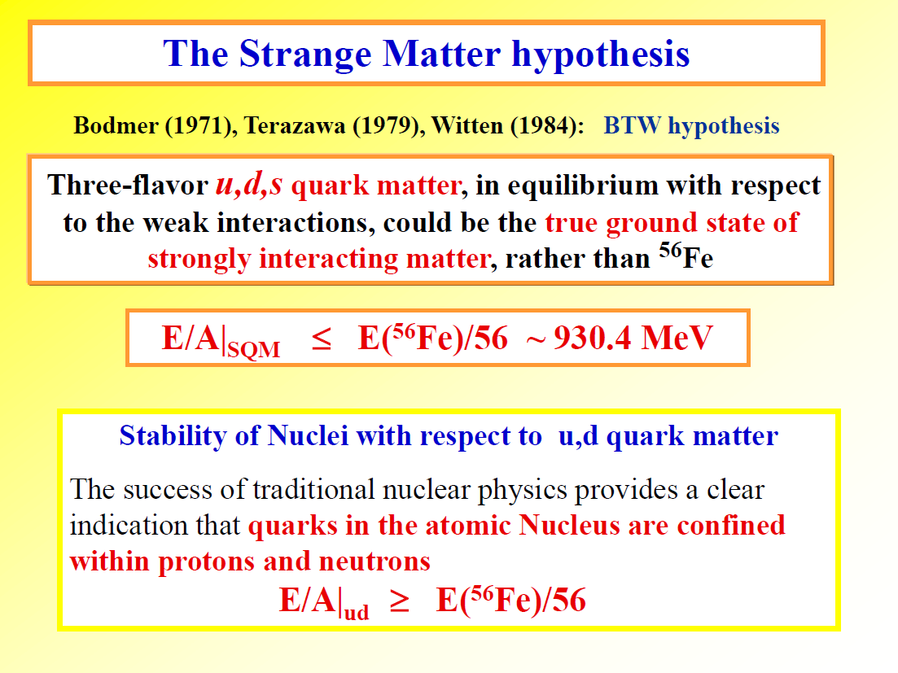
From I. Bombaci

Slide 8
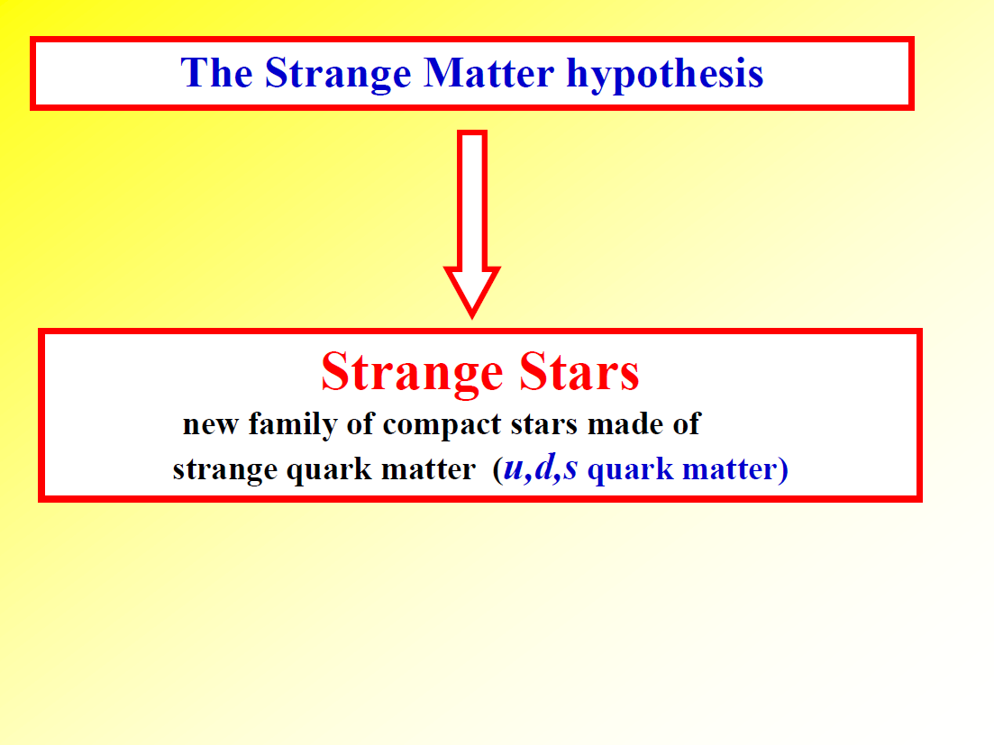
From I. Bombaci

Slide 9
Radii for M=1.4 M_{s} smaller than about 11.5 km are impossible in the absence of a strong phase transition
Most et al. Phys.Rev.Lett. 120 (2018) 261103

Slide 10
The twin-stars scenario: classification of all possible hybrid stars
From Alford, Han, Prakash, Phys.Rev. D88 (2013) 083013
Note that in B and D the formation of quarks triggers the instability, i.e. quarks are at the origin of the instability producing the formation of the second configuration.
At variance, in the two-families scenario the first family becomes chemically unstable while quark are not yet present. The quark matter phase stabilizies the system.

Slide 11
Models with a strong phase transition: the «twin stars» configurations
Small radii are possible if the sound velocity of quark matter is close to 1
Alford, Burgio, Han, Taranto, Zappalà, PRD92 (2015) 083002
Radii smaller than about 11.5 km for stars of M = 1.4 M_{s} are possible
ONLY if c² is close to 1 and
for Disconnected configurations.

Slide 12
Models with a strong phase transition: two-families of compact stars
Stars made of hadrons co-exist with stars made of strange quark matter
G. Wiktorowicz, A.Drago, G. Pagliara, S. Popov; Astrophys. J. 846 (2017) 163
The existence of strange quark stars is based on the validity of the validity of the Witten’s hypothesis, telling that the absolute ground state of matter is made of a mix of deconfined up, down and strange quarks.
The velocity of sound in quark matter need not to be close to 1 in this scheme.
Massive stars have larger radii, at variance with models based on one family and with the twin stars scenario.
The process of quark deconfinement is triggered by the formation of a large hyperon content (or maybe by kaon condensation) at the center of the hadronic star.

Slide 13
Why strange quark stars can reach large masses while keeping c_{s}² ≤ 1/3?
Because the adiabatic index diverges at the surface of the star.
Haensel, Zdunik, Schaeffer, A&A 160 (1986) 121
The condition for stability
in post-newtonian approx. is:
The divergence of Γ is due to
the vanishing of the pressure at
a finite density ρ_{s}

Slide 14
In the two-families scenario sound velocity never needs to be large

Slide 15
The Rough Guide to dense matter in compact stars
R_{1.4} >= 13 km or I₄₅ >= 1.6 purely nucleonic stars (ρ_{max} ≤ 3 ρ₀)
11.5 km < R_{1.4} < 13 km or 1.3 <= I₄₅ <= 1.6 hyperonic or hybrid stars (ρ_{max} as large as 5 ρ₀)
R_{1.4} << 11.5 km or I₄₅ << 1.3 two-families or twin stars (solutions in which a new stable branch entirely or almost entirely made of deconfined quarks is present)

Slide 16
Observational data
of masses and radii

Slide 17
Radii from x-ray spectra
Oezel and Freire, Ann.Rev.Astron.Astrophys. 54 (2016) 401
Steiner et al. MNRAS 476 (2018) 412
«Our model with the largest evidence
suggests that R_{1.4} is less than 12 km
to 95 percent of confidence»

Slide 18
Indications of both small and large radii
QLMXBs
N. B. d’Etivaux, S. Guillot, J. Margueron, N. A. Webb, M. Catelan, and A. Reisenegger, (2019), arXiv:1905.01081
4U1702429
J. Nattila,M. C.Miller, A.W. Steiner, J. J. E. Kajava, V. F. Suleimanov, and J. Poutanen, Astron. Astrophys. 608, A31 (2017)
PSRJ04374715
P. D. Lasky, B. Haskell, V. Ravi, E. J. Howell, and D. M. Coward, Phys. Rev. D89, 047302 (2014)
GW170817
B. P. Abbott et al. (LIGO Scientific, Virgo), Phys. Rev. Lett. 121, 161101 (2018)
NICER
T.E.Riley et al., Astrophys.J.Lett. 887 (2019) L21

Slide 19
Was GW190814 a black-hole neutron star system?
The gravitational wave signal GW190814 has been generated by the merger of a binary system whose components are a 23M_{s} black hole and a (2.5-2.67)M_{s} compact object.
R. Abbott et al. (LIGO Scientific, Virgo), Astrophys. J.Lett.896, L44 (2020), 2006.12611
If we assume 𝑀_{max} = 2.5M_{s}, the causal limit is strictly violated for 𝑅_{1.4} = 11.38 km, and if we assume 𝑀_{max}=2.6M_{s}, the causal limit is strictly violated for 𝑅_{1.4} = 11.8 km.
Godzieba, Radice, Bernuzzi, Astrophys.J. 908 (2021) 122
EOSs which allow for the existence of such massive NSs are in tension with constraints obtained from heavy-ion collisions experiments and from the tidal deformability constraints derived from GW170817 which favor softer EOSs.
F. Fattoyev, C. Horowitz, J. Piekarewicz, and B. Reed(2020), 2007.03799

Slide 20
Was GW190814 a black-hole strange quark star system?
I. Bombaci, A.D., D. Logoteta, G. Pagliara, I. Vidana, 2010.01509

Slide 21
Predictions and tests of the two-families scenario

Slide 22
Evidence of bimodality in the mass distribution of MSPs with a WD companion
(from Antoniadis et al. 2016 and Tauris et al. 2017) compared with the two-families scenario

Slide 23
Three possible types of mergers in the two-families scenario
De Pietri et al. Astrophys.J. 881 (2019) 122
Chirp mass of GW170817
is 1.188 M⊙
Could be HS-HS or HS-QS,
but HS-HS would correspond
to a direct BH formation

Slide 24
Condition for quark deconfinement in HS-HS merger
De Pietri, Drago, Feo, Pagliara, Pasquali, Traversi, Wiktorowicz, Ap.J. 881 (2019) 122
The formation of hyperons in the post-merger triggers quark deconfinement potentially stabilizing the newly formed compact object.

Slide 25
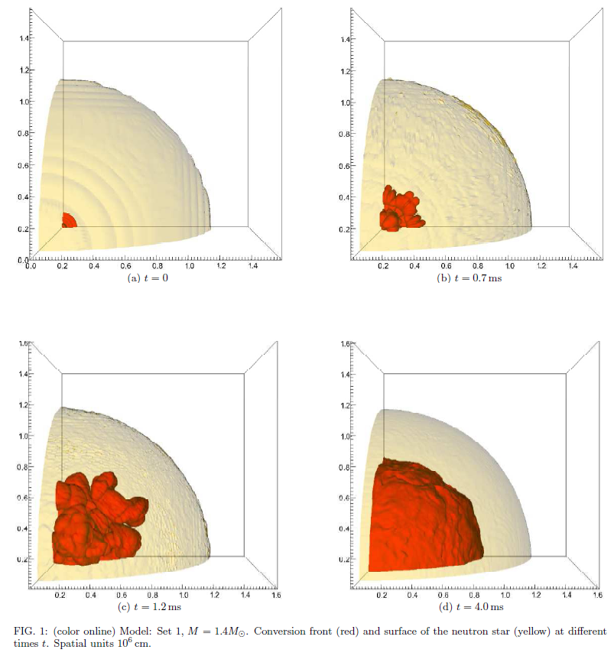
The merger of two NSs can produce a
strange quark star
Rayleigh-Taylor instabilities develop
and the conversion of the core occurs
on the time scale of ms.
The rapid burning stops before the whole
hadronic matter has converted
(the process is no more exothermic
as a hydrodynamical process,
about 0.5 Msun of unburned material)
The configuration obtained after
the rapid burning is
mechanically stable
although not yet in chemical equilibrium
Herzog, Roepke 2011, Pagliara, Herzog, Roepke 2013
After the rapid burning the conversion proceeds via strangeness production and diffusion.
The burning reaches the surface of the star after about 10s.

Slide 26
A very strong prediction of the two-families scenario
if M_{g} ≥ M ^{H} _{threshold} = 2.48 M⊙
→ HS-HS direct collapses to a BH without any significant electromagnetic emission.
There is no equivalent in the twin-stars scenario, because the process of quark combustion is there assumed to proceed without any delay.
In the two-families scenario quark matter production stabilizes the hadronic star configuration.
In the twin-stars scenario quark matter production destabilizes the hadronic configuration and produces the transition to the “third family”, i.e. to the second configuration.

Slide 27
Conclusions and tests from masses, radii and moments of inertia and from GWs analysis
New measurements of masses and radii challenge nuclear physics:
tension between high mass and small radii.
A 2.4 M_{s} candidate already exists and GW190814 could be a BH-’neutron-star’ system.
New missions (NICER, eXTP), reaching a precision of ~ 1km in the measure of radii ,
can clarify the composition of compact stars, similarly a measure of the moment of inertia with a precision of about 20-30 percent (SKA):
R_{1.4} >= 13 km or I₄₅ >= 1.88 purely nucleonic stars (ρ_{max} ≤ 3 ρ₀)
11.5 km < R_{1.4} < 13 km or 1.55 <= I₄₅ <= 1.88 hyperonic or hybrid stars
R_{1.4} << 11.5 km or I₄₅ << 1.55 two families of compact stars or twin stars
Very strong predictions of the two-families scenario for mergers:
Possible direct collapse to a BH for masses smaller than GW170817
«anomalous» KN for low mass HS-HS merger (large dynamical mass ejected)
Behaviour of tidal deformability as a function of m_{chirp} (different in 1-f vs 2-f vs twin-stars)
Spectrum of GWs in the mergers (soft to hard transition in the post-merger EoS, implying a change from high to low frequencies)

Slide 28
A.D., A.Lavagno, G.Pagliara, Phys.Rev. D89 (2014) 043014
Two-families scenario
A.D., A.Lavagno, G.Pagliara, D.Pigato, Phys.Rev. C90 (2014) 065809
Delta resonances and «delta-puzzle»
A.D., G.Pagliara, Phys. Rev. C 92 (2015) 045801
Combustion of hadronic stars into quark stars: the turbulent and the diffusive regime
A.D., A.Lavagno, G.Pagliara, D.Pigato, Eur.Phys.J. A52 (2016) 40
A.D., G.Pagliara, Eur.Phys.J. A52 (2016) 41
Review papers on the two-families scenario
A.D., A.Lavagno, B.Metzger, G.Pagliara, Phys. Rev. D93 (2016) 103001
Quark deconfinement and duration of short GRBs
A.G.Pili, N.Bucciantini, A.D., G.Pagliara, L. del Zanna, MNRAS 462 (2016) L26
Quark deconfinement and late-time activity in long GRBs
G.Wiktorowicz, A.D., G.Pagliara, S.Popov, Astrophys.J. 846 (2017) 163
Strange quark stars in binaries: formation rates, mergers and explosive phenomena
A.D., G.Pagliara, Astrophys.J. 852 (2018) L32
Merger of two neutron stars: predictions from the two-families scenario
A.D. et al., Universe 4 (2018) 50
A short overview of GW170817/ GRB170817A/ AT2017gfo
F.Burgio, A.D., G.Pagliara, H.-J. Schulze, J.B.Wei, Astrophys.J 860 (2018) 139
Are small radii for hadronic stars compatible with GW170817/AT2017gfo?
R.De Pietri, A.D., A.Feo, G.Pagliara, M.Pasquali, S.Traversi, G.Wiktorowicz, Astrophys.J. 881 (2019) 122
Merger of compact stars in the two-families scenario
N. Bucciantini, A.D., G.Pagliara, S. Traversi, 1908.02501
  Production and evaporation of strangelets
I. Bombaci, A.D., D. Logoteta, G.Pagliara, I.Vidana, 2010.01509
    Was GW190814 a black hole -- strange quark star system?

