Slide 1
Chances to test Λ(1405) with K mesic atoms
Sławomir Wycech NCBJ , Warsaw

Slide 2
֎ KNOWN TRIVIALITIES
֎ AN ANALYSIS OF LIGHT P-bar ATOMIC LEVELS
֎ AN ATTEMPT TO LEARN Λ(1405) FROM „ UPPER”
K ATOMIC LEVELS
LIMITATIONS, REQUIREMENTS

Slide 3
The interest in Λ(1405) : S01 state located below KN threshold
Elementary : odd location in SU(3) QCD multiplet
Chiral models : extension from pions to strange sector
Nuclear Physics : quasibound states
Astophysics : K condensates

Slide 4
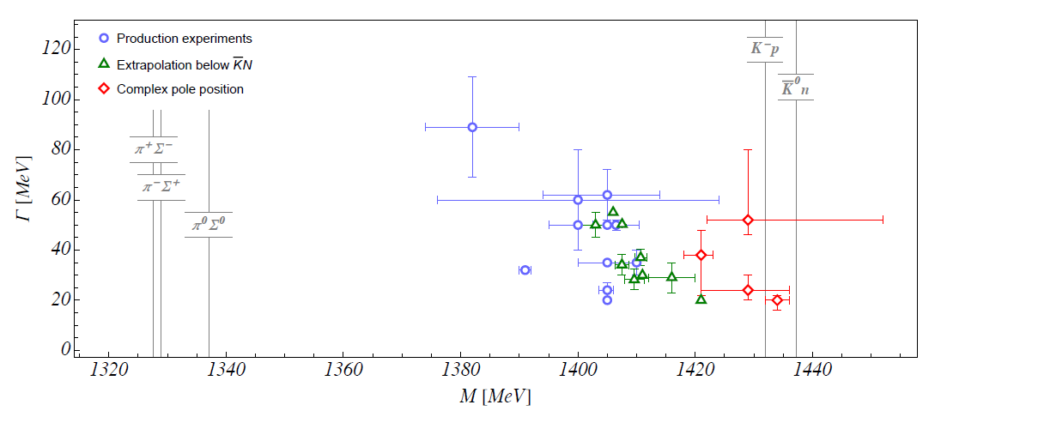
No clear prediction for Λ(1405) position and width
From Maxim Mai review ,EPJ

Slide 5
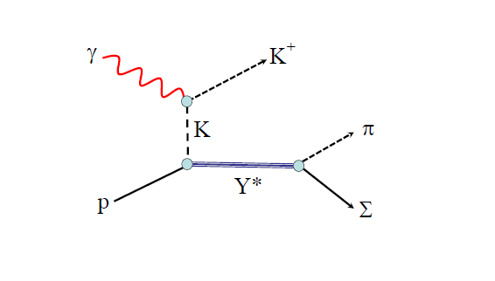
A recent method to test Λ(1405) below Kp threshold
Jefferson Lab, Moryia ,2013

Slide 6
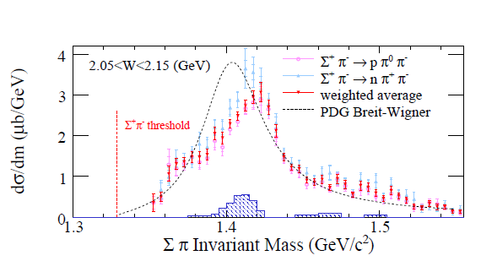
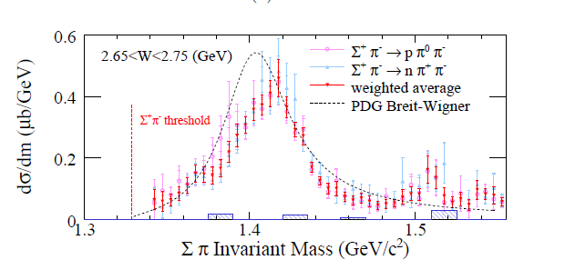
W – centr. mass energy

Slide 7
The real testing is below KN threshold Virtual K p→ ∑π
yields Im F(Kp→Kp) ~ | F(Kp→∑π)|²
Could we have F(Kp→Kp)
F(Kp→Kp)I=0
directly below threshold ?
YES, on protons bound at nuclear surfaces.

Slide 8
ADVANTAGE of KAONIC ATOMS
Direct test of sub-threshold region in K p channel
AMPLITUDE not |AMPLITUDE|
ADDITIONAL ADVANTAGE of UPPER LEVELS
Single colission ( Born term) is good enough
Asymptotic nucleon wave functions
Weak effects of the nucleus: Pauli bloking,
collision broadening , KNN captures
DISADVANTAGE
Level shifts not always available, experiments are difficult
Energy region is limited: -33 ….. 0 MeV

Slide 9
FIRST AN EXAMPLE
LIGHT ANTIPROTONIC ATOMS
PURPOSE
CHECKING BARYONIUM STATES PREDICTED BY N-Nbar INTERACTION MODELS
An analogy to Λ(1405)

Slide 10
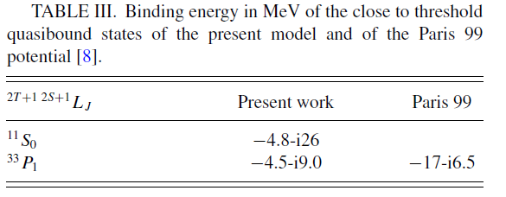
Paris N- Nbar potential predicts baryonium in a P- wave Phys.Rev. C59,2313(1999) : Phys. Rev C79,054001(2009)
TO BE CHECKED by levels in H ,2H, 3He , 4H atoms

Slide 11
GOING BELOW THRESHOLD
Energy in the N –Pbar Centre of Mass System
E= M + M - BN - BP - ERECOIL
ERECOIL = PPAIR² / 2 MREDUCED

Slide 12
Energy regions involved- recoil spread about 5 MeV
‾p N interactions with valence nucleons involve
subthreshold amplitudes F ( - EB – ERECOIL )
- 33 -15 -7 - 0 MeV
4He 3He 2H H
Quasi free amplitudes in „upper levels „

Slide 13
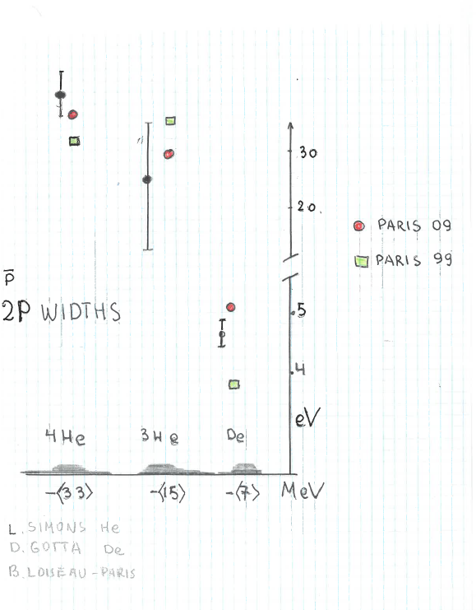
ANTIPROTONS - REPRODUCING 2P LEVEL WIDTHS by PARIS N-Nbar POTENTIAL
THE TRUTH IS IN THE MIDDLE

Slide 14
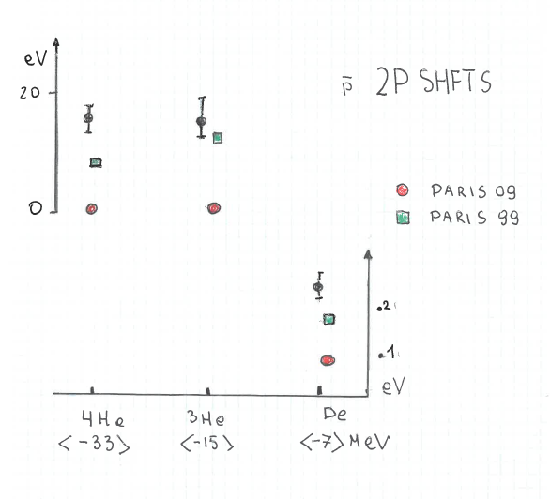
REPRODUCING 2P LEVEL SHIFTS BY PARIS POTENTIAL
Baryonium closer to Paris 99 , 4 He requires new physics

Slide 15
CONCLUSION
QUASIBOUND STATE ( BARYONIUM ) IS LOCATED in BETWEEN the TWO PREDICTIONS
E(³³ P₁ ) about -12 MeV
B.Loiseau, S.W. Phys Rev. C102(2020 )3,034006
MODEL TO CORRECT
QUESTION
COULD ONE INVERT THE PROCEDURE
EXTRACT Λ(1405) PROFILE FROM KAONIC ATOMS

Slide 16
K - atomic level shifts due to S and P wave Kp ,Kn interactions Born approximation
ε-iΓ/2 =
2π/μ ʃ dr φψ(r) [ a0(E) + 3a1(E) ∂∂ ] φ ψ(r)
φ nucleon wave functions
ψ atomic wave function
Energy dependent amplitudes
In upper levels - higher order terms ~5%

Slide 17
ANALYSIS OF UPPER WIDTHS IN K ATOMS
THREE AMPLITUDES REQUIRED
A0 (E) for Λ(1405) to extract
A1 assumed constant
A1P (E) describing ∑(1385 )
calculated

Slide 18
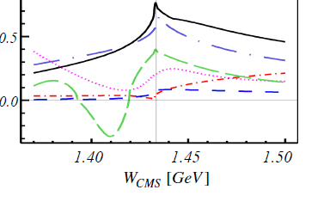
UNCERTAINTY A1 = A( Kn → Kn ) unknown ,
it dominates „statistically „
Vopt ~ ( A 0 + A 1)/ 2 ρp + A1 ρn
M. Mai Review, EPJ
Im A(Kn→Kn)
A1 =0.2 assumed here

Slide 19
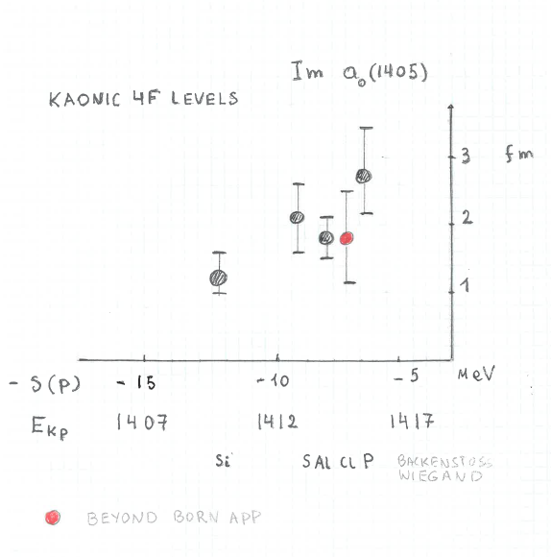
A SHOULDER OF Λ(1405)

Slide 20
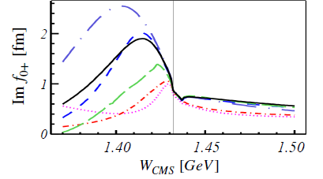
OLD DATA – LARGE ERRORS
RESULTS COMPARABLE TO CLASS BUT INVOLVE ONLY I = 0
I = 1 Im a( Kn → Kn ) REQUIRED ( FROM OTHER ATOMS)
extracted A0(E) slope is stable , magnitude changes
M. Mai , review , EPJ

Slide 21
LIMITATIONS
CHECK THAT HIGHER ORDER IS SMALL simple
FIND Im A 1 requires other experiment
THE MAIN INTEREST IS Re A0 (E)
REQUIRES UPPER LEVEL SHIFTS difficult
Bragg method as with antyprotons

Slide 22
Isotopic differences to learn Im(Kn→Kn)
3D widths in
7Li , versus 6 Li E ~ 5KeV , low intensity alas
10 B versus 11B E~ 8 KeV
3D→ 2P observed by Wiegand, Batty
-----------------------------------------
2P widths useful for Λ(1405)
4He versus 3He
LEVEL SHIFTS VALUABLE in these states !

Slide 23
Thank you

Slide 24
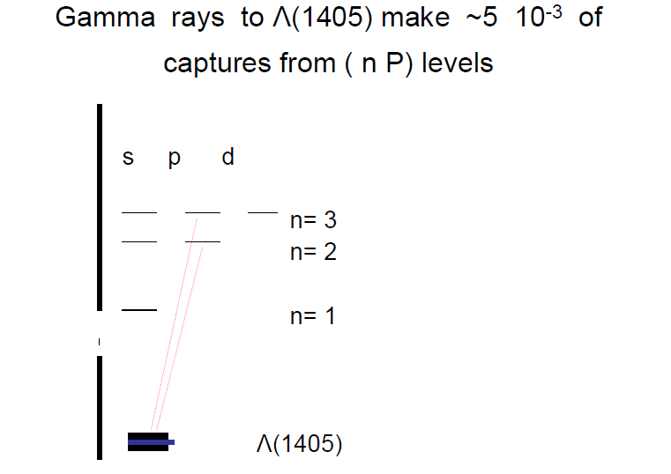

Slide 25
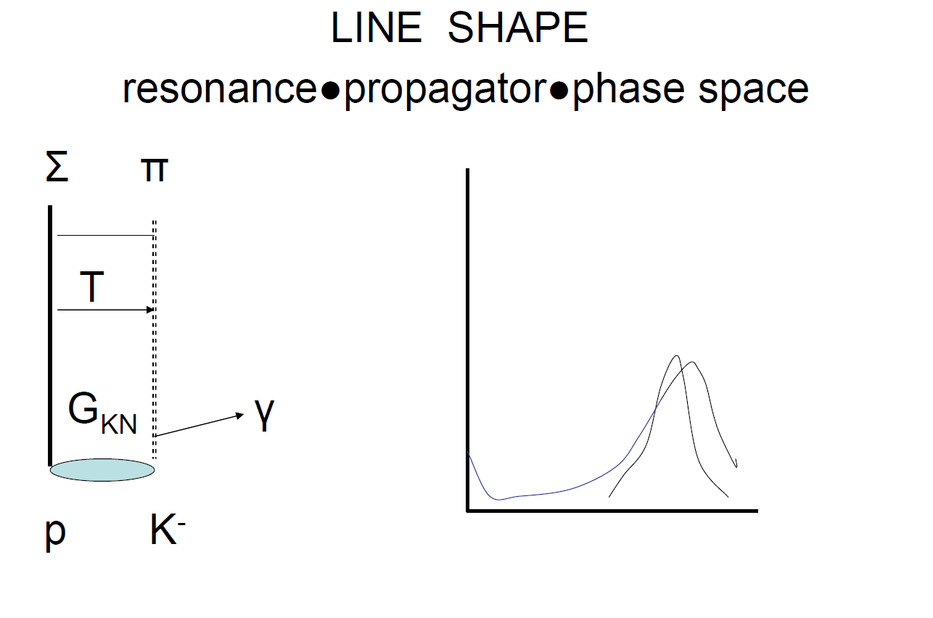
TRANSITION FROM KAONIC ATOM 2P → TO Λ(1405)

