Slide 2
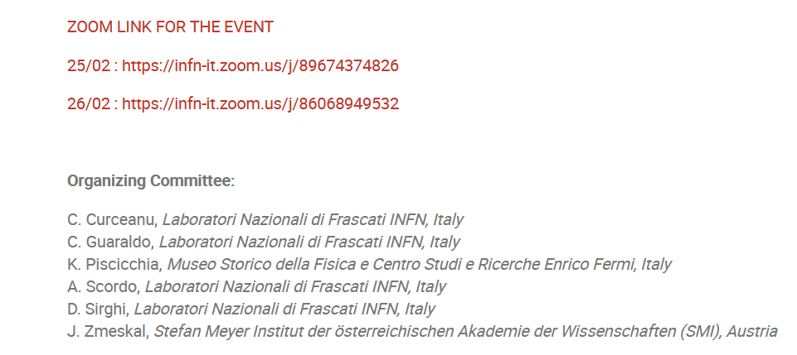

Slide 3
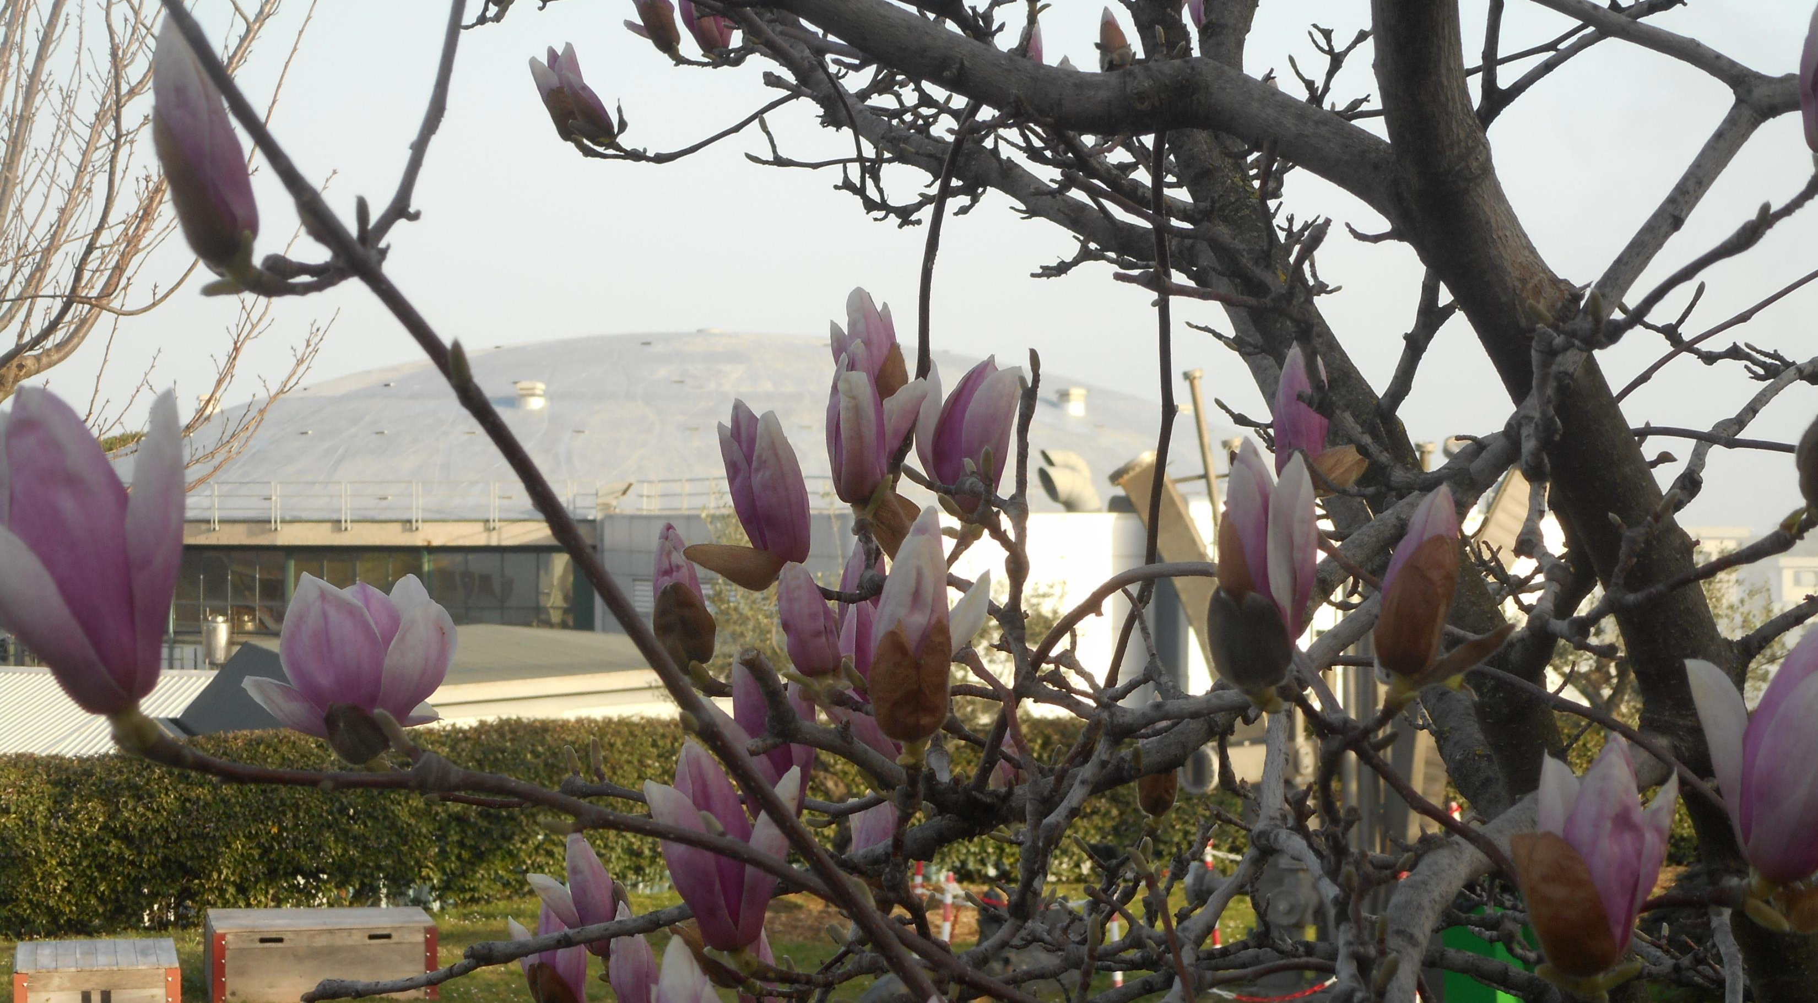

Slide 4
The DAΦNE electron-positron collider at the Laboratories of Frascati, INFN-LNF, is a unique facility in the world to perform strangeness physics experimental studies with low-energy charged (and neutral) kaon mesons.
Experiments measuring kaonic atoms transitions have been realized at DAΦNE in the last 25 years, with DEAR and SIDDHARTA which performed unique measurements on light kaonic atom transitions, such as the most precise kaonic hydrogen measurement and the first kaonic-helium3 transitions measurement. Presently SIDDHARTA-2, installed on DAΦNE, is aiming to perform the first kaonic deuterium measurement.

Slide 5
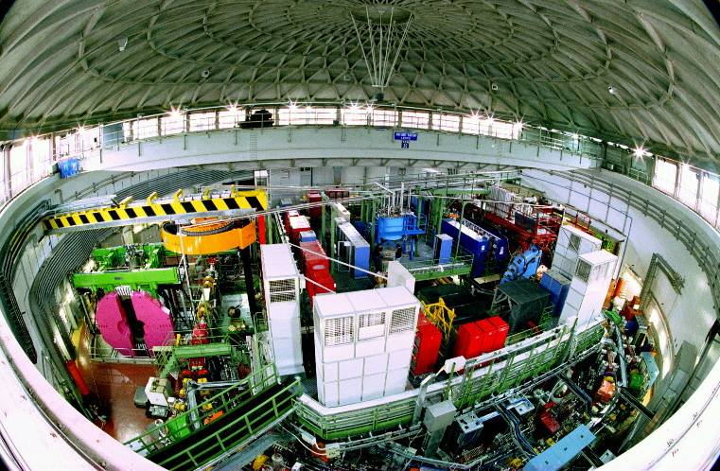
DAΦNE

Slide 6
DEAR on DAΦNE autumn 2002

Slide 7
SIDDHARTA on DAΦNE 2009

Slide 9
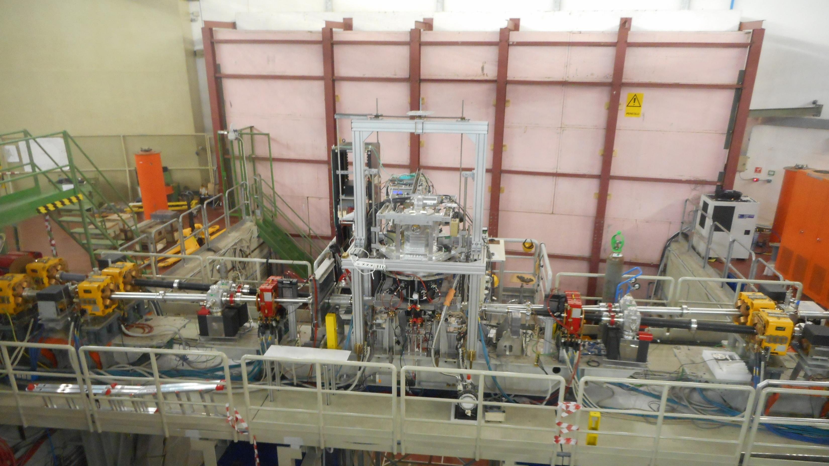
SODDHARTA-2 now

Slide 10
The broad international scientific community involved in low-energy strangeness studies is envisaging and proposing new fundamental measurements using the unique kaon beams at DAΦNE. New experimental breakthroughs, parallelized by theoretical progress, can bring us into a new era in the strangeness physics studies with an impact extending from fundamental physics to astrophysics and beyond.
These two-days workshop is devoted to discuss a road-map for the experiments to be proposed at DAΦNE for the next 5 years time window to start after the end of SIDDHARTA-2 run.

Slide 11
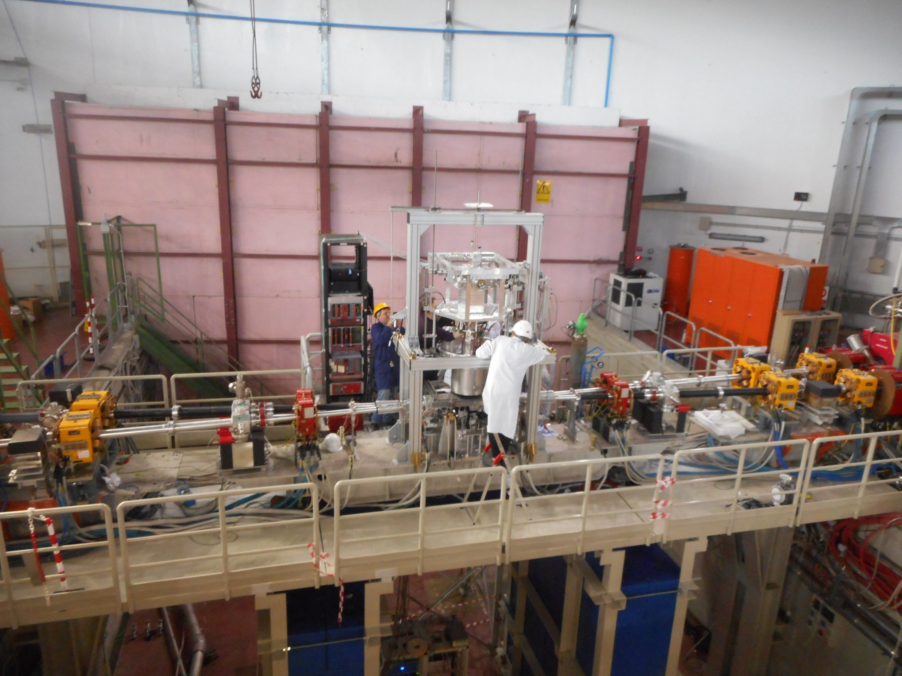

Slide 12
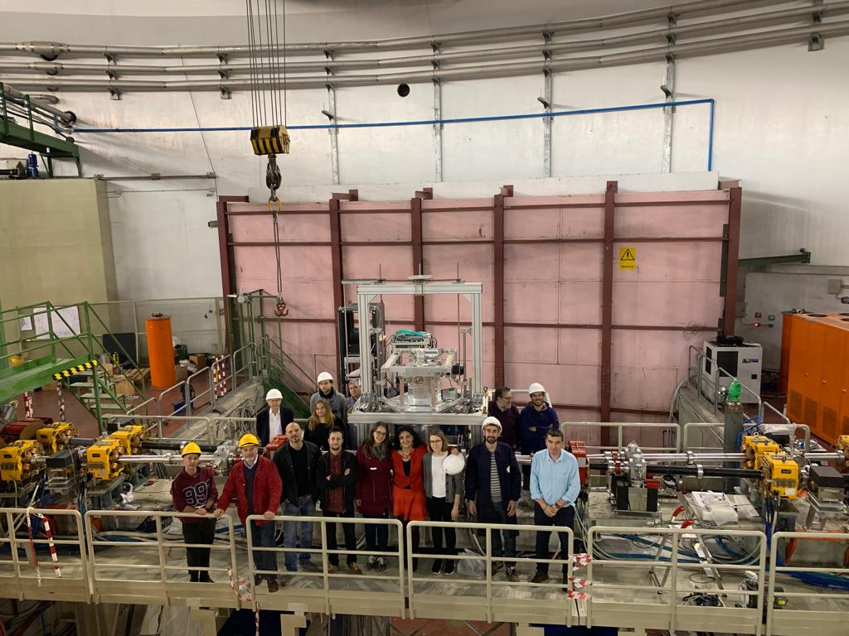

Slide 13
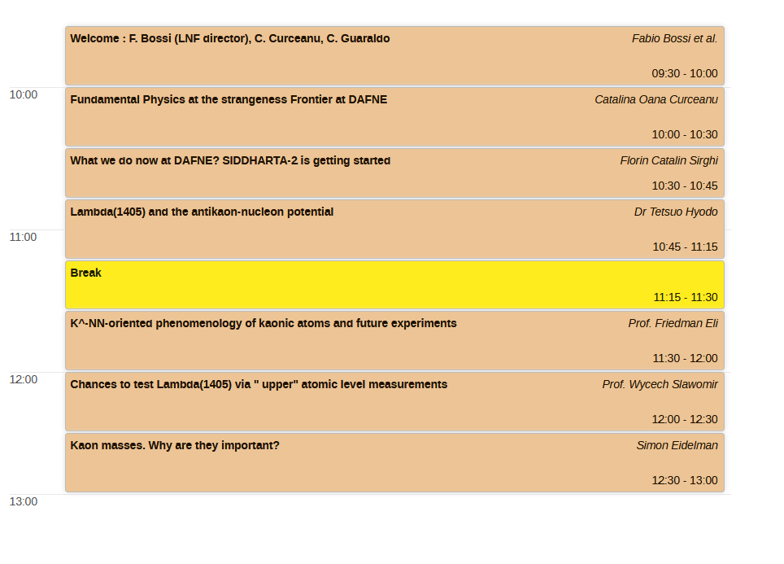

Slide 15
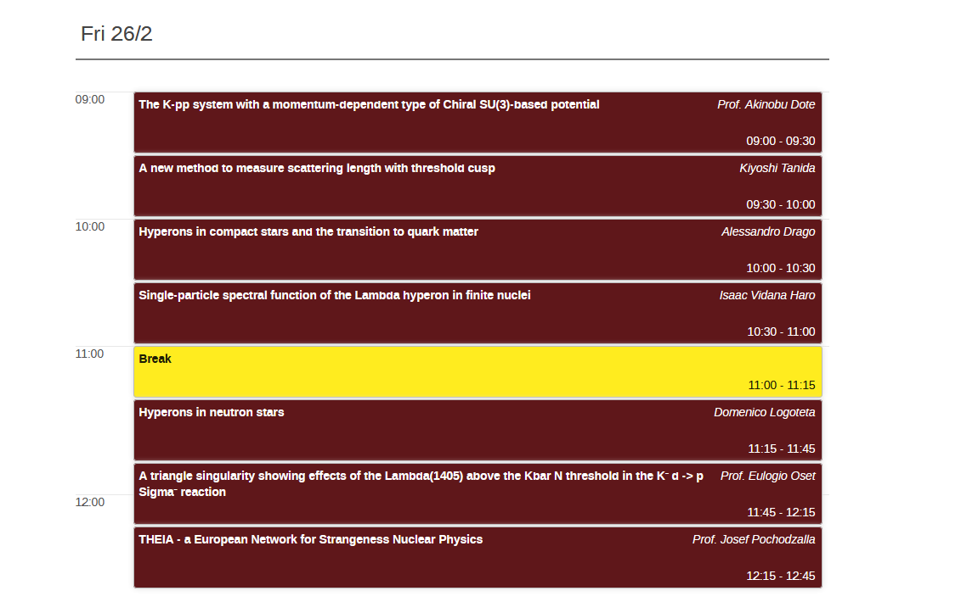

Slide 16
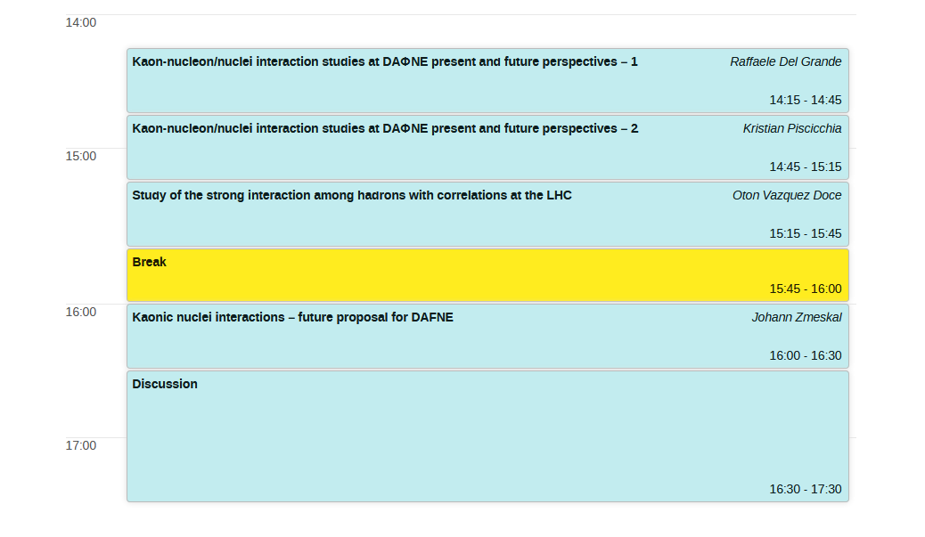

Slide 17
