Slide 1
AIDAInnova
Task: 7.4.1: 4-channel cluster counting board
08/02/2021 Meeting
M. Primavera per Bari/Lecce
WP7: Gaseous detectors
Task: 7.4.1: 4-channel cluster counting board
Local responsible: Margherita Primavera (LE) - INFN sections: BA, LE
Person months: 14 (10)

Slide 2
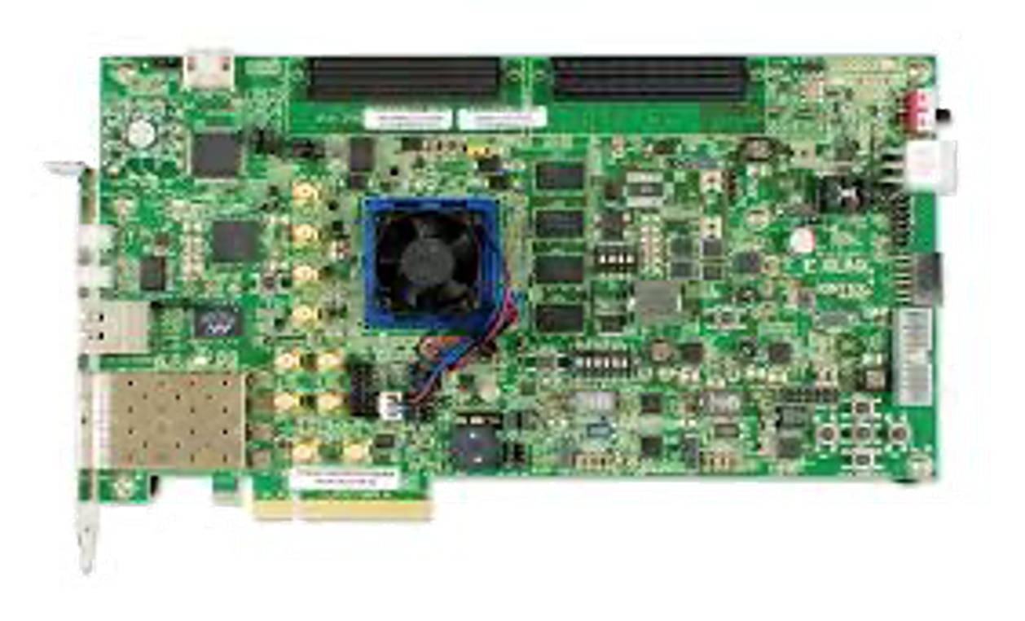
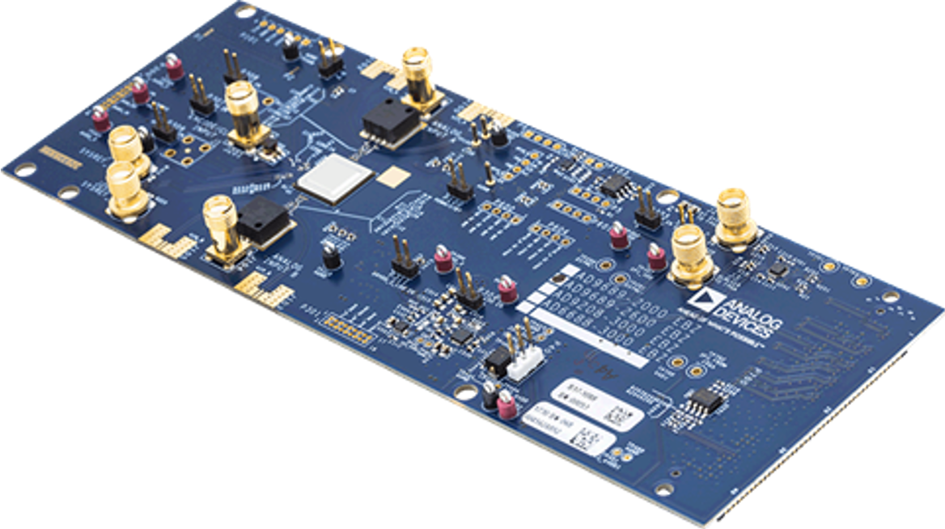
Cluster Counting board – activities started in March 2020
G. Chiarello, A. Corvaglia
New hardware to test the algorithm:
  Xilinx Kintex UltraScale FPGA KCU105 Evaluation Kit
    The new FPGA was chosen based on the hardware used in CAEN's digitizers (partner in AIDAInnova)
  AD9689 - 2000EBZ (dual channel)
The choice of the FPGA and ADC made by choosing (at that time) the ADC with better resolution and transfer capacity wrt the one used for the 1-channel board already built. ADC now allows us to read 2 channels simul.
The new FPGA allows to have better time constraints.
Code migration from ISE to Vivado framework → Done
Problems → JESD204B Interface for ADC-FPGA communication (demo license is now expired, we are trying to use something open source (not 100% compatible with the hardware!!)
New ADC choices under evaluation -> 4-channel ASoC by Nalu Scientific or TEXAS INSTRUMENT ADC32RF45 Dual-Channel, 14-Bit, 3GSPS
Goal →card with 4 channels:
  two ADCs if the performance is satisfactory
  Four-channel ADC

Slide 3
A causa del fatto che abbiamo considerato ab initio il costo di 1 mese uomo a 5800 invece che a 5000 come hanno fatto altri, ci toccano 10 p.m. invece che 8 come per altre sezioni a parità’ di finanziamento (Total direct costs avrebbe dovuto essere 60000 e non 70000 e il costo del personale 40000 e non 50000)
 | Progetto sinergico | 2021 (fte) | 2022 (fte) | 2023 (fte) | 2024 (fte) | T7.4.1
N. De Filippis | RD_FCC | 0.05 | 0.05 | 0.05 | 0.05
E. Gorini | RD_FCC | 0.05 | 0.05 | 0.05 | 0.05
A. Ventura | RD_FCC | 0.05 | 0.05 | 0.05 | 0.05
A. Corvaglia |  | 0.1 | 0.1 | 0.1 | 0.1 | 5
M. Primavera |  | 0.1 | 0.1 | 0.1 | 0.1 | 5
Potremmo essere pronti a bandire un assegno di ricerca, ma occorre la conferma della promessa integrazione da parte della CSN1

Slide 4
Backup

Slide 5
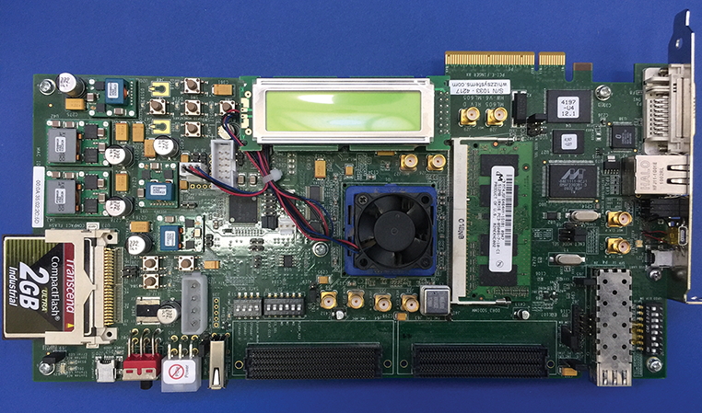
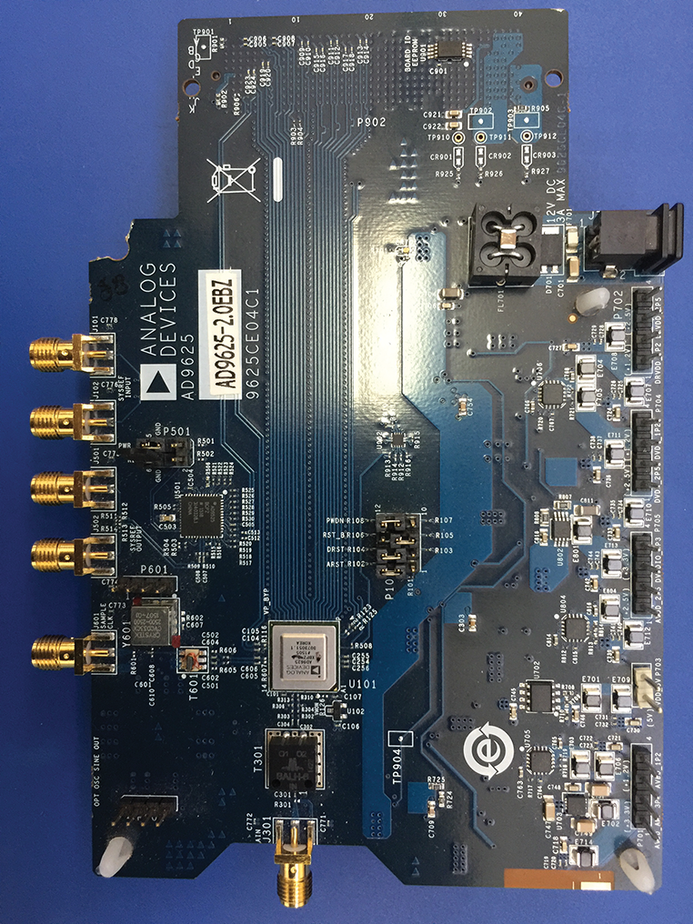
Cluster Counting board – old (2016/2017) hardware
G. Chiarello, A. Corvaglia
A board to test the cluster counting algorithm on a single channel of the drift chamber has been built;
To carry out this first test we used obsolete hardware:
  Xilinx ML605 Evaluation Board (Virtex 6)
  Analog Devices AD9625-2.0EBZ
These tests were carried out with a demo license of the JESD204 which has now expired.
The algorithm with this hardware has a peak detection efficiency of 69%. In simulation, the efficiency is about 80%.
The difference in algorithm efficiency can be improved by increasing the signal-to-noise ratio, filtering the signal and increasing the data processing rate.
  For this we have chosen a new hardware with higher resolution (you have to import the code into the new system with the different licensing issues)
FPGA
ADC

Slide 6
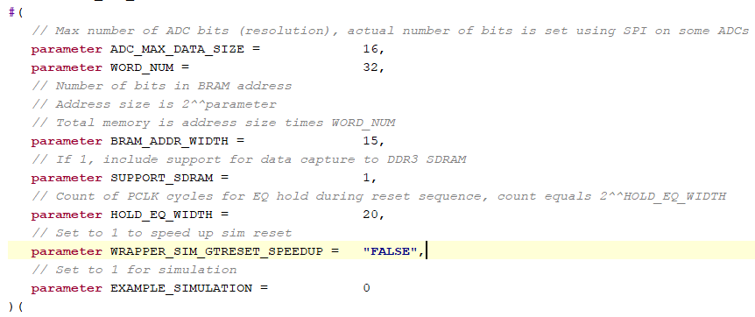
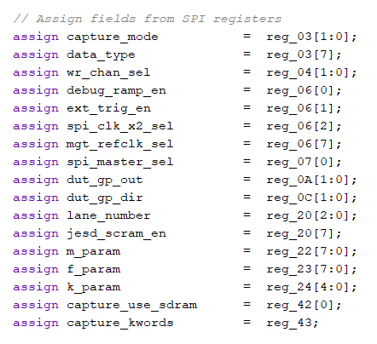
Cluster Counting board – Status firmware
G. Chiarello, A. Corvaglia
AWG
1 ch
ADC Evaluation BOARD
2 ch
FMC
This part is critical we are testing the OPEN SOURCE version (otherwise we have to find the license)
JESD204B
Interface
SPI Configuration
Waveform
FMC
Xilinks Evaluation BOARD
Workstation
Ethernet

Slide 7
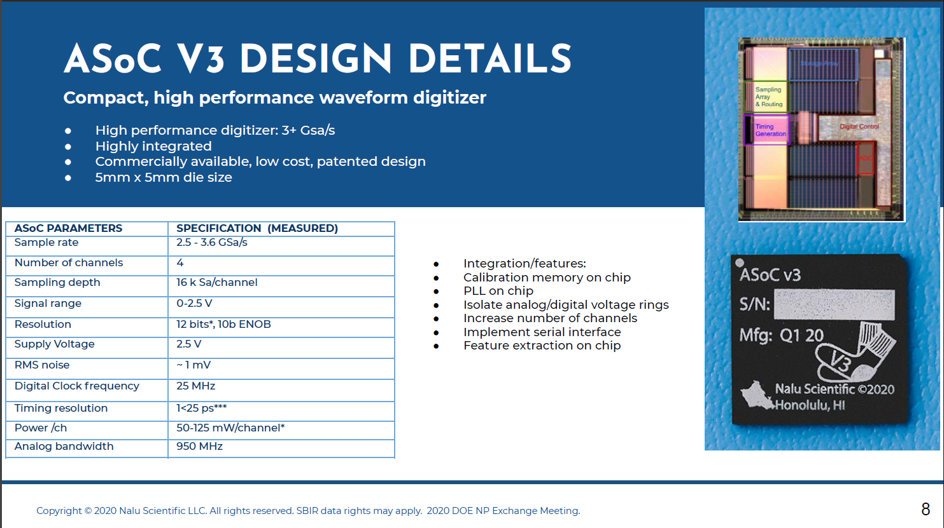
ASoC Project – NEW DIGITILIZATER
G. Chiarello, A. Corvaglia,
F. Grancagnolo
The SiRead Chip manufacturers themselves are developing a new digitizer (ASoC) with better performance compatible with our requests (4-channel).
We have contacted the company (Nalu Scientific) and most likely, after passing their quality tests, they will provide us with a demo board to test it.
  Maybe we need a Digilent Evaluation Board (with Xilinx FPGA, about 500€) compatible with the board
Nuovo Chip
Evaluation Board

Slide 8
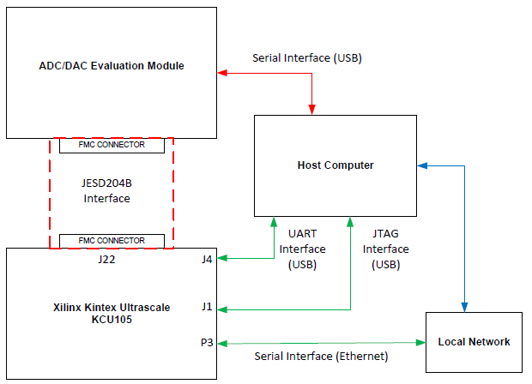
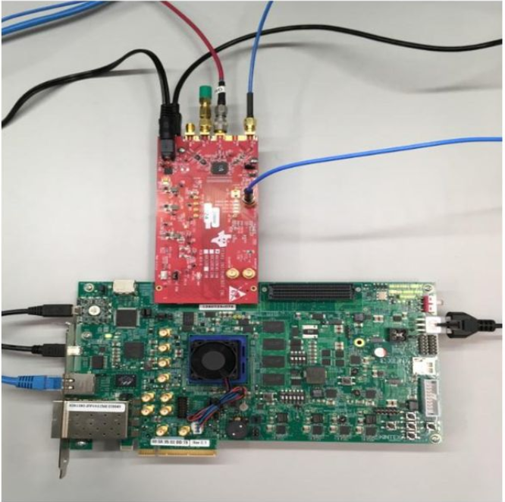
Possible new ADC
G. Chiarello, A. Corvaglia,
F. Grancagnolo
ADC with better characteristics and performance than the current one is from TEXAS INSTRUMENT ADC32RF45 Dual-Channel, 14-Bit, 3GSPS (about 2.5k€)
ADC is better at:
  performance in terms of noise,
  ENOB,
  Cross talk lower than in the one presently used
Compatible with our current FPGA

