Slide 1
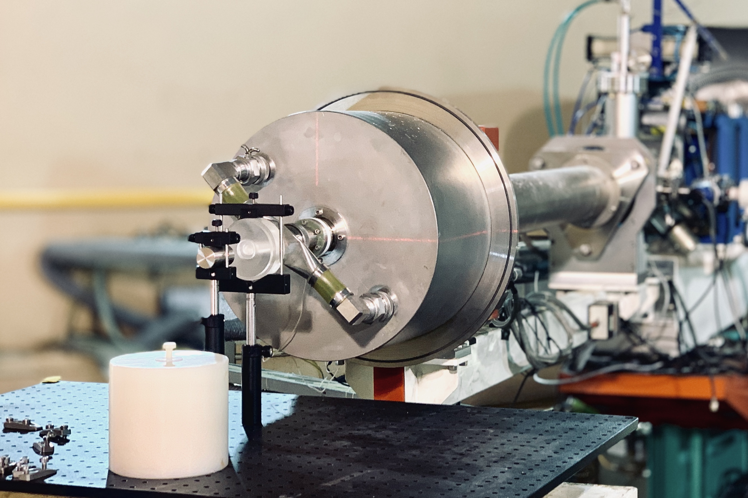
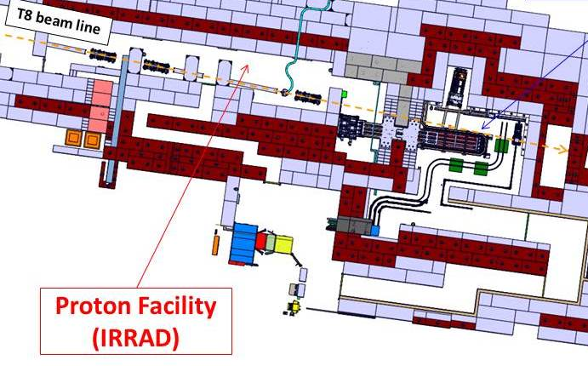
WP4: Upgrade of Irradiation and Characterization Facilities
Devoted to the integration of software, hardware and quality control systems for the management of data obtained at different European irradiation facilities

Slide 2
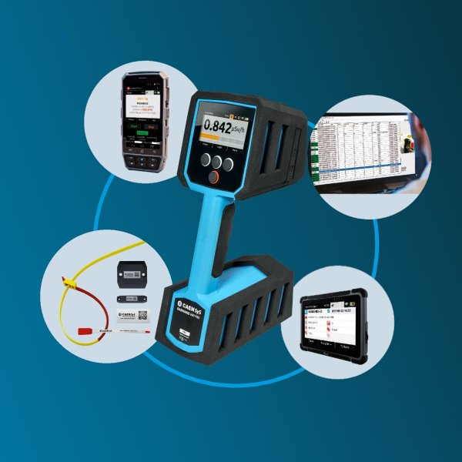
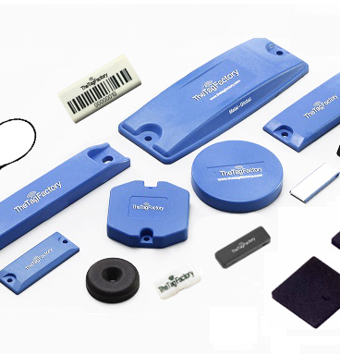
Task 4.3: Common Tools for Irradiation Facilities Quality Control: Data Management, Traceability, Dosimetry and Activation Measurements
Design and develop the prototype of an integrated system to manage induced activation (gamma spectrometry) and traceability data for irradiated objects
improve detector performances, MC for absolute activation measurement calibration
RFID wireless id tags radiation hardness studies
Partners: INFN, CERN
Collaborating partner: ENEA
Industrial partner: CAEN

Slide 3
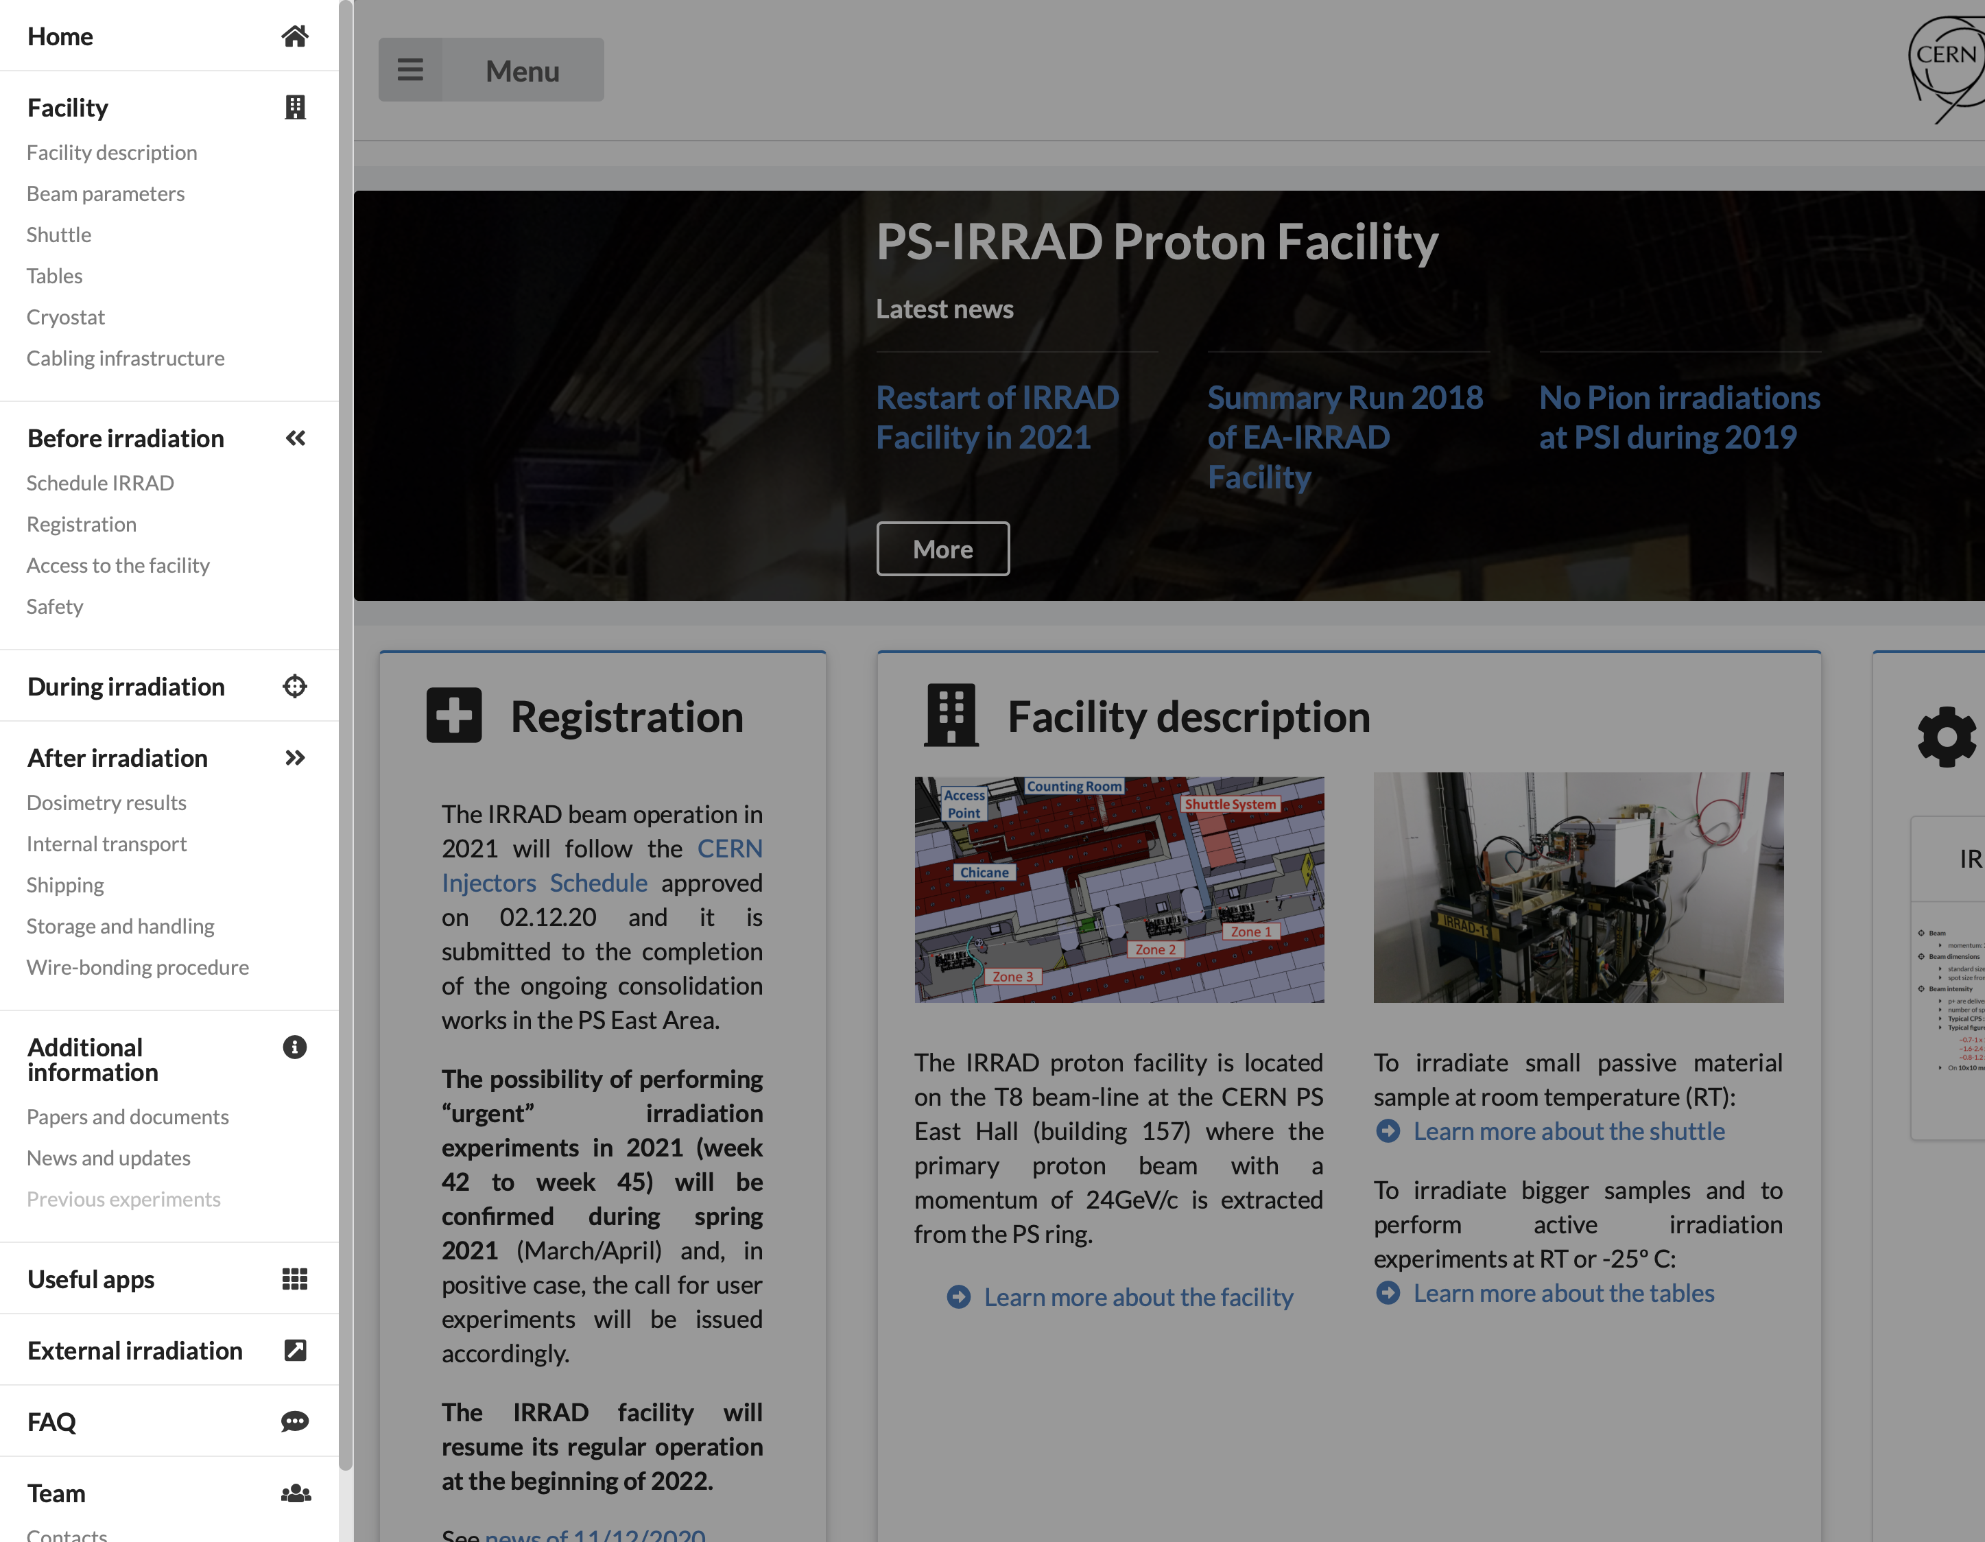
Task 4.3: Common Tools for Irradiation Facilities Quality Control: Data Management, Traceability, Dosimetry and Activation Measurements
Generalize the IRRAD Data Manager (IDM) system to new facilities and improve the sharing of the irradiation experiment results, control system and operational data
develop a HW-SW integrated system to manage activated prototypes at beam test and reactor facilities
Partners: INFN, CERN
Collaborating partner: ENEA

Slide 4
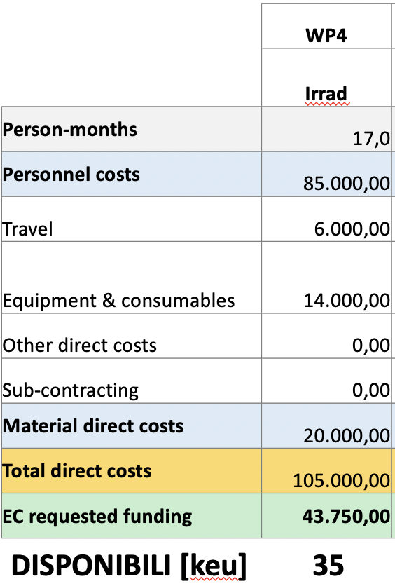
Sinergie, ricadute, sviluppi
R&D su rivelatori spettroscopici portatili per misure quantitative
ottimizzazione prestazioni e power management di un calorimetro a scintillazione portatile
sviluppo calibrazioni per misure quantitative tramite modelli geometrici semplificati
valutazione Radiation Hardness tag RFID (identificazione component acceleratori o subdetector in apparato)
Sviluppo e applicazione di Data Management integrato alle beam test facilities e reattori di ricerca
gestione ottimale delle attivita’ di test per utenti esterni e non
tracciamento device, campioni, prototipi attivati durante i test

