Slide 1


Linking Nano and Micro-dosimetric measurements to biological effectiveness (WP2)
MICROBE_IT
Microdosimetry-based assessment of Biological Effectiveness in Ion Therapy
Giusi Irma Forte, Luigi Minafra, Francesco Paolo Cammarata, Marco Calvaruso, Giorgio Russo
giorgio-russo@cnr.it

Slide 2
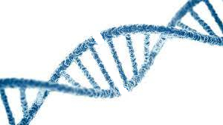
Radiobiology experiments for GSM2 development and verification (1)
DNA Double Strand Breaks Repair Mechanisms
DNA Damage Response
High-LET particles
generates DSBs
Features
Homologous Recombination (HR)
More Complex
Longer (7 hours or more)
Error-Free
Non Homologous End Joining (NHEJ)
Less Complex
Faster (30 mins)
Error-Prone
Prevalent in mammalians
DSB are mainly responsible of acute cell killing, causing a greater quote of non-reparable or mis-repaired DNA damages.
«Since NHEJ is often accompanied by deletion or addition of nucleotides, NHEJ potentially compromises genetic information» Varga T, et al. DNA Repair 2005

Slide 3
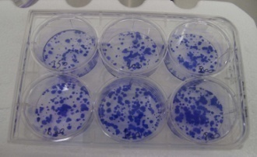
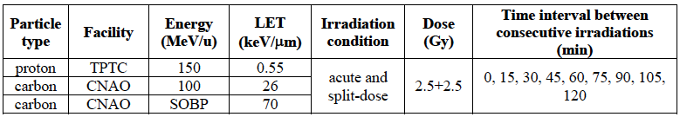
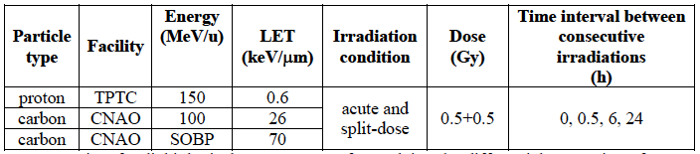
Radiobiology experiments for GSM2 development and verification (2)
Characterization of Non-Homologous End-Joining (NHEJ) driven by High-LET Particles
in non-tumorigenic breast epithelial cell line MCF10A
In vitro evaluation of the influence of split-dose irradiation on survival fractions by means of clonogenic assay
In vitro evaluation of split dose-irradiation effects on NHEJ and DSBs key markers (Ku70, 53BP1 and γH2AX) by western blotting analysis.

Slide 4
WP2 - Milestones
M2.3 (Month 1-12) – Radiobiological measurements with protons at TPTC
M2.4 (Month 1-12) – Radiobiological measurements with carbon ion at CNAO
CNAO availability for COVID will be very hard to obtain milestone 2.4

